Slide 1

DESIGN YOUR LIFE
Journal club By Vth MU
CHEIF:DR.SYED BAHAVUDEEN HUSSAINI MD
ASST.PROF:DR.VINOTH KANNAN MD.
DR.V.P.PRIYA.MD
PRESENTOR:DR.MOHANDOSS

Slide 2
Ianalumab plus Eltrombopag in Immune Thrombocytopenia

Slide 3
BACKGROUND
Current second-line treatments for immune thrombocytopenia (ITP) require long-term administration.
Ianalumab, a monoclonal antibody targeting B cells, is being assessed as a short-course second-line therapy in ITP.

Slide 4
Methods
Phase 3
Randomised
Double Blinded
we assigned, in a 1:1:1 ratio, adults with primary ITP and an insufficient response or a relapse after first-line glucocorticoid therapy to receive ianalumab
at a dose of 9 mg or 3 mg per kilogram of body weight or placebo once monthly for 4 months.
Eltrombopag, an oral thrombo- poietin-receptor agonist, was administered once daily in each group

Slide 5

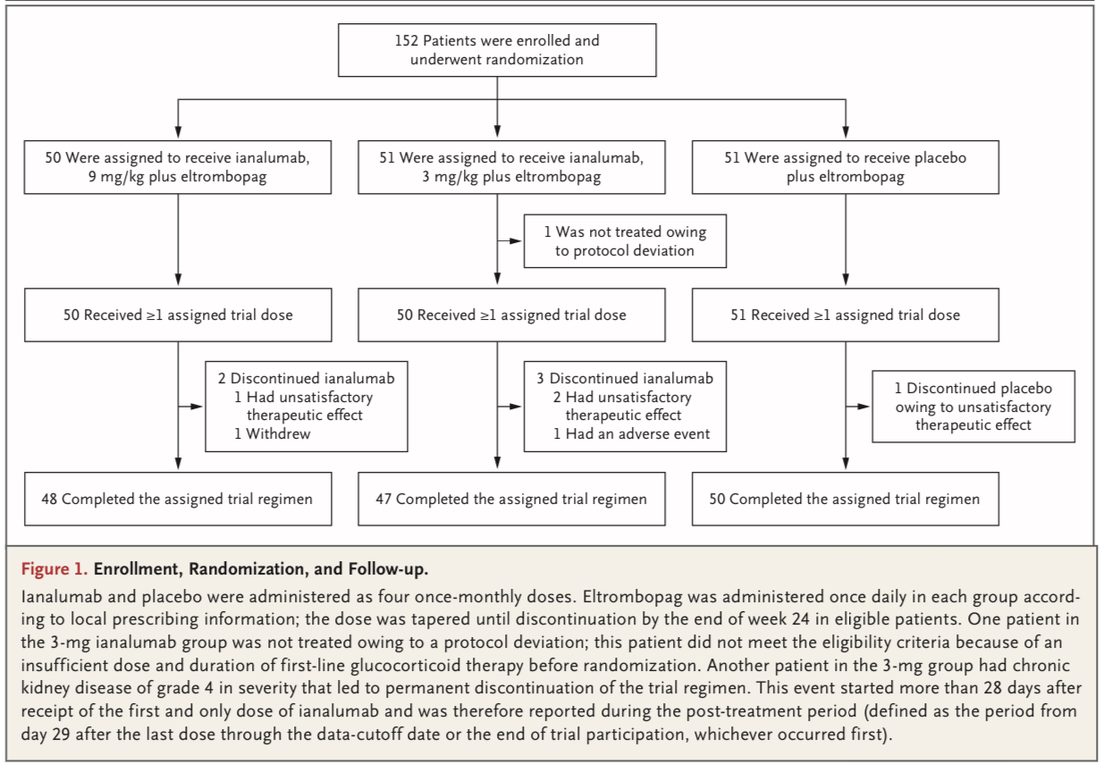
Caption

Slide 6
INCLUSION CRITERIA
Adults with primary immune thrombocytopenia (ITP) who met:
Age≥18 years
Diagnosis - Confirmed primary ITP
Platelet count <100 × 10⁹/L (disease definition)
Disease Status
Insufficient response OR relapse after first-line glucocorticoids
Prior Therapy Allowed
First-line glucocorticoids ± IVIG
Short-term TPO-RA use (≤7 days before screening) allowed
Insufficient response defined as:
Platelet count <30 × 10⁹/L
OR
Need for glucocorticoids >8 weeks
Relapse defined as:
Platelet count <30 × 10⁹/L after initial response

Slide 7
EXCLUSION CRITERIA
Prior Second-Line Therapy
Any second-line ITP therapy (other than steroids ± IVIG)
Prior rituximab
Long-term TPO-RA
Splenectomy
(This ensured early-line population.)
Other Important Exclusions
Secondary causes of thrombocytopenia
Active severe infection
Significant uncontrolled comorbidities
Insufficient steroid exposure before randomization

Slide 8
TRIAL PROCEDURES
evaluated two dose levels of ianalumab in combination with eltrombopag.
Patients with primary ITP were randomly assigned, in a 1:1:1ratio,to receive for once-monthly doses of ianalumab at a dose of 3 mg per kilogram of body weight (3-mg ianalumab group) or 9 mg per kilogram of body weight (9-mg ianalumab group) or placebo.
Vials containing concentrate for in- travenous infusion were provided for both ianalu- mab and placebo (identical in formulation, pack- aging, and labeling).
Eltrombopag was administered once daily in each group according to local prescribing infor- mation.
At the end of the 16-week treatment period, patients with a platelet count of at least 50×109 per liter at two or more consecutive as- sessments initiated tapering of eltrombopag until discontinuation of the drug by the end of week 24 (if the patient’s platelet counts remained at least 30×109 per liter without the use of rescue treatment).

Slide 9
Safety
During the treatment period, the frequency of adverse events was similar in the threegroups.
No adverse event during the treatment period led to discontinuation of ianalu- mab or placebo or resulted in death.
The most frequently reported adverse events were headache (in 14% of the patients in the 9-mg ianalumab group, in 10% in the 3-mg ianalumab group, and in 8% in the placebo group) and infusion-related reaction (in 14%, 8%, and 8%, respectively).
All infusion-related reactions were of grade 1 or 2 in severity. No infusion-related hypersensitivity reac- tions were observed.
Serious adverse events during the treatment period were observed in 16% of the patients in the 9-mg group, in 6% of those in the 3-mg group, and in 4% of those in the placebo group; most of these events were probably related to underlying ITP.

Slide 10
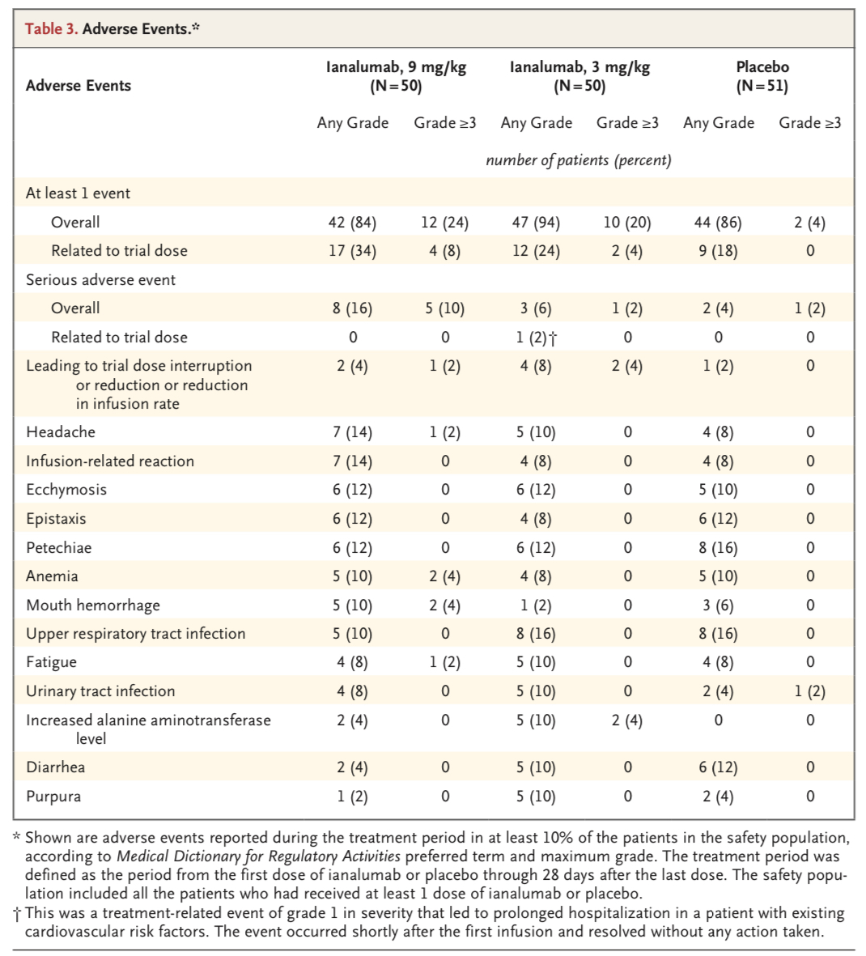

Slide 11
END POINTS
first occurrence of any of the following after 8 weeks of randomization:
Platelet count < 30 × 10⁹/L
Initiation of rescue therapy
Initiation of new ITP therapy
Inability to taper or discontinue eltrombopag due to inadequate platelet count
Death from any cause
Primary End Point
Freedom from treatment failure
(time-to-event analysis)
Analyzed using Kaplan–Meier estimates and hazard ratios (Cox model).
Key Secondary End Point
Stable response at 6 months
Platelet count ≥ 50 × 10⁹/L
Achieved in ≥ 75% of measurements between weeks 19–25
No rescue therapy in the previous 4 weeks
No new ITP therapy at any time

Slide 12
RESULTS
12-Month Freedom from Treatment Failure:
  9 mg → 54%
  3 mg → 51%
  Placebo → 30%
  Hazard Ratio (9 mg vs placebo) = 0.55 (P=0.04)
  Hazard Ratio (3 mg vs placebo) = 0.58 (P=0.045)
Stable Response at 6 Months:
  9 mg → 62% (Significant)
  3 mg → 57%
  Placebo → 39%
  Higher successful eltrombopag discontinuation in ianalumab groups

Slide 13
Complete Response (Platelet ≥100 ×10⁹/L):
  9 mg → 55%
  3 mg → 40%
  Placebo → 26%
  Rapid and sustained platelet rise in treatment groups
Overall adverse events similar across groups
  Serious adverse events:
  9 mg → 16%
  3 mg → 6%
  Placebo → 4%
  Higher neutropenia but no increase in severe infections

Slide 14
LIMITATIONS
  • Early ITP population only
  • Longer follow-up needed

Slide 15
CONCLUSION
Ianalumab plus eltrombopag led to a longer time to treatment failure than placebo plus eltrombopag.

Slide 16
Clinical Implication
• Short-course therapy possible
  • Potential disease-modifying approach
  • Reduces long-term TPO-RA dependence
  • Early intervention may improve durability

Slide 17




THANKYOU
+86 010 8888 8888
www.domain.com

