Slide 1
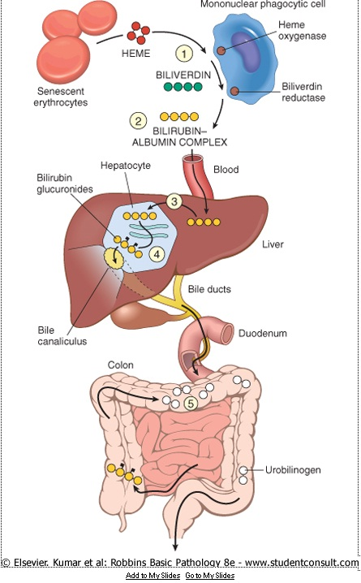
AN INTERESTING CAUSE FOR CHRONIC LIVER DISEASE
DEPARTMENT OF
MEDICAL GASTRO
ENTEROLOGY

Slide 2
CASE SUMMARY
37 YEAR OLD FEMALE presented with initial complaints of jaundice and pruritis for past 2 months
She was initially on native therapy (eye drops were given)
As the symptoms persisted she visited a nearby consultant
On examination she was found to be icteric, pale with bilateral pedal edema
Per abdomen findings distended gross splenomegaly
Mild hepatomegaly
Free fluid +
No distended veins
Bowel sounds heard
Other systems normal

Slide 3
She was taken routine investigations
It showed
Random blood sugar, urea, creatinine
normal limits
TC,DC,PCV and BT, CT
Hb 6.8 g/dl
Platelet count 10,000 cells/mm3
ESR 78 (1 hour) 105 (2 hours)
MCV 78.5 fl
MCH 24.7 pg
MCHC 31.4%
RDW 19.0%
MPV 12.0 fl

Slide 4
Liver function tests showed total bilirubin elevated (9.3)
Direct (6.3) indirect (3.0)
SGOT 343 IU/L
SGPT 125 IU/L
Alkaline phosphatase 416 IU/L
Total protein - 6.2 g/dl albumin 2.9 g/dl, globulin 3.3 g/dl
A:G ratio – 0.87
PT 14 seconds
aPTT 39 seconds
INR 1.2
Urine bile salt and pigment Positive

Slide 5
VIRAL MARKERS
HIV I & II NEGATIVE
HBsAg NEGATIVE
Anti HCV NEGATIVE
USG ABDOMEN AND PELVIS SHOWED
Mild hepatomegaly,
Gross splenomegaly with dilated portal (1.2cm), splenic and superior mesentric vein
Few GE junction collaterals
Minimal ascites
Focal fatty infiltration in liver

Slide 6
The patient was referred here for further management
Vitals were stable
We proceded on with investigations
SERUM CERULOPLASMIN 36 mg/dl
ANA (IFA) POSITIVE (CYTOPLASMIC)
ANTISMOOTH MUSCLE ANTIBODIES NEGATIVE
ANTI MITOCHONDRIAL ANTIBODIES STRONGLY POSITIVE
LIVER KIDNEY MICROSOME ANTIBODIES NEGATIVE

Slide 7
MRI ABDOMEN AND PELVIS
Liver normal in size. The IHBR not dilated.
Periportal hyperintense areas are noted
Mild diffuse increased signals seen in the liver parenchyma
Dilated portal vein measures 16 mm in calibre
Gall bladder – contracted
Spleen enlarged and measures 16 cm
Prominent splenic vein (10mm)
Pancreas is normal
Both kidneys are normal
Other visualized abdominal organs appears normal

Slide 8
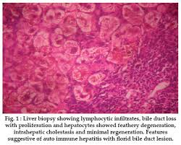
LIVER BIOPSY
DESCRIPTIVE MORPHOLOGY
Liver biopsy shows protal tracts which are expanded due to moderate to marked neutrophilic infiltrate and reactive bile ductular proliferation. There is no definite granuloma
The hepatocytes show scattered intracanalicular cholestasis and intracytoplasmic cholestasis with feathery degeneration and rosetting noted in the centrizonal region.

Slide 9
UPPER GI ENDOSCOPY
Oesphagus : grade I and II varices seen
Stomach : all parts including fundus normal
Duodenum first and second part normal
Impression : grade 1 and 2 oesophageal varices seen.

Slide 10
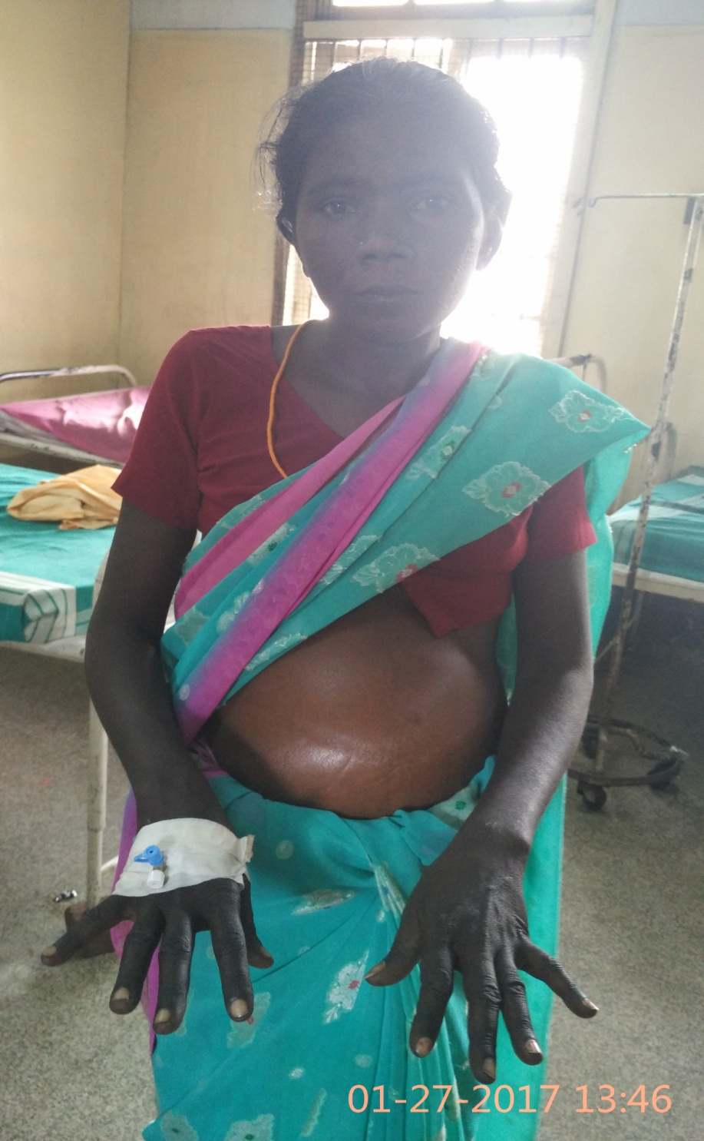
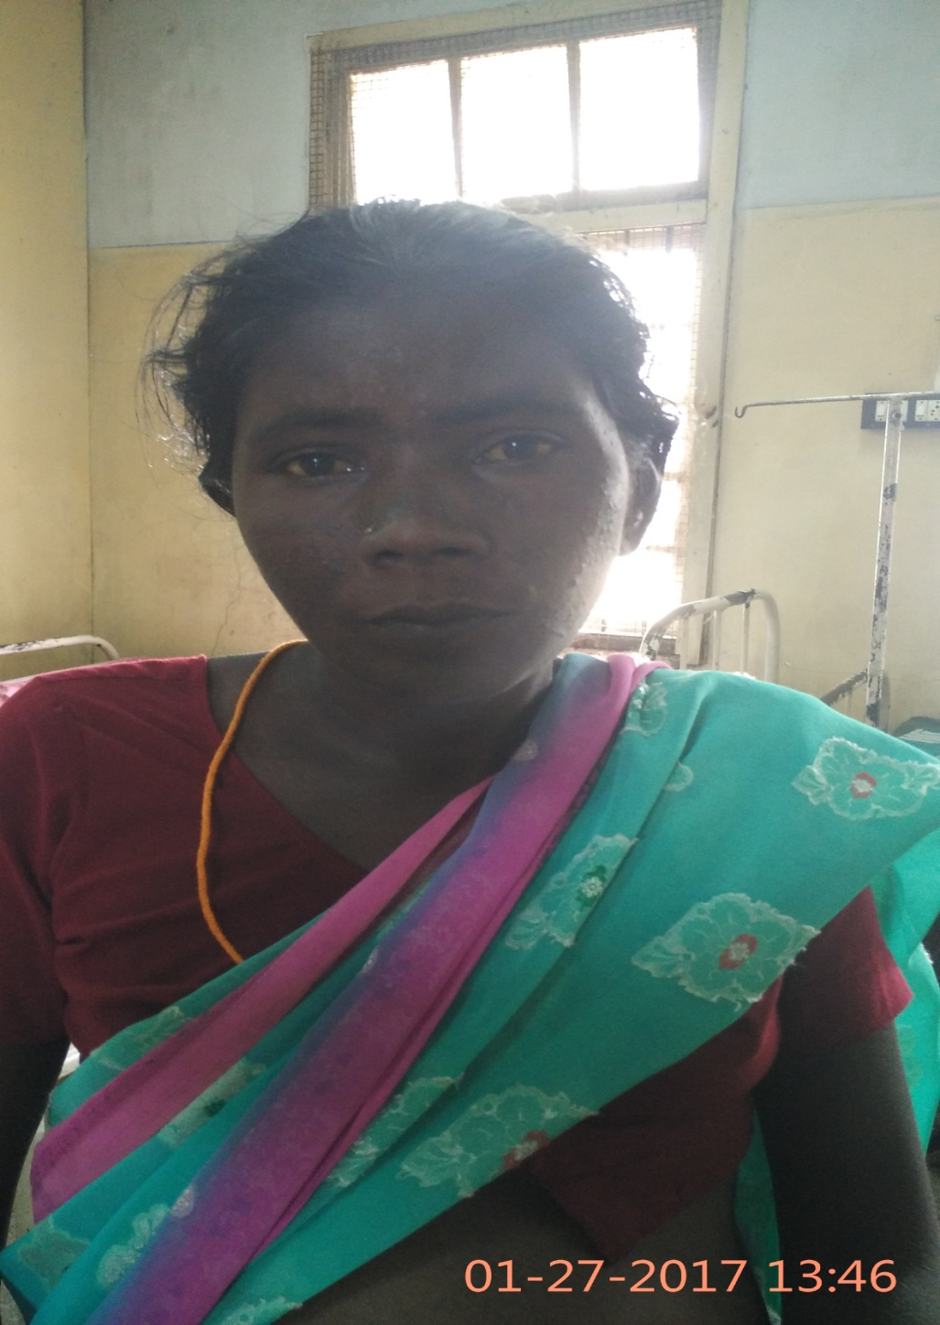

Slide 11
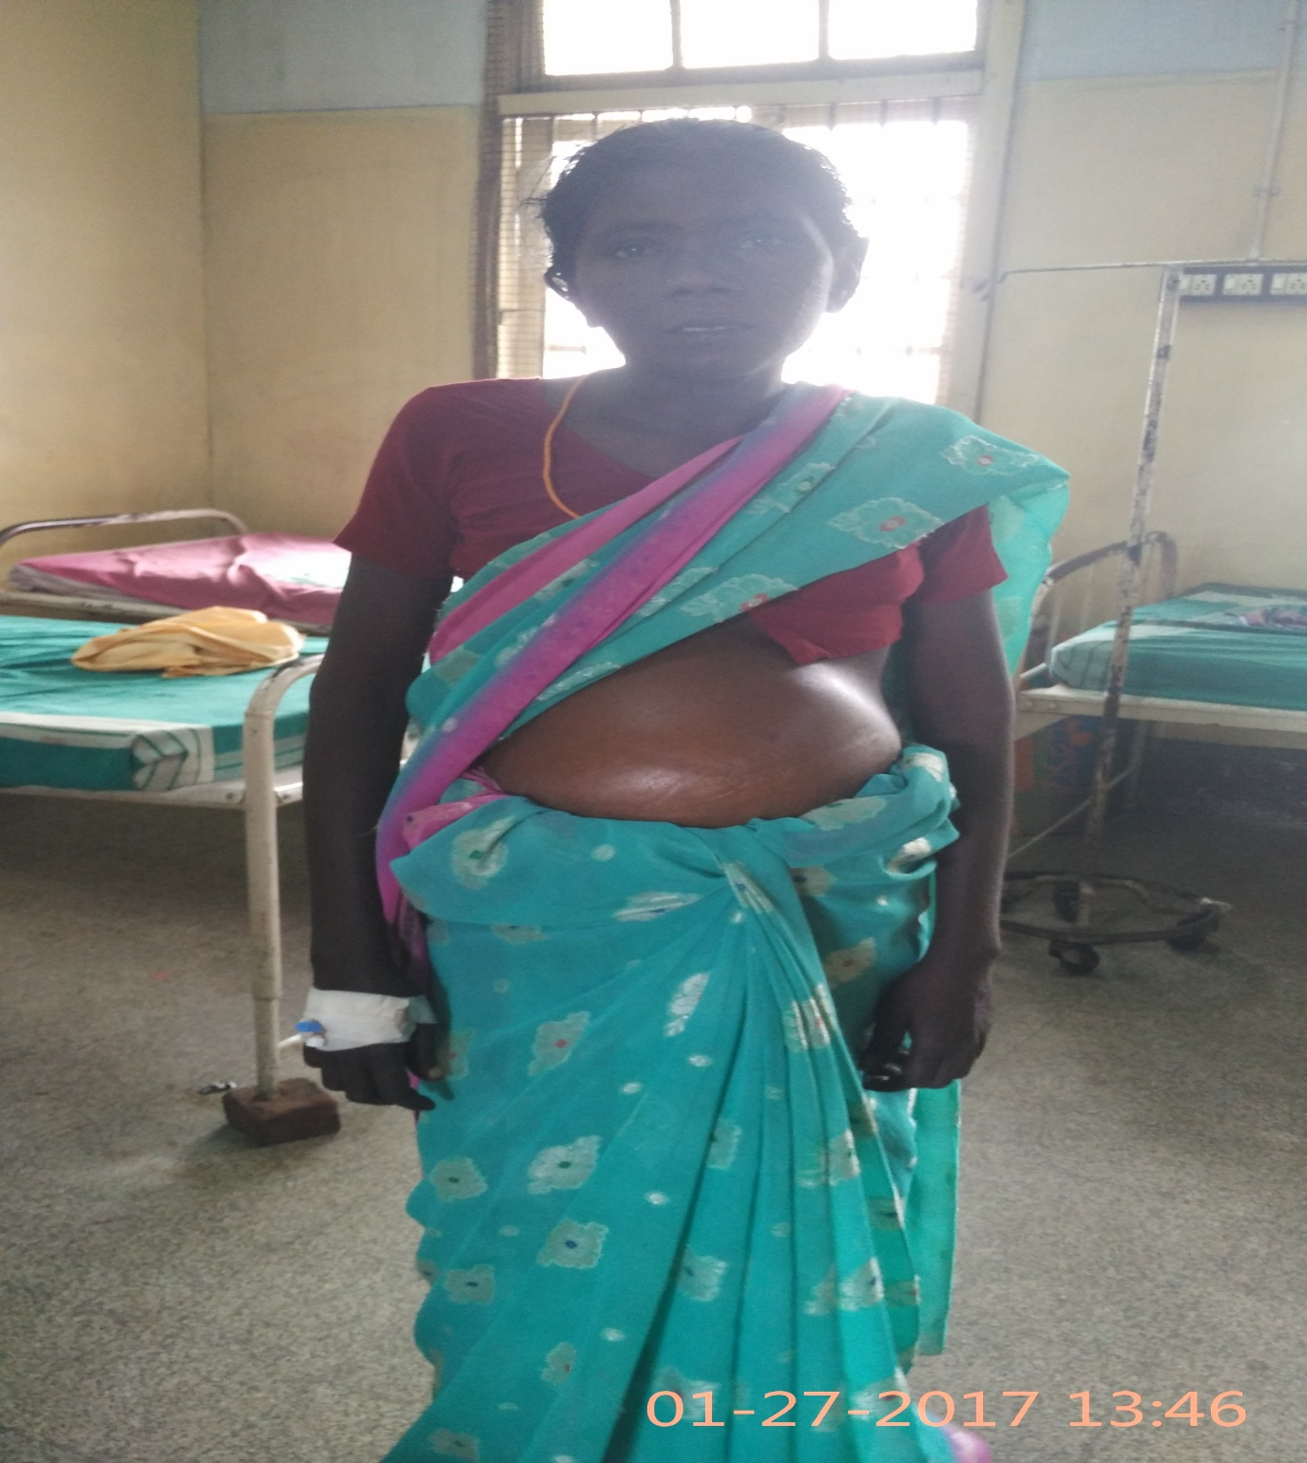

Slide 12
DIAGNOSIS
PRIMARY BILIARY CIRRHOSIS
DECOMPENSATED LIVER DISEASE

Slide 13
TREATMENT
T. Frusemide 40mg OD
T. Spironolactone 25mg 2 OD
Syp. Lactulose 15ml TDS
T. ISDN 5mg TDS
T. Propranalol 40mg ½ BD
T. Ranitidine 150mg BD
T. Calcium OD
VITD3 sachet
T. Cpm HS

