Slide 1
An ECG For Discussion
Presentor
Vathsalyan
III Medicine Unit
Chief: Dr M Natarajan MD
Asst Prof: Dr Syed Bahavudeen Hussaini MD
Dr Vallidevi MD

Slide 2
A middle aged female known case of Rheumatic Heart Disease/Mitral regurgitation has been admitted with complaints of palpitation
Patient was on torsemide and ramipril.

Slide 3
ECG at the time of Admission

Slide 4
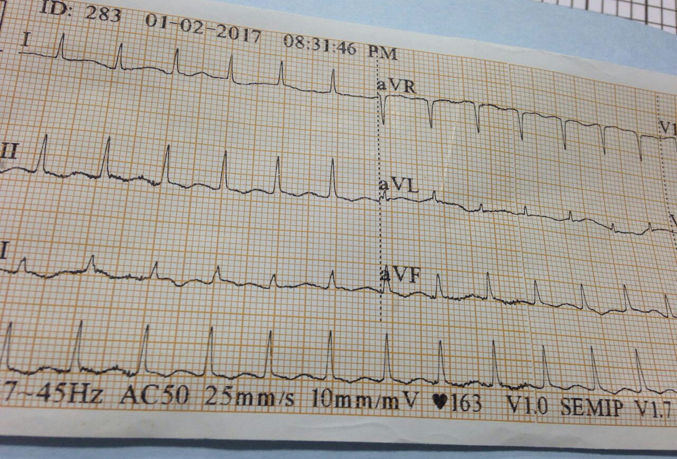

Slide 5
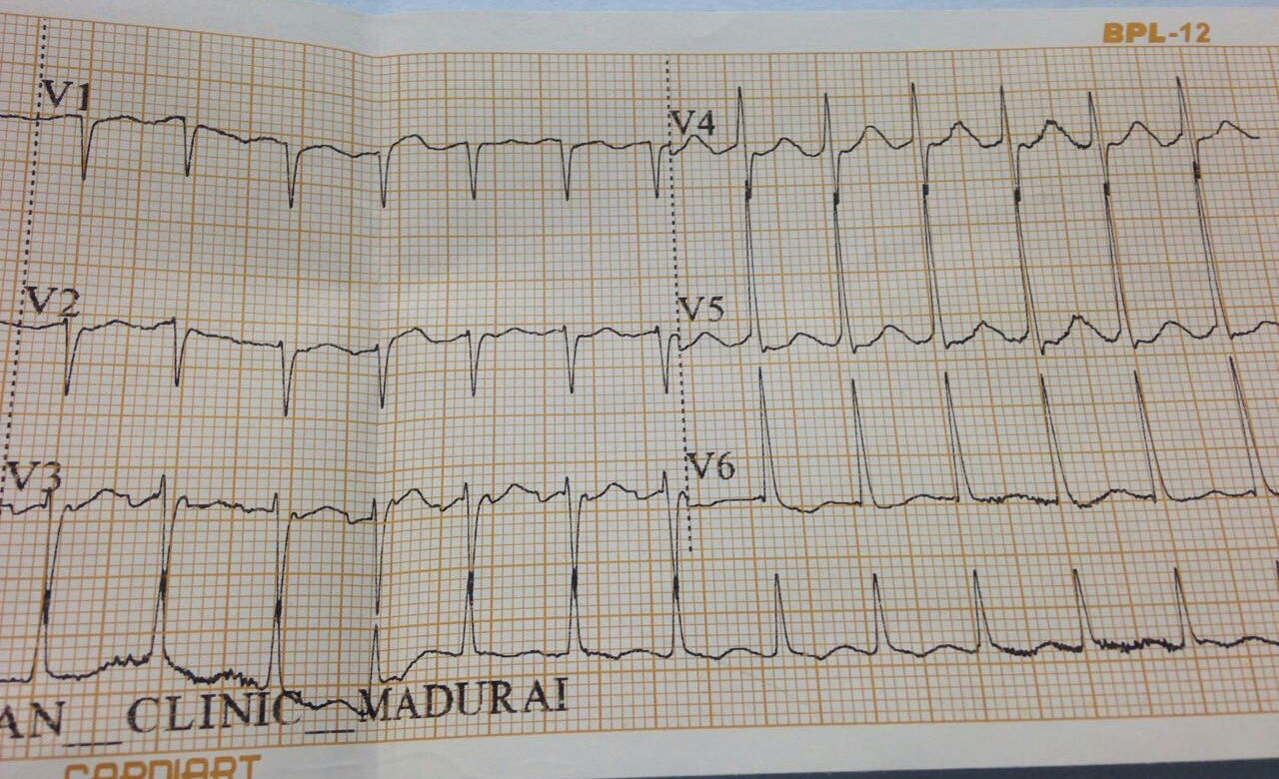

Slide 6
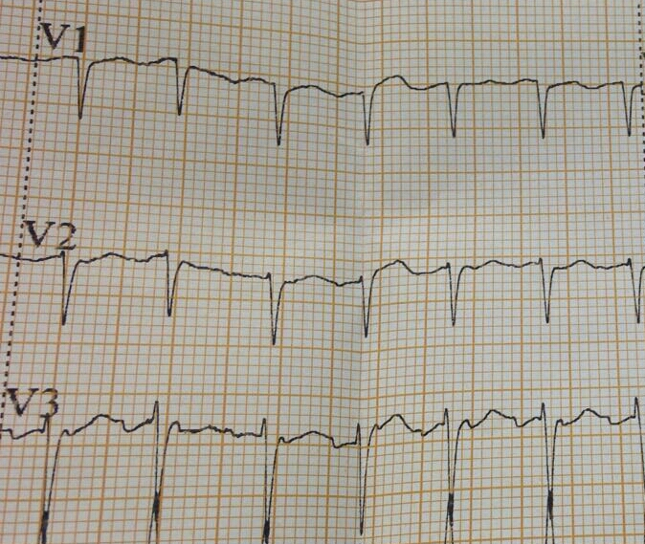

Slide 7
Inference
Narrow complex tachycardia
Regular rhythm
No obviously visible p waves except in V3
Lead V3 shows p waves first preceding QRS complex and second just following QRS complex

Slide 8
Diagnosis
Focal Atrial Tachycardia with 2:1 block

Slide 9
Thank you

