Slide 1
TREATMENT OF MALARIA
CHIEF:
Dr.R.SUNDARAM M.D.,
ASSISTANT PROFESSORS:
Dr.S.SUGADEV M.D.,
Dr.P.KRISHNARAJAN M.D.,
PRESENTOR:
Dr.N.S.SRIKANTAN

Slide 2
After confirmation of malaria by microscopy / RDT, treatment started according to the species and severity.
Treatment regimen
Treatment of uncomplicated falciparum Malaria
Treatment of uncomplicated vivax malaria
Treatment of mixed infections
Treatment of P.ovale, P.malariae and P.knowlesi
Treatment of severe malaria
Treatment of malaria in pregnancy

Slide 3
Treatment of uncomplicated falciparum Malaria
Artemisinin combination therapy (ACT) plus
Primaquine 45 mg (available as 7.5,15 mg tablets) on day 2 alone
Choice of ACT in all other states except north eastern states includes
Artesunate (AS) 200 mg daily for 3 days (available in 50, 100, 200 strength tablets)
plus
Sulfadoxine 1500 mg and Pyrimethamine 75 mg on day 1 (available strength of SP tablet is 500 mg sulfadoxine and 25 mg of pyrimethamine)
Choice of ACT in north eastern states includes
Artemether (80 mg) -Lumefantrine (480 mg) BID for 3 days

Slide 4
Treatment of uncomplicated Vivax Malaria
Chloroquine base 1500 mg divided over 3 days as
600 mg on day 1,
600 mg on day 2,
300 mg on day 3
plus
Primaquine 15 mg for 14 days
250 mg chloroquine phosphate tablet preparation contains ~155 mg chloroquine base.

Slide 5
Treatment of mixed infections
Artemisinin Combination Therapy (as given for P. falciparum)
plus
Primaquine 15 mg/day for 14 days (hypnozoitocidal)

Slide 6
Treatment of P.ovale, P.malariae and P.knowlesi
P.ovale should be treated as P.vivax
P.malariae can be treated with chloroquine/ ACTs
P.knowlesi malaria should be treated as P.falciparum.

Slide 7
Treatment of severe Malaria
Parenteral ACT is the drug of choice for severe malaria
Artesunate: 2.4 mg/kg IV or IM given stat, then at 12 h and 24 h, then once a day
Or
Artemether: 3.2 mg/kg IM given stat then 1.6 mg/kg per day
Or
Arteether: 150 mg daily IM for 3 days
Or
Quinine: 1200 mg quinine salt stat (IV infusion or divided IM injection) followed by maintenance dose of 600 mg 8 hourly (infusion rate should not exceed 300 mg per hour)
Loading dose should not be given if patient has already received quinine

Slide 8
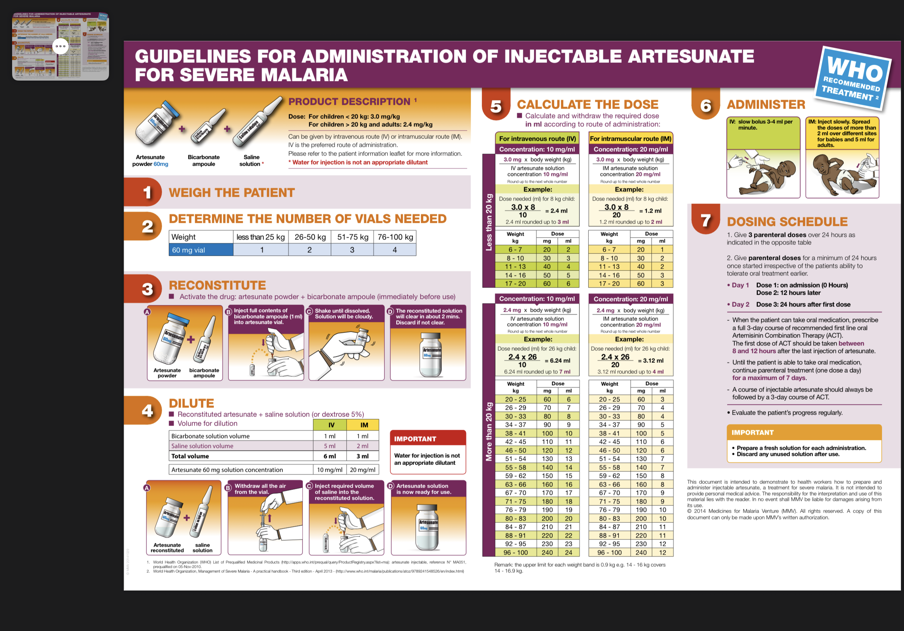

Slide 9
Follow-up treatment started after patient starts taking orals.
For patients treated with parenteral ACT,
Full oral course of area-specific ACT: In North Eastern states: ACT- AL 80/480 mg for 3 days + Primaquine 45 mg single dose on day 2 (gametocidal)
In other states: ACT 200 mg 3 days -SP 1500 mg/75 mg single dose + Primaquine single dose 45 mg on day 2 (gametocidal)
For patients treated with parenteral quinine
Oral Quinine 600 mg three times a day for 7 days
plus
Either Doxycycline 100 mg BD for 7 days Or Clindamycin 600 mg BID in pregnant women and children under 8 years of age for 7 days

Slide 10
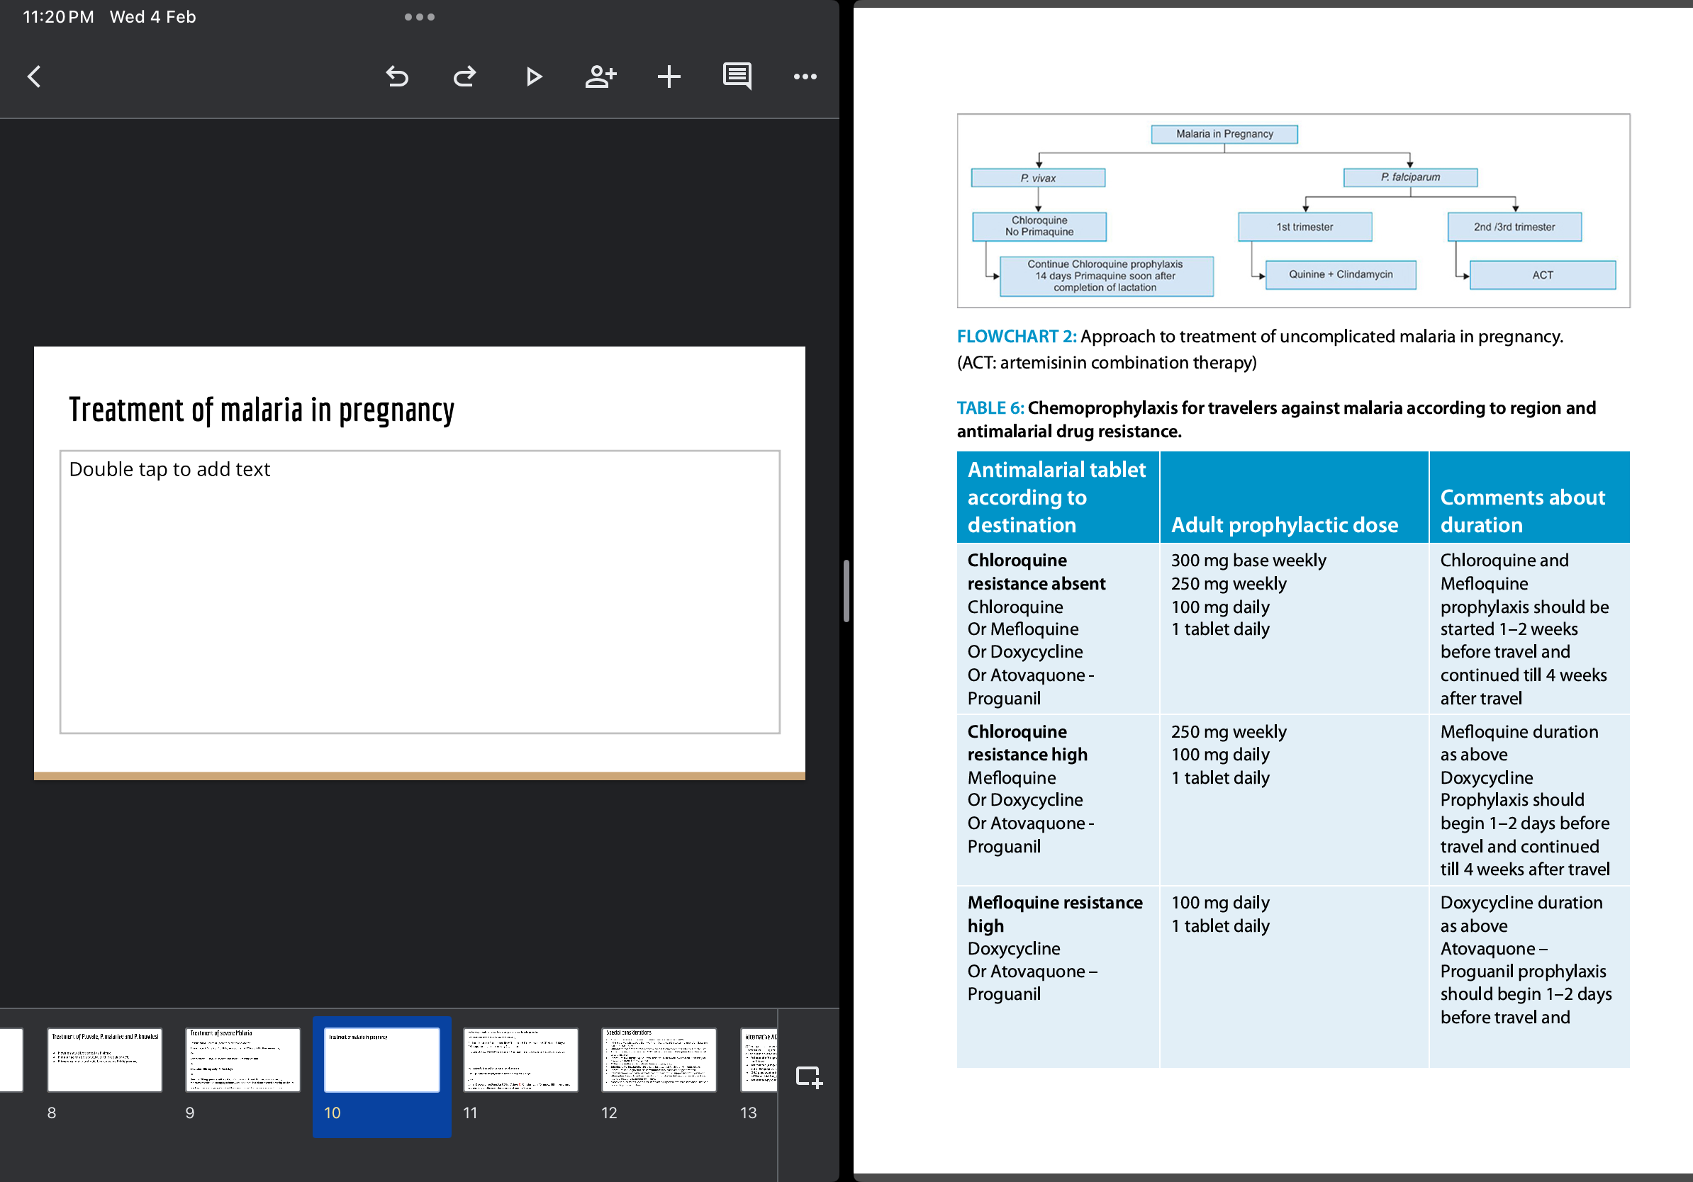
Treatment of malaria in pregnancy
source: API textbook of Medicine 12th edition
The ACT regimens now recommended are safe and effective in adults, children, and pregnant women (all trimesters). The WHO recommends that artemether-lumefantrine should be given preferentially in the first trimester of pregnancy.
source: Harrison’s principle of internal medicine 22nd edition

Slide 11
Special considerations
Chloroquine resistant plasmodium vivax malaria is treated with ACTs.
If there is any doubt as to the identity of the infecting malarial species, treatment for falciparum malaria should be given.
Sulfadoxine-pyrimethamine is ineffective against P.vivax hence alternative ACT is to be used.
Primaquine may induce hemolysis in G6PD deficient individuals.
Primaquine 0.75 mg/kg may be administered weekly for 8 weeks with careful monitoring for hemolysis in G6PD deficiency patients.
Mefloquine should be avoided in cerebral malaria.

Slide 12
Sulfadoxine/Pyrimethamine (SP) is not to be prescribed for children <5 months of age.
Primaquine and Doxycycline are contraindicated in infants and pregnant women.
Pregnant women with vivax or ovale malaria should receive suppressive prophylaxis with chloroquine (300 mg per week) until 1 month after delivery, after which they should receive primaquine 15 mg for 14 days.
If artemisinin-resistant severe falciparum malaria is suspected, both artesunate and quinine can be given together in full doses.
Quinine can induce hypoglycemia in pregnant women.

Slide 13
Adverse effects of antimalarial drugs
ACTs
Delayed hemolysis
hypersensitivity
QT prolongation
Quinine / Quinidine
hypotension,
blindness,
hemolysis,
hemolytic-uremic syndrome,
vasculitis,
cholestatic hepatitis,
neuromuscular paralysis.
QT prolongation
Hypersensitivity
Hypoglycaemia
Cinchonism
Primaquine
Contraindicated in
G6PD deficiency
Pregnancy
Infants
Sulfadoxine–Pyrimethamine (SP)
Megaloblastic anemia
Pancytopenia
Chloroquine
Retinal disease / visual field defects /blindness
Psoriasis (may precipitate flare)
Qt prolongation, arrhythmias

Slide 14
Other ACTs
Artesunate (4 mg/kg od for 3 days) plus amodiaquine (10 mg of base/kg od for 3 days)
Artesunate (4 mg/kg od for 3 days) plus mefloquine (24–25 mg of base/kg either 8 mg/kg od for 3 days or 15 mg/kg on day 2 plus 10 mg/kg on day 3)
DHA-piperaquine (target dose: 4/24 mg/kg od for 3 days in children weighing <25 kg and 4/18 mg/kg od for 3 days in persons weighing ≥25 kg)
Artesunate-pyronaridine (4/12 mg/kg od for 3 days)

Slide 15
Treatment of complications
Convulsions should be treated promptly with IV (or rectal) benzodiazepines. Levetiracetam is the preferred anticonvulsant to control seizures.
Hypoglycemia is managed with iv dextrose. Recurrent hypoglycemia is common among patients receiving quinine.
Blood transfusion is recommended that if the hematocrit falls to <20%, whole blood (preferably fresh) or packed cells should be transfused slowly.
IV fluids are cautiously administered because of the risk of overhydration (leading to pulmonary edema) and under-hydration (contributing to renal impairment).

Slide 16
Patients in sepsis / suspected bacterial coinfection should be treated with both antimalarials and broad-spectrum antibiotics with activity against nontyphoidal Salmonella species from the outset until cultures are negative.
If plasma levels of BUN and creatinine rise despite adequate re hydration, fluid administration should be restricted to prevent volume overload. Renal replacement therapy is best performed early. Hemofiltration and hemodialysis are more effective than peritoneal dialysis and are associated with lower mortality risk.
Acute Pulmonary Edema (Acute Respiratory Distress Syndrome): Patients should be positioned with the head end elevation at 45° elevation and should be given oxygen and IV diuretics. Positive-pressure ventilation should be started early if the immediate measures fail.

Slide 17
Chemoprophylaxis against malaria for travellers
If Chloroquine resistance absent in the destination;
Chloroquine 300 mg base weekly (started 1–2 weeks before travel and continued till 4 weeks after travel)
If Chloroquine resistance high in the destination
Mefloquine 250 mg weekly (started 1–2 weeks before travel and continued till 4 weeks after travel)
If Mefloquine resistance high in the destination
Doxycycline 100 mg daily (1–2 days before travel and continued till 4 weeks after travel) or
Atovaquone-Proguanil 1 tablet (1–2 days before travel upto 7 days of leaving)
Doxycycline is preferred for short-term chemoprophylaxis (up to 6 weeks) and Mefloquine is preferred for longer stays (>6 weeks)

Slide 18
Thank you

