Slide 1
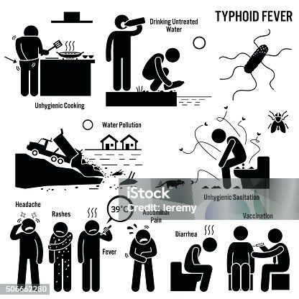
ENTERIC FEVER
BY II TH MEDICL UNIT
CHIEF:
  DR. S.PEER MOHAMED MD
  DR.RAJKUMAR MD
ASST. PROFESSORS:
DR.SURESH KUMAR MD
DR.SATHEESH KUMAR MD
PRESENTOR:
DR. ARUN T

Slide 2
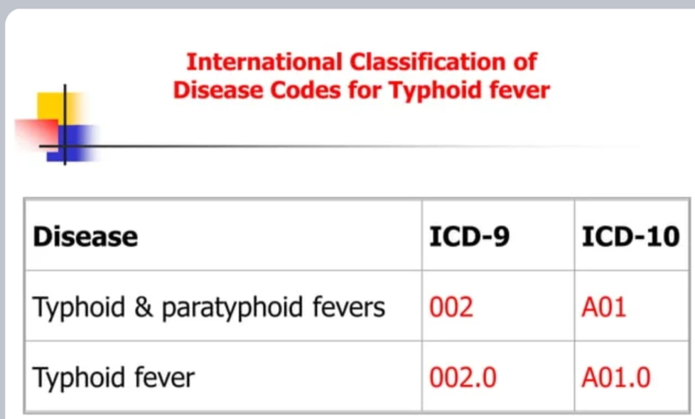

Slide 3
ENTERIC FEVER
Systemic disease charecterised by Fever and abdominal pain due to dissemination of s . typhi and s . paratyphi
It was initially called as typhoid due to its initial resemblance to typhus
Then it was segregated due to its unique resemblance to its enlarged peyer’s patches and mesentric lymph node hypertrophy

Slide 4
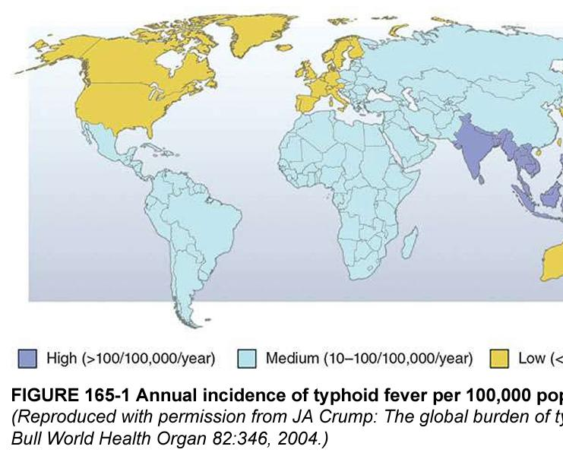
EPIDEMOLOGY
The annual incidence is highest in South Central and Southeast Asia; medium in the rest of Asia, Africa, Latin America,

Slide 5
TRANSMISSION
Most commonly by foodborne or waterborne illness and most commonly by fecal contamination by ill or asymptomatic chronic carriers
sexual transmission between male partners have been described
A high incidence of enteric fever correlates with mixing of drinking water with human sewage.
An asymptomatic human carrier is someone who is still excreting typhoid bacteria in their stool a year after the acute stage of the infection.
Known risk factors are Fecally contaminated drinking water or ice food and water from street vendors , Raw fruits and vegetables grown in sewage , ill household practices and Association with helicobacter pylori infection(probably)

Slide 6
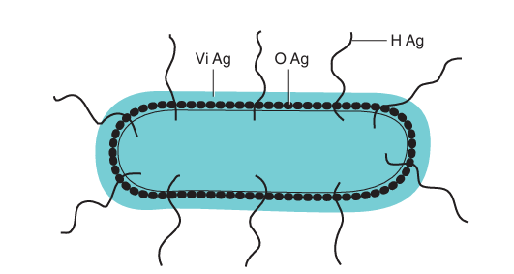
ANTIGENIC STRUCTURE
Salmonellae possess three important antigens on their cell wall, based on which they are classified.
The antigens are:
1. Somatic antigen (O)
2. Flagellar antigen (H)
3. Surface envelope antigen (Vi)—found in some species.
4.Fimbrial Ag
5.M Ag

Slide 7
SOMATIC ANTIGEN
FLAGELLAR ANTIGEN
SURFACE ENVELOPE ANTIGEN (Vi Ag)
Part of cell wall lipopolysaccharide
Heat stable alcohol stable
Less immunogenic
O Ab appears early and disappears early – RECENT INFECTION
Serogrouping is done based on somatic Ag
Made of proteins flagellin.
Heat and alcohol labile
More antigenic
H Ab appears late and disappears late – CONVALESCENT INFECTION
Serogroups are differentiated into serotypes based on H Ag.
Surface polysaccharide Ag covering the O Ag.
Expressed only in S.typhi and S.paratyphi c ,S.Dublin,rare strains of Citrobacter freundii
Poorly immunogenic hence not used in widal
Used for vaccination

Slide 8
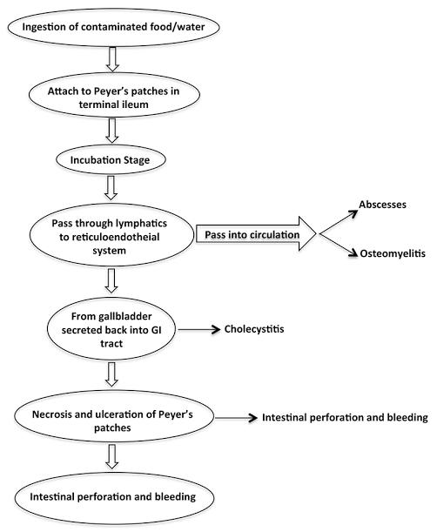
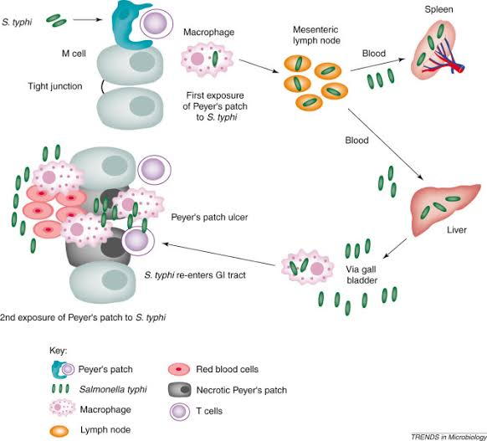
PATHOGENESIS

Slide 9
RESERVOIR OF INFECTION
CASES: A case is infectious as long as Bacilli appears in stool or urine
Reservoir: temporary/incubatory Excrete Bacilli for 6 to 8 weeks
Chronic : Excrete Bacilli for more than a year
Organism present in gall bladder /biliary tract
SOURCES OF INFECTION
Primary sources : feces and urine Cases and carriers
Fecal carriers are most frequent than urinary carriers
Secondary sources:
Contaminated Water and Food

Slide 10
CLINICAL FEATURES
Term enteric fever is a misnomer and fever and abdominal pain are variable
Fever is presented in greater than 75% Abdominal pain is reported in 30 to 35 %
Mean incubation period is 10 to 14 days but average varies from 5 to 21 days depending on inoculum size host healt condition and vaccination status
Most important feature is prolonged fever (101.8-104.9 F) Which can continue upto 4 weeks if left untreated

Slide 11
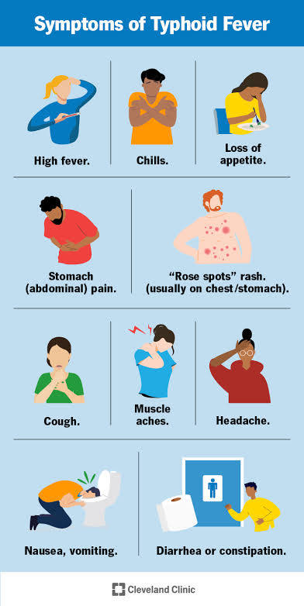
CLINICAL FEATURES
Headache
stepladder type of fever pattern and chills
Cough
Myalgia
Gastrointestinal manifestations which include anorexia
Nause ,vomitting diarrhoea and constipation
coated tongue

Slide 12
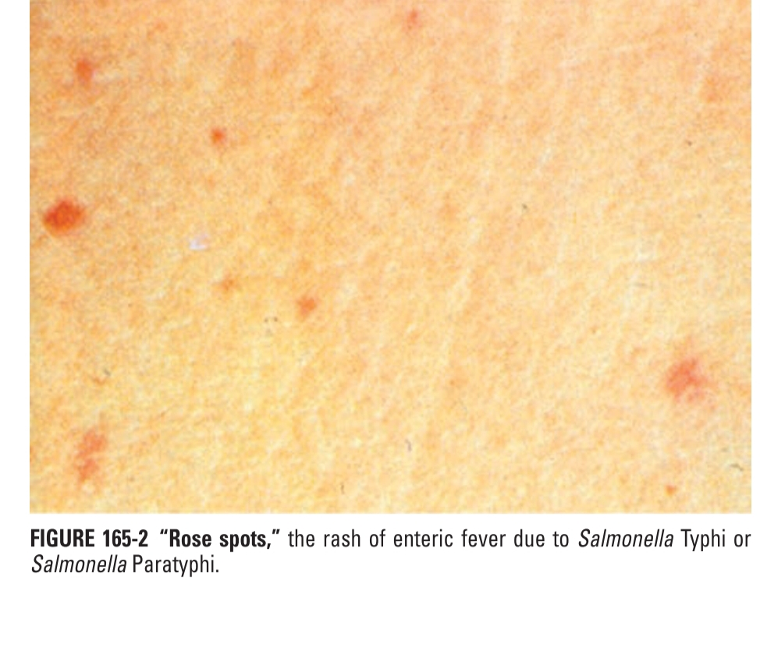
PHYSICAL FINDINGS
Rash –rose spots
Hepatosplenomegaly
Epistaxis
Relative bradycardia
Peak of high fever
Rose spots include faint ,blanching ,Maculopapular rash located primarily on trunk and chest
Patients have two or three crops of lesion and salmonella can be cultured from punch biopsies of those lesions

Slide 13
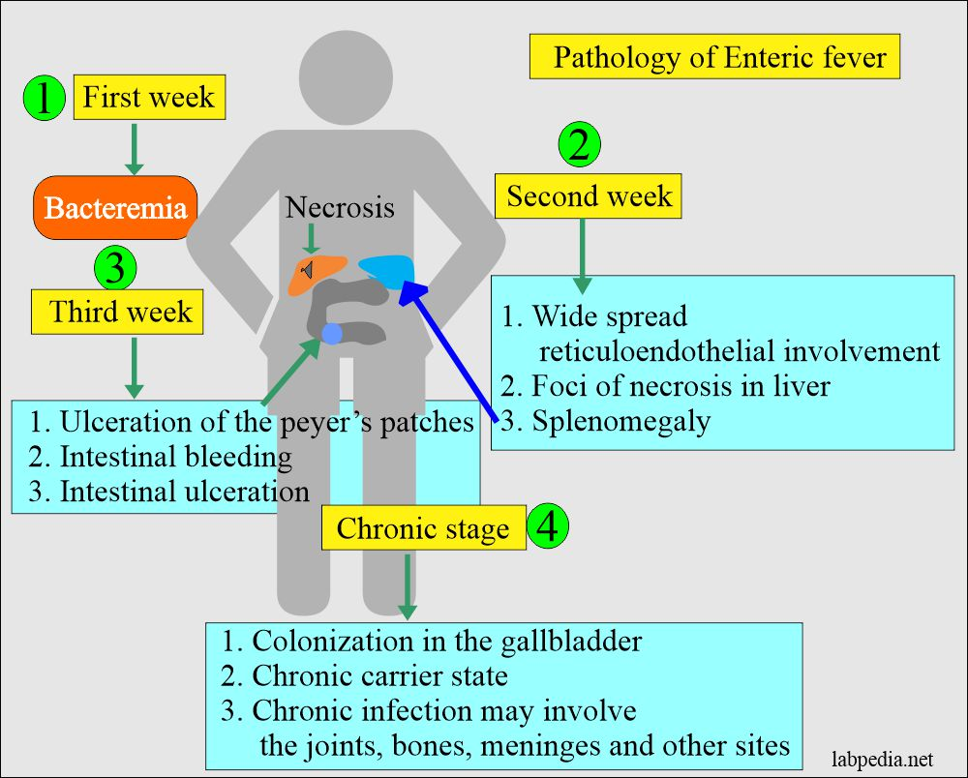
MANIFESTATION OF CLINICAL FEATURES
First week : Fever ,headache ,sore throat , myalgias
Second week : hepatosplenomegaly ,rose spots and relative bradycardia may be seen
Third week: patient will appear in Typhoid state which is a state of Prolonged apathy, toxaemia , delirium, Disorientatiom , coma or diarrhoea

Slide 14
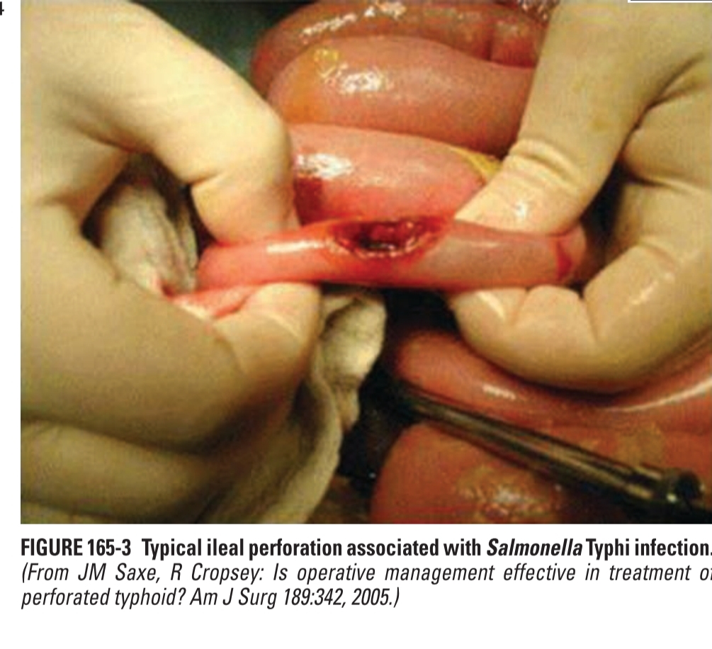
COMPLICATIONS
Depends on host factors immunosuppression ,vaccination status ,previous status , strain virulence ,inoculation ,choice of antibiotic therapy
Gastrointestinal bleeding and intestinal perforation are the most common occur in third to fourth week..
Bronchitis and bronchopneumonia may be found
Neurological manifestations may include guillain Barre syndrome , Neuritis and neuropsychiatric symptoms Described as muttering delirium or coma

Slide 15
Uncommon complication include DIC,Hemophagocytic syndrome,Pancreatitis,hepatic and splenicGranulomas
Endocarditis,pericarditis,myocarditis,Glomerulonephritis,arthritis,Pyelonephritis
Relapse rate is higher in patients treated with chloromphenicol
Infection and inflammation of the membranes and fluid surrounding brain and spinal cord (meningitis)
Low platelet count (thrombocytopenia) is sometimes seen.

Slide 16
Parameter | Typhoid Hepatitis | Viral Hepatitis
AST / ALT | Moderately elevated (<300 IU/L) | Markedly elevated (>500–1000 IU/L)
AST:ALT ratio | AST > ALT | ALT > AST
ALP | Mild–moderate ↑ | Mild ↑
Bilirubin | Mild–moderate ↑ | Marked ↑
PT/INR | Usually normal | Prolonged in severe case

Slide 17
CARRIERS
Source of infection is patient or more often a carrier
Patients who shed three week to three months is called as convalescent carriers
Patients who shed more than three months less than a year is called as temporary carriers
Patients who shed more than a year is called as chronic carriers
Shedding of Bacilli is usually intermittent and Bacilli persist in gallbladder and eliminated in feces
Urinary carriage is less frequent and often associated with calculi or schistosomiasis

Slide 18
LABORATORY DIAGNOSIS
Type of specimen to be collected depends on duration of illness
Various specimen that can be collected-blood ,bone marrow , stool , urine ,duodenal aspirate
Other – rose spots – punch biopsy,csf ,pus from suppurative lesions

Slide 19
FIRST WEEK OF ILLNESS
BLOOD CULTURE – CONVENTIONAL OR AUTOMATED
BONE MARROW CULTURE – WHEN BLOOD CULTURE IS NEGATIVE OR PT ON ANTIBIOTIC
DUODENAL ASPIRATE CULTURE – WHEN BOTH BLOOD AND BM CULTURE NEGATIVE
STOOL CULTURE :LESS SIGNIFICANCE ,Third to fourth week of illness

Slide 20
After overnight incubation at 37 degree Celsius bile broth is inoculated in mc konkey agar . pale non lactose fermenting colonies appear
If the culture is negative ,subculture should be repeated and culture declared negative only after 10 days.
CATENADAS METHOD is widely used where double medium is used
Serotyping by slide agglutinition:Loopful of growth from an agar slope is emulsified in two drops of saline on a slide .if S.typhi is suspected a loopful of typhoid o antiserum ,prompt agglutination indicates isolate belong to s typhi

Slide 21
Fresh isolates are of v form and do not agglutinate with O antiserum.such strains are tested against anti Vi serum.
Feces culture : fecal culture are most valuable as blood culture .most valuable in patients on antibiotics as the antibiotics do not eliminate bacteria from gut
Fecal samples are plated on DCA OR XLD AND WILSON BLAIR METHOD..
On mc konkey and Wilson Blair salmonella appear as pale colonies on XLD appear pink and Wilson Blair appears black
Other materials such as urine ,bone marrow culture is done
Culture of bile is done and usually positive and employed for detection of carriers

Slide 22
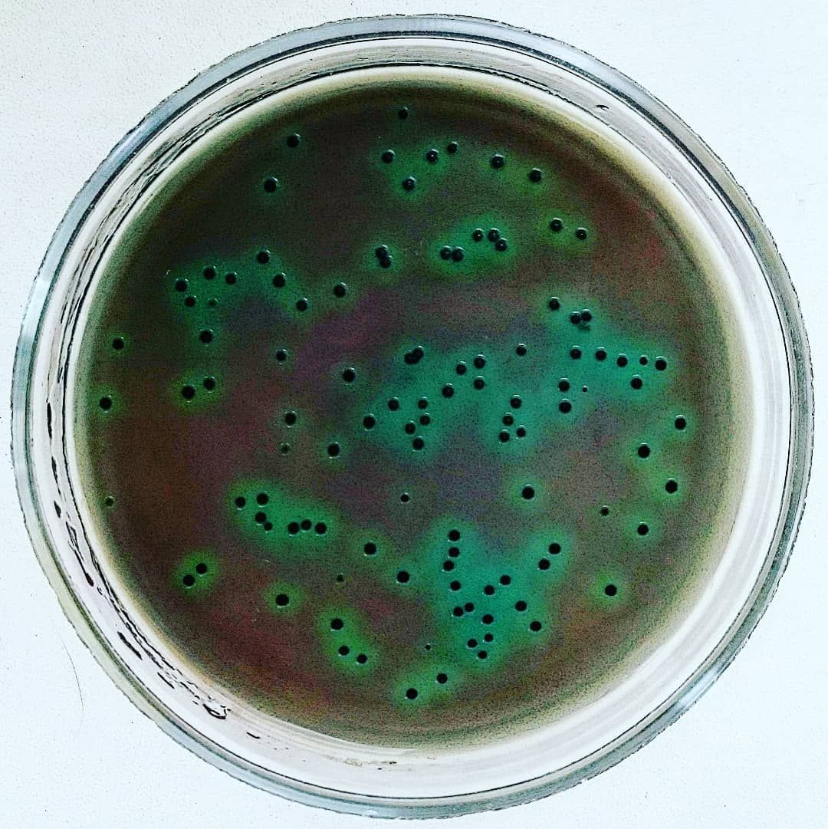
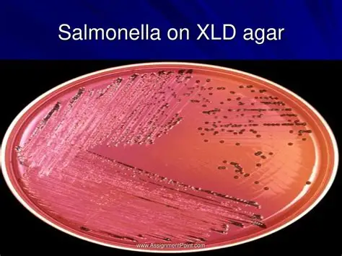
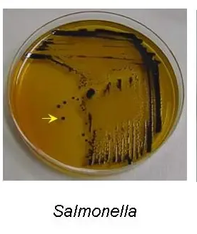
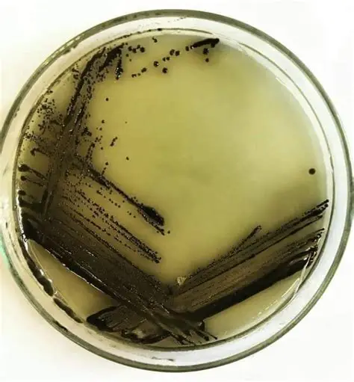
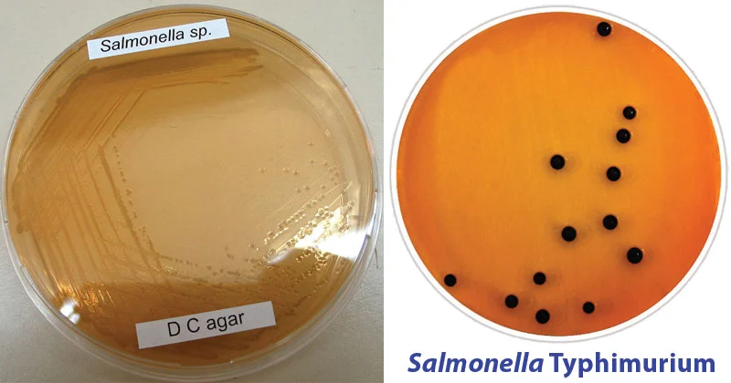
SELECTIVE MEDIA FOR STOOL CULTURE
MODERATELY SELECTIVE
HIGHLY SELECTIVE
SS AGAR
WILSON BLAIR BISMUTH SULFITE
HEKTOEN ENTERIC AGAR DEOXYLATE CITRATE AGAR

Slide 23
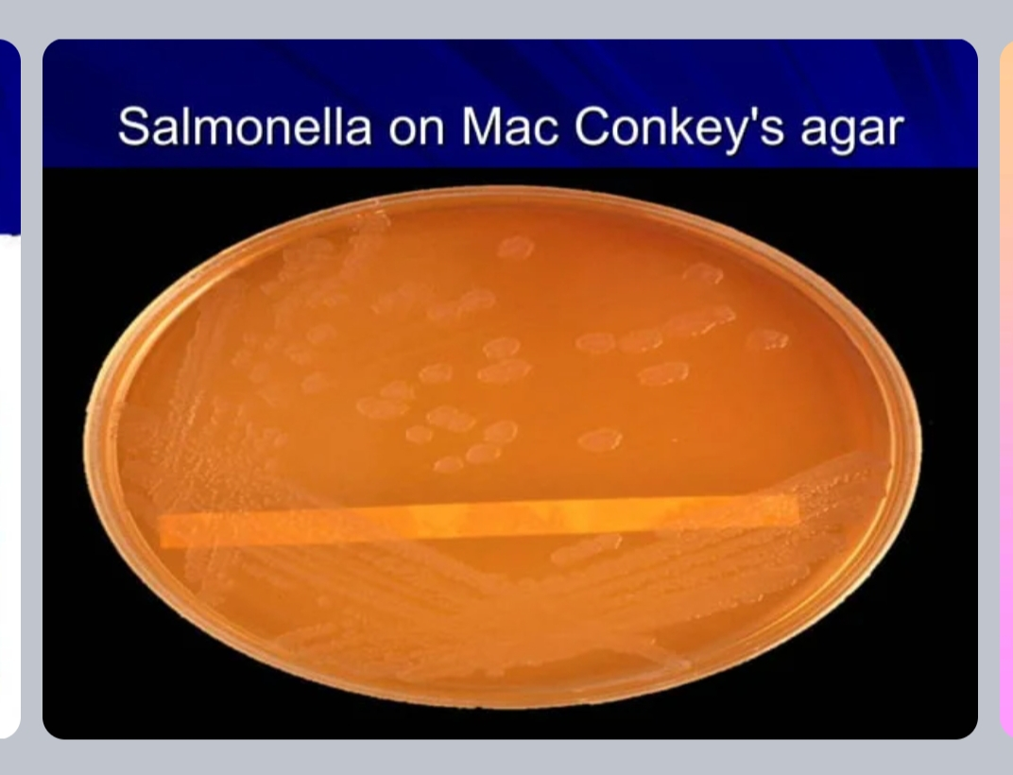
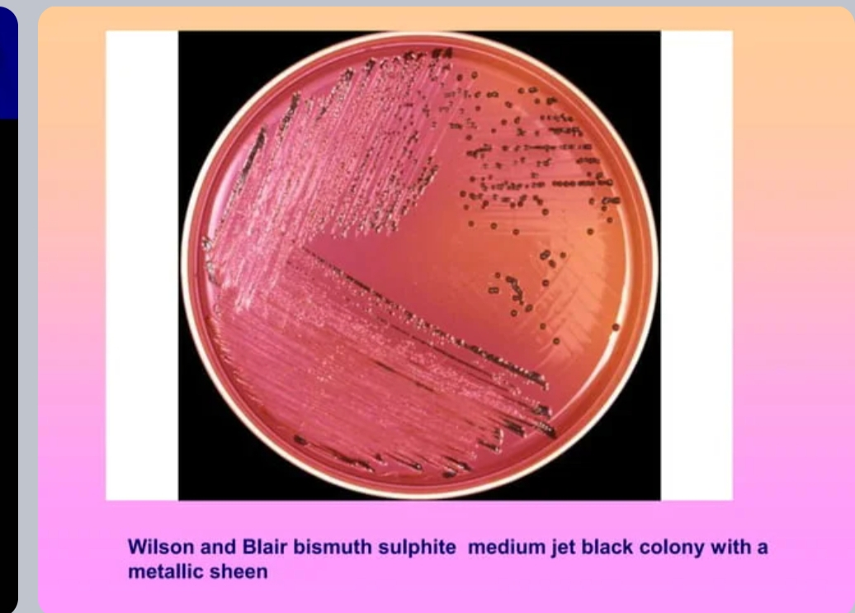

Slide 24
WIDAL REACTION
It is a measurement of H and O antigens
A narrow tube conical bottom dryer agglutination tube For h agglutination and short rounded tube Felix tube for o agglutination
In this test, the serum is mixed with a dead bacterial suspension of salmonella with specific antigens. If the patient’s serum contains antibodies against those antigens, they get attached to them, forming clumps. If clumping does not occur, the test is negative. The Widal test is time-consuming and prone to significant false positives. It may also be falsely negative in recently infected people. But unlike the Typhidot test, the Widal test quantifies the specimen with titres

Slide 25
WIDAL TEST
PRINCIPLE – AGGLUTINATION TEST
Done on 2nd and 3rd week of illness
ANTIGENS USED – 1.O antigens of S. Typhi (TO)
2. H antigens of S. Typhi (TH)
3. H antigens of S. Paratyphi A (AH)
4. H antigens of S. Paratyphi B (BH)
0 Ag of paratyphi not used as they cross react with O Ag of typhi
H agglutinins persist longer than O agglutinins .serum from individual immunised with TAB vaccine will generally have antibodies to s typhi and paratyphi A and B

Slide 26
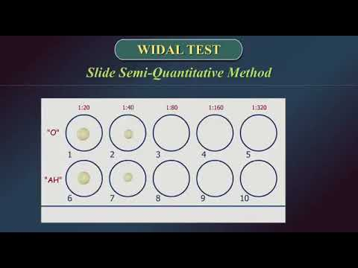
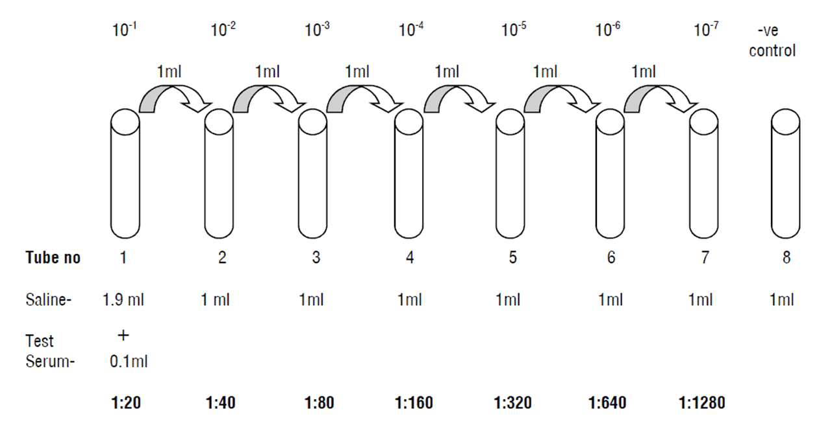
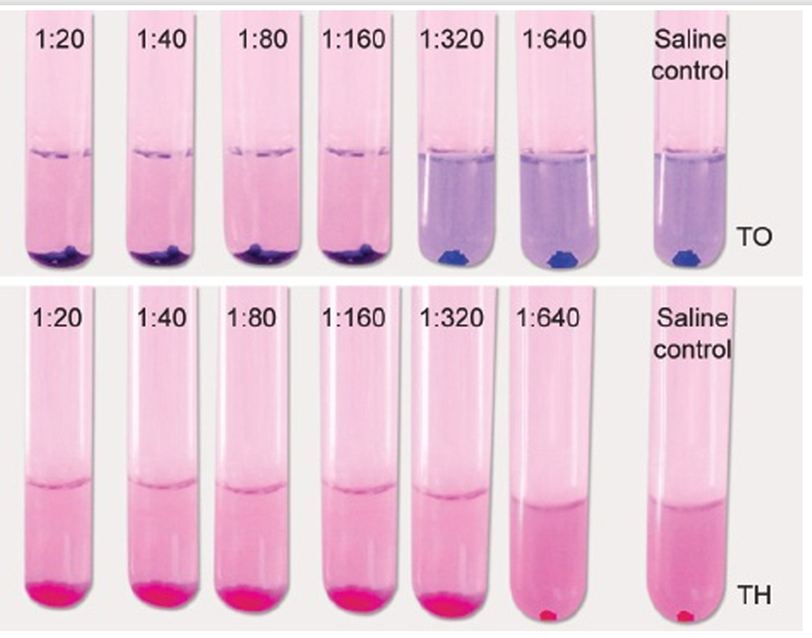
SLIDE WIDAL TEST
TUBE WIDAL TEST

Slide 27
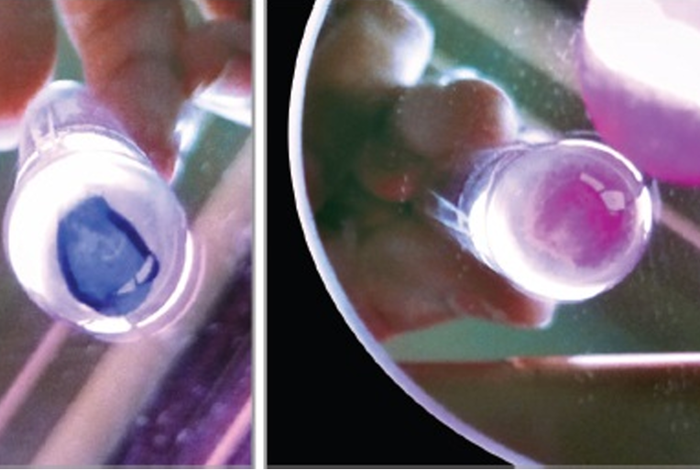
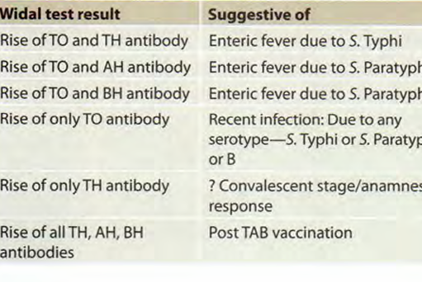
REPORTING

Slide 28
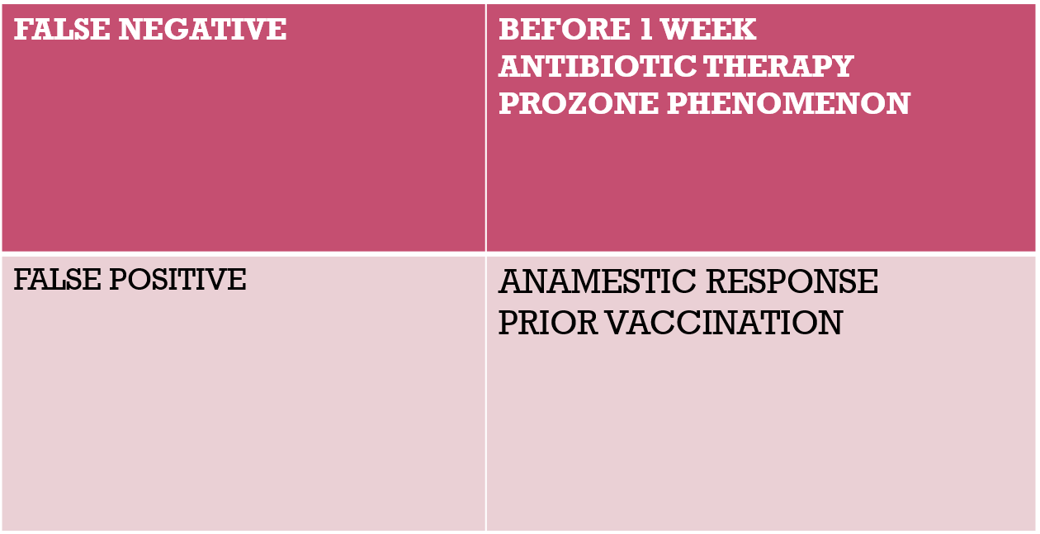
SIGNIFICANT TITRE
O >1 in 160
H>1 in 320
SINGLE TEST – NO SIGNIFICANCE IN ENDEMIC COUNTRY
FOURFOLD RISE - SIGNIFICANT
Persons who are prior immunised and show reaction and called as anamnestic response .anamnestic response shows transient rise where enteric fever shows sustained raise .

Slide 29
OTHER METHODS TO DETECT ANTIBODY
MODIFIED WIDAL TEST Widal detects igG and igM
ANTISERA TESTING- SLIDE AGGLUTINATION- serogrouping
Rapid diagnostic tests such as Tubex , Typhidot, and Test-It have shown moderate diagnostic accuracy
TYPHI DOT TEST
Principle – dot enzyme immunoassay – IgM and IgG Ab against outer membrane protein of S . typhi.
Typhidot has a sensitivity of about 70–90% and specificity of 80–95%
TUBEX TEST
PRINCIPLE –Monoclonal Ab based colorimetric test.

Slide 30
DIAGNOSIS OF CARRIERS :
Identification of fecal carriers by isolation of bacillus from feces or from bile or urine
Stool and bile culture – Fecal carrier
Urine –urinary carrier
Urinary carriers repeated urine culture must be sent
Detection of Vi antibodies- TUBE AGGLUTINATION TEST
Even a titer of 1:10 is also considered as significant
Widal has no value in detecting carriers
Tracing in cities may be detected by sewer swab technique . another technique of isolating from sewage is filtration through Millipore membrane and culturing through Wilson Blair method
The diagnosis confirmed by culture Isolation of salmonellae from sewage
METHOD - Sewer–swab technique

Slide 31
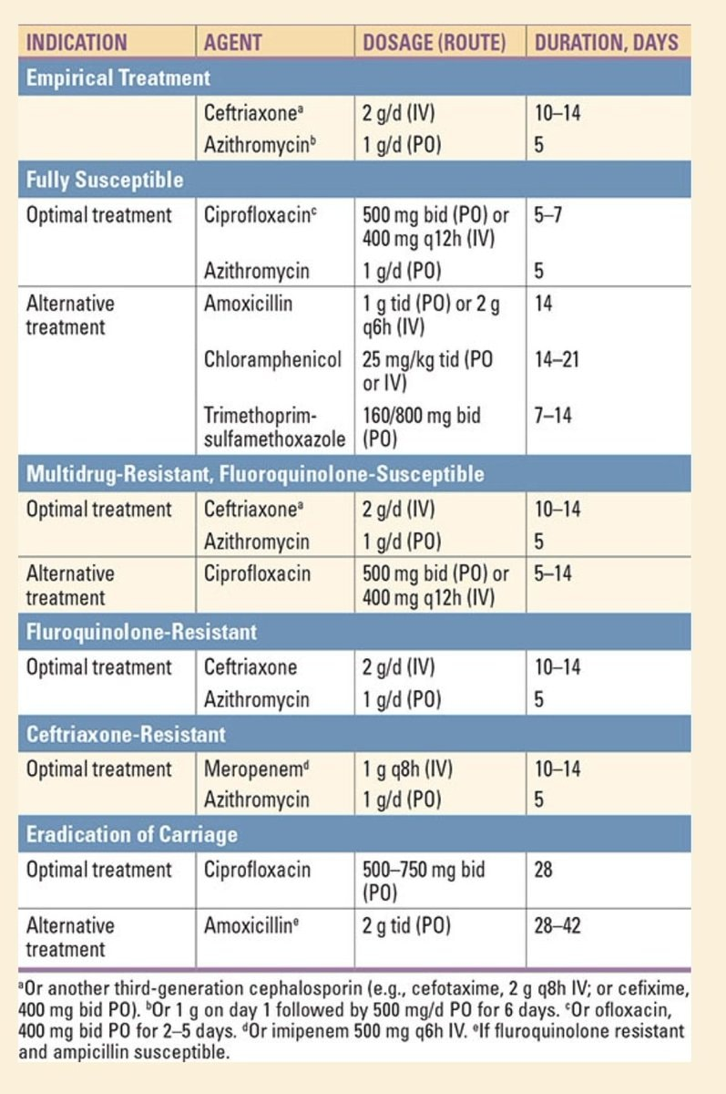
TREATMENT

Slide 32
For drug susceptible typhoid treatment of choice is fluroquinolones and has cure rate more than 97%
Because of high prevalence of Decreased susceptibility To strains of s typhi to ciprofloxacin MIC>. 0.125 Fluroquinolones should not be no longer used in treatment in indian subcontinent and nepals
Patients with DSC strains of s typhi should be treated with Ceftriaxone or Azithromycin .in DSC STRAINS Azithromycin is associated with lowest treatment failure and shorter duration of hospitalizations than fluroquinolones
Ceftriaxone ,cefotaxime and cefixime are treated in multidrug resistant typhoid .

Slide 33
Multidrug resistance — MDR strains (ie, those resistant to ampicillin, trimethoprim-sulfamethoxazole, and chloramphenicol) are prevalent worldwide, though they have been in decline as other antibiotics have been more widely used for treatment of enteric fever.
Extensively drug-resistant typhoid — Extensively drug-resistant (XDR) strains (ie, those resistant to five antibiotics: ampicillin, trimethoprim-sulfamethoxazole, chloramphenicol, fluoroquinolones, and third-generation cephalosporins)
corticosteroids for severe infection — For patients with suspected or known enteric fever and severe systemic illness (delirium, obtundation, stupor, coma, or shock), the administration of dexamethasone (an initial dose 3 mg/kg followed by eight dose of 1 mg/kg every 6 hours.

Slide 34
Patients with persistent abdominal features such as vomiting diarrhea and Abdominal distension is treated with parental cephalosporins, fluroquinolone or carbapenems based on their susceptibility . therapy should be at least 10 days or 5 days after resolution of fever
2 to 5 % which develop chronic carriage Is treated with oral ciprofloxacin for 4 weeks . with eradication rate ~80%
Oral Amoxicillin has lower eradication rates than fluroquinolone but can be used in fluroquinolone resistant cases for carriers

Slide 35
PREVENTION
General measures such as improved sanitation and increasing quality of water supply .
Vaccines:
Three vaccines are available globally for protection against S. Typhi:
  parenteral Vi polysaccharide vaccine,
  live oral S. Typhi vaccine strain Ty21a, and
  parenteral Vi conjugate vaccine.
None of these vaccines offer complete protection, and periodic revaccination is needed if exposure risk continues.-
In endemic areas, the World Health Organization (WHO) recommends implementation of national typhoid vaccination programs, preferably with a conjugate typhoid vaccine.

Slide 36
Typhoid conjugate vaccines (TCV) –
These vaccines consist of the Vi polysaccharide antigen linked to various carrier proteins.
Formulations-
TYPBAR -TCV – a Vi-TT (tetanus toxoid) conjugate, received WHO prequalification in 2017.
It is administered as a single intramuscular dose. Revaccination for continued protection may be needed;.
The vaccine is licensed in India, Nepal, Bangladesh, and several other ates.-
TYPHIBEV –containing Vi conjugated to CRM197 (a nontoxic mutant of diphtheria toxin), received WHO prequalification in December 2020. This vaccine demonstrated safety and noninferior immunogenicity in clinical trials [113] but has not yet been evaluated for clinical efficacy.

Slide 37
VI ANTIGEN CAPSULAR POLYSACCHARIDE (VI-CPS) VACCINE
TYPHORAL (ORAL LIVE ATTENUATED S. TYPHI TY21A VACCINE)
COMPOSITION: purified Vi capsular polysaccharide antigen derived from S. Typhi strain Ty2.
Dosage: It is administered as a single intramuscular dose. It can also be given subcutaneously.
Age :only after 2 years of age.
Valid 2 years
Booster is given every 2 years
COMPOSITION : d mutant of S. Typhi strain Ty21a
Dosage It is given orally before food, on alternate days—1,3, 5, 7.
Age : after 6 years of age.
Valid - 4 years.
Revaccination recommended every three to five years.

Slide 38
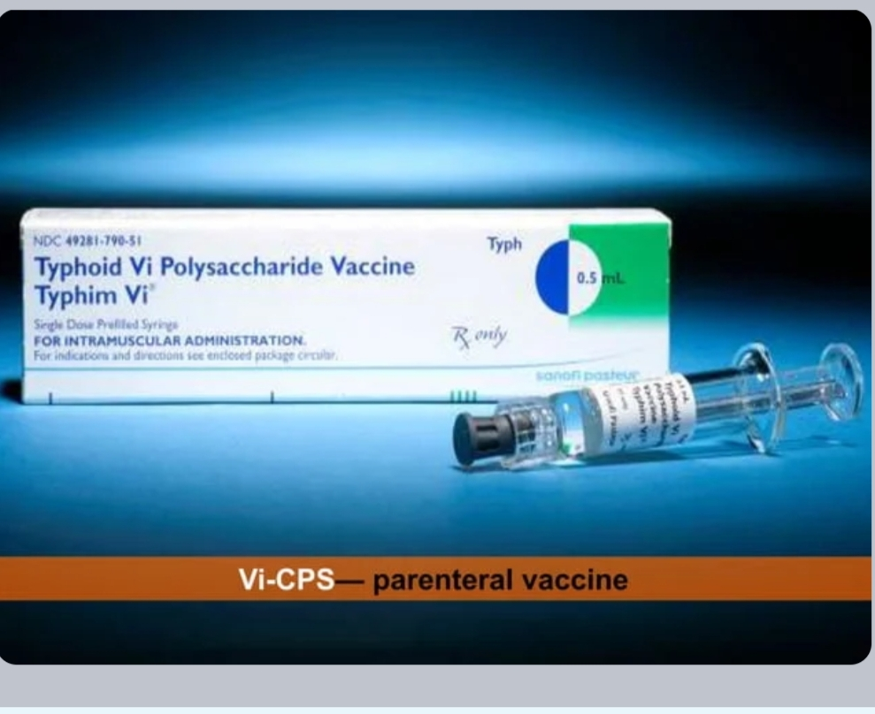
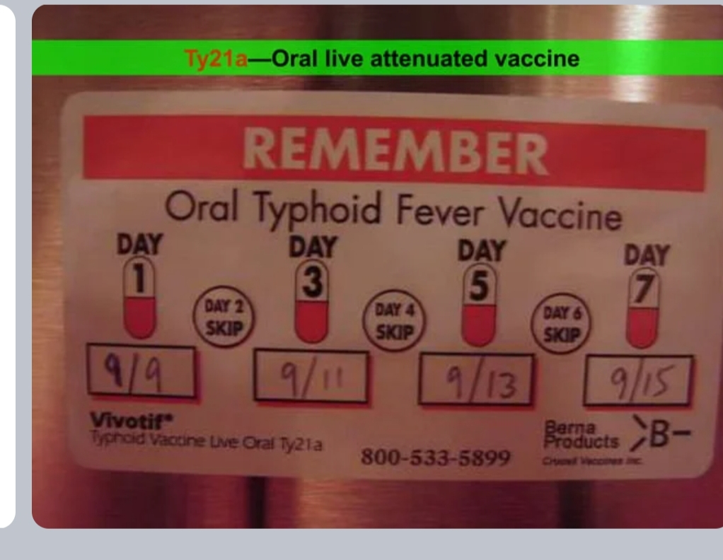

Slide 39
THANK YOU

