Slide 1
A CASE OF CJD
BY 5TH MEDICAL UNIT

Slide 2
CHIEF : PROF DR. K. SENTHIL MD
ASSOCIATE : DR. K. MURALIDHARAN MD
ASSISTANT : DR. V. MANIKANDAN MD
DR. SARAVANA MADHAV MD
DR.ILAMARAN MD DM
PRESENTOR : DR.S.K.KUGAN

Slide 3
58 years old female Mrs.Alagumeena was brought by her attenders with complains of altered behaviour for 2 months
H/O memory loss for 2 months,sudden in onset,progressive
H/O delusion,visual hallucination+
H/O decreased vision+
H/O involuntary movements involving all 4 limbs,quick jerk like movements,aggrevated by noise/touch relieved on its own
H/O involuntary facial movements+

Slide 4
No H/O reduced urine output
No H/O swelling of legs
NO H/O chest pain
No H/O fever
No H/O vomiting,loose stools
No H/O difficulty in breathing
No H/O joint pain,rash,oral ulcer

Slide 5
Past history:
No known comorbidities
Personal history:
Mixed diet
Normal sleep and appetite
Normal bowel and bladder habits

Slide 6
Menstrual history:
Attained menopause
Obstetric history:
P4L4

Slide 7
O/E:
Patient is awake,not obeying oral commands,
responds to pain
Myoclonic jerks+
No pallor,No icterus,No cyanosis,No clubbing,
No lymphadenopathy,No pedal edema
Breast examination – normal
Thyroid – normal
No neurocutaneous markers
No external markers of tb/HIV

Slide 8
Vitals:
BP:130/80 mm hg
Pulse:90/min
SPO2:97% at RA
RESPIRATORY RATE : 18/ MIN

Slide 9
S/E:
CVS-S1S2 +
No murmurs
RS-BAE+
No added sounds
Abdomen-soft
Bowel sounds+

Slide 10
CNS:
HIGHER MENTAL FUNCTIONS :
awake,not obeying oral commands,
responds to pain
Memory-impaired
Delusion+,Visual hallucination+

Slide 11
Power could not be elicited
Tone Increased in all 4 limbs
Sensory system,cerebellar signs could not be elicited
Myoclonic jerks + in all 4 limbs(stimulus sensitive)
Bilateral pupils 3mm equally reactive to light
Bilateral plantar-extensor

Slide 13
Investigations:
CBC 2/9
TC 7800
HB 10.3
Platelets 1.7 lakhs
RBS-116
Sr.sodium-138
Sr.potassium-4.8

Slide 14
LFT: T.B-1.3,D.B-0.5,I.B-0.8,SGOT-92,SGPT-66,ALP-116
RFT:
2/9 VCTC-Non reactive
Urea 21 RPR-Negative
Creatinine 0.8
Serum TSH – 1.66
Anti TPO - Negative

Slide 15
CSF ANALYSIS
TC- No cells
Sugar-79 mg/dl
Protein-37 mg/dl
LDH-156 U/L
Serum.protein-5.3
Serum.albumin-2.8
Serum.globulin-2.5
Serum.calcium-7.9
Corrected.calcium-8.9

Slide 16
EEG Report:
Generalized periodic sharp and slow wave discharges noted with the periodicity of 1.2 seconds

Slide 19
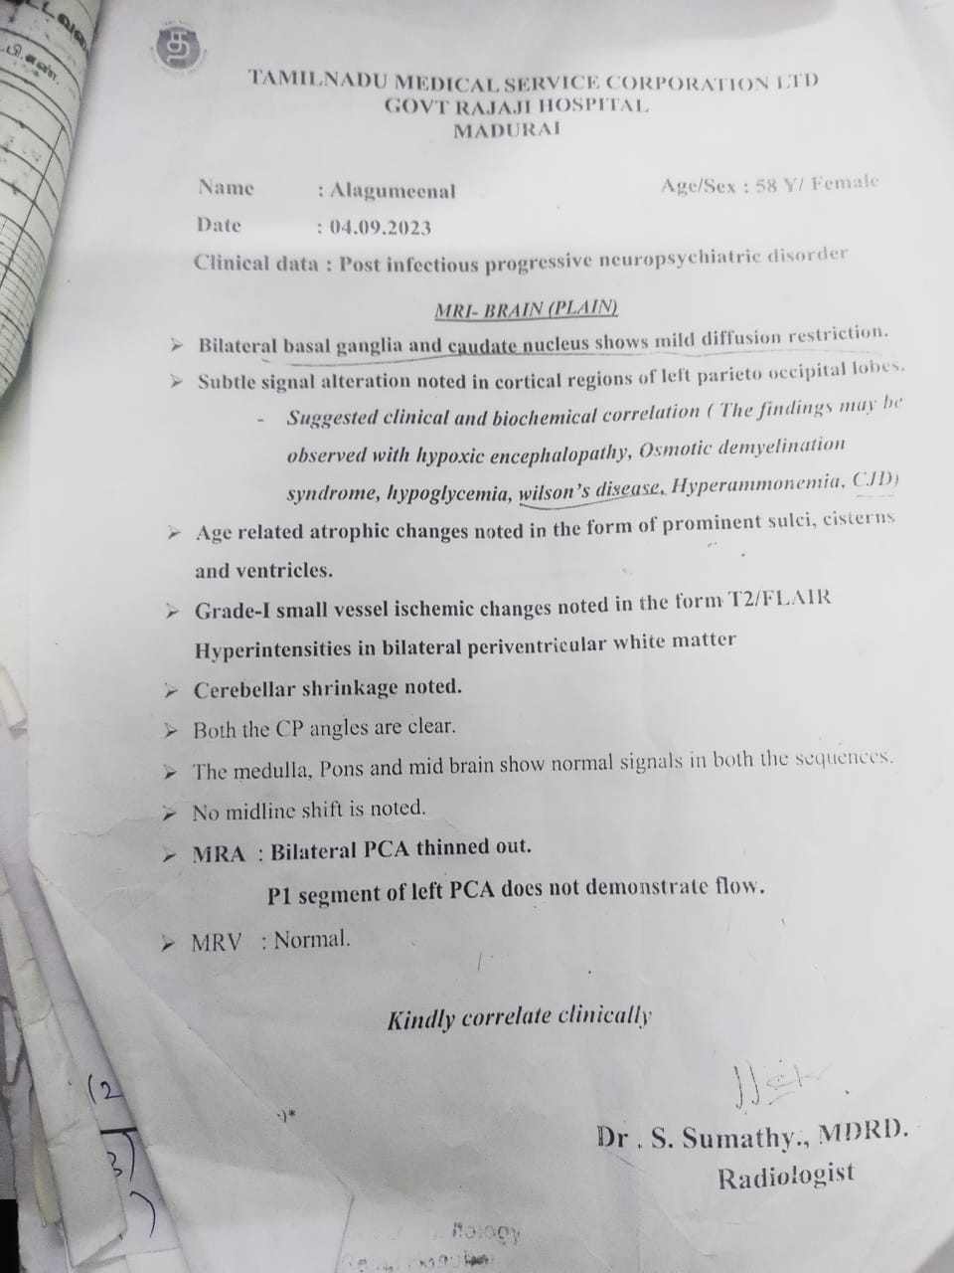
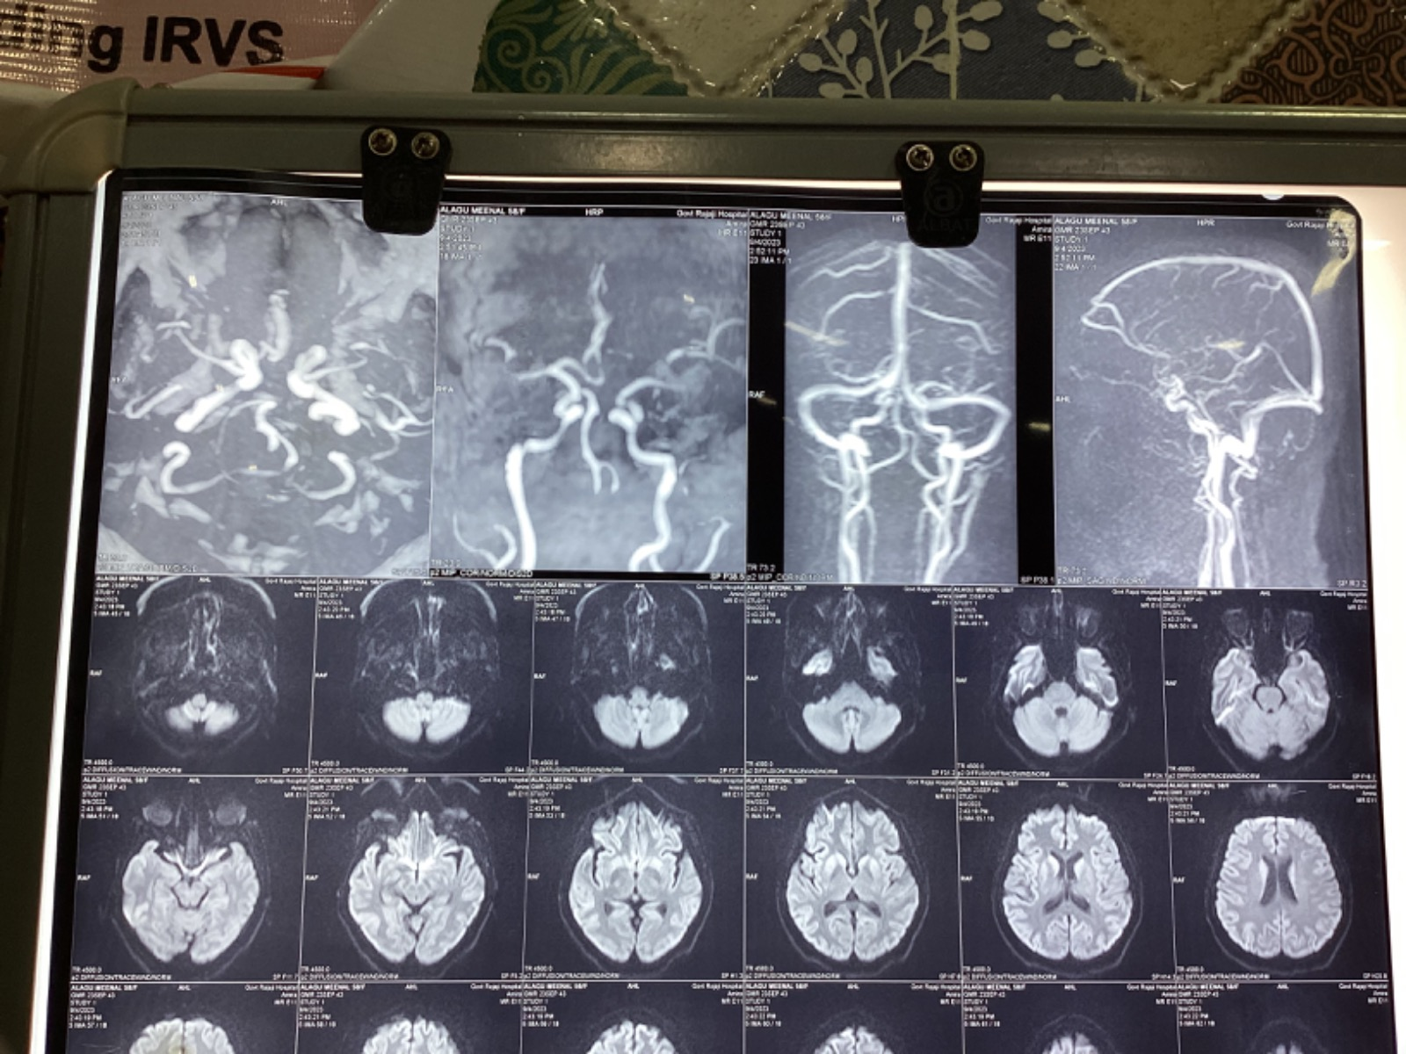
MRI Brain:

Slide 20
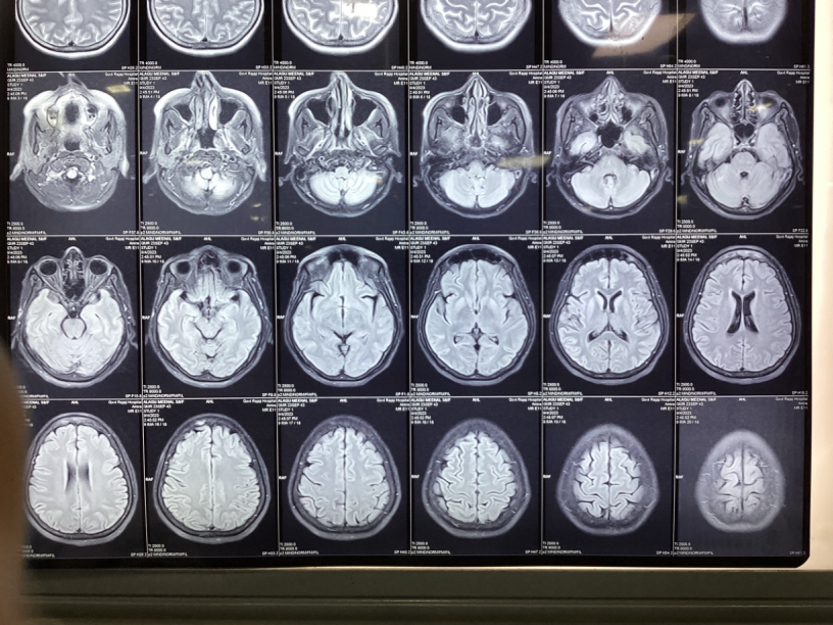

Slide 21
MRI Brain:
-Diffusion restriction in bilateral basal ganglia and caudate nucleus
-Cortical ribbon sign+

Slide 22
Psychiatry opinion:
No H/O previous psychiatric illness
Nil psychiatric intervention needed at present
Patient may be reviewed after improving physical condition
Ophthalmalogy opinion:
Both eye:Normal fundus at present
No evidence of KF ring

Slide 23
Neurophysician opinion:
Rapidly progressive dementia with features of parkinsonism and myoclonus
Impression:CREUTZFELDT JAKOB DISEASE

Slide 24
Treatment given:
Ryles tube feeding
IV Fluids
Inj.ceftriaxone 1gm IV BD
T.Sodium valproate 200mg 1-1-1
T.Folic acid 5mg 1-0-0
Physiotherapy

Slide 25
THANK YOU

