Slide 1


BLEEDING ON PAPER, NOT IN PERSON
Prof & HOD: Dr. S. Peer Mohamed, MD
Presentor:
Associate Prof: Dr. K. Muralidharan, MD
Dr. Arun T
Assistant Professors: Dr. Vasantha Kalyani MD,
Dr.V. Manikandan MD,
Dr. R. Jegatheesh MD,
Dr.M.Suresh Kumar MD
Dr.M.Satheesh Kumar MD
Postgraduate, Govt Rajaji Hospital

Slide 2
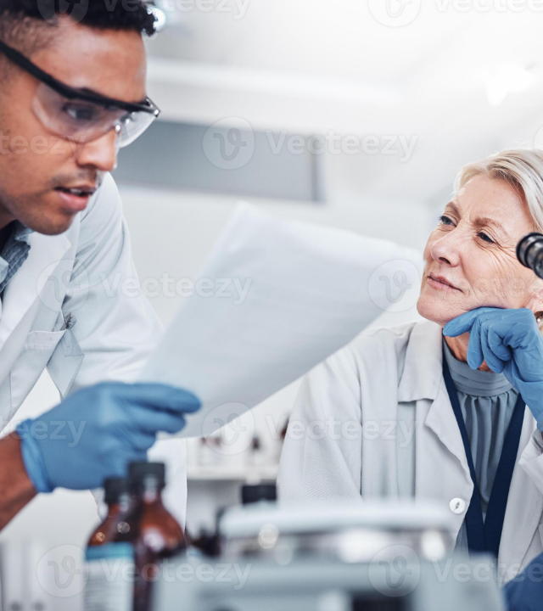

HOPI:
A 17-year-old female from Sivagangai was referred to
GRH following an alleged Road Traffic Accident (RTA) one week prior with facial injuries
Incidental Laboratory Finding:
Profound prolongation of PT, INR, and APTT was discovered during the routine post-trauma investigations for which she was referred here for further evaluation.

Slide 3






Negative Bleeding History
Despite abnormal labs, the patient was asymptomatic for hemorrhage:
Soft Tissue
Musculoskeletal
Internal Review
No history of uncontrolled or prolonged bleeding from traumatic site or gums.
No history of joint pain or swelling
No headache, malena, hemoptysis, hematemesis or hematuria

Slide 4


Medical & Menstrual History
Past Medical History
Physiological Profile
Not a known case of DM / HTN / Hypothyroid.
No history of liver /kidney disease
Cycle: 4 / 28 days (Regular).
Menorrhagia: Negative history.
Family History: Not significant.
CSOM Treated 1yr ago: PT/INR/APTT were prolonged then …. surgery was deferred because of abnormal coagulation profile but never evaluated.

Slide 5

General Examination & Vitals
110/70
85
98%
15
BP (MMHG)
PULSE (/MIN)
SPO2
RR (/MIN)
Patient conscious, oriented, and afebrile.
Pallor Present,
no icterus, no clubbing,
no pedal edema/generalized lymphadenopathy noted.
no ptechiae,purpura,ecchymosis.

Slide 6

Physical Review
Systemic Examination
Local Trauma (Post-RTA)
CVS: S1, S2 present; no murmurs.
Multiple facial abrasions (left side).
RS: Normal Vesicular Breath Sounds.
Sutured wound over jaw (4 × 1 cm).
P/A: Soft; normal bowel sounds.
Wound status: Healthy; no ooze.
CNS: NFND .

Slide 7
Hematology & Biochemistry
CBC Parameter | Value | Biochemistry | Value
WBC | 4800 cells/mm³ | T. Bilirubin | 0.6 mg/dL
Hemoglobin (HB) | 6.8 g/dL | SGOT / SGPT | 12 / 10 U/L
HCT | 26.9 % | ALP | 39 U/L
MCV | 66.9 fL | RBS | 72 mg/dL
Platelets (PLT) | 2,70,000 /mm³ | Urea / Creatinine | 20 / 0.7 mg/dL
Viral markers –negative
TSH -0.90 mIU/ml fT4- 1.09 ng/dl
Bleeding time- 2 minutes 30 seconds
Clotting time- 4 minutes 20 seconds

Slide 8
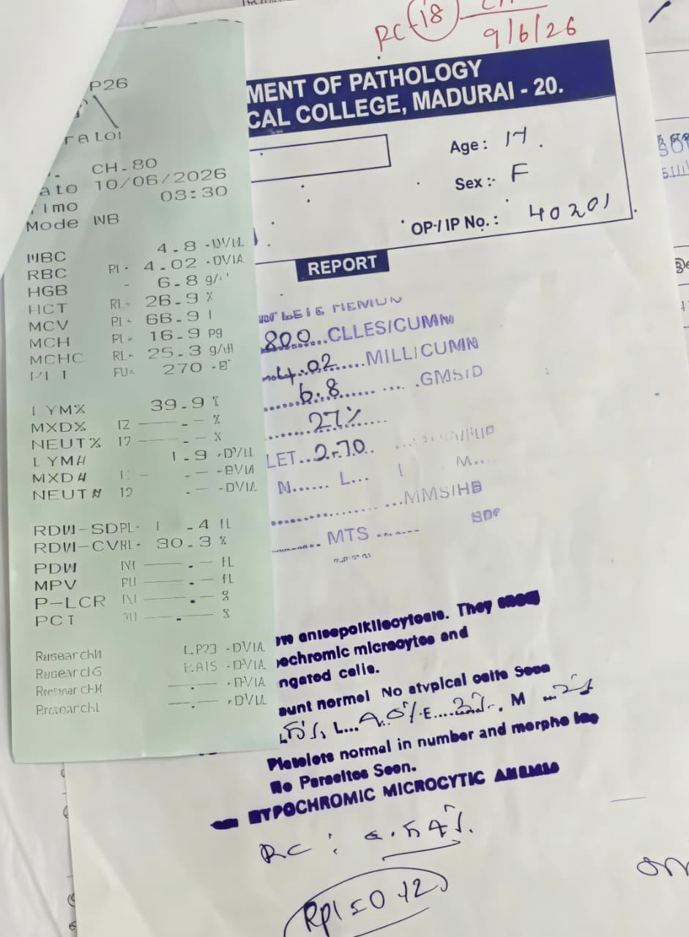
Complete Hemogram –peripheral smear
Complete hemogram- hypochromic microcytic anemia

Slide 9
Investigations — Coagulation Profile
PT
INR
APTT
seconds
ratio
seconds
8 / 6
8 / 6
8 / 6
36.9
3.01
60.3
↓
↓
↓
9 / 6
9 / 6
9 / 6
67.5
5.64
98.2
PROLONGED
PROLONGED
PROLONGED
7

Slide 10
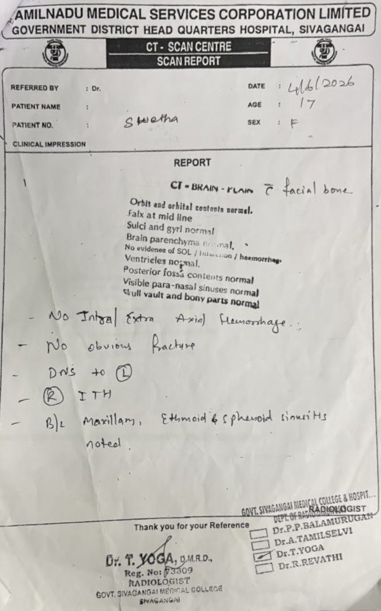
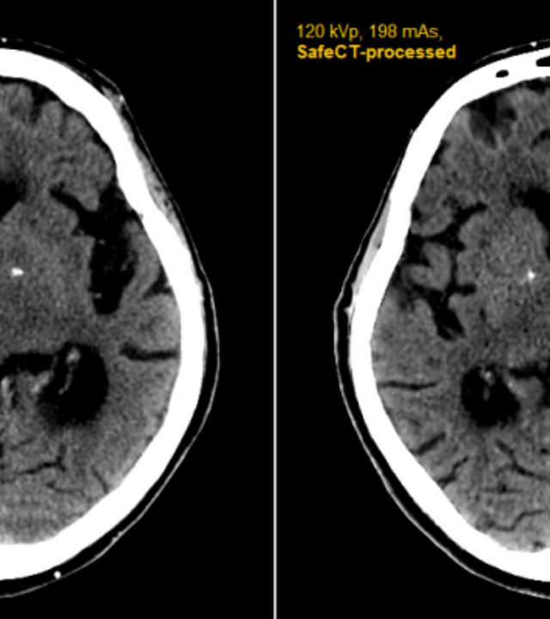
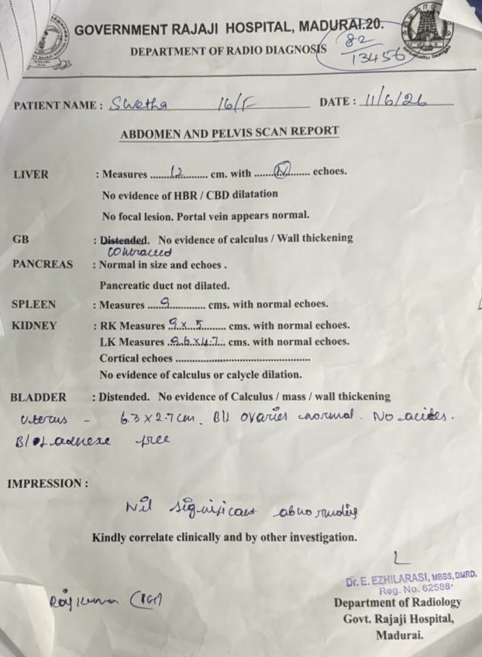
Radiology Findings
CT Brain (Plain): No evidence of intra/extra-axial hemorrhage or traumatic sequel. Maxillary/Ethmoid sinusitis noted.
USG Abdomen & Pelvis: Nil significant abnormalities; organs healthy with normal echoes.

Slide 11
Treatment given..
inj . Ceftriaxone 1 GM iv bd
1 unit packed red cell transfused
T.Fst 1-0-0
T.Bct 1-0-0
surgery opinion obtained-
Advised higher antibiotics..
daily cleaning and dressing
In admission patient complaints of headache
repeat CT brain was done . No evidence of intra/extra-axial hemorrhage or traumatic sequel.

Slide 12
Provisional diagnosis..
severe anemia ? Iron deficiency….
Abnormal coagulation profile- ?bleeding disorder…

Slide 13

Response to Vitamin K
Parameter | On Admission | Post Vit. K
PT (sec) | 36.9 | 40.7
INR | 3.01 | 3.3
APTT (sec) | 60.3 | 67.3
Conclusion: No correction observed after Parenteral Vitamin K administration.

Slide 14

LET'S DISCUSS

