Slide 1
Once in a blue moon

Slide 2
DEPARTMENT OF GENERAL MEDICINE GRH,MADURAI. PROF AND HOD:DR.NATARAJAN MD CHIEF:DR.A.SENTHAMARAI MD
ASSISTANT PROFESSORS:DR.M.J SENTHILKUMAR MD
DR.P.SUDHA MD
DR.SUGADEV MD
PRESENTOR:DR.NOORUL AMEEN

Slide 3
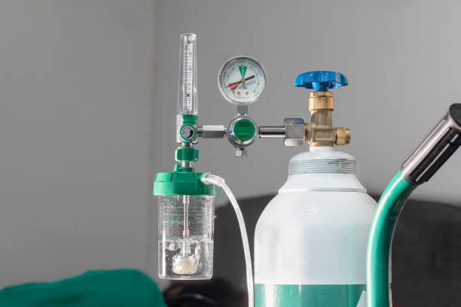
Interesting case of hypoxia
A 23 year old female patient presented with the history of giddiness for 1 day .

Slide 4
History of presenting illness
She was apparently normal until the day of her father demise,as per the history she was in grief and depressed for two weeks for which she was taken to native therapy,there she inhaled the steam generated from camphor and chilli ,some other native ingredients
Then developed a c/o giddiness for she had been taken to private hospital where SpO2 measured to be 57% and CT chest normal, referred to GRH Madurai

Slide 5
H/O dyspnea on and off for 2 months
Non progressive belongs to MMRC grade 1
No diurnal/postural variations
Not provoked by exertion, stressful situations, cold weather
H/O bluish discoloration of skin
Onset from childhood
Persistent
Not precipitated by cold temperatures/emotion
No relieving factors

Slide 6
No H/O Loss of consciousness
No H/O sense of motion
No H/O light headedness
No H/O unsteadiness or impaired balance
No H/O headache,visual disturbance

Slide 7
No H/O hemoptysis
No H/O cough with expectoration
No H/O chest pain /palpitations
No H/O change in voice /stridor
No H/O atopy/known allergen
No H/O fever

Slide 8
No H/O malaise, arthralgia
No H/O altered sensorium
No H/O dark colored urine
No H/O abdominal pain, nausea, vomitng
No H/O recurrent respiratory tract infection

Slide 9
Past history
Not a k/c/o cardiac disease, TB, Bronchial asthma, COPD, Diabetes, Hypertension
No significant birth/prenatal history
No H/O failure to thrive/developmental delay
No H/O immobilization/previous surgery in the past
No H/O drug intake/illicit drug abuse
No H/O recent anesthetic procedures

Slide 10
Family history

Slide 11
Personal history Menstrual history
Takes mixed diet
Unmarried
Regular sleep wake cycle
Normal bowel and bladder movements
Attained menarche at 13 yrs of age
Regular menstrual cycle 3/30

Slide 12
General examination
Conscious, oriented
Moderately built & nourished
Afebrile
No pallor
Icterus +
Not tachypneic/dyspneic
Cyanosis+
Present over the palms and tongue
Warm peripheries
No clubbing
No pedal edema
No lymphadenopathy

Slide 13
Vitals
Blood pressure
PR-78/min
Regular rhythm,
Normal volume,
No radio radial delay,
No Radio-femoral delay,
No special characters,
All peripheral pulses felt
Condition of vessel wall normal
 | Right | Left
Upper limb | 110/70 | 112/70
Lower limb | 108/72 | 110/70

Slide 14
Spo2 monitored by pulse oximeter
Respiratory rate – 14/min, Thoracoabdominal
 | Right | Left
Upper limb | 63% | 62%
Lower limb | 65% | 63%

Slide 15
Systemic examination
CVS
First heart sound and second heart sound heard
No murmurs
No parasternal heave/precordial bulge
RS
Normal vesicular breaths heard
Bilateral air entry equal
P/A
Soft
Bowel sounds heard
No apparent organomegaly
CNS
Conscious
Oriented
No focal neurological deficit
Pupil equally reacting to light
Fundus normal

Slide 16
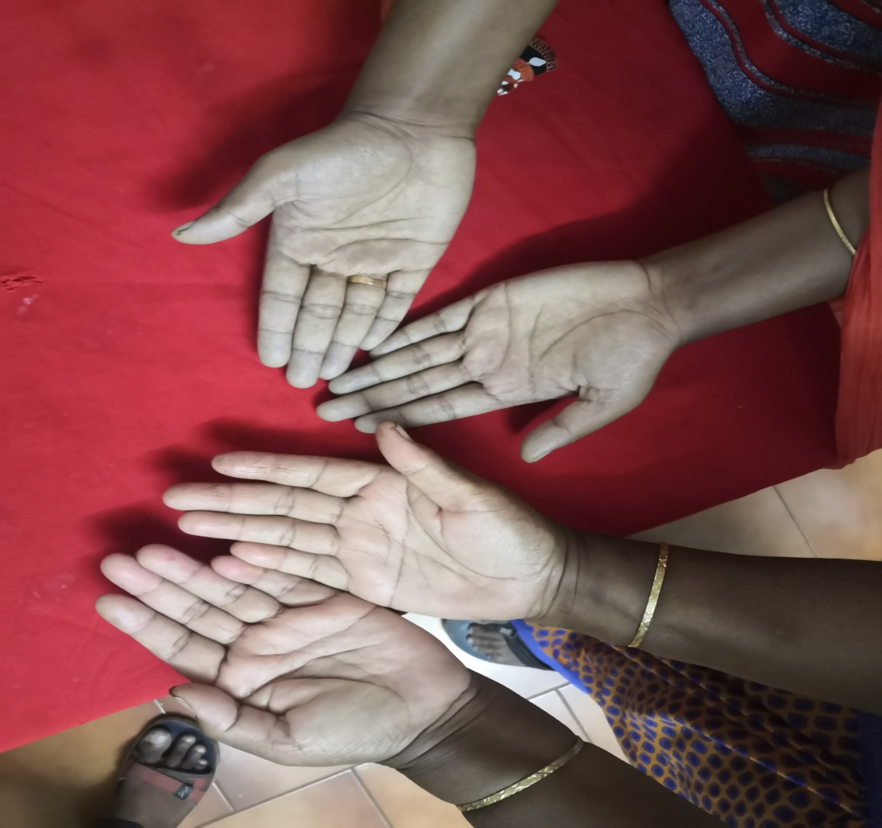
WORKING DIAGNOSIS
CENTRAL CYANOSIS F/E

Slide 17
INVESTIGATION
Complete blood count
Red cell indices
Total count | 7800
Differential count | 89/9/2
Hemoglobin | 11.5 g/dl
PCV | 37%
Platelet | 1.9L/cu.mm
ESR | 18mm/hr
MCV | 101 fl
MCH | 32.2 pg
MCHC | 31g/dl
RDW-SD | 52.5%
RDW-CV | 14.2%
RBC | 2.7 million/cu.mm

Slide 18
RFT and Serum electrolytes
Liver function test
Total bilirubin | 5.6mg/dl
Direct bilirubin | 0.4mg/dl
Indirect bilirubin | 5.2mg/dl
SGOT | 56 U/L
SGPT | 42 U/L
ALP | 10 U/L
RBS | 114mgs%
Urea | 21mg/dl
Creatinine | 0.5mg/dl
Sodium | 139mEq/l
Potassium | 3.7mEq/l

Slide 19
Peripheral smear
Microcytic hypochromic anemia
Red blood cell normal in number and shape
White blood cell ,platelet normal in number and count
Reticulocytosis
RPI -3.0
No hemoparasites seen
LDH-410U/L
Direct Coombs Test-Negative
ANA-negative

Slide 20
Urine R/E
Albumin – nil
Sugar- nil
Deposits – 2-3
RBCs- nil
Crystal/cast – nil
Bile salts/bile pigment-negative
Chest Xray PA

Slide 21
Covid RT PCR CT CHEST

Slide 22
USG ABDOMEN &PELVIS
Liver-Normal echoes and Normal size
Gall bladder-distended
Pancreas-Normal size
Spleen-14.3 cm mild splenomegaly
Bilateral ovaries seen
Uterus normal shape and size
Kidney
Right 10.4 cm x 4.3 cm
Left 9.1 cm x 4.7 cm
Bilateral cortical echoes normal
CMD maintained

Slide 23
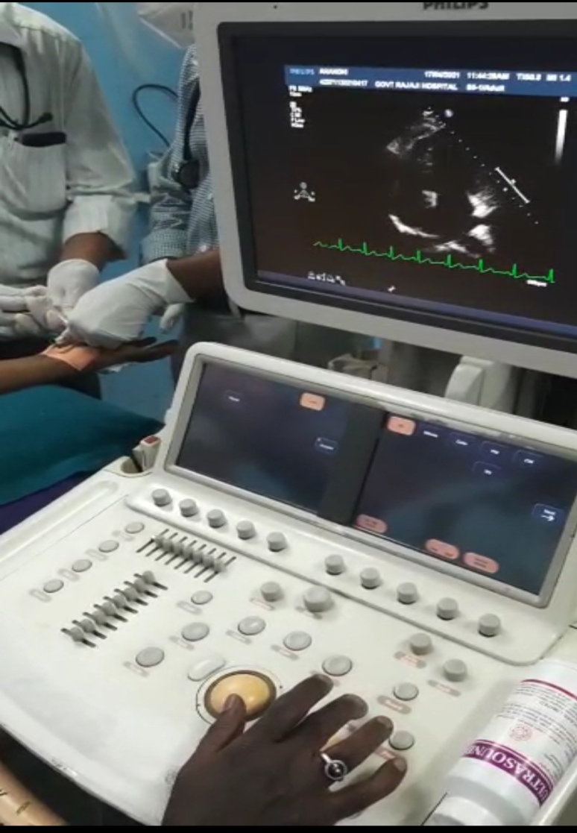
ECHO-Cardiac study
Bubble Contrast study
LVIDs-4.3cm
LVIDd-4.9cm
Tachycardia during study
LVEF-60%
Normal valves
Normal chambers
No PDA/TGA
No pericardial effusion
No obvious intracardiac shunt
Impression:normal study

Slide 24
Arterial bood gas analysis
pH | 7.41
PCo2 | 45
PO2 | 83
Na+ | 141
K+ | 3.5
Ca++ | 0.93
Lactate | 1.1
HCO3 | 28.5

Slide 25
ABG with derived parameters
pH | 7.41
PCo2 | 45
PO2 | 83
Na+ | 141
K+ | 3.5
Ca++ | 0.93
Lactate | 1.1
HCO3 | 28.5
Hct | 31%
Ca++ | 0.40 mmol/L
HCO3std | 22.4 mmol/L
TCO2 | 21.8 mmol/L
BEecf | -3.7 mmol/L
BE(B) | -3.3 mmol/L
SO2c | 100%
THbc | 9.9 g/dl

Slide 26
WHAT NEXT?

Slide 27
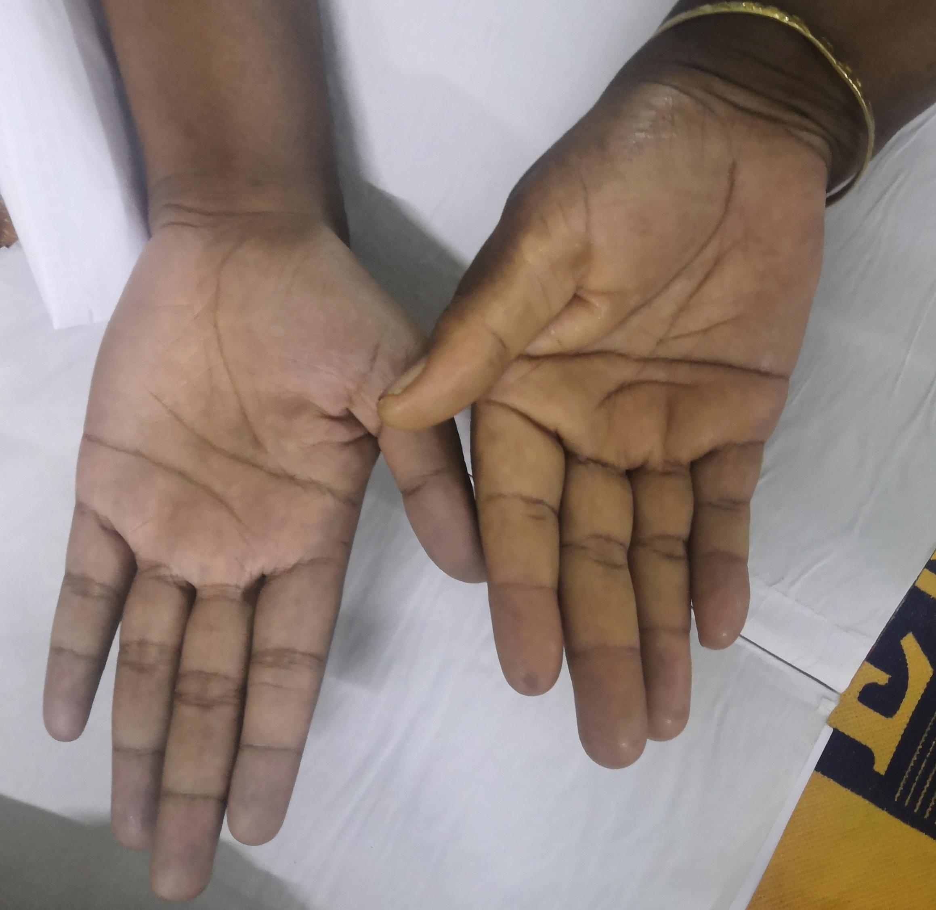
Differential diagnosis
Cardiopulmonary causes
Hemoglobinopathy
Methemoglobinemia
Variant hemoglobin
Sulfhemoglobinemia
Low oxygen affinity hemoglobins

Slide 28
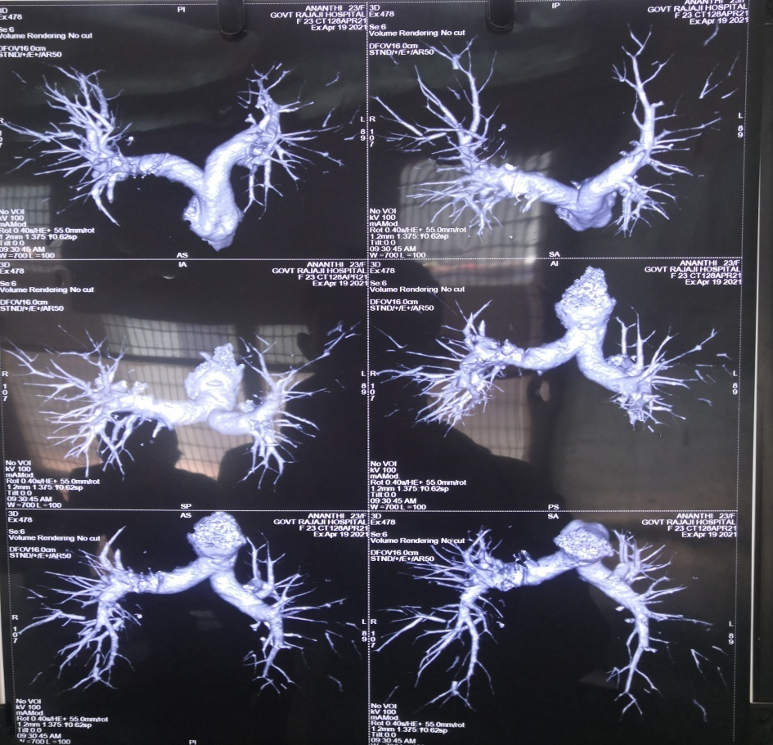
CT pulmonary angiogram

Slide 29
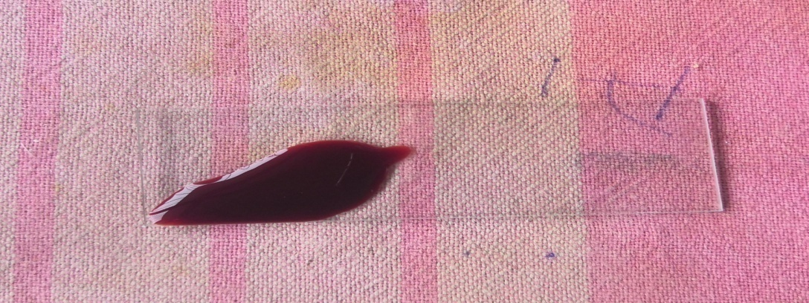
Bedside tests
Hyperoxia test –in vivo
Ventilate the patient with 100FiO2 for 10 mins
PaO2<100 mmhg
Expose the patient blood to ambient oxygen
Color of the blood (dark brown) didn’t change

Slide 30
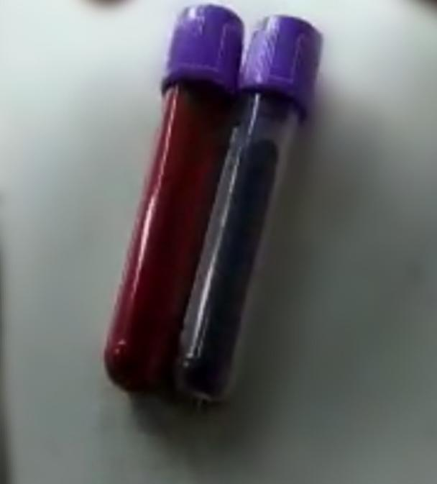
Patient actual A-a gradient
PAO2-PaO2 = FiO2(Pi-PH2O) - (PaCO2/RQ)-PaO2
= 10.5 mmhg
Expected A-a gradient for age = 9.8 mm hg
Saturation gap = SpO2-SaO2 =35%

Slide 32
IN VITRO IN VIVO
Added in 1:10 dilution of KCN to patient blood
No change in color
Administered Inj methylene blue iv 1mg/kg iv infusion over 60 minutes given
No improvement in cyanosis

Slide 33
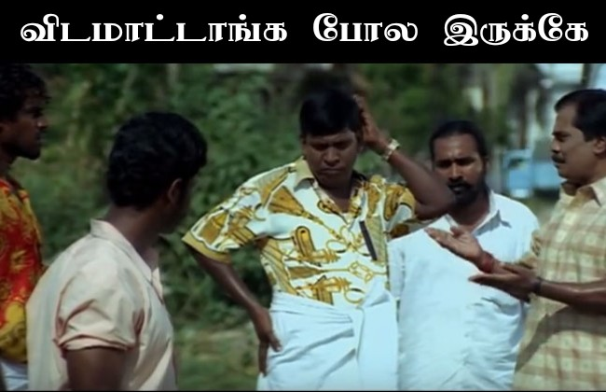
REPEAT INVESTIGATION
Complete blood count
Red cell indices
Total count | 6000
Differential count | 65/26/9
Hemoglobin | 11.0 g/dl
PCV | 33%
Platelet | 1.65L/cu.mm
ESR | 33mm/hr
MCV | 98 fl
MCH | 32.8 pg
MCHC | 34.8 g/dl
RDW-SD | 52.8%
RDW-CV | 15.0%
RBC | 3.3 million/cu.mm

Slide 34
Total bilirubin | 4.4mg/dl
Direct bilirubin | 0.5mg/dl
Indirect bilirubin | 3.9mg/dl
SGOT | 27
SGPT | 25
ALP | 40
Urobilinogen mildly elevated
Normochromic normocytes
Few macrocytes
No schistocytes/bite cells/spherocytes

Slide 35
GLUCOSE LOAD TEST
Fasting bilirubin taken (Total bilirubin/indirect bilirubin) i.e 3.9/3.5
Administration of oral glucose 100grams
Repeat serum bilirubin after 4 hours
Measured to be 3.9/3.5
Increased reticulocytes

Slide 36
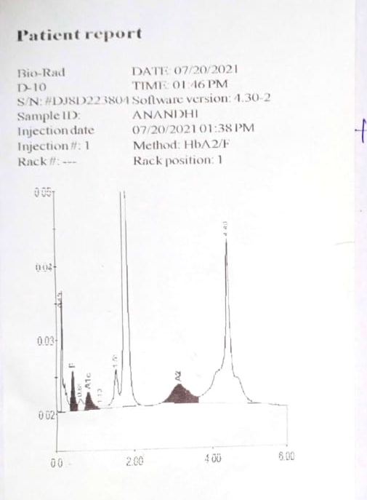
HPLC
Abnormal hemoglobin is seen as unknown peak in the retention time windows of 4.47 minutes.
HbA2 values are elevated

Slide 37
WHAT IS HbQ?
WHAT IS HbM?

Slide 39
Final Diagnosis
The diagnosis is Hemoglobin M variant - HbM Milwaukee 2/ HbM Hyde park/ HbM Akita
Heterozygous point mutation leads to substitution of histidine (CAC) by tyrosine(TAC) at the b 92 position
Presence of this variant has two types of functional consequences
Methaemoglobinaemic cyanosis caused by intact HbM Hydepark tetramer
Hemolytic anemia as a result of precipitation of globin after the loss of heme from the structural aberrant beta chains

Slide 40
Take home message
Hb M Hemoglobinopathy is rare hemoglobinopathy should be considered as underlying cause of cyanosis especially other common causes has been unproductive.
Correct diagnosis is important because this will forestall therapeutic and diagnostic misadventures.

Slide 41
What next to do?
Treatment is neither necessary nor possible
Premarital Genetic counseling
Anesthetic precaution

Slide 42
THANK YOU

