Slide 1


CLINICO-PATHOLOGICAL
CONFERENCE
DEPARTMENT OF GENERAL MEDICINE
MEDICAL UNIT-1
PROFESSOR&HOD: DR K.SENTHIL MD
PROFESSOR: DR ALAGAVENKATESAN MD
ASSOCIATE PROFESSOR: DR MURALIDHARAN MD
ASSISTANT PROFESSORS:DR SUDHA MD
DR MANIKANDAN MD
DR SARAVANA MADHAV MD
PRESENTOR: DR RANJITH MD(FINAL YEAR PG)

Slide 2
Patient was apparently normal before 3 months then he developed Fatiguability which is insidious in onset,progressive over 3 months interfering with the daily tasks ,most noticeable on exertion
Parasthesia over palms and soles over 3 months
Intermittent Loose stools for 2 months
Intermittent cough with expectoration for 2months
No dysnea at rest/chest pain/palpitations/syncope
No bleeding manifestations/bruising of skin
No weight loss /night sweats/anorexia/bone pain
No fever/recurrent infections/mouth ulcer/urinary symptoms
No jaundice/dark urine/abdominal pain/abdominal fullness
No diarrhea/constipation/nausea/vomiting
No neck swellings & swellings elsewhere
HISTORY OF PRESENTING ILLNESS
CLINICAL VIGNETTE
A 65 Years old male, who is a Temple priest by occupation came to OPD with the complaints of Easy fatiguability FOR 3 months

Slide 3
PAST HISTORY
K/C/O Type 2 Diabetes mellitus for 12 years on T.METFORMIN 500 mg TDS
K/C/O Systemic hypertension for 10 years on T.TELMISARTAN 40 mg OD
Patient is on Dyslipidemic medication T.ROSUVASTATIN 20mg HS & PPI taken before food daily for 5 years
H/O Antibiotic usage for cough (records NA)
Previous report of MRI BRAIN was taken in view of headache 2 years back s/o Partial empty sella
Previous history of Jaundice 15 years back ,recovered with native medications in 1 month(records NA)
No other comorbid illness
No radiation/toxin exposure before
No c/o similar illness in the past,previous hospital admission
No h/o blood transfusions in the past
No past history of fever/ abdominal pain
Consumes strict vegeterian diet
Denies history of alcohol consumption
Non smoker and no other substance abuse
Decreased appetite
Normal sleep
Normal bowel and bladder habits
PERSONAL HISTORY
No significant family history
FAMILY HISTORY

Slide 4
Alert
Comfortable at rest
Cooperative
Well built & nourished
Pallor
Pedal edema (Grade 1+)
No pallor,icterus,cyanosis,clubbing
Small,discrete,mobile,non tender inguinal nodes around 1cm bilaterally
GENERAL EXAMINATION
BP- 130/90 mm of Hg Right upper arm in sitting position
PR- 82/min
SpO2- 98% RA
RR- 16/min
VITALS

Slide 5
SYSTEMIC EXAMINATION
CENTRAL NERVOUS SYSTEM
Conscious
Oriented to time,place,person
Right handed person
Memory-Immediate,recent and remote memory intact
Intelligence-Normal
Speech&Language-Comprehension,fluency,repetition all are intact
Normal
CARDIOVASCULAR SYSTEM:
S1, S2 HEARD
ESM heard over Aortic area
RESPIRATORY SYSTEM:
Bilateral air entry equal,scattered crackles+
PER ABDOMEN:
SOFT , BS+
Liver palpable 2cm below the right costal margin in the MCL,with a smooth surface,regular margins,soft consistency,non tender and moving with respiration
HIGHER MENTAL FUNCTION
CRANIAL NERVE EXAMINATION

Slide 6
SENSORY SYSTEM
MOTOR SYSTEM
TONE | RIGHT | LEFT
UL | NORMAL | NORMAL
LL | NORMAL | NORMAL
 |  | RIGHT | LEFT
SPINOTHALAMIC | PRESSURE | INTACT | INTACT
 | PAIN | INTACT | INTACT
 | TEMPERATURE | INTACT | INTACT
POSTERIOR COLUMN | VIBRATION
 | FINE TOUCH
 | JPS | INCONCLUSIVE | INCONCLUSIVE
CORTICAL | TACTILE LOCALIZATION | INTACT | INTACT
 | 2 POINT DISCRIMINATION | INTACT | INTACT
 | STEREOGNOSIS | INTACT | INTACT
 | GRAPHASTHESIA | INTACT | INTACT
POWER | RIGHT | LEFT
UL | 5/5 | 5/5
LL | 5/5 | 5/5
DTR | RIGHT | LEFT
BICEPS | + | +
TRICEPS | + | +
SUPINATOR | + | +
KNEE JERK | + | +
ANKLE JERK | ABSENT | ABSENT
SUP.REFLEX | RIGHT | LEFT
ABDOMINAL | + | +
CREMASTRIC | + | +
PLANTAR | FLEXOR | FLEXOR

Slide 7
FNT/FNFT-Intact
No dysmetria
No ataxia
No nystagmus
No intentional tremor
No staccato/scanning speech
No hypotonia
Pendular knee jerk-absent
Rebound phenomenon-absent
CEREBELLAR FUNCTION TEST
MENINGES:
No neck rigidity,Kernigs,Brudzinski sign
ROMBERG SIGN:Negative
SPINE&CRANIUM: No tenderness/defect
PERIPHERAL NERVE:No thickening/tenderness of peripheral nerve

Slide 8
LAB PARAMETER | RESULT
TOTAL WBC COUNT | 4650 cells/cu.mm
DIFFERENTIAL COUNT
NEUTROPHILS | 58.7%
LYMPHOCYTES | 31.7%
EOSINOPHILS | 3.9%
MONOCYTES | 4.8%
BASOPHILS | 0.9%
HEMOGLOBIN | 6.3g/dl
RBC COUNT | 2.01mill/cu.mm
MCV | 108.5 fl
MCH | 31.3 pg
MCHC | 28.9%
PLATELET COUNT | 2.96Lcells/cu.mm
RDW | 28.4%
AEC | 180cells/cu.mm
RETIC COUNT | 3.25%
MEAN PLATELET VOLUME | 9.9fl
IMMATURE PLATELET FRACTION | 3.5 %
CBC
EPO LEVEL | 256.84mIU/ml (5.45-28.35)

Slide 9
LAB PARAMETERS | RESULTS
UREA | 38
CREATITINE | 0.8
SODIUM | 137
POTASSIUM | 4.3
TOTAL BILIRUBIN | 0.9
SGOT/SGPT | 25/23
ALP | 80
LDH | 458
ESR | 36 mm/hr
CRP | 10
CALCIUM | 10.1
PHOSPHATE | 3.3
URIC ACID | 6.2
ALBUMIN/GLOBULIN | 4.2/2.3
VCTC | NEGATIVE
VM | NEGATIVE
VITAMIN B12 | 225pg/ml(180-914)
FOLATE | >23.20ng/ml(4.00-19.90)
HOMOCYSTEINE | 28.39micmol/L(3.70-13.90)
S.FREE T4 | 0.80ng/ml(0.6-1.2)
S.TSH | 6.5 uIU/ml
HBA1C(HPLC method) | 7.10% *ABNORMAL HbF NOTED
URINE
ALBUMIN | Faint Trace
GLUCOSE | Nil
DEPOSITS | 4-6 pus cells/HPF Epithelial cells+ No RBCs,casts&crystals

Slide 10
PERIPHERAL SMEAR
RBC: Anisopoikilocytosis with microcyte,normocyte,macrocytes with few nucleated RBC noted
WBC: Counts adequate
PLATELET: Counts adequate
DIFFERENTIAL COUNT:
Neutrophils-38%
Lymphocytes-51%
Eosinophils-01%
Monocytes-04%
No Blasts
IMPRESSION: Features suggestive of DIMORPHIC ANEMIA
LIVER: Normal size and architecture
SPLEEN: Normal
No Ascites
KIDNEY: Normal
No Abdominal Lymphadenopathy
USG-ABDOMEN

Slide 11
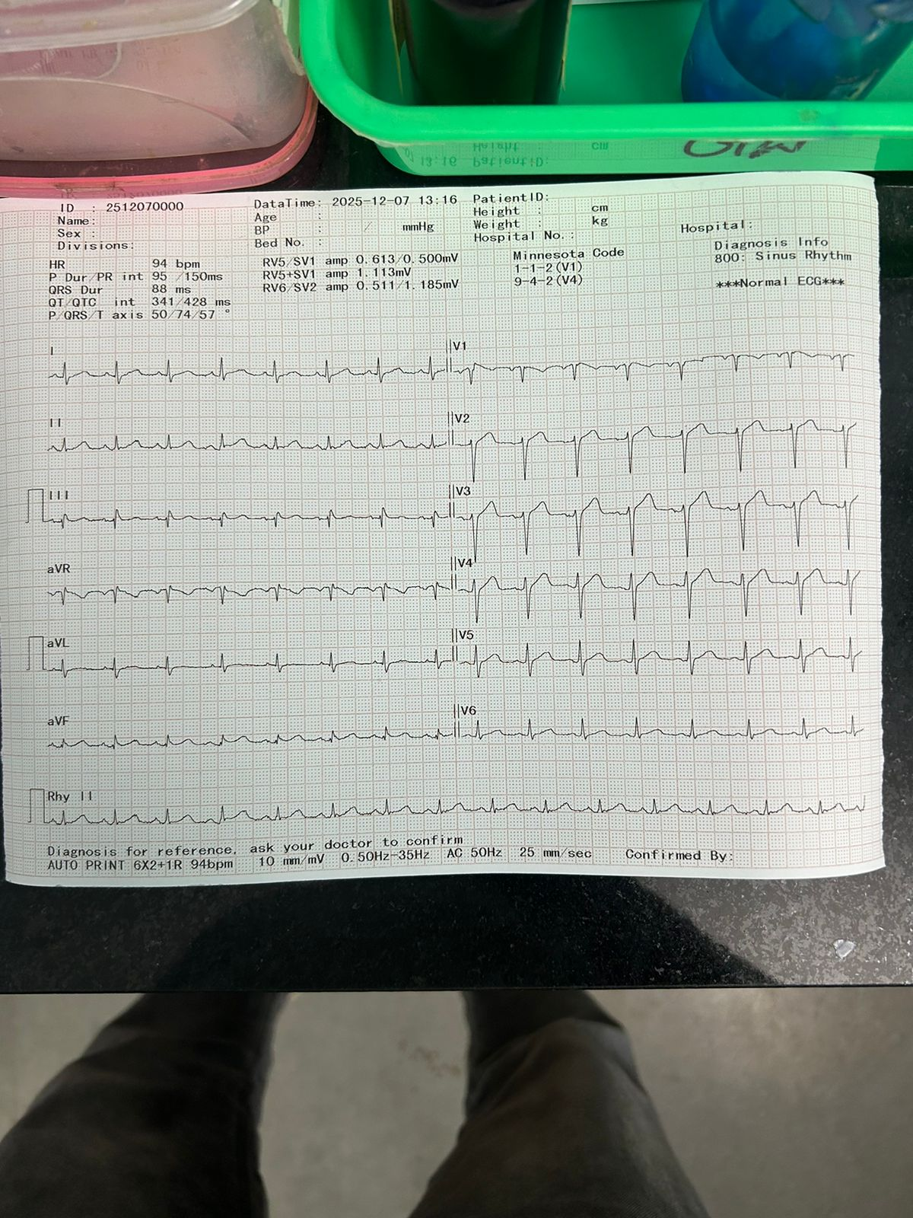
ECG

Slide 12
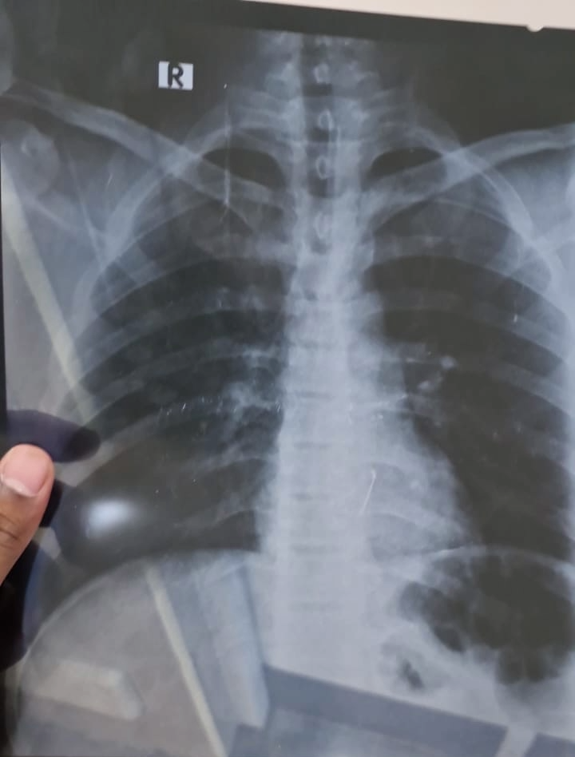
CHEST XRAY

Slide 13
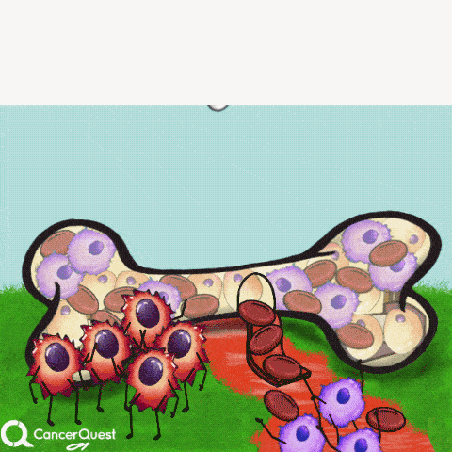

LETS’S GET DOWN TO IT

