Slide 1
JOURNAL
PRESENTATION
CHIEF : Dr. Dharmaraj MD
Asst Prof : Dr Prabhu MD
Dr Arul Prakash MD
Dr Vinoth Kannan MD
Presentor : Dr Rajeswaran

Slide 2
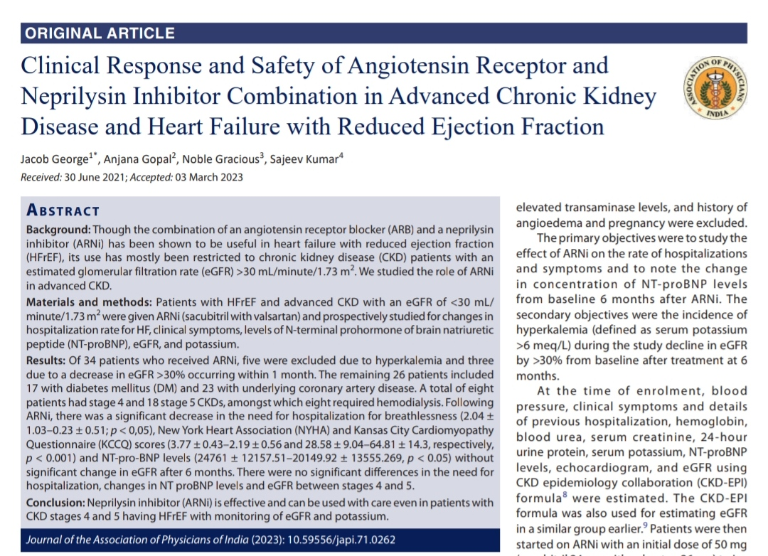

Slide 3
BACKGROUND OF STUDY
Though the combination of an angiotensin receptor blocker (ARB) and a neprilysin inhibitor (ARNi) has been shown to be useful in heart failure with reduced ejection fraction EF), its use has mostly been restricted to chronic kidney disease (CKD) patients with an estimated glomerular filtration rate (eGFR) >30 mL/minute/1.73 m2. We studied the role of ARNi in advanced CKD.

Slide 4
MATERIALS AND METHODS
Patients with HFrEF and advanced CKD with an eGFR of <30 mL/ minute/1.73 m2 were given ARNi (sacubitril with valsartan) and prospectively studied for changes in hospitalization rate for HF, clinical symptoms, levels of N-terminal prohormone of brain natriuretic peptide (NT-proBNP), eGF, and potassium.

Slide 5
INCLUSION CRITERIA:
Inclusion criteria were age between 18 and 80 years, mean sitting systolic blood pressure ≥120 mm Hg, and NT-proBNP levels >600 pg/mL.
The NT-proBNP level was chosen as it was shown that ARNi was beneficial in such patients.
EXCLUSION CRITERIA:
Those with serum potassium >5.5 mmol/L at baseline (due to ethical concerns of increased risk of hyperkalemia), hepatic involvement based on elevated transaminase levels, and history of angioedema and pregnancy were excluded.

Slide 6
OBJECTIVE OF STUDY
The primary objectives were to study the effect of ARNi on the rate of hospitalizations and symptoms and to note the change in concentration of NT-proBNP levels from baseline 6 months after ARNi.
The secondary objectives were the incidence of hyperkalemia (defined as serum potassium >6 meq/L) during the study decline in eGFR by >30% from baseline after treatment at 6 months.

Slide 7
STUDY DESIGN
Single group interventional prospective study.

Slide 8
METHOD OF STUDY
  At the time of enrolment, blood pressure, clinical symptoms and details of previous hospitalization, hemoglobin, blood urea, serum creatinine, 24-hour urine protein, serum potassium, NT-proBNP levels, echocardiogram, and eGFR using CKD epidemiology collaboration (CKD-EPI) formula were estimated.
  Patients were then started on ARNi with an initial dose of 50 mg (sacubitril 24 mg with valsartan 26 mg) twice daily (novartis AG) and, if tolerated, increased to 100 mg twice daily (sacubitril 49 mg with valsartan 51 mg) after 1 month.

Slide 9
They were advised low potassium diet, leaching of vegetables prior to cooking, continuing salt and fluid restriction, and were continued on diuretics and other antihypertensives.
The dose of antihypertensive medication was adjusted to keep blood pressure <140/90 mm Hg and <130/80 in proteinuric patients.

Slide 10
Patients were reviewed initially after 2 weeks and thereafter monthly for 6 months or earlier if necessary, and symptoms, need and frequency of hospitalizations, blood pressure, serum creatinine and potassium, 24-hour urine protein, NT-proBNP levels were noted, and eGFR was estimated.
ARNi was stopped if the patient had intolerance, hypotension, serum potassium levels >5.8 meq/L (due to ethical concerns of increased risk of arrhythmias with hyperkalemia) or a decline in eGFR >30% from baseline by 1 month in patients not on dialysis.

Slide 11
Patients who had serum potassium levels >5.5 meq/L were emphasized dietary potassium modification with leeching of vegetables and continued on ARNi.
Symptoms of HF were assessed using the KCCQ clinical summary score scale, 0–100, with higher scores indicating fewer symptoms and physical limitations and NYHA at recruitment and at the end of 6 months.

Slide 12
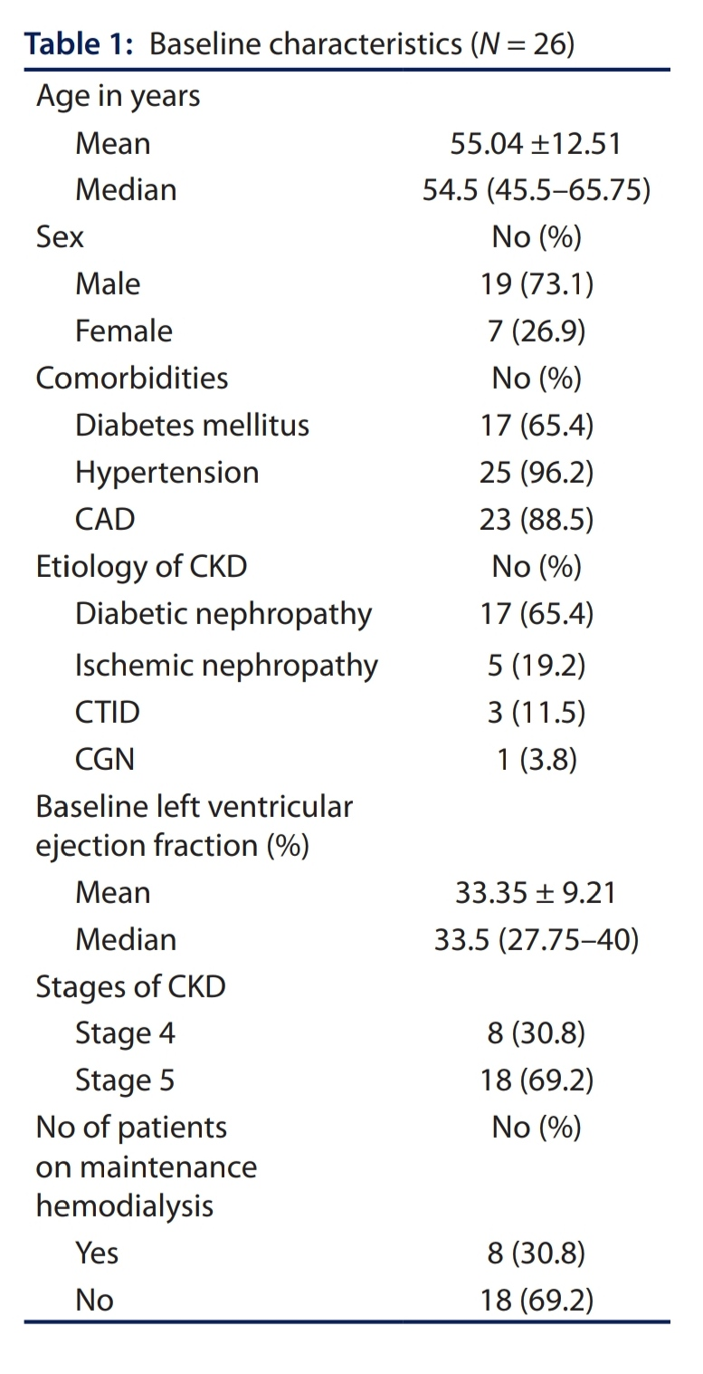

Slide 13
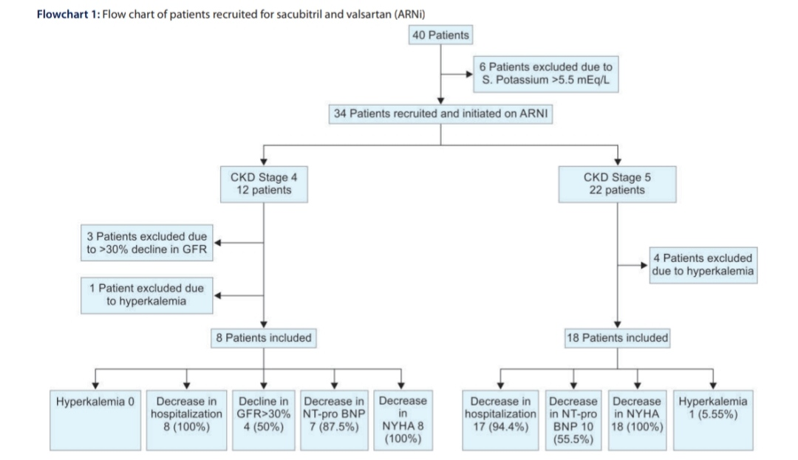
RESULTS ANALYSIS

Slide 14
CONCLUSION
Neprilysin inhibitor (ARNi) is effective and can be used with care even in patients with CKD stages 4 and 5 having HFrEF with monitoring of eGFR and potassium

Slide 15
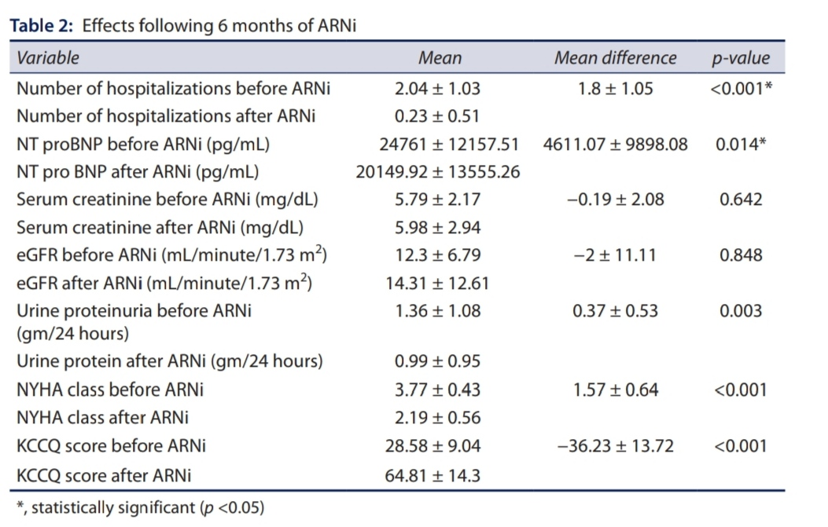

Slide 16
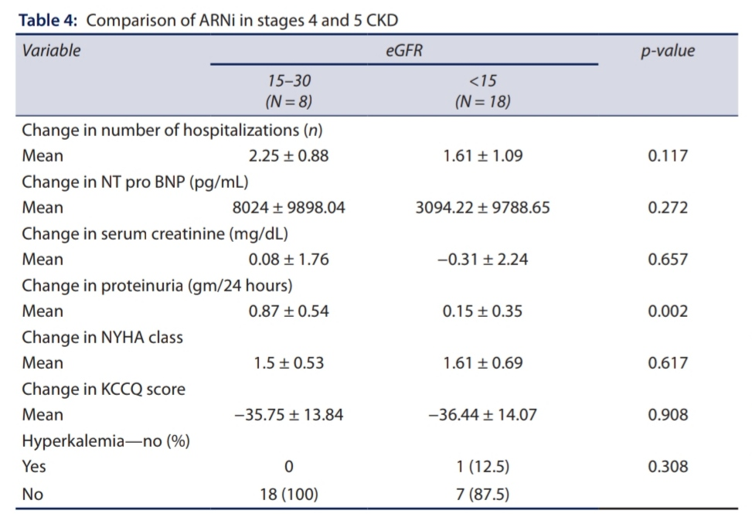
Comparison of ARNi in stages 4 and 5 CKD

Slide 17
DISCUSSION
Renin-angiotensin-aldosterone blockers (RAASb) have been shown to decline the progression of CKD due to DKD17 and nondiabetic renal disease.
This could be due to the reversal of the protective glomerular efferent arteriolar vasoconstriction preserving GFR by RAASb in the setting of reduced glomerular perfusion pressure.
As early withdrawal often restores the eGFR to previous levels, this emphasizes the need for monitoring eGFR in the initial few weeks after starting ARNi.
However, if the fall in eGFR is <30%, RAAS blockers can preserve or attenuate the progression of CKD.

Slide 18
Even after 36 week s of treatment,ARNi has shown a reduction in the fall of eGFR, suggesting long-term benefits.
A comparison of ARNi and Enalapril has shown better renal protection with the former.
It is possible that the afferent arteriolar dilatation that can occur with neprilysin inhibition may have a role.
This could suggest better renal protection with ARNi in CKD when the reduction of eGFR is <30 mL/minute/1.73 m2.

Slide 19
THANK YOU

