Slide 1
Spot the diagnosis on roentgen’s view
By 4th medical unit
Cheif: dr.david pradeep kumar m.d.
Assistant professors:
Dr.n.ragavan.m.d.
Dr.m.ramkumar.m.d.
Dr.r.ponraj.m.d.

Slide 2
Cheif complaints
A 50 year old female with history of shortness of breath on walking a few steps for 2 days , progressed to breathlessness at rest over the next 2 days
History of present illness
brethlessness at rest and aggravated on walking.

Slide 3
Negative history
No h/o fever
chest pain
cough
limb swelling
pnd
recent major trauma

Slide 4
Past history
Had breast carcinoma with multiple metastasis , diagnosed 4 years ago
undergone left mastectomy and completed radio and chemotherapy
Now, on palliative pain care with morphine
k/c/o t2dm 3 years ago , on insulin therapy

Slide 5
Family history
No family history of breast carcinoma
Menstrual history
menopause 3 years ago
Personal history
Mixed diet

Slide 6
Vitals
Bp 130/90 mmhg
Pr 112/min
Spo2 85% on room air , with 6l/min o2 95%
Rr 28/ min
Temp 98*f

Slide 7
General examination
Conscious , tachypnoic , dyspneic
Pallor, bilateral axillary lymph nodes
No icterus /cyanosis / clubbing / pedal edema

Slide 8
Systemic examination
Cvs
S1s2 , no murmur
Rs
Bae
Nvbs
Left amastia

Slide 9
Abdomen
Soft
Bs normal
Cns
nfnd

Slide 10
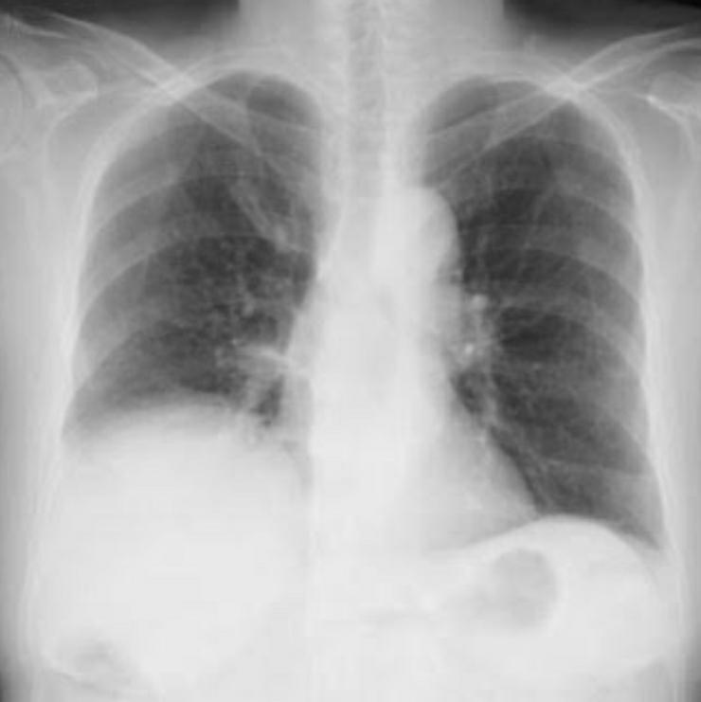

Slide 11
Discussion
Right hemidiaphragm is elevated ( eventeration )
Differentials are
Supradiaphragmatic
Phrenic nerve palsy ( can be due to trauma, spine, spinal cord diseases
or autoimmune diseases )
Lung disorders (pneumothorax , atelectasis)
2. diaphragmatic
Neuromuscular disorders like als , ms or muscular dystrophy ( usually bilateral )
Infradiaphragmatic
Hepatomegaly , ascites , abd tumors , splenomegaly , subphrenic abscess

Slide 12


