Slide 1
PIGMENTED EYES & PLUGGED EARS
I MEDICAL UNIT
CHIEF: Dr.M.Natarajan M.D.
Asst Professors: Dr.V.Palanikumaran M.D ,D.DIAB
Dr.D.Vasantha kalyani M.D.,DCP
Dr.M.Suresh kumar M.D.
PRESENTOR:J.NAVEENKUMAR

Slide 2
A 13 YEARS OLD MALE BROUGHT TO GRH WITH CHIEF COMPLAINTS OF
C/O FEVER FOR PAST 4 DAYS
h/o blurring of vision for past 2 days
H/O ALTERED SENSORIUM FOR PAST 1 DAY

Slide 3
HISTORY OF PRESENTING ILLNESS
Pt was apparently normal before 4 days.then he developed fever
-high grade,continuous,
-not associate with chills and rigor
H/o blurring of vision for the past 2 days
H/O altered sensorium for the past 1 day
H/o GTCS -1 episode ,involving both upper and lower limbs,lasting for about 5 minutes,associate with uprolling of eye balls,not associate with involuntary urination and defaecation.
H/O vomiting -2 episodes

Slide 4
h/o loose stools 2 episodes [2 days back]
NO H/O NIGHT BLINDNESS
NO H/O AGITATED BEHAVIOUR
No H/O ABDOMINAL PAIN & DISTENSION
No H/o trauma
No h/o reduced urine output
No h/o ear discharge/ear ache
No h/o vertigo
No h/o gait abnormality
NO H/O WALKING DIFFICULTY

Slide 5
PAST HISTORY
K/C/O congenital SNHL for which right side cochlear implantation done 6 yrs back [2016]
H/O Febrile seizure disorder at 1 year of age .
H/O Usage of myopic glasses for the past 5 years.

Slide 6
PERSONAL HISTORY
Mixed diet
Bladder and bowel habits normal
No h/o similar illness in family.

Slide 7
GENERAL EXAMINATION
On admission
Pt was Drowsy,Irritable
Not obeying oral commands
Febrile
No pallor
Not icteric
No cyanosis
No clubbing
No lymphadenopathy
No pedal edema

Slide 8
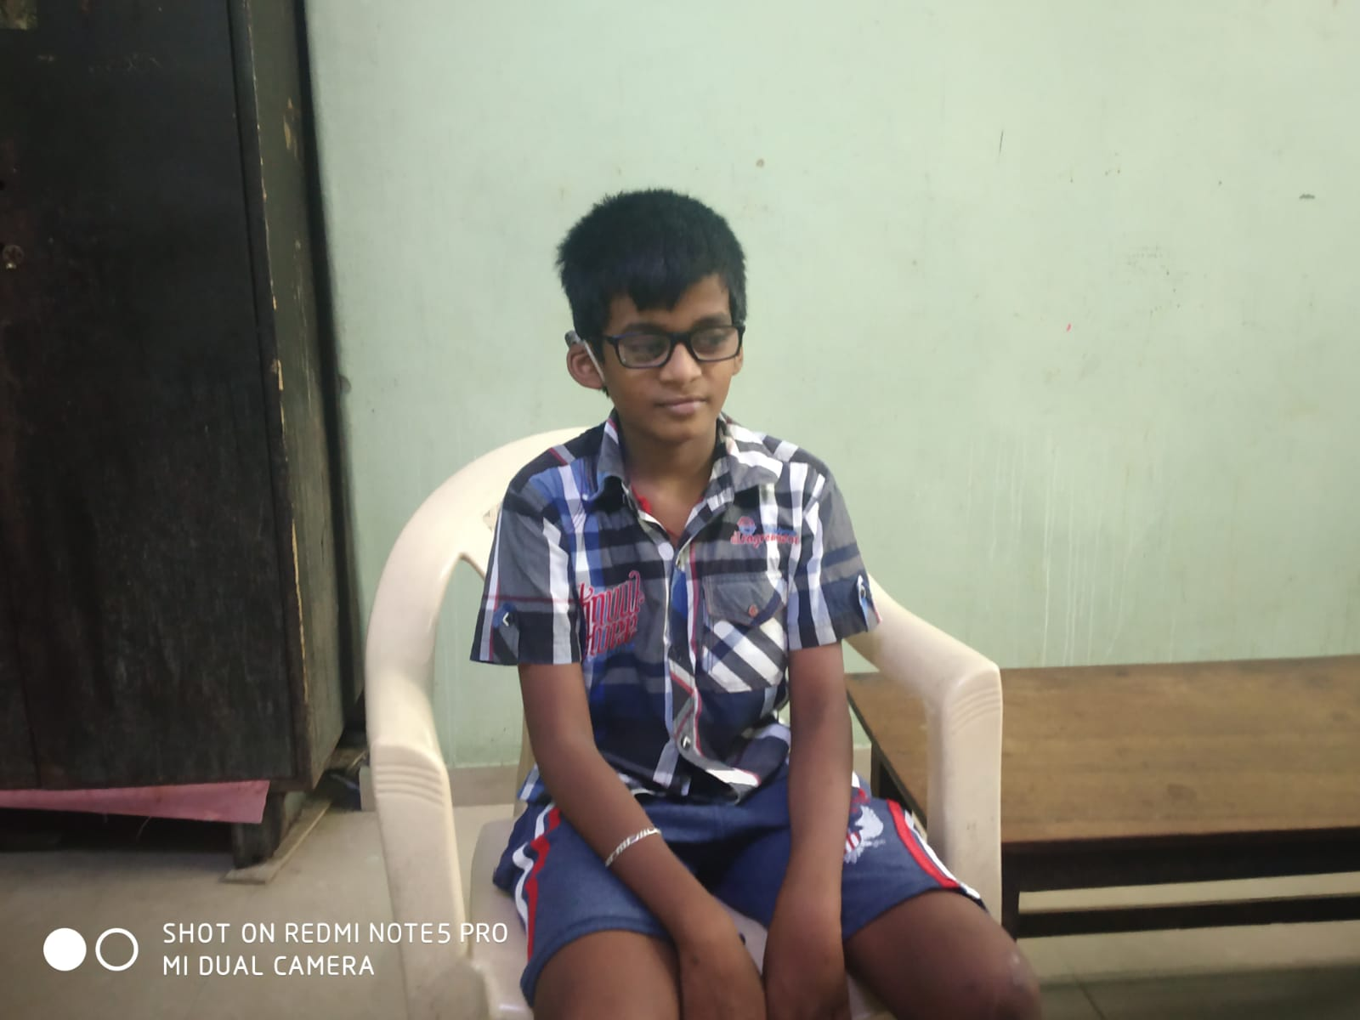

Slide 9
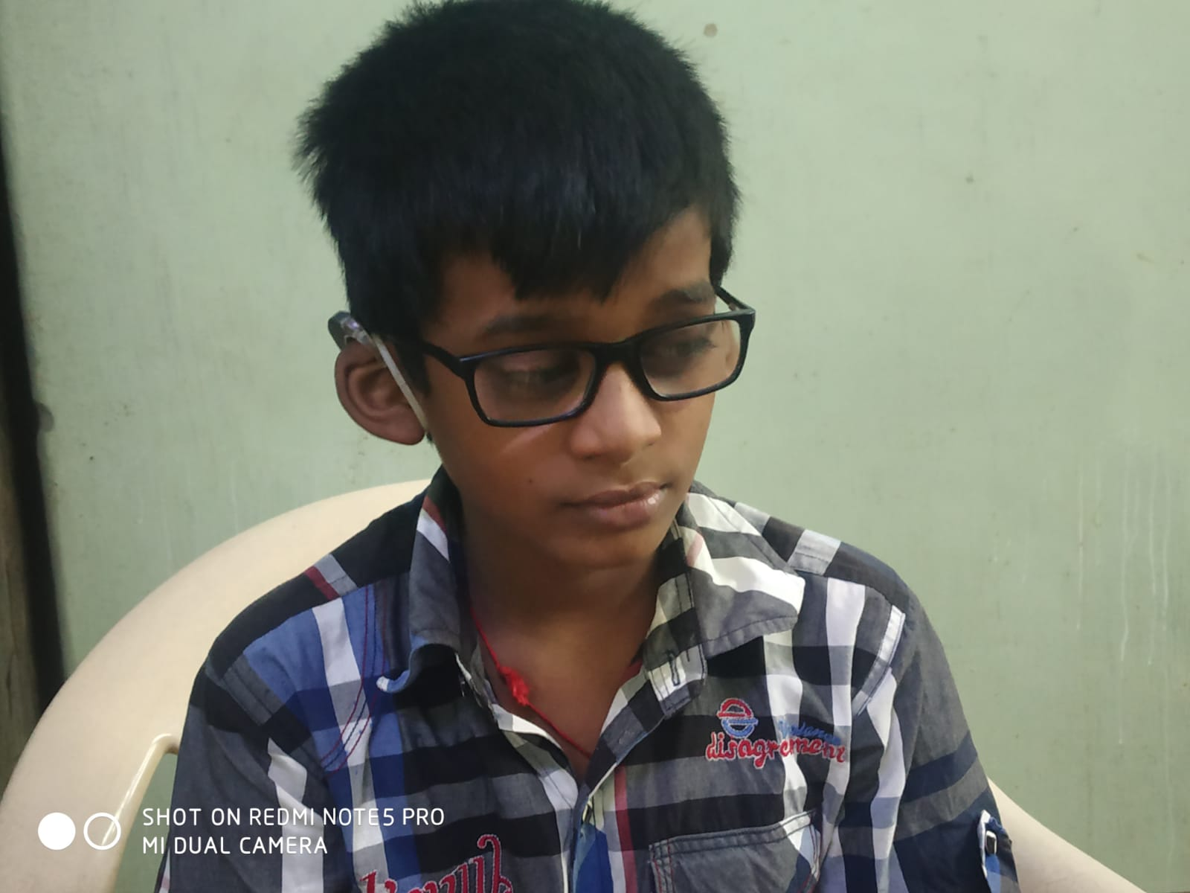
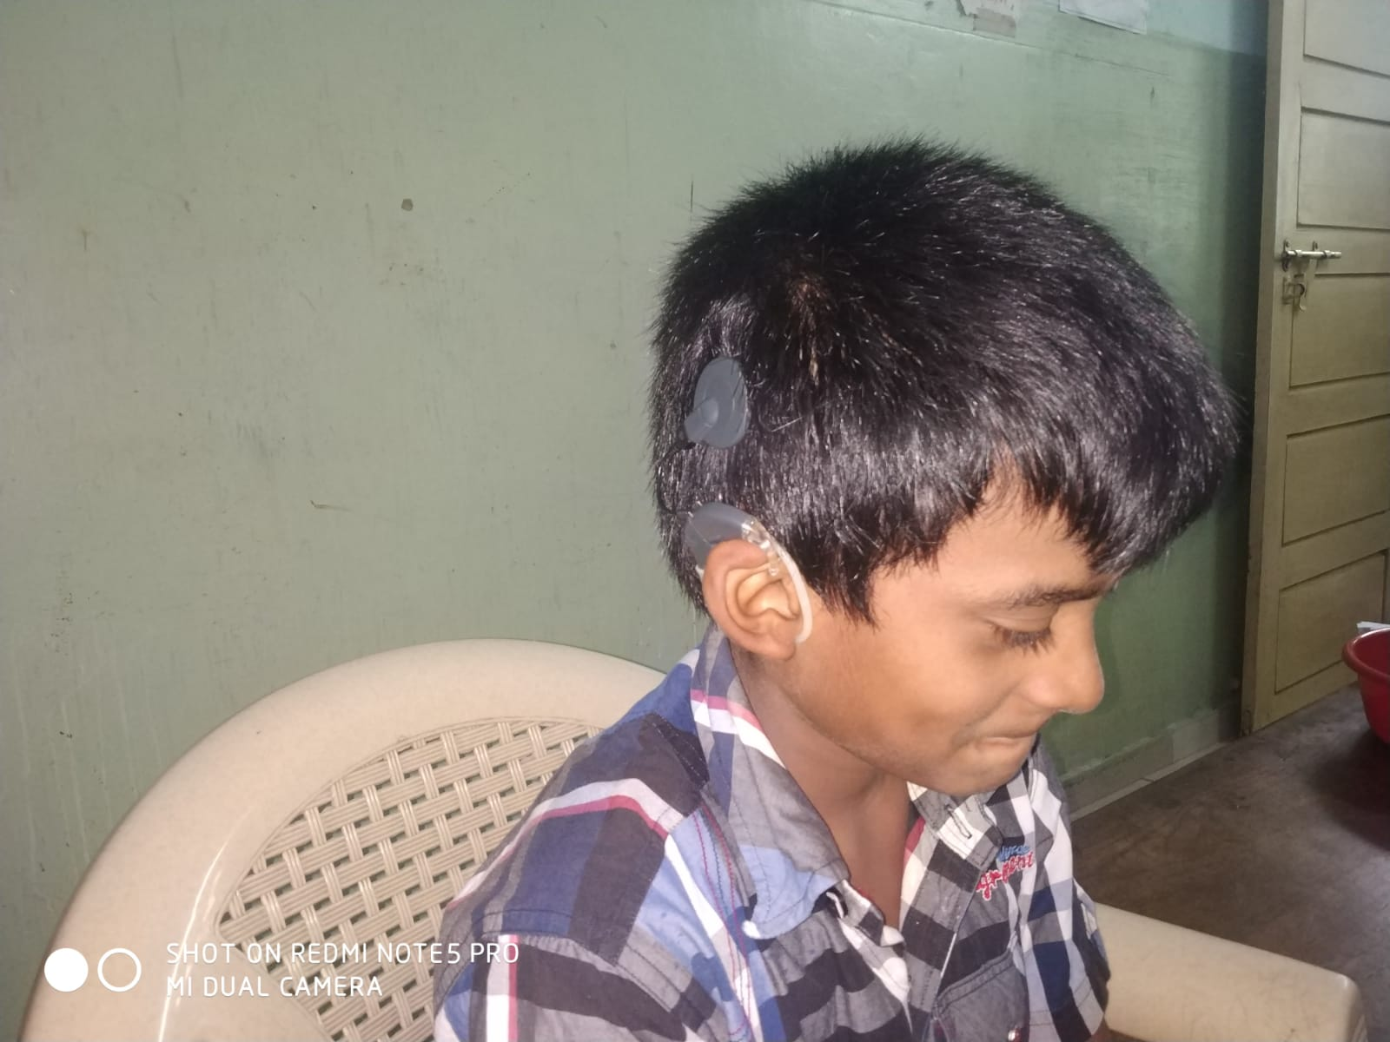

Slide 10
VITALS
BP: 90/60 mmHg
PR: 134/min
SpO2: 98% on Room air
Temperature: 102 F

Slide 11
SYSTEMIC EXAMINATION
CVS: S1S2+ ,No murmur
RS: B/L NVBS +,No added sounds
P/A: soft, BS+
CNS: Pt drowsy,irritable,
Moves all 4 limbs
No neck stiffness
No meningeal signs
B/L Pupil 3mm RTL
DEM +
B/L plantar withdrawl

Slide 12
INVESTIGATION
 | 18/4/22 | 19/4/22 | 22/4/22
Total count | 7,800 | 6,700 | 9,900
DC | 73/15/12 | 75/13/12 | 50/34/16
HB G% | 11.9 | 11.4 | 11.4
PCV | 35 | 34 | 34
PLT | 82,000 | 1.01 | 2.06
RFT | 18/4/22 | 22/4/22
UREA | 70 | 33
CREATININE | 1.8 | 1.1

Slide 13
investigation
ESR: 36mm/Hr
qCRP: 64 mg/l
LFT: normal
HbSAg: Non reactive
HCV: Non reactive
USG abdomen:
no hepatosplenomegaly
No pleural effusion

Slide 14
IGM Dengue- Negative
IGM Scrub -Negative
IGM Leptospirosis- Negative
CT BRAIN :No significant abnormality

Slide 15
CSF ANALYSIS
CSF Glucose : 50mg/dl [50-80]
CSF protein : 26 [15-60].
CSF Neutrophil -0
lymphocyte- 2
monocyte- 0
CSF ADA : 1
CSF C/S:NO GROWTH

Slide 16
NEUROMEDICINE OPINION
O/E
EOM: Opsoclonus +
Moving all four limbs
Tone Normal in four limbs
DTR Present in all four limbs
Plantar: B/L Flexor
Advice:
Antiepileptics,
EEG,
MRI BRAIN &MRA,MRV.

Slide 17
ELECTROENCEPHALOGRAM[EEG]
Background posterior dominant reacting alpha.
No provocative abnormality.
B/L sharp wave discharges
IMPRESSION: Abnormal EEG

Slide 18
TREATMENT GIVEN
DIL/BACK REST
IV FLUIDS
INJ CEFTRIAXONE 1G IV BD
INJ.DEXAMETHASONE 4MG IV OD
INJ PHENYTOIN 100MG IV BD
INJ.RANITIDINE 50MG IV BD
T.SODIUM VALPORATE 200MG 1-1-1
C.DOXYCYCLINE 100MG 1-0-1
T.ACYCLOVIR 200MG 2-2-2-2-2
T.PARACETAMOL 500MG 1-1-1

Slide 19
After 4 days of treatment, patient became afebrile, platelet count was improved. No agitated behaviour.

Slide 20
ENT EXAMINATION
 | RIGHT | LEFT
PINNA | NORMAL | NORMAL
EAC | NORMAL | NORMAL
TYMPANIC MEMBRANE | INTACT | INTACT
NO SPONTANEOUS NYSTAGMUS
ROMBERG TEST NEGATIVE

Slide 21
ENT OPINION REGARDING MRI
Patient can be subjected to MRI upto 1.5 Tesla.
Device is compatable upto 1.5 Tesla with safety precautions.
Advice to remove external components of implant & Apply elastic Creepe bandage over head while doing MRI.

Slide 22
FUNDUS EXAMINATION
 | RIGHT | LEFT
MEDIA | CLEAR | CLEAR
DISC | WAXY PALLOR | WAXY PALLOR
C:D | NOT MADE OUT | NOT MADE OUT
VESSELS | AA+ | AA+
MACULA | BULL EYE MACULOPATHY | BULL EYE MACULOPATHY
BACKGROUND | BONY SPICULES+ | BONY SPICULES+
RIGHT LEFT
IMPRESSION
BOTH EYE RETINITIS PIGMENTOSA

Slide 23
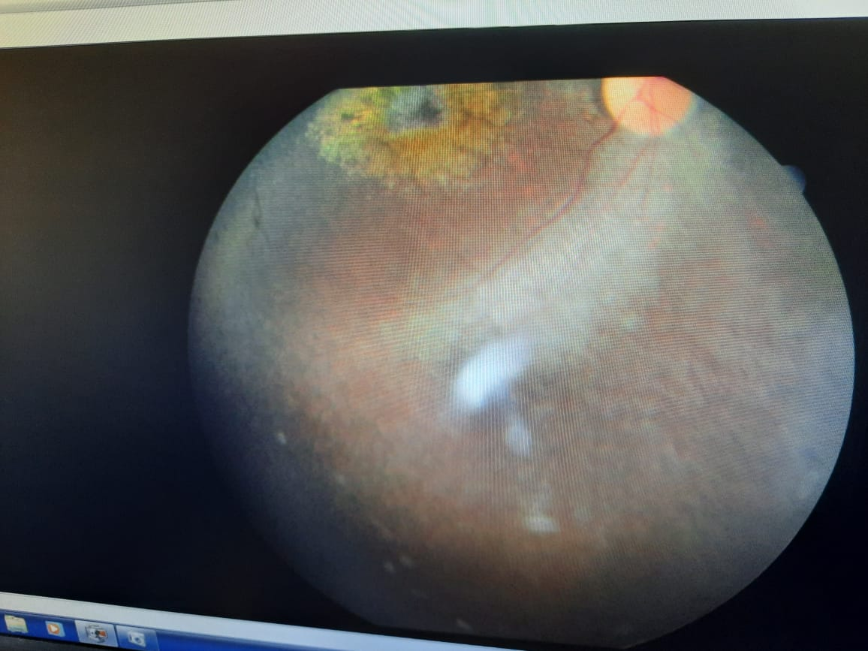
FUNDUS

Slide 24
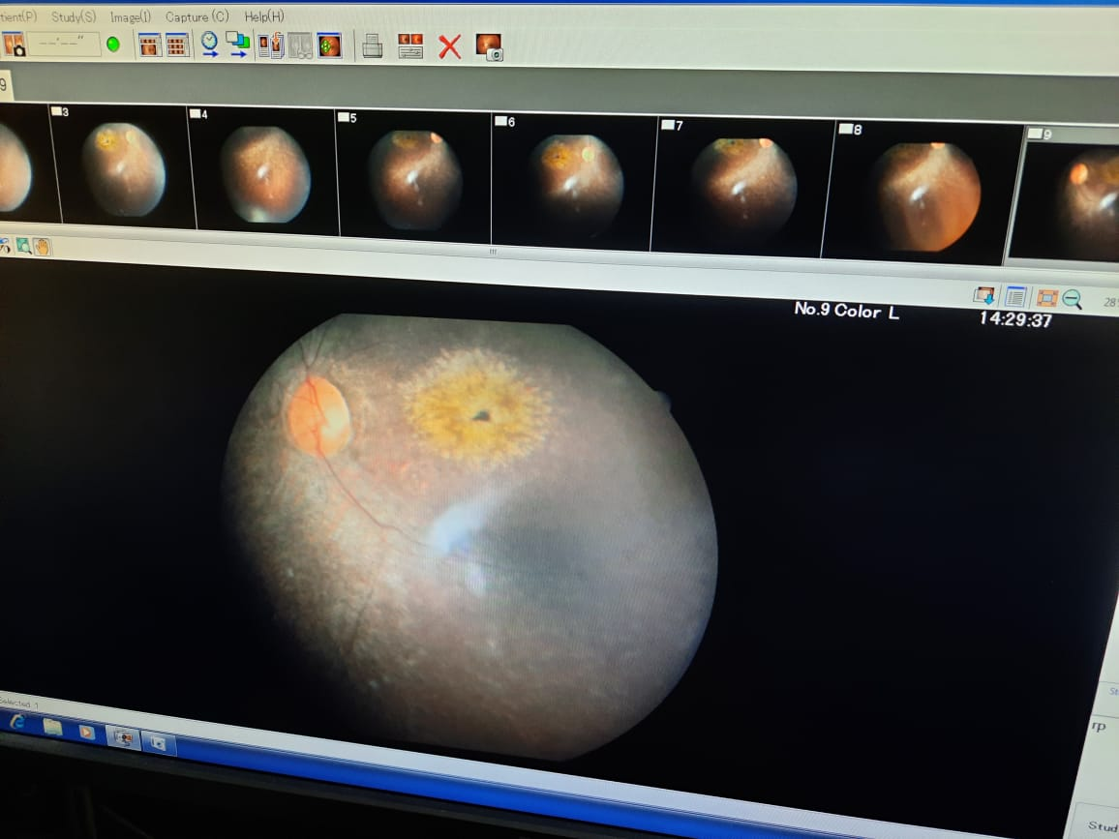
Fundus left eye

Slide 25
POSSIBLE DIAGNOSIS

Slide 26
WHAT NEXT???

