Slide 1
A CASE OF SILICO TUBERCULOSIS

Slide 2
CHIEF COMPLAINTS
A 58 year old male who is a sand miner by occupation came with c/o
Breathlessness for past 2 weeks.

Slide 3
HISTORY OF PRESENTING ILLNESS
The patient was apparently normal 2 years back, then he developed
Breathlessness which is insidious in onset
Progressive
MMRC grade 2 to 4(now for past 2 weeks)
Aggravated on exertion initially and relieved by medication(now present even at rest)

Slide 4
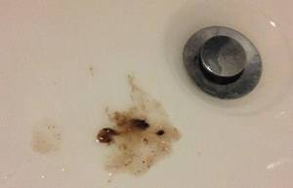
CONT
H/O cough with expectoration present
On and off
Mucoid in nature
Aggravated on lying down and lateral position
No specific relieving factors
Patient is typically complaints of grey particulate matter in sputum

Slide 5
No h/o fever
No h/o loss of weight and loss of appetite
No h/o hoarseness of voice
No h/o swelling in the neck
No h/o abdominal pain, distention ,yellowish discolouration of eyes
No h/o swelling of legs
No h/o puffiness of face
No h/o decreased urine output
No h/o facial congestion
No h/o seizure , altered sensorium , weakness of limbs
No h/o chest pain , palpitations and syncope

Slide 6
PAST HISTORY
k/c/o PTB and completed ATT 20 years back
k/c/o COPD x 5 years and on irregular treatment
N/K/C/O SHTN,T2DM,asthma,epilepsy,thyroid disorders

Slide 7
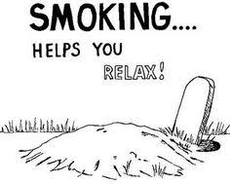
PERSONAL HISTORY
DIET
TAKES MIXED DIET
NORMAL BOWEL AND BLADDER HABITS
RISKFACTORS
SMOKER FOR 15 YEARS
NOT AN ALCOHOLIC
NO H/O OTHER DRUG INTAKE

Slide 8
TREATMENT HISTORY
K/C/O COPD FOR 5 PAST 5 YEARS AND NOT ON REGULAR TREATMENT
T.SALBUTAMOL BD
T.DERIPHYLLINE TDS
FLUTICASONE+FORMETEROL MDI

Slide 9
GENERAL EXAMINATION
PT IS CONSCIOUS
ORIENTED
AFEBRILE
TACHYPNEIC AT REST
ACCESSORY MUSCLES OF RESPIRATOTY ACTIVITY SEEN
PALLOR PRESENT
NO CYANOSIS/CLUBBING/NO PEDAL EDEMA/NO GENERALIZED LYMPHADENOPATHY

Slide 10
VITALS
BLOOD PRESSURE – 120/80 mmhg
PULSE – 94/min
SPO2 – 92 % IN RA
RR – 38/MIN

Slide 11
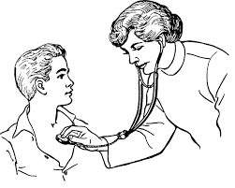
SYSTEMIC EXAMINATION
CVS – S1S2 HEARD , NO MURMUR
RS – B/L AE PLUS
TRACHEA SHIFTED TO RIGHT
AE DECREASED IN RT INFRACLAVICULAR,INFRASCAPULAR,SUPRASCAPULAR AREAS
VOCAL RESONANCE DECREASED OVER ABOVE AREAS
PERCUSSION – IMPAIRED OVER ABOVE AREAS
B/L CREPTS PRESENT IN ALL LUNG FIELDS
B/L POLYPHONIC WHEEZE +
P/A – SOFT , BS+
CNS – B/L PERTL+
MOVES ALL 4 LIMBS
NO FLAPPING TREMORS

Slide 12
INVESTIGATIONS
CBC
TC | 18300
HB | 11.8
DC | 90/6/4
PCV | 34
PLT | 1.72
RFT
RBS | 78
B.UREA | 22
S.CREAT | 1.3
LFT
TOTAL BIL | 0.7
DIRECT | 0.5
INDIRECT | 0.2
SGOT | 17
SGPT | 14
ALP | 92
T.PROTEINS | 7.2
S.ALBUMIN | 3.8
S.GLOBULIN | 3.4
ECG
HR-100/MIN
NSR
RAD
PR INTERVAL-120ms
p.Pulmonale +
PPRW UPTO V4 +
URINE ROUTINE
ALBUMIN | NIL
SUGAR | NIL
DEPOSITS | 0-3PUS CELLS

Slide 13
Notes:
Cxr pa view…… TRACHEA IS SLIGHTLY SHIFTED TO RT SIDE …BL UPPER ZONE OPACITIES NOTED …RT LL HYPERINFLATED COMPARED TO LEFT..ASSOCIATED WITH CALCIFIED HILAR NODE

Slide 14
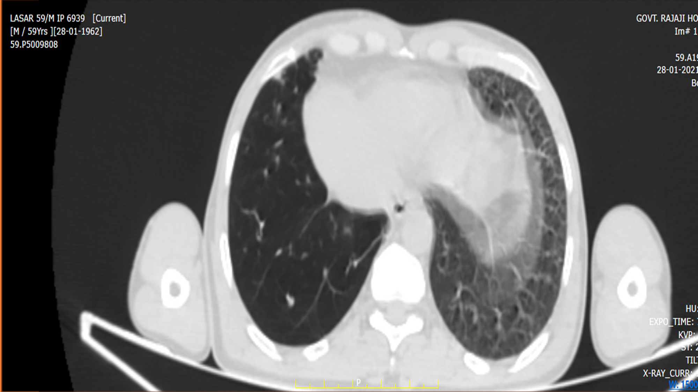
CHRONIC COMPLICATED SILICOSIS
Notes:
DEF: LARGE OPACITIES OVER 1CM IN DIA IVOLING UPPER LOBE(PMF)…THE LESION MIGRATES TOWARDS HILUM LEAVING OVERINFLATED EMPHYSEMATOUS SPACES…LEFT IMAGES BL EMPHYSEMATOUS LUNG R>L BCOZ IN RT SIDE IMAGE SHOWS LARGE PMF THAN THE LEFT.

Slide 15
Notes:
OBLIQUE FISSURE ELEVATED THAN IN NORMAL POSITION …WHICH INDICATES UPPER LOBE COLLAPSE PROBABLY DUE TO FIBROSIS …. AS THIS CASE PROGESS TO THE MASSIVE FIBROSIS

Slide 16
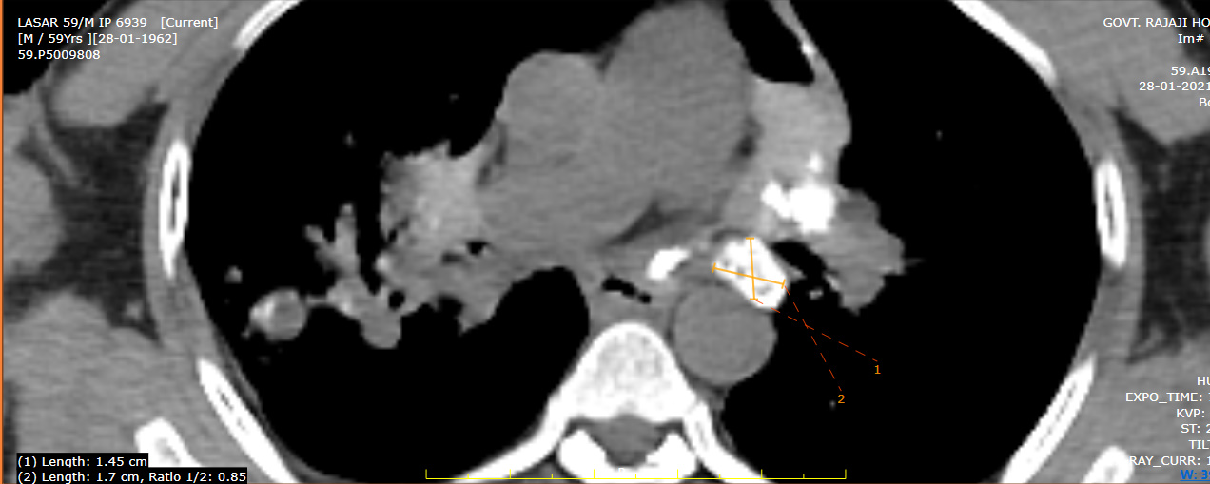
Notes:
CRITERIA FOR EGGSHELL CALCIF; SHELL LIKE CALCI UPTO 2MM IN PERIPHERAL ZONE ATLEAST 2 LYMPH NODES CALCFI MAY BE BROKEN /SOLID THICKNESS OF WALL CALCIFICATION

Slide 17
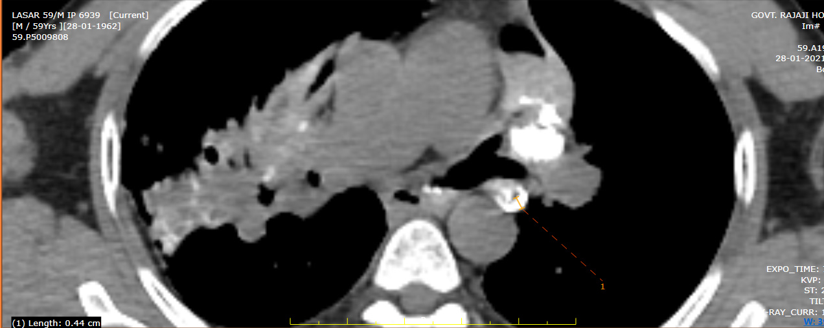
Notes:
THIS ARROWS INDICATES AIR BRONCHOGRAM SIGN INSIDE THE OPACITY WHICH GIVES A CLUE OF SUPERADDED SECONDARY INFECTION PROBABLY INFECTION DUE TO TB,WHICH IS MORE COMMON IN SILICOSIS LEADS TO THE FINAL DIAGNOSIS OF SILICOSIS.

Slide 18
CT CHEST REPORT
Trachea shifted to right
Ill defined conglomated mass noted in apical and anterior segment of bilateral upper lobe with pleural thickening –possible of progressive massive fibrosis to be considered.
Multiple enlarged calcified mediastinal and hilar lymph nodes noted.

Slide 19
CT GUIDED LUNG BIOPSY DONE AND SENT FOR HPE
THE BIOPSY SHOWS LUNG PARENCHYMA CALCIFICATION,COLLAGENISATION,FIBROBLASTIC PROLIFERATION WITH PIGMENT LADEN MACROPHAGES
NO EVIDENCE OF GRANULOMATOUS OR MALIGNANCY IN THE SECTIONS STUDIED.
SUGGESTIVE OF SILICOTIC NODULES

Slide 20
DIAGNOSIS
SILICOTUBERCULOSIS

Slide 22
SILICOSIS
Silicosis is caused by the inhalation of fine particles of crystalline silicon dioxide (silica)
Quartz is the most common form of crystalline silica.
Occupations such as mining, quarrying, and tunneling are associated with silicosis.
Carcinoma and tuberculosis are potential serious complications of silicosis

Slide 23
Factors that influence the likelihood of progression to silicosis
Duration and intensity of exposure,
Form of silicon (exposure to crystalline form poses greater risk than bound form),
Surface characteristics (exposure to uncoated form poses greater risk than coated form),
Rapidity of inhalation after the dust is fractured and becomes airborne
The current limit for free silica in the industrial atmosphere is 100 μg/m3

Slide 24
Chronic (or Classic) Silicosis
Accelerated Silicosis
Acute Silicosis

Slide 25
Chronic (or Classic) Silicosis
Most common form of the disease
Usually follows one or more decades
Respirable dust containing < 30% quartz
Pathological hallmark- silicotic nodule
Usually bilateral upper zones, visceral pleura, regional lymph nodes

Slide 26
PATHOLOGY
Macroscopic:
Hard grey-black nodules upper lobes and perihilar
Massive fibrosis - large firm masses, shrunken upper lobes, emphysematous lower lobes and subpleural blebs
PMF (progressive massive fibrosis): upper mid and lower lobes (accelerated silicosis)
Cavitation (ischaemic necrosis) → secondary TB → silicotuberculosis
Microscopic: Silicotic nodule

Slide 27
Diagnosis: Physiology
Lung function: -varies from normal to obstructive or restrictive or combination
Diffusion decreased
Hypoxaemia on exertion

Slide 28
Diseases associated with exposure to Silica dust
Chronic obstructive pulmonary disease
Emphysema
Chronic bronchitis Mineral dust- induced small airway disease
Lung cancer
Mycobacterial infection MTB NTM
Immune –Related Disease PSS, RA, SLE

Slide 29
COMPLICATIONS
Cor pulmonale
Spontaneous pneumothorax
Broncholithiasis
Tracheobronchial obstruction
Lung cancer
Tuberculosis
Hypoxemic ventilatory failure

Slide 30
TREATMENT
Prevent further exposure to silica dust.
Strongly advise patients to quit smoking
Immunize against influenza, pneumococci
No specific therapy for silicosis
Experimental approaches are - whole-lung lavage, aluminum inhalation, and corticosteroids
Latent tuberculosis infection should be treated with isoniazid
Complications should be treated appropriately

Slide 31
PREVENTION
Dust suppression,
Process isolation,
Ventilation,
Use of non–silica–containing abrasives.
Respiratory masks
Surveillance of exposed workers with respiratory questionnaires, spirometry, and chest x-rays is recommended.

Slide 32
Pulmonary tuberculosis occurs in 25% of patients with acute or classic silicosis
2.8 times more prone than normal patients.
How to identify onset of tuberculosis in a patient of silicosis???
1) pleural effusion
2) consolidation
3) infiltrates
4) cavitation in a PMF.

Slide 34
IRON HYPOTHESIS
Mycobacteria are dependent on iron for growth and produce the iron chelators mucobactin
Silica particles absorbed body iron and act as a reservoir of iron
Silicoto-iron complexes may activate dormant tubercle bacilli

