Slide 1
SACRIFICING THE MUSCLE FOR SAVING THE MYOCARDIUM
UNIT IMCU
H.O.D : DR.M.NATARAJAN
ASSISTANT PROFESSOR : DR.VIGNESH
PRESENTOR : DR.S.T.GOVARTHANAN
CASE COURTESY: III MEDICAL UNIT

Slide 2
CASE HISTORY
A 47 year old male k/c/o t2dm/cad/s/p pci to LAD+LcX on treatment has come to casualty with c/o
myalgia for 10 days
decreased urine output for 2 days

Slide 3
PRESENTING ILLNESS
PT was apparently normal 1 month ago.then he developed chest pain on 21.7.2021 was taken to private hospital found to have CAD/DVD on CAG and DES PCI TO LAD + LCx done on 23.7.2021 and discharged with antiplatelets and high intensity statin and other drugs,was doing well for 15 days.later he developed
h/o myalgia for 10 days
h/o back pain
h/o difficulty to stand up/to get up from bed/ to walk
h/o decresed urine o/p for 2 days
h/o passing high coloured urine
No h/o vomiting
No h/o headache/blurring of vision/seizures

Slide 4
No h/o dysuria
No h/o trauma
no h/o fever
No h/o chest pain/palpitation
No h/o dyspnea
No h/o cough with expectoration

Slide 5
h/o ulcer in right great toe for 1o days

Slide 6
PAST HISTORY
K/C/O type 2 diabetes mellitus on dapaglifozin for 2 months
No other co-morbidities
PERSONAL HISTORY:
chronic smoker and alcoholic for >20 years
Last binge of alcohol 2 months ago

Slide 7
TREATMENT HISTORY
Pt is on cardiac drugs for 2 weeks
T. Ticagrelor 90mg 1BD
T. Aspirin 75mg 1OD
T. Rosuvastatin 20 mg 1HS
T. spiaranolactone 25mg 1OD
T. Lasix 40mg 1-0.5-0
T. Dapaglifozin 1OD
Pt was taken to private hospital for the same complaints admitted there for 2 days referred here for further management
h/o hernia operation 15 years ago

Slide 8
GENERAL EXAMINATION
Patient conscious,oriented,pallor,cold peripheries,no icterus,no clubbing,no cyanosis,no GLE,no pedal edema
VITALS
BP – 50/?
PR- NOT RECORDABLE
SPO2- NOT RECORDABLE

Slide 9
SYSTEMIC EXAMINATION
CVS – s1s2 heard,no murmur
RS - b/l air entry, b/l nvbs
P/A – soft ,bs+,non tender
CNS
conscious
oriented
obeys oral commands
Higher mental function: normal
Cranial nerve examination: normal

Slide 10
TONE normal on both the limbs
Power
Deep tendon reflex + +
+ +
b/l plantar withdrawal
Muscle tenderness + in upper and lower limbs
Sensory system intact
RIGHT | LEFT
5/5 | 5/5
3/5 | 3/5

Slide 11
l/e right wet gangrene toe +
 | RIGHT | LEFT
FEMORAL ART | + | +
POP. ART | - | +
ANT&POST ART | - | +
DORSALIS PEDIS | - | +

Slide 12
Provisional diagnosis
TYPE 2 DM/CAD/PVD/RT TOE GANGRENE /SEPSIS/SEPTIC SHOCK/AKI(MULTIFACTORIAL)/?STATIN INDUCED RHABDOMYOLYSIS

Slide 13
INVESTIGATONS
TC 28200 TB- 0.5
DC 96/2/2 DB- 0.2
HB 13.3 IDB- 0.3
PCV 40 SGOT- 426
PLT 2.21 SGPT- 112
RBS 167 ALP - 153
Urea 156 na 145
Creatinine 4.4 k 3.8
CPK 17019
PERIPHERAL SMEAR: MILD NORMOCHROMIC NORMOCYTIC ANEMIA WITH NEUTROPHILIC LEUCOCYTOSIS
VCTC- NEGATIVE
HBsAG- NON REACTIVE
ANTI HCV Ab- NON REACTIVE

Slide 14
URINE ROUTINE
COLOUR – muddy brown
ALBUMIN – loaded
RBCs – 10-15/hpf
pus cells – 2-3/h
myoglobin - positive
no casts,crystals
PT- 18.4 bleeding time 4 mins
INR 1.5 clotting time 11 mins
APTT 45

Slide 15
DATE | SR.UREA | SR.CREATININE | CPK
22.07.21 | 25 | 0.8
25.07.21 | 20 | 0.9
23.8.21 | 81 | 2.6 | 31757
24.8.21 | 155 | 4.1 | 23066
25.8.21 | 171 | 4.4 | 17019
26.8.21 | 194 | 10.9
27.8.21 | 162 | 3.9
28.8.21 | 148 | 3.8 | 10235
29.8.21 | 127 | 3.4 | 9624
30.8.21 | 105 | 2.9 | 8625
31.8.21 | 102 | 2.9 | 7368
1.9.21 | 94 | 3.3
Na/k
139/3.5
142/3.9
136/4.2
146/4.1
143/4.0
135/3.8
136/3.8
136/3.7
2.9.21 | 85 | 2.8 | 5132
3.9.21 | 80 | 2.7 | 4216
4.9.21 | 78 | 2.5

Slide 16
Covid swab: negative
RIGHT LOWER LIMB DOPPLER : intermittent wall calcification of rt. SFA,PA,PT,ATA and DPA
Cellulitis involving the rt foot and no DVT
ECHO: global hypokinesia of LV
moderate lv systolic dysfunction
gr 1 diastolic dysfunction
LV APICAL CLOT+
EF 38%

Slide 17
PUS C/S : E.coli sensitive to tigecycline,amikacin
URINE C/S : non fermentative gram negative bacilli, sensitive to nitrofurantoin,amikacin
BLOOD C/S : no growth

Slide 18
USG ABD & PELVIS:
LIVER : measures 14cm.shows altered echoes with minimal surface irregularity
RIGHT KIDNEY : 11.2 * 4.6 cm,cortical echogenicity increased
LEFT KIDNEY : 11.4 * 5 cm, cortical echogenicity increased
Other visualised organs sonographically normal

Slide 19
MRI BRAIN WITH SPINE :
no evidence of any infarct/hemorrhage.MRA and MRV no evidence of any oclussion /thrombosis
CERVICAL SPINE : minimal central disc protusion @C5-C6 level
THORACIC SPINE : no significant cord compression
LUMBAR SPINE : no significant abnormality

Slide 20
OPINIONS OBTAINED
NEPHROLOGY : PD at imcu
inj.30ml nahco3 in 100 ml ns over 4 hours
SURGERY : crepe bandage,rt LL elevation,vascular (o)
VASCULAR SURGERY : adequate vascularity at present ,diabetic control,general surgery(O) for diabetic foot management

Slide 21
MANAGEMENT
PD 76 cycles completed
ionotrope supports
inj.heparin 5000 IU iv qid
inj.amikacin 500mg in 100ml ns infusion once in 3 days
insulin acc to cbg
T.aspirin 75mg 1 0d
T.linezolide 600mg 1BD
Diabetic foot management
planned for ray’s amputation
serial rft,cpk,urine o/p monitoring

Slide 22
AIM OF PRESENTATION
To highlight the incidence of rhabdomyolysis and AKI in patients receiving rosuvastatin and ticagrelor combination .
11 cases have been reported so far.

Slide 23
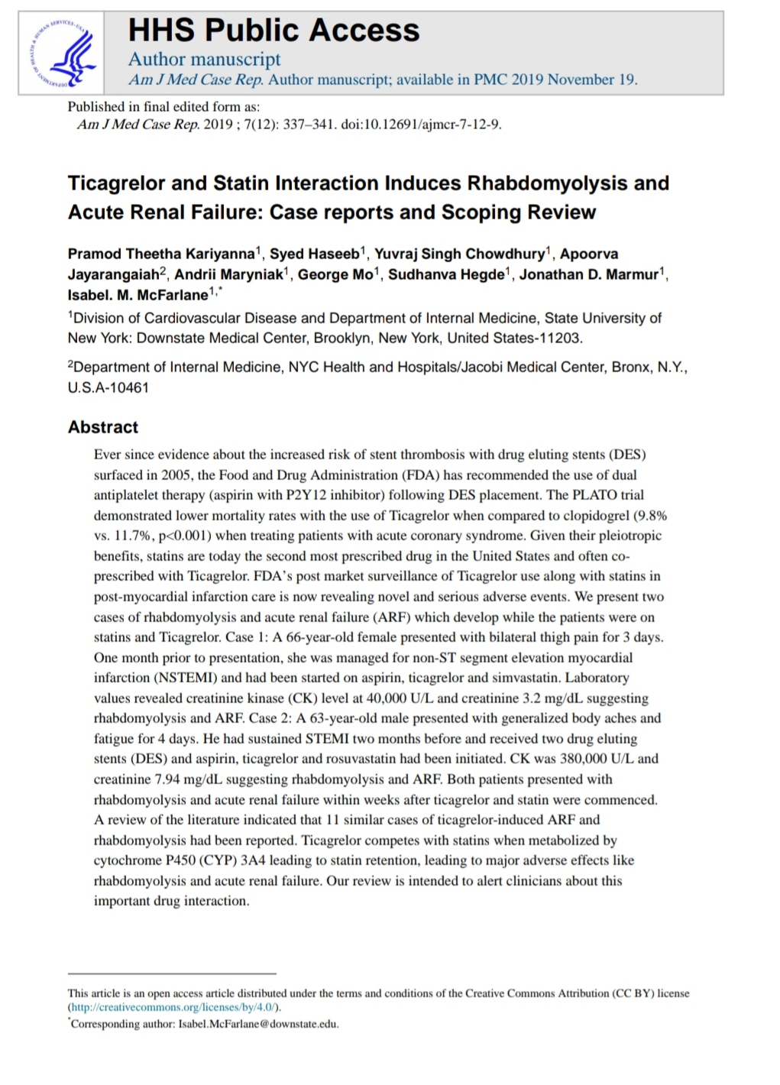

Slide 24
THANK YOU

