Slide 1
TREATMENT DILEMMA IN A PARASITIC INFECTION
II MU
CHIEF : DR G BAGIALAKSHMI MD
ASSISTANT PROFESSORS : DR. P. SARAVANAN MD
: DR. PON SENTHILKUMAR MD
: DR. M. SATHEESH KUMAR MD
PRESENTOR : VINOTH S

Slide 2
CHIEF COMPLAINTS..
A 55/M patient working as a coolie from Peraiyur was admitted with
complaints of abdominal distension for the past 25 days, insidious onset gradually progressive in nature.

Slide 3
HISTORY OF PRESENTING ILLNESS..
H/o Bilateral pedal edema
H/o yellowish discolouration of eyes
H/o itching over the trunk
No h/o clay coloured stools
H/o decreased urine output
No h/o hemetemesis,malena
No h/o abdominal pain

Slide 4
No h/o altered sensorium
No h/o facial puffiness
No h/o breathlessness
No h/o chest pain,palpitation
No h/o orthopnea,PND
No h/o fever,cough with expectoration, hemoptysis

Slide 5
PAST HISTORY
Not a k/c/o T2DM,SHT,CAD,CKD,PTB.
PERSONAL HISTORY
Mixed diet
Normal bowel and bladder habits,normal sleep pattern
Chronic alcoholic,smoker for past 10 years, around 180ml/day, last intake 1 month back
H/o dog rearing for the past 10 years.

Slide 6
TREATMENT HISTORY
Patient had taken treatment in private hospital and evaluated for obstructive jaundice and MRCP was done and referred to GRH as a case of CLD( to r/o malignancy)

Slide 7
ON EXAMINATION
Conscious, oriented, afebrile, no clubbing,
no cyanosis, no lymphadenopathy
Pallor+ , Icterus + , B/L pedal edema , scratch marks + ,
VITALS
BP-120/80mmhg , PR-96/min
SPO2-97% in room air
TEMP – 99F

Slide 8
SYSTEMIC EXAMINATION
CVS-S1S2 heard , No murmur
RS-NVBS , no added sounds
P/A- Soft, distended , Liver enlarged 4cm below RCM, traubes space obliterated, shifting dullness present
CNS - flapping tremor +
constructional apraxia +

Slide 9
INVESTIGATION
RBS | 60 | 88
UREA | 37 | 39
CREATININE | 2.0 | 2.6
CBC
TC | 8400
DC | P59/L17/E24
HB | 4.3
PCV | 14.5
PLATLET | 1.66
ESR | 76
MCV | 80
MCH | 31.2
MCHC | 29.7
RDW | 27.9
NA | 140
K | 4.1
Urine albumin | trace
sugar | Nil
deposits | 0-2 pus cells/hpf

Slide 10
LFT | D1 | D4 | D8
BILLIRUBIN | 6.5 | 5.9 | 5.2
DIRECT | 3.4 | 2.9 | 2.6
INDIRECT | 3.1 | 3.0 | 2.6
SGOT | 65 | 85 | 70
SGPT | 16 | 27 | 22
ALP | 111 | 106 | 130
T.PRO | 6.7
ALB | 2.0
GLOBULIN | 4.7
PT | 15.0
APTT | 19.0
INR | 1.14

Slide 11
ASCITIC FLUID ANALYSIS
Protein-2325mg/dl
Sugar-Negative
Cell count-10 cells/hpf
3 Lymphocytes
7 Polymorphs
ASCTIC FLUID CYTOLOGY – NO MALIGNANT CELLS
PERIPHERAL SMEAR – HYPOCHROMIC MICROCYTIC ANEMIA WITH EOSINOPHILIA
VCTC – NON REACTIVE
HBSAG AND HCV - NON REACTIVE
CHEST XRAY - NORMAL
ECHO – EF 60%, NORMAL STUDY

Slide 12
USG ABDOMEN
Liver- 13cm Coarse Echoes with severe surface irregularities
Evidence Of 9*6 Cm mixed echoeic mass lesion with cystic space noted in lesser sac region -P/O Parasitic Cyst.
Spleen –Normal
Rt Kidney – 7.4cm*3cm, Lt kidney – 7cm*3.2cm
B/L Cortical Echoes Increased, CMD Lost.
E/O Free Fluid Noted In Abdomen
IMPRESSION
CHRONIC PARENCHYMAL LIVER DISEASE
CHRONIC KIDNEY DISEASE
MODERATE ASCITIS
? PARASITIC CYST

Slide 13
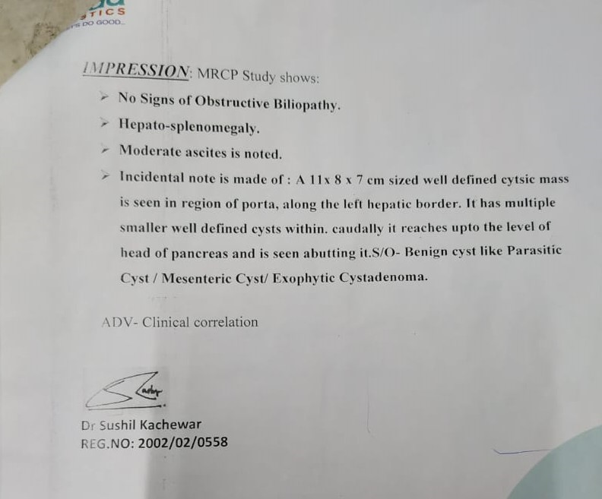
MRCP

Slide 14
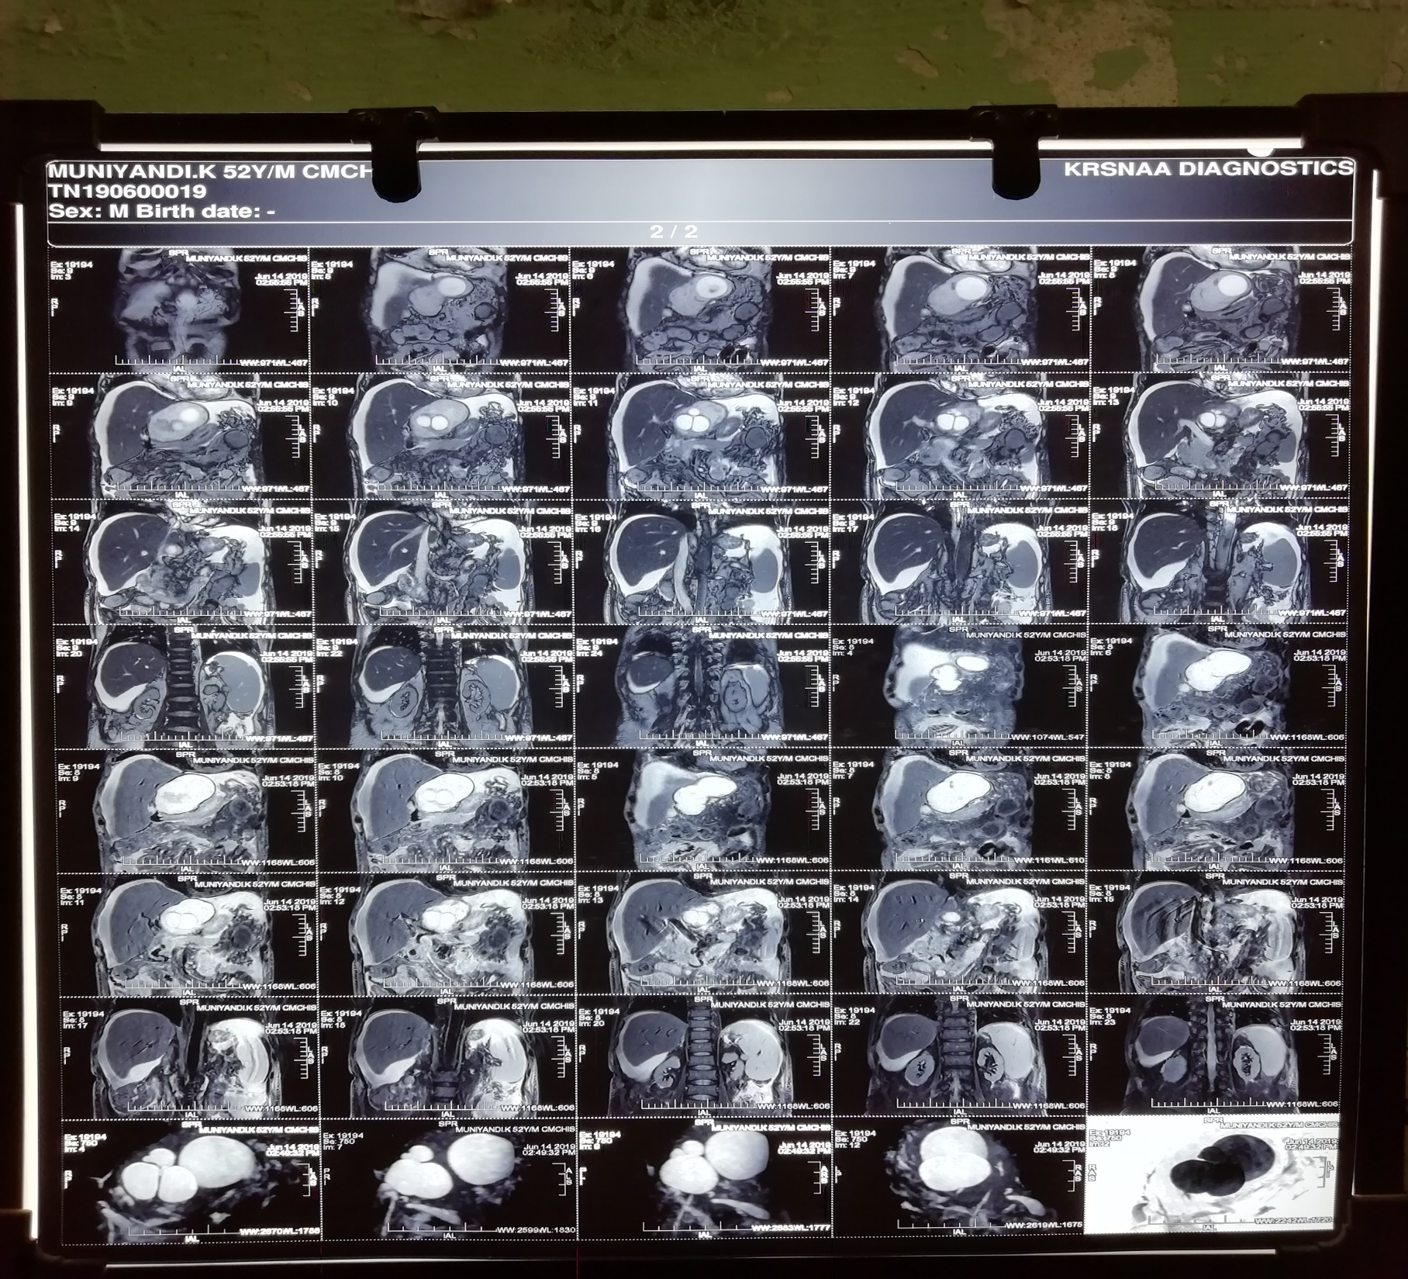

Slide 15
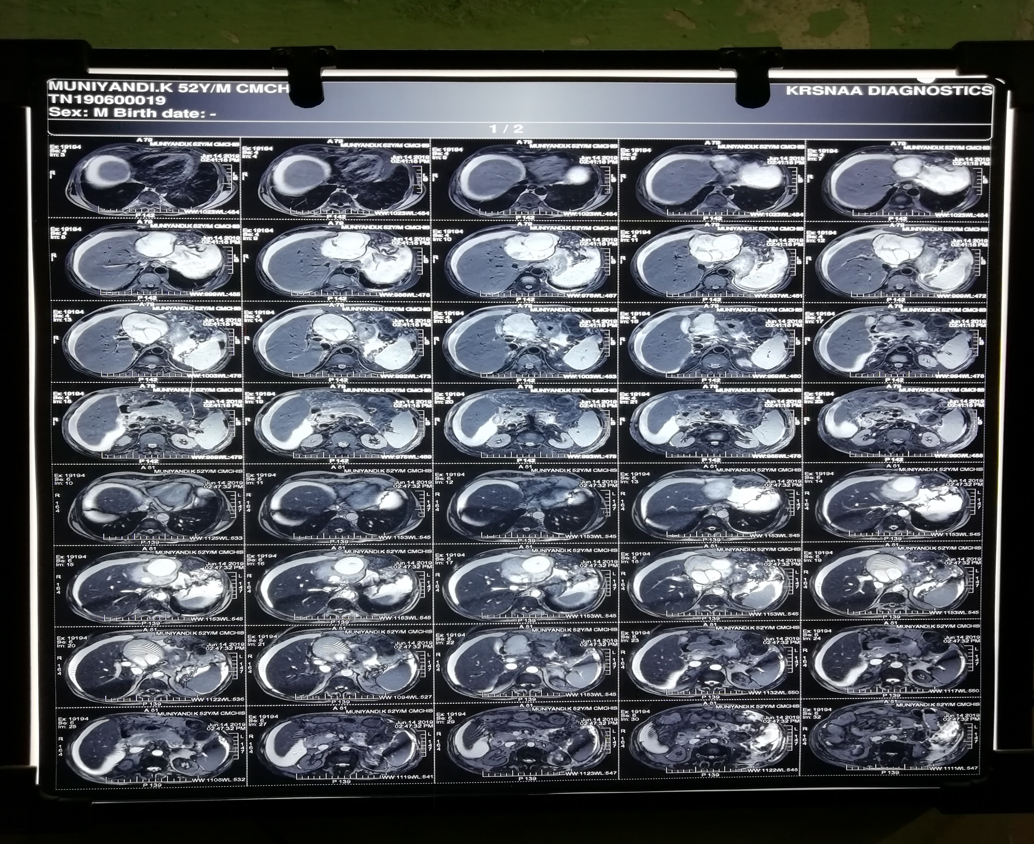

Slide 16
PROVISIONAL DIAGNOSIS
DCLD
EARLY HEPATIC ENCEPHALOPATHY
CYSTIC MASS LEFT LOBE OF LIVER
RENAL FAILURE

Slide 17
TREATMENT GIVEN…
DIL
Inj Cefotaxime 1g iv bd
Inj Ranitidine 50mg iv bd
Inj Terlipressin 1mg iv tds
Inj Human albumin 1g iv bd
Syrup Lactulose 20ml tds
C. Rifaximin 550mg 1 bd
Tab UDCA 300mg 1 tds
Packed cell transfusion 1
FFP transfusion sos
I/O chart/Daily weight chart/ abdominal girth chart

Slide 18
MGE OPINION
Chronic Alcoholic Liver Disease – Decompensated
Cyst Left lobe of liver
Suggested…
To continue the same line of management
OGD
SGE opinion

Slide 19
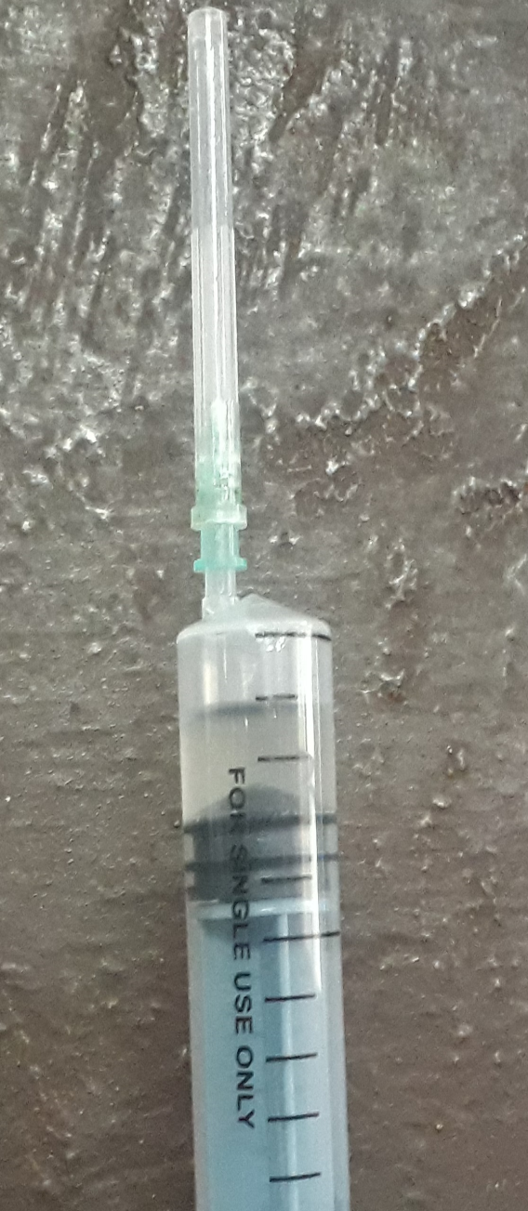
Serum Eichnococcus IGG – 8NTU (Positive > 11)
Patient not from endemic area
USG abdomen couldn’t confirm Hydatid cyst
Most studies showed that the risk of severe anaphylaxis during aspiration and percutaneous procedure is very low (Approx. 0.03%)
After getting consent, under ultrasound guidance 20ml of cystic fluid was aspirated. Post procedure,vitals stable and no e/o any anaphylactic reaction

Slide 20
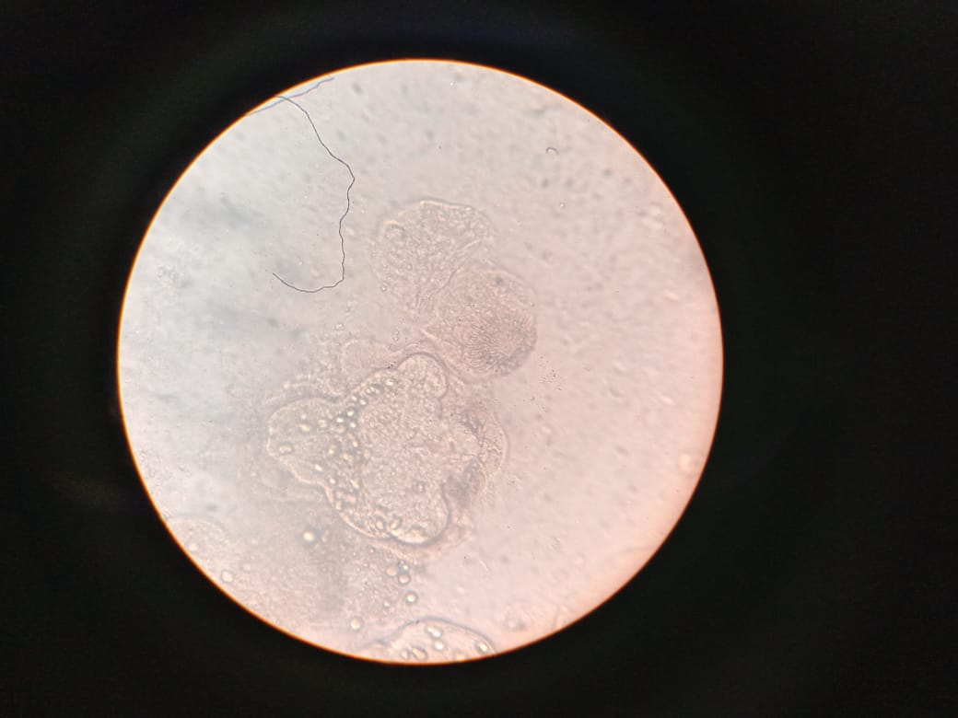

Slide 21
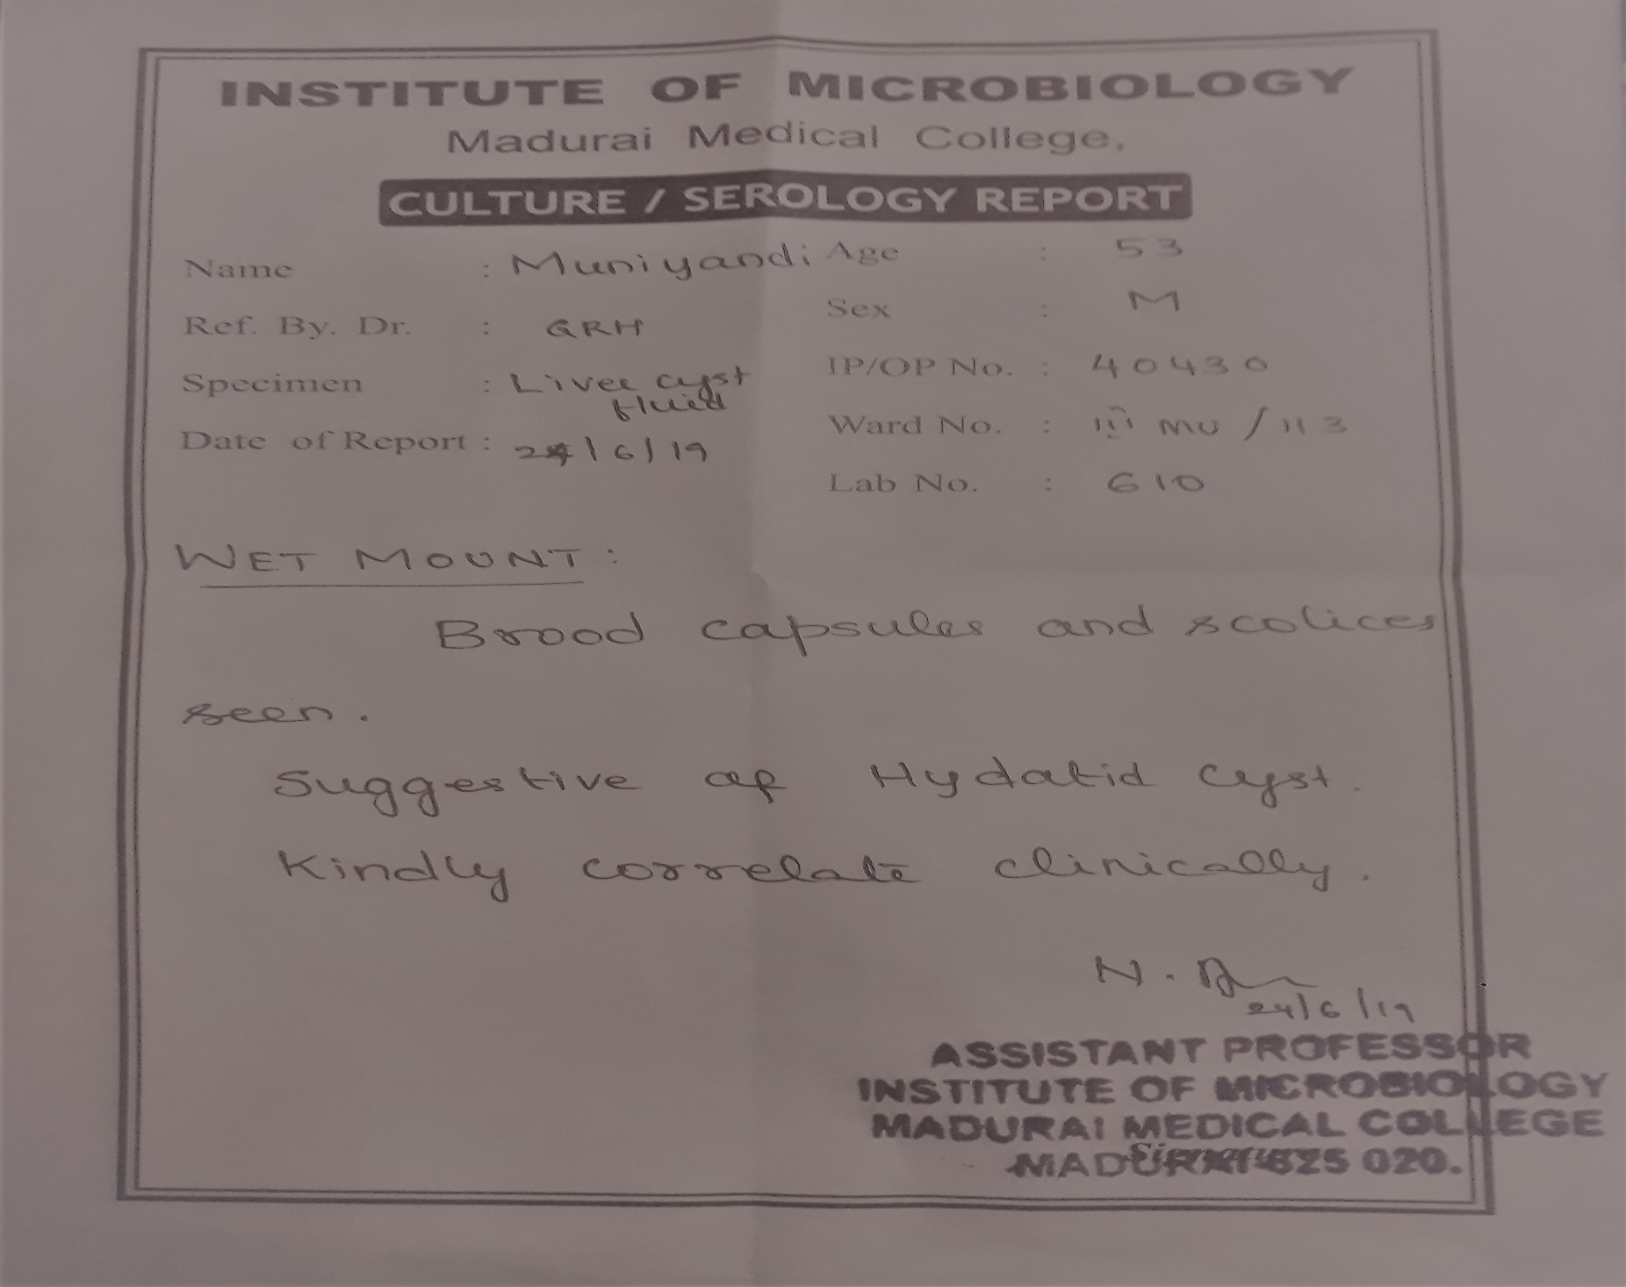

Slide 22
Gram Stain And AFB Stain of Aspirated Fluid – No Organisms Seen
Cystic Fluid C&S – No Growth In Culture

Slide 23
SGE opinion
Decompensated CLD
Elevated renal parameters
Incidentally detected cystic lesion in left lobe of liver
Suggested
Conservative management of DCLD
OGD

Slide 24
OGD..
GRADE B OESOPHAGITIS
LAX LES
DUODENAL ULCER ( Multiple small <5mm ulcer)

Slide 25
NEPHROLOGY OPINION
USG – B/L contracted kidneys, CMD Lost
DCLD/CKD/HYDATID CYST LEFT LOBE OF LIVER
ADVICE
SRD < 2g/Day
Tab. NAHCO3 1tds
Tab. FST 1bd
Tab. VIT C 1bd
Packed Cell Transfusion sos

Slide 26
FINAL DIAGNOSIS
DCLD
HEPATIC ENCEPHALOPATHY RECOVERED
CKD
HYDATID CYST LEFT LOBE OF LIVER
Patient was not willing for further management. Patient was discharged at request

Slide 27
Treatment on discharge
Tab. Ranitidine 150mg 1 bd
Tab. Frusemide 40mg 1 od
Tab. UDCA 300mg 1 tds
Tab. FST 1 bd
Tab. Vit C 1bd
Syp Lactulose 15ml tds

Slide 28
Why?
Surgery – patient not fit
Percutaneous treatment – patient not willing
Medical management –
Benzimidazoles (BMZ) can cause elevation of liver enzymes. So cautiously used in liver disease.
BMZ alone are not effective if Cyst>10 cm
Ours is a case of decompensated liver disease with hepatic encephalopathy recovered, hence not started.
Wait and watch – patient couldn’t be followed up because of poor compliance

Slide 29
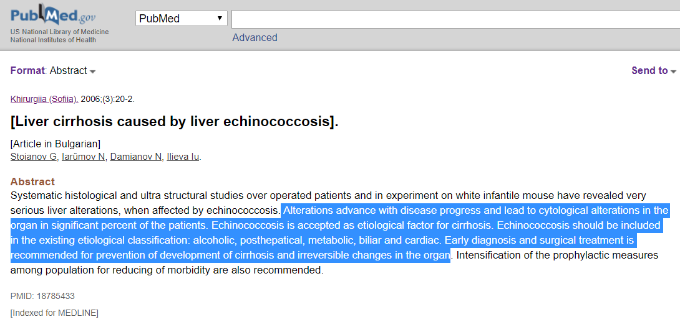

Slide 30
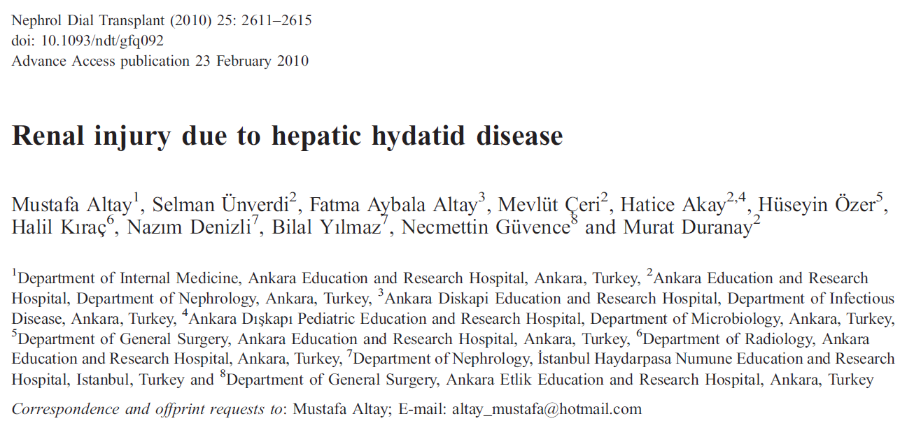
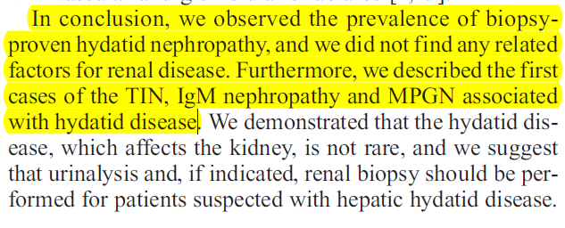

Slide 31
AIM OF PRESENTATION
TREATMENT DILEMMA OF HYDATID CYST IN PATIENTS WITH CLD, CKD AND OTHER COMORBIDITIES AND THOSE WHO ARE SURGICALLY UNFIT.
RARITY OF PRESENTATION

