Slide 1
A tale of 2 presentations
II MEDICAL UNIT
UNIT CHIEF PROF -DR.S.PEER MOHAMED MD
ASST PROF - DR.M.SURESH KUMAR MD
DR.M.SATHEESH KUMAR MD
PRESENTOR - DR. G.GOURI

Slide 2
Chief complaints
1ST TALE
75 year old female patient presented with
c/o easy fatiguability x 3 months
c/o breathlessness x 3 months
c/o giddiness x 7 days

Slide 3
History of present illness
H/o easy fatiguability x 3 months
H/o dyspnea on exertion x 3 months
insidious onset ,NYHA class II
not associated with orthopnea and PND
H/o giddiness x 7 days
No h/o chest pain /palpitations
No h/o swelling of legs

Slide 4
No h/o bleeding gum / hematochezia/melaena
No h/o abdominal pain / vomiting /loose stools
No h/o fever
No h/o headache
No h/o altered sensorium/ seizure
No h/o visual disturbances
No h/o bone pain
No h/o decreased urine output
No h/o weight loss

Slide 5
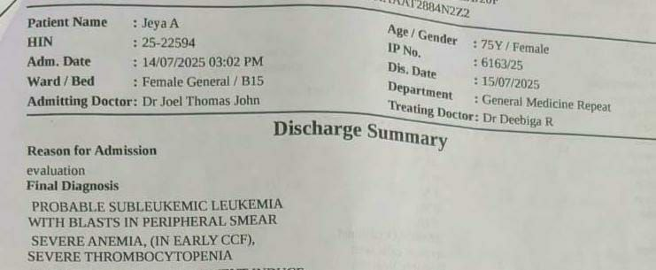
Past history
K/c/o hypothyroidism on T.Thyroxine 100 mcg OD x 10 years
Not k/c/o T2DM/SHTN/Bronchial asthma/PTB/CAD/Epilepsy
PAST SURGICAL H/O - Nil
TREATMENT H/O
Patient initially admitted in private hospital were diagnosed as ? sub leukemic leukemia, severe anemia with thrombocytopenia- treated symptomatically , then referred to GRH Madurai for further management.

Slide 6
Personal history
Mixed diet
Normal bladder and bowel habits
Sleep - adequate

Slide 7
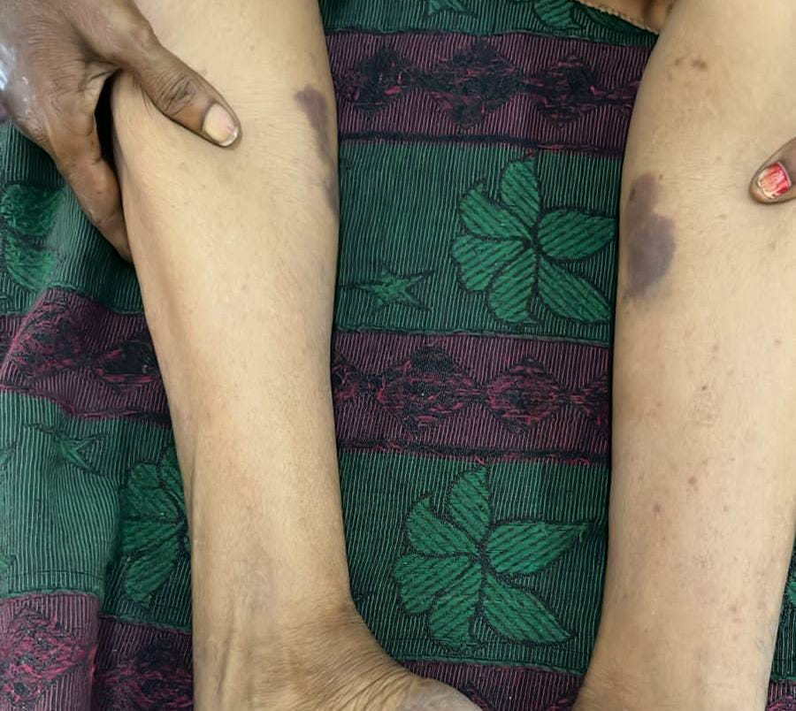
General examination
Conscious , oriented
Pallor +
No icterus/ cyanosis/clubbing/ generalized lymphadenopathy/pedal edema
Multiple purpura and ecchymotic spots seen over both lower limbs below knee
Oral cavity
- No Bleeding Gums
- No Wet Purpura
- Tonsil - normal
No external markers of TB/HIV

Slide 8
vitals
PR – 100/ min
BP – 140/80 mm hg
Spo2 – 95% RA
RR- 20/min

Slide 9
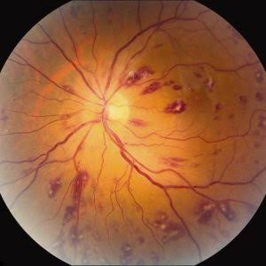
Systemic examination
CVS – S1 S2 heard , No murmur.
RS – B/L AE present, B/L NVBS heard,
occasional creps+
P/A – soft , non tender
- no organomegaly
- petechiae seen over anterior abdominal wall
CNS – conscious , oriented
No focal neurological deficits
FUNDUS – multiple retinal hemorrhages present in both eyes
Roth spots present in both eyes

Slide 10
INVESTIGATIONS
CBC | 16/7/25
TC | 5,200cells/cu.mm
DC | N 40.5% L 43.6% M 15.9%
HB | 5.6 g/dl
PLATELET | 12,000 cells /mcl
MCV | 95.5fl
MCH | 28.3pg
MCHC | 29.6g/dl
ESR | 70mm/hr

Slide 11
INVESTIGATIONS
RFT | 16/7/25
Urea | 44 mg/dl
Creatinine | 1.6 mg/dl
Creatine clearance | 36 mL/min
Na+ | 142 Meq/L
K+ | 3.5 Meq/L
RBS | 110mg/dl
LFT | 16/7/25
Total bilirubin | 0.7mg/dl
Direct/ indirect bilirubin | 0.3/0.4mg/dl
SGOT/SGPT | 80/50 U/L
ALP | 44 U/L
 | 16/7/25
TOTAL PROTEIN | 11.8g/dl
SERUM ALBUMIN | 2.7 g/dl
SERUM GLOBULIN | 9.1g/dl
 | 16/7/25
s.calcium | 9.8mg/dl
S.Phosphorus | 3.0mg/dl
S.Uric acid | 13.9mg/dl

Slide 12
INVESTIGATIONS
PT/INR | 13.2sec/1.08
APTT | 19.7 secs
SERUM B12 | 450pcg/ml
DCT | Positive
S.Ferritin | 314ng/ml
 | 16/7/25
VCTC | NON REACTIVE
HBSAG | NEGATIVE
ANTI HCV AB | NEGATIVE
Urine | 13/7/25
Albumin | Nil
Sugar | Nil
deposits | 0-3 pus cells/ hpf

Slide 13
PERIPHERAL SMEAR (15/7/25) outside report
- RBC – 1.9 million/mcl
- hypochromic microcytes, normochromic normocytes, and few macrocytes, target cells and elliptical cells
- WBC counts-5200 cells/mcl- adequate with left shift upto blast stage
- cell is large with high nuclear chromatin ratio with immature chromatin
- hypersegmented neutrophils
- Diff count – neutrophils – 46 %
- lymphocytes – 47%
- eosinophils – 4%
- monocytes – 3%-
- Platelets diminished in number = 9000 cells
- Reticulocyte count – 1.5 %
- Corrected retic count - 0.62
- RPI – 0.2
IMP- HIGHLY SUSPICIOUS OF SUBLEUKEMIC LEUKEMIA

Slide 14
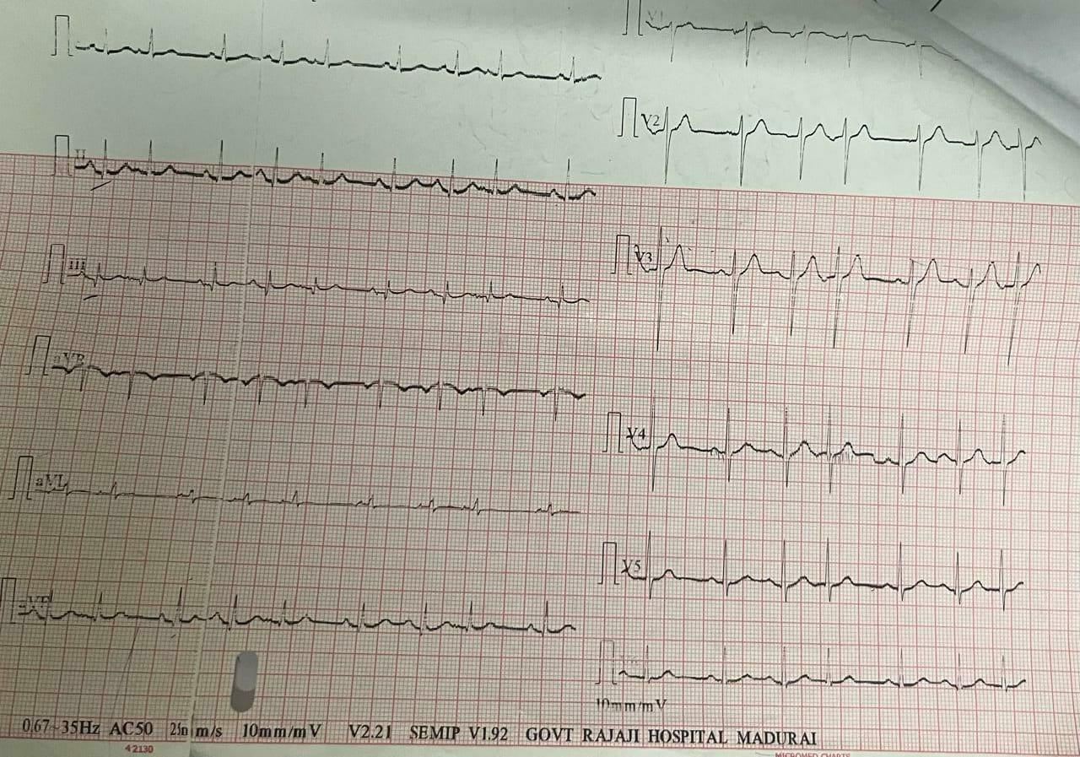
ECG

Slide 15
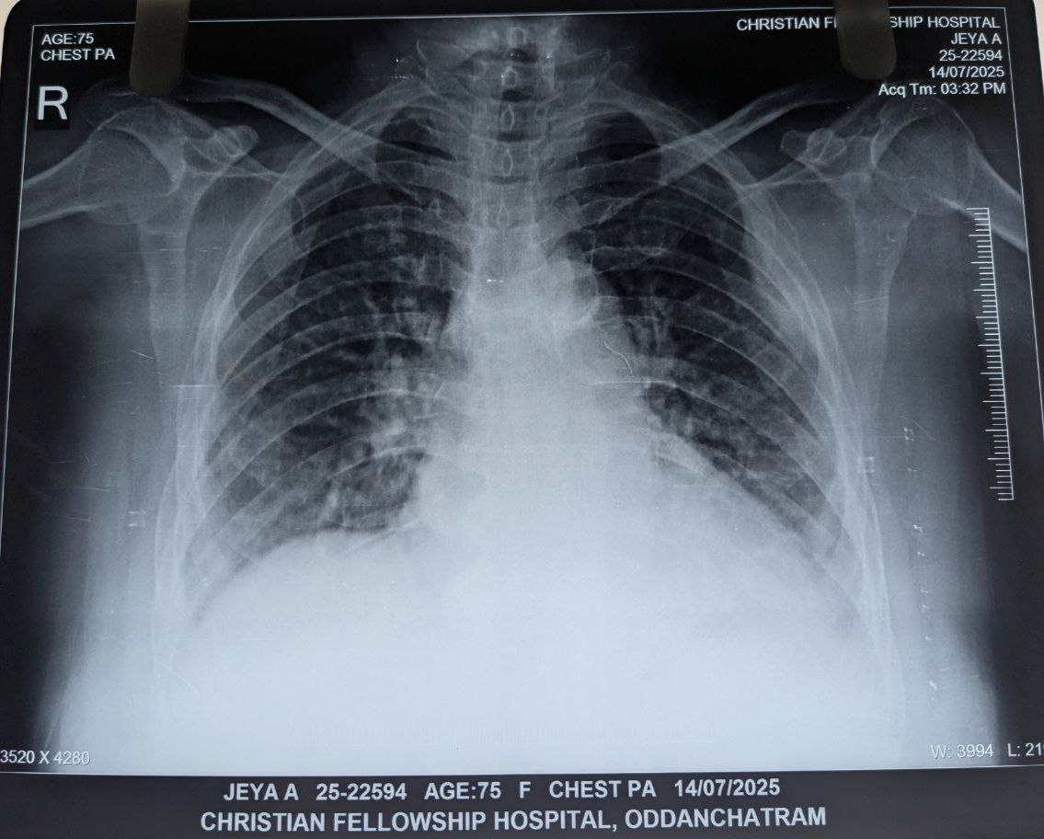
CHEST X RAY b/l perihilar infiltrates with b/l minimal pleural effusion

Slide 16
USG ABDOMEN &PELVIS
LIVER – 14.6cm and normal echoes.
Gallbladder – No e/o calculus/ wall thickening.
Spleen -10cm and Normal echoes.
Right kidney size - 9.5cmx 4.2 cm, normal echoes, CMD +
Left kidney size – 9.5cmx4.2cm , normal echoes, CMD +
Imp – Nil significant abnormality
ECHO- No Regional wall motion abnormality
EF-60%

Slide 17

WHAT NEXT?

Slide 18
HISTORY OF PRESENT ILLNESS
2 ND TALE
46 years old female patient was apparently normal 2 years back when she presented to neurosurgery department with sudden onset weakness of B/L lower limb which was associated with decreased sensation below xiphisternum
CT screening showed expansile lytic lesion in D6 vertebra involving posterior elements
MRI LS spine with whole spine screening was taken which showed extra dural mass lesion involving D6 vertebra with spinal canal narrowing and cord compression
Excision of SOL with D6 laminectomy was done on 24/7/23
Histopathology report showed small round cell tumour
Patient was lost to follow up after that .

Slide 19
After 2 years , 2025 patient again presented in neurosurgery department with c/o back pain and sudden onset weakness of bilateral lower limb and loss of sensation below xiphisternum .
Routine investigations and peripheral smear was taken
MRI LS spine (P +C) was taken which showed lytic lesion involving D6 vertebra with compressive myelopathy. And a small lytic lesion in the first rib
Patient was referred to for medical oncology opinion and PET CT scan was done which showed lytic lesions in left 1ST rib , D6 and L3 vertebra and illiac bone
Bone marrow aspiration was done which was normal

Slide 20
Excision of D6 SOL was done on 9/6/25 & sent for histopathological examination , IHC markers and reports were awaited.

Slide 21
PAST HISTORY
Not a k/c/o T2DM/SHTN/CAD/bronchial asthma/thyroid disorder
Not a known case of PTB
No h/o trauma

Slide 22
PERSONAL HISTORY
Mixed diet
Normal bowel and bladder habits
Adequate sleep
Menstrual H/o – Regular cycle , 5-7days/28days cycle
H/o menorrhagia +

Slide 23
GENERAL EXAMINATION
Conscious , oriented
Afebrile
Pallor +
No pedal edema/icterus
No generalized lymphadenopathy
No cyanosis/clubbing

Slide 24
VITALS
BP-110/70 mm hg
PR-80/MIN
SPO2-98% IN ROOM AIR
RR – 16/min

Slide 25
S/E
CVS-S1S2+
- NO MURMUR
RS-B/L AE+
- NO ADDED SOUNDS
P/A-SOFT ,BS+
-NO ORGANOMEGALY

Slide 26
CNS EXAMINATION
ATTITUDE – B/L UPPER LIMBS BY THE SIDE OF THE BODY AND B/L LOWER LIMBS EXTENDED AT HIP AND KNEE JOINT IN SUPINE POSITION
BULK
GROUP | RIGHT | LEFT
ARM | 23 cm | 23 cm
FOREARM | 21 cm | 21 cm
THIGH | 40cm | 41 cm
LEG | 30 cm | 29 cm

Slide 27
TONE
POWER
GROUP | RIGHT | LEFT
UPPER LIMB PROXIMAL | Normal | normal
UPPER LIMB DISTAL | Normal | Normal
THIGH | Normal | Normal
LEG | normal | normal
GROUP | RIGHT | LEFT
ARM | 5/5 | 5/5
FOREARM | 5/5 | 5/5
THIGH | 4+/5 | 4+/5
LEG | 4+/5 | 4+/5

Slide 28
DTR
GROUP | RIGHT | LEFT
UPPER LIMB | + | +
LOWER LIMB | + | +
PLANTAR - B/L MUTE
SENSORY SYSTEM – NORMAL
CRANIAL NERVE EXAMINATION-NORMAL
NO CEREBELLAR SIGNS
NO MENINGEAL SIGNS
SPINAL TENDERNESS AT D6 LEVEL
FUNDUS - NORMAL

Slide 29
INVESTIGATIONS
CBC | 20/3/25
HB | 6.7 GM/DL
TC | 6200 cells/MCL
DC | L28.3 N64 M7.7
PLT | 3.9 LAKH cells/MCL
MCV | 56.6 FL
MCH | 17.2 PG
MCHC | 30.4 GM/DL
ESR 1 HR | 55 MM/HR
 | 20/3/25
TOTAL PROTEIN | 5.8 GM/DL
ALBUMIN | 3.6 GM/DL
GLOBULIN | 2.2 GM/DL
QCRP | 12 MG/L
SERUM FERRITIN | 7.18 NG/ML

Slide 30
LFT | 20/03/25
TOTAL BILIRUBIN | 0.3 MG/DL
DIRECT BILIRUBIN | 0.1MG/DL
INDIRECT BILIRUBIN | 0.2MG/DL
SGOT | 38 U/L
SGPT | 11 U/L
ALP | 92 U/L
RFT,ELECTROLYTES | 20/3/25
UREA | 17 MGS%
CREATININE | 0.7 MGS%
SODIUM | 132 MEQ/L
POTTASIUM | 4.5 MEQ/L
CALCIUM | 8.9 MG/DL
ECHO – NO REGIONAL WALL MOTION ABNORMALITIES
-EF-62%
URINE
ALBUMIN | NIL
SUGAR | NIL
DEPOSITS | 0-3 PUS CELLS/HPF

Slide 31
PERIPHERAL SMEAR(21/3/25)
RBC – anisopoikilocytosis
- hypochromic microcytes , normochromic normocytes
WBC – normal in number
- DC – neutrophils – 72% , lymphocytes – 22% , eosinophils – 4%
monocytes – 1 %
Platelets – normal in number
Impression - microcytic hypochromic anaemia
- reticulocyte count – 1.1 %
- RPI – 0.3

Slide 32
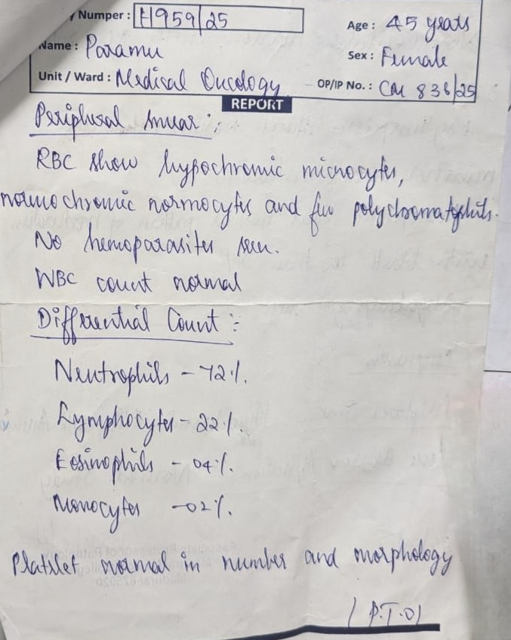

Slide 33
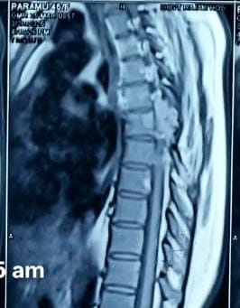
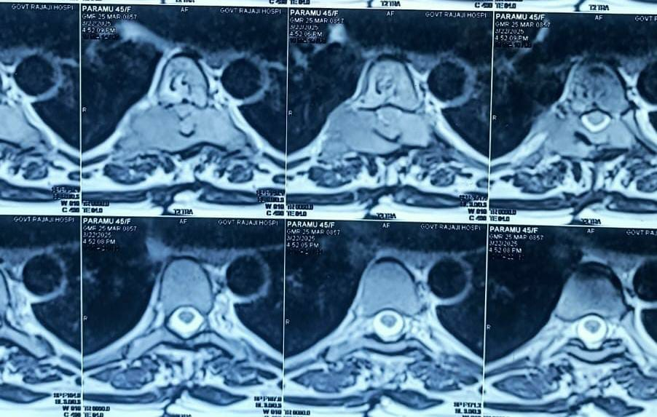
MRI DORSOLUMBAR SPINE(22/3/25)
Extradural lytic lesion involving the D 6 vertebra causing compressive myelopathy
A small lytic lesion noted in left 1st rib anterior aspect

Slide 34
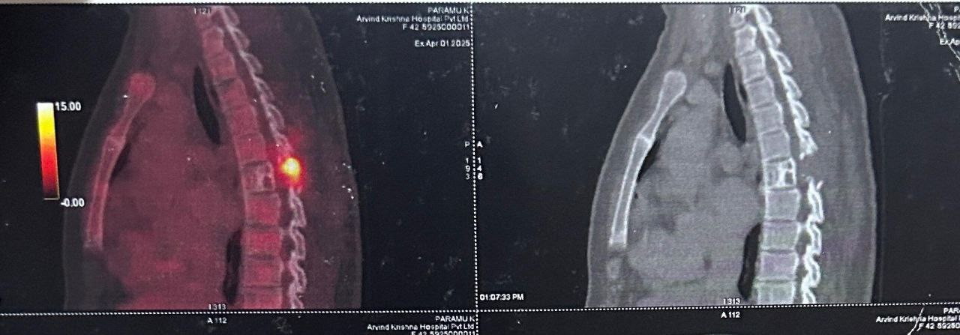
WHOLE BODY FDG PET SCAN(1/4/25)
Metabolically active lytic lesion with soft tissue component noted involving the T6 vertebra showing intraspinal extension
Metabolically active lytic lesion noted in the left second rib ,L3 vertebra and right iliac bone

Slide 35
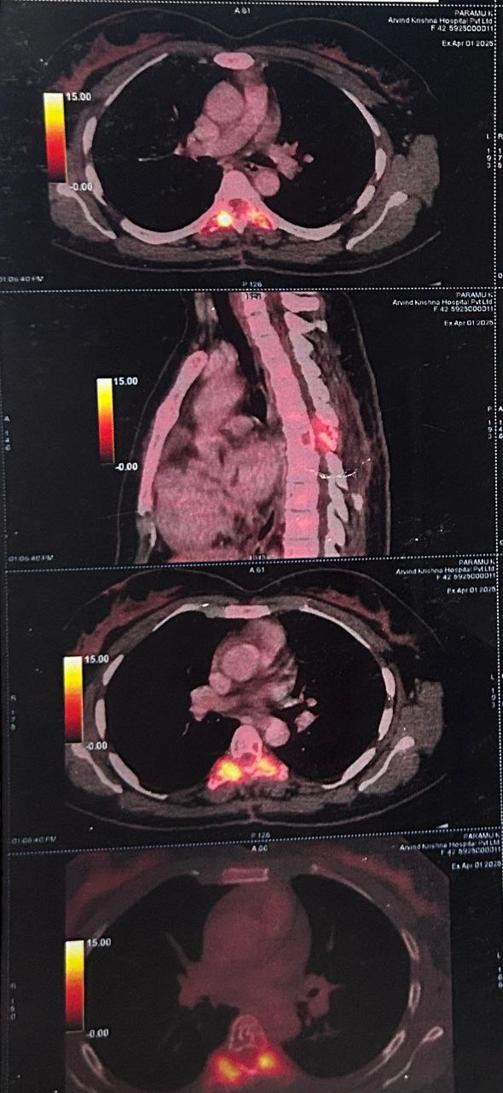

Slide 36
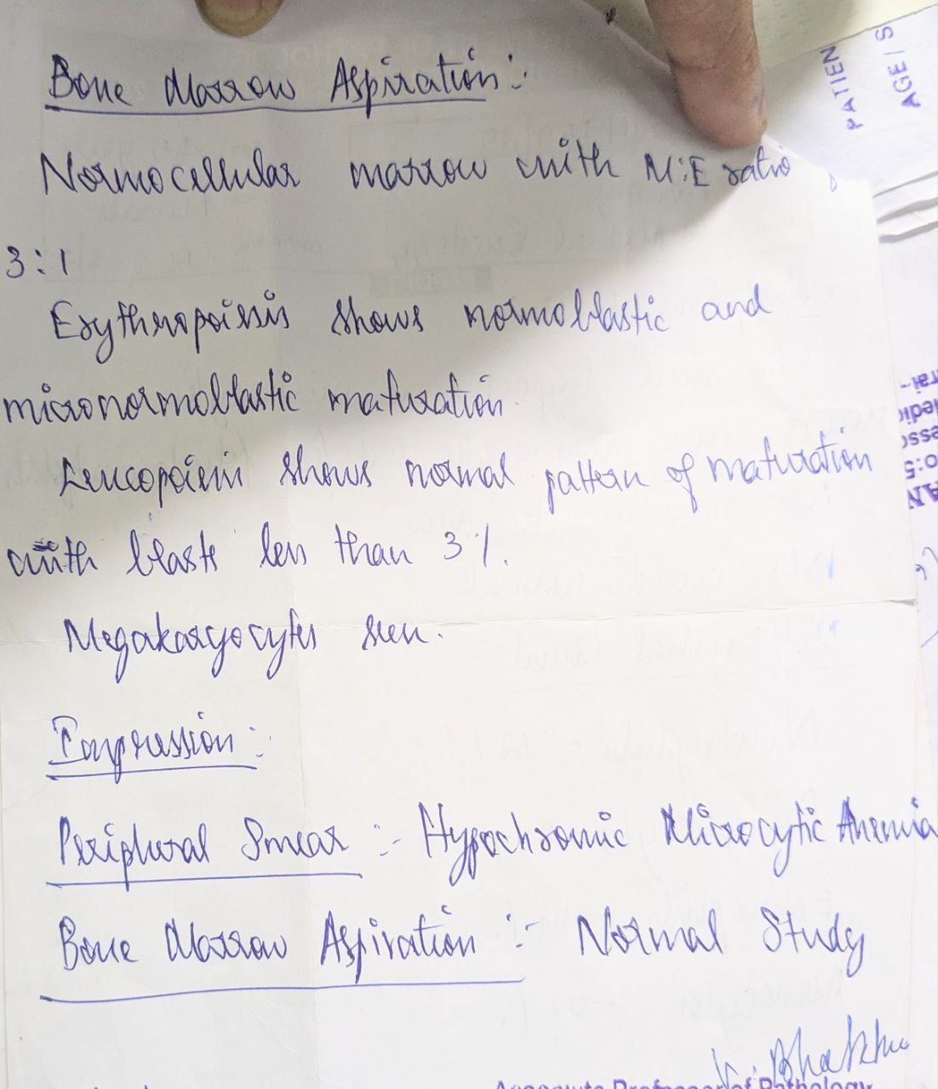
BONE MARROW ASPIRATION (25/4/25)
Myeloid:erythroid ratio - 3:1
Normocellular marrow
Erythropoesis - normal maturation
Leucopoesis – normal maturation
Blasts < 3 %
Megakaryocytes seen
Imp – Normal study

Slide 37
D6 EXTRADURAL SOL (17/6/25)
Macroscopy – received soft tissue in multiple pieces together measuring 6cc with bony tissues in each piece measuring 2 x 0.8 cm
Microscopy –shows tumor tissue arranged in sheets showing small round to oval cells with dark stained nuclei and scant cytoplasm . Adjacent fibro cartilagenous stroma shows chronic inflammatory infiltrates
Impression – picture suggestive of small blue round cell tumor

Slide 38
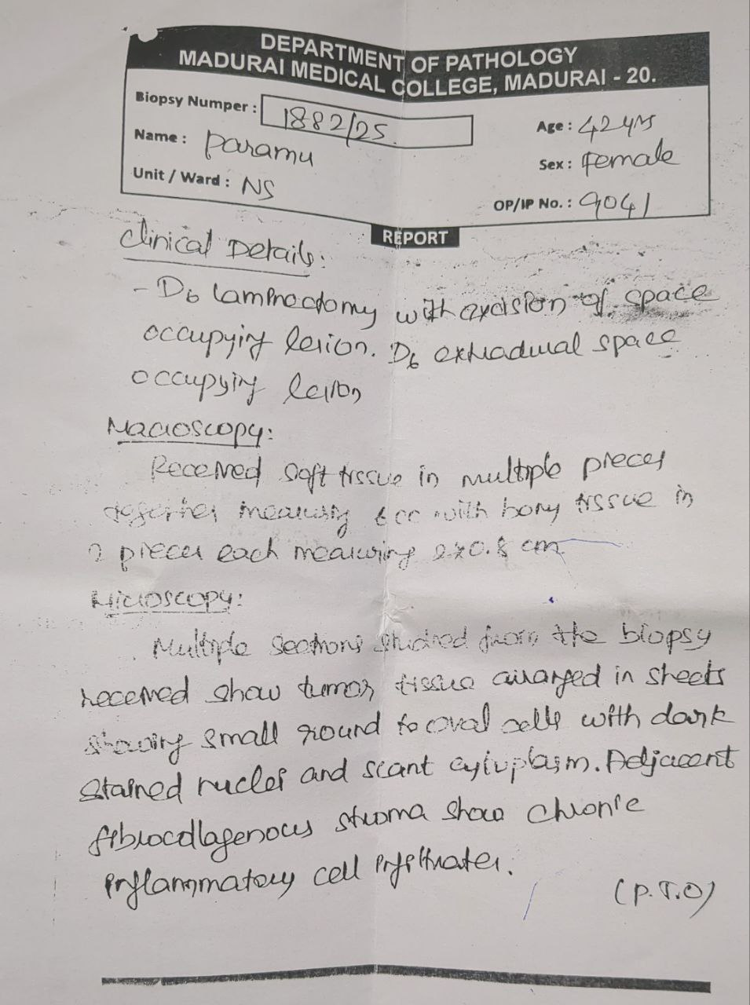
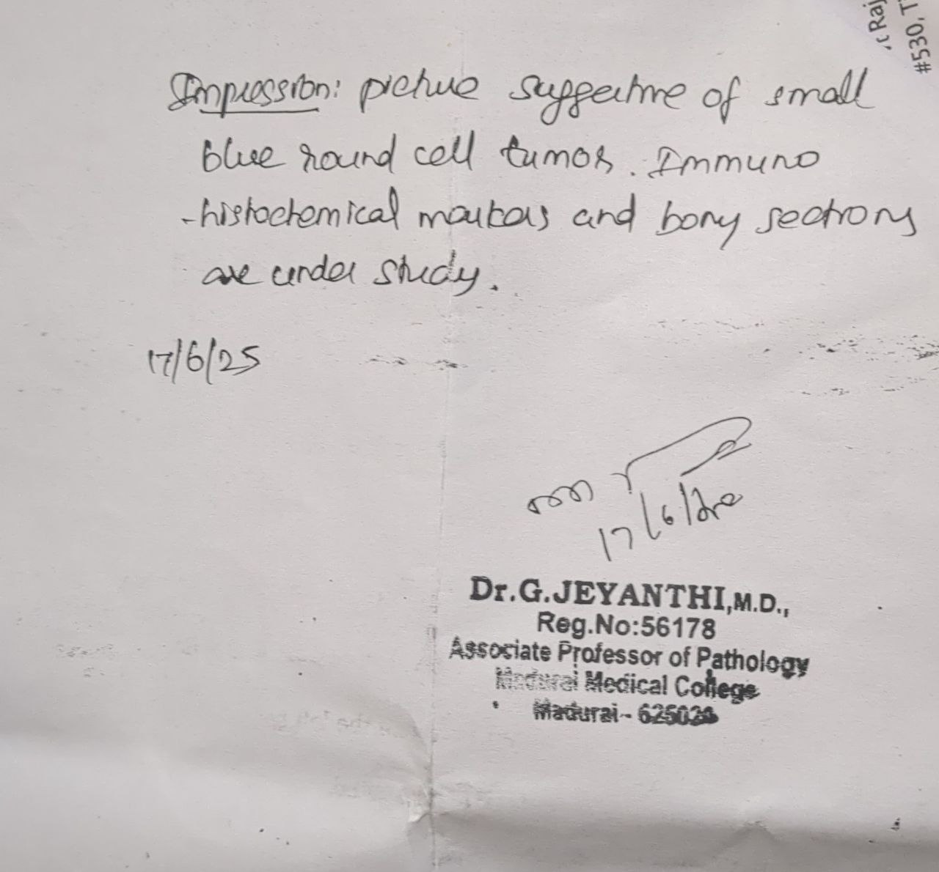

Slide 39
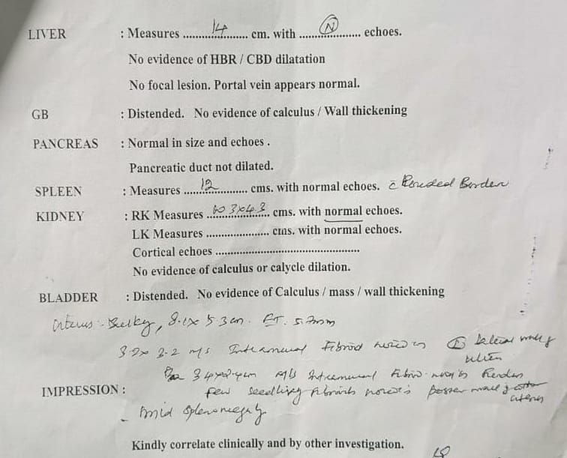
USG ABDOMEN &PELVIS (6/7/25) fibroid uterus mild splenomegaly

Slide 40
WHAT NEXT ?

