Slide 1
Bleeding PUZZLE
Medical unit I
HOD and CHIEF - Dr.M.NATARAJAN MD
Asst. professors - Dr. PALANIKUMARAN MD D.DIAB
- Dr. VASANTHA KALYANI MD DCP
-Dr. SURESHKUMAR MD

Slide 2
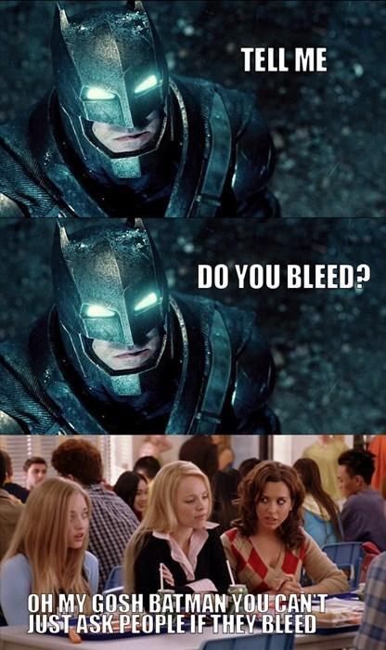
SHORT HISTORY
SHORT HISTORY
A 20 yr old female DENTAL STUDENT , after donating blood , was found to have continuous bleeding from the needle puncture site made for collecting the blood.
She gave previous history of ON and OFF gum bleeding
No family history of bleeding
No h/o menorrhagia or any abnormal uterine bleeding
No other comorbidities , no fever ,no vaccination , no drug intake

Slide 3
On examination :
conscious
oriented CVS - S1S2+
afebrile RS- BAE + ,NVBS
no rash PA- SOFT, NO ORGANOMEGALY
no pallor CNS- CONSCIOUS , ORIENTED , NFND
no icterus
no cyanosis

Slide 4
Investigations:

Slide 6
Differentials :

