Slide 1
Clincopathological conference
By 4th Medical Unit

Slide 2
Chief : Prof Dr.K.SENTHIL M.D
Associate professor : DR. K. MURALIDHARAN M.D
Assist. professor : DR. V. MANIKANDAN M.D
DR.S. SARAVANA MADHAV M.D
DR.M.ILAMARAN M. D D. M presentor:Dr.Dharmaraj.M
2nd year PG

Slide 3
H/O PRESENTING ILLNESS
Mr.Sathishkumar, 47 years old male came with H/o abdominal pain for 1 month
which was acute in onset
progressive,colicky pain
aggravated by food intake occasionally relieved by vomiting and loose stools
h/o loose stools for 1 month
5-6 episodes /day ,
a/w blood and mucus
h/o vomiting for 1 month
3 episodes /day , projectile ,a/w food particles not a/w blood

Slide 4
h/o abdominal swelling
h/o loss of weight and appetite
h/o fever – low grade, intermittent, relieved by taking medicine
h/o knee joint pain and swelling
h/o constipation -15 days back
h/o easy fatigability
h/o belching
h/o excessive sweating and palpitation
no h/o noturnal diarrhea

Slide 5
No h/o melena /hematemesis
No h/o b/l leg swelling
No h/o jaundice
No h/o cough with expectoration
no h/o claudication
No h/o chest pain
No h/o loc/seizure
No h/o radiation exposure

Slide 6
Past h/o
h/o ptb diagnosed 10 yrs back took ATT for 6 months
k/c/o T2DM for 15 yrs on OHA ( T.Metformin + glimipride 1BD )
H/o similar episodes in the past for 2 yrs ,treated at local hospital records NA.h/o vomiting and constipation 6 months back ,diagnosed as paralytic ileus corrected with potassium supplementation
H/o abdominal pain 6 months back diagnosed right ureteric and renal calculi ,taking siddha medicine
n/k/c/o SHTN/BA/Epilepsy/ thyroid disorder

Slide 7
Personal history
Consumes mixed diet
Chronic alcoholic for 15 yrs ,90 ml /day
Chronic smoker 1 packet/day for 10 yrs
Normal bladder habits
Normal sleeping pattern

Slide 8
Family history
No h/o similar complaints in his family members
No h/o any allergic food substances
No h/o TB contact with his family members

Slide 9
On examination
Comfortable at rest
Afebrile
Malnourished
Hydration fair
Pallor present
Pandigital grade 2 clubbing present
No pedal edema/icterus/cyanosis/generalised lymphadenopathy

Slide 10
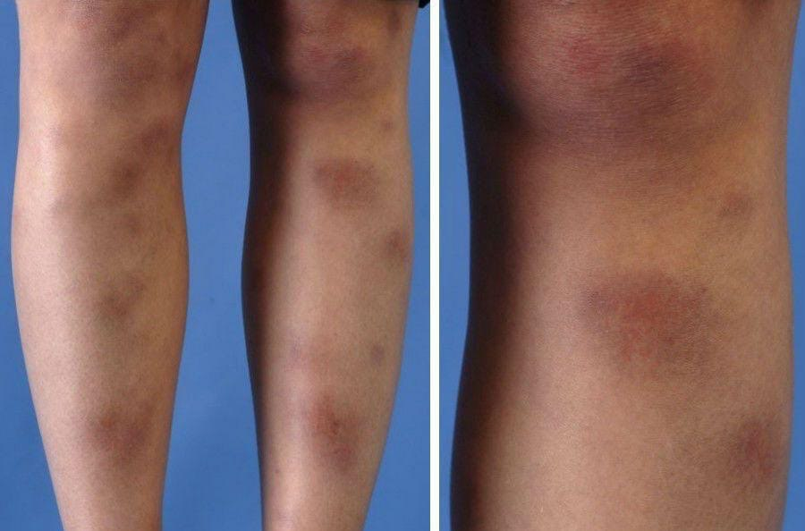
vitals
Bp- 100/70 mmhg
Pulse rate- 100/min
Tempratue- 97 F
SPo2- 98% in room air
fundus exam - normal
erythematous nodules present over b/l shin of tibia - ?erythema nodosum

Slide 11
Systemic examination
P/A – soft ,bowel sounds present . Tenderness present in RIF
No mass /organomegaly
Genital examination – skin tag present at 3 o clock position which is edematous and tender
CVS- S1,S2 present no murmur
RS- BAE present ,no added sound
CNS - no focal neurological deficit

Slide 12
investigations
 | day1 | day 3 | day 4 | day 8
HB | 13.0 | 10.4 | 9.5 | 10.4
Total count | 6830 | 9940 | 14260 | 10010
Diff count | P-54 L-41 M-05 | P-75 L-22 M-03 | P-93 L-04 M-03 | P-84 L-11 M-05
Platelet | 1.97L | 2.74L | 3.04L | 2.47L
ESR | 57
CRP | 90
HBA1c | 7.9
RBS | 145 |  | 100
Sr Urea | 35 |  | 18.6
Sr Creatinine | 0.99 |  | 1.0
Sr Na | 132 |  | 136
Sr K | 3.0 |  | 2.8

Slide 13
Total bilirubin | 0.9
Direct bilirubin | 0.5
Indirect bilirubin | 0.4
SGOT | 16.5
SGPT | 11.6
ALP | 115.6
Total Protein | 5.4
Sr Albumin | 4.0
Sr Globulin | 1.4
Urine Sugar | 1(+)
urine albumin | 1+
VCTC | Non Reactive
HbSAg | Negative
HCV | Negative
S.Calcium | 9.8
S.Phosphate | 3.4
S.magnesium | 1.5
TSH | 2.4

Slide 14
ECG:HR-88/min,NAD,NSR,NO ST -T Wave changes
Chest X Ray -No significant Abnormality
2D ECHO
Grade 1 LVDD,
Mild concentric LVH,
Normal LVSF
LVEF 75%

Slide 15
USG ABDOMEN AND PELVIS
GB- Distended
Pancreas- obscured
Bowel-inflammatory bowel wall thickening associated with mass lesion in RIF 3x2 cm and luminal narrowing
Multiple mesenteric lymphnodes and paraaortic nodes are enlarged ,largest measures 2x1cm
IMP- ? INFLAMMATORY/NEOPLASTIC BOWEL LESION

Slide 16
CECT abdomen | -Circumferential regular wall thickening in the ileum and proximal transverse colon showing pericolic fat stranding, heterogenous hyperenhancement and luminal narrowing. - Mild irregular thickening at distal transverse colon and splenic flexure with mild luminal narrowing.Multiple mesentric lymph nodes and paraaortic nodes are enlarged -Left renal pelvis calculus. - B/L Multiple intra renal calculi - B/L bosiniak class 1 simple renal cortical cysts - Fatty infiltration of liver

Slide 17
WHAT NEXT???

