Slide 1
CASE 1

Slide 2
LUTEMBACHER SYNDROME
FROM 4th MEDICAL UNIT
CHIEF : Dr.David Pradip Kumar MD,MRCP
ASSISTANT PROF:
Dr.Ragavan MD
Dr.Naseema Banu MD
Dr.Ramkumar MD

Slide 3
42 years old female presented with,
Breathlessness for 3 days
-NYHA Class 3 to 4 progression
-aggravated on exertion.
-orthopnea and PND present.
Epigastric pain for 3 days
-burning type
-no radiation
-no aggravating and relieving factors.
No chest pain,palpitation,syncope and leg swelling.
No decrease in urine output.

Slide 4
Past history:
No h/o T2DM, SHTN, BA, PTB, Epilepsy, Thyroid disorder, CAD, CKD, CVA
H/o heart disease diagnosed during pregnancy
(records not available)
Personal history:
Non smoker
Non alcoholic
Mixed diet

Slide 5
VITAL SIGNS:
PR-96/min , irregular in rhythm, normal volume, no special character.
BP-110/70 mmhg
SPo2-90% on RA

Slide 6
GENERAL EXAMINATION:
No pallor
No icterus
No clubbing
No cyanosis
No generalized lymphadenopathy
No pedal edema

Slide 7
SYSTEMIC EXAMINATION:
CVS-S1 present
wide split S2 present
ESM present in pulmonary area
JVP Elevated
RS-Bilateral air entry equal
Bilateral basal crepts present.
ABDOMEN-Soft,tender hepatomegaly present
CNS-NFND

Slide 8
INVESTIGATIONS:
TC-9400
Hb-13.4 g
PCV-39
Platelets-2.28 lakhs
Na-131
K-4.3
Urea-43
Creat-1.0
RBS-180mg/dl

Slide 9
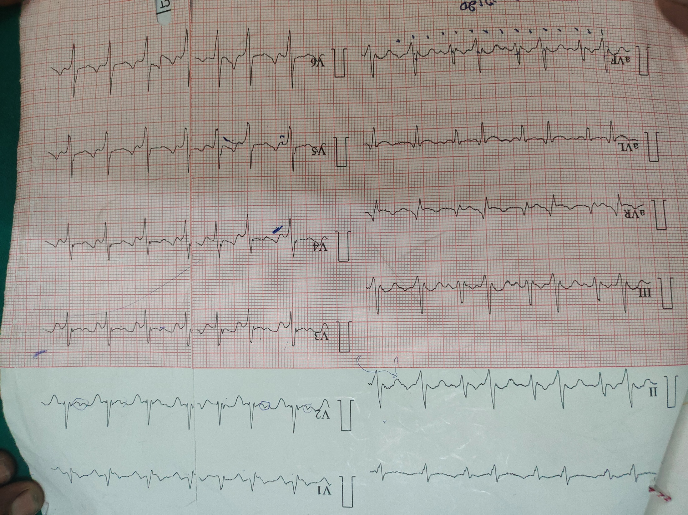

Slide 10
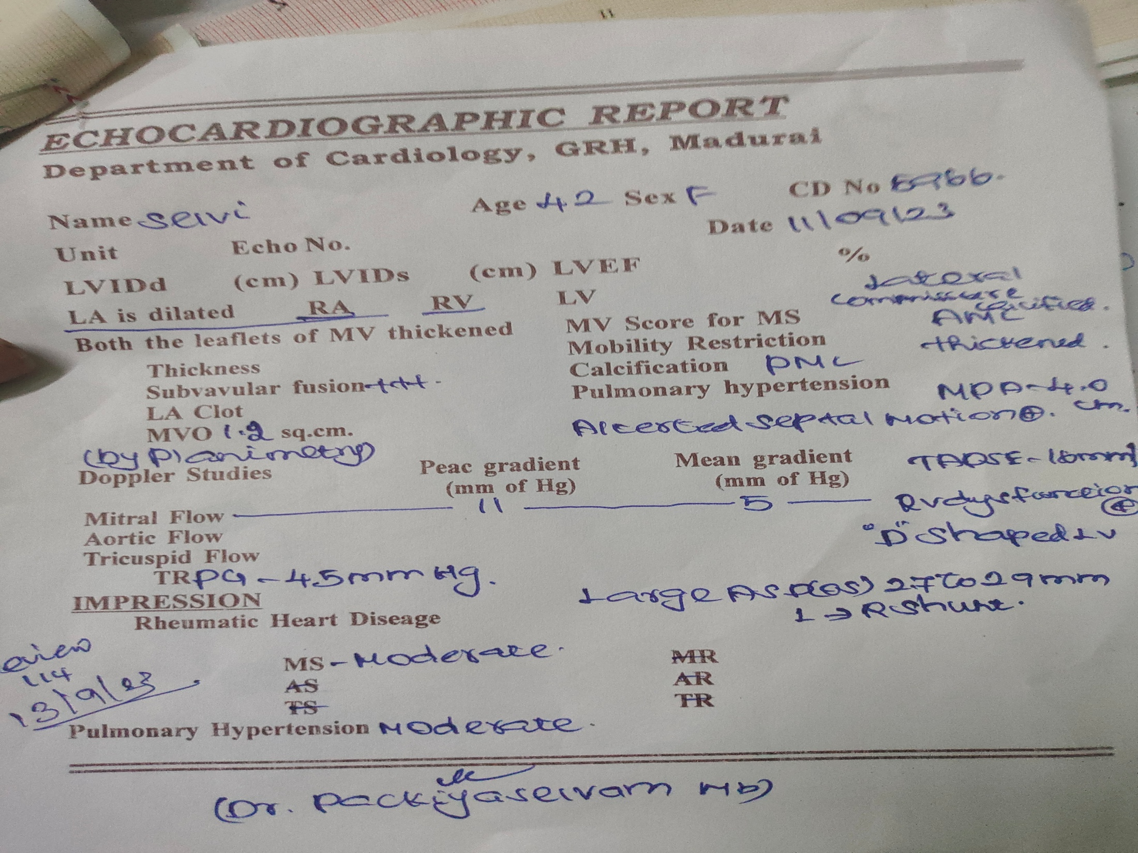

Slide 11
Patient went into SVT spontaneously on 2nd day of admission with Hypotension
Reverted by 100J DC shock.
SVT reverted to sinus rhythm.

Slide 12
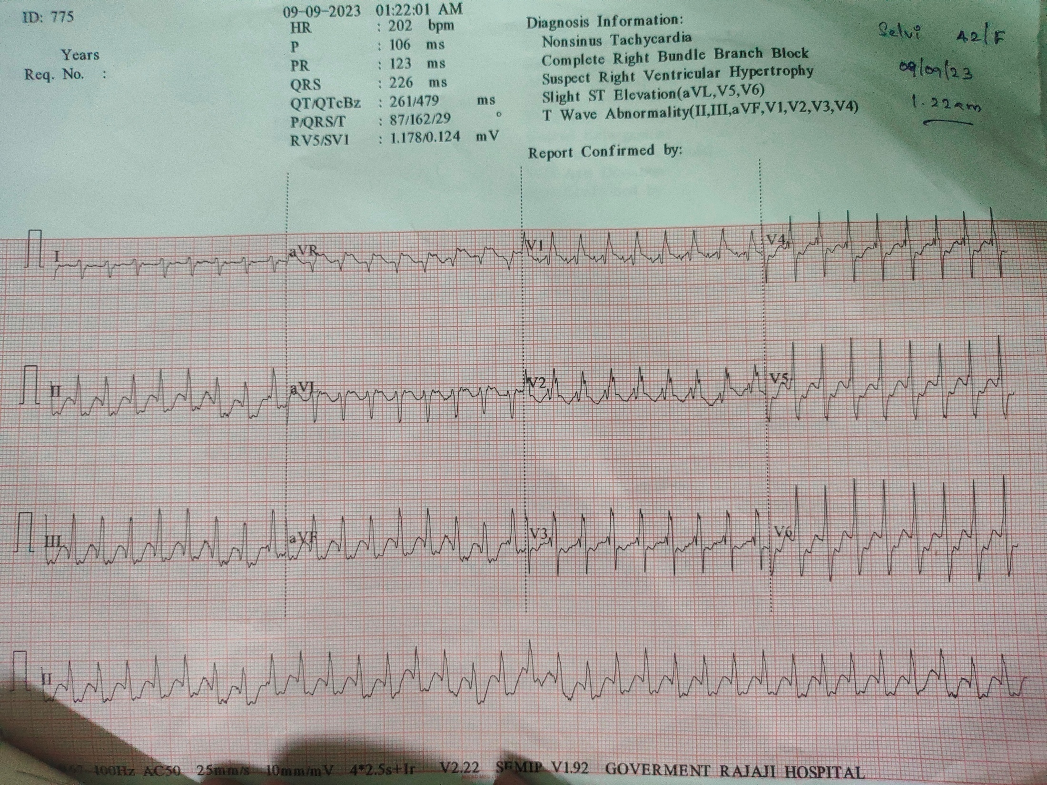

Slide 13
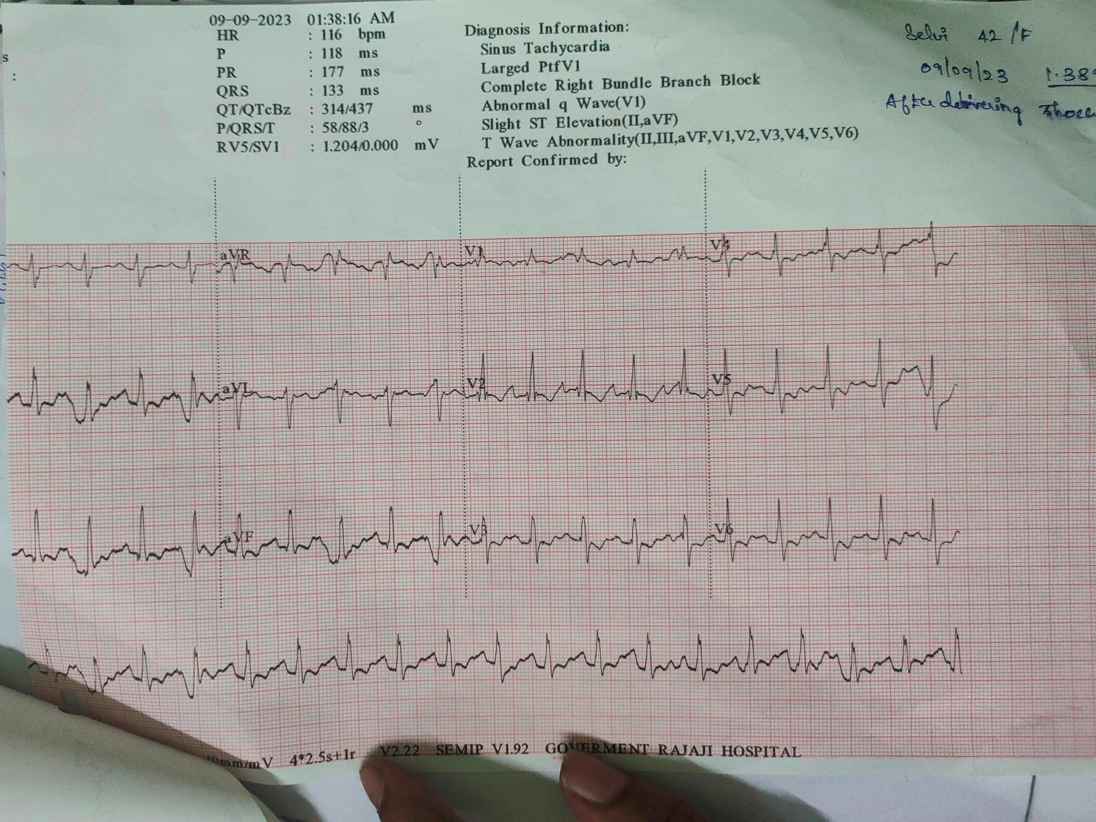

Slide 14
TREATMENT:
Inj Frusemide 40mg IV BD
Inj.Heparin 5000IU IV qid
Tab.Acitrom 2mg OD
Tab.penicillin 250mg BD
Tab Metoprolol 25mg OD
C.Omeprazole 20mg BD
T.Enalapril 2.5mg BD

Slide 15
CASE 2

Slide 16
63 year old female presented with,
Breathlessness for 2 days
-Insidious onset and gradually progressive
-Aggravated on exertion and relieved by rest
-Orthopnea and PND prsent
Palpitation for 2 days
-No complaints of chest pain,syncope leg swelling.
-No complaints of decreased urine output.
Fever 1 day
No chills and rigor
No burning micturition
No abdominal pain,vomiting,loose stools

Slide 17
Past history:
No history T2DM, SHTN, BA, PTB, Epilepsy, Thyroid disorder, CAD,CKD, CLD, CVA.
Personal history:
-non smoker
-non alcoholic
-mixed diet
-P1L1 and pregnancy was uneventful.

Slide 18
VITAL SIGNS:
PR-160/min
-irregularly irregular,normal volume,no radio femoral,no radio radial delay,no special character.
BP-120/60 mmhg
SpO2-98 percent in RA

Slide 19
GENERAL EXAMINATION:
No pallor
No icterus
No clubbing
No cyanosis
No generalised lymphadenopathy
No pedal edema

Slide 20
SYSTEMIC EXAMINATION:
CVS-S1 S2 present, Variable S1
-low pitched rough rumbling MDM heard in mitral area with bell of the stethescope with patient in left lateral position.
RS-Bilateral air entry equal
-Bilateral basal crepts present and
ABDOMEN-soft, non tender, no organomegaly.
CNS-NFND

Slide 21
INVESTIGATIONS:
Urea-16
Creatinine-0.8
Na-141
K-4.1
TC-10400
Hb-10.8g
PCV-35
Plt-3.31lakh

Slide 22
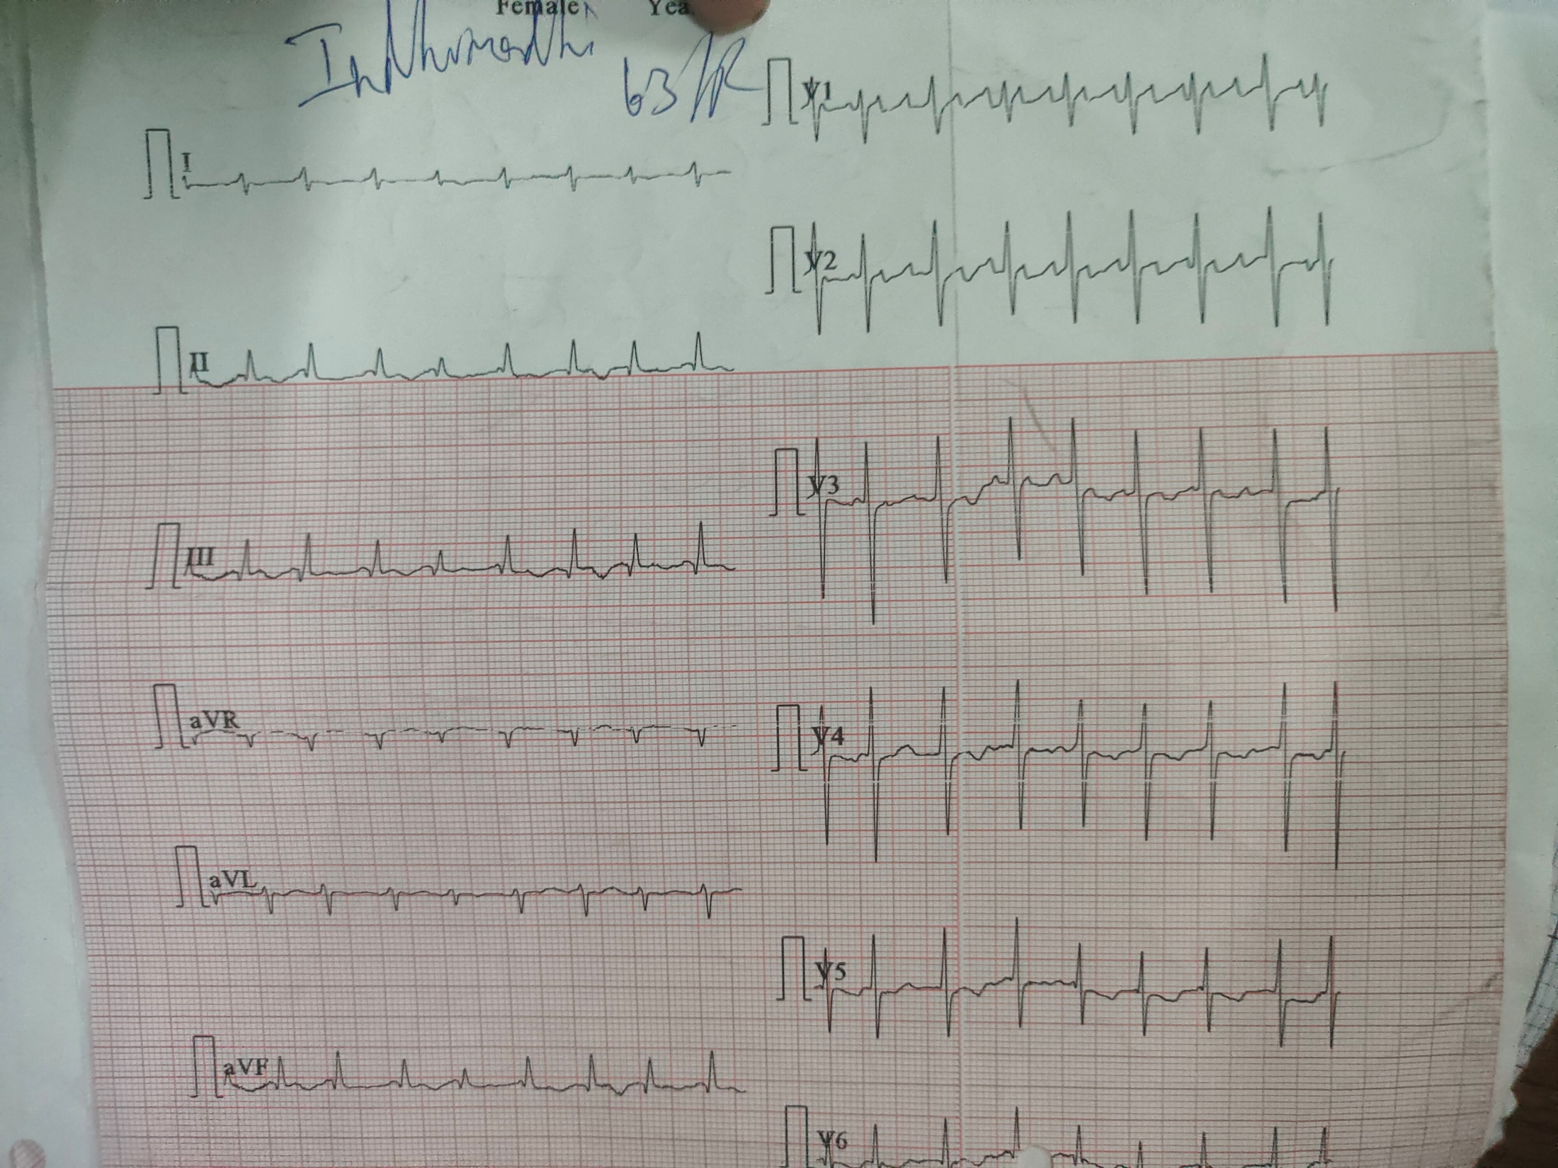

Slide 23
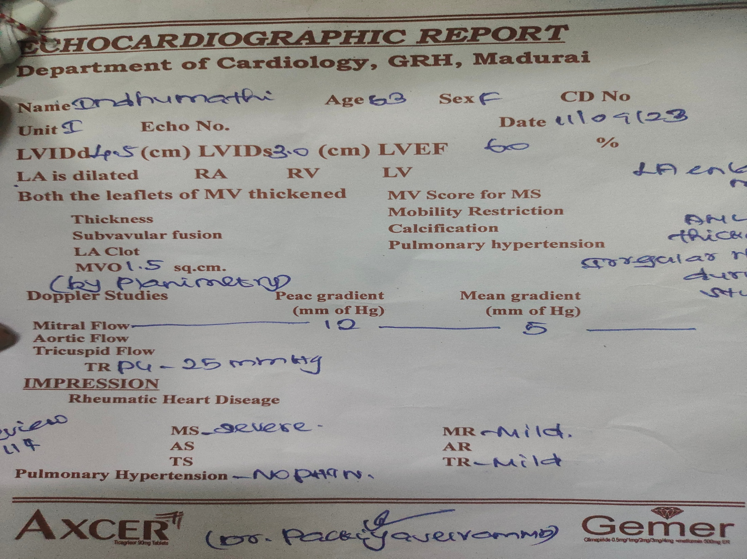

Slide 24
TREATMENT GIVEN:
-Fluid restriction
-Inj Heparin 5000IU IV qid
-Inj Ceftriaxone 1g IV BD
-Tab.Azithromycin 500mg OD
-Tab.Acitrom 2mg OD
-Tab Digoxin 0.25mg OD
-Neb Budecort 12 hrly

