Slide 1
Interesting case from iii mu
CHIEF : Dr.DAVID PRADEEP KUMAR
ASSIT PROFESSORS .
Dr. NASEEMA BANU
Dr. RAM KUMAR
Dr. FAYAZ NABIL

Slide 2
HOPI
34 female with
h/o Left hip pain 10 months with no aggravating and relieving factors
h/o skin lesion after 1 week started as blister, progressed to non healing ulcerated lesion with undermined edges in multiple areas involving Right wrist ,Left forearm ,L FOOT, LEFT ANKLE
H/o weight loss (10 kg) duration 6 months
H/o fever on and off. Low grade , intermittent ,no diurnal variation
No h/o cough with expectoration
No H/O alternate bowel habits
No h/o breathlessness and palpitation
No h/o skin rashes, oral ulcers, hair loss

Slide 3
Past history
Hypothyroid 8 years on Thyroxine 50mcg od.
No T2DM, SHTN, CAD, B asthma.

Slide 4
Investigation outside
Blood count
WBC 5150/c mm | S. Bilirubin 0.69
DC 66/18/6/9 | SGOT 18.2U/L SGPT 15.7 U/L
HB 11.4 g/dl | ALP 99.6IU/L
HCT 36.5 | SERUM PROTEIN 7.41
MCV 76.84fL | ALBUMIN 4.47g/dl
PLT 513000/Ul | GLOBULIN 2.94 g/dl
ANC 3418/c mm(2-7k) | A/G ratio 1.52
ALC 933(1k-3k)
RBC morphology hypochromic and microcytic | Skin biopsy- pyoderma granulosum

Slide 5
USG ABDOMEN AND PELVIS (NOVEMBER 2023)
IMP: Mesenteric thickening with collection of free fluid. Right and left ovary show multiple tiny follicles
MRI LS spine (nov 2023)
Two T1,T2 hypointense with peripheral hyperintense and STIR heterintense lesion in left sacral ala and sacroiliac joint with CT screening showing LYTIC lesion
Moderate amount of free fluid in peritoneal cavity ? neoplastic metastatic lesion.

Slide 6
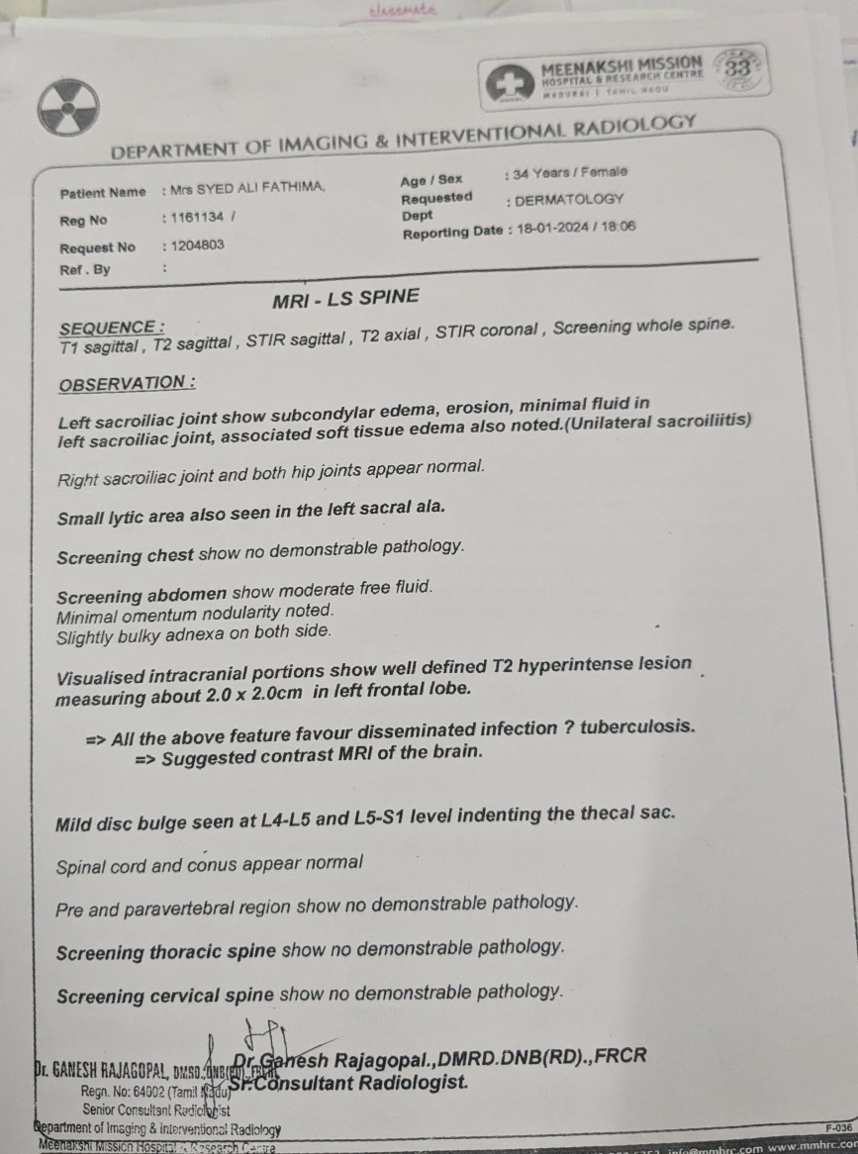
MRI ls spine (jan 2024)

Slide 7
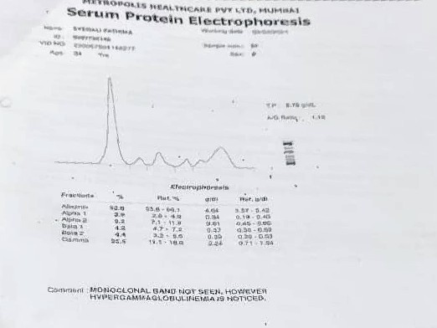
Feb 2024
CEA 1.19 (0-2.5) | Total protein 8.6 g/dl
ANA weak + (1:100) | Albumin 4.07g/dl
HLA B27 –VE | Alpha 1- 0.49 Alpha 2-0.98
ACE 33.90 (12-68) | Beta 1-0.42 Beta 2-0.43
ESR 95mm/hr | Gamma glob 2.24 (high)
CA 125 93.30 (0-35)

Slide 8
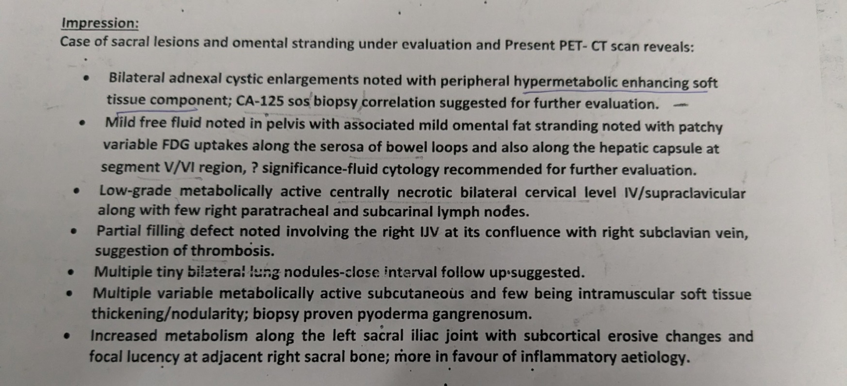
PET SCAN feb 2024

Slide 9
March 2024
CT guided biopsy L sacral bone
Microscopic details: lympocyte, plasma cells and neutrophils in edematous stroma, deep sections with ill defined epitheloid histiocytes.
Definite granuloma not seen. ZN stain for AFB negative
Gene Xpert MTB not detected.
Treated as seronegative spondyloarthritis with sulfasalazine and rivaroxaban for 1week.
Treatment discontinued

Slide 10
Personal history
Mixed diet. Normal bowel and bladder habits
Married at 17 years.
Treated for infertility 6 months before 10 yrs and discontinued.
P1L1
Psychiatric illness since 4 years, not on treatment.
Amenorrhea since April 2024

Slide 11
On examination
Patient comfortable, cooperative
Pale, thin built
No icterus, cyanosis, clubbing, pedal edema
VITALS
BP:100/70 mmHg
PR 102/min
SPO2 98%
Afebrile
SYSTEMIC EXAMINATION
CVS: S1S2, No murmur
RS: BAE, NVBS
P/A :SOFT, LSCS Scar
CNS :conscious, oriented
Muscle bulk decreased
Power 4/5 4/5
4/5 4/5
TONE NORMAL
DTR + +
+ +
B/L PLANTAR FLEXOR
B/L PUPIL 3mm RTL

Slide 12
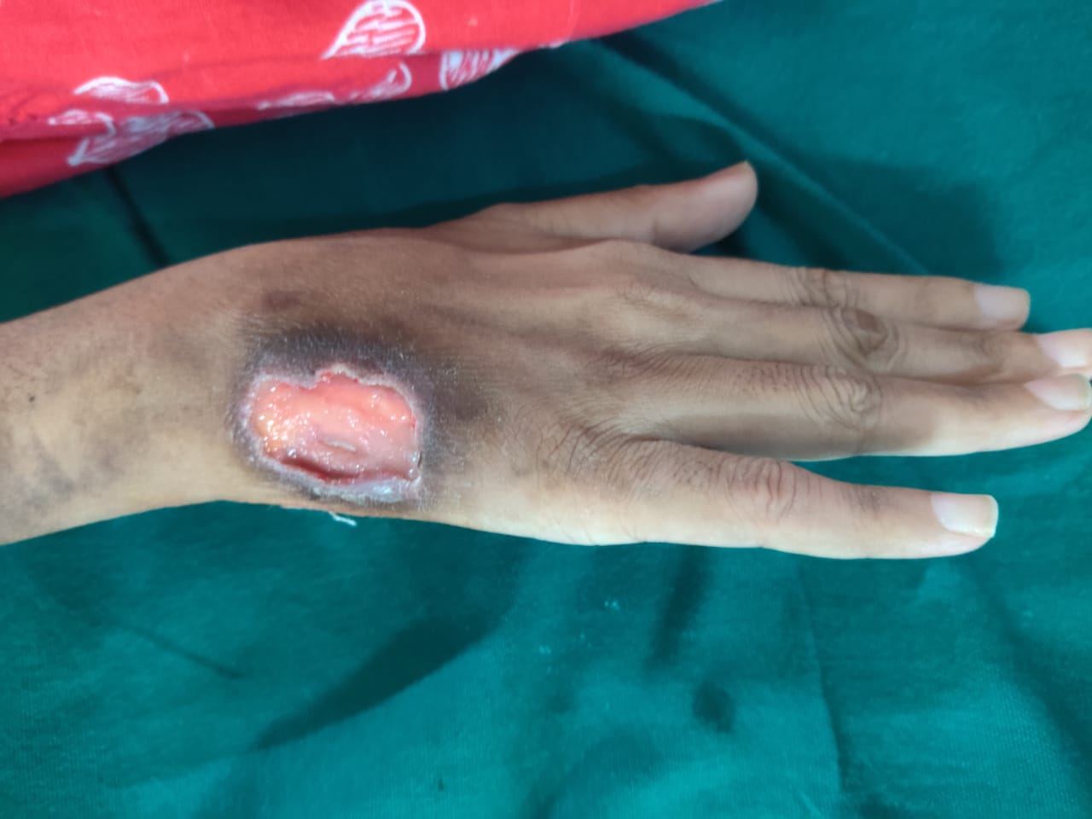
LOCAL EXAMINATION
Multiple skin lesion
Large non healing ulcer in R wrist,L DORSUM OF foot,L SHIN
Healed ulcer with scar in face, both knee,chest

Slide 13
INVESTIGATION DONE IN GRH
T. PROTEIN 7.9 g/dl | VM negative
ALBUMIN 3.3 g/dl | VCTC non reactive
Globulin 4.6 g/dl | ESR 33mm/hr
TSH 4.55 | HCG 0.651 m iu
Sr. cortisol 63.44mcg/dl | Alpha fetoprotein 4.55
Urine routine Sugar nil Albumin nil 0-3 pus cells | Sr. procal 0.176
UPT negative | CRP positive
BLOOD COUNT | OTHERS
WBC 5700/MCL | TOTAL BILIRUBIN 0.4
HB 9.3g/dl | SGOT 57U/L
HCT 30.2 | SGPT 33U/L
PLT 377000 | ALP 91
RBS 97mg/dl | Sr. CAL 7.2
Urea -10mg/dl cr- 0.7 mg/dl | Sr. uric acid 2.1
Sr. Na/K 132/3.6Meq/L | Sr. PO4 2.3
Urine spot Cal 5.3 Creat 75 Protein 147

Slide 14
CSF CULTURES
CSF ANALYSIS
TC 1
DC 1PMN
SUGAR 69
PROTEIN 86
ADA 11.9
Pus culture P mirabilis
Blood culture K pneumoniae
CSF culture Enterococcus species

Slide 15
Radiological investigation
USG ABDOMEN AND PELVIS
Liver increased echoes
Right ovary enlarged echogenic stroma with solid components and vascularity
Left ovary enlarged with predominantly solid
Minimal free fluid in abdomen and pelvis
Diffuse omental thickening and caking
IMP: ? Ovarian malignancy with omental deposits
sugg CA125 and MRI pelvis
CECT THORAX
Centrilobular nodule with tree in bud pattern in both lung fields(UL)
P/O PTB endo bronchial spread

Slide 16
CECT ABDOMEN
Multiple tiny scattered cystic lesion in liver not contrast enchancing p/o simple hepatic cyst
Diffuse mesenteric haziness
All bowel loop shows normal enhancing pattern, no wall thickening noted
SMA,IMA and coeliac arteries normally opacified
PV, HV and SMV normally opacified
BONES: subchondral sclerosis in Left sacroiliac joint ? sacroiliitis

Slide 17
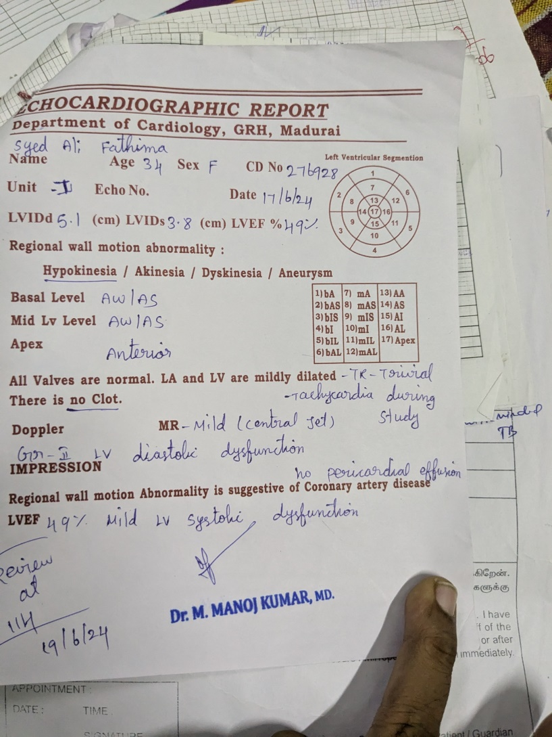
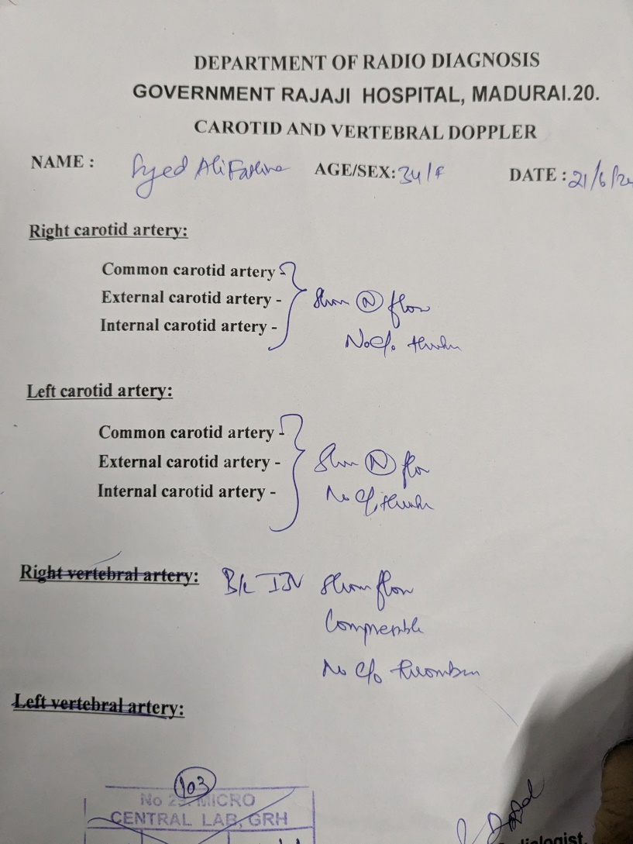
ECHO AND dOPPLER

Slide 18
Bone marrow reports
ASPIRATION
Peripheral smear - hypochromic microcytic anemia with mild neutrophilia
Bone marrow aspiration - myeloid hyperplasia
No granuloma or infiltrates
BIOPSY
Normocelluar marrow with normal erythroid, myeloid precursor and megakaryocyte. Focally vague granulomas noted formed by epitheloid histiocytes and langhans type giant cell
IMPRESSION
BM biopsy - focal granulomatous inflammation

Slide 19
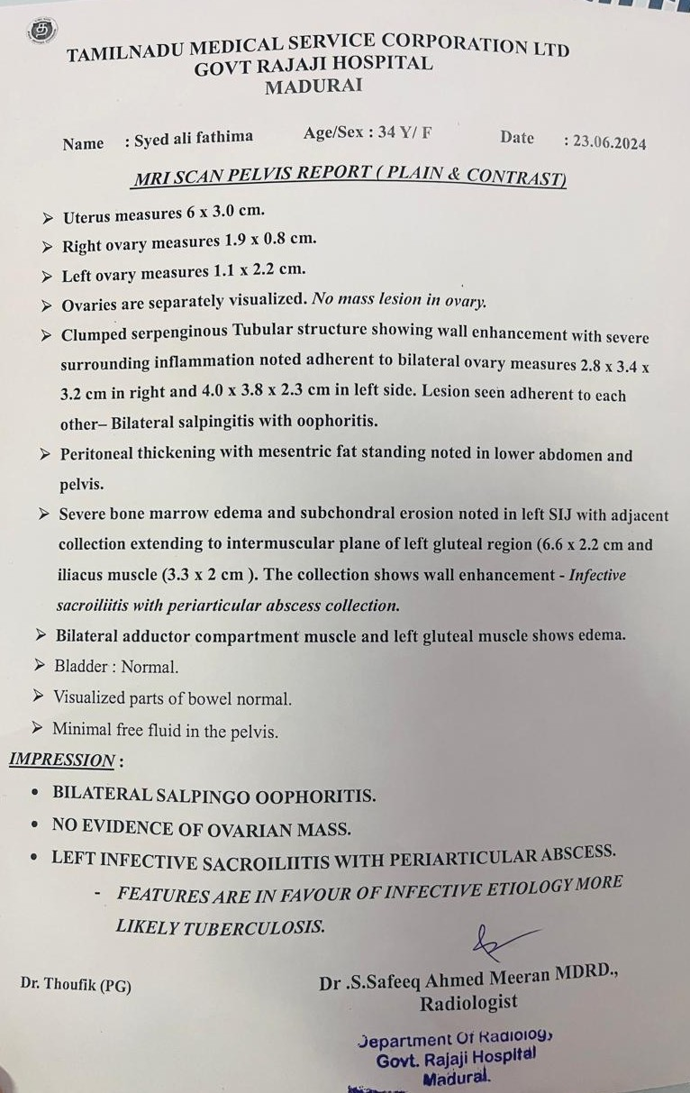
MRI PELVIS WITH CONTRAST

Slide 20
CBNAAT Ascitic fluid – NEGATIVE
CBNAAT CSF – NEGATIVE
SKIN LESION AFB – NEGATIVE
BONE MARROW GENE XPERT- MTB NOT DETECTED

Slide 21
LETS DISCUSS

