Slide 1
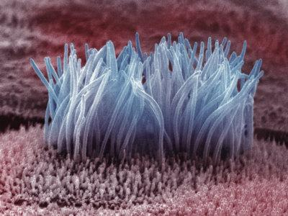
A case of immotile cilia syndrome
Prof. DR. M.NATARAJAN MD
DR.SYED BAHAVUDEEN HUSSAINI MD DNB
DR. VALLI DEVI MD
Presentor; P. Muthukrishnan

Slide 2
COMPLAINTS
42 year old male came with complaints of cough with expectoration 1 month
HISTORY OF PRESENTING COMPLAINTS
h/o cough with expectoration 1 month
around 50 ml/day
sputum-yellowish
not foul smelling
not blood stained
no diurnal, postural variation
h/o dyspnoea for 15 days
insidious, progressive
MMRC class 2

Slide 3
No h/o haemoptysis
No h/o PND, trepopnoea
No h/o chest pain
No h/o fever
No h/o seizure
No h/o abdominal pain
No h/o abdominal distension
No h/o headache

Slide 4
Past history
Not a known case of DM/SHTN/TB/ASTHMA/CAD/ SEIZURE/ HYPOTHYROIDISIM
He had recurrent documented URI and LRI since 10 years of age
No h/o viral exanthem fever in childhood
Family history
no h/o similar illness in family members

Slide 5
PERSONAL HISTORY Auto driver by occupation occasional smoker and alcoholic
Married since 10 years
Pt was evaluated for infertility
Pt was found to have persistent azoospermia
(Semen analysis done in (2009 , 2012)
No h/o erectile dysfunction
No h/o dyspareunia
Early morning erection +
Ejaculatory volume 2 ml

Slide 6
Wife : pituitary micro adenoma / hypothyroidism on tab.cabergoline 0.25mg twice/ weekly and thyroxine 150mcg od
a single spindle shape uterus -unicornuate,
single fallopian tube in right side-
PCOD in right ovary

Slide 7
GENERAL EXAMINATION
Conscious
Oriented
Afebrile
No pallor
No icterus
Pan digital painless clubbing
No cyanosis
No pedal edema
No generalized lymphadenopathy

Slide 8
vitals
Pulse rate :82/mint regular
Blood pressure : 110/80 mmhg
Respiratory rate:18/min
Spo2; 97 at room air

Slide 9
RESPIRATORY examination
Examination of upper respiratory system
No DNS
No nasal polyps
No sinus tenderness
No halitosis, no tonsillar enlargement
Respiratory system -proper
trachea in mid line
No dropping of shoulder
respiratory movement equal on both sides
no scar and sinus

Slide 10
Tactile fremitus in left infra scapular area
No friction fremitus
Percussion
resonant note all over lung field
Auscultation
coarse leathery crackles in bilateral infra scapular infra axillary , inter scapular ,axillary area

Slide 11
CVS
Apical impulse: left 5 th ics 1cm medial to mcl
S1S2+, no murmur
Abdomen
no organomegaly, no free fluid
External genitalia
Both testis normal in size
Hernial orifices free
Central nervous system
no focal neurological deficit

Slide 12
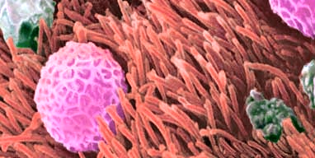
diagnosis
Bilateral lower lobe bronchiectasis
Azoospermia
?obstructive
To r/o immotile cilia syndrome

Slide 13
Treatment given
Inj; ceftriaxone 1g iv bd
T. azithromycin 500mg 1 od
T. ranitidine 150mg 1 bd
Chest physiotherapy

Slide 14
INVESTIGTION
HB-14 g/dl
TC-8800cells/cu.mm
DC-Neutrophils-68%, lymphocytes-20% mixed-12%
PCV-39%
PLATELET-1.35 lakhs
ESR-47mm/hour
Urine albumin ; nil
sugar ; nil , no deposits

Slide 15
RBS-96 mg/dl
UREA-30mg/dl
CREATININE-1.4mg/dl
Total bilirubin – 0.9 mg/dl
direct;0,5mg/dl
indirect;0.4mg/dl
SGOT;35u/l
SGPT; 44u/l

Slide 16
HIV 1 and HIV 2 – non reactive
HBsAg -negative
HCV- negative
VDRL – negative
Sccharin test: 34 min

Slide 17
ECG; WITHIN NORMAL LIMIT
ECHO; normal study
CT chest ;
bilateral bronchiectasis
X ray PNS
normal

Slide 19
USG abdomen and pelvis ; normal
USG SCROTUM;
right testis 2.3 x 2.1 x 1.2cm normal in size and echos
left testis 2.8 x2.7 x1.3 cm normal in size and echos
b/l epididymis normal size and echoes

Slide 20
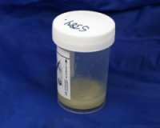
Sputum
Sputum AFB negative
Gene xpert negative
Sputum culture and sensitivity
klebsiella pneumoniae grown
sensitive to amikacin, piptaz,co trimoxazole

Slide 21
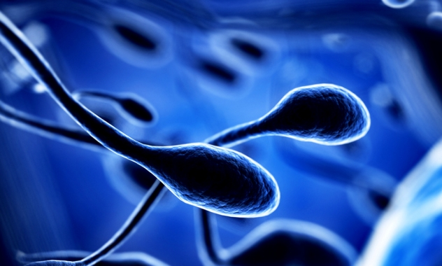
Semen analysis
amount; 2ml
alkaline
sperm; nil
Moderate viscoscity

Slide 22
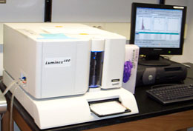
HORMONAL PROFILE
TSH;0.93 HIU/ml (0.3-5.5)
FREE T4;1.76ng/gl (0.89-1.72)
LH; 6.4 mlu/ml (1.1 -25)
FSH; 13.29 mlu/ml (1.5-11.3)
PROLACTIN; 6.73ng/dl (2.6-16.4)
TESTOSTERONE; 719.15ng/dl (220-1050)

Slide 23
Expert Opinion
Thoracic medicine
sputum AFB NEGATINE
iv antibiotics
chest physiotherapy
PFT-very severe obstruction
ENDOCRINOLOGY
?non obstructive azoospermia
urology opinion
ICSI,TESE, for fertility issue

Slide 24
Urology opinion
testicular biopsy
ENT opinion
no evidence of chronic sinusitis

Slide 25
Aim of presentation
Rarity of case
Investigate for infertility in relevant bronchiectasis cases
To highlight various methods of in vitro fertilization in azoospermia

