Slide 1
MTP
I MEDICAL UNIT
CHIEF & HOD:
PROF. DR . M. NATARAJAN M.D.
ASSISTANT PROFESSORS:
DR . V. PALANI KUMARAN M.D. , D.DIAB
DR . D. VASANTHA KALYANI M.D. , D.C.P.
DR. M. SURESH KUMAR M.D.
PRESENTOR:
DR. A. KISHORE

Slide 2
A 41 year old male came to GRH Madurai with
- C/O epistaxis for 2 days

Slide 3
HOPI
A 41 year old male initially came to GRH Madurai with C/O inability to retract the foreskin of penis and underwent circumcision in a private hospital outside and biopsy of was sent. (January 2024)
Histopathology report showed Squamous cell carcinoma following which he was admitted outside and partial penectomy was done(16/1/2024)
HPE showed Squamous cell carcinoma and was on follow-up when he developed inguinal lymphadenopathy
Left inguinal node FNAC showed SCC deposits (March 2024)
Following which he was admitted and found to have thrombocytopenia and complaints of epistaxis after a week of admission(March 2024)
after which the patient was taken over by General Medicine department

Slide 4
HOPI
No h/o fever/arthralgia/myalgia
No h/o drug intake
No h/o any other bleeding manifestations
No h/o loose stools
No h/o abdominal distension
No h/o easy fatiguability/recurrent infections

Slide 5
PAST HISTORY
Not an known case of T2DM/SHTN/BA/CAD/SEIZURE DISORDER/THYROID DISORDER
No h/o previous blood transfusion
No h/o any native medicine intake
PERSONAL HISTORY
Mixed diet
Normal bowel and bladder habits
Alcoholic and smoker for past 8 years (last drink 2 years ago)
No h/o high risk sexual behaviours
TRATMENT HISTORY
No significant drug history
No h/o any recent vaccination

Slide 6
GENERAL EXAMINATION
O/E
Pt conscious
oriented
afebrile
no pallor not icteric
no cyanosis
no clubbing
no pedal edema
no petechia/purpura/ecchymosis
bilateral inguinal lymphadenopathy+

Slide 7
SYSTEMIC EXAMINATION
CVS : S1S2+
No murmur
RS : BAE+
No added sounds
P/A : Soft
BS+
No organomegaly
CNS: NFND

Slide 8
INVESTIGATIONS
TC | 13800 | 12600 | 23100 | 25800 | 17300
Hb | 13.4 | 13.4 | 12.2 | 12.8 | 12.5
HCT | 39 | 37.6 | 32.7 | 34.1 | 33.5
Platelet | 10000 | 15000 | 39000 | 60000 | 74000

Slide 9
INVESTIGATIONS
RBS- 110
Urea-16
Cr- 1.0
TB-0.8
Dir-0.5
Ind-0.3
OT-45
PT-38
ALP-89
Urine albumin and sugar- nil
urine RBCs-, no casts

Slide 10
INVESTIGATIONS
PT-12.8
INR-1.1
APTT-28.1
ANA by IF-Negative
VCTC-Non reactive
Viral markers-Negative
IPF-22(Normal 1.1 – 6.1), MPV 9.5 fL, PCT 0.05%
VDRL- negative
TPHA- negative
Fundus- Normal
DCT- Negative

Slide 11
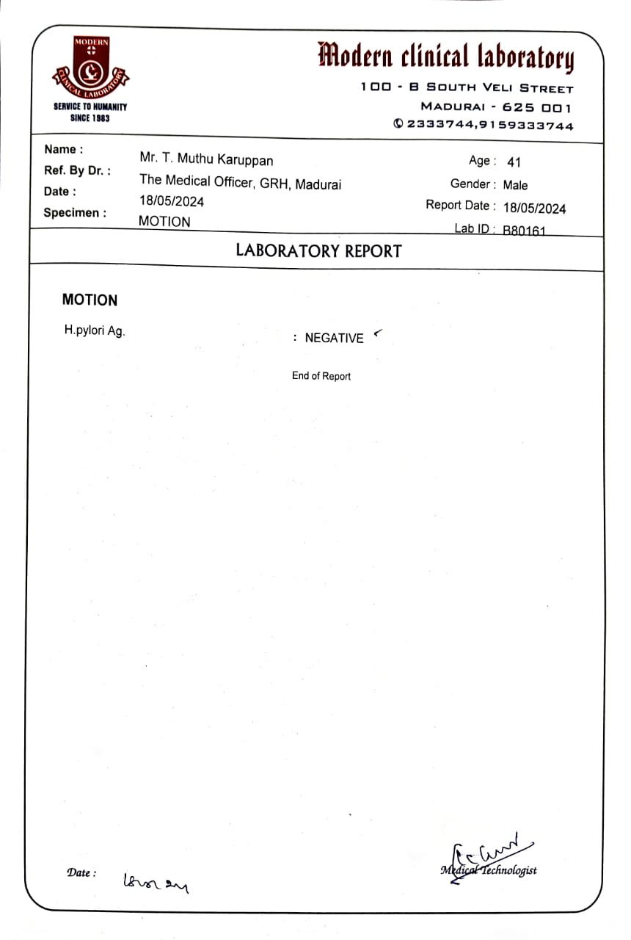

Slide 12
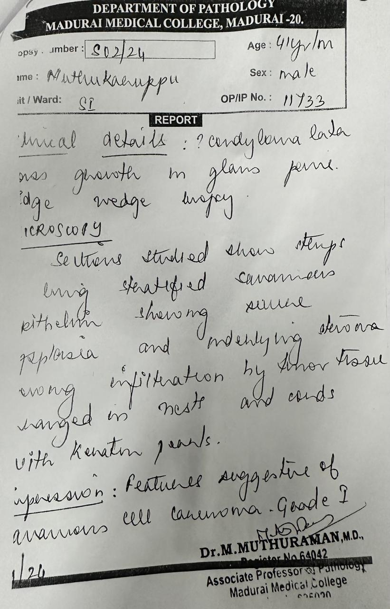
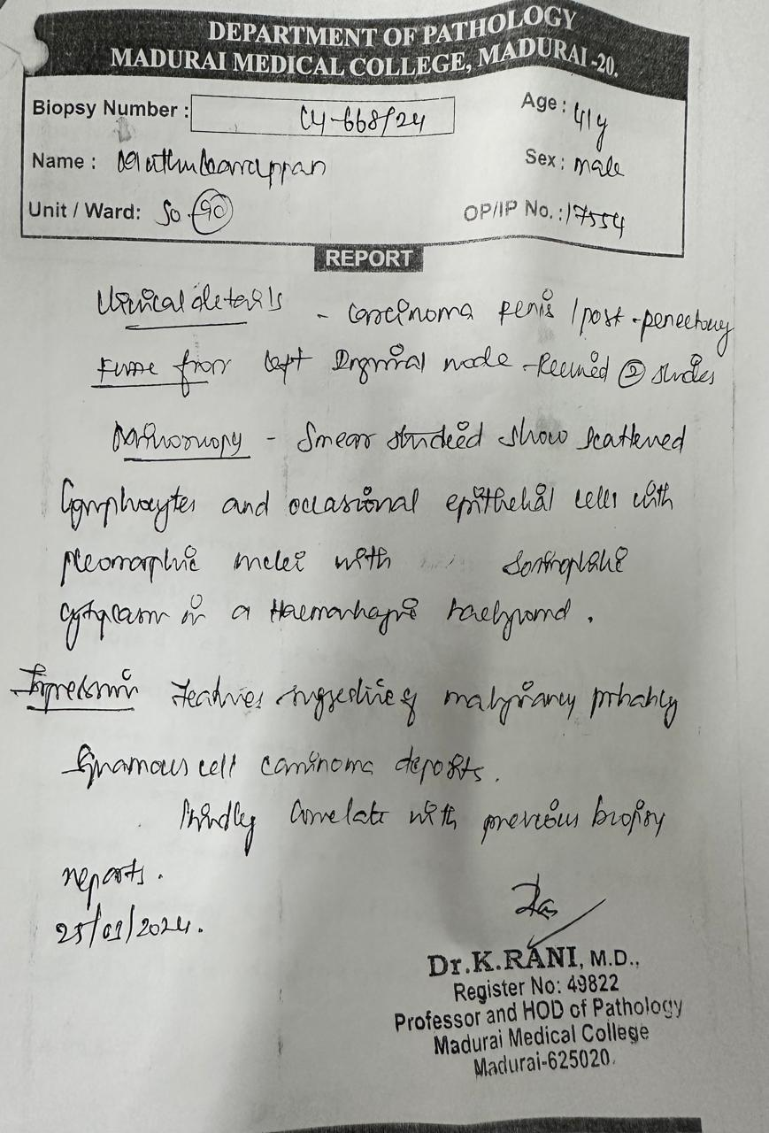
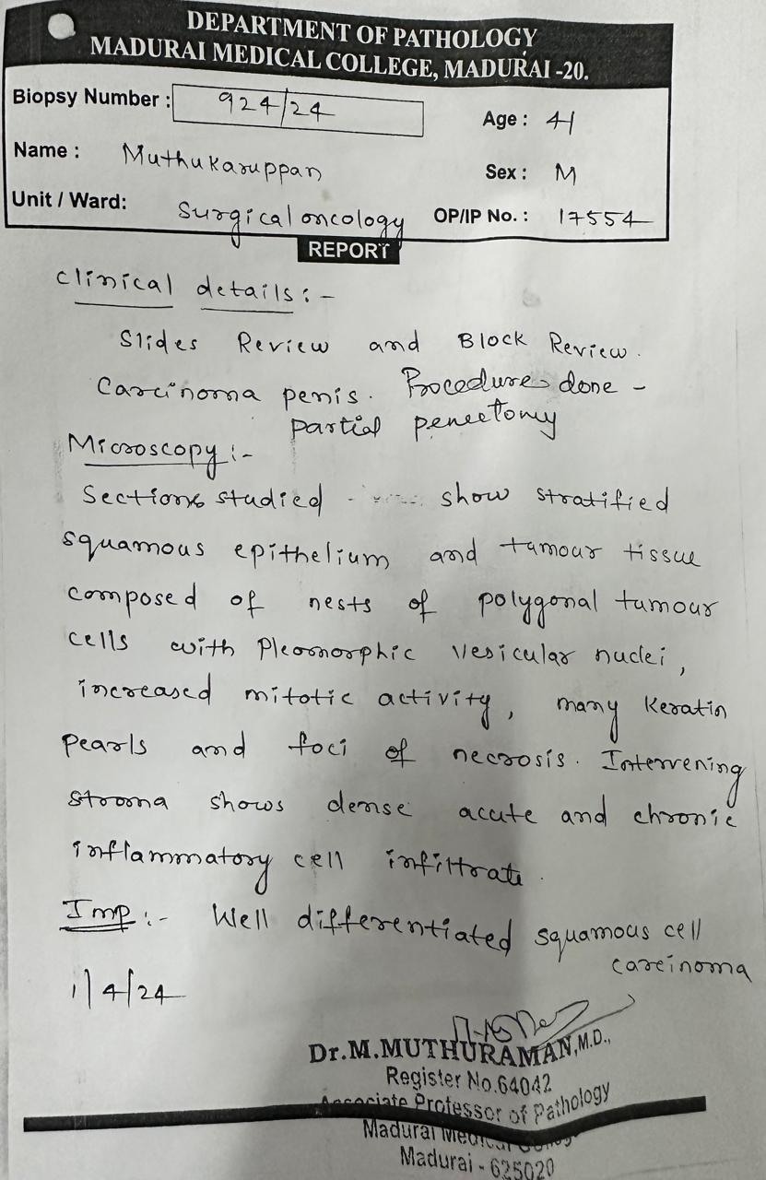

Slide 13
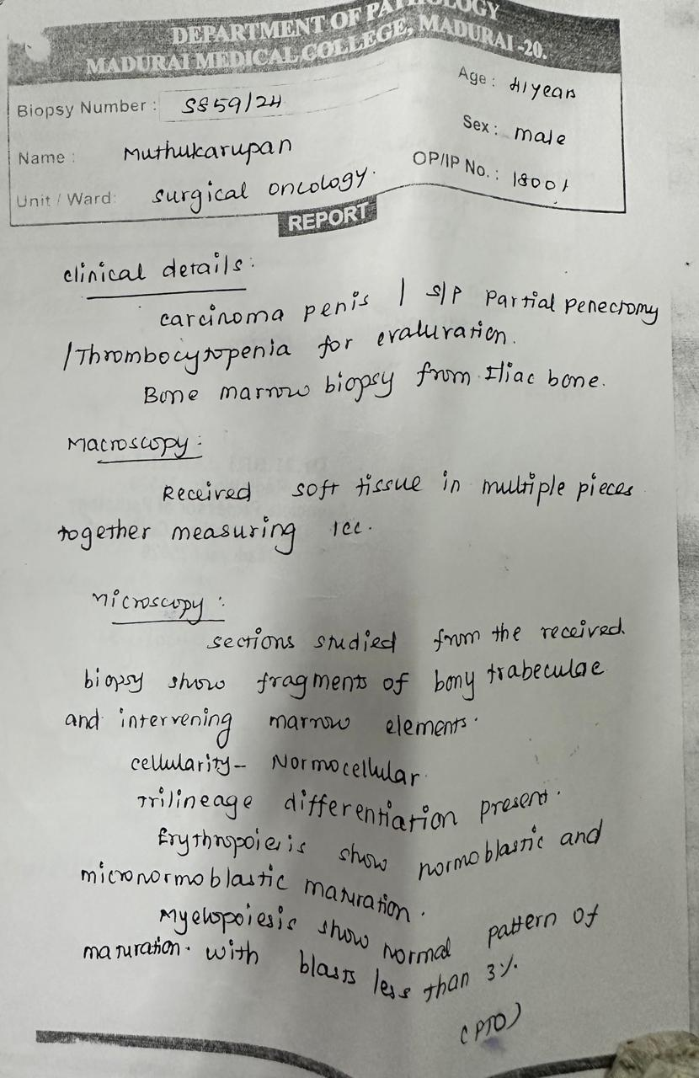
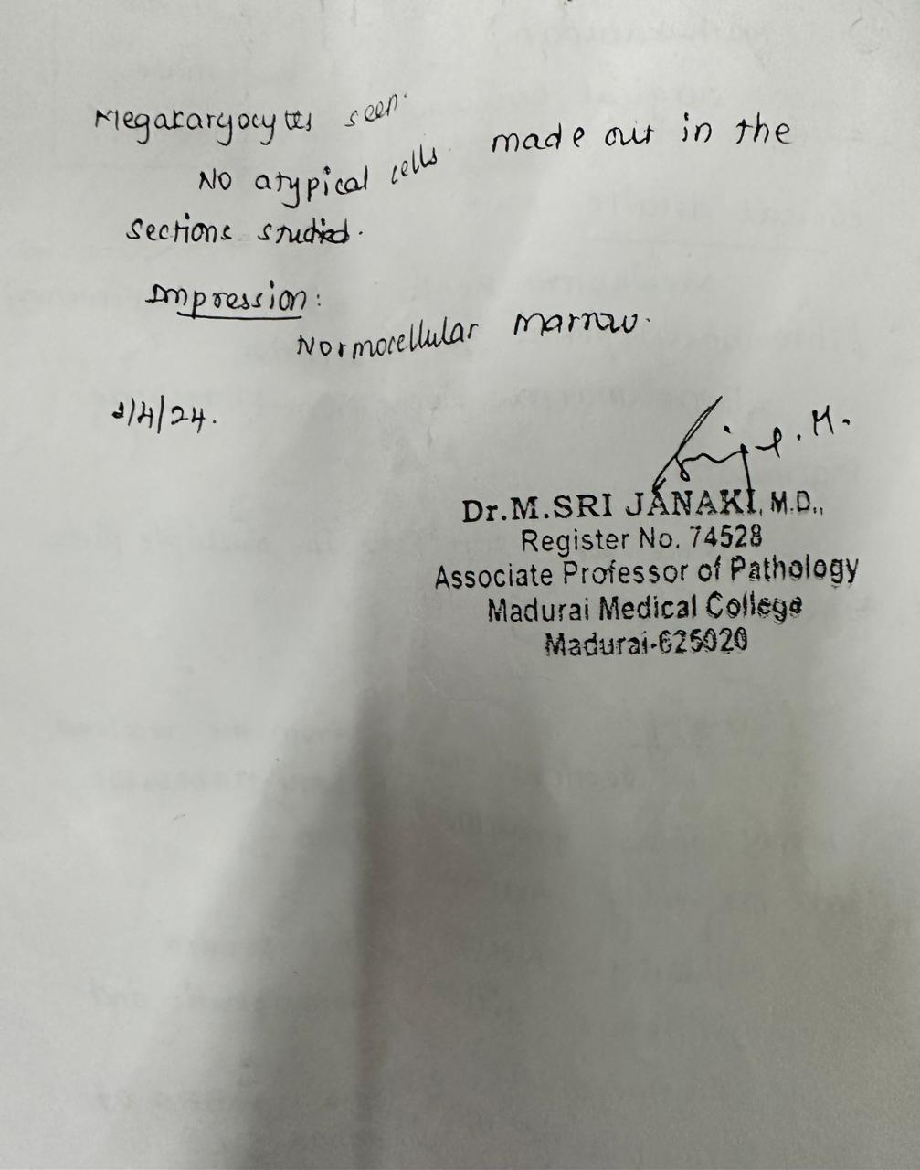

Slide 14
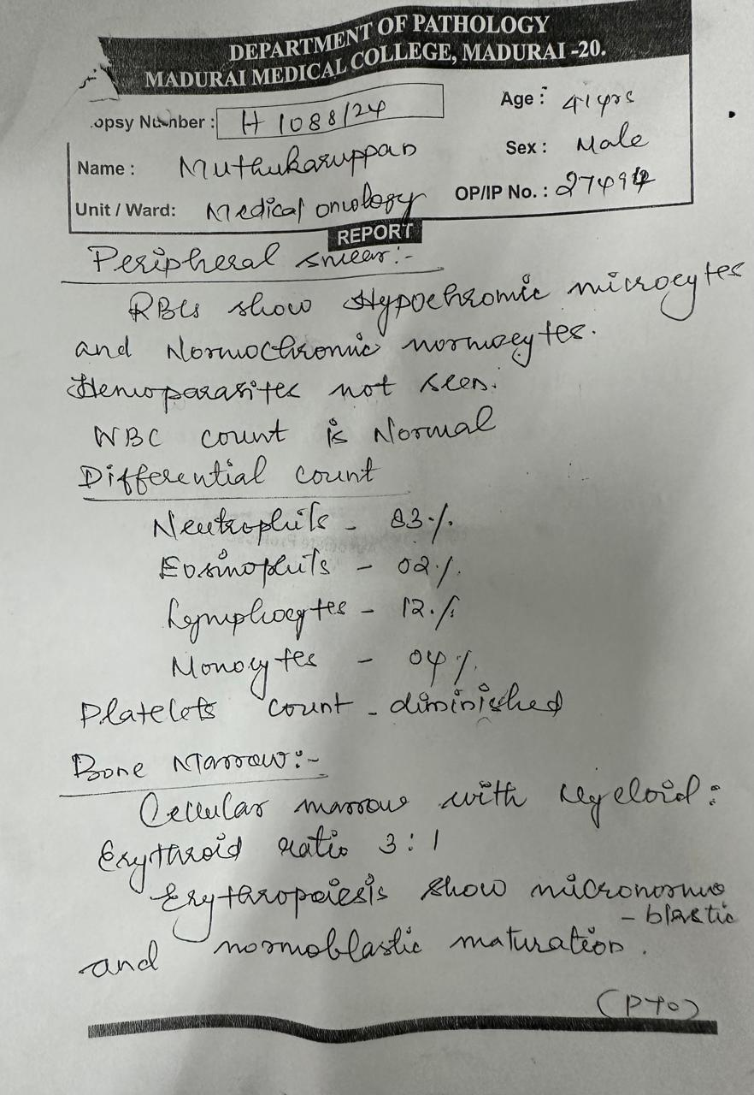
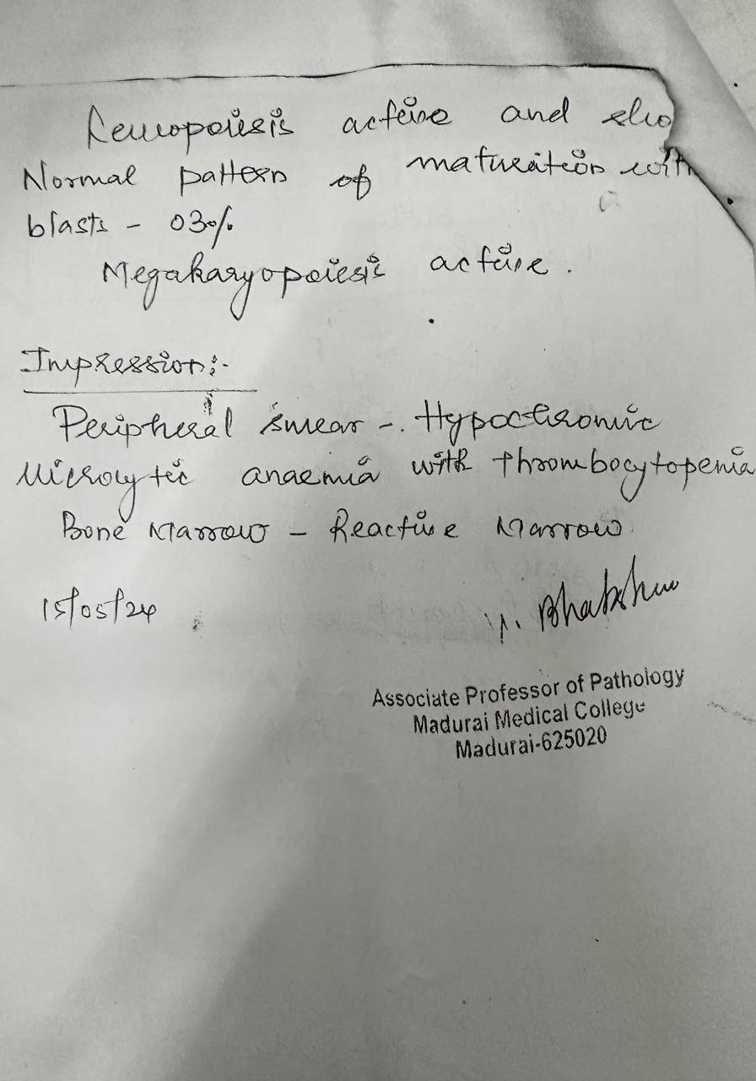

Slide 15
