Slide 1
HYPOTHERMIA
By 3 rd medical unit
Chief.Prof.Dr.S.Peer Mohamed M.D
Assistant professors
Dr.M.Satheesh kumar M.D
Dr.C.Vignesh M.D
Dr.V.P.Priya M.D

Slide 2
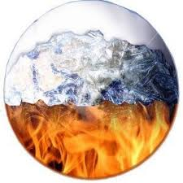
HYPOTHERMIA

Slide 3
HYPOTHERMIA
Definition:
Core temperature ≤ 35°C
Mild hypothermia: 32-35°C
Moderate hypothermia: 28-32°C
Severe hypothermia: < 28°C
Notes:
Hypothermia is defined as core body temperature ≤ 35°C (≤ 95°F).
It can be further classified by severity: mild/moderate/severe

Slide 4
PATHOPHYSIOLOGY
32–35°C : ↓ neural function, ineffective shivering.
<32°C : ↓ metabolism/ventilation, shivering ceases.
After drop risk(continuous decrease of core temperature): peripheral vasodilation → core temp ↓ → arrhythmias.
The hypothalamus receives input from central and peripheral thermal receptors.
In response to a cold stress, the hypothalamus attempts to stimulate heat production through shivering and increased thyroid, catecholamine, and adrenal activity.

Slide 5
PATHOPHYSIOLOGY
Sympathetically mediated vasoconstriction minimizes heat loss by reducing blood flow to peripheral tissues, where cooling is greatest.
Peripheral blood vessels also vasoconstrict in direct response to cold. During removal from cold environment or rewarming, increased perfusion of cold extremities occurring from peripheral vasodilation can cause core temperature after drop and ventricular arrythmias.

Slide 6
RISK FACTORS
Substance use (ethanol/opioids) → ↓ awareness
Homelessness → ↓ shelter access
Psychiatric illness → ↓ cold recognition
Older adults → ↓ physiologic reserve + social isolation
Key vulnerabilities in elderly - chronic diseases, malnutrition - medications impairing thermoregulation
Outdoor work (exposure)
Excessive alcohol

Slide 7
Hypothermia causes
Environmental causes - outdoor exposure (Immersion, inadequate clothing). - Substance use (↓ awareness, vasodilation). - Homelessness, older age, psychiatric illness.
Secondary (non-environmental) causes
Endocrine/metabolic: - hypothyroidism, adrenal insufficiency, hypoglycemia, thiamine deficiency.
Infectious/systemic: - sepsis (hypothermia may be the only sign in elderly). - Malnutrition (↓ metabolic heat production).
Neurologic: - spinal cord injury, neuromuscular disease, CNS infection.
Toxins/medications: - alcohol, carbon monoxide, opioids, sedatives, beta-blockers.
Notes:
As we learned above, the mortality rate is related more to the cause of the hypothermia and less to the degree of temperature depression.
The most common cause of hypothermia is prolonged exposure to cold water or air.
Immersion in cold water causes the most rapid fall in body temperature. This is due to conductive heat loss. Death occurs in 15 minutes in water at 0°C (32°F) but significant hypothermia can occur even in water at 21°C (70°F).
Struggling or swimming movements increase blood flow to the extremities and hasten hypothermia’s onset.
Exposure to extremely cold air is an obvious cause of hypothermia. This is due to convective heat loss to cold air.
However, realize that wet or windy conditions hasten heat loss and can precipitate hypothermia even in warm climates. An example is a trauma victim found unconscious and immobile on a wet, windy summer’s day.
In addition to hypothermia due to environmental exposure, many medical conditions can result in hypothermia.
Sometimes the cause is iatrogenic, such as the trauma patient who is fully exposed during the resuscitation and never covered up, or the patient given infusions of cold fluids.

Slide 8
Clinical Manifestation of Hypothermia
Mild (32º - 35ºC) | Hyperventilation ,CNS depression Increased metabolic rate Tachypnea ,Tachycardia Shivering thermogenesis Dysarthria, amnesia, ataxia, apathy
Moderate (28º - 32ºC) | Further CNS and vital sign depression Loss of shivering Arrhythmias common, QT prolonged, J waves Inability to rewarm spontaneously Cold diuresis
Severe (< 28ºC) | Comatose and areflexic Profoundly depressed vitals Little respiratory stimulation

Slide 9
Labaratory Investigations
Arterial blood gas | Metabolic acidosis, respiratory alkalosis, or both
Glucose Increased, decreased, or no change | Decreased due to splenic sequestration
Hemoglobin , hematocrit | Increased due to hemoconcentration
Lipase | May be increased due to hypothermia-induced pancreatitis
Prothrombin and partial thromboplastin times | Increased in vivo due to inhibition of coagulation cascade, despite normal reported values
Electrocardiogram | Prolongation of PR, QRS, QT intervals ST segment elevation T wave inversions; Osborn J wave Atrial fibrillation or sinus bradycardia
Chest radiograph | Aspiration pneumonia, vascular congestion, pulmonary edema

Slide 10
ECG

Slide 11
HYPOTHERMIA TREATMENT LEVELS
Mild hypothermia
Passive external rewarming (PER)
Remove wet clothing, cover with warm blankets, keep room temperature at approx. 28°C.
Provide active external rewarming, with forced air warming systems if available.
Warmed blankets, heating pads, radiant heat sources can also be used. Avoid burning skin.

Slide 13
Moderate hypothermia
Provide active external rewarming.
Give warmed iv fluids (40 to 42°c) and warmed humidified oxygen as adjuncts (these are not primary rewarming methods).
Beware of after drop , a drop in core temperature caused by return of cold blood from the extremities to the core circulation.
Rewarm trunk first to minimize afterdrop.

Slide 15
Severe hypothermia:
ACTIVE EXTERNAL REWARMING AND ACTIVE INTERNAL REWARMING (active core rewarming).
Perform interventions for moderate hypothermia.
For hemodynamically stable patients, rewarm with endovascular temperature catheter whenever available.
For hemodynamically unstable patients, rewarm with Extracorporeal membranous oxygenation (preferred approach) or Cardiopulmonary bypass if possible.
If ECMO or CPB not available, can perform continuous veno-venous rewarming, hemodialysis, continuous arterio-venous rewarming.
If other interventions unavailable, may perform peritoneal or pleural irrigation with warmed, isotonic saline (40 to 42°c)

Slide 17
TREATMENT OF ARRYTHMIAS IN HYPOTHERMIC INDIVIDUALS
Initiate CPR in all patients with cardiac arrest; do not perform chest compressions if an organized rhythm is present on the cardiac monitor.
Arrhythmias may persist until patient rewarmed. Ignore atrial arrhythmias with slow ventricular response.
Ventricular fibrillation is common rhythm – electrical defibrillation may be attempted up to three times but then withheld until core temperature is above 30°c.
In a patient with a core temperature <30°c, do not administer ACLS medications
After the patient is rewarmed to 30°c ,double the epinephrine interval as compared with normothermia (every 6 to 10 minutes), and then resume normal intervals when the temperature is ≥35°c.

Slide 18
What is Frostbite?
Most common freezing injury of tissues
Actual freezing of a body part occurs when the temperature of the body part falls below the freezing point of body tissue (about minus 4ºc or 25ºf)
Irreversible tissue damage depends on the extent and duration of freezing at the tissue level
Ice crystal formation damages cells
Stasis progressing to microvascular thrombosis

Slide 19
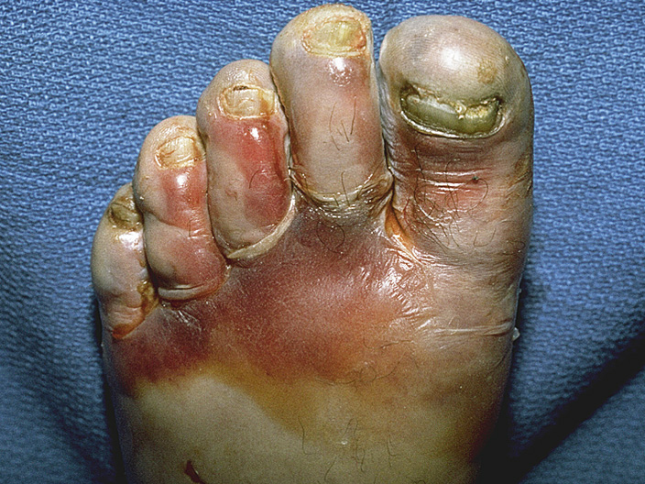
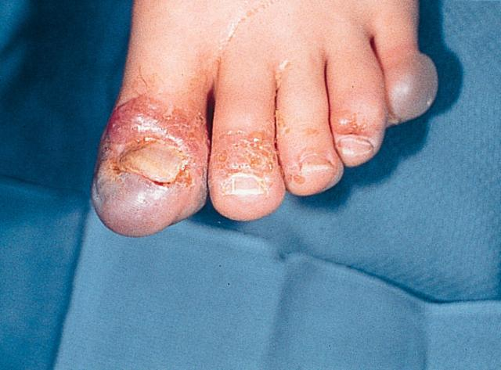
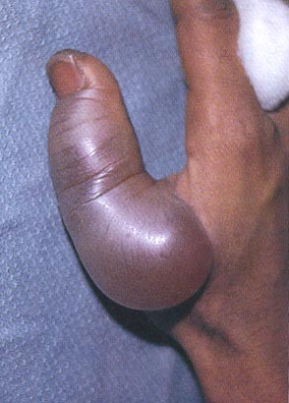
FROSTBITE

Slide 20
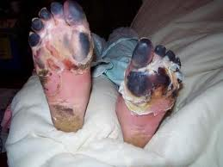
Trench foot (Immersion foot)
Prolonged exposure to wet cold above freezing
Feet are edematous, cold, cyanotic
Liquefaction gangrene more common than with frostbite

