Slide 1
THE SEDATED SA NODE
1st MEDICAL UNIT
CHIEF :DR.M.NATARAJAN M.D
ASST.PROF: DR.P.S.VALLIDEVI M.D
DR.SHRIDHARAN M.D
DR.VASANTHA KALYANI M.D.DCP
PRESENTOR :DR ELANGOVAN 1st YR PG

Slide 2
HISTORY
37 yrs old male patient brought to the hospital with alleged h/o tablet poisoning (tab.alprazolam 0.5 mg) around 10 tablets.
h/o giddiness +
No h/o chest pain
No h/o palpitation
No h/o dyspnea
No h/o syncope
No h/o vomiting

Slide 3
No h/o seizuers
No h/o altered sensorium
No h/o headche
No h/o blurring of vision
Past history :
pt k/c of diabetes melitus- type 2 past one year under treatment
Not a k/c of htn ,tb ,bronchial asthma,epilepsy,thyroid problem.

Slide 4
Personal history :
mixed diet , not an alcoholic & smoker
General examination :
pt conscious
Oriented
afebrile
no pallor
not icteric
no cyanosis ,no clubbing,no pedal edema ,no lymphadenopathy

Slide 5
vitals :
BP-100/60 mm hg supine position,
PR -90/mint
SPO2-98 %in RA
systemic examination
cvs –s1 s2 + no murmur
RS – BAE +
P/A – soft ,bs +
CNS-NFND

Slide 6
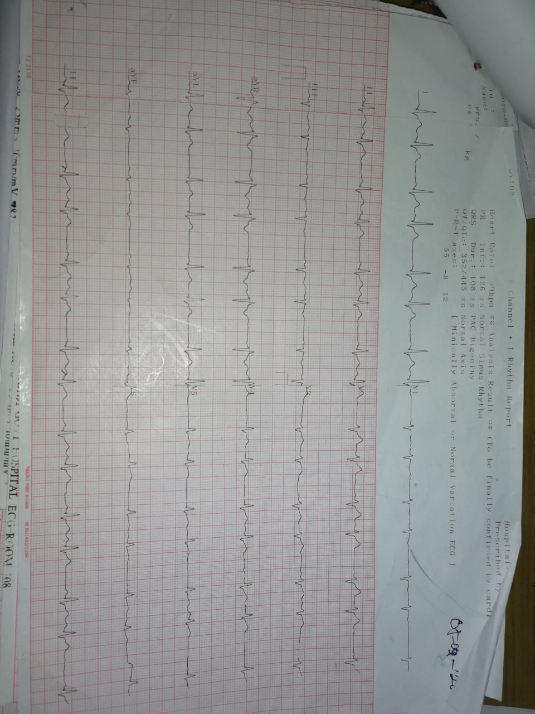

Slide 7
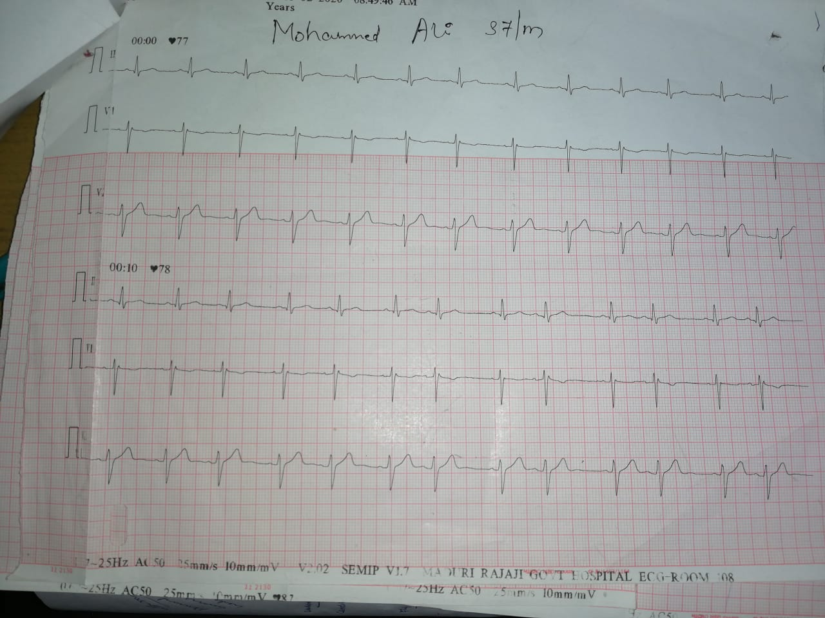

Slide 8
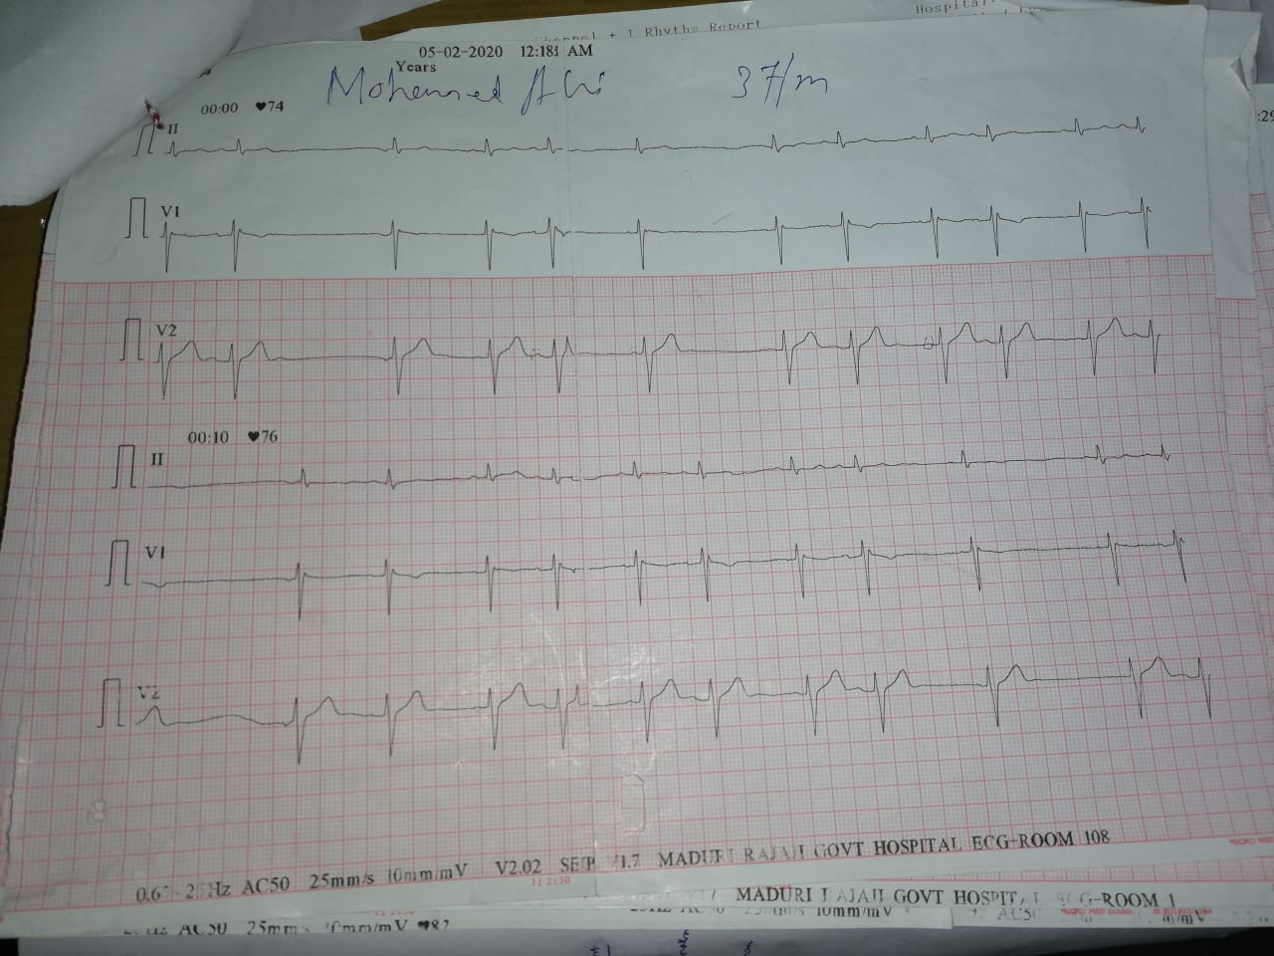

Slide 9
AN INTERESTING ECG FOR DISCUSSION

Slide 10
45 yrs old male came with complaints of
dyspnea for 2 days[ grade II acc to nyha ]
h/o chest pain +
h/o dizziness +
h/o palpitaion +
No h/o syncope
No other significant compliants

Slide 11
Past history :
pt k/c of RHD /MS past 10 yrs under treatment
No other co morbid illness
General examination :
pt conscious ,oriented,afebrile,no pallor ,no icterus ,no clubbing,no cyanosis,mild pedal edema,no lymphadenopathy

Slide 12
Vitals : bp- 110/70 mm hg supine position
PR -128/min HR 143/min ,pulse deficit -15
JVP – ‘a’ wave seen
S/E :
CVS –s1 s2 +, MDM + ,loud p2 +
RS – BAE +
P/A –SOFT
CNS -NFND

Slide 13
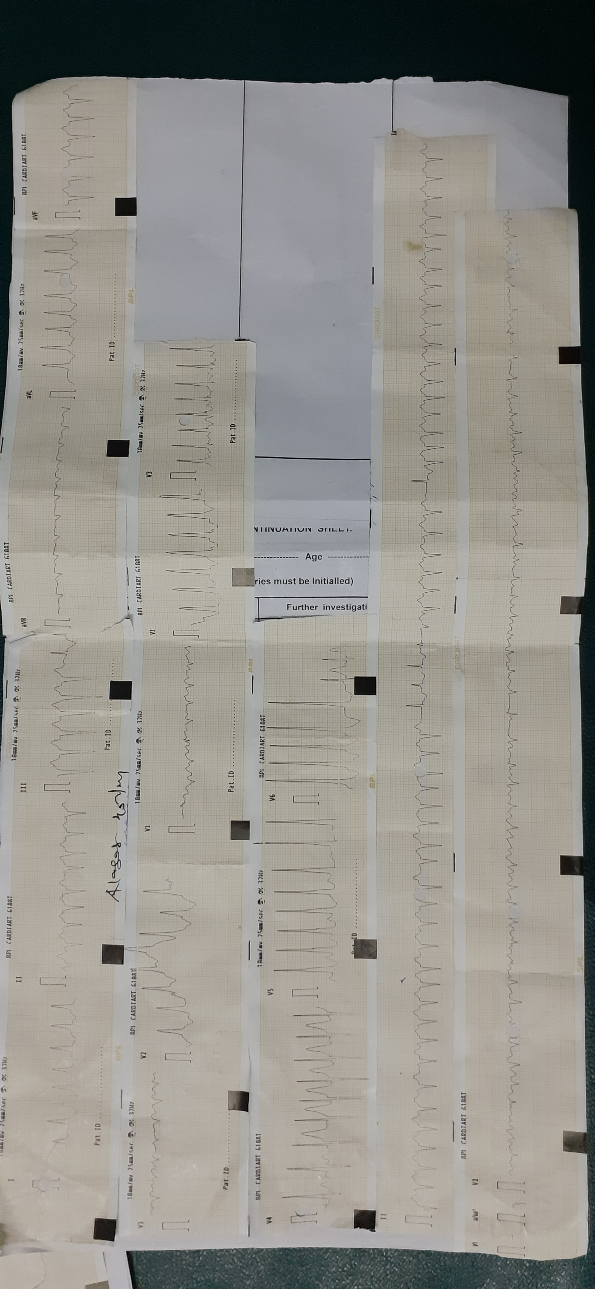

Slide 14
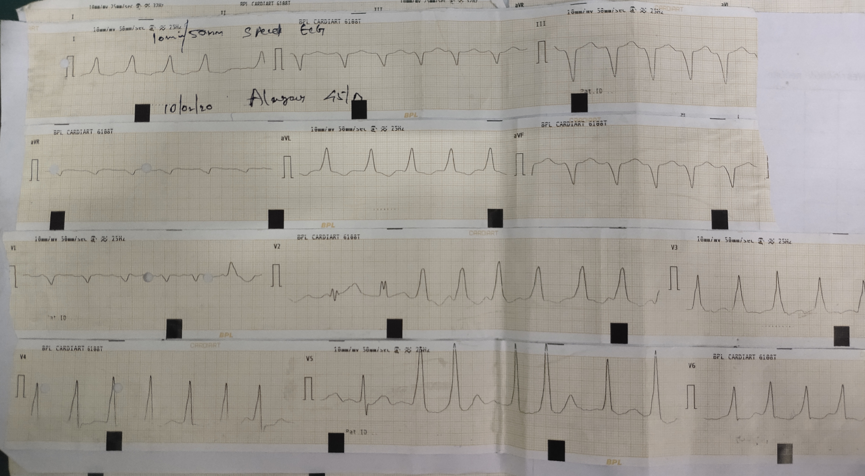

Slide 15
THANK YOU

