Slide 1
METABOLIC SYNDROME
- A Modern Health challenge
Chief
Dr M Rajkumar MD
Assistant Professors
Dr Balaselvi MD DGO
Dr N P Madhan Vignesh MD
Presentor
Dr Bharath Kumar MD

Slide 2
What’s METAbolic syndrome !!
Metabolic Syndrome is a complex group of abnormal metabolic symptoms that are closely associated with cardiovascular disease , including a state comprising abnormal lipid metabolism, hypertriglyceridemia, lowered high-density lipoprotein cholesterol, increased arterial blood pressure, and impaired glucose tolerance, which progressively causes hypertension, central obesity, insulin resistance, dyslipidemia, and dysregulation of glucose homeostasis, increasing the risk of individuals developing type 2 diabetes mellitus and CVD.

Slide 3
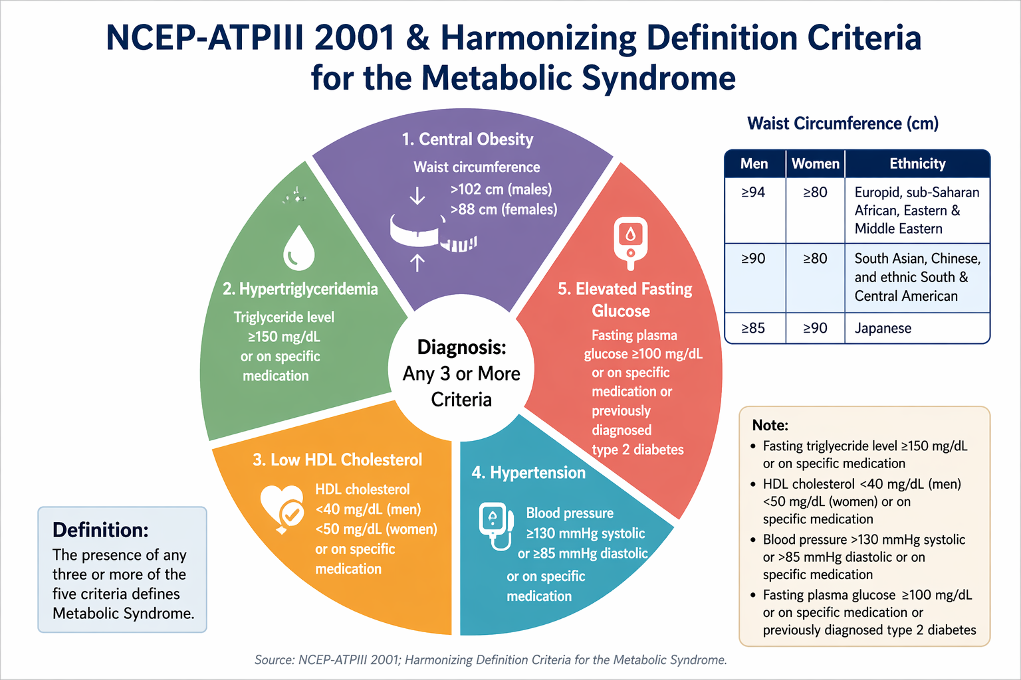

Slide 4
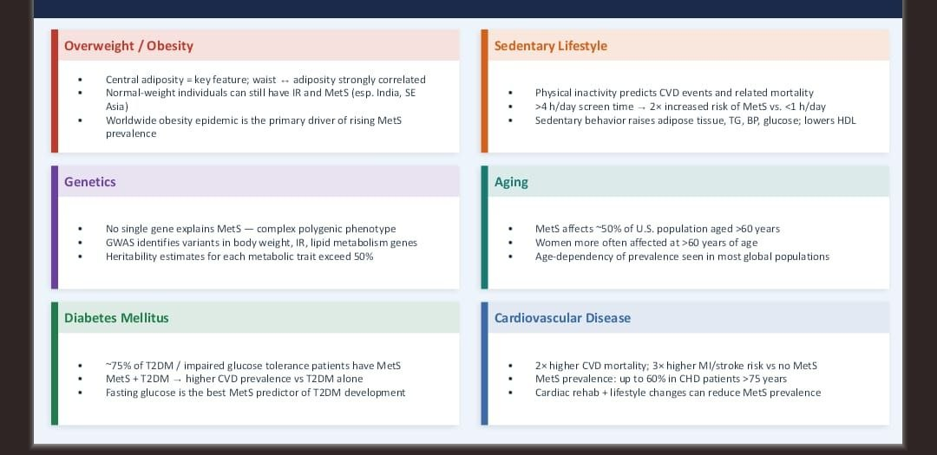
RISK FACTORs
Obesity/ over weight
Sedentary lifestyle
Aging
Diabetes mellitus
Cardiovascular disease
Lipodystrophy

Slide 5
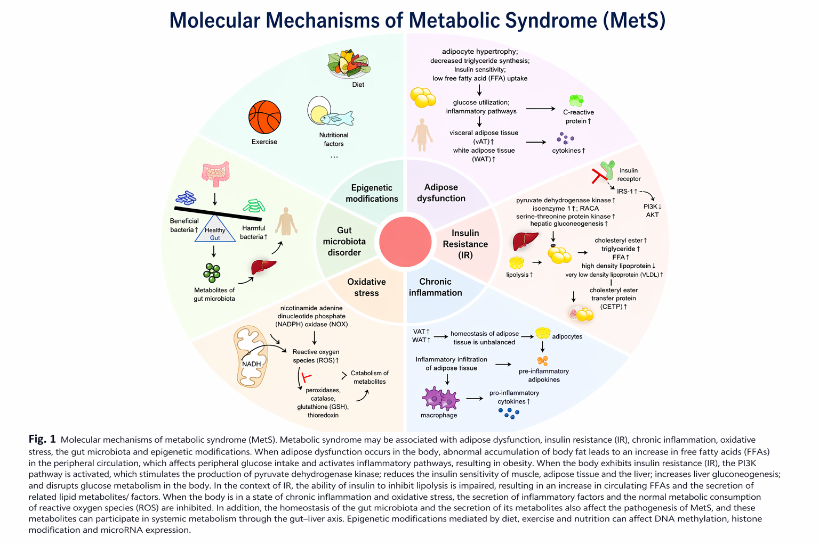

Slide 6
Insulin Resistance in Metabolic Syndrome
Most accepted unifying mechanism of metabolic syndrome
Major contributor for insulin resistance increased free fatty acid released from expanded adipose tissue mass
Progression
Postprandial hyperinsulinemia
→ Fasting hyperinsulinemia
→ Hyperglycemia
Insulin
↓ Lipolysis by suppresses Hormone sensitive lipase
↑ Lipoprotein lipase activity - breakdown triglycerides in chylomicrons and VLDL
In Insulin Resistance
↓ Anti-lipolytic effect
↑ Lipolysis → ↑ FFA
Vicious cycle worsening insulin resistance

Slide 7
Effects of Excess FFA:
↓ Glucose uptake (muscle)
↑ Triglyceride accumulation in skeletal muscle and cardiac muscle
Liver:
↑ Endogenous Glucose production in liver
↑ Triglyceride synthesis & secretion
Leptin Dysfunction:
Normally reduces appetite, promote energy expenditure and enhances insulin sensitivity
Leptin may regulate cardac and vasular function through nitric dependent mechanism
In obesity hyperleptinemia with resistance in brain and other tissues resulting insulin resistance
Adiponectin improves insulin senitivity
Visfatin ,fetuin,resistin,asprosin ,plasminogen activator inhibitor-1 contribute insulin resistance
Oxidative Stress Hypothesis
Defect in mitochondrial oxidative phosphorylation
Seen in:
Obesity
Type 2 diabetes
Offspring of diabetics
Elderly
Leads to: Increased triglycerides accumulation in muscles and liver

Slide 8
Increased waist circumference
Waist circumference is important components and frequently applied diagnostic criteria for metabolic syndrome
Measuring waist circumference does not reliably distinguish increase in subcutaneous or intra abdominal fat
Requires dual X- ray absorptiometry,computed tomography or magnetic resonance imaging to discriminate
Visceral adipose tissue released free fatty acid reaches liver more readily
Contrast subcutaneous free fatty acid released into systemic circulation
Asians / Asian Indian's more visceral fat at lower waist circumference - increased risk for metabolic complications

Slide 9
Dyslipidemia
↑ Free fatty acid (FFA) flux from adipose tissue → liver
Liver responds with ↑ production of apoB-containing VLDL
Result → hypertriglyceridemia (key marker of insulin resistance)
↑ VLDL production from liver - ↑ apoC-III levels
Inhibits lipoprotein lipase (LPL) -↓ clearance of triglyceride-rich remnants
Net effect:Persistent ↑ triglycerides
↑ remnant lipoproteins → atherogenic
Low HDL Cholesterol
↑ triglycerides → CETP-mediated exchange
HDL loses cholesteryl esters → gains triglycerides
HDL becomes small, dense, unstable
↑ clearance from circulation → ↓ HDL levels
Small Dense LDL (Highly Atherogenic)
Seen when TG > ~180 mg/dL (>2.0 mmol/L)
LDL becomes: Small + dense - More prone to oxidation

Slide 10
Hypertension
Insulin stimulates nitric oxide (NO) production → vasodilation
sodium reabsorption in kidney
Maintains vascular homeostasis
Impaired PI3K signaling pathway
↓ Nitric oxide production
↑ Endothelin-1 secretion
Net effect: vasoconstriction
Insulin still promotes Na⁺ reabsorption in kidney
Leads to:
↑ Plasma volume
↑ Blood pressure
Insulin → ↑ sympathetic activity
Increased heart rate
Peripheral vasoconstriction

Slide 11
Perivascular Adipose Tissue Effects
Releases Reactive oxygen species (ROS) via NADPH oxidase impair endothelial function and results in local vasoconstriction
Insulin resistance → ↑ uric acid
Uric acid
Inhibits nitric oxide synthase (kidney, macula densa)
Activates RAAS
Leads to hypertension

Slide 12
Proinflammatory Cytokines and Adiponectin
In obesity and metabolic syndrome, enlarged adipose tissue becomes metabolically active and inflammatory.
Key cytokines involved:
Interleukins: IL-1, IL-6, IL-18,Tumor Necrosis Factor-α (TNF-α),ResistinC-reactive protein (CRP) (systemic marker)
Source:
Mainly from adipose tissue macrophages (infiltrating immune cells)Also from adipocytes themselves

Slide 13
Adiponectin
Adiponectin is anti-inflammatory and insulin-sensitizing.
Source:
Produced only by adipocytes
Functions:Improves insulin sensitivity ,Anti-inflammatory effects
Organ-specific actions:
In Liver:
↓ Gluconeogenic enzyme expression
↓ Hepatic glucose production
In Muscle:
↑ Glucose uptake
↑ Fatty acid oxidation
Via activation of AMP kinase (AMPK)
Metabolic syndrome:
↑ Proinflammatory cytokines
↓ Adiponectin
Net effect: Insulin resistance + chronic inflammation

Slide 14
CLINICAL FEATURES
Not associated with symptoms
Physical examination - increased waist circumference/ increased Blood pressure
Less frequently lipoatrophy and acanthosis nigricans seen
Relative risk for new onset CVD in patients with metabolic syndrome without diabetes 1.5 - 3 fold
Risk for type 2 Diaetes mellitus in metabolic syndromecreased about 3- 5 fold
Diabetes mellitus and hypertension associated with increased risk of CVD
Metabolic associated fatty liver disease most common liver disease as consequences of insulin resistance in metabolic syndrome
MAFLD (Metabolic dysfunction–associated fatty liver disease) is not limited to obese individuals
About 10% of non-obese people can still have MAFLD
In contrast, among people who already have metabolic syndrome, the burden is much higher
→ Up to 65% of them have MAFLD
over half of these patients have metabolic dysfunction-associated steatohepatitis(MASH)

Slide 15
Metabolic alterations associated with insulin resistance
Lipoproteins & biochemical changes
↑ ApoB, ApoC-III → more atherogenic lipoproteins (↑ VLDL, remnants)
↑ Uric acid → gout risk + endothelial dysfunction
↑ Serum viscosity → sluggish blood flow
↑ Homocysteine → vascular injury, atherosclerosis
Prothrombotic & endothelial dysfunction
↑ Fibrinogen
↑ PAI-1 (plasminogen activator inhibitor-1)
Net effect: prothrombotic state (higher risk of clots)
↑ Asymmetric dimethylarginine (ADMA)
Inhibits nitric oxide → endothelial dysfunction
Inflammatory markers C-reactive protein (CRP)
↑ Proinflammatory cytokines (IL-6, TNF-α)
↑ White blood cell count
Indicates chronic low-grade inflammation (key driver of atherosclerosis)
Renal & vascular marker
Urine albumin/creatinine ratio (microalbuminuria)
Early marker of endothelial + kidney damage
Polycystic ovary syndrome (PCOS) → hyperinsulinemia-driven androgen excess
Obstructive sleep apnea (OSA) → linked to obesity & metabolic dysfunction

Slide 16
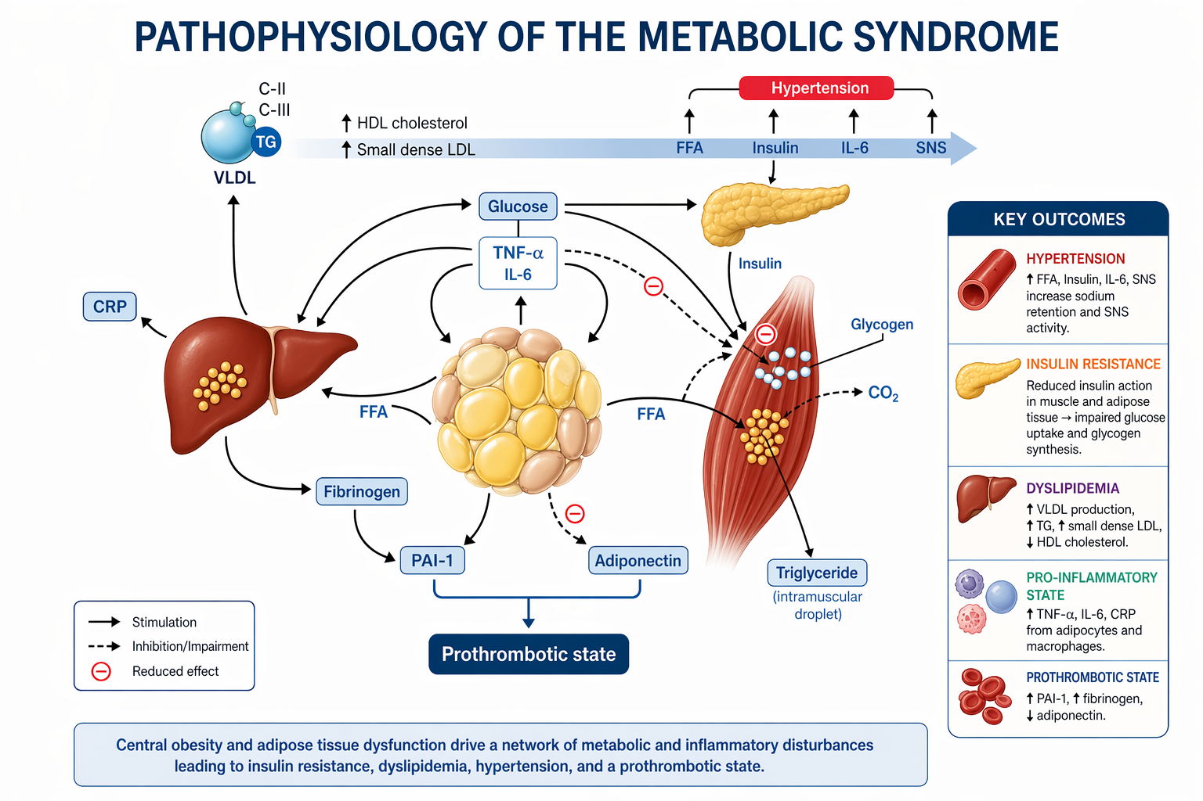

Slide 17
Treatment
Lifestyle Management
Obesity (especially abdominal) is the primary driver of metabolic syndrome
Weight Reduction – First-Line Therapy
≥ 5% weight loss → improves insulin sensitivity
≥ 10% weight loss → significant metabolic benefits
Core Strategies
Caloric restriction → most important factor
Physical activity → essential for weight maintenance
Behavior modification → ensures long-term success
Exercise Role
May enhance visceral fat loss when combined with diet

Slide 18
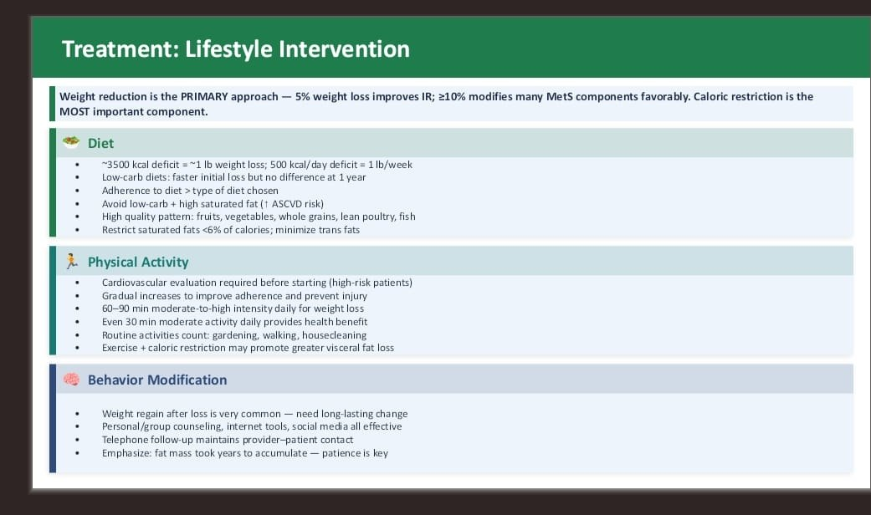

Slide 19
Pharmacologic management of Obesity (Metabolic Syndrome)
Failure of lifestyle modification
Significant obesity ± comorbidities
Weight-Loss Drugs
1. Appetite Suppressants
Phentermine (maximum for 3 months)
Phentermine/Topiramate → ~8% weight loss. S/ E palpitations/ headache / paresthesia
Naltrexone/Bupropion → ≥10%
Avoid in seizure disorders, uncontrolled HTN
Liraglutide → ~6% loss
Semaglutide → ~15% loss
Tirzepatide → up to ~21% loss
Greater weight loss → greater improvement in metabolic syndrome
2. Absorption Inhibitor
Orlistat - inhibits gastric and pancreatic lipases
↓ Fat absorption (~30%)
~4% additional weight loss
↓ risk of Type 2 Diabetes Mellitus
Oily stools (poor tolerance)

Slide 20
LDL Management in Metabolic Syndrome (ASCVD Prevention)
LDL ≥190 mg/dL (20–75 yr) → High-intensity statin
(Atorvastatin 40–80 mg / Rosuvastatin 20–40 mg)
Type 2 DM (40–75 yr) → Moderate → High intensity
Metabolic syndrome without diabetes mellitus Use 10-yr ASCVD risk
If risk ≥7.5% - less than 20%→ Consider statin
→ Coronary calcium score helps decision
LDL-Lowering Drugs
Statins (1st line) → ↓ LDL 15–60%
Each statin dose doubling → only ~6% extra LDL reduction
S/E Myopathy (10–20%), rare hepatotoxicity
Ezetimibe → ↓ LDL upto 15–20%
Bempedoic acid ± ezetimibe → ↓ up to 35% .S/E increase uric acid

Slide 21
PCSK9 inhibitors potent LDL lowering drugs → ↓ upto 45–60% not routinely used in metabolic syndrome
For familial hypercholesterolemia / resistant cases
Bile acid sequestrants - cholestyramine colestipol and colesevelam effective in LDL lowering
Used in caution in patients with metabolic syndrome when fasting triglycerides are more than 300 my/ dl
Nicotinic acid has similar LDL cholesterol lowering capabilities.However associated with multiple adverse effect
cutaneous flushing
hepatotoxic
Hyperglycemia
Hyperuricemia, Hypotension.

Slide 22
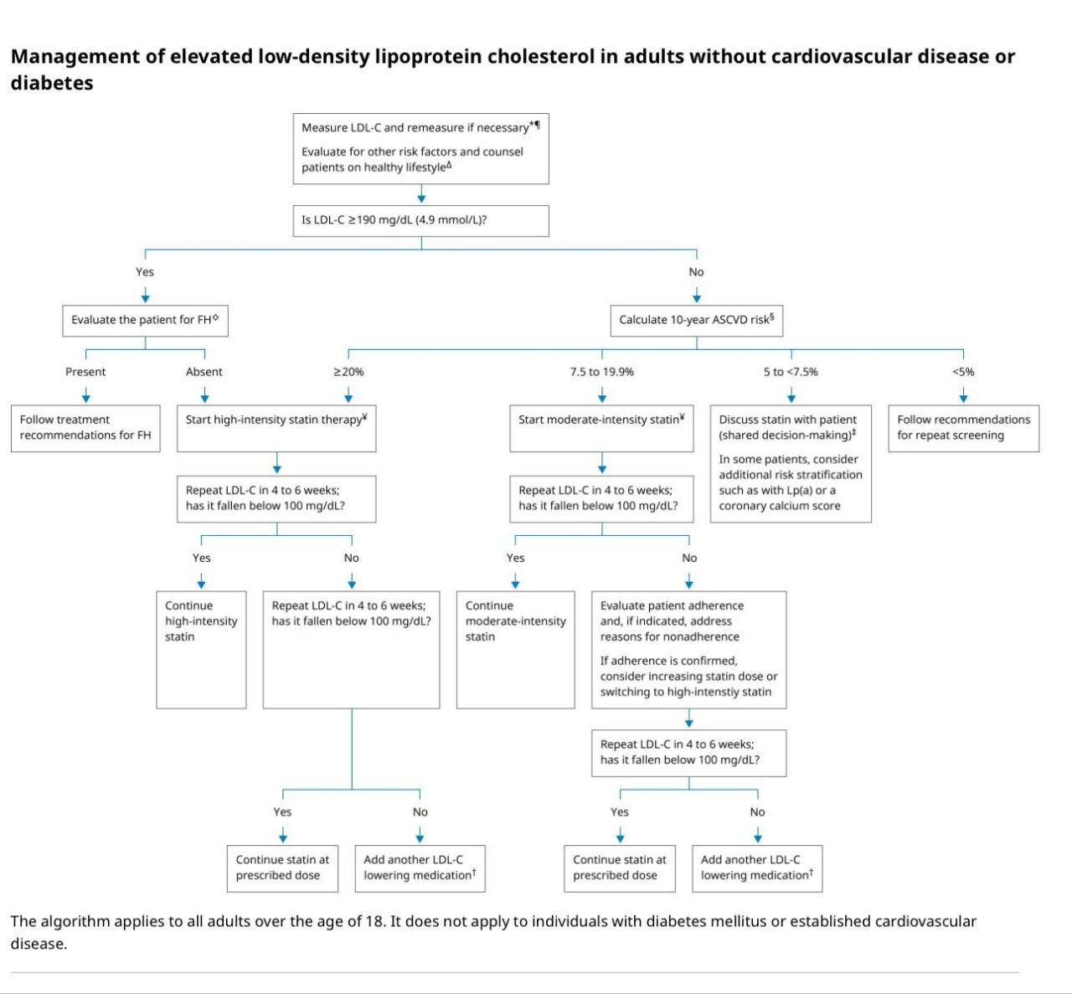

Slide 23
TRIGLYCERIDES MANAGEMENT IN METABOLIC SYNDROME
Fasting triglycerides more than 500 my/dl should be treated to prevent serious hypertriglyceridemia and pancreatitis
Lowering triglycerides does not consistently reduce ASCVD events
Fibrate first line of choice lowering fasting triglycerides levels . reduce upto 35- 40%
Increased risk of myopathy when used along with statins.In this case fenofibrate preferable to gemfibrozil
Statins -intermediate or high dose of more potent statins needed( Atorvastatin ,Rosuvastatin )
Nicotinic acid reduce triglycerides upto 20-35%
Omega 3 fatty acid preparation include High dose of eicosapentaenoic acid ( EPA) with or without docosahexanoic acid( DHA) Lower fasting triglycerides of 25%-40%

Slide 24
HDL MANAGEMENT
Nicotinic acid is the only currently available drug with predictable HDL increasing effect
Response is dose related and increases HDL cholesterol upto 30%
There is no evidence that raising HDL cholesterol with nicotinic acid beneficially affect ASCVD events

Slide 25
MANAGEMENT OF INSULIN RESISTANCE
Biguanides and thiazolidinediones increases insulin sensitivity.
Biguanides ( Metformin)- decrease hepatic gluconeogenis and increases insulin sensitivity
Doesn't significantly increase peripheral glucose uptake
Thiazolidinediones( pioglitazone ,Rosiglitazon) increase insulin sensitivity and improve peripheral glucose intake
Decreases ASCVD events.usefull in metabolic dysfunction-associated fatty liver disease
Adverse effect
Weight gain
Fluid retention
Risk of heart failure
Bone fracture
GLP -1 Receptor agonist - liraglutide
Insulin sensitivity improve secondary to weight loss

Slide 26
THANKYOU

