Slide 1
Paraquat poisoning
PRESENTED BY : UNIT 2
CHIEF AND PROFESSOR: DR.B.PALANIKUMAR.MD
ASSOCIATE PROFESSOR: DR. V.PALANIKUMARAN MD
ASST.PROFESSOR : DR.S.PONSENTHIL KUMAR MD
DR.S.SARAVANAMADHAVAN DTCD MD
DR.M.ILAMARAN MD
PRESENTER: DR. NAGAPRANITH 1st YEAR PG

Slide 2
Introduction
Paraquat is one of the world’s most widely used herbicides due to its cost effectiveness and fast acting nature to remove weeds and clear the land before ploughing
It acts by blocking the photosynthesis pathway in plants and makes them to wilt and die within days
It is a non selective herbicide
It gets inactivated on contact with soil so, no risk of soil contamination

Slide 3
Epidemiology
MOST CASES OF PARAQUAT POISONING OCCUR DUE TO DELIBERATE INGESTION WITH SUICIDAL INTENTION
SOUTH AMERICA, ASIA AND MEXICO HAVE HIGH PREVELANCE
HIGHEST INCIDENCE OCCURS IN SOUTHERN AND EASTERN STATES OF INDIA, WITH TELANGANA TOPPING THE LIST

Slide 4
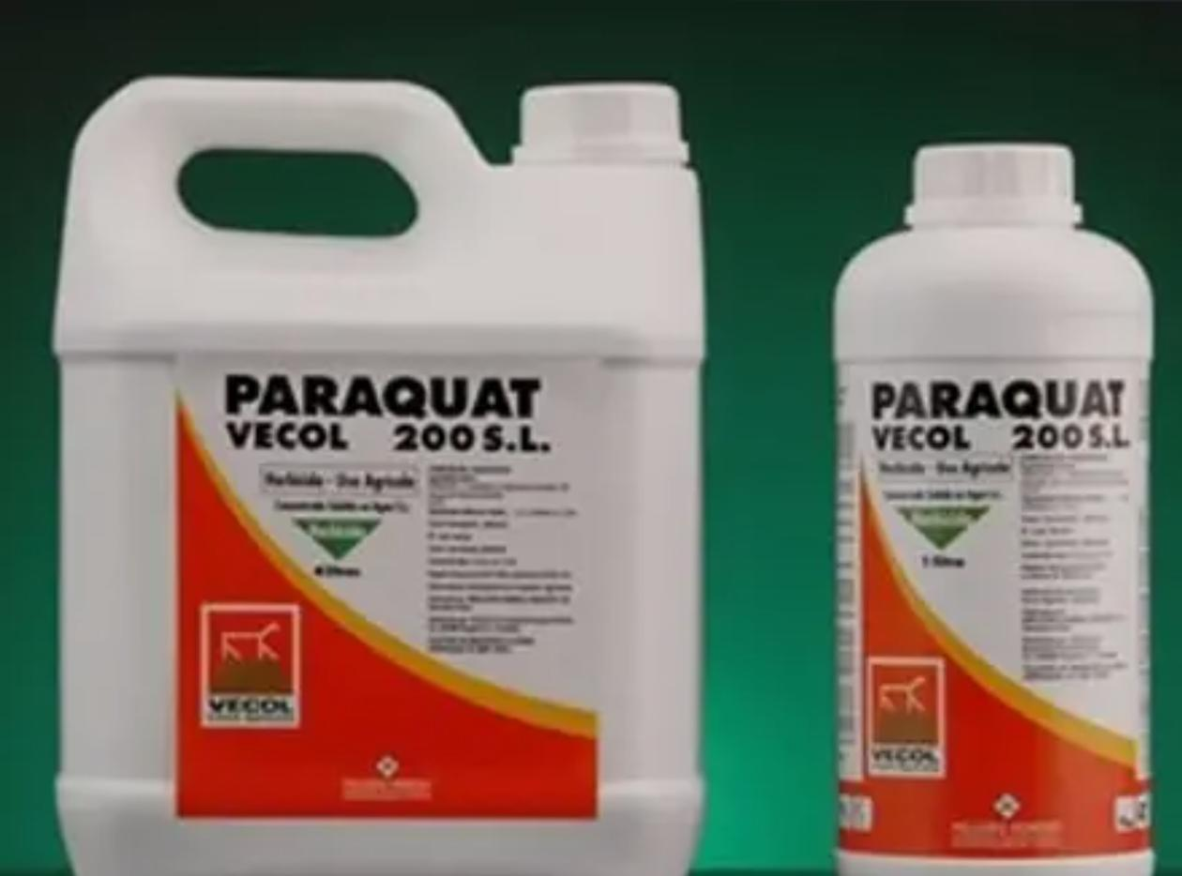
Unintentional exposure
POISONING CAN OCCUR DUE TO UNINTENTIONAL EXPOSURE AS WELL
CAN BE ABSORBED THROUGH INTACT SKIN , PROLONGED OCCUPATIONAL SPRAYING
METHODS TAKEN TO CURB
  Capping the maximum concentration
  Using blue dye
  Making it unpleasant by mixing Pyridine stenchants
  Addition of emetics

Slide 5
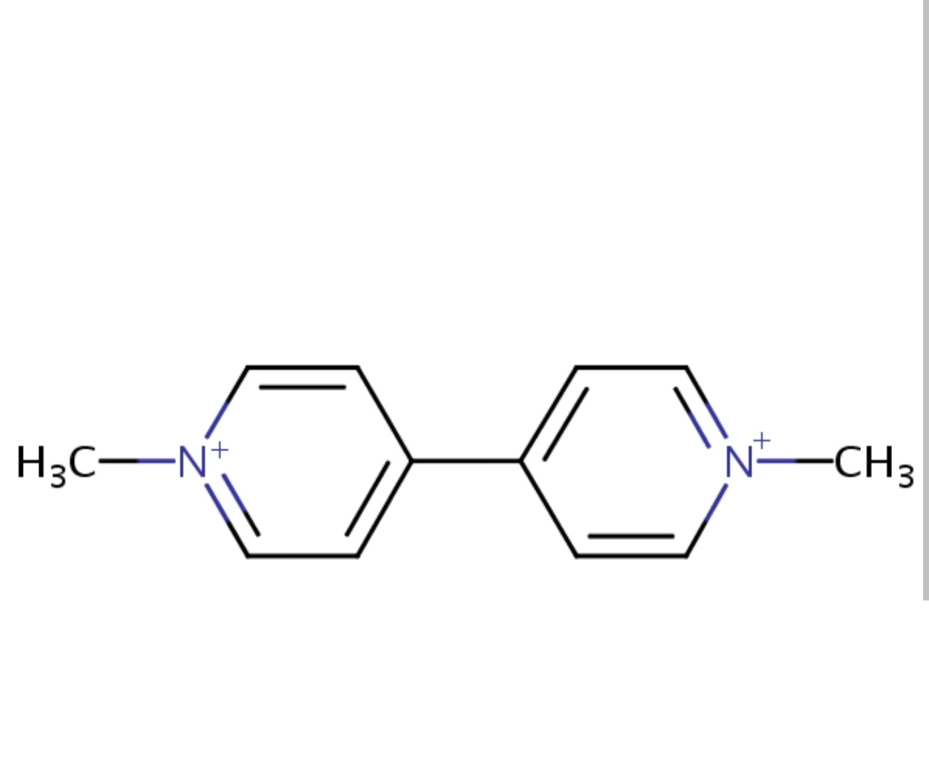
Chemistry
1,1′-DEMETHYL-4,4′-BIPYRIDINIUM DICHLORIDE
COMES IN 20% w/v CONCENTRATION
SPRAY : 0.5 TO 2 %
STRUCTURALLY SIMILAR TO NATURALLY
OCCURING POLYAMINES LIKE SPERMIDINE AND
PUTRESCINE

Slide 6
TOXICokinetics
ABSORPTION : SKIN, MUCOUS MEMBRANE, MAINLY THROUGH SMALL INESTINE
DISTRIBUTION : VOLUME OF DISTRIBUTION IS HIGH (1 – 2 L/KG)
PEAK PLASMA CONC : 2 HOURS AFTER INGESTION
CONCENTRATED IN LUNGS AND KIDNEYS
ELIMINATION : THROUGH THE KIDNEYS

Slide 7
Pathophysiology
1: KINETIC MIMICRY AND SEQUESTRATION
  MIMICS POLYAMINES LIKE SPERMIDINE, PUTRESCINE THROUGH THE POLYAMINE TRANSPORTER
  CONCENTRATED IN BOTH TYPE 1 AND TYPE 2 ALVEOLAR CELLS
  INTRALUNG CONCENTRATIONS : 20 TO 30 TIMES OF PLASMA

Slide 8
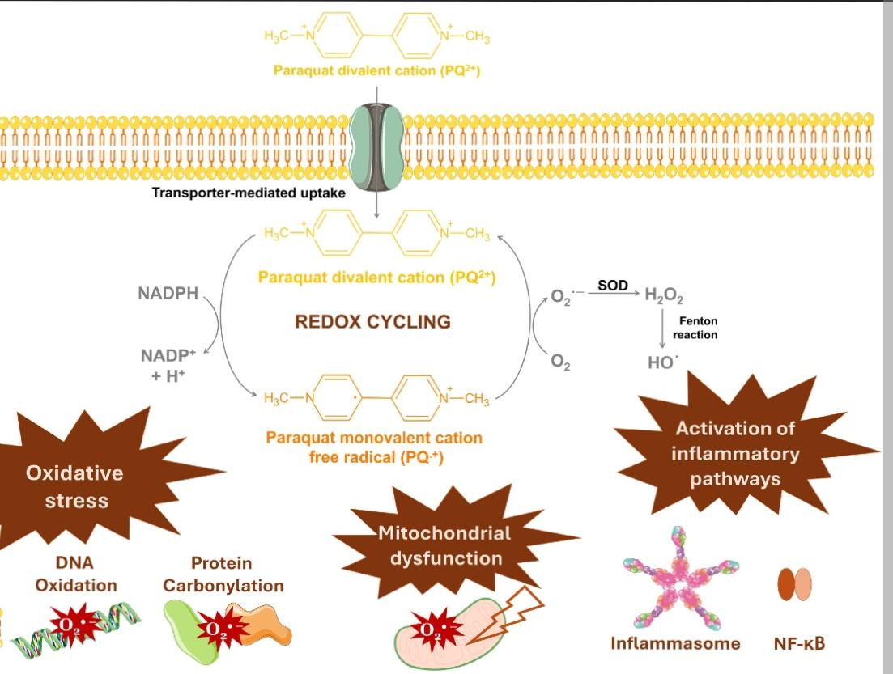
REDOX CYCLING

Slide 9
Inflammation
LIPID PEROXIDATION
  Superoxide radicals undergo dismutation to hydrogen peroxide (H₂O₂), generating hydroxyl radicals via the Fenton reaction. These attack polyunsaturated fatty acids in the cell membrane.
FIBROTIC SWITCH
  The destruction of Type II pneumocytes triggers an massive inflammatory influx (macrophages and neutrophils), releasing Profibrotic Cytokines: TGF-β and TNF-α. (Etanercept used as experimental treatment)
FIBROBLAST PROLIFERATION
  Within days, this unregulated cascade causes rapid intra-alveolar fibrosis, transforming functional lung tissue into non-viable collagen scar tissue.

Slide 10
Toxicity
MILD | 10ml 20mg PARAQUAT CATION PER KG | Asymptomatic Mucosal ulceration Transient renal impairment Recovery is expected
MODERATE | 10 to 20ml 20 to 40mg | Corrosive injury Acute tubular necrosis Acute hemorrhagic lung injury Death usually occurs in 5 days
SEVERE/ FULMINANT | > 20ml | MODS GImucosa ulcerations/perforation Renal and hepatic injury Cardiac dysrhythmias Mediastinitis

Slide 11
CLINICAL FEATURES
CVS | Hypovolemia, shock, myocarditis, arrhythmias
CNS | Coma, convulsions, cerebral edema
ENDOCRINE | Adrenal necrosis leading to Adrenal insufficiency
GI | Ulceration, perforation, nausea, centrilobular necrosis of liver, pancreatitis
HEMATOLOGY | Early :leukocytosis Late : Anemia, Methemoglobulinemia

Slide 12
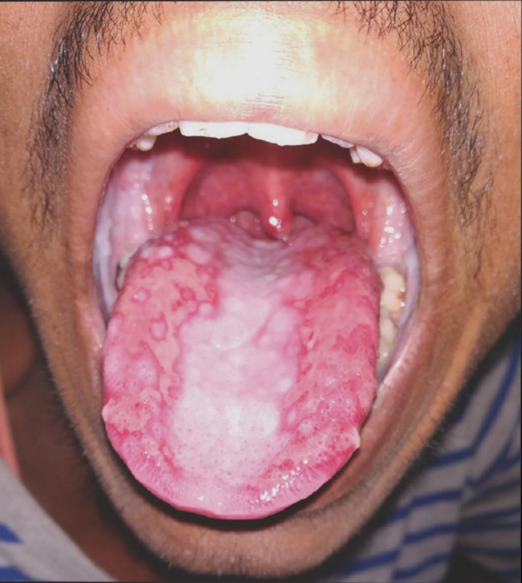
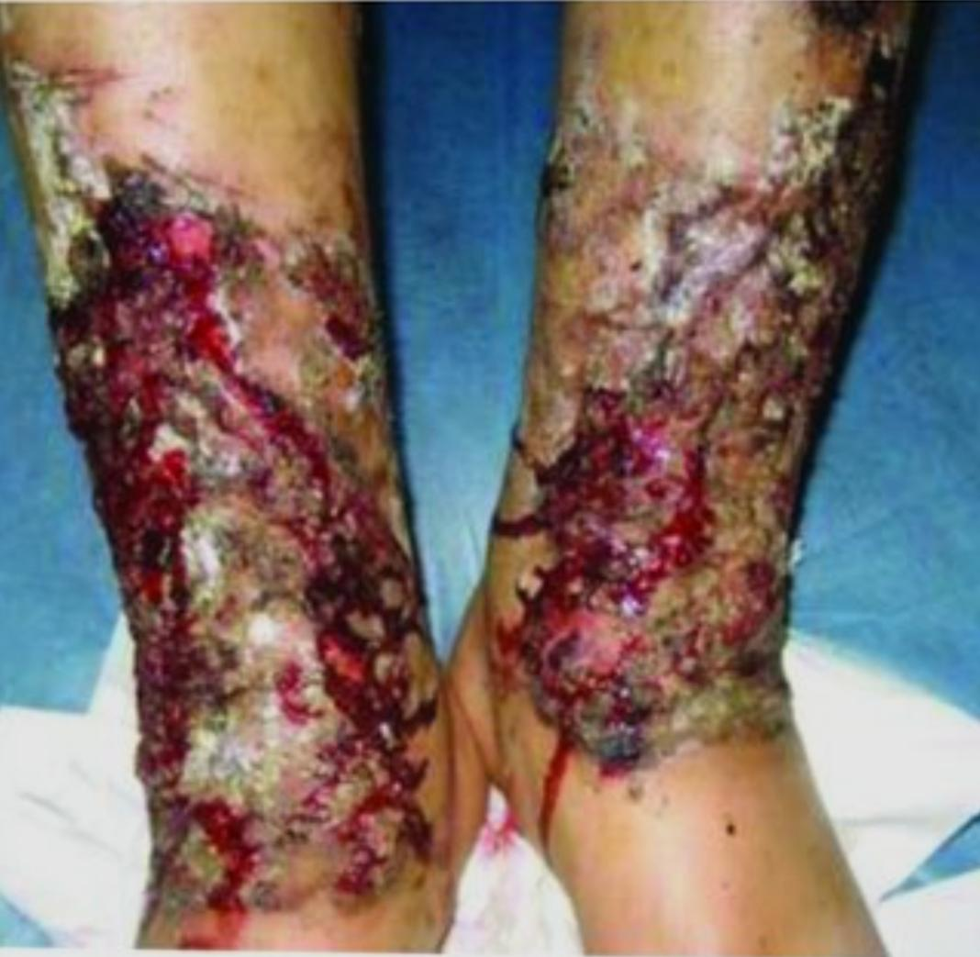
PARAQUAT TONGUE
SKIN CHANGES

Slide 13
Clinical features
RENAL
  PHASE 1 : PRE RENAL AKI
  PHASE 2 : INTRINSIC KIDNEY INJURY
      ACUTE TUBULAR NECROSIS
      DISPROPOTIONATE RISE IN CREATININE
TOXIN DAMAGES THE KIDNEY → KIDNEY FAILS TO EXCRETE THE TOXIN
. → INCREASE IN SYSTEMIC TOXICITY

Slide 14
PULMONARY
UOUGH INTO ALVEOLAR CELLS AGAINST CONC GRADIENT
ALVEOLAR DESTRUCTION BY ROS → ACUTE PULMONARY EDEMA/ARDS
INFLAMMATION → FIBROBLAST PROLIFERATION → FIBROSIS (ALVEOLI)
OTHER SYMPTOMS
  COUGH, APHONIA, PSEUDO DIPTHERIA(PHARYNGEAL MEMBRANE)
  HEMOPTYSIS, HEMORRHAGE

Slide 15
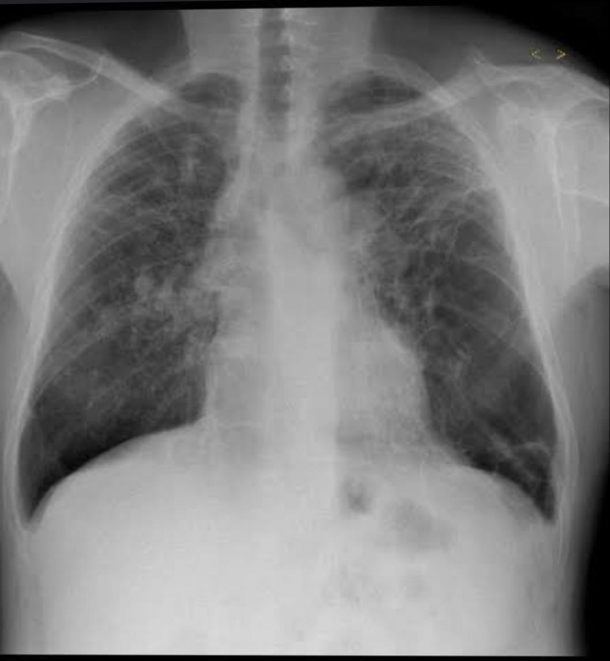
PULMONARY FIBROSIS

Slide 16
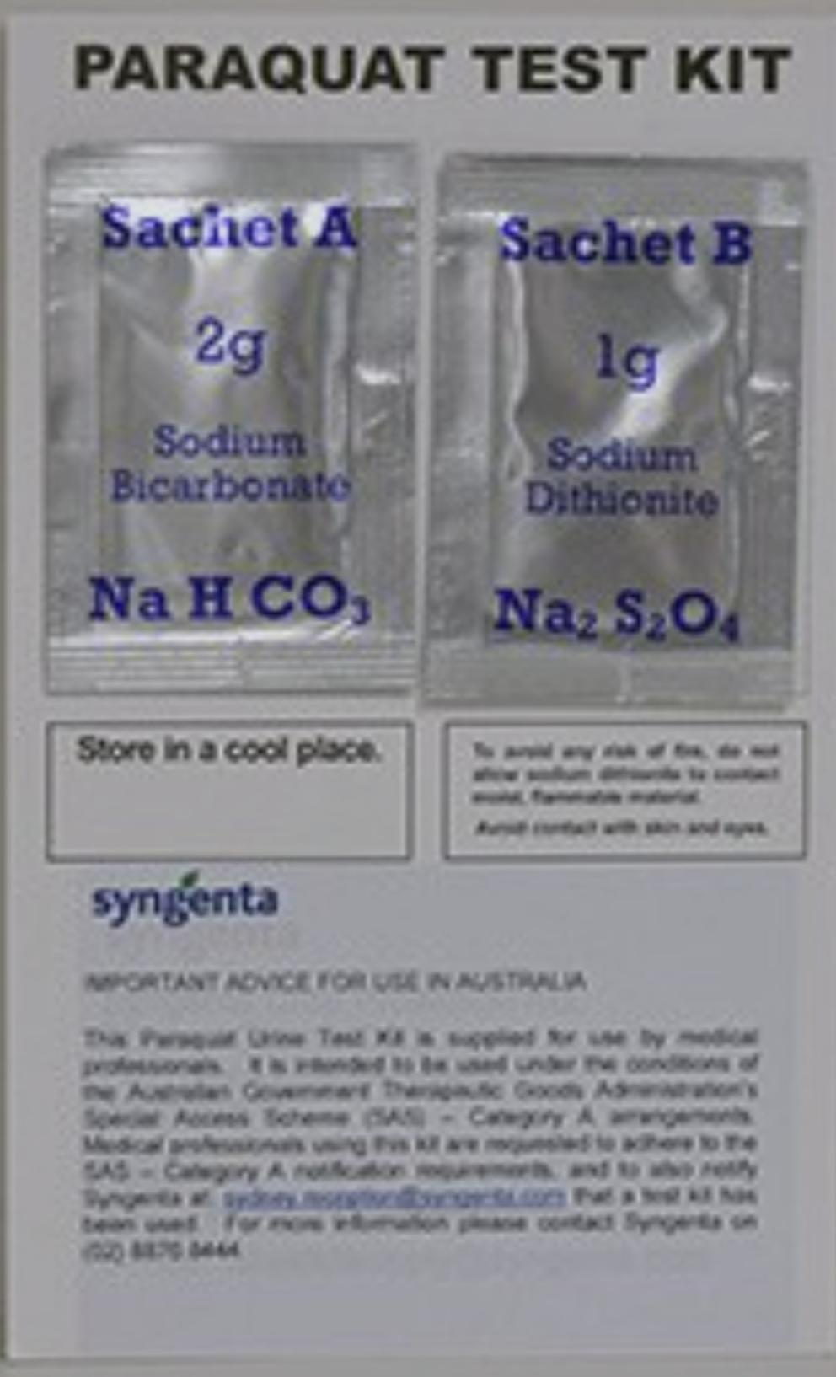
Diagnosis
SODIUM DITHIONATE TEST
  100MG SODIUM DITHIONATE + 5ML OF 5M NAOH
  ADDED TO 1ML URINE
  IF PARAQUAT LEVEL > 2microgram/L
  PARAQUAT : BLUE TO BLACK (BASED ON CONC)
  DIQUAT : YELLOWISH GREEN

Slide 17
QUANTITATIVE : CHROMATOGRAPHY, RADIOIMMUNOASSAY
MONITOR : RFT, LFT, CBC
SERUM CREATININE AND LDH :
    LEVELS ARE FALSELY HIGH BECAUSE OF INTERFERENCE WITH COLORIMETRIC METHODS
    THRESHOLD : 10mg/L

Slide 18
MANAGEMENT
DECONTAMINATION
PREVENT ABSORPTION
EXTRACORPOREAL REMOVAL
IMMUNOSUPPRESION
SUPPORTIVE CARE

Slide 19
MANAGEMENT
DECONTAMINATION :
  SKIN : WASHED WITH SOAP AND WATER
  EYES : WASHED FOR 15MINS
  DRESS : CONSIDERED CONTAMINATED EVEN BY VOMITUS
DELAY ABSORPTION
  LAVAGE : IF PRESENTED EARLY( <1 HR),
  ACTIVATED CHARCOAL/FULLER’S EARTH, BENTONITE

Slide 20
Extracorporeal elimination
CHARCOAL HEMOPERFUSION :
    WITHIN 4 HOURS
    LASTING 6 TO 8 HOURS
CAVH vs CVVH
HEMODIALYSIS

Slide 21
Lin protocol
PULSE THERAPY
  METHYLPREDNISOLONE 1GM/DAY FOR 3 DAYS
  CYCLOPHOSPHAMIDE 15MG/KG FOR 2 DAYS
DEXAMETHASONE FOLLOWUP IN LOW DOSES ( TO TAPER) : 20MG/DAY
  UNTIL OXYGEN LEVELS STABILIZE
REPEAT PULSE
  3 DOSES OF METHYLPREDNISOLONE
  1 DOSE OF CYCLOPHOSPHAMIDE

Slide 22
SUPPORTIVE TREATMENT
IV FLUIDS : ADEQUATE TO COVER ONGOING GI LOSS
  MAINTAIN HIGH NORMAL URINE OUTPUT
ANALGESICS
OXYGEN THERAPY
  ONLY IF PaO2 < 50MMHG

Slide 23
Experimental therapIES
REDUCE CIRCULATING PARAQUAT : Fab or RECOMBINANT SINGLE CHAIN ANTIBODY
REDUCE ACCUMULATION : D-PROPRANOLOL, POLYAMINES
ANTIOXIDANTS :
  VITAMIN E, VITAMIN C,SOD, NAC, S-CARBOXYMETHYL CYSTEINE
  EDAVARONE
LUNG TRANSPLANTATION

Slide 24
Prognosis
APACHE 2
SERUM CREATITINE
PROUDFOOT NOMOGRAM
LUNG SCINTIGRAPHY
RESPIRATORY INDEX

Slide 25
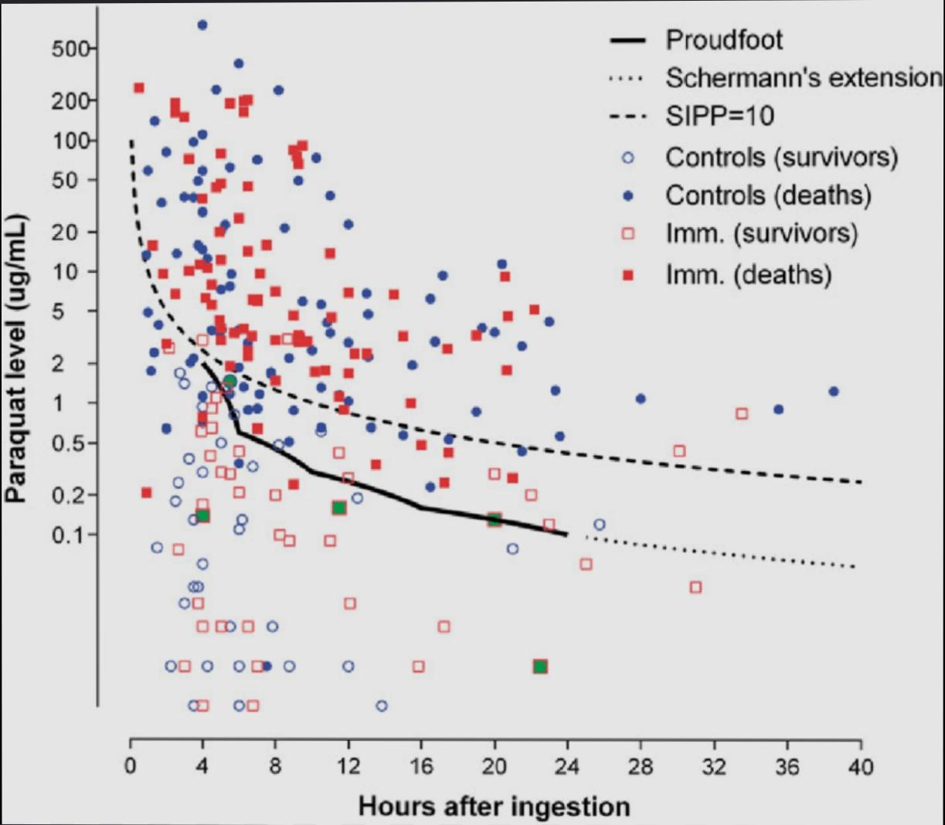
Proudfoot nomogram
PREDICTS SURVIVAL
PLOTS PLASMA
PARAQUAT CONCENTRATION VS TIME SINCE COMSUMPTION
HIGHER CONCENTRATION AT
EARLIER TIME, PREDICTS MORTALITY

Slide 26
Public health
SRILANKA
    IMPOSED SEQUENCIAL BANS CULMINATING IN COMPLETE BAN OF PARAQUAT
  LEADING TO 50% DECREASE IN TOTAL SUICIDE MORTALITY WITHOUT AFFECTING AGRICULTURAL YIELD
GRH : TOTAL CASES : 13
    DEATH : 7
    AMA : 3
    TRANSFERED OUT : 3

Slide 27
THE ANTIDOTE
ANTHRAHYDRAQUINONE-2,6-DISULFONATE (AHQDS)
UNDERGOING EXTENSIVE ANIMAL AND IN VITRO TESTING
BINDS WITH THE DIBASIC PYRIDINIUM STRUCTURE IN PARAQUAT
AND INACTIAVTES IT
HUMAN TRIALS ARE YET TO YIELD RESULTS

Slide 28
TAKE HOME MESSAGE
No specific antidote is in routine clinical use.
Early decontamination is critical.
Hemoperfusion is most effective if started early.
Avoid oxygen therapy
Pulmonary fibrosis is the major cause of death.
Prevention and pesticide regulation save lives.

