Slide 1
ACUTE myeloid LEUKEMIA

Slide 2
CHIEF : PROF DR. K.SENTHIL MD
ASSOCIATE PROFESSOR : DR.K.MURALIDHARAN MD
ASSISTANT PROFESSOR : DR.V.MANIKANDAN MD
DR.SARAVANA MADHAV MD
DR.ILAMARAN MD DM
PRESENTOR : DR.BRINDHA P

Slide 3
HEMATOPOIESIS

Slide 4
WBC DISORDERS (NEOPLASMS)
LEUKEMIA LYMPHOMA
Neoplastic WBC Neoplastic lymphoid
Proliferation in BM proliferation in other
organs.

Slide 5
LEUKEMIA...
Based on cell of origin
Myeloid leukemia Lymphoid leukemia
AML CML ALL CLL
proliferation of proliferation of proliferation of proliferation of
Immature myeloid mature myeloid immature lymphoid mature
Cell(myeloblast) cell. cell(lymphoblast) lymphocyte.

Slide 6
ACUTE MYELOID LEUKEMIA
It is a neoplasm characterised by infiltration of blood, bone marrow and other tissues by proliferative, clonal, poorly differentiated cells of the hematopoietic system.
M/c acute leukemia in older patients with median age at diagnosis of 67 yrs.

Slide 7
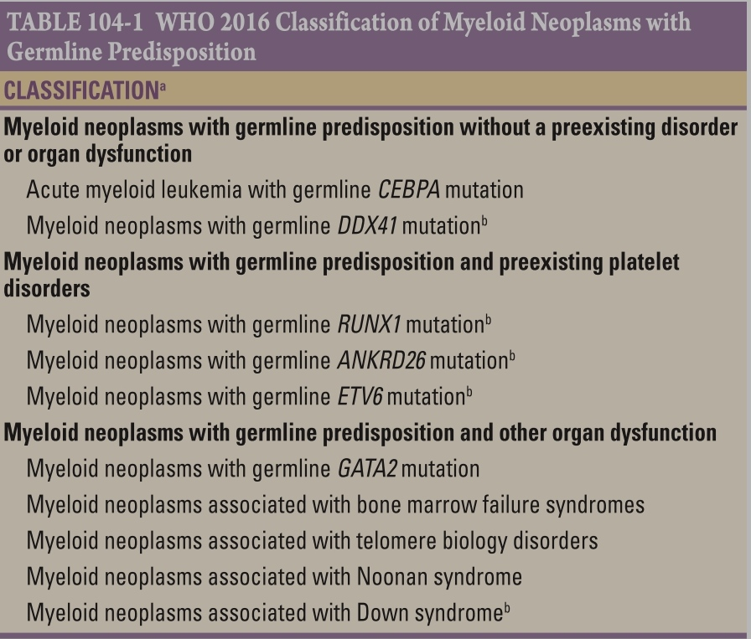
ETIOLOGY
Most cases are idiopathic.

Slide 8
HEREDITARY DISORDERS
Down’s syndrome – AML M7
Fanconi’s anemia, bloom syndrome,
Ataxia telangiectasia
Congenital neutropenia( kostmann syn.)
Amegakaryocytic thrombocytopenia
Diamond blackfan syndrome
Downs syndrome
Dyskeratosis congenita
Shwachman syndrome

Slide 9
ACQUIRED DISEASES
CML
Primary myelofibrosis
Essential thrombocytosis
Polycythemia vera
clonal cytopenias
PNH
OTHER HEMATOPOIETIC DISORDERS
Aplastic anemia
eosinophilic fascitis
myeloma

Slide 10
IONISING RADIATION
atomic bombing
therapeutic radiation
X ray exposure to fetus during pregnancy
CHEMICALS AND OTHER EXPOSURES
benzene
smoking and exposure to petroleum products.
DRUGS
Anticancer drugs
1. Alkylating agents
2. Topoisomerase 2 inhibitors and other cytotoxic drugs

Slide 11
WHO CLASSFICATION

Slide 12
FAB CLASSIFICATION

Slide 13
CLINICAL FEATURES

Slide 14
SYMPTOMS…
AML often have non specific symptoms..
fatigue
fever with or without identifiable infection
night sweats
loss of appetite
loss of weight
bone pain
cough, headache, diaphoresis

Slide 15
BONE MARROW FAILURE
Anemia – shortness of breath
excessive tiredness/ fatigue
Neutropenia - life threatening infections
Thrombocytopenia – bleeding manifestations in the form of petechiae, atraumatic ecchymosis, gum bleeding, epistaxis, urinary tract and fundal hemorrhages
ICH – serious and fatal complication
Marrow expansion and infiltration of subperiosteum causes Bone pain and sternal tenderness…

Slide 16
LEUKOSTASIS
Stasis of blood flow may develop when the blast count is above 50.000/cu.mm
Cerebral leukostasis may cause headache, confusion and visual disturbances.
Pulmonary leukostasis can cause dyspnea at rest, tachypnea. Chest pain, pulmonary infarction and acute respiratory distress syndrome...

Slide 17
Extra medullary leukemic infiltration
gingival hypertrophy
infiltration of skin
Seen in monocytic subtype.
Hepatosplenomegaly
Generalised lymphadenopathy
Leukemic meningitis is rare.. It presents as headache and nausea. As the disease progresses, papilledema, cranial nerve palsies , seizures and altered consciousness develop.
CSF characteristically shows leukemic blast cells, elevated proteins and reduced glucose levels

Slide 18
Metabolic abnormalities
hyperuricemia
elevated serum liver transaminases
elevated serum LDH
Coagulopathy
both DIC and primary fibrinolysis may lead to hemorrhagic diathesis. DIC is obseved in AML-M3
Myeloid sarcoma
sites involved are skin, lymph node, GI tract, soft tissue , testis.

Slide 19
INVESTIGATONS
BLOOD COUNT
HB is low, normocytic normochromic anemia, decreased reticulocyte count and RBC count.
Total leukocyte count – median presenting leukocyte count is 15,000.
low TC is typical of older patients and those with antecedent hematological disorders.
Between 25% and 40% of patients have counts < 5000/mcL and 20% have counts >1,00,000/mcL
Platelet count – markedly decreased

Slide 20
PHERIPHERAL BLOOD SMEAR
Severe normochromic anemia
Shows numerous blast cells
In AML, the cytoplasm often contains primary granules, and the nucleus shows fine, lacy chromatin with one or more nucleoli characteristic of immature cells.
Abnormal rod shaped granules called AUER RODS are present in myeloblast.

Slide 21
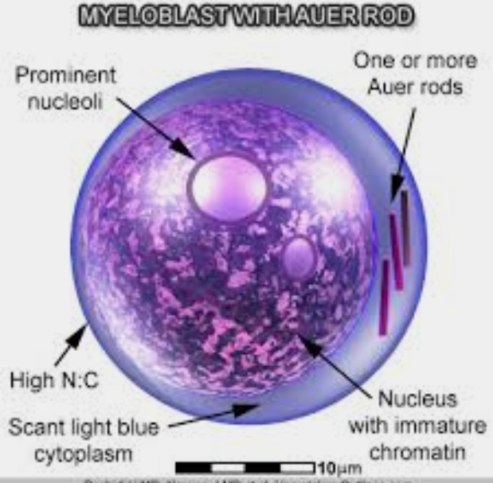
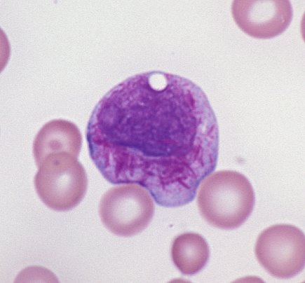
BONE MARROW ASPIRATE
hypercellular marrow with reduced erythropoiesis and reduced megakaryocytes are seen.
blast cells more than 20% is diagnostic.

Slide 22
IHC staining for Myeloperoxidase is the best method for determining AML

Slide 23
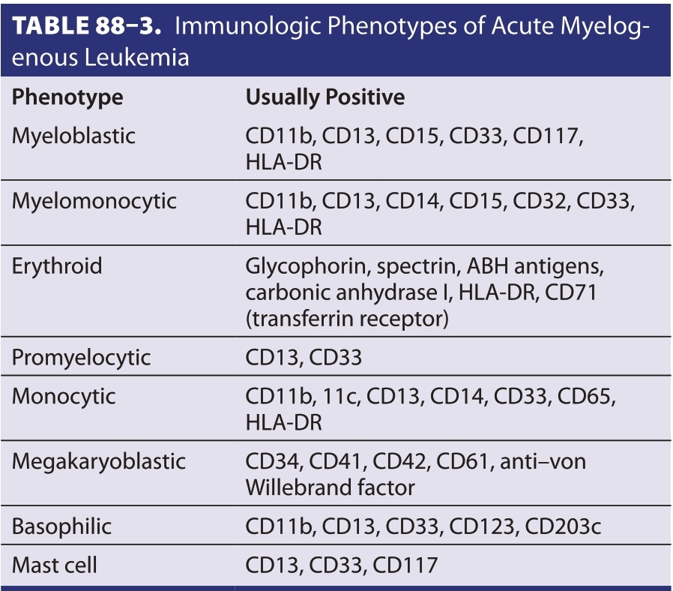
IMMUNOPHENOTYPIC FINDINGS
Immunophenotyping of human leukemic cells can be studied by MULTIPARAMETER FLOW CYTOMETRY after the cells are labelled with monoclonal antibodies to cell surface antigens.

Slide 24
TREATMENT
Two phases
1) Induction chemotherapy
2) Post remission therapy
Goal: complete remission
Based on age
<60 yrs – intensifying therapy with traditional chemotherapy such as CYTARABINE and ANTHRACYCLINES.
>60 yrs – benefit of intensive therapy is controversial

Slide 25
INDUCTION THERAPY
M/C used CR induction regimen for patients other than APL is combination of cytarabine and anthracyclines..
<60 yrs : 7 and 3 regimen Cytarabine standard dose of 100-200mg/m2 continuous iv infusion for 7 days
or
Cytarabine higher dose of 2g/m2 iv every 12 hr for 6 days
+
Daunorubicin 60- 90 mg/m2 or idarubicin 12mg/m2 iv on day 1, 2, 3.

Slide 26
> 60 yrs:
7 and 3 regimen has poor outcome due to higher induction related mortality rate and frequency of resistant disease.
older patients may be considered for single agent therapies with CLOFARABINE or hypomethylating agents such as AZACITIDINE or DECITABINE.
After 1 cycle of 7 and 3 chemotherapy induction regimen if persistence of leukemia is documented, pt is usually retreated with same agents for 5 and 2 days respectively.

Slide 27
POST REMISSION THERAPY
To eradicate residual leukemic cells to prevent relapse and to prolong survival.
In the post remission therapy , high dose cytarabine for 3 to 4 cycles is more effective than standard dose cytarabine.
For younger patients most studies include intensive chemotherapy and allogenic or autologous hematopoietic stem cell transplantation.
Autologous HSCT preceded by 1 or 2 cycles of high dose cytarabine is also an option for intensive consolidation therapy

Slide 28
RELAPSED OR REFRACTORY DISEASE
Recommended chemotherapy regimens:
MEC ( Mitoxantrone, etoposide, cytarabine)
CLAG – M ( cladrabine, cytarabine, mitoxantrone, filgrastim)
FLAG- IDA ( fludarabine, cytarabine, idarubicin, filgrastim)

Slide 29
ACUTE PROMYELOCYTIC LEUKEMIA
Highly curable AML subtype.
Diagnosis is by presence of t(15;17), (q22;q12) cytogenic rearrangement or PML-RARA fusion product of translocation.
Induction therapy is with all trans retinoic acid and anthracyclines or a combination of ATA with arsenic trioxide.
Allogenic transplantation
In relapsed cases, arsenic trioxide is found to be effective.
Complication: APL syndrome

Slide 30
POOR PROGNOSTIC FACTORS
age more than 60 yrs
Total leuckocyte count >1,00,000/mm3
FAB type – M0, M5, M6, M7
High risk karyotype t(6;9), inv(3)
AML Following MDS
Relapsed disease
Secondary leukemias
Extra medullary disease

Slide 32
DIAGNOSTIC WORKUP OF AML

Slide 33
APPROACH TO AML THERAPY

Slide 34
SUPPORTIVE CARE
Multilumen right atrial catheters
Platelet transfusions to maintain count more than10,000/mcL
RBC transfusions to keep HB more than 8 g/dl
Blood products leukodepleted by filtration should be used to avert or delay alloimunisation as well as febrile reactions.
Antibacterial and antifungal prophylaxis

Slide 35
THANK YOU….

