Slide 1
CML IN PREGNANCY
II nd MEDICAL UNIT
PROFESSOR; DR.R.BALAJINATHAN MD,
ASST.PROFESSOR; DR.V.N.ALAGAVENKATESAN MD,
ASST.PROFESSOR; DR.P.V.BALAMURUGAN MD.

Slide 2
21 years old primi , 24 wks GA was found to have massive spleenomegaly, referred from arupukottai GH for further evaluation
HISTORY OF PRESENTING ILLNESS
married since 1 yr ,pregnancy confirmed with urine pregnancy test on december 2015.
Splenomegaly was incidentally detected on antenatal scan on march 2016 in private hospital at 17 wks of GA.
h/o pruritus
h/o swelling of legs
no h/o easy fatigueablity
no h/o weight loss

Slide 3
no h/o fever
no h/o abdominal pain
no h/o bladder and bowel disturbances
no h/o bone pain or joint pain
no h/o bleeding episodes
no h/o visual disturbances
no h/o altered sensorium
no h/o chest pain
no h/o breathlessness
no h/o night sweats

Slide 4
PAST HISTORY
Not a known HT/DM/TB/Asthma/Epilepsy
No h/o previous surgeries
MENSTRUAL HISTROY
Attained menarche at age of 17 years
Regular menstrual periods 3/28
LMP -13/11/2015
EDD – 20/08/2016
ANTENATAL HISTORY
Regular antenatal visits
Had vaccinations till date
On FST/BCT/Calcium
One unit blood transfusion and iron sucrose inj for anemia correction

Slide 5
GENERAL EXAMINATION
Pt Conscious
oriented
afebrile
pallor
not icteric
no cyanosis
no clubbing
B/L minimal pitting pedal edema
no generalised lymphadenopathy

Slide 6
VITALS
PULSE-86/min
BP-110/70 mmhg
RR-12/min
SPO2-98%

Slide 7
SYSTEM EXAMINATION
CARDIOVASCULAR SYSTEM
S1S2 +
No murmur
RESPIRATORY SYSTEM
B/L NVBS
No added sounds

Slide 8
PER ABDOMEN
spleen is palpable 17 cm from left costal
margin,
crossing the midline
sharp borders,
lower pole palpable,
smooth surface,
Fetal parts palpable in the right side of the
abdomen
CENTRAL NERVOUS SYSTEM
No FND

Slide 9
COMPLETE HEMOGRAM
TC-1,50,900 cells/cu mm
RBC-2.43 mill/cu mm
HB -7.9 g/dl
MCV-91.8 fl
MCH-32.5 pg
MCHC-35.4 g/dl
PLT -3.57 lakhs/cu mm
ESR-10 mm/hr
BT-2min
CT-5min

Slide 10
Sugar-82
Urea -16
Creatinine-0.6
Sodium-136
Pottasium-4.0
Chloride-110
Bilirubin-0.7
SGOT-28
SGPT-12
T.Protein – 7.0
Sr.Albumin – 4.0
Sr. Globulin- 3.0
Blood grouping & RH typing - 0 positive
PPTCT-NR
Viral markers - neg

Slide 11
USG ABDOMEN
SPLEEN-22.8cm ,normal echoes
Liver, gallbladder, pancreas, kidneys-normal
No free fluid in abdomen /pelvis
AN SCAN
SLIUG ,variable lie
BPD
AC 25-26weeks
FL
FH- good
liquor –adequate
placenta- posterior
IMPRESSION
SLIUG 25-26 weeks of gestational age
Massive splenomegaly

Slide 12
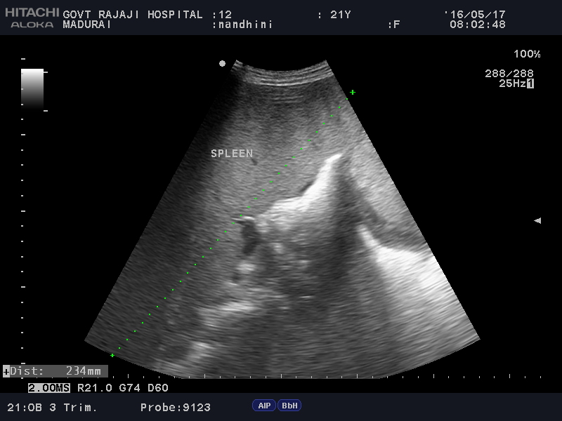

Slide 13
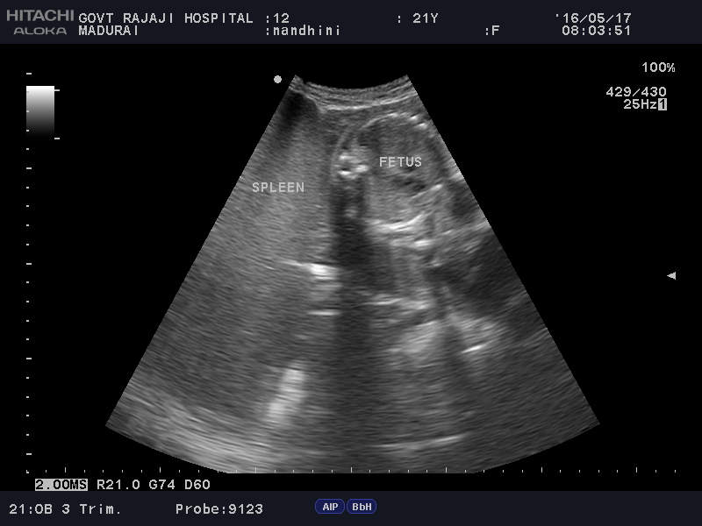

Slide 14
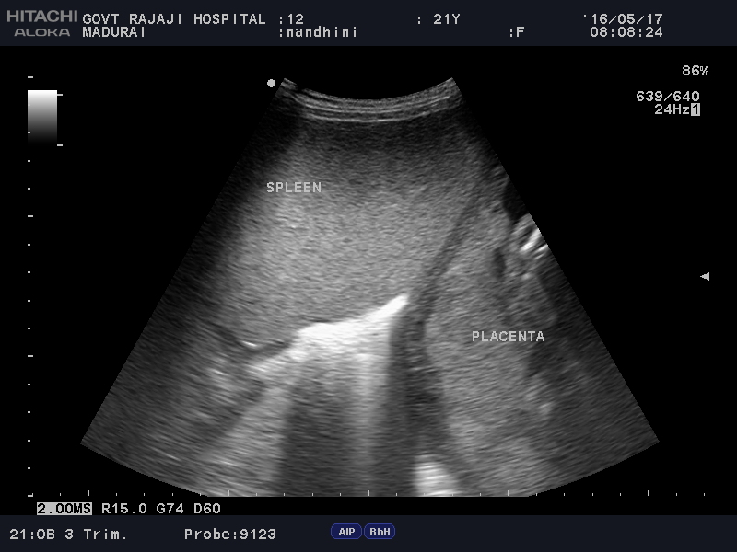

Slide 15
PERIPHERAL SMEAR
RBC-hypochromic microcytes, normochromic normocytes, elongated cells with nucleated RBCs
WBC-count is markedly increased with cells of myeloid series
DC- Blast-2%
promyelocyte-1%
myelocyte-23%
metamyelocyte-15%
band form-14%
neutrophil-40%
eosinophil-1%
basophil-2%
lymphocytes -2%
PLATELET-normal in number & morphology

Slide 16
BONEMARROW ASPIRATION
Erythropoiesis shows micro normoblast type of maturation
Leucopoiesis increased and show cells of myeloid series in different stages of maturation with 3% blast
Occasional megakaryocytes are seen
IMPRESSION-
picture is suggestive of chronic phase of CHRONIC MYELOID LEUKEMIA

Slide 17
CYTOGENETICS
Qualitative BCR-ABL GENE-detected

Slide 18
FINAL DIAGNOSIS-
CML IN PREGNANCY
CHRONIC PHASE

