Slide 1
INFECTIVE ENDOCARDITIS
6th MEDICAL UNIT
CHIEF:DR.R.SUNDARAM MD
ASSISTANT PROFESSORS: . DR.P.SUDHA MD
DR.M.J.SENTHILKUMAR MD
DR.S.SUGADEV MD
PRESENTOR: DR.K.SELVAPRAKASH
( 1st year Post Graduate)

Slide 2
DIAGNOSIS
Blood culture / serological testing
Echocardiogram
Clinical criteria

Slide 3
Blood culture
It should contain 3 sets of blood culture sets (each one containing 2 bottles)- appropriate amount of blood to be filled in each bottle is 10 ml
Ideal time between collecting blood samples is 6 hrs apart - taken from different venipuncture sites
Serological tests
Used for organisms that are difficult to be isolated from blood culture- Brucella, Bartonella, T.whipplei, C.Burnetii
Vegetations taken after surgical intervention sent for PCR with organism specific primer or broad range PCR targeting 16 S RNA. vegetations also sent for HPE and examined with special stains

Slide 4
IMAGING
ECHOCARDIOGRAPHY (TTE & TEE)
TTE - DISADVANTAGES
Fails to detect vegetations <2mm
Not optimal for evaluating PVE
Not a better tool in assessing intracardiac complications
TEE - detects vegetations > 90%
NEGATIVE TEE DOES NOT EXCLUDE THE DIAGNOSIS BUT WARRANTS REPEAT STUDY AFTER 7-10 DAYS

Slide 5
Other causes for vegetations
Malignancy like lymphoma
Autoimmune disease
Tuberculosis rarely
Rheumatic
Symmetrical
Small
Nodules may be present
Raised ASO titre
Fever is not long lasting

Slide 6
Other imaging
Cardiac CT ANGIOGRAM:
Superior than TEE in defining paravalvular infection
FDG PET
Increases the sensitivity of DUKE CRITERIA
Useful for infection associated with implantable devices
Detects extracardiac infection ( septic emboli)

Slide 7
CLINICAL CRITERIA
MAJOR CRITERIA ( MODIFIED DUKE CRITERIA)
1.Positive blood culture
Typical microorganism for infective endocarditis from two separate blood
cultures
Viridans streptococci, Streptococcus gallolyticus, HACEK group organisms,
Staphylococcus aureus, or
Community-acquired enterococci in the absence of a primary focus,
or
Persistently positive blood culture, defined as recovery of a microorganism
consistent with infective endocarditis from:
Blood cultures drawn >12 h apart; or
All of 3 or a majority of ≥4 separate blood cultures, with first and last drawn
at least 1 h apart
or
Single positive blood culture for Coxiella burnetii or phase I IgG antibody titer
of >1:800

Slide 8
2. Evidence of endocardial involvement
Positive echocardiogram
Oscillating intracardiac mass on valve or supporting structures or in the
path of regurgitant jets or in implanted material, in the absence of an
alternative anatomic explanation, or
Abscess, or
New partial dehiscence of prosthetic valve,
or
New valvular regurgitation (increase or change in preexisting murmur not
sufficient)

Slide 9
MINOR CRITERIA
1.Predisposition: predisposing heart condition
or injection drug use
2. Fever ≥38.0°C (≥100.4°F)
3. Vascular phenomena: major arterial emboli, septic pulmonary infarcts, mycotic
aneurysm, intracranial hemorrhage, conjunctival hemorrhages, Janeway
lesions
4. Immunologic phenomena: glomerulonephritis, Osler’s nodes, Roth’s spots,
rheumatoid factor
5. Microbiologic evidence: positive blood culture but not meeting major criterion,
as noted previously,d or serologic evidence of active infection with an
organism consistent with infective endocarditis

Slide 11
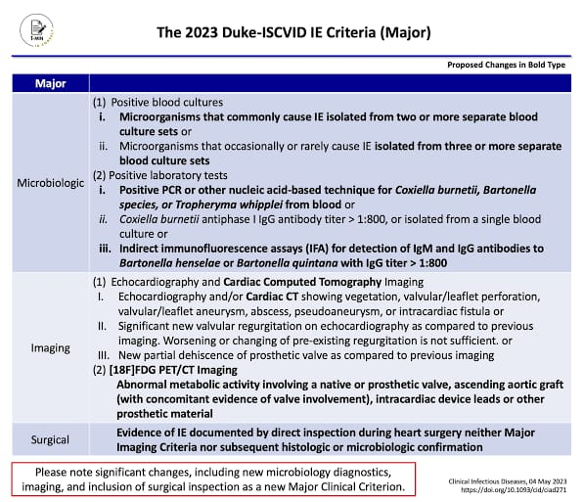

Slide 12
Major changes
New microbiology diagnostics
Imaging
Intraoperative inspection
List of ‘typical’ microorganisms expanded
Timing and separate venepuncture for blood cultures removed

Slide 13
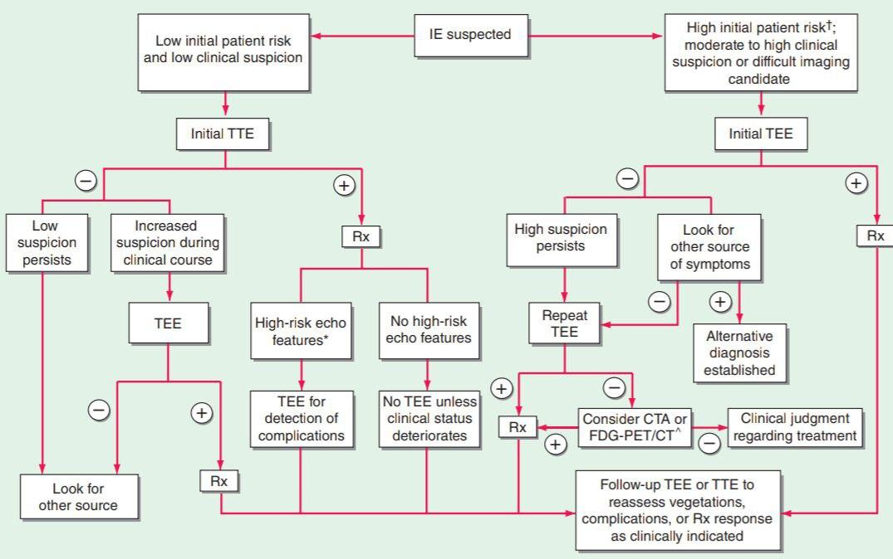

Slide 14
TREATMENT
Antimicrobial therapy
Surgical intervention
Dental evaluation and treatment
Remove the potential source of infection
Note on anticoagulation

Slide 15
ANTIMICROBIAL THERAPY
Primary goal : To eradicate infection and sterilizing vegetations
Disadvantage : Focal infection with increased bacterial density
Slow rate of bacterial growth in biofilm
Impaired host immunity
Increased binding of drugs with protein leading to inadequate antibiotic penetration
PROLONGED PARENTERAL BACTERICIDAL THERAPY should be done to
mask the inoculum effect .

Slide 16
CHOOSING THE DRUG
Empirical therapy should cover typical organisms causing IE( Staph,strep)
Knowing about local resistance pattern and MRSA PREVALENCE
Finalizing the highly effective antibiotic
Special Considerations : for less common organism( recently placed prosthetic valve,prolonged health care exposure,critical illness)- COMBINATION THERAPY - SYNERGISTIC action by adding Aminoglycosides

Slide 17
DURATION OF TREATMENT
Native valve endocarditis ;
RIGHT SIDED - 4 weeks or 2 weeks ( if combination therapy used)
LEFT SIDED - 6 weeks of parenteral antibiotic therapy
( alternative - oral switch after 10 days of IV antibiotic therapy)
Prosthetic valve endocarditis - 6 weeks of parenteral antibiotic therapy

Slide 18
ORGANISM SPECIFIC THERAPY
STREPTOCOCCUS
PENICILLIN SUSCEPTIBLE ( S.GALLOLYTICUS) MIC <0.12 mcg/ ml | Penicillin G / vancomycin/ceftriaxone 4 week OR Penicillin G/ ceftriaxone (+) Gentamicin (2 weeks). (2 weeks)
RELATIVE PENICILLIN RESISTANT (S.GALLOLYTICUS) MIC >0.12 <0.5 mcg /ml | Penicillin G/ ceftriaxone (+) Gentamicin (4 weeks). (2 weeks) OR Vancomycin ( 6 weeks)
MODERATELY PENICILLIN RESISTANT ( Granulicatella, Abiotrophia etc.,) MIC >0.5 < 8 mcg / ml | Penicillin G/ ceftriaxone (+) Gentamicin (6 weeks). (6 weeks) OR Vancomycin ( 6 weeks)

Slide 19
ENTEROCOCCUS - resistant to NAFCILLIN /OXACILLIN CEPHALOSPORINS
ENTEROCOCCUS | Penicillin G / Ampicillin( +) Gentamicin - 4 to 6 weeks OR Vancomycin (+) Gentamicin 6 weeks
ENTEROCOCCUS FAECALIS | Ampicillin (+) Ceftriaxone (6 weeks )
VANCOMYCIN RESISTANT ENTEROCOCCUS | Daptomycin (10 to 12 mg/kg IV OD)

Slide 20
STAPHYLOCOCCUS
 | NVE | PVE
MSSA | NAFCILLIN/ CEFAZOLIN/ VANCOMYCIN (6 weeks) | NAFCILLIN /OXACILLIN (6-8w) + Gentamicin ( 2 weeks ) + RIFAMPIN (6 weeks)
MRSA | VANCOMYCIN (or) DAPTOMYCIN | Vancomycin (+) Gentamicin (+) Rifampin 6 to 8 weeks

Slide 21
HACEK | Ceftriaxone/ Ampicillin
Coxiella Burnetii | Doxycycline (+) HCQ [18-24] months
Bartonella | Doxycycline (6w) (+) GENTAMICIN (2w)
Streptococcus pneumoniae causing IE without meningitis | Penicillin (+) ceftriaxone/ vancomycin
Streptococcus pneumoniae causing IE with meningitis | Ceftriaxone (+) Vancomycin
Candida | AMPHOTERICIN B +/- Flucytosine OR HIGH DOSE ECHINOCANDIN

Slide 22
EMPIRICAL THERAPY
 | NVE |  | PVE
Acute IE | Vancomycin (+) GENTAMICIN/ CEFEPIME | (PV : <1 yr) | Vancomycin (+) GENTAMICIN/ CEFEPIME
Subacute IE | Vancomycin (+) Ceftriaxone | (PV : >1 yr) | Treat as culture negative Endocarditis

Slide 23
CULTURE NEGATIVE ENDOCARDITIS
In the treatment of blood culture negative episodes, marantic endocarditis and antiphospholipid antibody syndrome should be considered
In the absence of prior antibiotic therapy with negative blood cultures, infection due to S.aureus , CONS , enterococci is unlikely
Target of empirical therapy : FASTIDIOUS STREPTOCOCCI, Abiotrophia, Granulicatella, HACEK group and Bartonella species
Treatment: Vancomycin (+) Ampicillin - sulbactam { or} Ceftriaxone
(Doxycycline can be added for Bartonella coverage )

Slide 24
Causes of fever during treatment
Uncontrolled infection
Annular abscess
Organ infarcts
Mycotic aneurysm
Thrombophlebitis
Drug fever
Super infection
Immunological phenomenon

Slide 25
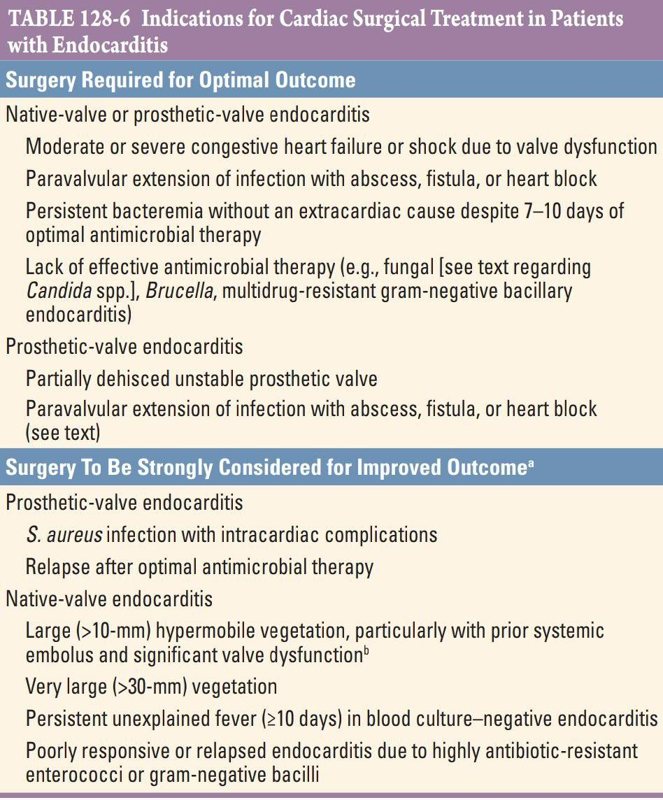
SURGICAL INTERVENTION
Patient with heart failure
Patient with uncontrolled infection
Large vegetation >10 mm
(Ref : Harrison principles of Internal medicine)

Slide 26
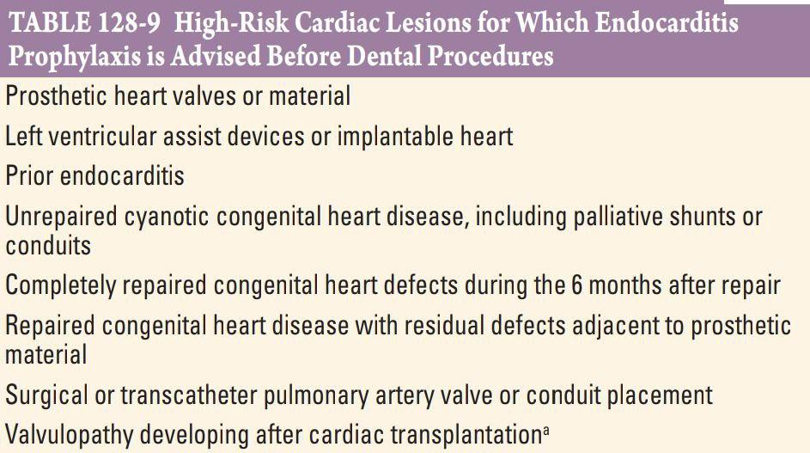
PREVENTION
No evidence of benefits from
Antibiotic prophylaxis
Should maintain good hygiene
Prophylaxis should be given if
Manipulation of gingival tissues
Is being done
Ref : Harrison principles of Internal medicine)
medicine

Slide 27
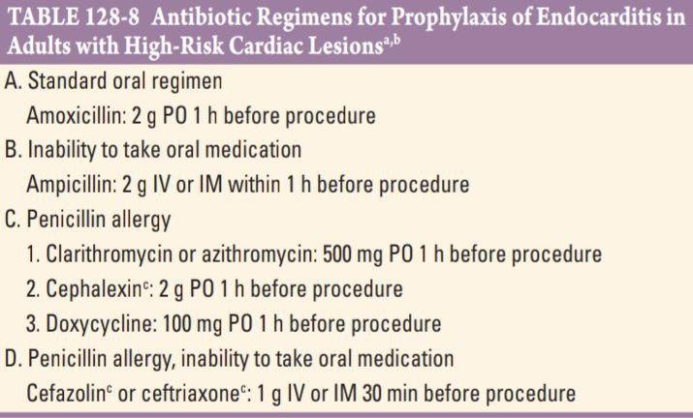
ANTIBIOTIC REGIMEN
PROPHYLAXIS
Ref : Harrison principles of Internal edicine)
medicine

Slide 28
ROLE OF ANTICOAGULATION
Neither anticoagulant nor antiplatelet therapy reduces the risk of emboli in patients with NVE
IF NO CONTRAINDICATIONS, the following patients can take anticoagulation ;,
Patient on mechanical prosthetic valve
2. AF with either MS (or) CHADS VASC score >_2
3. Deep vein thrombophlebitis

Slide 29
LIST OF REFERENCES
1.HARRISON PRINCIPLES OF INTERNAL MEDICINE
2.Infective endocarditis Journal published by Guy P. Armstrong, MD, Waitemata District Health Board and Waitemata Cardiology, Auckland
3.Infective endocarditis journal published by American heart association

Slide 30
THANK YOU

