Slide 1
PILL CAUSING MILK IN THE LUNG
By 3 Rd medical unit

Slide 2
57 yr old female presented with
H/o breathlessnes for the past 1 week ,which is insidious in onset ,gradually progressive ,initially grade 2 MMRC progressed to grade 4 not associated with orthopnea and Paroxysmal nocturnal dyspnea
H/o dry cough present
No H/o evening rise of temperature
No h/o loss of appetite /weight
No h/o hemoptysis
No H/o chest pain /palpitation
No H/o swelling of legs /abdominal distension
No H/o decreased urine output

Slide 3
Past History
K/c/o Diabetes mellitus ,Hypertension on treatment
K/c/o Chronic myeloid leukemia chronic phaseon T.Dasatinib 100 mg for the past 3 years
N/k/c/o Tuberculosis/Bronchial Asthma ,coronary artery disease
No h/o surgery in the past
No H/o any other malignancies
Contact history
No contact with tuberculosis
Menstrual history
Attained menopause

Slide 4
Examination
Conscious
Tachypneic
Pallor present
No Cyanosis /clubbing/icterus /pedal edema
On admission
BP 140/90 mmhg
PR 86/min
Spo2 -93
Respiratory rate 24/min

Slide 5
Systemic examination
CVS S1 S2 present,No Murumur
RS- Air entry decreased in right infrascapular ,infraaxillary ,mammary area ,and left infrascapular area
P/A –Soft ,bowel sound present
CNS –NFND

Slide 6
Total count | 4300 | 3500 | 3700 | 6500
Hb | 11.5 | 10.7 | 10.9 | 11.3
Platelet | 80000 | 1.50 | 1.86 | 2.46
Urea | 46 |  | 38
Creatinine | 0.9 |  | 1.0
Total bilirubin | 0.32
Direct Indirect | 0.04 0.28
SGOT | 37
SGPT | 38
FBS | 110
PPBS | 185

Slide 9
Usg Abdomen

Slide 10
CT chest Shows Bilateral Pleural Effusion more on Right side

Slide 12
Pleural fluid analysis :
On examination pleural fluid found to be milky white
Total cell count -100 cells
Sugar -137 mg/dl
Protein -5g/dl
LDH -240 u/l
Serum LDH -313 U/l
On fulfilling Lights criteria found to be exudative effusion

Slide 13
On further investigation
Pleural fluid ADA -18 U/L
Pleural fluid Triglyceride-412 And serum triglyceride 286
Pleural fluid cholestrol – 62 and serum cholestrol 239
Pleural fluid culture –No growth
Pleural fluid AFB –Negative
Pleural fluid gene expert-MTB not detected
Pleural fluid amylase -68
Pleural fluid triglyceride/serum triglyceride ratio more than 1
Pleural fluid cholestrol/serum cholestrol less than 1

Slide 16
Medical oncology opinion
Suggestive of dasitinib induced chylous effusion
Plan
To stop dasatinib
Start other tyrosine kinase inhibitor

Slide 19
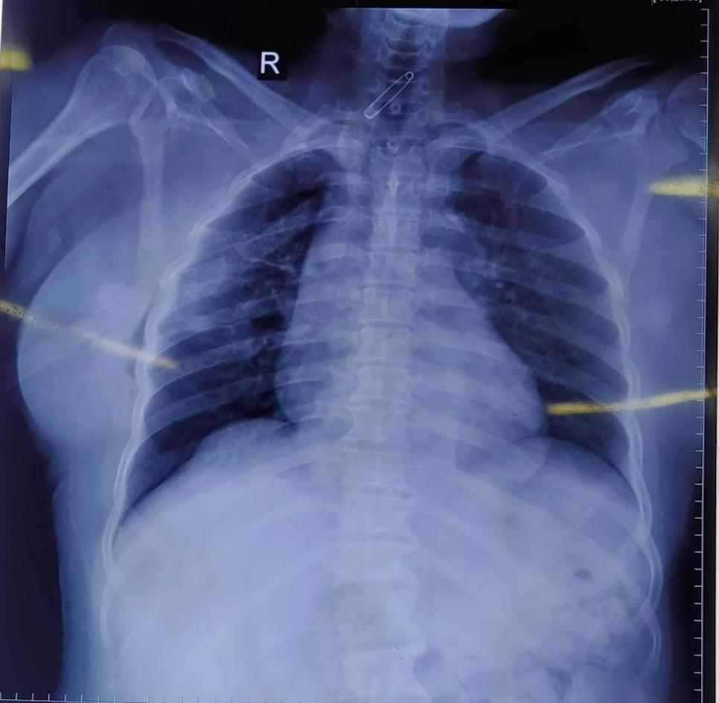
Dasatinib was stopped from the day of admission
Patient was treated with diuretics and prednisolone .
After 12 days ..collection was nil for 3 days
ICD removed

Slide 21
Aim of the presentation
To discuss rare cause of ??dasatinib induced chylothorax

