Slide 1
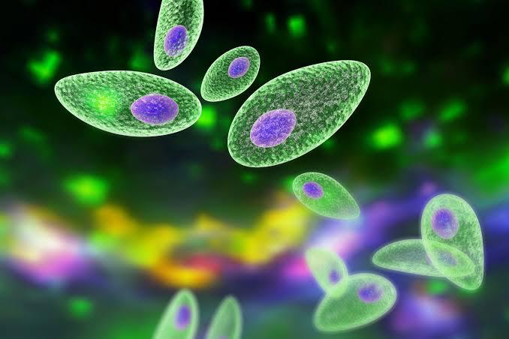
TOXO-TAX
FIRST MEDICAL UNIT
CHIEF - PROF.DR.M.NATARAJAN M.D
ASSISTANTS
DR.PALANIKUMARAN M.D
DR.VASANTHA KALYANI M.D, DCP
DR.SURESH KUMAR M.D

Slide 2
CASE SCENARIO
A 53 year old male presented in a state of altered sensorium to our GH
H/O inappropriate behaviour + *3weeks
H/O unresponsiveness to verbal commands and touch sensation
*3 weeks
No h/o seizures
No h/o loss of consciousness
No h/o weakness of limbs
No h/o fever
No h/o accidental fall
No h/o vomiting/loose stools

Slide 3
Past history
A K/C/O T2DM *4 yrs on T.Metformin 500mg 1 BID
Not a K/C/O SHTN/CVA/Seizure disorder
Pt.is an occasional alcoholic & smoker

Slide 4
On admission
Pt awake,
Not obeying commands
Afebrile
Vitals
BP-110/80 mm Hg
PR-86/min
SpO2-96% in RA

Slide 5
S/E
CVS- S1S2 + ,No murmur, no carotid bruit
RS- Bilateral air entry+ , no added sounds
P/A- soft, BS+

Slide 6
S/E of CNS
Pt. awake
Not obeying commands
B/L pupils 2.5mm ERTL
Tone - hypertonia in all 4 limbs
Power couldn’t be elicited
Reflexes 1+ in all 4 limbs
B/L plantar flexor
Cerebellar signs & sensory system couldn’t be elicited
No meningeal signs
No muscle wasting/hypertrophy

Slide 7
INVESTIGATIONS
Hb | 12.4g%
TC | 19200 cells/mm3
DC | 92/2/6
PLATELETS | 2.33 lakhs
UREA | 40
CREATININE | 1.5
BILIRUBIN | 0.6 mg
SGOT | 41 U/L
SGPT | 27 U/L
ALP | 86 U/L

Slide 8
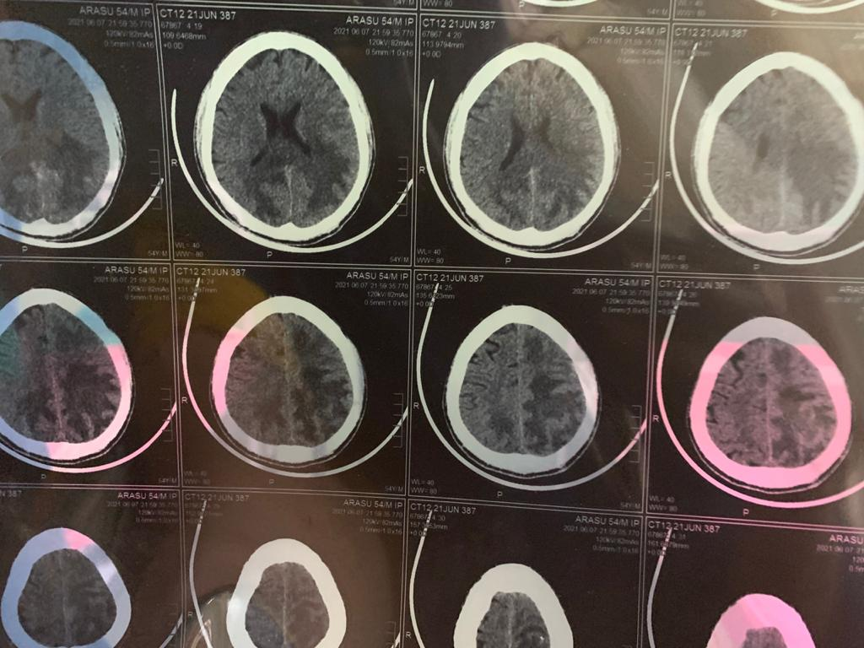
NCCT BRAIN

Slide 9
MRI BRAIN

Slide 10
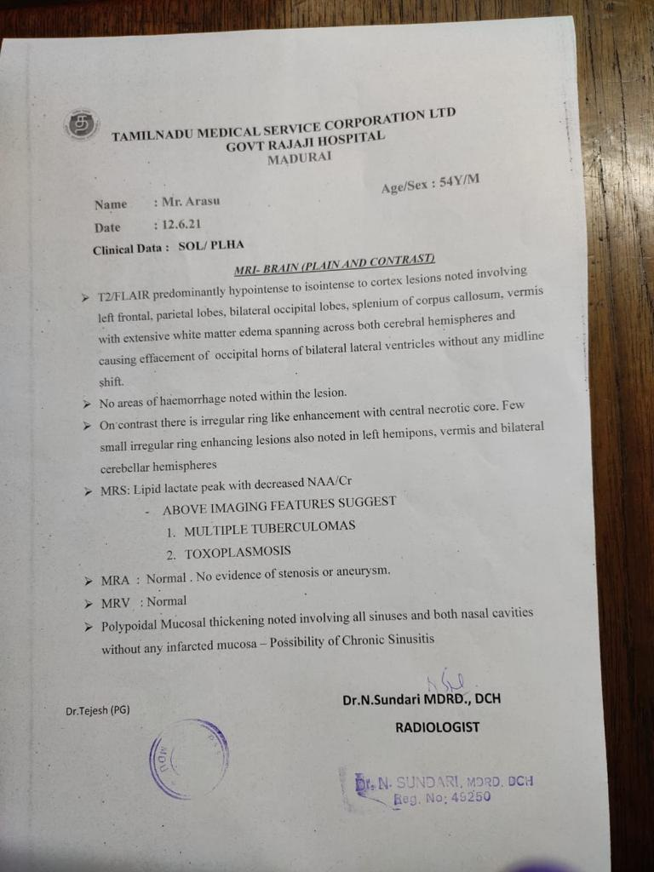

Slide 11
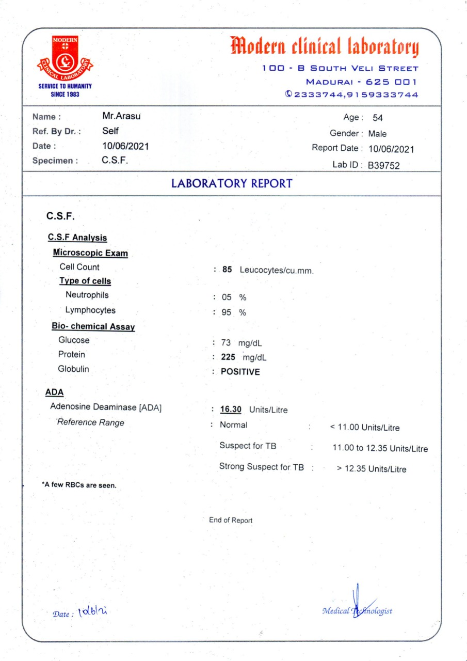
CSF ANALYSIS

Slide 12
SPUTUM AFB – Negative
SPUTUM TRUNAAT – MTB not detected
CT CHEST – No e/o PTB
CSF ADA – 16 U/L
Pt.was started on ATT
ART withheld for 2 weeks

Slide 13
VIRAL MARKERS
HbSAg & Anti-HCV – Negative
VCTC - REACTIVE
CD4 cell count – 47 cells/mm3

Slide 14
RPR – Negative
TSH – 0.78 U/L
Fundus examination – no E/O chorioretinitis/choroid tubercles/retinopathy

Slide 15
OPINIONS
NEUROLOGY
Impression – PLHA/central toxoplasmosis
Adv – Inj.dexa 8mg iv tds
T.pyrimethamine + T.sulfadiazine q6h
OPHTHALMOLOGY
Impression – External framework Normal
Fundus & media – Clear
no e/o chorioretinitis

Slide 16
IgG Toxoplasma

Slide 17
TOXOPLASMA
TUBERCULOMA
Multiple ring enhancing lesions
CD4 < 100 cells/mm3
Dx- MRI + CNS PCR/TOXO IgG
Multiple ring enhancing lesions with granulomatosis
CD4 cells > 100mm3
Dx- sputum afb/cbnaat + CT chest

Slide 18
DDx
PRIMARY CNS LYMPHOMA
BRAIN ABSCESS
PML
FUNGAL INFECTION

Slide 19
TREATMENT
Inj.Dexa 8mg iv tds
Inj.HA 6 units sc tds
ATT
TMP-SMX 960mg (480mg DS tablet)
T.Azithromycin 1200mg/wk
T.Fluconazole 150mg 1 OD
Pyrimethamine + sulfadizine + leucovorin

Slide 20
THANK YOU..

