Slide 1
METABOLIC DANCE IN MEDICINE
CHIEF PROF. Dr. David Pradeep kumar M.D, MRCP
ASST.PROF. Dr. Raghavan M.D
ASST.PROF. Dr. Naseema banu M.D
ASST.PROF. Dr. Ram kumar M.D
ASST.PROF. Dr. Nabil fayaz M.D
Presentor. Dr. Revathi PG

Slide 2
CHIEF COMPLAINTS
A 50 year old female patient
with chief complaints of involuntary movements involving all 4 limbs and face × 3 days.

Slide 3
HISTORY OF PRESENTING ILLNESS
Patient was apparently normal before 3 days then she developed
H/o Involuntary movements involving all 4 limbs and face ( Right >left ) × 3 days
No H/o Fever
" H/o Headache
" H/o Nausea/ Vomiting

Slide 4
No H/o blurring of vision
“ H/o altered sensorium
“ H/o chest pain/ palpitation/ sweating
“ H/o weakness of limbs
“ H/o sensory disturbances
“ H/o bowel and bladder disturbances
“ H/o loss of weight/ loss of appetite

Slide 5
PAST HISTORY
No H/o previous similar episodes
Not a K/c/o DM/HTN/TB/CAD/CVA/Seizure disorder/Thyroid disease
No H/o drug intake/ substance abuse
No H/o Trauma
FAMILY HISTORY
No H/o similar illness in her family members

Slide 6
PERSONAL HISTORY
Mixed diet
Not an alcoholic or smoker
Normal Bowel and bladder habits
Normal sleep pattern
MENSTRUAL HISTORY
Attained menopause

Slide 7
GENERAL EXAMINATION
Conscious
Oriented
Afebrile
Moderately built & nourished
No pallor / Icterus/ cyanosis/ clubbing/ pedal edema /generalised lymphadenopathy
No external markers of HIV/TB
“ Neurocutaneous markers

Slide 8
VITALS
BP- 100/70 mm/Hg – left upper arm in supine posture
PR – 88/min regular rhythm, normal volume, no specific character, felt equally in all peripheral vessels, no radioradial and radiofemoral delay
SPO2 - 98% in room air
RR – 16/min

Slide 9
SYSTEMIC EXAMINATION
CNS
Conscious
Oriented to time/place/person
Right handed individual
MOTOR EXAMINATION
RIGHT LEFT
BULK Normal Normal
TONE UL Normal Normal
LL Normal Normal
DTR UL + +
LL + +
PLANTAR flexor flexor
Bilateral pupil 3mm equally reactive to light

Slide 10
Sensory system – normal
Cerebellum – No nystagmus,
Other signs couldn’t be elicited
Autonomic system – normal
Spine and cranium – normal
Neck stiffness absent
CVS : S1, S2 heard, no murmur
RS : Bilateral air entry (+), no added sounds
P/A : Soft, BS (+)

Slide 11
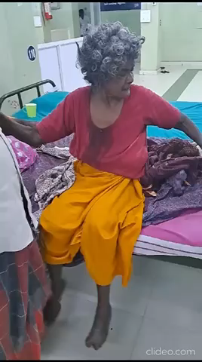

Slide 12
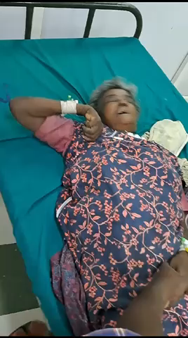

Slide 13


