Slide 1
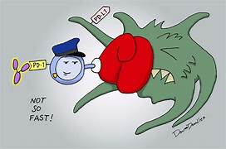
SYMPOSIUM ON Biologics: The Future of Targeted Therapy
CHIEF:PROF.DR.K.SENTHIL MD
ASSO PROF:DR.MURALIDHARAN MD
ASST PROF:DR.SUDHA MD
DR.MANIKANDAN MD
DR.SARAVAN MADHAV MD

Slide 2
*Next-Gen Monoclonal Antibodies Smarter, Stronger, and More Precise Than Ever

Slide 3
What Are Monoclonal Antibodies?
Key Points:
Lab-engineered proteins targeting specific antigens
(e.g., CD20, HER2, PD-1).
Evolution: Mouse → Chimeric (Rituximab) → Humanized (Ocrelizumab) → Fully Human (Ofatumumab).
*"We’ve gone from ‘mouse-made’ to ‘designer drugs’—like swapping a horse cart for a Ferrari!"*

Slide 4
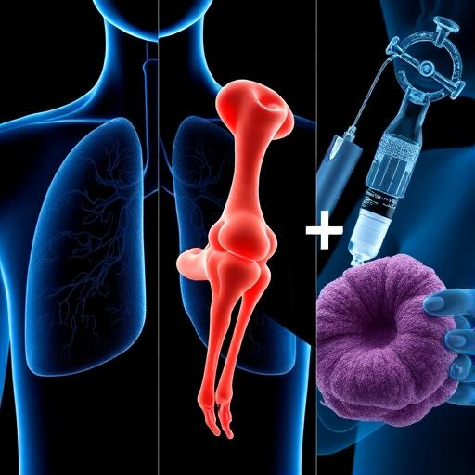
Biologics Are Reshaping Modern Medicine Content:
The Paradigm Shift:
From broad immunosuppression → Precision-targeted therapies.
2023 Global Market: 400+billion(CAGR9.4400+billion(CAGR9.48 billion*.
Why Biologics Matter:
Asthma: Cut exacerbations by 50–70%, reduce steroid dependence.
Rheumatology (RA, PsA): Halt joint destruction (e.g., TNF-α inhibitors).
Oncology: Checkpoint inhibitors (e.g., PD-1 blockers) extend survival in metastatic disease.
This Presentation Focuses On:
Asthma: Phenotype-driven biologic selection (IgE, IL-5, TSLP).
Rheumatology: Key biologics (TNF-α, IL-6, JAK inhibitors).
Malignancy: Immunotherapy (PD-1/PD-L1, CAR-T).

Slide 5
OVERVIEW OF TYPE 2 VS NON TYPE 2 ASTHMA{PHENOTYPE}

Slide 6
Persistently Uncontrolled Severe Asthma: Biologic Therapies
Indications for Biologics
Patients with severe asthma uncontrolled despite:
High-dose inhaled glucocorticoids (ICS).
Additional controllers (e.g., LABA, LAMA, leukotriene modifiers).
Role of Biologics:
Biologics target underlying airway inflammation (type 2 or non-type 2 pathways).
Reduce exacerbations, oral GC dependence, improve lung function.
~80% of patients experience ≥50% reduction in exacerbations/oral GC use.
~25% achieve normal lung function, no exacerbations, and cessation of oral GCs.
~50% remain partially uncontrolled, so biologics are not a cure-all.

Slide 7
Workup Before Biologic Initiation
Confirm uncontrolled asthma (exclude poor adherence/comorbidities).
Assess phenotype:
History: Childhood vs. adult onset, atopy.
Testing: IgE, BEC, FeNO, allergen testing.
Repeat testing if biomarkers are borderline (intermittent elevations common).
Exclude mimics: Chronic infections (e.g., helminths), alternative diagnoses.

Slide 8
Available Biologic Agents
Drug | Target | Key Eligibility Criteria
Omalizumab | IgE | IgE 30–700 IU/mL + atopy, age ≥6
Mepolizumab | IL-5 | Blood eosinophils ≥150 (≥300 in EU), age ≥6
Benralizumab | IL-5Rα | Eosinophils ≥150, age ≥6 (US) or ≥18 (EU)
Dupilumab | IL-4Rα (blocks IL-4/13) | Eosinophils ≥150 or FeNO ≥25, age ≥6
Tezepelumab | TSLP | No biomarker threshold, age ≥12

Slide 9
Dosing & Administration
Omalizumab | Subcutaneous | 150–375 mg every 2–4 weeks* (weight/IgE-based)
Mepolizumab | Subcutaneous | 100 mg every 4 weeks
Benralizumab | Subcutaneous | Loading: 30 mg q4w ×3 → Maintenance: 30 mg q8w
Dupilumab | Subcutaneous | Loading: 400–600 mg → Maintenance: 200–300 mg q2w
Tezepelumab | Subcutaneous | 210 mg every 4 weeks
Footnotes:
Omalizumab: Dose calculated by weight/IgE (0.016 mg/kg per IU/mL monthly).
Dupilumab: Higher dose (300 mg q2w) for GC-dependent asthma/atopic dermatitis.

Slide 10
Efficacy and Key Trials
Dupilumab:
Reduces exacerbations by ~50%, improves FEV1.
Oral GC-sparing: 70% reduction in GC dose vs. 42% with placebo.
Tezepelumab:
Reduces exacerbations by 56–73%, even in low FeNO/BEC subgroups.
No significant GC-sparing effect in overall population (but benefits high eosinophils).
Anti-IL-5/5R (Mepo/Resli/Benra):
Exacerbation reduction: 50–70% in eosinophilic asthma.
Benralizumab: More potent eosinophil depletion; every-8-week dosing.
Omalizumab:
Best for allergic asthma; reduces exacerbations by 25%.

Slide 11
Which biologic would you choose for a patient with eosinophilia + oral GC dependence?
CONSIDER
Patient Profile:
Severe asthma (uncontrolled on high-dose ICS + LABA).
Eosinophilia: Blood eosinophils ≥150 cells/µL (or ≥300 in EU).
Oral GC-dependent: Requires chronic systemic steroids (e.g., prednisone ≥5 mg/day).

Slide 12
Recommended Biologic: Dupilumab or Benralizumab
1. Dupilumab (Anti-IL-4Rα)
Why?
Strongest evidence for GC-sparing:
In clinical trials, dupilumab reduced oral GC doses by 70% (vs. 42% placebo) and enabled discontinuation in 80% of patients (SIRIUS trial).
Dual inhibition of IL-4/IL-13: Broader anti-inflammatory effect.
Additional benefits: Improves lung function (FEV1 ↑0.15 L) and reduces exacerbations by 50%.
Dose:
Loading: 600 mg SC → Maintenance: 300 mg q2w (higher dose for GC-dependent patients).

Slide 13
2. Benralizumab (Anti-IL-5Rα)
Why?
Rapid eosinophil depletion: Kills eosinophils via antibody-dependent cytotoxicity.
GC-sparing data:
In the ZONDA trial, benralizumab reduced oral GCs by 75% (vs. 25% placebo).
PONENTE study: 62% of patients stopped oral GCs entirely.
Convenient dosing: q4w ×3 → q8w maintenance.
Dose:
Loading: 30 mg SC q4w ×3 → Maintenance: 30 mg q8w
Alternatives (If Contraindications Exist)
Mepolizumab (Anti-IL-5):
Modest GC-sparing (50% reduction in SIRIUS trial).
Less potent than benralizumab for eosinophil depletion.
Tezepelumab (Anti-TSLP):
Limited GC-sparing data but effective in eosinophilic asthma.
Consider if FeNO ≥25 ppb or non-Type 2 features.

Slide 14
Phenotype-Driven Selection
Algorithm:
Allergic Asthma (IgE+): Omalizumab.
Eosinophilic Asthma (BEC ≥150):
Anti-IL-5 (mepolizumab/reslizumab) or anti-IL-5R (benralizumab).
High FeNO (≥25 ppb): Dupilumab/tezepelumab.
Non-Type 2/Low Biomarkers: Tezepelumab.

Slide 15
Switching Biologics for Non-Responders
When to Switch:
Persistent exacerbations, poor symptom control after 4–6 months.
Options:
Anti-IL-5 → Benralizumab (more potent eosinophil depletion).
Anti-IgE → Anti-TSLP (tezepelumab for broader inflammation).
Limited data on sequential use; monitor closely.

Slide 16
Safety & Monitoring
Drug | Adverse Effects | Monitoring
Omalizumab | Anaphylaxis (0.1–0.2%) | Observe post-injection.
Dupilumab | Eosinophilia, arthralgias, psoriasis | Check BEC at 3–6 months.
Anti-IL-5 | Herpes zoster (mepolizumab) | Vaccinate high-risk patients.
Tezepelumab | Hypersensitivity | Prefilled auto-injector option.
Recommendations:
Treat helminth infections pre-biologic initiation.
Assess response at 4–6 months (exacerbations, lung function, GC use).

Slide 17
Alternatives for Non-Responders
Azithromycin: 250 mg 3x/week (reduces exacerbations, independent of eosinophils).
Bronchial Thermoplasty: For select patients (risks:bronchospasm, hospitalizations).
Practical Takeaways
Biologics are transformative but not curative; ~50% of patients remain partially uncontrolled.
Phenotype-driven selection (IgE, eosinophils, FeNO) is critical.
Dupilumab and tezepelumab have broad efficacy (including oral GC-sparing and non-type 2 asthma, respectively).
Consider tezepelumab for non-Type 2 asthma.
Monitor response at 4–6 months.
Optimize adherence before switching
Switching biologics may help non-responders, but evidence is limited.

Slide 18
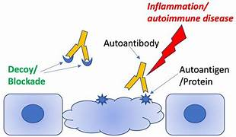
Monoclonal Antibodies in Rheumatological Disorders
Precision Medicine for Autoimmune Diseases

Slide 19
Rheumatological Disorders: A Snapshot
1. Rheumatoid Arthritis (RA)
Pathology: Symmetrical synovitis → joint destruction (anti-CCP/RF+).
Hallmark: Morning stiffness, pannus formation.
2. Psoriatic Arthritis (PsA)
Pathology: Enthesitis, dactylitis, axial/skin involvement (IL-23/17-driven).
Hallmark: "Pencil-in-cup" deformity on X-ray.
3. Ankylosing Spondylitis (AS)
Pathology: Sacroiliitis, spinal fusion (HLA-B27+).
Hallmark: "Bamboo spine" on imaging.
4. Systemic Lupus Erythematosus (SLE)
Pathology: Autoantibodies (ANA, anti-dsDNA), multi-organ involvement.
Hallmark: Malar rash, glomerulonephritis.
5. Vasculitis (e.g., ANCA-associated)
Pathology: Vessel inflammation (c-ANCA/PR3+).
Hallmark: Necrotizing granulomas (GPA), pulmonary-renal syndrome.

Slide 20
Unmet Needs in Rheumatology & Why mAbs Matter
1. Steroid Dependence: The Vicious Cycle
Problem:
Long-term glucocorticoids (GCs) cause diabetes, osteoporosis, and cardiovascular disease
30-40% of RA/SLE patients remain steroid-dependent despite conventional DMARDs
mAb Solution:
TNF-α/IL-6 inhibitors (e.g., adalimumab, tocilizumab) reduce steroid doses by 50-70%
Rituximab enables steroid-free remission in 60% of vasculitis patients (RAVE trial)
2. Progressive Joint Damage: The Silent Destroyer
Problem:
Irreversible erosions occur within 2 years in 70% of untreated RA
Syndesmophytes in AS lead to spinal fusion
mAb Solution:
TNF-α inhibitors halt radiographic progression in 80% of RA patients
IL-17 inhibitors (secukinumab) reduce spinal inflammation in AS

Slide 21
3. Beyond Joints: Systemic Complications
Problem:
Cardiovascular disease (RA patients have 2x higher MI risk)
Pulmonary fibrosis (in 10% of scleroderma)
mAb Solution:
Tocilizumab reduces arterial inflammation (RA)
Nintedanib (mAb-like tyrosine kinase inhibitor) slows lung fibrosis

Slide 22
KEY TARGETS[overview on currently available drugs]
Mechanisms of Action
Cytokine Neutralization (TNF-α, IL-6).
Cell Depletion (CD20 on B-cells).
Receptor Blockade (IL-17R).
Table:
Target | Disease Relevance | Example mAbs
TNF-α | RA, PsA, AS | Adalimumab, Infliximab
IL-6R | RA, juvenile idiopathic arthritis | Tocilizumab
CD20 | RA, ANCA vasculitis | Rituximab
IL-17/23 | PsA, ankylosing spondylitis | Secukinumab, Guselkumab

Slide 23
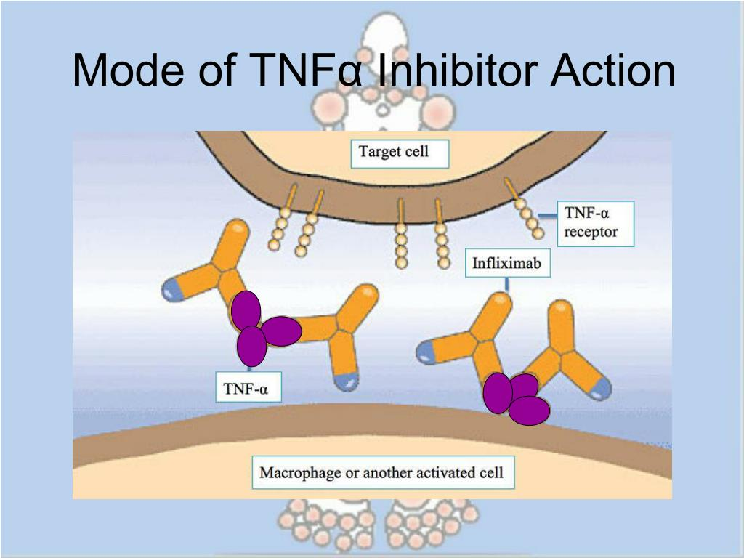
TNF-α Inhibitors (Deep Dive)
Drugs: Adalimumab, Etanercept, Infliximab.
Efficacy:
ACR50 in 60% RA patients.
Halt radiographic progression.
IL-6 Inhibitors
Tocilizumab/Sarilumab:
For TNF-refractory RA.
Improves fatigue (JAK-STAT modulation).

Slide 24
B-Cell Depletion (Rituximab)
Mechanism: Targets CD20 → B-cell apoptosis.
Uses:
Refractory RA.
ANCA vasculitis (90% remission in RAVE trial). Caution: Hypogammaglobulinemia risk.
IL-17/23 Inhibitors
Secukinumab/Ixekizumab (IL-17): PsA, AS.
Guselkumab (IL-23): PsA skin/joint symptoms

Slide 25
Safety Profile
Risk Stratification:
Infections: TB, herpes zoster (screen pre-treatment).
Malignancy: Controversial (long-term data needed).
Cardiovascular: TNF-α inhibitors in CHF.
Monitoring Protocol
Checklist:
Baseline: TB/HEP B/C, CBC, LFTs.
Ongoing:
Infection signs (every 3–6 months).
Lipid panels (IL-6 inhibitors).

Slide 26
Unmet Needs:
Refractory disease (30% fail TNF inhibitors)
Safety (infections, cardiovascular risks)
Convenience (less frequent dosing)

Slide 27
Novel Targets & Mechanisms
Hot Targets in 2024:
TSLP (Tezepelumab – under trial for SLE)
IL-23p19 (Mirikizumab – PsA phase III)
GM-CSF (Otilimab – RA phase III)
Bispecific mAbs
Definition: Single antibody binding two targets (e.g., TNF-α + IL-17).
Example: Vunakizumab (IL-17A/IL-17F bispecific – PsA trials).

Slide 28
IgG4-Engineered mAbs
↓ Infections: Less immune cell activation (e.g., fewer neutropenia cases).
↓ Cytokine Release Syndrome: Weak FcγR binding avoids excessive inflammation.
Ideal for Blocking Pathways:
Targets where cell depletion is undesirable (e.g., cytokine neutralization).
Example:
Nipocalimab (anti-FcRn IgG4):
Mechanism: Blocks FcRn to degrade pathogenic IgG (e.g., in SLE/RA).
Phase II Trials:
RA: Reduced autoantibodies without B-cell depletion.
SLE: Lower anti-dsDNA antibodies

Slide 29
Clinical Advantages of IgG4 mAbs
Safety: Fewer infusion reactions vs. IgG1 (e.g., vedolizumab for IBD).
Flexibility: Can be used in combo therapies without over-suppression.
Limitations:
Not for diseases requiring cell depletion (e.g., CD20 mAbs like rituximab).
IgG4 mAbs are like ‘silent blockers’—they neutralize targets without kicking the immune system into overdrive.“
Future Pipeline
2025+ Candidates:
IL-33 inhibitors (e.g., Etokimab – RA phase II).
CAR-T for SLE (early trials).

Slide 30
GM-CSF Inhibitors
Rationale: Targets macrophage activation.
Otilimab:
Phase III for RA (BAROQUE trial).
Potential in TNF-refractory disease.
TSLP Inhibitors “The next TNF-α?"
Beyond Asthma: Tezepelumab in SLE/lupus nephritis trials.
Promise: Broad anti-inflammatory effects.
Neonatal Fc Receptor (FcRn) Blockers
Mechanism: Reduce pathogenic IgG (e.g., in SLE).
Drugs:
Efgartigimod (approved for myasthenia gravis, SLE trials).
Batoclimab (phase III for RA).

Slide 31
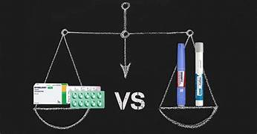
Oral mAbs?
Breakthrough: Nanoparticle-conjugated mAbs (preclinical).
Challenge: GI stability.
Nanoparticle Solutions
Polymer-Based Nanoparticles (e.g., PLGA):
Protect mAbs from gastric acid
Example: Oral adalimumab in phase I (RA trials)
Cell-Penetrating Peptides (CPPs):
Enhance intestinal uptake (e.g., TAT peptide-conjugated infliximab)
Mucoadhesive Carriers:
Chitosan nanoparticles prolong contact with intestinal mucosa
"Oral mAbs could transform compliance—but can they match biologic efficacy?"

Slide 32
Safety of Newer mAbs
Emerging Risks:
IL-23 inhibitors: Possible IBD exacerbation.
FcRn blockers: Hypogammaglobulinemia.
Key Takeaways:
New targets (TSLP, GM-CSF) address refractory disease.
Bispecifics/IgG4 engineering improve precision.
Safety and convenience remain priorities.

Slide 33
Next-Gen Monoclonal Antibodies in Hematology & Oncology

Slide 34
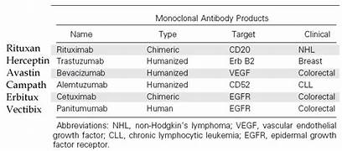
Current mAbs – The "Old Guard“[OVERVIEW]
Key Drugs & Targets:
These drugs saved millions, but it’s 2025—time for an upgrade!"

Slide 35
Limitations of Current Monoclonal Antibodies (mAbs)
Why Current mAbs Aren’t Perfect“
Immunogenicity "Imagine your immune system attacking your therapy—like friendly fire in a war!"
Problem: Chimeric (mouse-human) mAbs (e.g., Rituximab) trigger HAMA (human anti-mouse antibody) responses, reducing efficacy over time.
Example: ~30% of patients develop anti-drug antibodies against infliximab.
Resistance: "Cancer is a master of disguise—it ‘changes its outfit’ to evade mAbs!"
Problem: Tumors downregulate target antigens (e.g., CD20 loss in lymphoma after Rituximab).
Example: ~40% of HER2+ breast cancers resist trastuzumab via PI3K mutations.
Infusion Reactions’’These drugs save lives, but they can hit like a truck on the first ride."
Problem: Cytokine release syndrome (CRS), fever, hypotension (e.g., with first-dose Rituximab).
Example: Severe CRS in ~10% of patients receiving blinatumomab.

Slide 36
Why We Need Next-Gen Monoclonal Antibodies "Cancer evolves—why shouldn’t our drugs?"
Key Problems with Current mAbs:
Resistance
Example: Up to 40% of lymphomas become Rituximab-refractory due to:
CD20 antigen loss
Complement evasion
Impact: Treatment failure → Worse survival
Toxicity
Example: Trastuzumab’s cardiotoxicity (↓LVEF in 5-10% of patients)
Other toxicities: Cytokine storms, severe infections
Limited Efficacy in Aggressive Cancers
Example: Glioblastoma, pancreatic cancer barely respond to current mAbs
Why? Poor tumor penetration, immunosuppressive TUMOR MICROENVIRONMENT

Slide 37
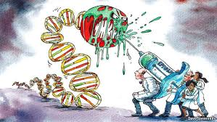
Next-Gen mAbs – The "Superheroes" "Forget ‘targeted therapy’—this is precision warfare.
4 Breakthrough Categories:
Bispecific Antibodies (Blinatumomab, Mosunetuzumab)
ADCs (Brentuximab vedotin, Enfortumab vedotin)
Checkpoint Inhibitors (Pembrolizumab, Nivolumab)
Fc-Engineered mAbs (Obinutuzumab, Mogamulizumab)

Slide 38
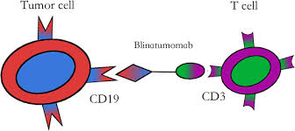
Bispecific Antibodies – The "T-Cell Bridge" Revolution
Blinatumomab in ALL: A Game-Changer for Tough Cancers*
Two Arms, One Mission:
Arm 1 (CD19): Binds *B-cell cancers* (ALL, NHL).
Arm 2 (CD3): Grabs *T-cells* (even exhausted ones).
Forces a "Synapse": T-cells deliver lethal hits directly
to tumors.
*"No chemo needed—just a T-cell escort to cancer’s doorstep!"*
Key Trial Data:
TOWER Trial: 2x overall survival vs chemo in relapsed/refractory ALL (7.7 → 16.2 months).

Slide 39
COMPARISION;
Limitations (Keep It Real)
Cytokine Release Syndrome (CRS): 15% severe cases (tocilizumab works!).
Short Half-Life: Requires continuous IV infusion (newer bispecifics fix this).
Transition: *"But wait—bispecifics are evolving. Next up: *off-the-shelf* versions!"*
Feature | Chemotherapy[HARSH REALITY] | Blinatumomab
Response Rate (R/R ALL) | 30-40% | 80% CR/CRh*
Toxicity | Cytopenias, infections | Mild cytokine release (manageable)
Treatment Time | Months in hospital | Outpatient (continuous infusion)
*CRh = Complete remission with partial hematologic recovery

Slide 40
Off-the-Shelf" Bispecifics - The Solution
Key Advantages: ✅ Pre-made, standardized doses (like traditional mAbs) ✅ Longer half-life (weekly/monthly dosing) ✅ Instant availability (no production delays)
Leading Examples:
Mosunetuzumab (CD20xCD3):
First subcutaneous bispecific for lymphoma
FDA-approved for R/R follicular lymphoma
Glofitamab (CD20xCD3):
Fixed-duration therapy (12 cycles max)
56% CR rate in aggressive DLBCL

Slide 41
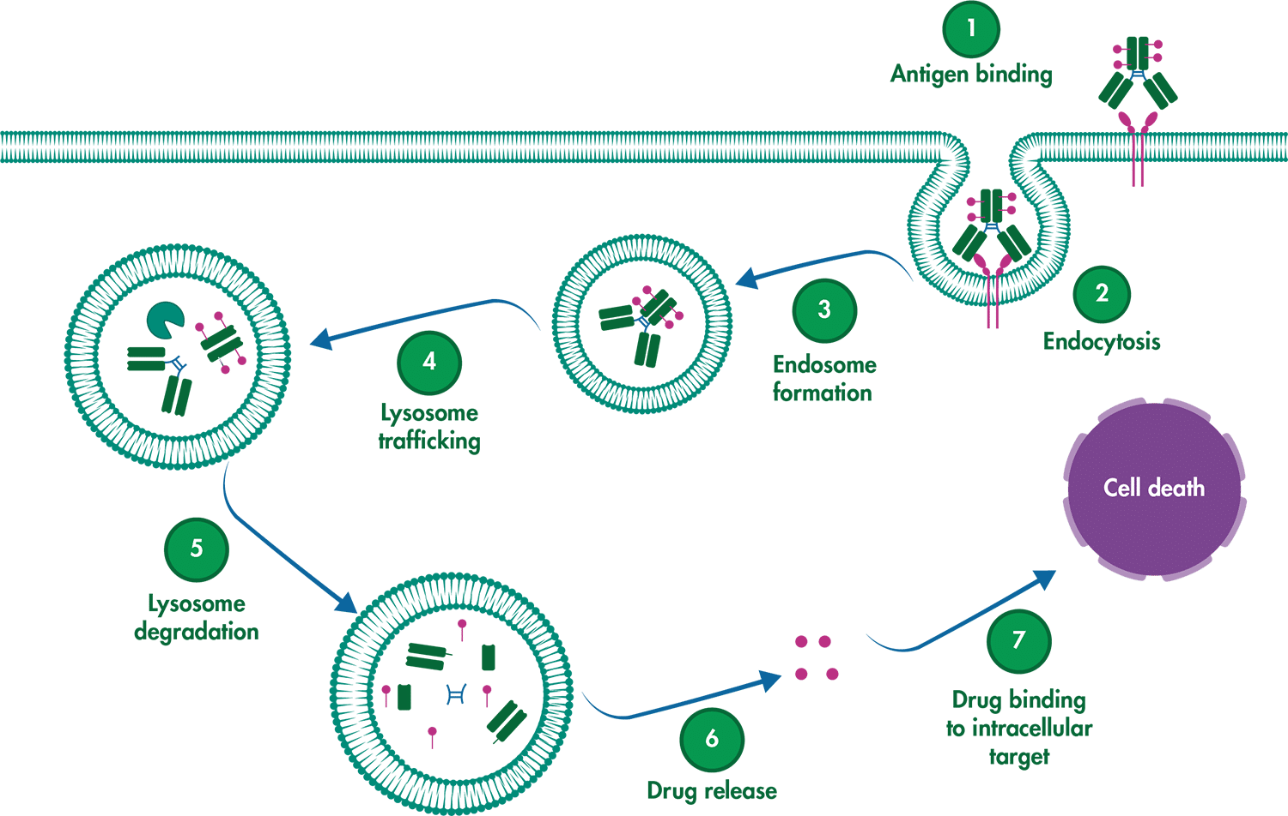
ADCs [Antibody-drug conjugates]– The "Smart Bombs" of Cancer Therapy
How ADCs Work
Targeting: Antibody binds tumor antigen (e.g., CD30, Nectin-4)
Internalization: ADC enters cancer cell
Detonation: Linker breaks → releases potent chemo
Advantages vs Traditional Chemo:
✅ 10x Lower Systemic Exposure (Less hair loss/nausea)
✅ Works in Chemo-Resistant Tumors
✅ Fewer Hospitalizations (Outpatient administration)

Slide 42
Clinical Superstars
Drug | Target | Cancer | Game-Changing Trial
Brentuximab vedotin | CD30 | Hodgkin’s | AETHERA: 5-yr PFS 59% vs 41% (placebo)
Enfortumab vedotin | Nectin-4 | Bladder | EV-302: OS 31.5 mo vs 16.1 mo (chemo)
Trastuzumab deruxtecan | HER2 | Breast | DESTINY-Breast04: HR 0.64 for HER2-low
Real-World Impact:
Brentuximab transformed relapsed Hodgkin’s from fatal → chronic
Enfortumab doubled survival in platinum-refractory bladder cancer
Limitations (Keep It Real)
Unique Toxicities:
Brentuximab: Peripheral neuropathy (30%)
Enfortumab: Skin rash (50%)
Resistance: Tumors downregulate target antigens

Slide 43
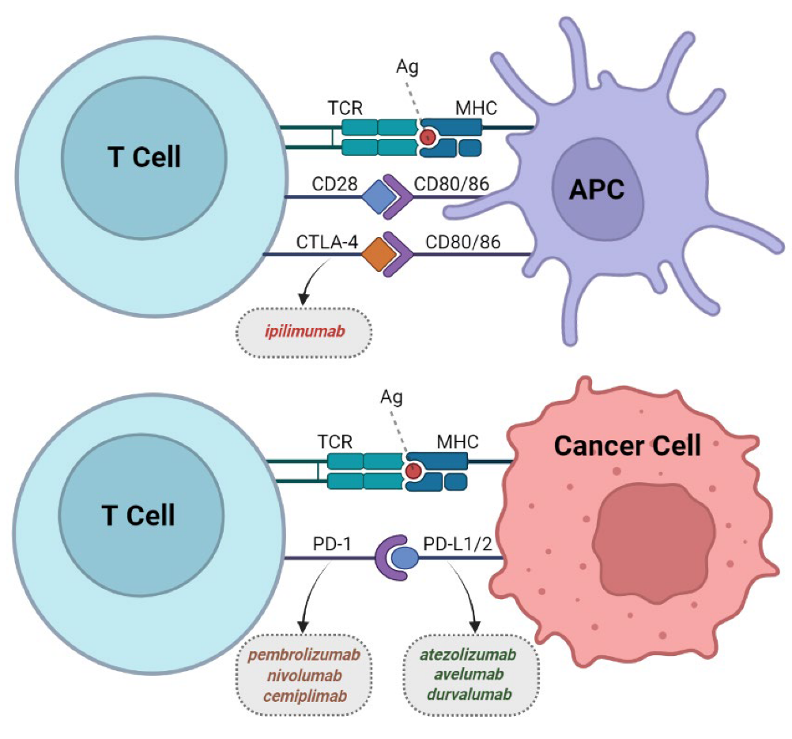
Checkpoint Inhibitors – Mechanism & Key Drugs These drugs don’t kill cancer—they empower your immune system to do it!"
The Immune Evasion Problem
Tumors exploit PD-1/PD-L1 and CTLA-4 pathways to "switch off" T-cells
How Checkpoint Inhibitors Fight Back
Pembrolizumab/Nivolumab (anti-PD-1):
Blocks PD-1 → T-cells see through cancer’s disguise
Ipilimumab (anti-CTLA-4):
Boosts T-cell activation earlier in immune response

Slide 44
Clinical Superstars
Drug | Target | Key Indication | Landmark Trial
Pembrolizumab | PD-1 | NSCLC, Melanoma | KEYNOTE-024: 31% 5-yr OS in NSCLC
Nivolumab | PD-1 | Hodgkin’s | CheckMate-205: 69% ORR in R/R HL
Ipilimumab | CTLA-4 | Melanoma | CA184-002: First to show OS benefit

Slide 45
Durable Responses & Real-World Impact "From Terminal to Chronic: Checkpoint Inhibitors in Action"
Why They’re Revolutionary
Durable Remissions:
Melanoma: 20% alive at 10 years (vs. <5% pre-2011)
NSCLC: 5-year survival now 25% (vs. 5% with chemo
Limitations ; Only 20-40% respond (need biomarkers like PD-L1/TMB)
Unique Toxicities:
Colitis, pneumonitis, endocrinopathies
Future Directions
Combinations:
PD-1 + CTLA-4 (e.g., Opdualag for melanoma)
PD-1 + LAG-3 (Relatlimab)

Slide 46
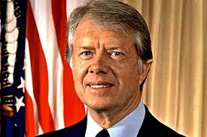
Metastatic Success Stories: GUESS THE PERSONALITY
After I was diagnosed, I just hoped I’d see my youngest daughter go to kindergarten,”. “Now maybe I can see her get married.”
Melanoma brain mets → cured with pembrolizumab

Slide 47
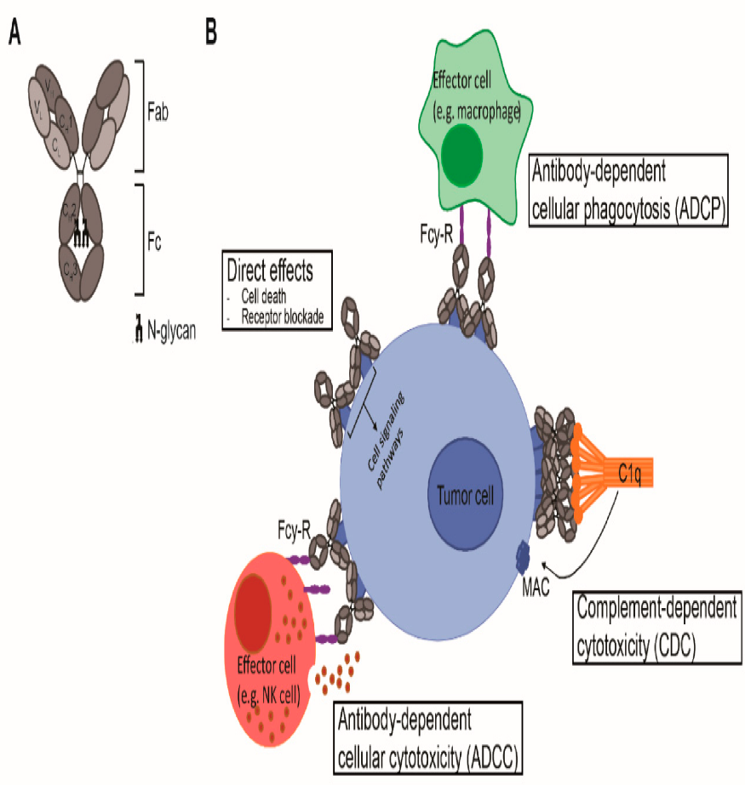
Fc-Engineered mAbs - The Upgrade Your Immune System Needs "Fc-Engineered mAbs: Next-Level Targeted Therapy"
What is Fc Engineering?
Modification of the antibody's Fc region to enhance immune system interactions
Like giving antibodies "superpowers" to better fight cancer
Key Improvements: ✓ Stronger binding to immune cells (NK cells, macrophages) ✓ Longer lasting effects in the body ✓ More efficient cancer cell killing
How They Work: Regular mAb: Weak Fc binding → modest immune activation
Fc-engineered: Supercharged Fc → robust immune attack

Slide 48
Key Drugs & Benefits:
Obinutuzumab (CLL/NHL):
78% response rate in CLL
Subcutaneous formulation available
Mogamulizumab (T-cell lymphomas):
Targets CCR4 on malignant T-cells
MAVORIC trial: Doubled PFS vs vorinostat (7.7 vs 3.1 months)
Advantages Over 1st Gen:
Feature | Rituximab | Obinutuzumab
ADCC | Moderate | Very Strong
PFS (CLL) | 15 months | 29 months
Infusion Time | 4+ hours | As fast as 90 min

Slide 49
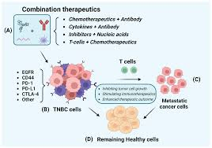
The Next Frontier - Combination Therapies
Key Developments:
CAR-T + mAb Synergy
Example: CD19 CAR-T + Blinatumomab for ALL
Rationale: mAbs prime tumor microenvironment for enhanced CAR-T activity
Early data: 92% CR in relapsed/refractory ALL (MSKCC trial)
ADC + Checkpoint Inhibitor Combos
Example: Enfortumab vedotin + pembrolizumab
Approved for bladder cancer (EV-302 trial: OS 31.5 vs 16.1 mo)
Triple Threat Approaches
Bispecific + CAR-T + cytokine therapy in development

Slide 50
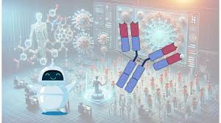
The AI Revolution in Antibody Design "From Lab Bench to Algorithm: AI in mAb Discovery"
Transformative Changes:
AI-Enabled Discovery
Example: Generate 100,000+ antibody variants in silico
Reduced development time from 5 years → 18 months
Next-Gen Improvements
Epitope prediction with AlphaFold3
Toxicity modeling to reduce clinical trial failures
Personalized mAbs
Patient-specific neoantigen targeting
Rapid manufacturing (<30 days)

Slide 51
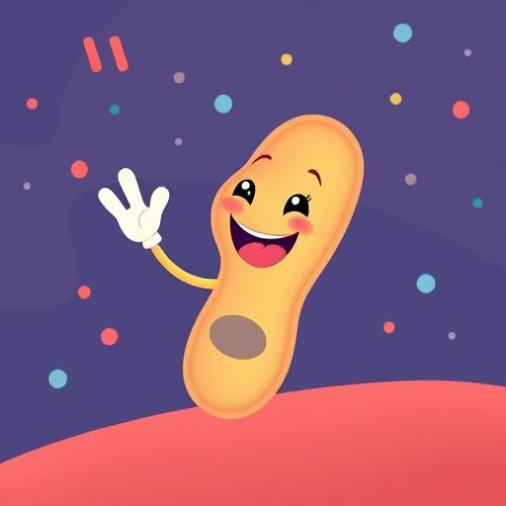
"You've been great antigens - hope we bonded perfectly!“ No immunogenicity detected,HOPE SO!
THANK YOU
Antibodies May Be Monoclonal… But Our Gratitude Is Polyclonal!

