Slide 1
BLEEDING PALE MAN CHIEF:DR.J.SANGUMANI MD D.Diab ASSISTANT PROFESSORS: DR.PALANIKUMARAN MD d.diab DR.SUDHA MD DR.SENTHILKUMAR MD presentor :dr.priyadharshan

Slide 2
A 58 year male came with complaints of
Bleeding from nose – 2 episodes
HISTORY OF PRESENTING ILLNESS
He was apparently normal before 4 years then had
Epistaxis on and off.
h/o Easy fatigability and breathlessness.
No h/o cough with expectoration
No h/o hemoptysis
No h/o bleeding from gums
No h/o hematuria
No h/o hematemesis,Malena

Slide 3
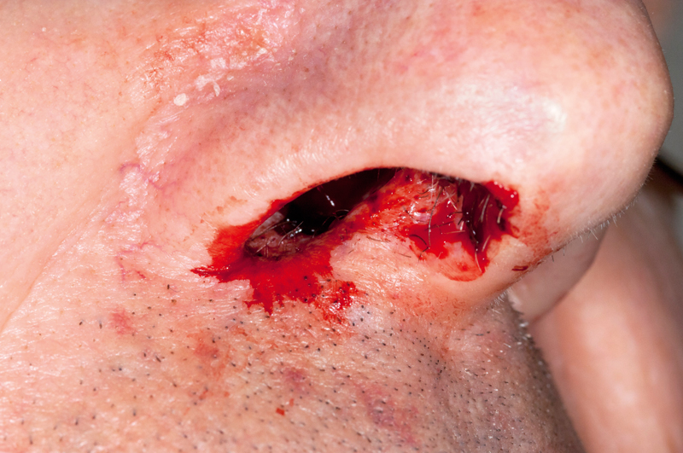
No h/o fever
No h/o chest pain
No h/o breathlessness
No h/o trauma

Slide 4
PAST HISTORY
H/O Epistaxis on and off for 4 years.
Age of onset -18 years of age,
H/o blood transfusion 2 times for severe Anemia
H/o sputum positive Pulmonary Tuberculosis on October 2019 and completed ATT ON may 2020
Not a diabetic,not a hypertensive.no h/o asthma,epilepsy

Slide 5
FAMILY HISTORY

Slide 6
Age of onset of bleeding(Epistaxis)
Patient-18 years of age
Daughter-18 years of age
Grandson – 8 years of age

Slide 7
General examination
Patient conscious ,oriented.
pallor +,
no icterus,
no cyanosis,
no clubbing,
no lymphadenopathy,
no pedal edema
BP -110/80 mmhg
PR - 80/min, normal volume
SPO2-
On standing -98% room air
On sitting -96% room air
MULTIPLE PURPURIC SPOTS OVER TONGUE,HARD PALATE.

Slide 9
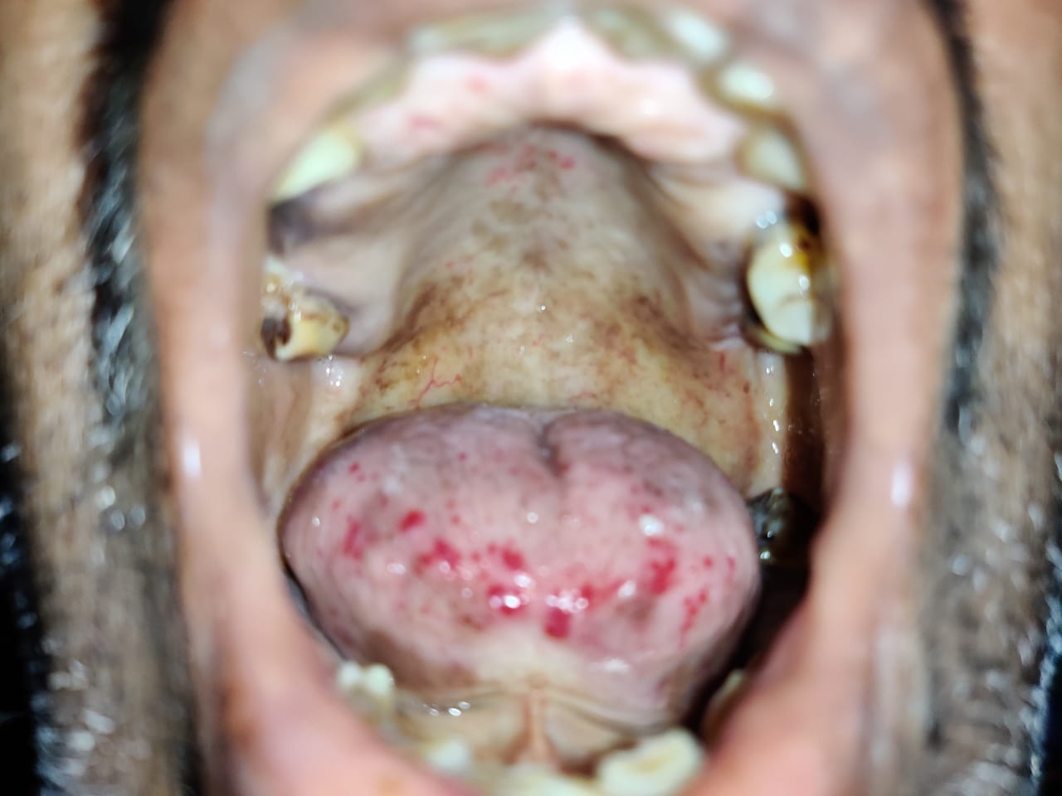

Slide 10
Non blanching erythematous
papules over trunk

Slide 11
INVESTIGATIONS
Total count-7,100
P/L/E-78/16/6
Hb-3.3g
Platelet-1.94 lakhs/cu.mm
RBC-1.73 millions/cu.mm
MCV-70.5 fl
MCH-19.1
MCHC-27
RDW-64.8
RBS-127 mg/dl
Urea -15 mg/dl
Creatinine -0.6 mg/dl
Total bilirubin -0.4 mg
Direct bilirubin-0.2 mg
Indirect bilirubin – 0.2
SGOT-14
ALP-35

Slide 12
COMPLETE HEMOGRAM WITH PERIPHERAL SMEAR
Total count-12,000
RBC-2.49 millions/cu.mm
Hb-4.2 g/dl
HCT-16.3 %
Platelet-2.72 lakhs/cu.mm(normal morphology)
ESR-40mm/hr
IMPRESSION: Severe microcytic hypochromic anemia

Slide 13
TOTAL COUNT | 7100 | 5900 | 5600 | 5200
P/L/E | 78/16/6 | 64/26/3 | 60/29/4 | 54/40/6
Hb | 3.9 g | 5.6 g | 6.5 g | 7 g
PCV | 12% | 20 | 23 | 26
Platelet | 1.94 lakhs | 2.73 lakhs | 2.25 lakhs | 2 lakhs

Slide 14
Bleeding time | 3 minutes
Clotting Time | 8 minutes
PT | 11.5 seconds
APTT | 23.5 seconds
INR | 0.8

Slide 15
POSITIVE FINDINGS
h/o Epistaxis
Family history
Oral lesion
Skin lesion

Slide 16
possibilities
Platelet disorders?
Coagulation disorders!
Telangiectasia?

Slide 17
DIFFERENTIAL DIAGNOSIS
Dermatomyositis
Systemic sclerosis
Cirrhosis of liver
Family history
Ataxia telangectasia
Xeroderma pigmentosum
Hereditary hemorrhagic telangectasia

Slide 18
ENT
Multiple bleeding point in
the nasal septum

Slide 20
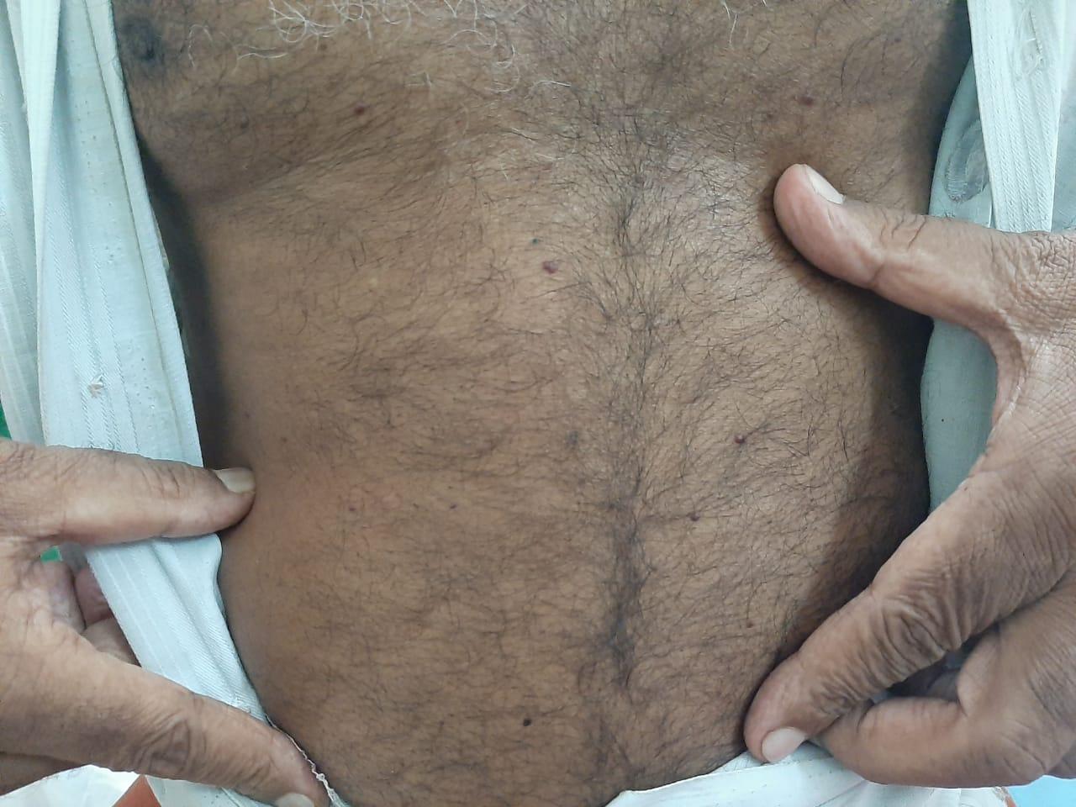
DERMATOLOGY
Multiple well defined non blanching erythematous papules all over trunk
Cherry angioma.

Slide 21
MEDICAL GASTROENTEROLOGY
UPPER GI ENDOSCOPY
Multiple Telangiectatic lesion in the Antrum .

Slide 23
COLONOSCOPY
Telangiectasia in Rectosigmoid junction

Slide 24
TO RULE OUT 0ther AV MALFORMATION
CT PULMONARY ANGIOGRAM – Normal
CT ANGIOGRAM – BRAIN –Normal
CECT ABDOMEN-NORMAL

Slide 25
CURACAO’S DIAGNOSTIC CRITERIA
Epistaxis –Spontaneous,Recurrent
Telangiectasia-Multiple
Visceral lesions (GIT,liver,lung,brain,spine)
Family history

Slide 26
DIAGNOSIS
Hereditary Hemorhagic Telangiectasia(HHT 2)
OSLER WEBER RENDU SYNDROME.

Slide 27
TREATMENT
Packed cell transfusion
T.Trenaxamic acid 1g tds
Planned for Laser cauterization of bleeding spots in the nasal septum
Follow up of Daughter and Grandson for futher evaluation.

Slide 28
AIM OF PRESENTATION
Rare presentation
HHT to be ruled out in patients with bleeding manifestation and skin lesions

Slide 29
MOLECULAR GENETICS: Requires multigene panel
Indicated only if clinical features are inconclusive.
ACVRL1 Gene
ENG
GDF2
SMAD4

