Slide 1
The tumor dance
BY FIRST MEDICAL UNIT
CHIEF: DR.M.NATARAJAN M.D.,
ASST. PROFESSORS: DR.V.PALANIKUMARAN M.D.,D.DIAB
DR. VASANTHAKALYANI M.D.,DCP
DR. SURESHKUMAR M.D.,
PRESENTOR : DR.RAGUPATHI

Slide 2
Chief complaints
A 30 year old female came to our hospital with chief C/O Palpitations for 2 days

Slide 3
HOPI
Patient was apparently normal 2 months ago, Then she had palpitation for which she was evaluated in private hospital and diagnosed to have SVT and treated with medications
Then she discontinued treatment for 1 month
H/o palpitation –sudden onset, persistent, not related to exertion
No H/o Chest pain
No H/o Giddiness
No H/o Breathlessness
No H/o swelling of legs
No H/o LOC
No H/o Fever, Arthralgia
No H/o Seizures

Slide 4
No H/o Reduced urine output
No H/o Wt loss
No H/o loss of appetite
No H/o Vomiting, Loose stools

Slide 5
PAST HISTORY
K/C/O SVT for 3 months –not on treatment for 1 month
N/K/C/O - HTN/DM/TB/BA/CAD/CKD/THYROID DISEASE

Slide 6
GENERAL EXAMINATION
PATIENT CONCIOUS
ORIENTED
AFEBRILE
NO PALLOR
NO CYANOSIS
NO CLUBBING
NO ICTERUS
NO PEDAL EDEMA
NO GENERALISED LYMPHADENOPATHY
NO LENTIGINES, / NEVI
NO E/O NEUROFIBROMA , AND NO MARKERS OF CONGENITAL HEART DISEASE

Slide 7
SYSTEMIC EXAMINATION
CVS: S1 ,S2 present, No murmur
JVP - Normal
RS : BAE Present
PA : SOFT,BS present
CNS: NFND
VITALS:
BP:110/70mmHg
PR:96/min regular,
normal volume,
no specific character
no Radio-radial delay , no radio-femoral delay
SPO2:99% RA

Slide 8
ECG ON 30.09.23

Slide 9
ECG ON 30.09.23

Slide 10
ECG ON 11.12.2023

Slide 12
Investigations
TC | 7300
Hb | 11.3
PCV | 36%
PLT | 2.67 lakhs
UREA | 28
CREATININE | 0.8
RBS | 126 mg/dL
Na | 136 mEq/L
K | 3.6 mEq/L
ESR- 34mm/hr
CRP- Negative
VCTC – NR
Viral Markers- neg
TSH – Euthyroid state

Slide 13
Trans thoracic ECHO

Slide 14
TEE

Slide 18
CARDIAC MRI

Slide 19
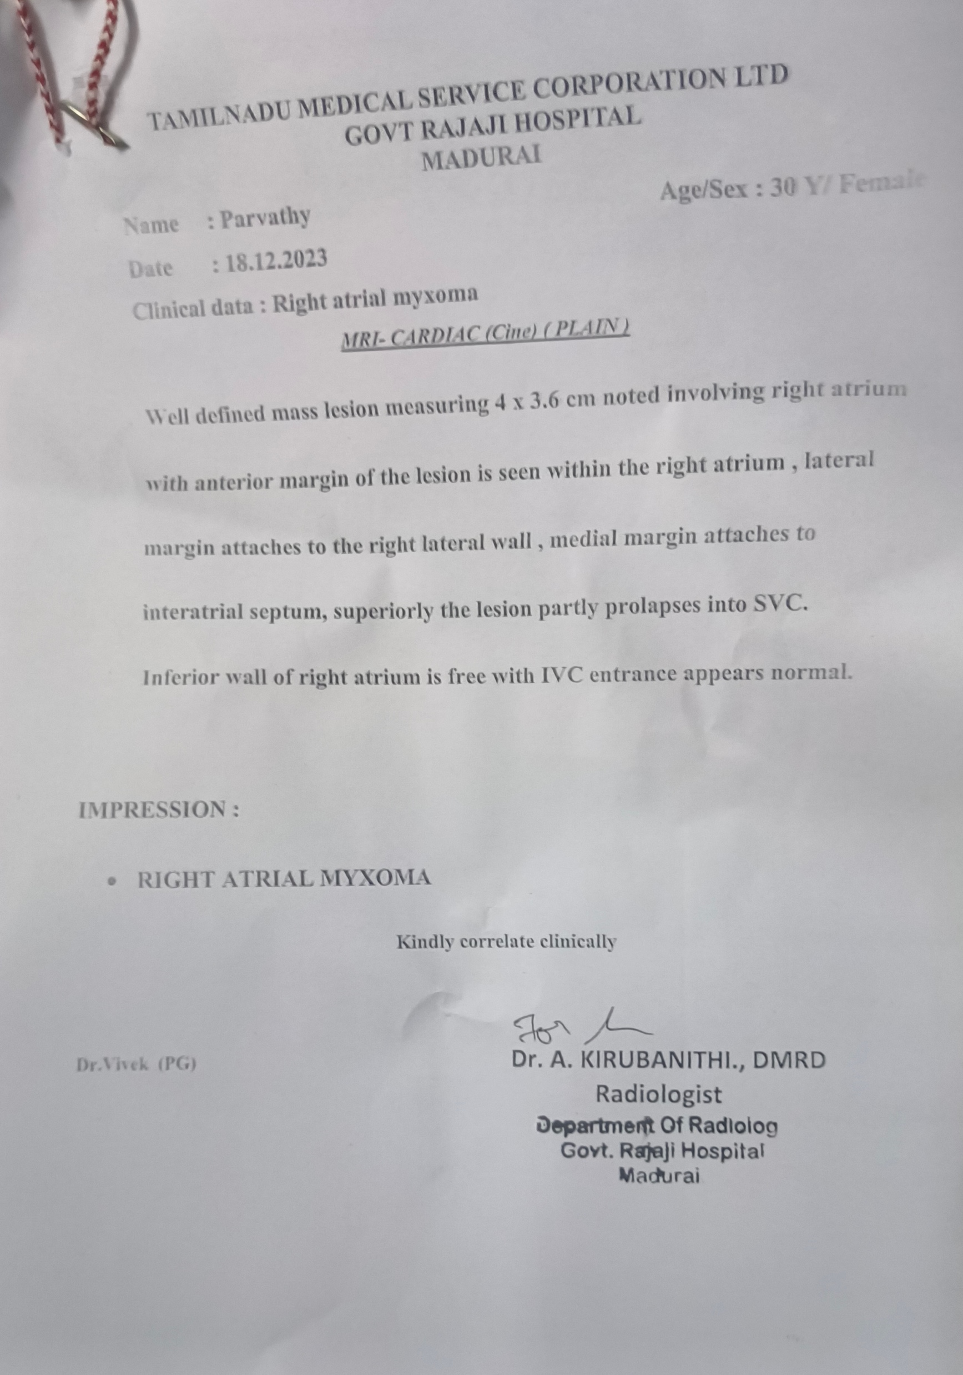

Slide 20
Treatment given
T. Verapamil 40 mg tds
Serial ECG monitoring
Patient was then transferred to CTVS ward for Surgical Management.

Slide 21
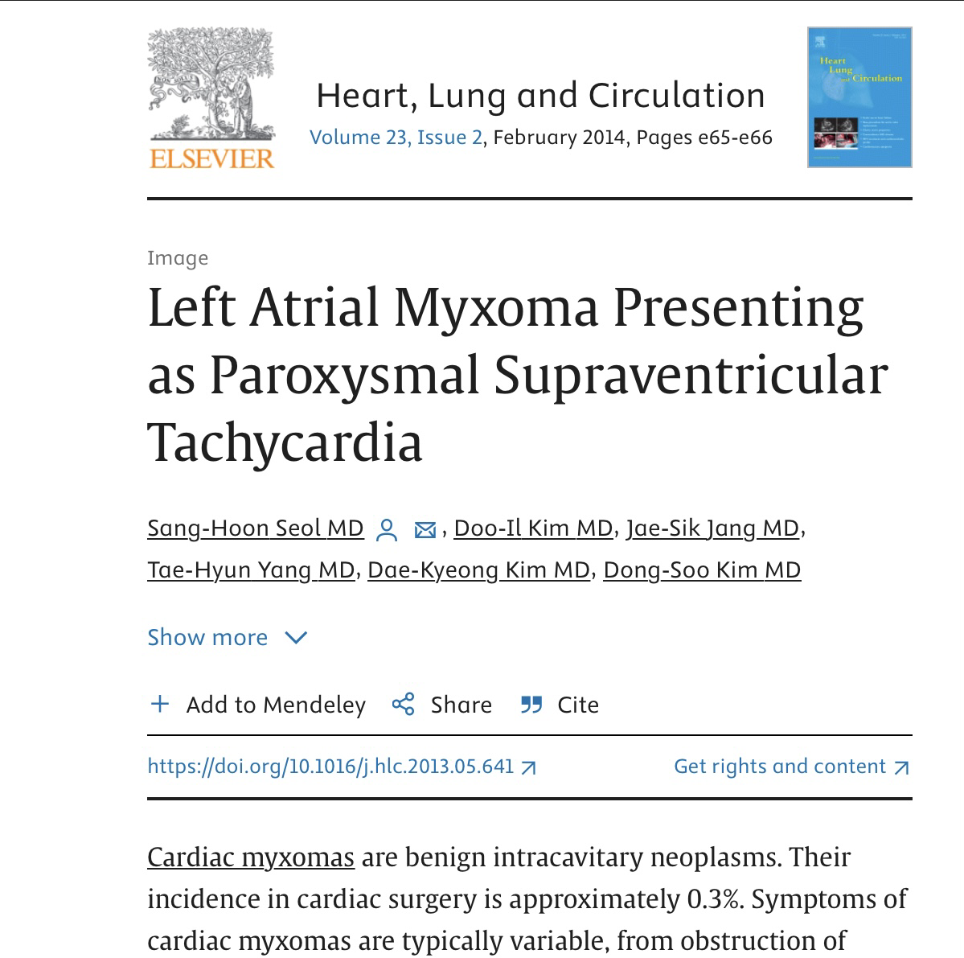

Slide 22
Aim of presentation
To Emphasise the Rarity of its Location
Rarity of its Presentation

Slide 23
Thank you

