Slide 1
An interesting ecg
FROM i MU
CHIEF PROFESSOR:
PROF AND HOD DR.K.SENTHIL MD
PROF.DR.V.N.ALAGAVENKATESAN MD
ASSOCIATE PROFESSOR
DR.K.MURALIDHARAN MD
DR.PALANIKUMARAN MD
ASSISTANT PROFESSORS:
DR.MANIKANDAN MD
DR.S.SARAVANA MADHAV MD DTCD
DR.M.MAHALAKSHMI MD
DR.T.KARTHIK PANDIAN MD

Slide 2
“A Silent Poison… with a Cardiac Twist”
Chief complaints
22/M came to GRH
C/o alleged history of consumption of
aluminium phosphide tablet (10 tablets)
Under influence of alcohol
No h/o abdominal pain
No h/o vomiting
No h/o palpitations
No h/o giddiness
No h/o chest pain
No h/o syncope
H/o diaphoresis (+)

Slide 3
Past history
PATIENT HAS A CHRONIC HISTORY OF EXERTIONAL DYSPNE SINCE CHILDHOOD
Chronic smoker and alcoholic
Vitals
BP – 150/90 mmHg
PR – 87/min
SpO₂ – 99% RA
RR – 16/min

Slide 4
O/E
Awake
Obeys commands
Afebrile
Hydration fair
No pallor / icterus / edema
Systemic examination
CVS – S1 S2 +, no murmur
RS – BAE +
PA – Soft
CNS – NFND

Slide 5
INVESTIGATION
Parameter | Day 1 | Day 2
WBC (×10³) | 9.7 | 8.0
Hb (g/dL) | 13.9 | 11.2
Platelets (lakh) | 2.09 | 1.32

Slide 6
Parameter | Day 1 | Day 2 | Day 3
RBS | 96 | 106 | 102
Urea (mg/dL) | 25 | 24 | 16
Creatinine (mg/dL) | 0.8 | 1.1 | 0.8
Total Bilirubin | 0.9 | 2.6 | 0.6
Direct Bilirubin | 0.5 | 1.0 | 0.3
Indirect Bilirubin | 0.4 | 1.6 | 0.3
SGOT (AST) | 32 | 86 | 28
SGPT (ALT) | 15 | 33 | 18
ALP | 93 | 54 | 16
Sodium (mEq/L) | 136 | 134 | 130
Potassium (mEq/L) | MORE THAN 6 | 3.2 | 3.2
PT (sec) | 19.1 | 15.9 | —
INR | 1.56 | 1.29 | —
APTT | 28 | 24.5 | —
CPK | 2577 | 1669 | 820
LDH | 649 | 798 | 583

Slide 7
ABG
Parameter | Value
pH | 7.35
pCO₂ | 34
pO₂ | 87
HCO₃ | 16.8
Lactate | 0.8

Slide 8
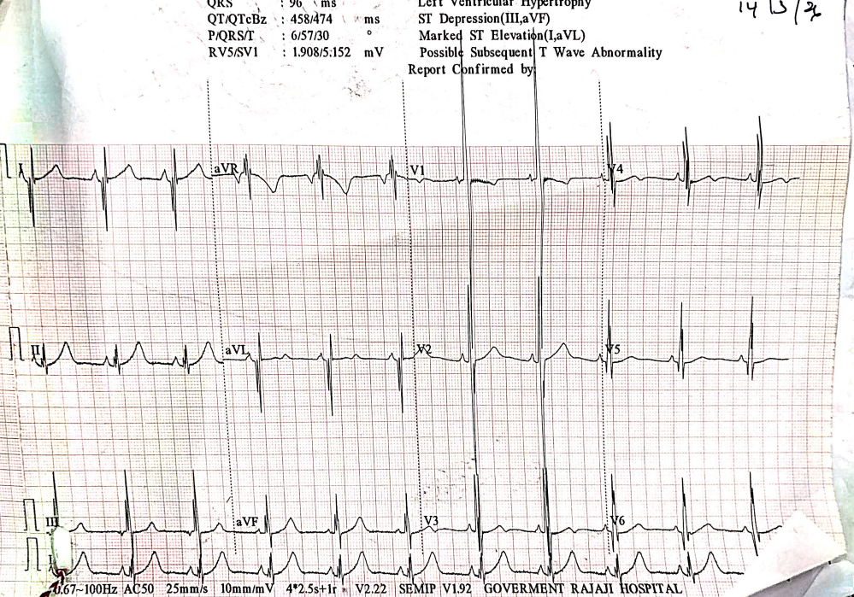

Slide 9
LETS DISCUSS…

Slide 10
THANK YOU

