Slide 1
INTERESTING X RAY
MVII

Slide 2
VII MEDICAL UNIT
CHIEF: PROF.DR.K.SENTHIL.MD
ASSOCIATE PROF: DR.K.MURALIDHARAN MD
ASST PROF:DR V.MANIKANDAN MD
DR C. RAMANAN MD
DR.SARAVANA MADAV MD,DTCD
PRESENTOR- DR E GOPINATHAN

Slide 3
18yr old female admitted with
c/o bloody sputum- 1 year
c/o cough – 1 year
c/o Breathlessness – 1 month
c/o fever – 10 days

Slide 4
HISTORY OF PRESENTING ILLNESS
Patients was apparently normal 1 year before after that patient noticed heaviness in the right side chest followed by
H/O hemoptysis for 1 year, occasional; mild in quantity
H/O cough – 1 year
initially dry cough,
later becomes Productive cough for past 10 days
Sputum – mucoid (approx 10-15ml/day)
not foul smelling
H/O difficulty in breathing – 1 month
gradual onset ,progressive
MMRC grade II

Slide 5
H/O Fever – 10 days
High grade
Intermittent,
not a/w chills/rigor
no rashes / no joint pain
no diurnal variation

Slide 6
No h/o palpitations
No h/o abdominal pain/distension
No h/o vomiting
No h/o loose stools
No h/o LOW/LOA
No h/o Jaundice
No h/o sneezing/nasal obstruction
No h/o Seizures

Slide 7
PAST HISTORY
Not a k/c/o T2DM/HTN/TB/BA/THYROID disorders/Congenital heart disease /seizure disorders
No H/O previous hospital admissions
PERSONAL H/O:
Mixed diet
Normal bowel and Bladder habits
No h/o contact with TB
Menstrual cycles – regular 5/30 days cycle
history of contact with dog in her home since her childhood

Slide 8
GENERAL EXAMINATION
Pt conscious
Oriented
Febrile on admission
Tachypneic at rest
No pallor
No icterus
No cyanosis
No clubbing
No Pedal edema
VITALS:
BP-100/60mm hg
PR- 120/Min
SPO2 – 98% RA
RR-24/min

Slide 9
SYSTEMIC EXAMINATION
RS: BAE + , NVBS ,
RT Infrascapular/Infraxillary fine crepts+
CVS- S1,S2+, No murmurs
P/A – soft, No organomegaly
CNS- Pt conscious, oriented, NFND

Slide 10
INVESTIGATIONS
DATE | 3/10/21 | 4/10/21 | 9/10/21
TOTAL COUNT | 14900 | 15200 | 8400
DIFF COUNT | 68/19/13 | 80/12/7 | 58/22/20
HB | 10.1 | 10.4 | 10.1
PCV | 32 | 30.8 | 33%
PLATELETS | 3.20 L | 2.99 L | 3.81 L
UREA | 20 |  | 13
Cr | 1.0 |  | 0.8

Slide 11
DATE | 3/10/21 | 9/10/21
TOT. BIL | 1.1 | 0.5
D.BIL | 0.4 | 0.2
I.BIL | 0.7 | 0.3
SGOT | 13 | 16
SGPT | 7 | 15
ALP | 41 | 47
CRP | 146.9 | 33
ABSOLUTE EOSINOPHIL COUNT | 856 Cells/mm3 | VCTC – NON REACTIVE
SPUTUM AFB & GENE XPERT | Negative | ESR-55 mm/hr

Slide 12
ECHO:
NORMAL STUDY
LVEF – 75%
LVIDD – 3.9
LVIDS – 2.0
USG ABDOMEN:
LIVER – Normal size and echoes, No focal lesion
PANCREAS – Normal size and echoes
SPLEEN – Normal
KIDNEYS – Normal size, normal echoes, CMD maintained

Slide 13
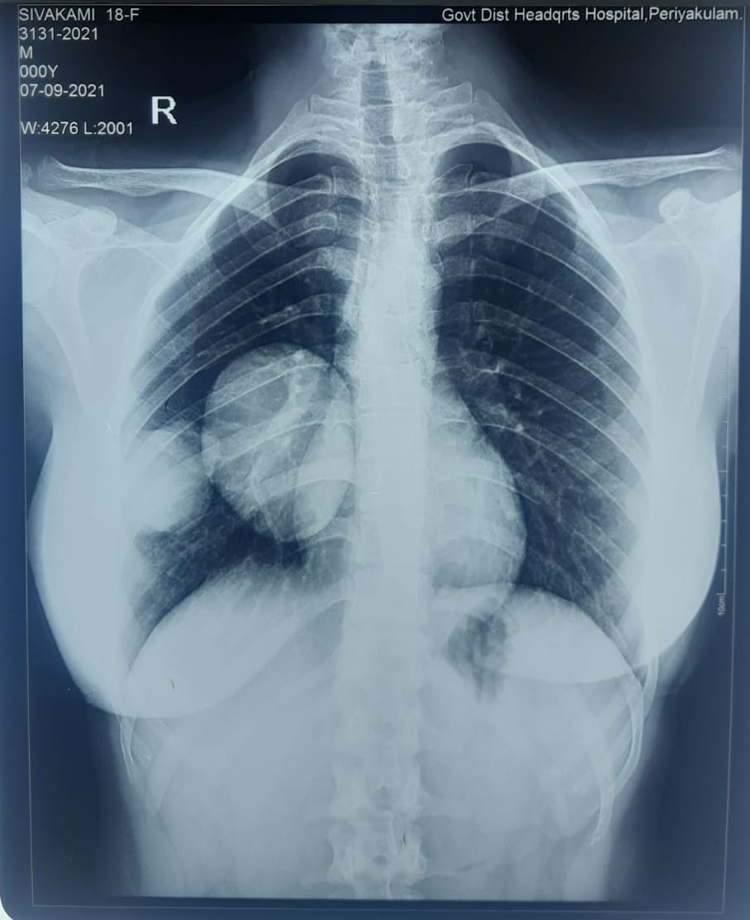
CHEST XAY – 07.09.21

Slide 14
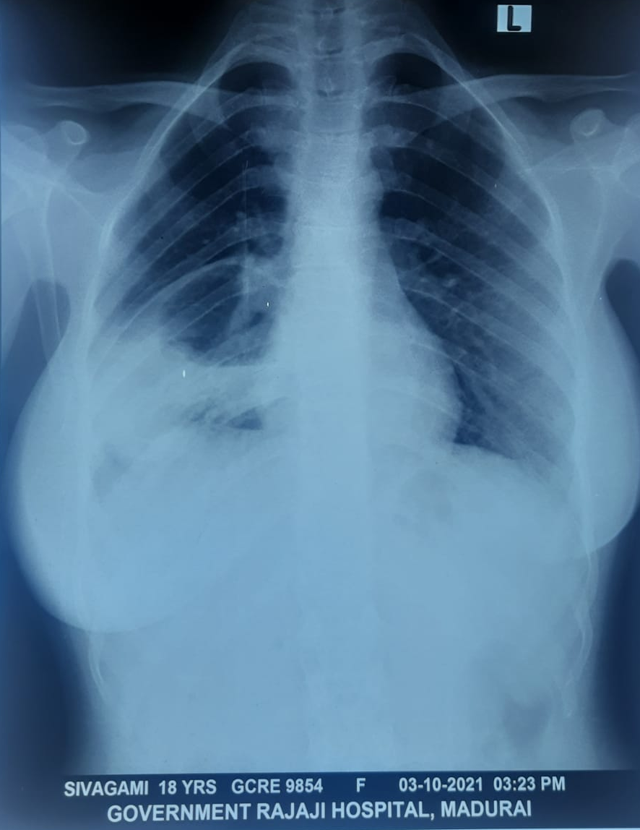
CHEST X RAY – 3.10.2021

Slide 15
CHEST X RAY - 12.11.2021

Slide 16
WHAT NEXT?

Slide 17
CHEST XAY - 07/09/21
A well defined oval shaped homogenous opacity in right hilar region forming acute angle with mediastinal pleura
An another similar type of opacity present in right lower zone lateral to the previous one forming acute angle with parietal pleura
Cardiac silhoutte maintained

Slide 18
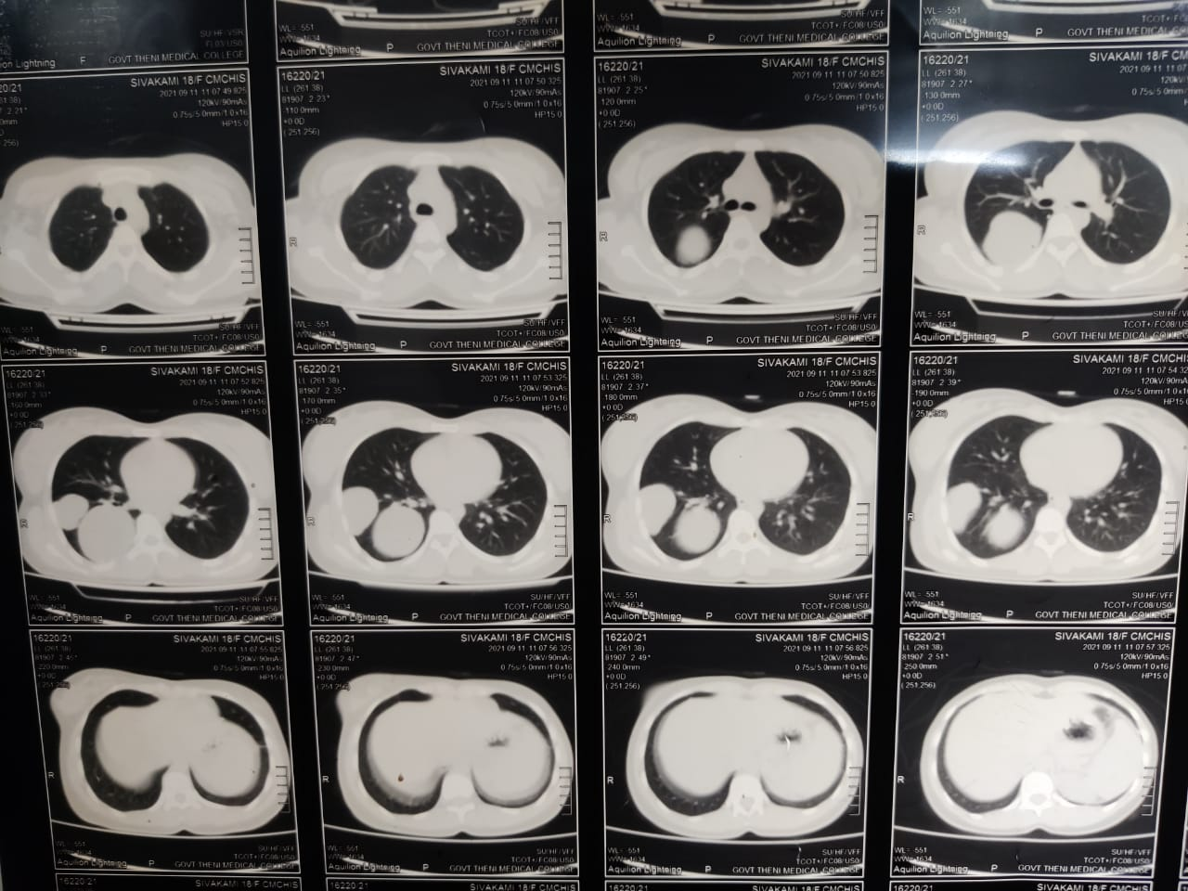
CT CHEST – 11.09.2021
Well defined oval thick walled fluid density lesion involving Superior and Medial Basal Segment of Right Lower Lobe
A similar lesion present
in the Lateral segment
of right Lower Lobe

Slide 19
CHEST XRAY – 03.10.21
Thick walled cavity lesion with air fluid level

Slide 20
CECT CHEST – 06.10.2021
Both cyst ruptured with air- fluid level with evidence of calcification
Consolidation of
Right Lower Lobe
with air Bronchogram
Minimal Right Pleural
effusion

Slide 21
WATER LILY SIGN

Slide 23
TREATMENT GIVEN
IV FLUIDS
INJ CEFOPERAZONE SULBACTAM 1GM IV BD
TAB CLINDAMYCIN 600 MG BD
TAB PARACETAMOL 500MG TDS
TAB ALBENDAZOLE 400 MG BD
CAP OMEPRAZOLE 20 MG BD
NEB SALBUTAMOL Q8H

Slide 24
CTS OPINION
PLAN – OPEN THORACOTOMY WITH CYST DEROOFING

Slide 25
FINAL DIAGNOSIS
RUPTURED LUNG HYDATID CYST
MULTIPLE SECONDARY LUNG ABSCESS
RIGHT LOWER LOBE CONSOLIDATION

Slide 26
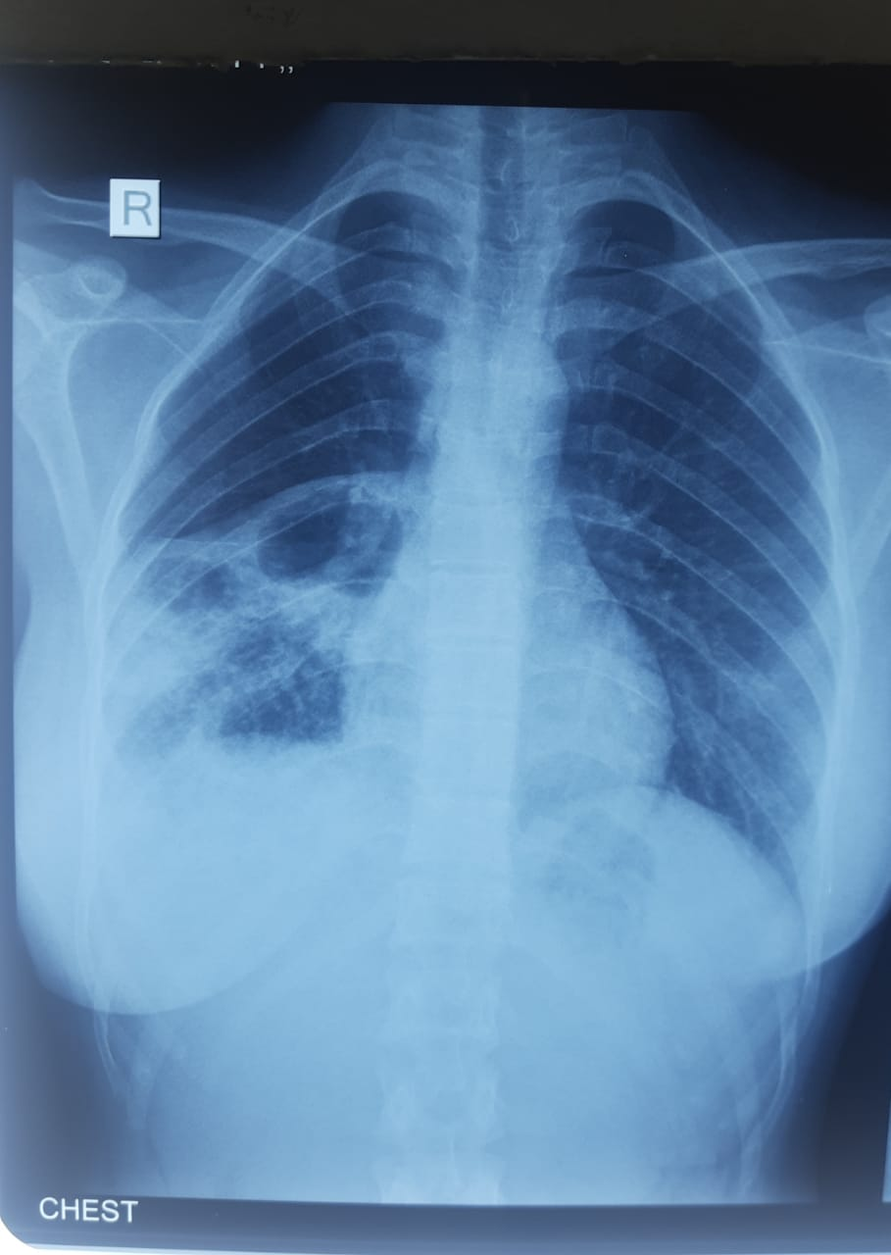
CHEST X RAY - 12.10.2021
First lesion regress in size
Second lesion shows air fluid level with resolving consolidation of right lower lobe .
Blunting of costophrenic angle

Slide 27
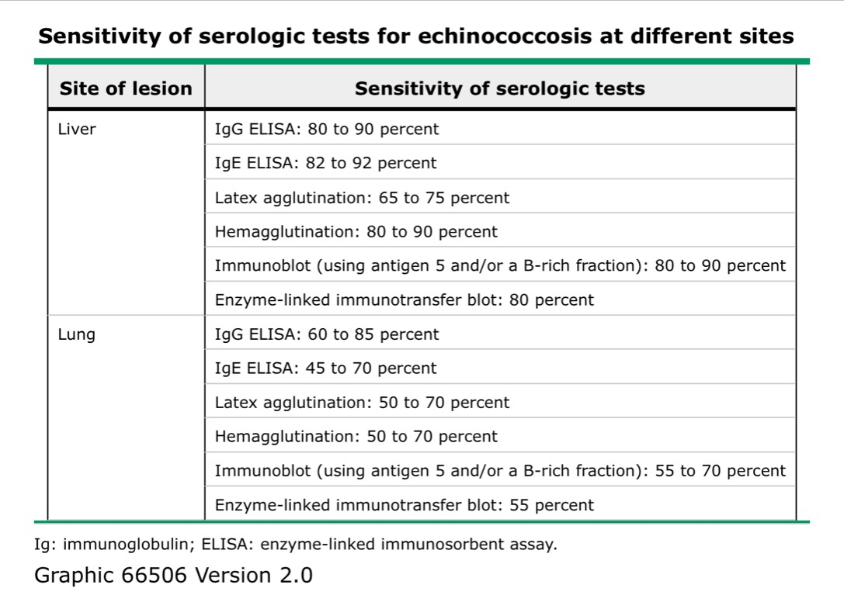

Slide 28
AIM OF PRESENTATION
To Sensitize About The Rare Presentation Of Isolated Lung Hydatid Cyst
To Emphasize On Rare Cause Of Lung Abscess

Slide 29
THANK YOU

