Slide 1
AN INTERESTING CASE OF QUADRIPLEGIA
IMCU-1:
CHIEF PROF.Dr.K.MURALIDHARAN MD
ASST PROF: DR.jegatheesh dch., md.,
Presentor: dr.s.harshon roy, MU-2

Slide 2
CASE HISTORY
Mrs.Muniyammal a 37 Years old female came to GRH Madurai with
chief complains of inability to use both upper and lower limb for 1 day
HOPI
Patient was apparently normal before 1 day, then she developed weakness of right upper limb and lower limb, sudden in onset which progressed to involve all 4 limbs by next day morning , flail type of weakness with no relieving factors and diurnal variation
h/o difficulty in lifting the head off the pillows
h/o difficulty in rolling over bed

Slide 3
H/o vomiting 1episode
non projectile
contains food particles
not blood /bile stained
No h/o altered sensorium
No h/o breathlessness
No h/o fever,loose stools
No h/o altered bowel and bladder habits

Slide 4
No h/o snake bite
No h/o recent trauma
No h/o numbness of limbs
No H/o respiratory tract infection
No H/o travel
No H/o root pain, neck pain, back pain
No H/o band like sensation
No H/o sensory symptoms
No H/o alteration in smell

Slide 5
No H/o blurring of vision
No H/o drooping of eyelids, double vision
No H/o inability in closing eyes and lips, deviation of angle of mouth, drooling of saliva.
No H/o hard of hearing/tinnitus/vertigo
No H/o difficulty in speech, nasal twang of speech, regurgitation of feeds
No H/o difficulty in moving the neck , lifting the shoulder

Slide 6
Past history
no h/o similar episodes in past
not known co morbidities
Personal history
mixed diet
normal bowel and bladder habits
normal sleep pattern

Slide 7
Menstrual history & Obstetric history:
regular menstrual cycles,5/25
No H/O abortions
P2L2,normal vaginal delivery
Family history:
no significant family history

Slide 8
GENERAL EXAMINATION
Awake,obeys oral commands
Afebrile
No pallor,icterus ,cyanosis,clubbing,lymphadenopathy
No external markers of TB,HIV, lymphadenopathy
VITALS
BP-110/70 mmhg
PR-86/min
SPO2-98 % on mv
CBG-97mg/dl
RR-14/min

Slide 9
CNS EXAMINATION
1.Higher mental functions-normal
2.Cranial nerves –normal
3.Sensory system -(spinothalamic, posterior column, cortical) –normal
4.Cerebellar signs- normal
5.Neck muscle weakness +
6. Gait-couldn’t be elicited

Slide 10
MOTOR SYSTEM
BULK | RIGHT | LEFT
UPPER LIMB | Normal | Normal
LOWER LIMB | Normal | Normal
TONE | RIGHT | LEFT
UPPER LIMB | Decreased | Decreased
LOWER LIMB | Decreased | Decreased

Slide 11
POWER
POWER |  |  | RIGHT | LEFT
UPPER LIMB | SHOULDER | Flexion | 0/5 | O/5
 |  | Extension | 0/5 | 0/5
 |  | Abduction | 0/5 | 0/5
 |  | Adduction | 0/5 | 0/5
 |  | Internal Rotation | 0/5 | 0/5
 |  | External rotation | 0/5 | 0/5
 | ELBOW | Flexion | 0/5 | 0/5
 |  | Extension | 0/5 | 0/5
 | WRIST | Flexion | 0/5 | 0/5
 |  | Extension | 0/5 | 0/5
 | HAND GRIP |  | 0/5 | 0/5

Slide 12
POWER |  |  | RIGHT | LEFT
LOWER LIMB | HIP | Flexion | 0/5 | 0/5
 |  | Extension | 0/5 | 0/5
 |  | Adduction | 0/5 | 0/5
 |  | Abduction | 0/5 | 0/5
 | KNEE | Flexion | 0/5 | 0/5
 |  | Extension | 0/5 | 0/5
 | ANKLE | Dorsiflexion | 0/5 | 0/5
 |  | Plantar flexion | 0/5 | 0/5

Slide 13
REFLEXES
 | RIGHT | LEFT
BICEPS | - | -
TRICEPS | - | -
SUPINATOR | - | -
KNEE | - | +
ANKLE | - | -
PLANTAR | Mute | Mute

Slide 14
OTHER SYSTEM EXAMINATION
CVS-S1,S2 ,
no murmur.
RS- B/L AE+,
NVBS+,
no added sounds.
P/A-soft, no organomegaly.

Slide 15
NEUROMEDICINE OPINION
Imp : Acute Flaccid Quadriparesis f/e / ? Hypokalemic paralysis / ? AIDP
Suggested:
Rpt ECG, Electrolytes
MRI Cervical Spine with whole spine screening
CSF analysis
Nerve Conduction Study

Slide 16
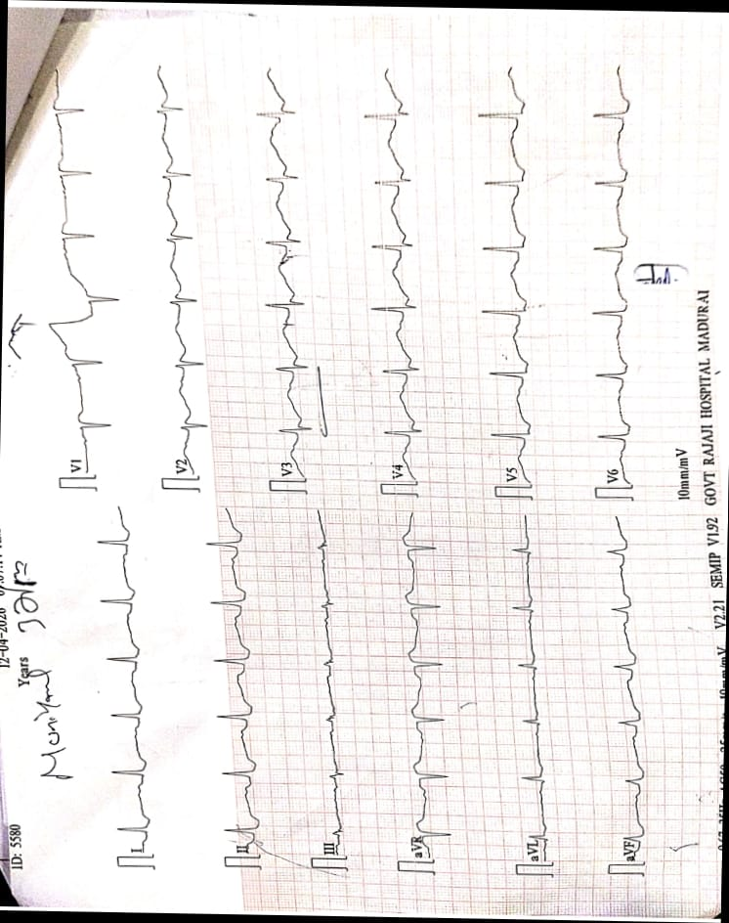
ECG
Global ST depression
Corrected QTc-537msec
U Waves +

Slide 17
BLOOD INVESTIGATIONS
 | 12/4 | 20/4
TLC | 8400 | 10200
HB | 13.4 | 14.5
PLT | 1.9 L | 3.46L
UREA | 26 | 23
CREAT | 1.0 | 0.8
T.BILI | 0.4 | 0.5
D.BILI | 0.2 | 0.2
ID. BILI | 0.2 | 0.3
SGOT/SGPT | 38/14 | 12/19
ALP | 83 | 118
RBS | 97 | 114
 | 12.4 | 13.4 | 14.4 | 15.4 | 16.4 | 18.4 | 19.4 | 21.4
Na+ | 136 | 148 | 144 | 135 | 132 | 135 | 138 | 136
K+ | <3.0 | 3.2 | 2.0 | 3.6 | 3.0 | 4.3 | 4.1 | 4.2
Total protein | 6.7
Sr.Albumin | 4.1
Sr.Globulin | 2.6
Sr.Calcium | 8.9
Sr.Magnesium | 1.9
PT | 13
INR | 1.65
APTT | 28

Slide 18
URINE ANALYSIS
Urine Sodium | 86.4 mEQ/L
Urine Potassium | 31.4 mEQ/L
Urine Chloride | 107 mEq/L
Urine Albumin | trace
Urine Sugar | nil
Urine Deposits | 0-2 pus cells
Urine Osmolality | 329 mOsm/kg

Slide 19
CSF ANALYSIS & ABG
TC | Acellular
Sugar | 81 mg%
Protein | 86 mg%
LDH | 54 U/L
CBG | 120 mg%
ABG | 12/4 | 15/4 | 23/4
PH | 7.16 | 7.22 | 7.35
PO2 | 85 | 103 | 86
PCO2 | 21 | 23 | 38
HCO3- | 7.5 | 9 | 17

Slide 20
OTHER INVESTIGATIONS
RA FACTOR- Negative
NCS- B/L Sensory and Motor conduction normal, F wave - Normal
TSH- 0.505 μIU/L (euthyroid status)
ANA- 3+ (Mixed pattern- Speckled + Nucleolar)

Slide 21
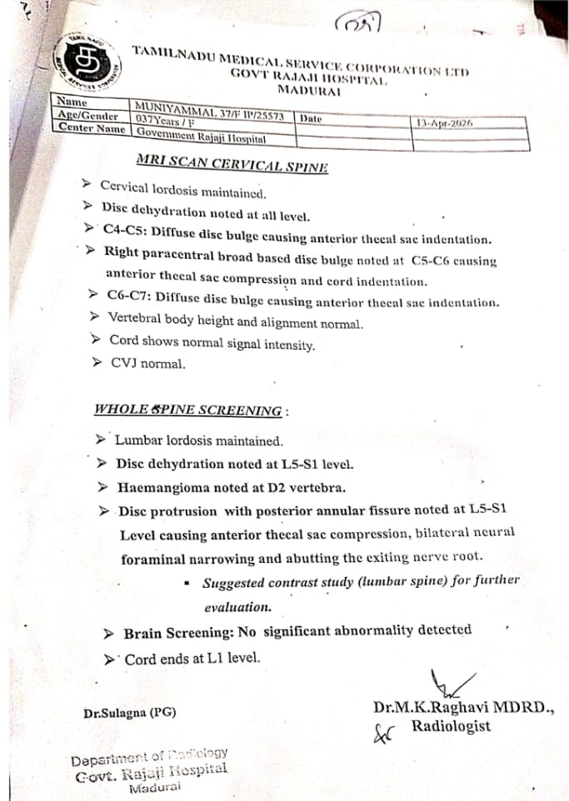
MRI C-SPINE WITH WHOLE SPINE SCREENING

Slide 22
LET’S DISCUSS

