Slide 1
HEMOPHAGOCYTOSIS- A RARE CAUSE

Slide 2
VII MEDICAL UNIT
CHIEF: PROF.DR.K.SENTHIL.MD
ASSOCIATE PROF: DR.K.MURALIDHARAN MD
ASST PROF: DR V.MANIKANDAN MD
DR C. RAMANAN MD
DR.SARAVANA MADAV MD

Slide 3
23 yrs / F admitted with chief complaints of
1. Fever * 2 weeks
2. Loose stools * 2 weeks

Slide 4
HISTORY OF PRESENTING ILLNESS
Patient was apparently normal two weeks before, then she had complaints of
1. Fever – on and off for 14 days
low grade fever
intermittent fever / no rash
not asso with chills/rigors
not asso with vomiting
no oral ulcers / no diurnal variation
2.Loose stools * 2 weeks
3 episodes /day;
small in quantity;
a/w mucous; not blood stained; not a/w tenesmus
3.Cough with mucoid expectoration * 1 day ; scanty sputum; not blood stained

Slide 5
h/o loss of appetite
No h/o Loss of weight
No h/o abdomen pain
No h/o abdomen distension
No h/o joint pain / skin rash/ hair fall
No h/o bleeding manifestations
No h/o breathing difficulty
No h/o burning micturation
No h/o decreased urine output

Slide 6
PAST HISTORY
Not a known case of T 2DM /SHTN /TB /Asthma /Thyroid /Congenital heart disease and CKD
No h/o similar illness and hospitalisation in the past
H/o scorpian sting 2 days prior to the onset of fever for which she was treated on op basis with TT and paracetamol

Slide 7
PERSONAL HISTORY
Mixed diet
Normal bowel and bladder habits
Pt was staying in chennai in a hostel and h/o frequent intake of outside food .
Working as a IT professional
No h/o any chronic drug abuse/ OTC drug, herbal product intake h/o,

Slide 8
TREATMENT HISTORY
Pt was treated in a nearby private clinic on op basis for presenting complaints with parentral drugs and pt denies the h/o intake of oral drug which was prescribed by the physician
MENSTURAL HISTORY :
LMP : 24.07.2021
Reg cycles 5/28; no menorrhagia

Slide 9
VITALS
VITALS
BP : 110 /60 mm hg in rt UA in supine position; no orthostatic hypotension
PR : 126/ MIN; regular rhythm; normal volume; felt equally in all peripheral vessels
SPO2 : 98% RA

Slide 10
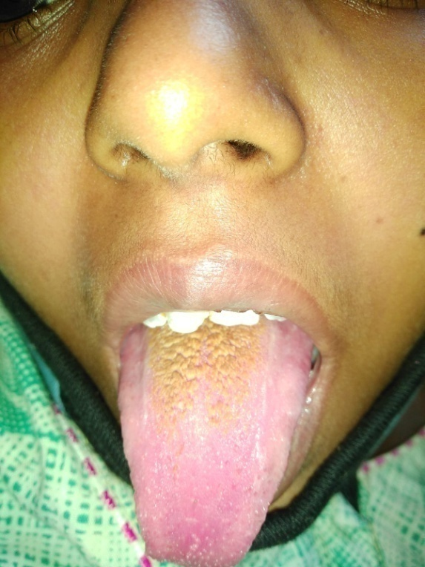
EXAMINATION
O/E
Pt conscious ,oriented
afebrile (presentation)
pallor+ / no pedal edema /not icterus
No cyanosis /no clubbing /no lymphadenopathy
Coated tongue+
CVS : S1 S2 + no murmur ; JVP not elevated
RS : BAE + NVBS , NO ADDED SOUND
P/A : SOFT ,SPLENOMEGALY + ;
not distended; BS+
CNS : NFND
L/E :
NO RASHES ALL OVER BODY
NO ESCHAR /cellulitis

Slide 11
INVESTIGATIONS

Slide 12
DATE | 23/8/21 | 25/8/21 | 27/8/21 | 30/8/21 | 3/8/21
TOTAL COUNT | 2400 | 3600 | 7100 | 8400 | 7400
DIFF COUNT | 68/27/5 | 67/24/9 | 68/25/7 | 56/34/10 | 58/32/10
HB | 5.8 | 6.6 | 7.1 | 7.0 | 7.1
PCV | 20 | 24 | 25 | 23 | 24
PLATELETS | 41000 | 89000 | 1.4L | 84000 | 2.2 L
UREA | 15 | 18 | 16
Cr | 1.0 | 0.8 | 0.7
Na | 121 | 126 | 134 | 137 | 136
K | 4.2 | 4.1 | 3.9 | 4.9 | 5.4

Slide 13
LFT | 23/8/2021 | 27/8/2021 | 2/9/2021
TOTAL BILIRUBIN | 1.0 | 0.6 | 0.4 | MCV | 70.1
DIRECT BILIRUBIN | 0.4 | 0.3 | 0.2 | MCH | 19.8
INDIRECT BILIRUBIN | 0.6 | 0.3 | 0.2 | MCHC | 28.3
SGOT | 356 | 130 | 36 | RDW | 19.6
SGPT | 252 | 105 | 56 | RBC | 3.58
ALP | 116 | 49 | 98 | PT | 15.8
RBS | 106 | 114 |  | INR | 1.24
ESR |  | 11 |  | U.ALB/SUGAR | NIL
TRIGLYCERIDES |  | 113 |  | DEPOSITS | 0-1 PUS CELLS

Slide 14
PERIPHERAL SMEAR

Slide 16
SUMMARY
Fever
Pancytopenia
Hypoproliferative marrow Response
Elevated liver enzymes

Slide 17
INVESTIGATIONS
VCTC – NON REACTIVE
VIRAL MARKERS – NEGATIVE
CRP – 35.3
CPK -2351 U/L (DAY 2)
CPK MB -54 U/L
SR.FERRITIN - 586 ng/ml
Sr procalcitonin- 0.3 ng/ml

Slide 18
SR.FIBRINOGEN - 313 mg/dl
LDH – 884 U/L
ANA – NEGATIVE
COVID SWAB – NEGATIVE
COVID IGM – 0.69 (NEGATIVE)

Slide 19
SEROLOGY
DENGUE NS 1 - NEGATIVE
DENGUE IG M - NEGATIVE
DENGUE IG G – NEGATIVE
SCRUB IG M – NEGATIVE
LEPTO IGM – NEGATIVE
QBC MALARIA- NEGATIVE

Slide 20
CULTURES
BONE MARROW C/S – POOR KLEBSIELLA AEROGENES GROWN IN CULTURE .
Stool c/s- NO GROWTH
URINE C/S - NO GROWTH
BLOOD C/S- NO GROWTH
On 3rd Week after 6 days of Iv Ceftriaxone

Slide 21
INVESTIGATIONS
MANTOUX – NEGATIVE
SPUTUM AFB – NEGATIVE

Slide 22
CT CHEST - PLAIN
NORMAL STUDY
USG ABDOMEN
MILD SPLENOMEGALY –SIZE 14 CM: ROUNDED BORDERS
MESENTRIC ADENITIS+ IN PERIUMBILICAL REGION
GB WALL EDEMA+
NO PERICHOLECYSTIC FLUID COLLECTION
NO ASCITES
LIVER /KIDNEY - NORMAL

Slide 23
CARDIOLOGY OPINION
ECHO – LVEF 65% ; Mild pericardial effusion
ENDOCRINOLOGY OPINION
TSH 1.62 – EUTHYROID STATE
OPTHAL OPINION
Bilateral normal fundus at present

Slide 24
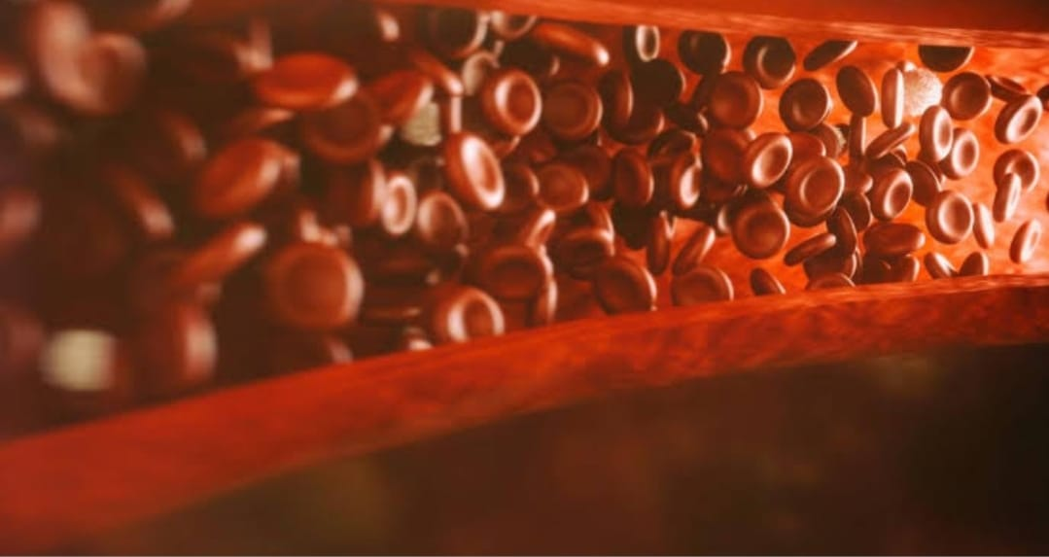
WHAT NEXT ?

Slide 25
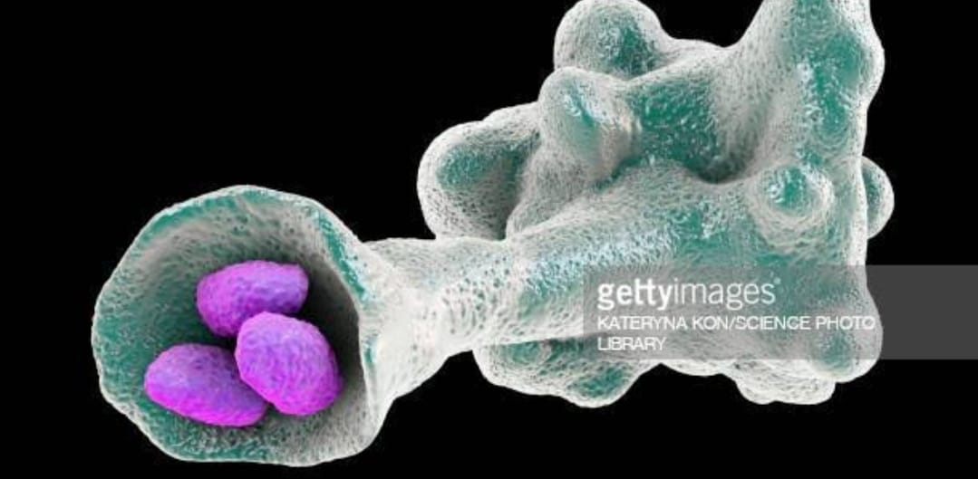
BONE MARROW STUDY

Slide 26
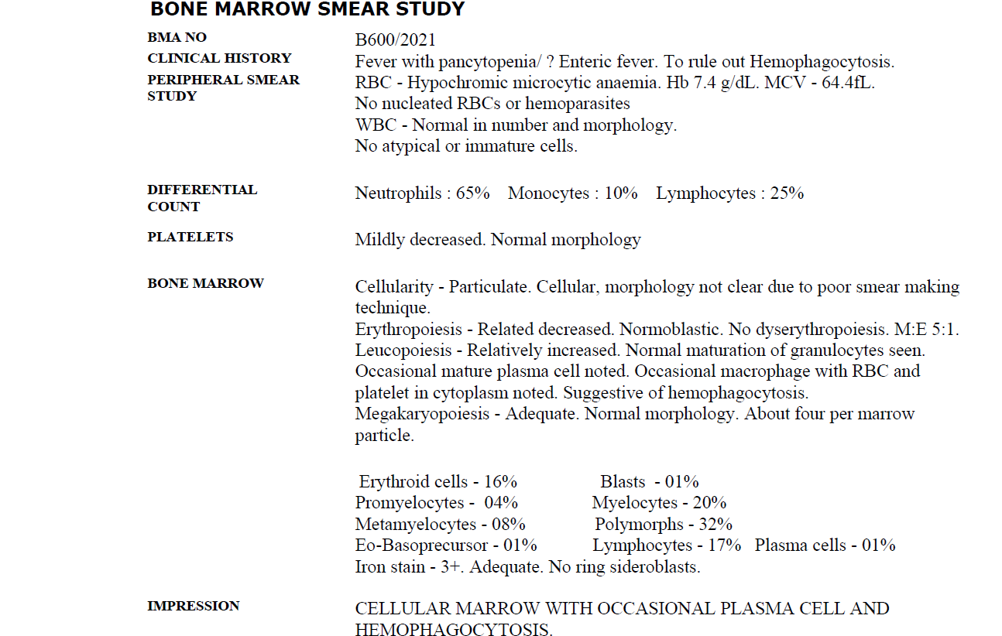
BONE MARROW ASPIRATE

Slide 27
BONE MARROW BIOPSY

Slide 28
BONE MARROW BIOPSY - HEMOPHAGOCYTOSIS

Slide 29
BONE MARROW BIOPSY - GRANULOMA

Slide 30
WIDAL TEST
 | 22/8 | 26/8 | 2/9
SALMONELLA TYPHI H | 1:400 | 1:320 | 1:320
SALMONELLA TYPHI O | 1:400 | 1:320 | 1:320

Slide 31
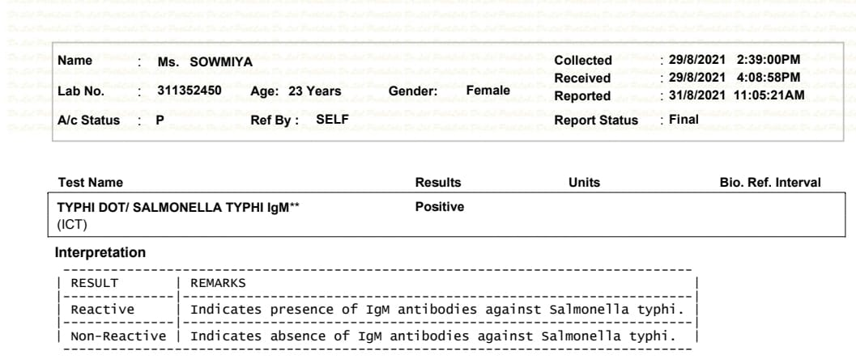
TYPHI DOT

Slide 32
TREATMENT GIVEN
IV FLUIDS
INJ CEFTRIAXONE 1G IV BD * 14 Days
Tab AZITHROMYCIN 1G * 5 Days
1 . Packed cell transfusion
Tab paracetamol 500 mg
C.Bifilac TDS
Antiemetics

Slide 34
CASE Reports

Slide 35
CASE REPORT

Slide 36
ENTERIC FEVER 2° HEMOPHAGOCYTOSIS
DIAGNOSIS

Slide 37
AIM OF PRESENTATION
To sensitise about unusual presentation of enteric fever
To sensitise about Hemophagocytosis

Slide 38
THANK YOU

