Slide 1
GOLD COPD GUIDELINES 2025
CHEIF:PROF.DR.K.SENTHIL MD
ASSO PROF:DR.MURALIDHARAN MD
ASST PROF:DR.SUDHA MD
DR.MANIKANDAN MD
DR.SARAVANA MADHAV MD

Slide 2
DEFINITION
COPD is a heterogeneous lung condition characterized by chronic respiratory symptoms due to abnormalities of the airways and/or alveoli that cause persistent, often progressive, airflow obstruction.

Slide 3
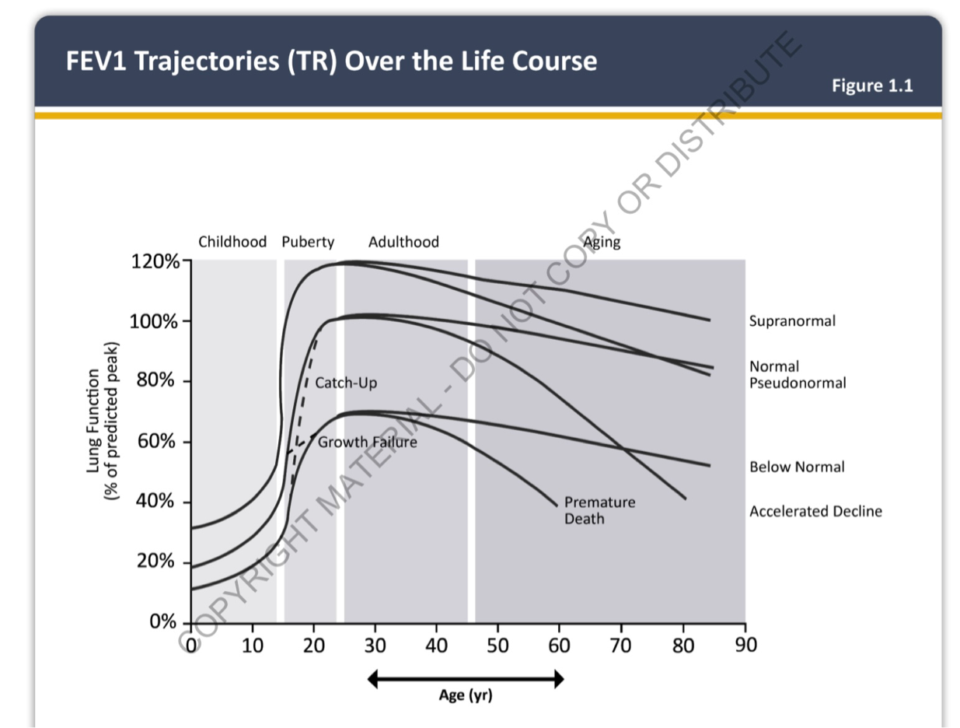

Slide 4

RISK FACTORS
COPD results from gene(G)-environment(E) interactions occurring over the lifetime(T) of the individual (GETomics) that can damage the lungs and/or alter their normal development/aging processes.
Cigarette smoking
Biomass exposure
Occupational exposure
Air pollution
Genetic factors

Slide 5
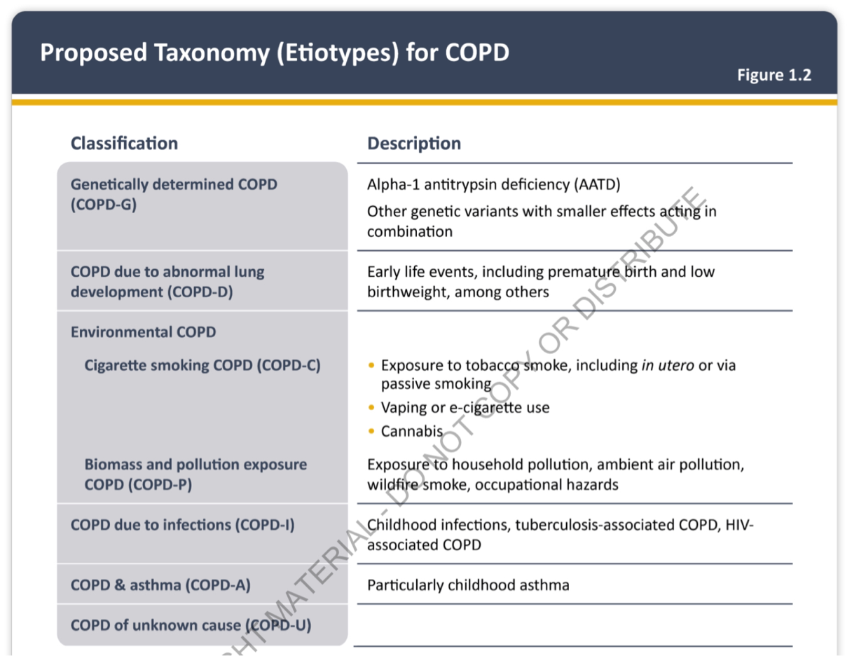

Slide 6
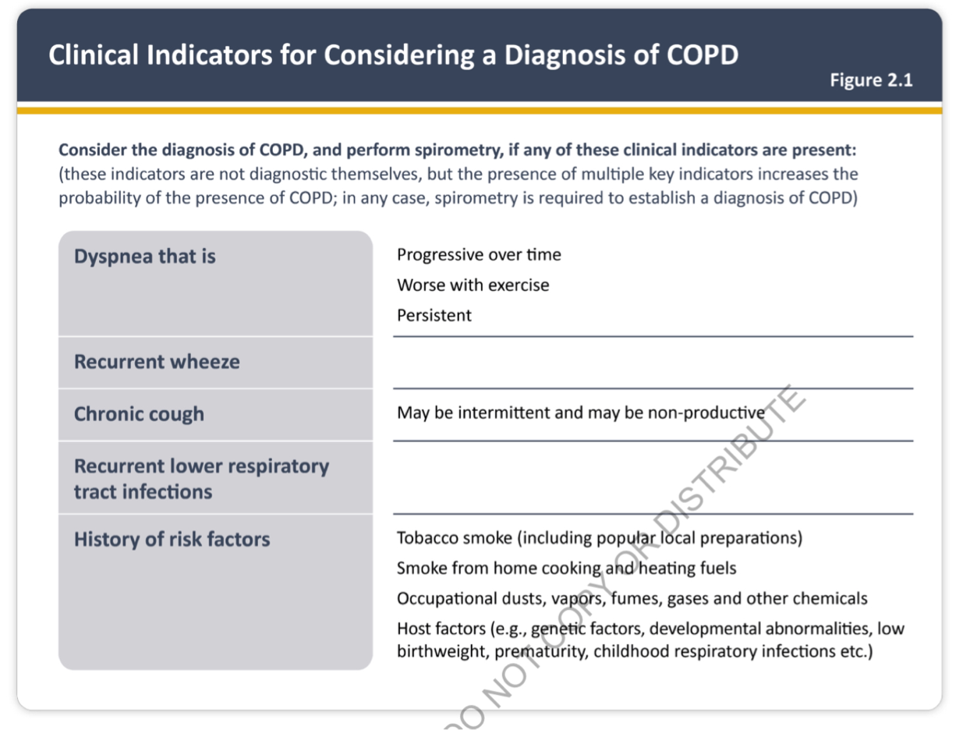

Slide 7
INITIAL ASSESSMENT
Severity of airflow obstruction
Nature and magnitude of current symptoms
Previous history of moderate and severe exacerbations
Blood eosinophil count
Presence and type of other diseases (multimorbidity)

Slide 8
SPIROMETRY
the most reproducible and objective measurement of airflow obstruction.
noninvasive, reproducible, cheap, and readily available test
GOLD has recommended using post-bronchodilator values when considering a diagnosis of COPD

Slide 9
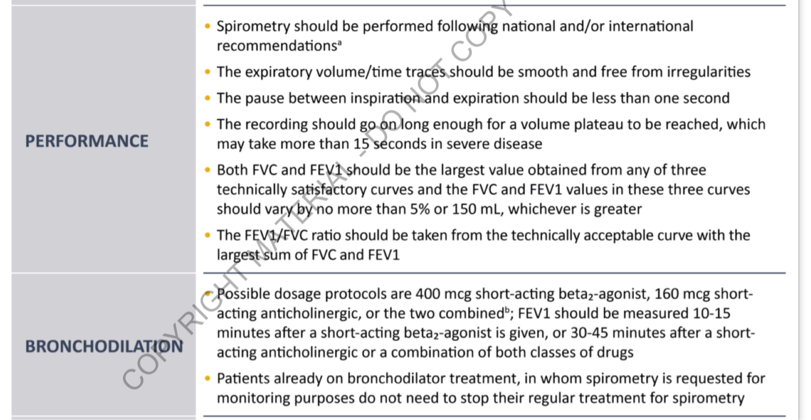

Slide 10
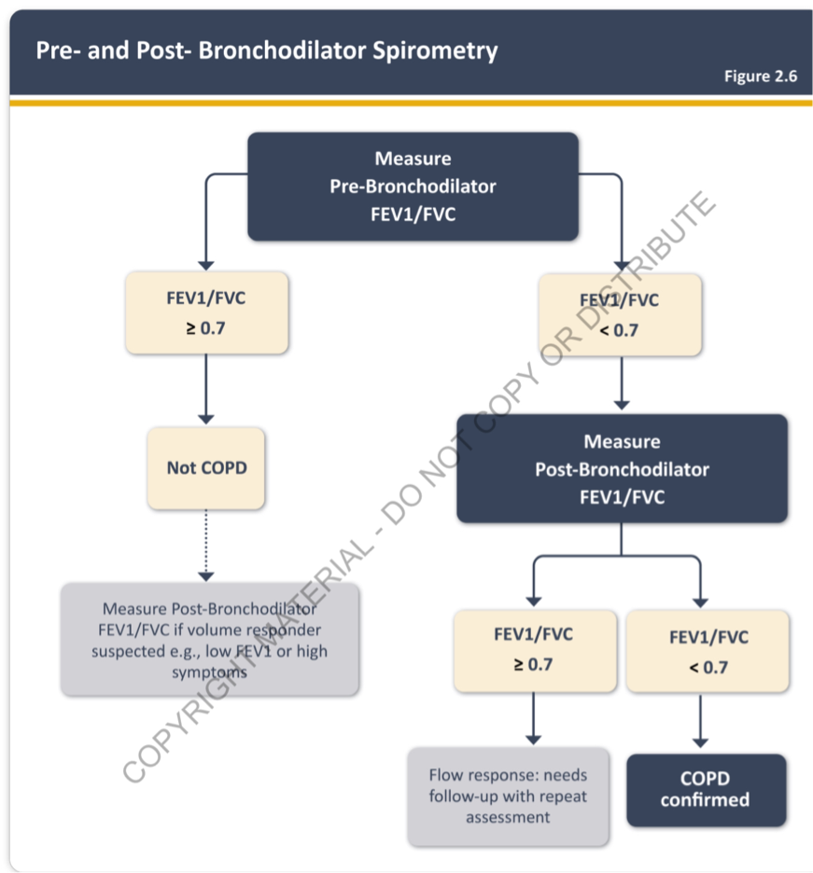

Slide 11
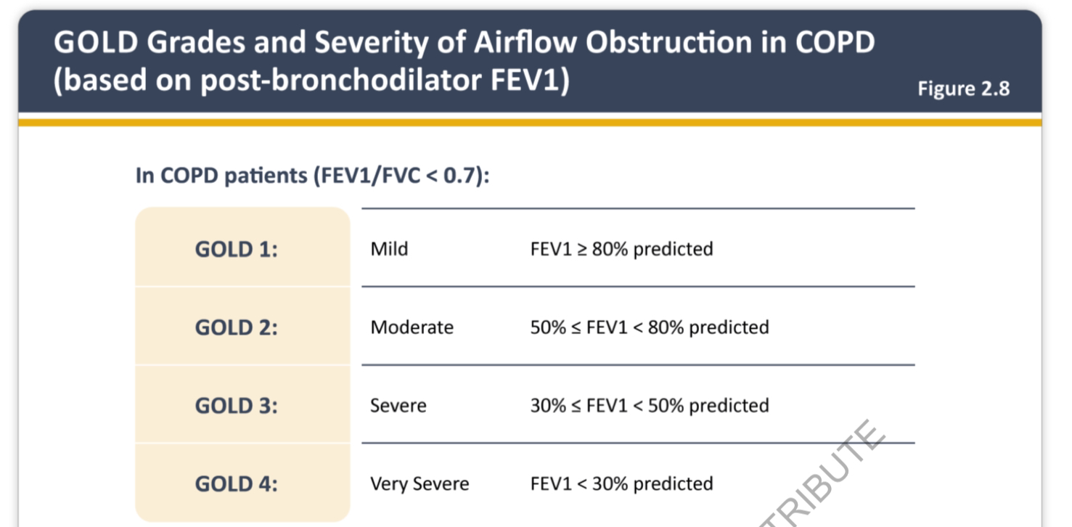

Slide 12

SYMPTOMS ASSESSMENT
Dyspnea questionnaire -Modified MRC dyspnea scale
Multidimensional questionnaires.
COPD Assessment test-CAT
Clinical COPD questionnaires

Slide 13
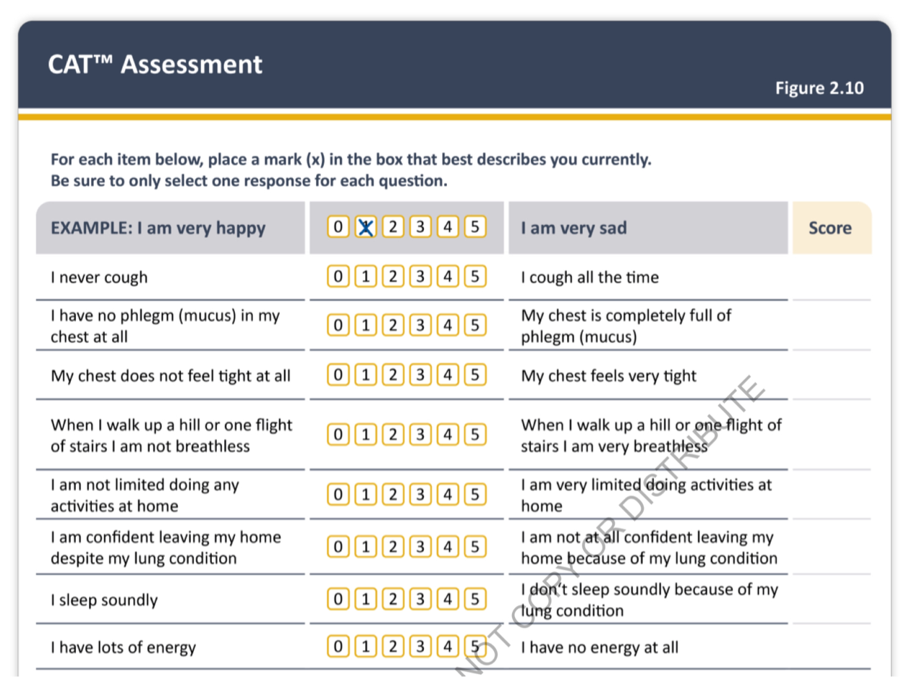

Slide 14
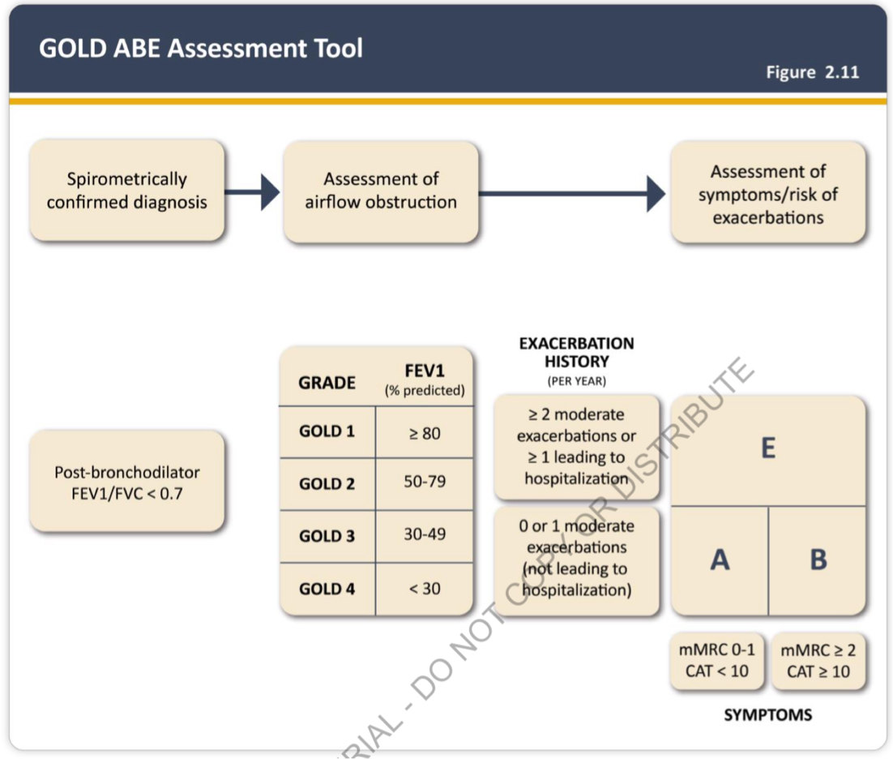

Slide 15
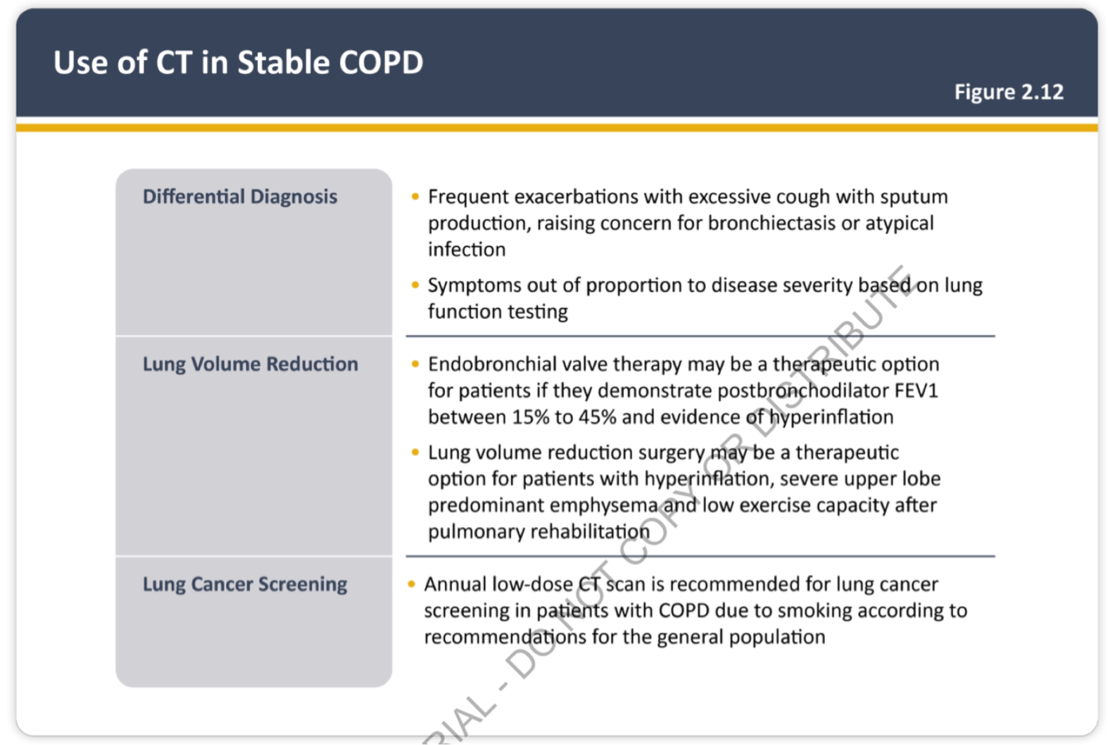

Slide 16
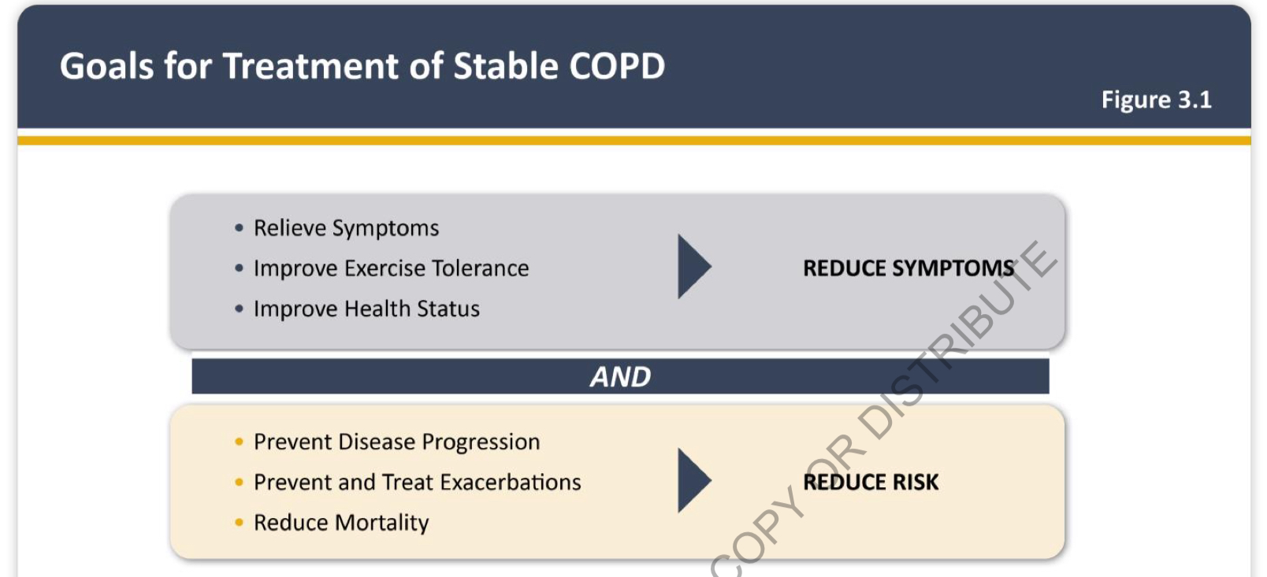

Slide 17
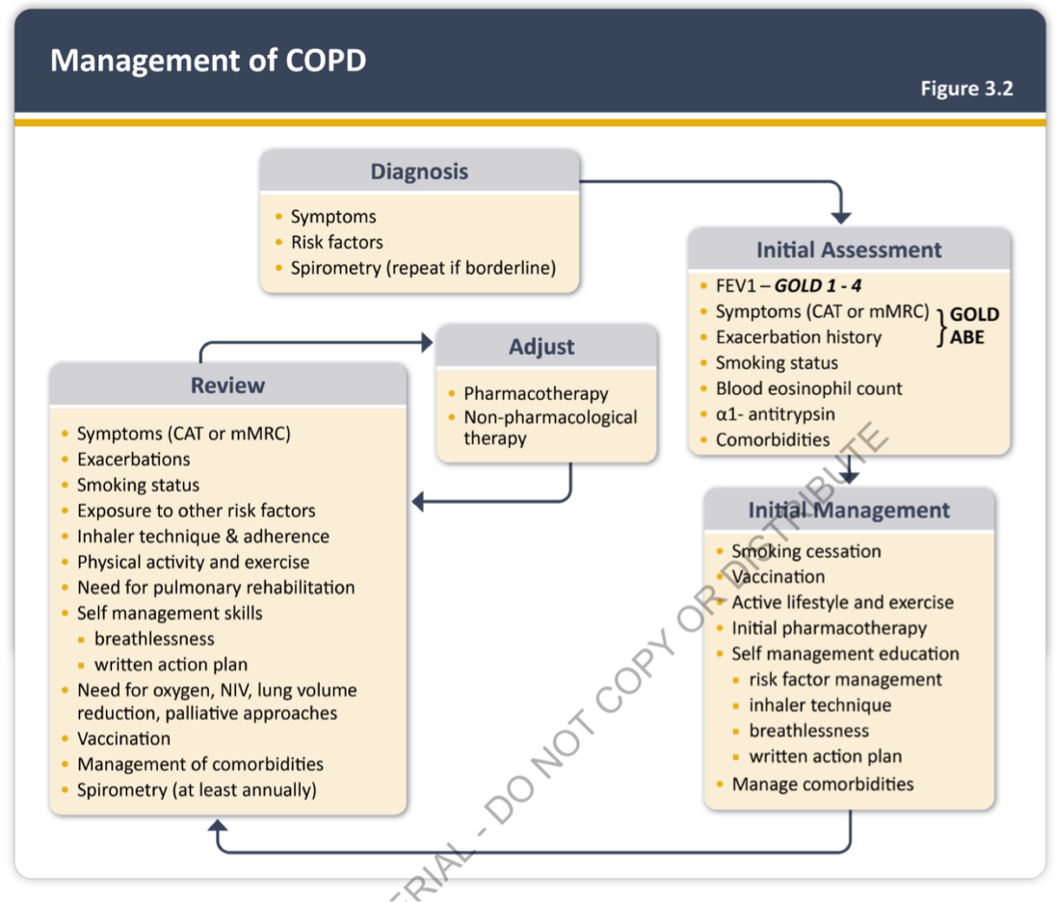

Slide 18
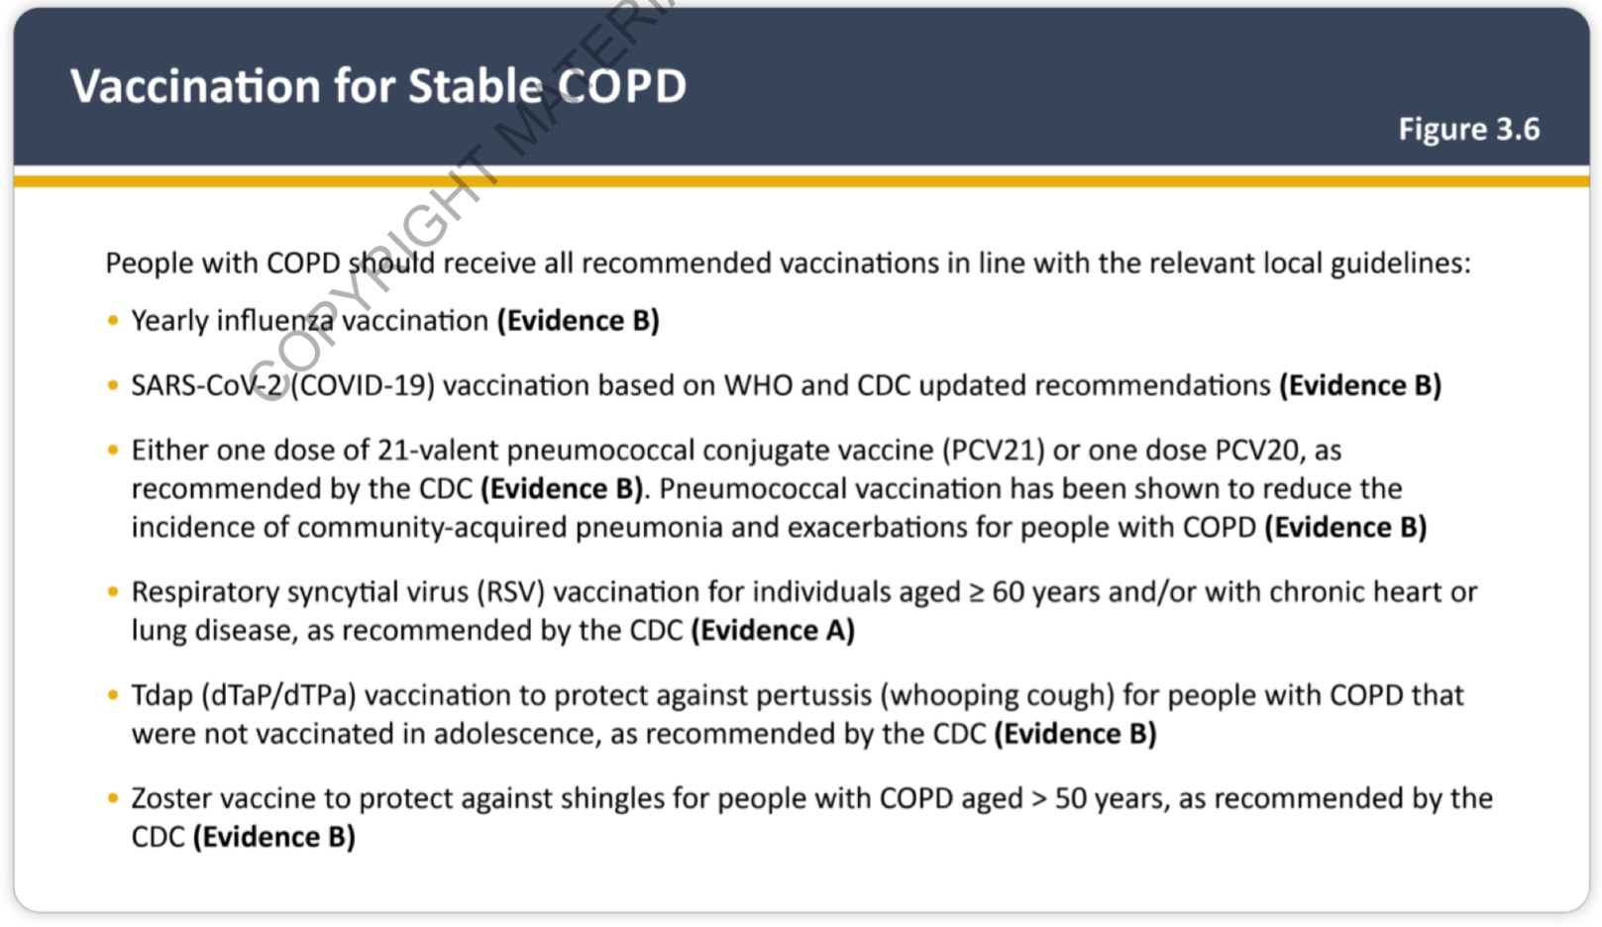

Slide 19
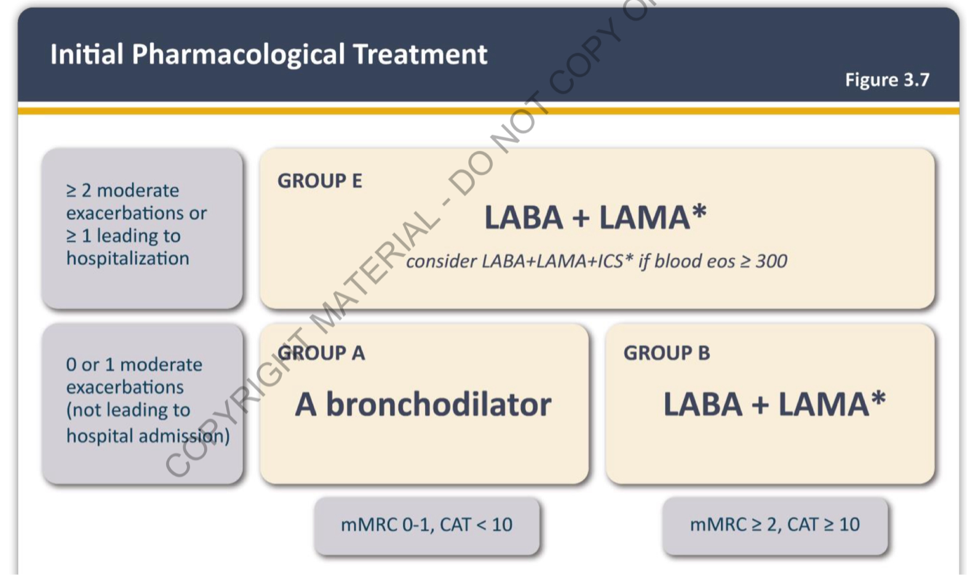

Slide 20
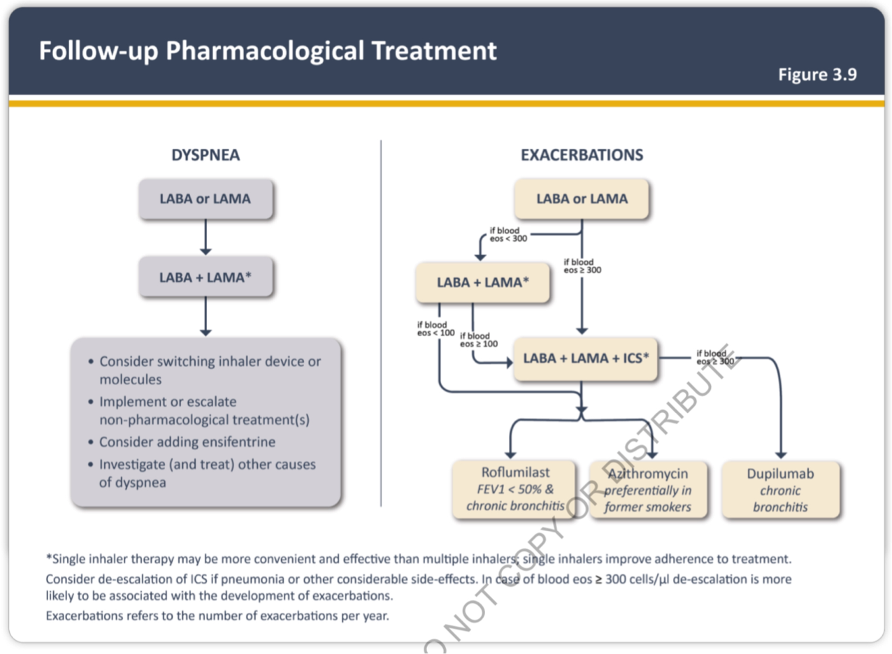

Slide 21
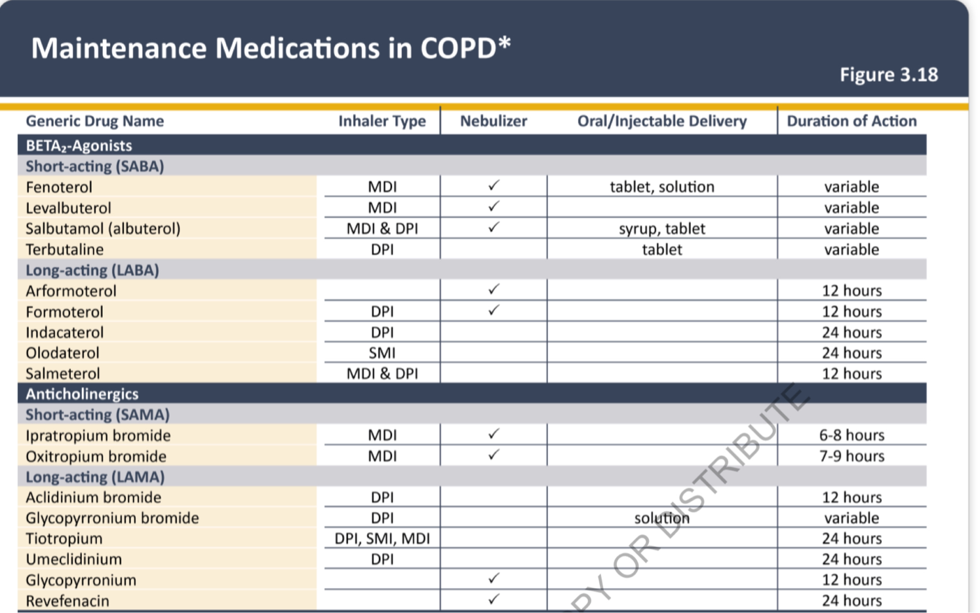

Slide 22
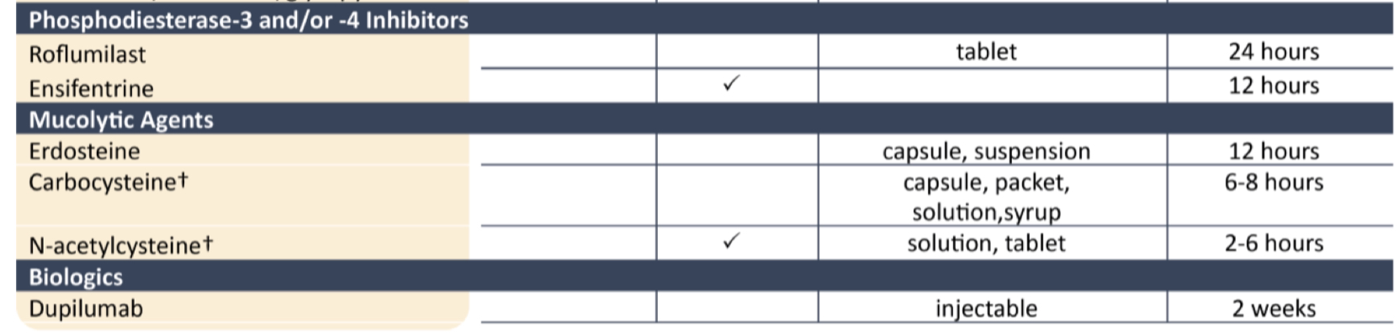

Slide 23
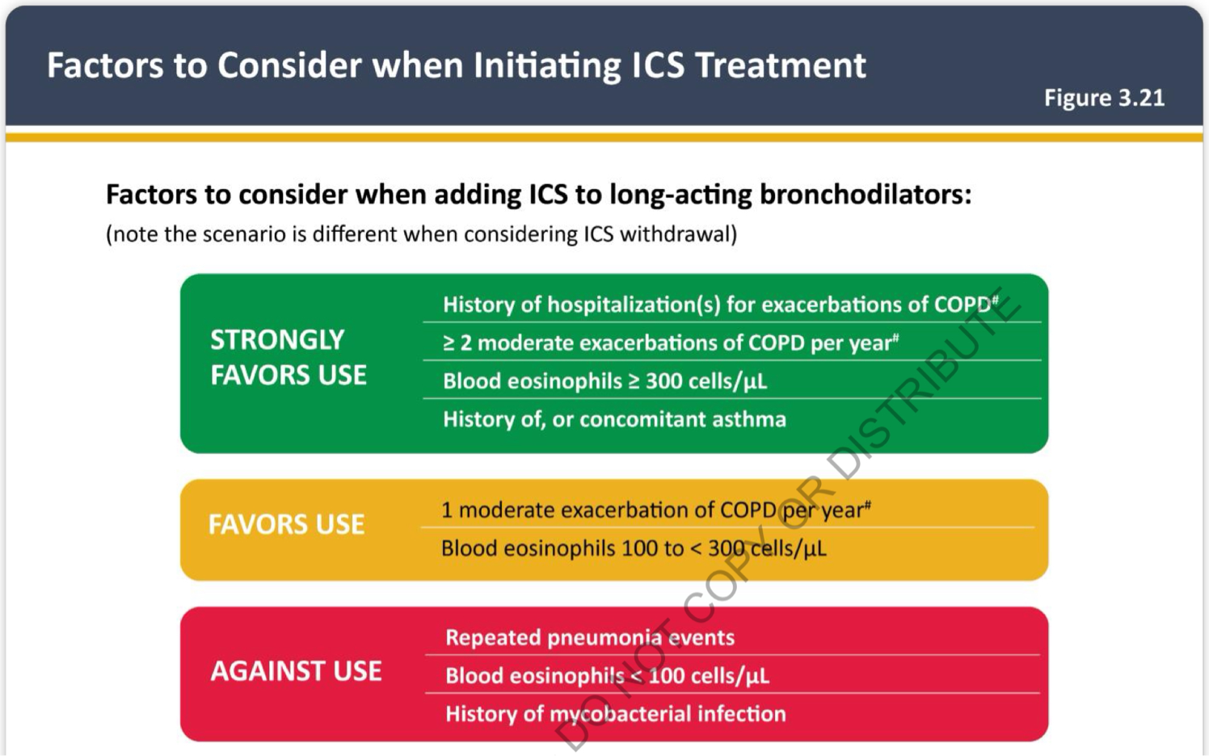

Slide 24
LONG TERM OXYGEN THERAPY
PaO2 below 55 mmHg or SaO2at below 88%, with or without hypercapnia confirmed twice over a three-week period
PaO2 between 55 mmHg and 60 mmHg or SaO 2 of 88%, if there is evidence of PHTN,CCF or polycythemia (hct> 55%).

Slide 25
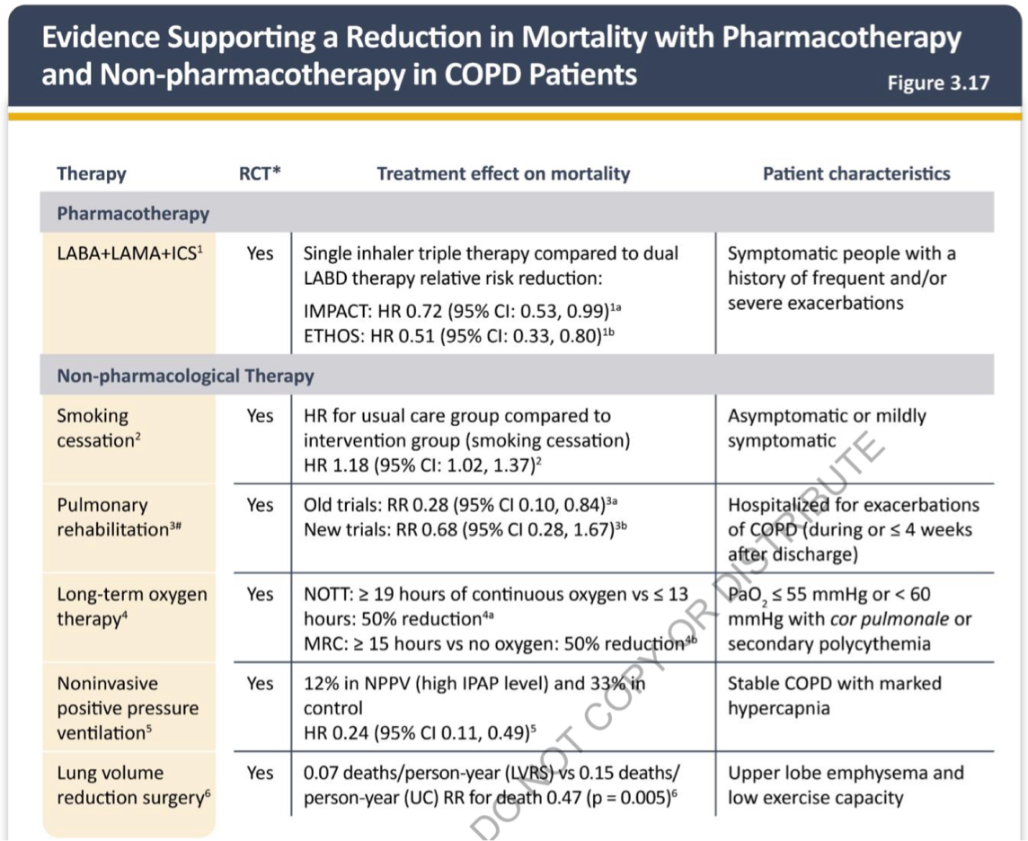

Slide 26
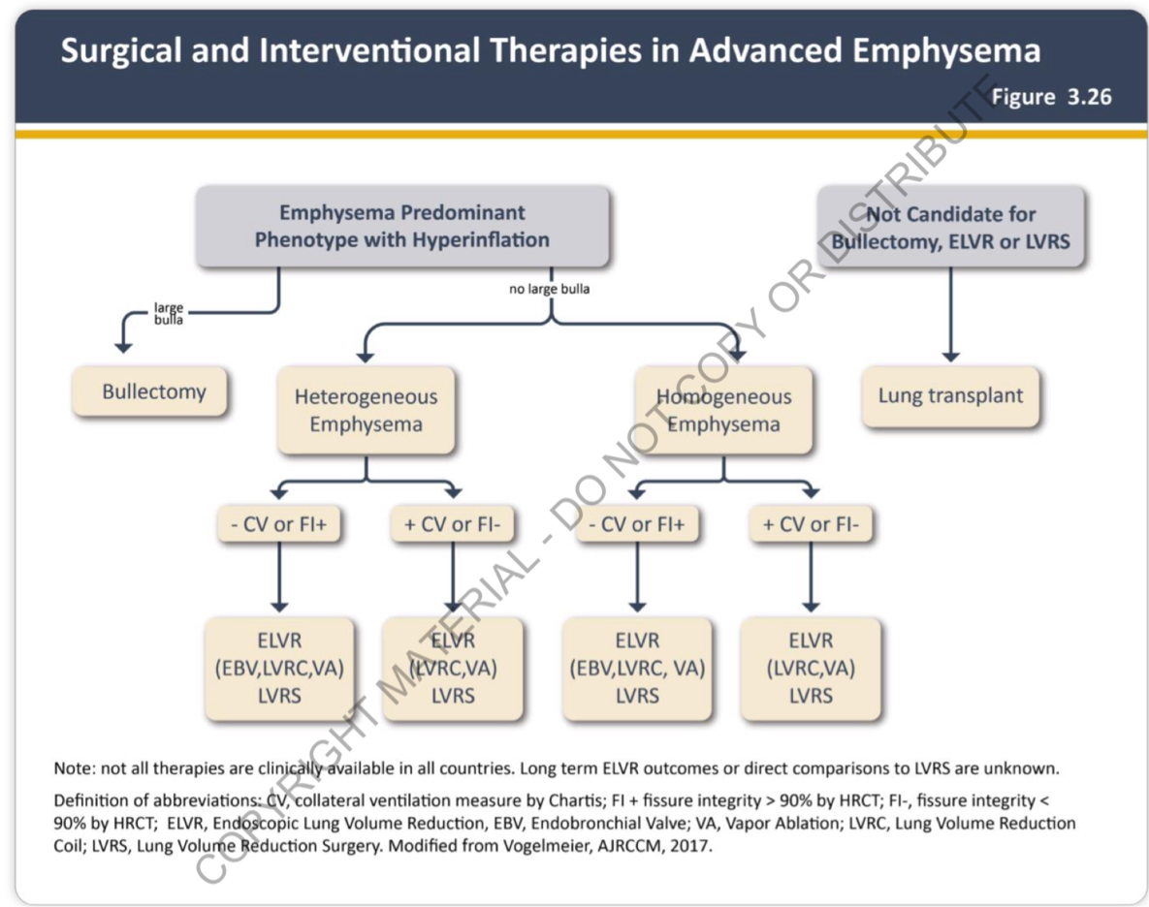

Slide 27
ACUTE EXACERBATION OF COPD
defined as an event characterized by increased dyspnea and/or cough and sputum that worsens in < 14 days which may be accompanied by tachypnea and/or tachycardia and is often associated with increased local and systemic inflammation caused by infection, pollution, or other insult to the airways.

Slide 28
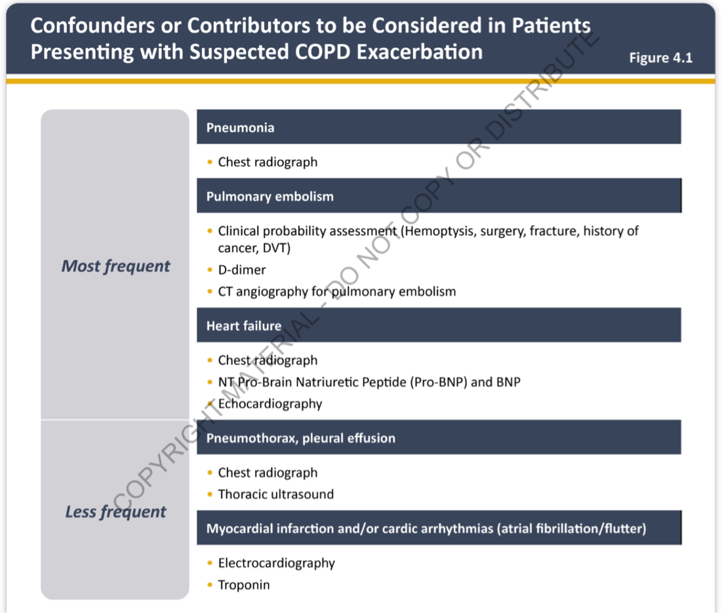

Slide 29
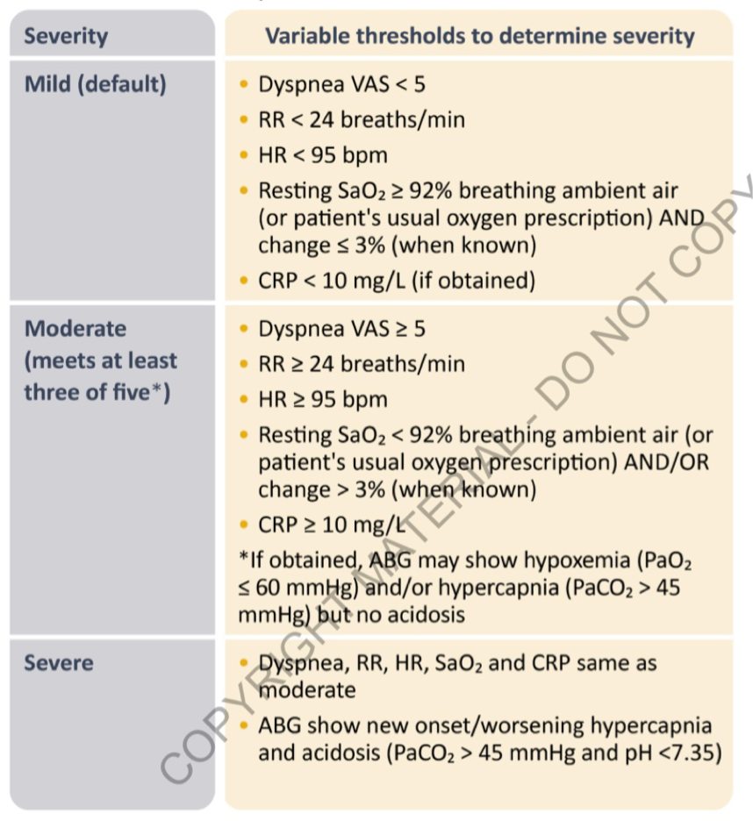

Slide 30
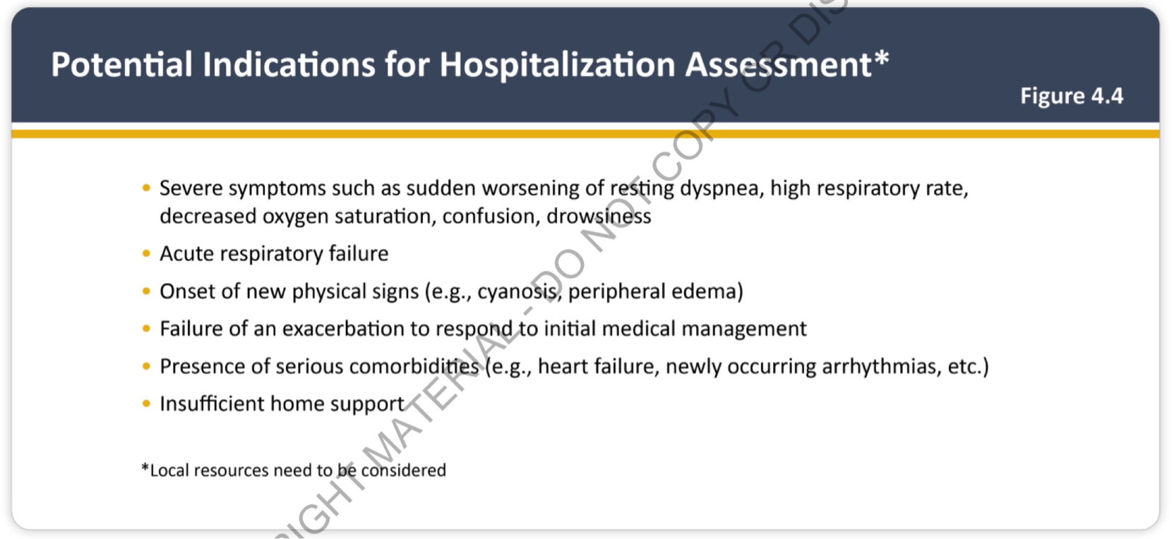

Slide 31
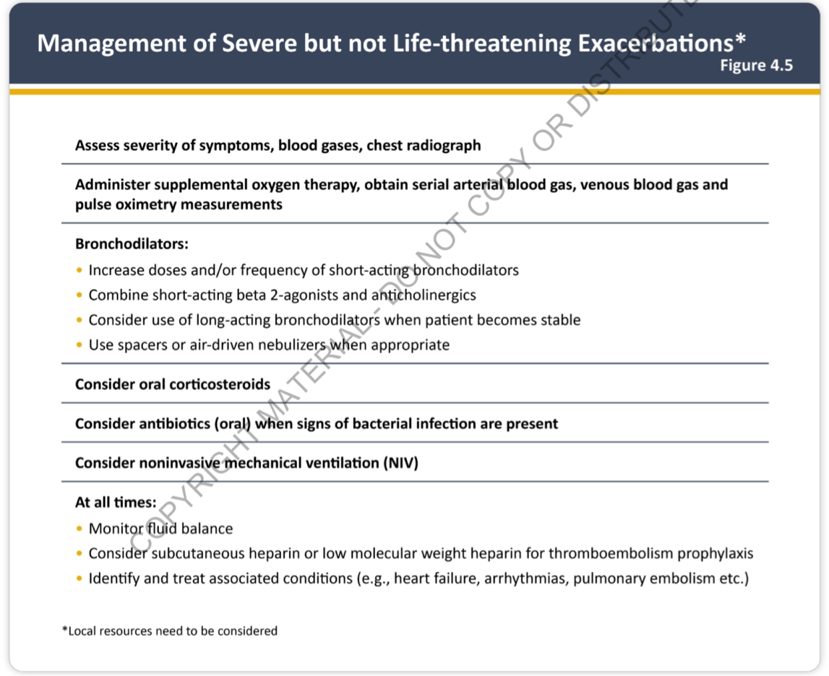

Slide 32
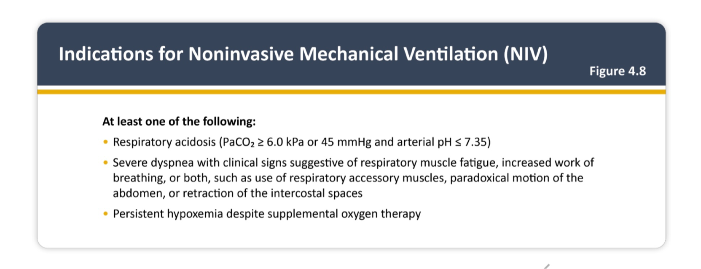

Slide 33
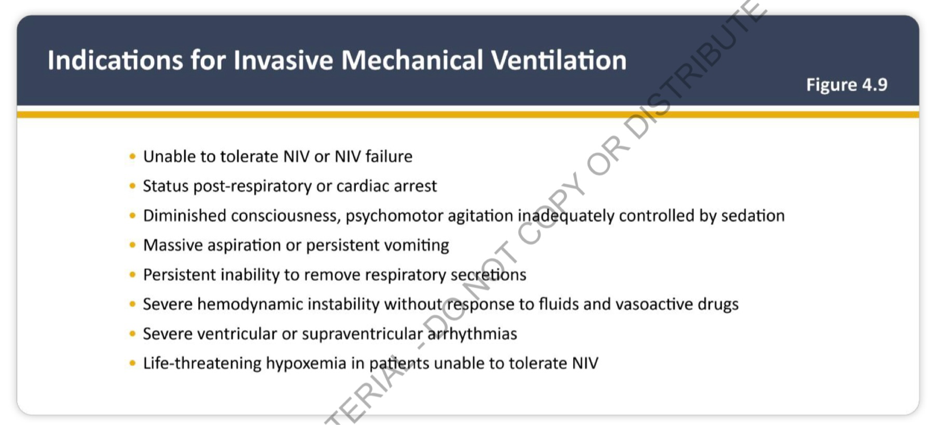

Slide 34
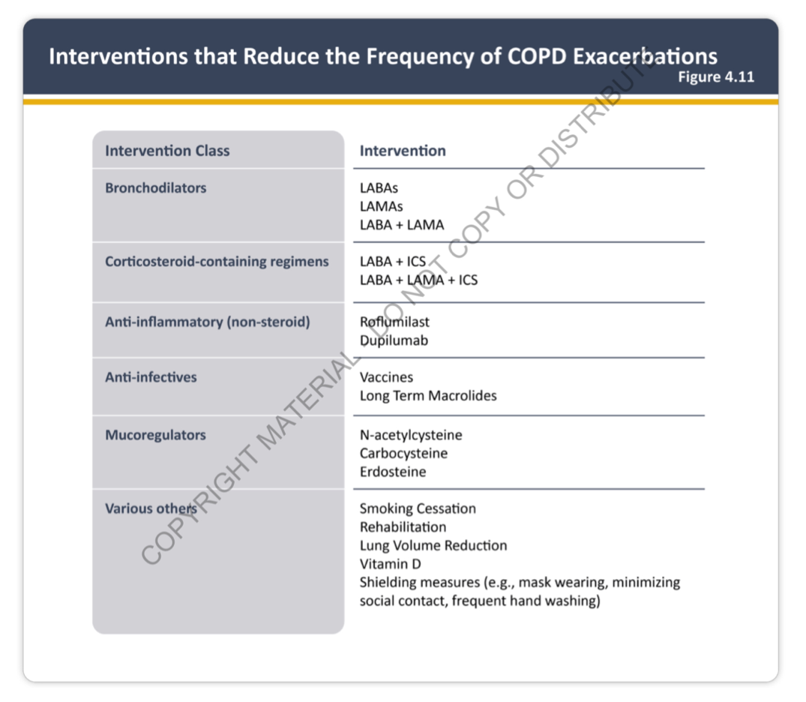

Slide 35
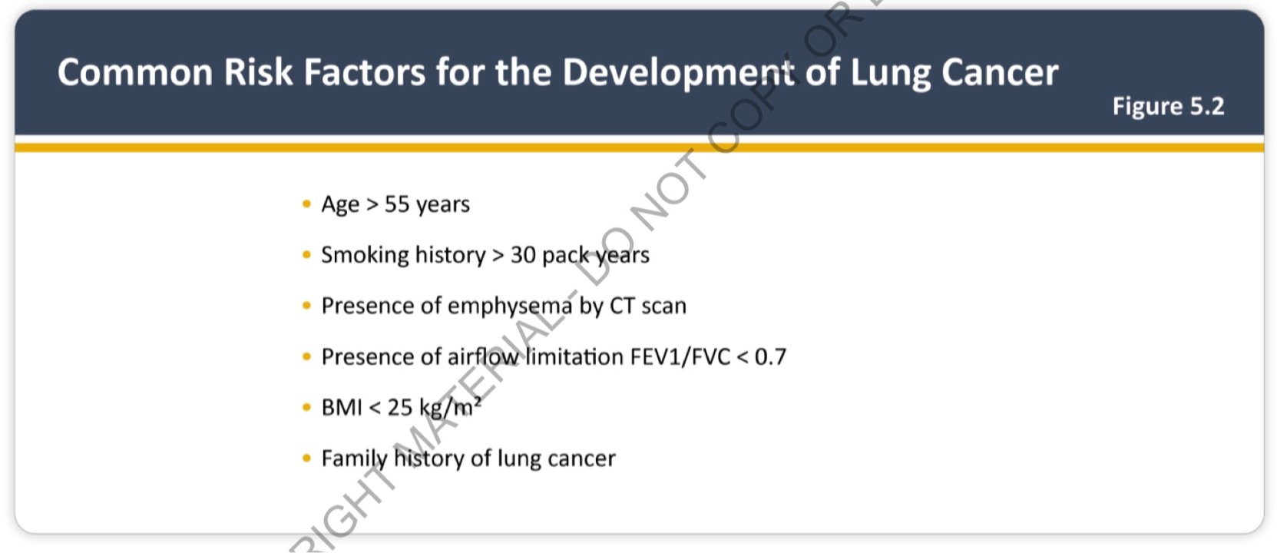

Slide 36
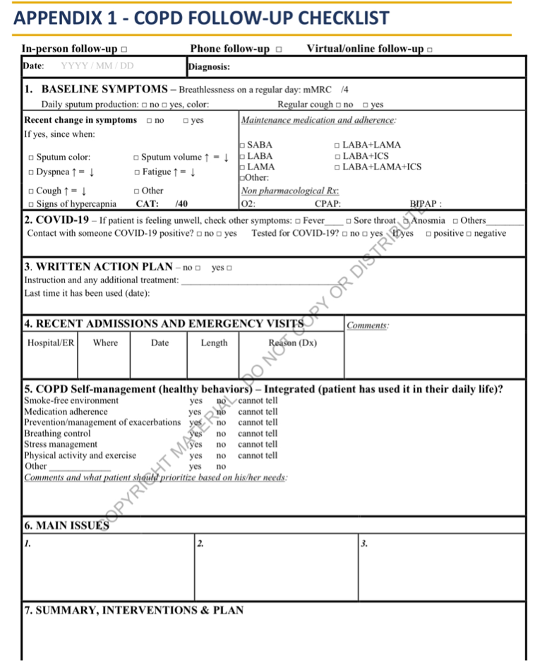

Slide 37
THANK YOU

