Slide 1
HEPATITIS C VIRUS
By Sixth Medical Unit
CHIEF - PROF DR.P.V.BALAMURUGAN MD
ASST PROFESSORS : DR.C. VIGNESH MD
DR.P. GAYATHIRI MD
PRESENTER : DR.SIVA KUMAR.B
(1st Year Postgraduate)

Slide 2
INTRODUCTION
Non A - Non B virus, 1989
small, single‐stranded positive‐sense enveloped RNA virus
E1,E2 : Highly variable : Persistance of infection
NS : NS2 to NS5
Hepatitis C replicates via an error‐prone RNAdependent RNA polymerase
HCV comprises six major genotypes

Slide 3
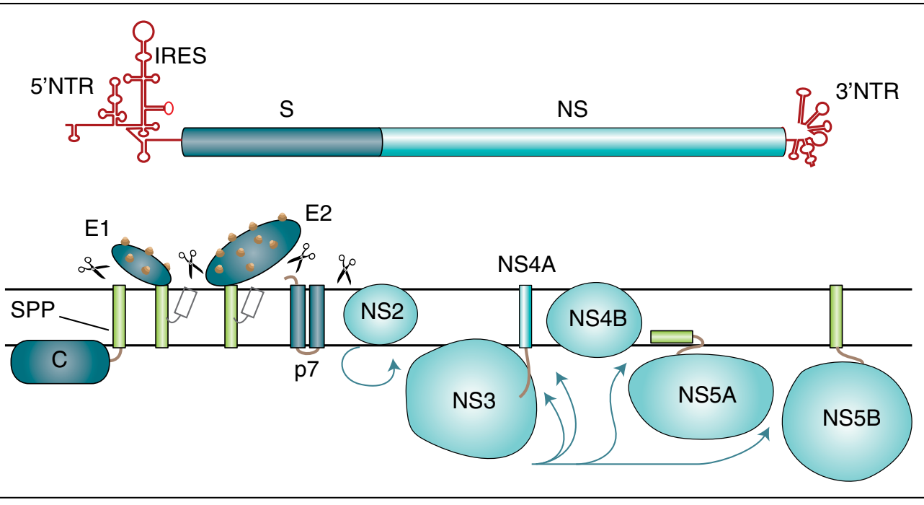

Slide 4
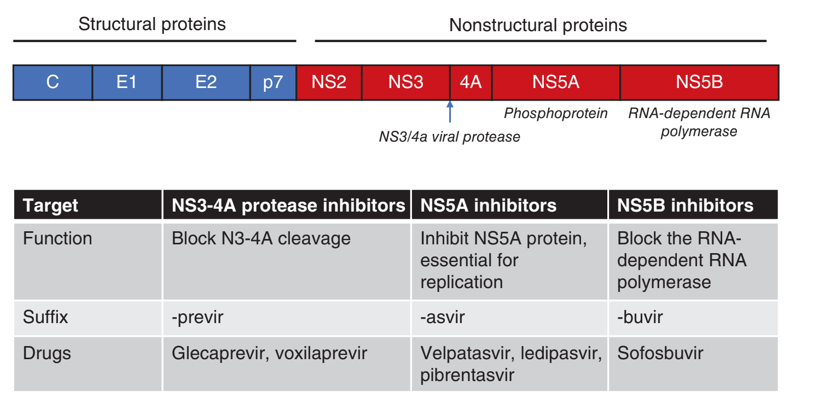

Slide 5
EPIDEMIOLOGY
Genotypes
In India, genotype 3 is the predominant genotype (~63.85%) followed by genotype 1 (25.72%).
Three patterns :
  Exposure via health care (lack of sterilization of medical instruments such as syringes)
  IV drug abuse
  Endemic (Sporadic / Unknown)
Transmission
  Percutaneous (Transfusion, Needle stick)
  Non-Percutaneous (Sexual, Perinatal)
https://doi.org/10.4103/ijmr.IJMR_1850_16

Slide 6
CLINICAL FEATURES
HCV infection rarely causes acute liver failure.
Majority proceeds to chronicty
Which inturn, triggers DCLD
There is no DNA intermediate in the replication of the HCV genome or integration of viral nucleic acid.

Slide 7
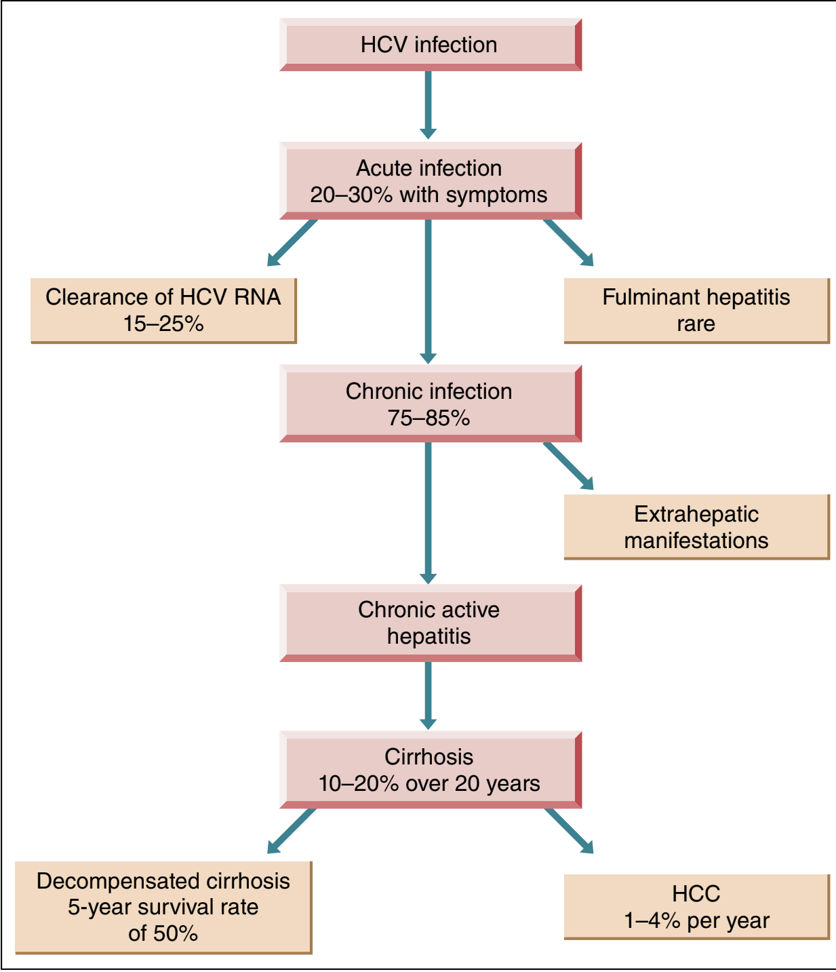
CLINICAL FEATURES
Acute HCV Infection
  Fulminant Hepatitis
Chronic HCV
  Extrahepatic manifestation
  Chronic Active Hepatitis
    Cirrhosis
      DCLD
    HCC

Slide 8
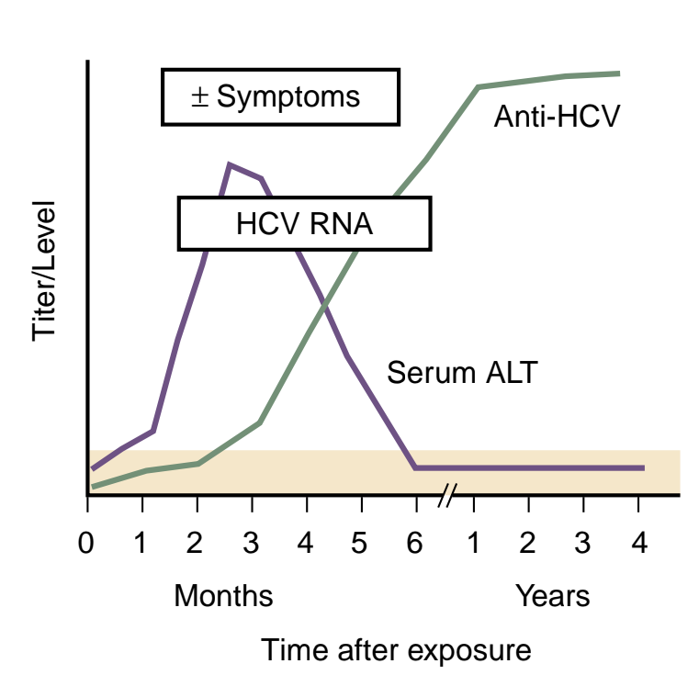
ACUTE HEPATITIS C
Majority asymptomatic
Diagnosis : anti‐HCV and HCV RNA.
Complication : Chronic HCV
Rx if AST/ALT are elevated, and HCV RNA remains detected 2–4 months after first ascertainment, in a patient with apparent recent onset, to minimize the risk of chronicity.
Shorter courses (6–8 weeks) of sofosbuvir and ledipasvir

Slide 9
CHRONIC HEPATITS C : EXTRA HEPATIC
 | PROVEN | POSSIBLE
IMMUNE COMPLEX RELATED | AI THYROIDITIS ESSENTIAL MIXED CRYOGLOBULINEMIA (MPGN, CUTANEOUS VASCULITIS) MGUS NHL - B CELL | Non Cryoglobulinemic Nephropathy
NON IMMUNE COMPLEX RELATED | LICHEN PLANUS RENAL INJURY | Sjogren, Sicca syndrome Metabolic syndrome, Insulin Resistance Porphyria cutenea tarda Vitiligo

Slide 10
CHRONIC HCV
Chronic hepatitis C is arbitrarily defined as the persistence of HCV RNA in serum for 6 months or longer.
Fatigue is the most common symptom; jaundice is rare.
Variability in rates of progression.
Serum ALT concentrations may fluctuate : may even persistently be normal (25-50%); seldom ≥ 5 ULN.
HCC has rarely been observed in the absence of cirrhosis, usually in the setting of advanced fibrosis.
Bottom line : ALT may not predict the course.
Two dreaded complications

Slide 11
DIAGNOSIS : WORK UP
HCV RNA
LFT
HCV GENOTYPE
FIBROSIS
Rule out
  HIV
  HBV (“Competitive Inhibition”)
  AIH

Slide 12
DIAGNOSIS : WORK UP : FIBROSIS ASSESSMENT
TEST | Principle | Types | Sensitivity
INVASIVE | Biopsy | Biopsy : Ishak, METAVIR scores | 100 %
NON INVASIVE | “Stiffness” : Elastography | Transient Elastography (“FibroScan”) ARFI (Acoustic Radiation Force Impulse) MR Elastography | 85-90%
 | Serological | APRI FIB4 Enhanced Liver Fibrosis (ELF™, Siemens) panel Fibrotest (Biopredictive) | 80-90%
http://www.hepatitisc.uw.edu/page/clinical‐calculators/fib‐4

Slide 13
TREATMENT : FDA APPROVED DRUGS
CLASSES | MOA / Subtypes | SVR
INTERFERONS | IFN Alpha | < 10%
 | Peg IFN Alpha 2a/2b | < 20%
RIBAVARIN | “BOOSTER” with IFN | ~ 40 - 50 %
DAA | NS 3/4A inhibitor NS 5A inhibitor NS 5B inhibitor | > 95 % (RVR achieved)

Slide 14
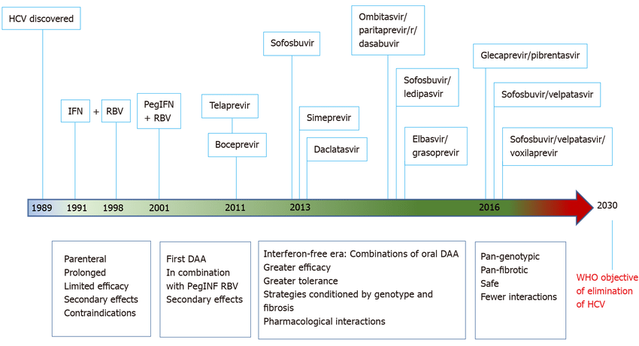
DAA (DIRECT ACTING AGENTS) ERA
(2011 - )
🤔
🤔
🤔

Slide 15
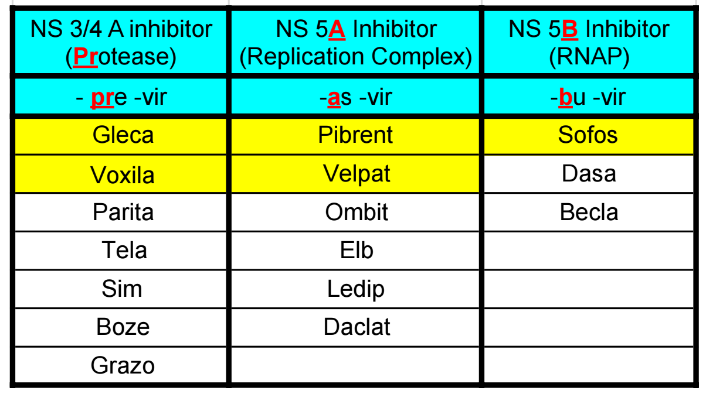
TREATMENT

Slide 16
TREATMENT : DAA … Why so special ?
five
all-oral
highly effective (>95%)
low-resistance
pangenotypic
well-tolerated
short-duration (primarily 8–12 weeks)
combination regimens

Slide 17
COMBINATION DAA (APPROVED REGIMENS)
 | REGIMEN | GENOTYPE
1 | Gleca-previr+ Pibren-asvir (GP) | PAN
2 | Velpat-asvir + Sofos-buvir (SOS-VEL) | PAN
 | Sofosbuvir - Ledipasvir (SOS-LED) | All ex. Gen 2,3
3 | Sofosbuvir-velpatasvir-voxilaprevir | PAN; Reserved
4 | Glecaprevir-pibrentasvir plus sofosbuvir/ribavarin (GPS) | PAN; Reserved
6 | Grazo-previr + Elb+asvir | Indicated in HIV co-infection
7 | Parita-orevir + Ombrit-asvir + Dasa-buvir | Genotype 1a; Only by EASL
8 | Daclat-asvir + Sofos-buvir

Slide 18
COMBINATION DAA (APPROVED REGIMENS) : TREATMENT NAIVE
CIRRHOSIS ? | REGIMEN | DURATION (Weeks) | GENOTYPE
WITHOUT | Gleca-previr 300mg + Pibren-asvir 120 mg | 8 | PAN
 | Velpat-asvir 100 mg + Sofos-buvir 40 mg | 12 | PAN
COMPENSATED CIRRHOSIS | Gleca-previr 300mg + Pibren-asvir 120 mg | 8 | PAN
 | Velpat-asvir 100 mg + Sofos-buvir 40 mg | 12 | All ex. 3 (RAS : Y93H)
DECOMPENSATED CIRRHOSIS | Velpat-asvir /r 100 mg + Sofos-buvir 40 mg | 12 | PAN
 | Ledip-asvir /r 90 mg + Sofos-buvir 400 mg | 12 | All ex. 3 (RAS : Y93H)
 | Velpat-asvir 100 mg + Sofos-buvir 40 mg | 24 | PAN
 | Ledip-asvir /r 90 mg + Sofos-buvir 400 mg | 24

Slide 19
COMBINATION DAA (APPROVED REGIMENS) : PREVIOUSLY TREATED
FAILURE | REGIMEN | DURATION (Weeks) | GENO TYPE
SOFOS-BUVIR | Sofosbuvir-velpatasvir-voxilaprevir | 12 | PAN
 | Glecaprevir-pibrentasvir | 16 | All ex. 3
GLECAPREVIR-PIBRENTASVIR | Glecaprevir-pibrentasvir plus sofosbuvir and weightbased ribaviri | 16 | PAN
 | Sofosbuvir-velpatasvir-voxilaprevir | 12 | PAN
DECOMPENSATED CIRRHOSIS | Sofosbuvir-velpatasvir plus weight-based ribavirin | 24 | PAN
 | Ledipasvir-sofosbuvir plus ribavirine | 24 | All ex. 3
MULTIPLE DAA | Glecaprevir-pibrentasvir plus sofosbuvir and weightbased ribavirin | 16 | PAN
 | Sofosbuvir-velpatasvir-voxilaprevir plus weight-based ribavirin | 24 | PAN

Slide 20
TREATMENT : CHOOSING REGIMENS ..
In Decompensated patients
  -previrs are contraindicated
  Add RBV for 12 weeks
  Or extend Rx to 24 weeks
If IFN Failures, switch to DAA’s
If First line DAA’s failure,
  Add another DAA
  Extend the duration
  Use “Reserve” drugs
  “Boost it” - Ribavarin
  Experimental
Drug - Drug interactions (www.hep-druginteractions.org)

Slide 21
MONITORING…
No routine Liver related tests needed !!!
SVR at 12 weeks
After SVR :
Patients without cirrhosis | No further monitoring
Patients with cirrhosis | Liver monitoring
With or without cirrhosis, but with ongoing risk factors | Liver monitoring

Slide 22
TAKE HOME MESSAGE
HCV is curable
It's as simple as 1..2..3 (“Simplified Regimen”)
Check HCV RNA, Rule out HIV/HBV/AIIH (No other investigations are mandatory)
Start GP or SOS-VEL (No in-treatment monitoring needed)
SVR at 12

Slide 23
Thank you…

