Slide 1
An interesting chest x-ray for discussion
II MEDICAL UNIT
CHIEF : PROF DR. R. BALAJINATHAN, MD
ASST PROFESSORS- DR.VN .ALAGAVENKATESAN ,MD
DR. PV. BALAMURUGAN, MD

Slide 2
CASE HISTORY:
A 45 YEAR OLD MALE CAME WITH COMPLAINTS OF BREATHLESSNESS X 2 WEEKS.
GRADE III DYSPNEA
H/O PEDAL EDEMA+
H/O ORTHOPNEA+
H/O CHEST PAIN+
H/O OCCASIONAL SYNCOPAL ATTACKS+
PAST HISTORY:
K/C/O SYSTEMIC HYPERTENSION X 5 YEARS NOT ON REGULAR TREATMENT.
K/C/O VALVULAR HEART DISEASE X 5 YEARS DETAILS NOT KNOWN.

Slide 3
PERSONAL HISTORY: SMOKER
ALCOHOLIC
ON EXAMINATION:
CONCIOUS
ORIENTED
AFEBRILE
PEDAL EDEMA+
NO PALLOR
NO ICTERUS
NO CLUBBING
NO CYANOSIS
NO GENERALISED LYMPHADENOPATHY

Slide 4
VITALS:
PULSE: 96/ MIN, LOW VOLUME, REGULAR RHYTHM.
BLOOD PRESSURE: 90/50 MM HG IN RIGHT ARM SITTING POSITION.
RESPIRATORY RATE: 28/MINUTE
SPO2: 96% IN ROOM AIR
SYSTEMIC EXAMINATION:
CVS:S1 S2+, GRADE 3 ESM+ IN AORTIC AREA,
PSM+ IN MITRAL AREA
CAROTID THRILL+
RS: B/L BASAL CREPITATIONS+
WHEEZE+
PER ABDOMEN: SOFT, NO ORAGANOMEGALY.
CNS: No FND

Slide 5
INVESTIGATIONS:
ECG: SINUS RHYTHM
LEFT AXIS DEVIATION.
LVH+
ECHO: CONCENTRIC LVH,
SEVERE AORTIC STENOSIS
MODERATE MITRAL REGURGITATION
DILATED LEFT ATRIUM
EF- 38%
CHEST XRAY WAS TAKEN ON THE DAY OF ADMISSION AND IT REVEALED…

Slide 6
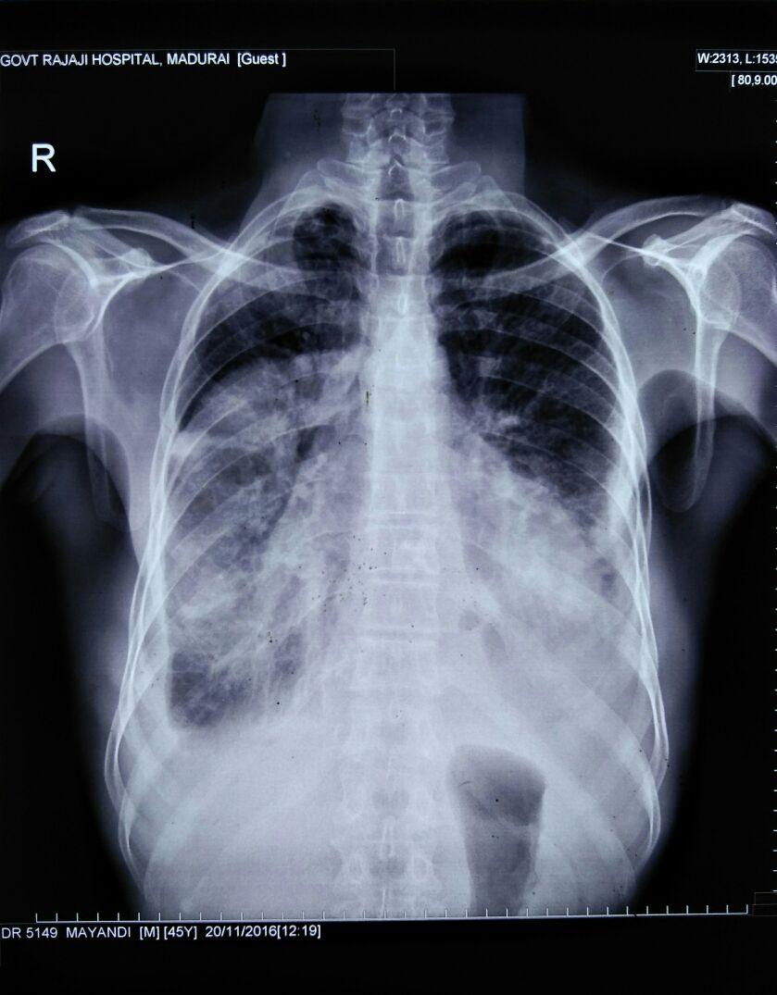

Slide 7
AFTER TREATMENT REPEAT CHEST XRAY WAS DONE AND IT SHOWED!!!!....

Slide 8
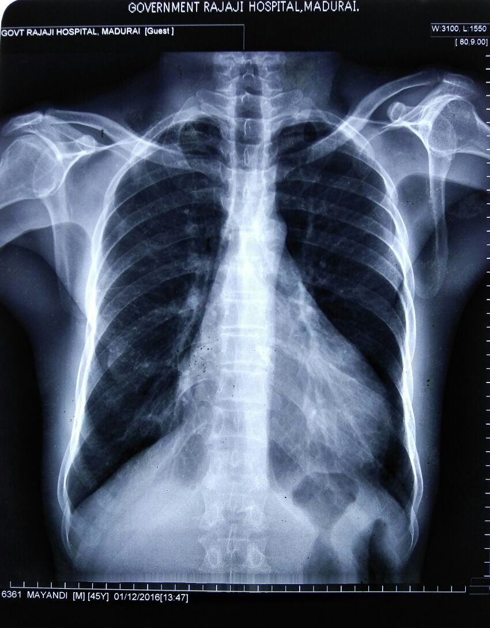

Slide 9
DISCUSSION???

Slide 11
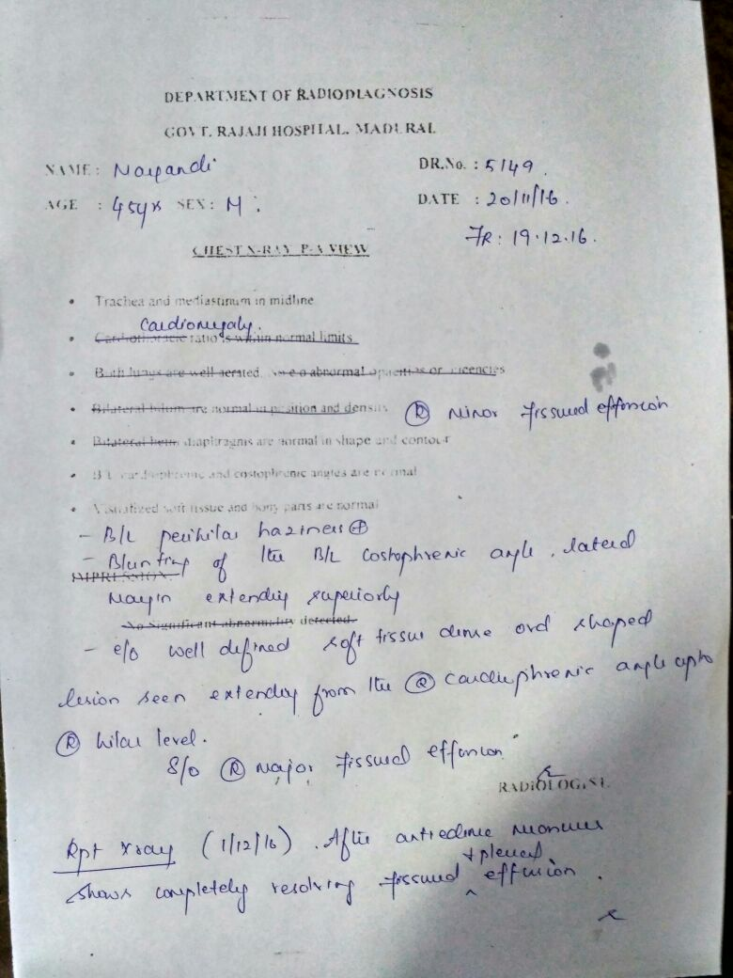

Slide 12
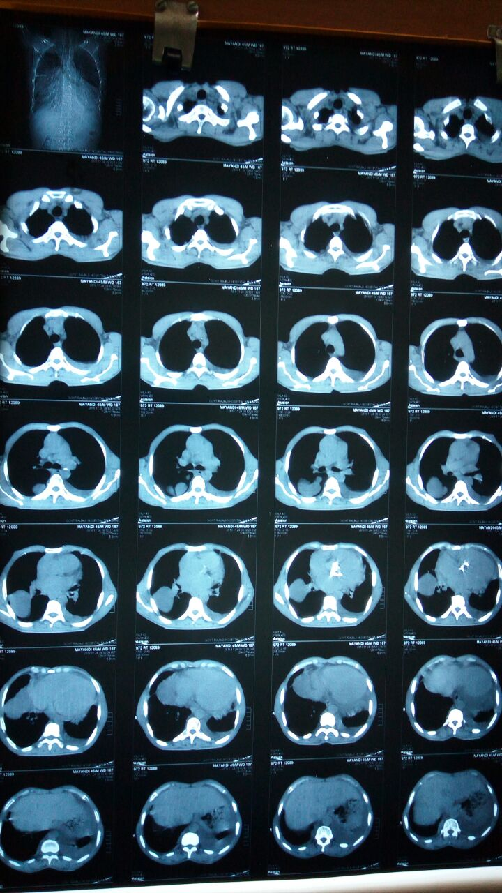

Slide 13
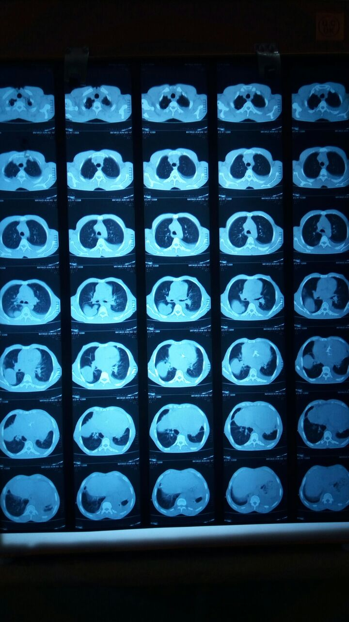

Slide 14
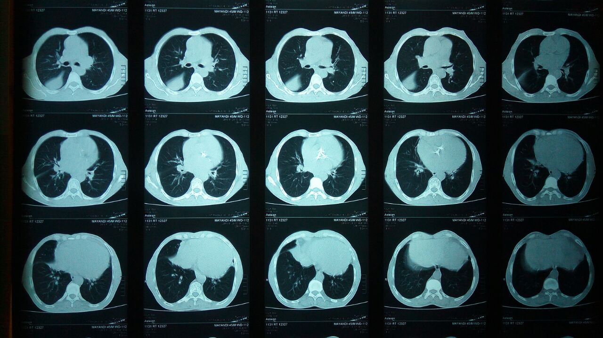

Slide 15
