Slide 1
ECG for discussion
Medical unit 1
HOD & CHIEF : Dr.Natarajan MD
Asst professors : Dr.Palanikumaran MD D.DIAB
Dr.Vasantha kalyani MD DCP
Dr.Sureshkumar MD

Slide 2
Short history
40 yr old male came with following complaints
c/o cough which gets aggravated by lying down and relieved by sitting up
h/o breathlessness of class 4 NYHA relieved by sitting upn
h/o swelling of legs for past 7 days
h/o syncope -multiple episode for past 3 months
no other significant positive history

Slide 3
past history
recently detected t2dm and S-HTN on treatment
h/o similar episode in the pasty before 5 yrs
on examination
concious ,oriented,tachypneic @ rest
pallor + ,B/L pitting pedal edema +,cold extremities
vitals : BP : not recordable started on inotropic support
PR: 114/min ,feeble regularly regular
spo2: not recordable

Slide 4
systemic examination
CVS:S1S2 + ,no murmur
RS: B/L air entry + ,b/l basal crepts +
b/l normal vesicular breath sound +
P/A: soft ,no organomegaly
CNS : no focal neurological deficit

Slide 5
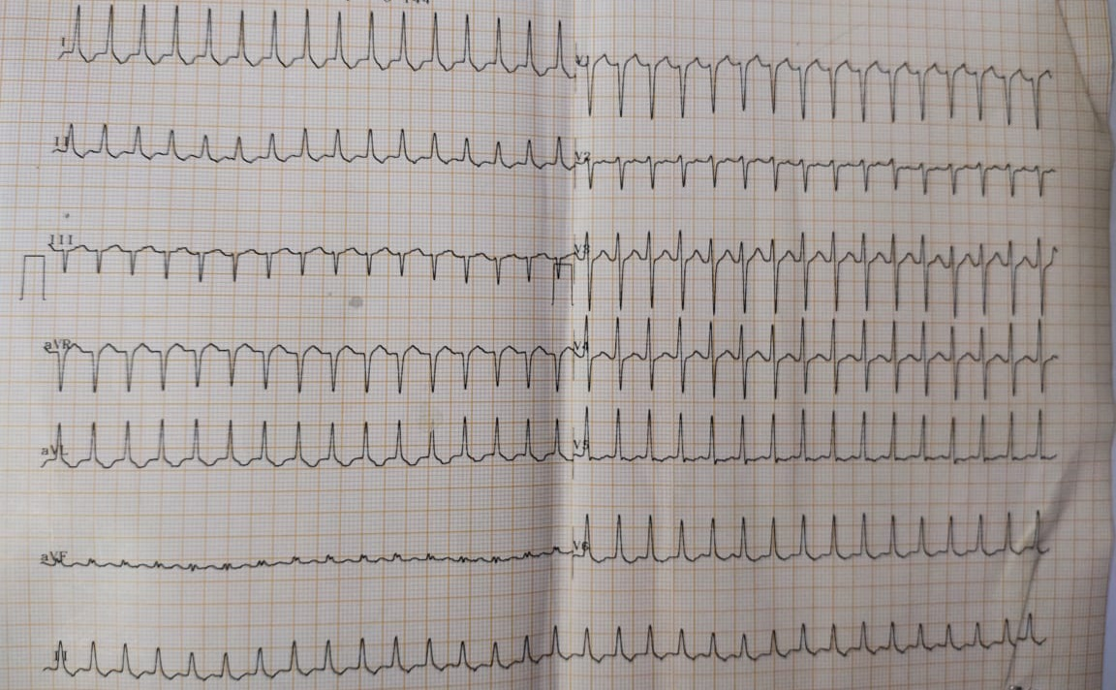
his ECG showed

Slide 6
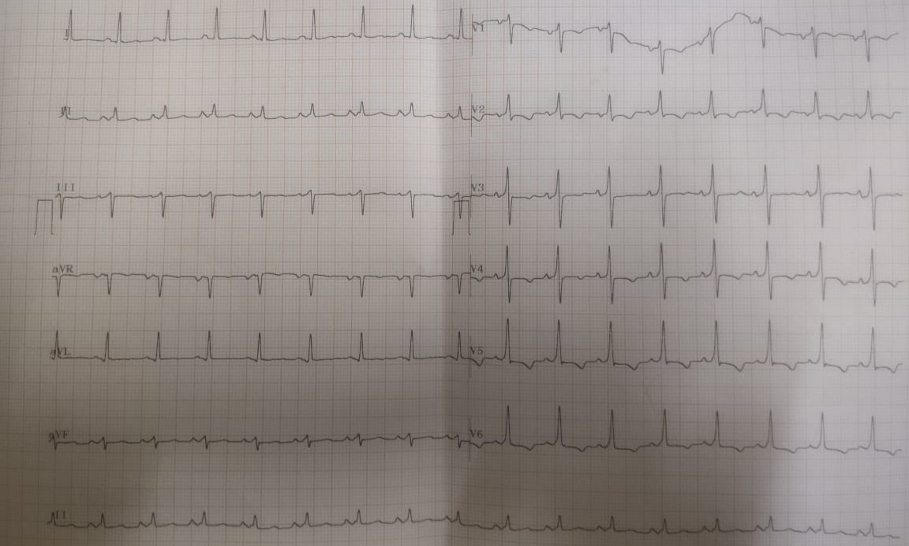
after therapy

