Slide 1
JOURNAL CLUB
BY 3RD MU
CHIEF PROF DR.K.SENTHIL MD
ASST PROF :DR.MANIKANDAN MD
DR.SARAVANA MADHAV MD
DR.ILAMARAN MD DM

Slide 2
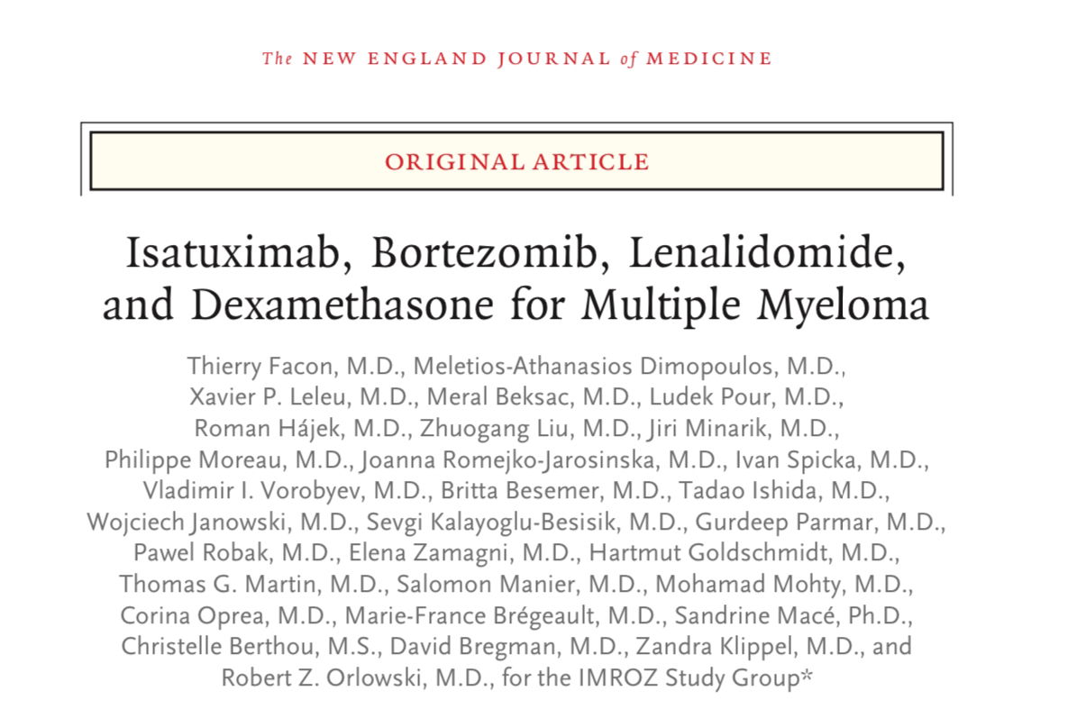

Slide 3
AIM OF THE STUDY
To assess the clinical benefit of isatuximab in combination with bortezomib, lenalidomide and dexamethasone versus bortezomib, lenalidomide and dexamethasone in patients with newly diagnosed multiple myeloma not eligible for transplant

Slide 4
METHOD OF STUDY
IMROZ trial is a prospective, multicenter, international, randomized, open-label, parallel group, 2 arm study done in 446 multiple myeloma patients
patients were randomly assigned using an interactive response technology (IRT) in a 3:2 ratio to one of the two treatment arms

Slide 5
INCLUSION CRITERIA
Symptomatic multiple myeloma, as defined by the IMWG criteria.
Patients who are newly diagnosed and not considered for high-dose chemotherapy due to: being age ≥65 years; or <65 years with important comorbidities likely to have a negative impact on tolerability of high dose chemotherapy with SCT

Slide 6
EXCLUSION CRITERIA
less than 18 yrs and more than 80 years of age.
Diagnosis of primary amyloidosis, monoclonal gammopathy of undetermined significance, or smoldering multiple myeloma .
Diagnosis of Waldenström's disease, or other conditions in which IgM M-protein is present in the absence of a clonal plasma cell infiltration with lytic bone lesion
Prior or current systemic therapy, or SCT for symptomatic multiple myeloma

Slide 7
INDUCTION PERIOD
The total duration of the induction period will be 24 weeks (4 cycles). The duration of each cycle in the induction period will be 42 days (6 weeks) and a total of 4 cycles is planned

Slide 8
Isatuximab (IVRd arm only) intravenously (IV) at the dose of 10 mg/kg on Days 1, 8, 15, 22, 29 in Cycle 1; from Cycle 2 onwards, it will be given on Days 1, 15, 29.
Bortezomib subcutaneously (SC) at the dose of 1.3 mg/m² on Days 1, 4, 8, 11, 22, 25, 29, and 32.
Lenalidomide per os (PO) at the dose of 25 mg/day (10 mg/day for patients with creatinine clearance [CrCl] ≥30 to <60 mL/min) from Day 1 to Day 14 and from Day 22 to Day 35 of each cycle.
Dexamethasone IV at a dose of 20 mg/day on the days of isatuximab administration (for patients in the IVRd arm) and PO otherwise

Slide 9
CONTINOUS TREATMENT PERIOD
After completion of Cycle 4, patients will enter the continuous treatment period.
The duration of each cycle will be 28 days (4 weeks). Continuous treatment may continue until disease progression, unacceptable AE, or patient’s decision to discontinue

Slide 10
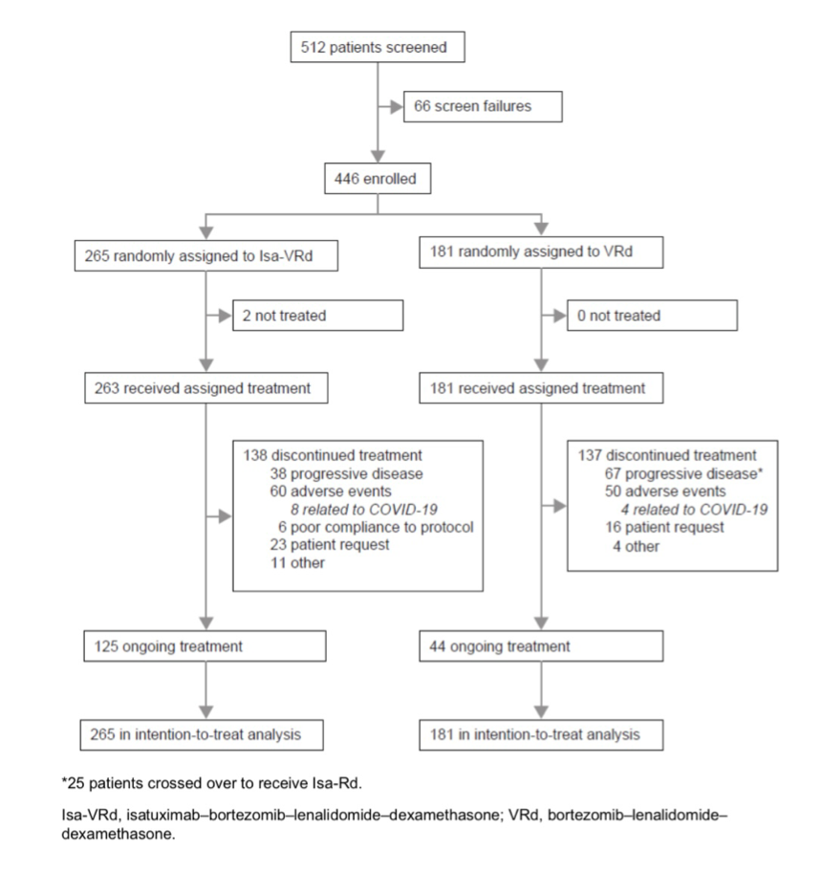

Slide 11
PRIMARY END POINT
PROGRESSION FREE SURVIVAL
the time from the date of randomization to the date of first documentation disease progression or the date of death from any cause, whichever occurs first.
At 60 months, progression-free survival as assessed on the basis of independent review was 63.2% in the isatuximab-VRd group, as compared with 45.2% in the VRd group (hazard ratio for disease progression or death, 0.60; 98.5% confidence interval [CI], 0.41 to 0.88; P<0.001)

Slide 12
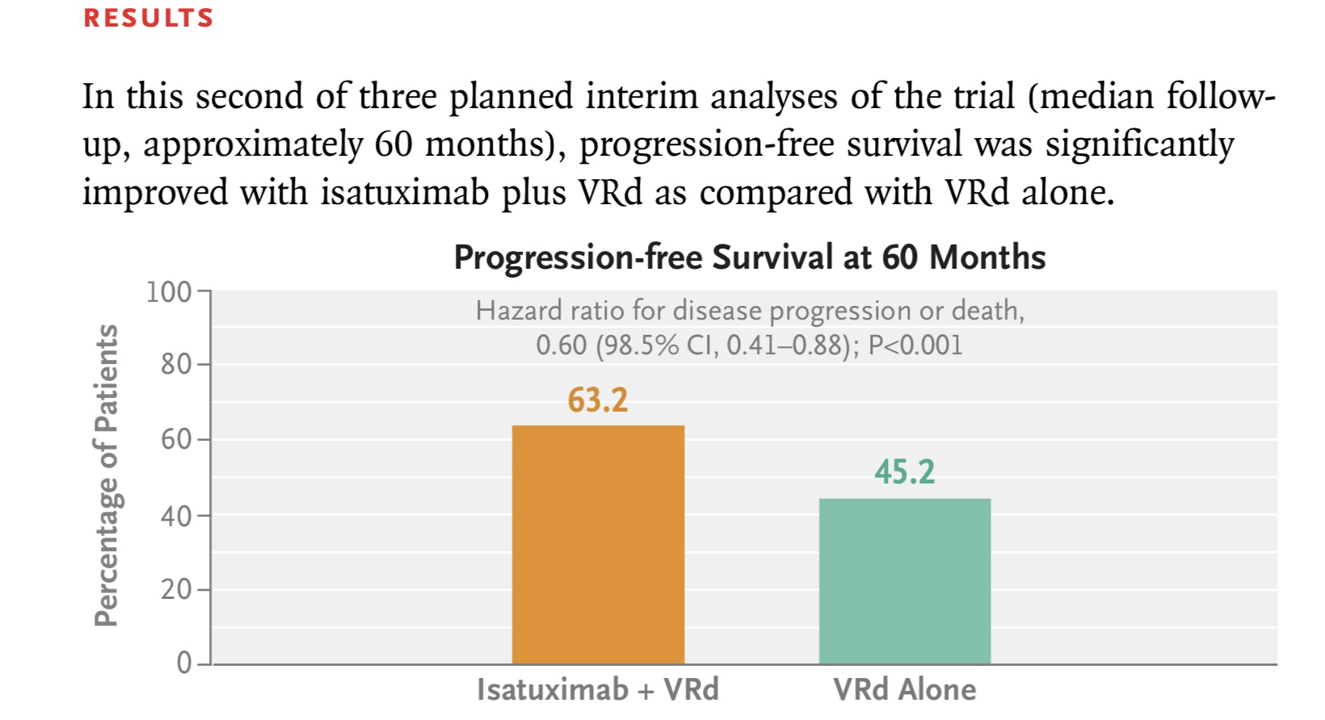

Slide 13
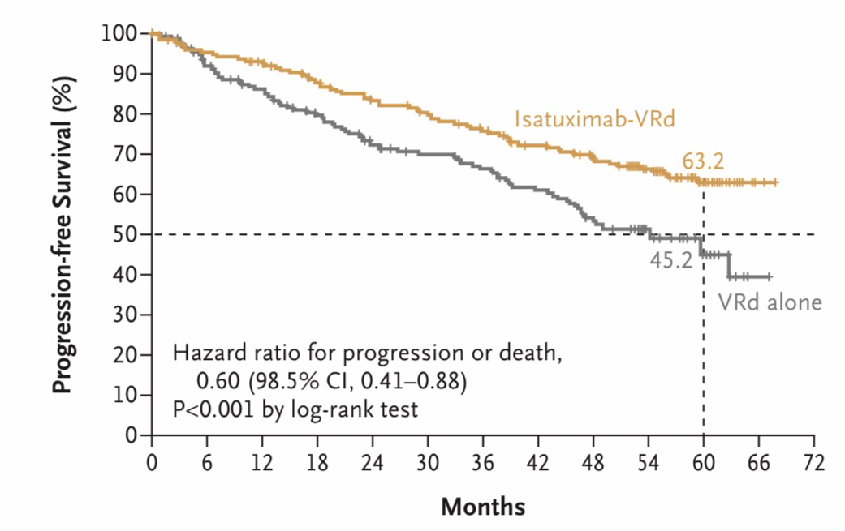

Slide 14
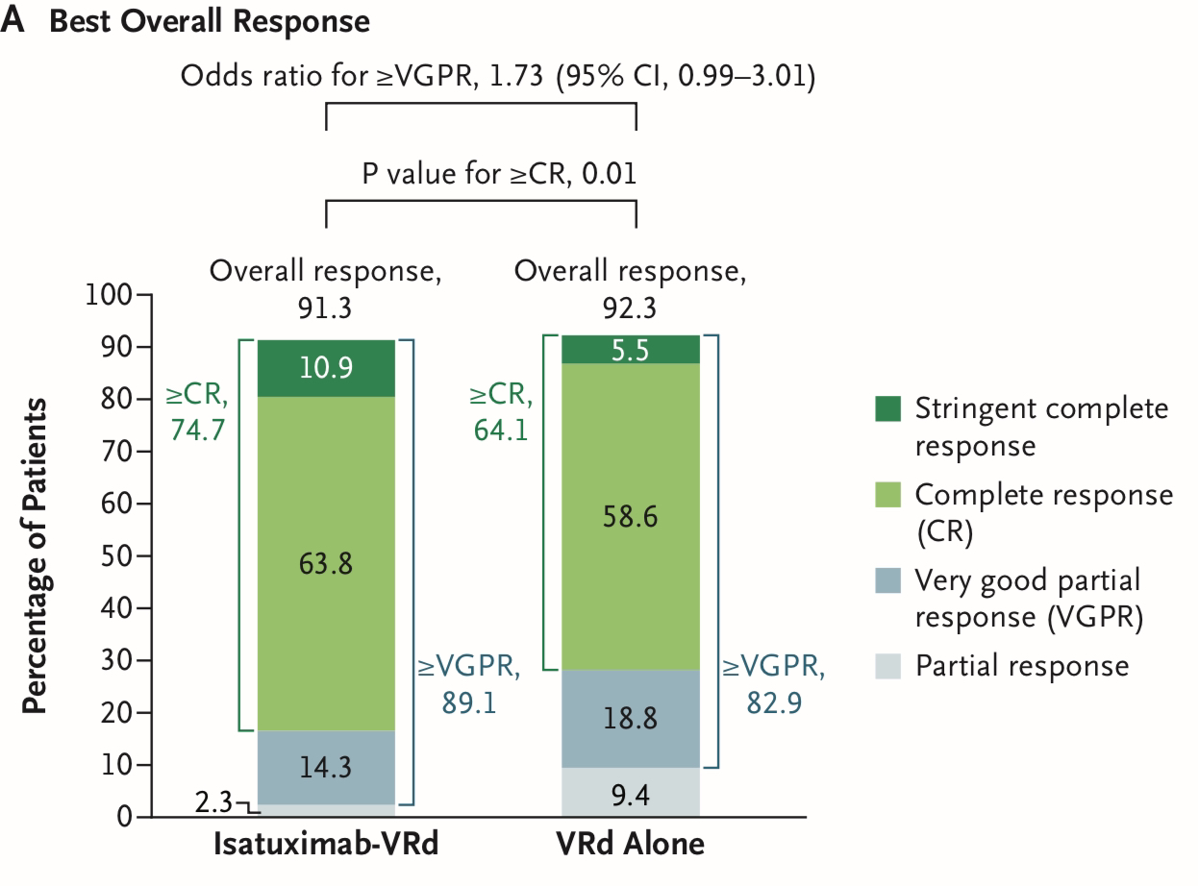

Slide 15
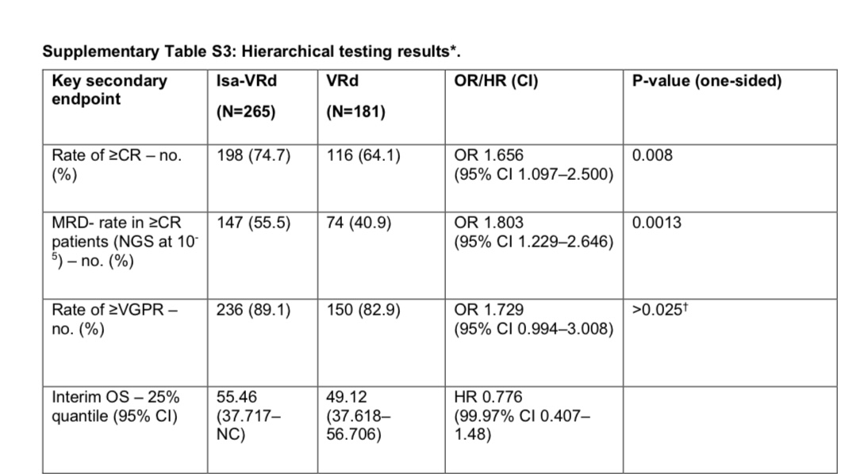

Slide 16
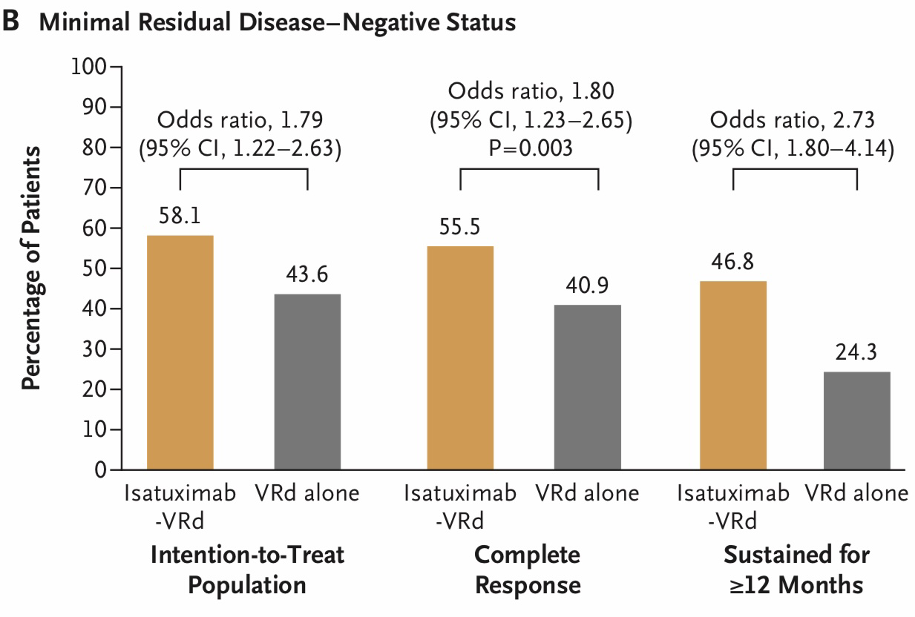

Slide 17
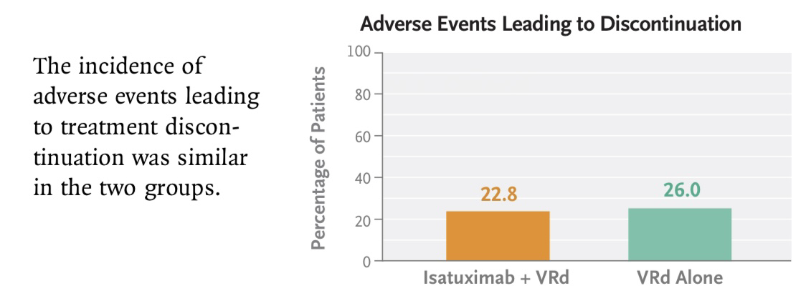
SAFETY

Slide 18
At a median follow-up of 59.7 months (inter- quartile range, 56.0 to 63.2), disease progression or death had occurred in 162 patients (84 of 265 [31.7%] in the isatuximab-VRd group and 78 of 181 [43.1%] in the VRd group)

Slide 19
LIMITATIONS
The trial excluded patients older than 80 years of age at the time of enrollment; whether outcomes in these older patients would be similar to those in the trial population is unclear.
Black patients were underrepresented

Slide 20
CONCLUSION
Results from the international, phase 3 IMROZ trial showed that the addition of isatuximab to a VRd regimen led to a significant 40% lower risk of progression or death at a median follow-up of 5 years.
The estimated progression-free survival at 60 months was 63.2% in the isatuximab-VRd group, as compared with 45.2% in the VRd group — a finding that highlights the profound progression-free survival benefit with the isatuximab-VRd regimen in patients 80 years of age or younger with previously untreated myeloma who were ineligible for transplantation.

Slide 21
THANK YOU

