Slide 1
Approach to coma
VII Medicine unit
Chief-Dr.Alagavenkatesan MD.,
Assistant professors-Dr.Arul prakash MD.,
Dr.Vinoth kannan MD.,
Dr.Nabil Fayaz MD.,

Slide 2
Coma-deep sleep like state with eyes closed from which the patient cannot be aroused.
Stupor-lower threshold for arousability in which the patient can be transiently awakened by vigorous stimuli.
Drowsiness refers to light sleep and is characterized by easy arousal that may persist for brief periods.

Slide 3
Consciousness has two dimensions-arousal and cognition.
Ascending reticular activating system is a system of fibres that arises from the reticular formation of brain stem and projects to paramedian,parafascicular ,centromedian and intralaminar nuclei of thalamus.

Slide 4
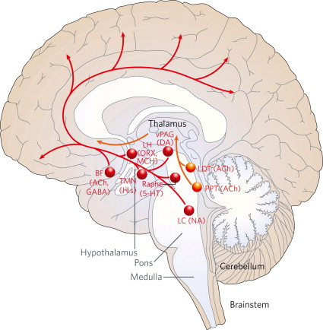

Slide 5
INITIAL MANAGEMENT OF COMA
Airway,breathing and circulation
Coma cocktail-dextrose,flumazenil,thiamine and naloxone
Preparations for intubation,respiratory support and ionotropes

Slide 6
History
General physical examination
Neurologic examination

Slide 7
History
known seizure disorder/Diabetes/hypertension/suicidal attempts/substance abuse
abrupt onset-Subarachnoid hemorrhage or seizure
gradual –subdural hematoma or metabolic encephalopathy
h/o fever,falls

Slide 8
GENERAL PHYSICAL EXAMINATION:
SYSTEM | FINDING | POSSIBLE IMPLICATIONS
BLOOD PRESSURE | HYPOTENSION HYPERTENSION | MI,Sepsis,intoxication, Hypovolemia Stroke,intracranial hemorrhage,increased ICP
HEART RATE | Bradycardia Tachycardia | Increased ICP Hypovolemia,cocaine overdose,infection
RESPIRATION | Hyperventilation hypoventilation | Hypoxia,hypercapnia, acidosis,fever,liver disease,sepsis Overdose,myxedema
 | Cheyne-stokes | Bilateral cerebral disease,upper brainstem lesions

Slide 9
Temperature | Fever hypothermia | Infection,inflammation,SAH, Anticholinergics Sepsis,shock,myxedema coma,wernicke’s encephalopathy,hypoglycemia
Head and neck | Stiff neck Unilateral,fixed dilated pupil Pinpoint pupil | Meningitis,SAH Uncal herniation,aneurysm Pontine hemorrhage or infarct,opiate overdose
Skin | Cyanosis Petechiae sweating | Hypoxia,cardiac disease DIC,TTP,meningococcemia Fever,hypoglycemia

Slide 10
Cushing’s reflex-hypertension and bradycardia

Slide 11
Neurologic examination
Level of consciousness
Pupils
Eye movements
Fundus examination
Motor status
Reflexes
Meningeal signs

Slide 12
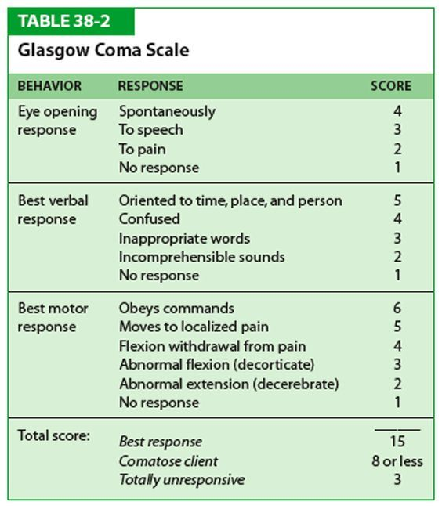

Slide 13
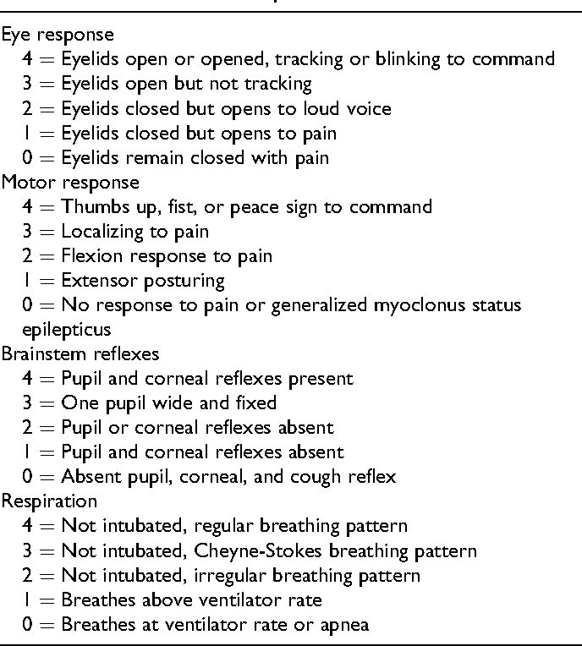
FOUR SCORE-Full Outline of Unresponsiveness

Slide 14
AVPU scale correlates to distinct GSC ranges, as outlined below
GCS Score 15 - Alert
GCS 12 to 13 - Verbally Responsive
GCS 5 to 6 - Physically Responsive
GCS 3 - Unresponsive

Slide 15
Cranial nerves
B/L pinpoint pupil-Opiate toxicity,pontine hemorrhage
B/L mydriasis-anticholinergic intoxication,botulism
Unilateral dilated pupil-uncal herniation(Hutchinson pupil)
Brain death-pupillary responses are absent
Pupillary light reactivity –prognostic sign

Slide 16
With deepening of coma first to disappear is roving of eye movements,then the oculocephalic response and then the oculovestibular reflex.
Conjugate gaze deviations
Vertical gaze deviations

Slide 17
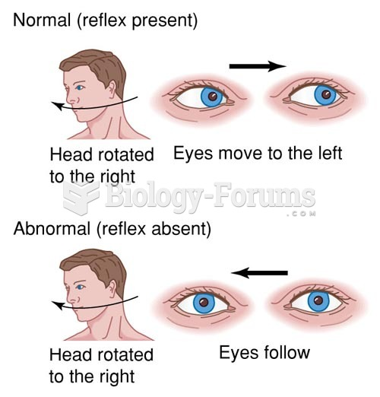
Oculocephalic reflex

Slide 18
Oculovestibular reflex
It is done when oculocephalic reflex is not intact
In coma the expected response is tonic deviation of eye towards the side of irrigated ear.
brainstem lesions affecting the pathways and nuclei subserving the reflex may cause an abnormal response

Slide 19
Eyelids closed in comatose patient-lower pons still functioning
Spontaneous blinking-intact pontine reticular formation
FUNDUS Examination:
papilledema
subhyaloid hemorrhage

Slide 20
Motor status-flaccidity
flaccidity of both arms with normal tone in the legs (man-in –the barrel syndrome)
Sensory
Reflexes-Tendon reflexes and plantar response should be tested. Frontal release signs may be present.
Meningeal signs

Slide 21
Differential diagnosis of coma:
Primary CNS disease
Depression of CNS by systemic metabolic process or drug intoxication
Psychogenic unresponsiveness

Slide 22
Structural lesions:
Mass lesions-increased ICP ,herniation and compression or hemorrhage into the upper midbrain
Brain stem lesion
Disease process that affects both cerebral hemispheres or both hemispheres and the RAS.
eg: meningitis,SAH,encephalitis

Slide 23
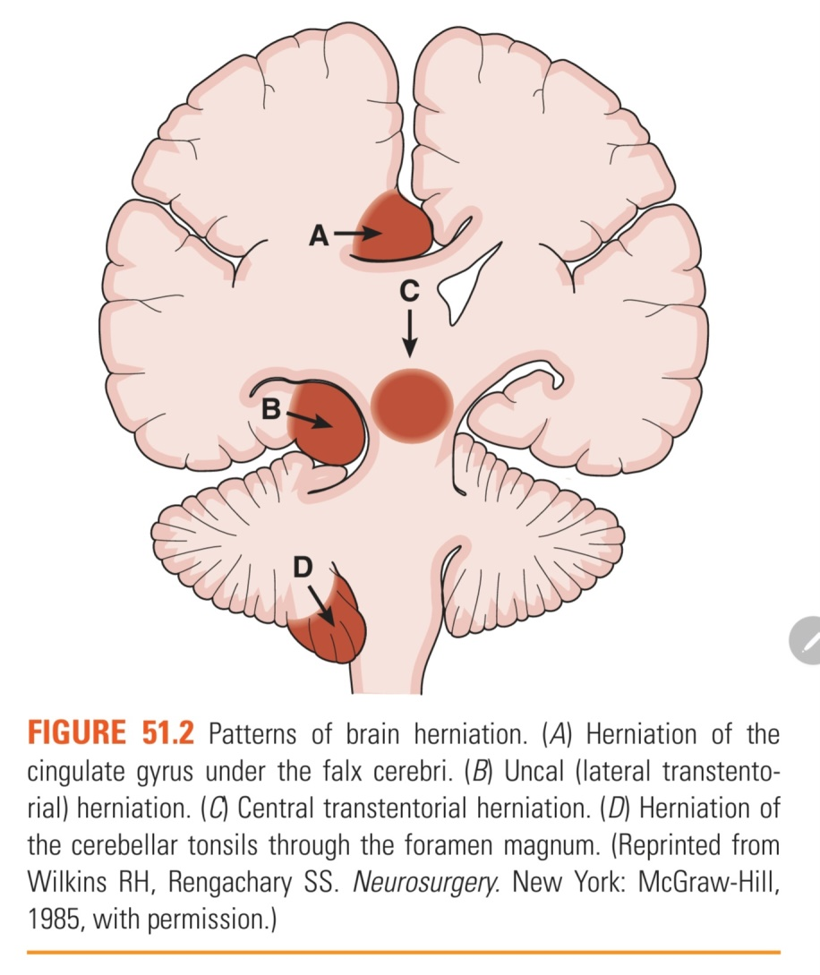

Slide 24
Metabolic encephalopathy
Intoxication-alcohol,opiates or sedative drugs.
Severe systemic metabolic disturbance-HIE,hypoglycemia,DKA,hypercalcemia,
hypercarbia
Systemic infection

Slide 25
Locked –in syndrome
Ventral brainstem dysfunction sparing the RAS renders the patient mute and quadriplegic not comatose.
Lesion-midpons
Cause-brainstem stroke,trauma
Average survival-71 months

Slide 26
Persistent vegetative state
Massive bilateral hemispheric damage with spared and intact brainstem
Devoid of cognition with preservation of arousal and sleep-wake cycle.
May develop as a sequel to acute insults,end stage of neurologic illness
Eye open permanent unconsciousness ,with intact sleep-wake cycle but no awareness of self or environment

Slide 27
Psychogenic unresponsiveness(hysterical coma)
Normal brainstem reflexes
Caloric testing produces nystagmus
Hypertonicity,opisthotonos
Usually precipitated by emotional stress
Mutism-severe depression,schizophrenia and organic psychoses

Slide 28
Brain death
prerequisites
clinical or neurological evidence of an acute CNS catastrophe
exclusion of complicating medical conditions that may compound clinical assessment
no drug intoxication or poisoning
core temperature >32degree celsius

Slide 29
Three cardinal findings:
coma or unresponsiveness
absent brainstem reflexes
apnea

Slide 30
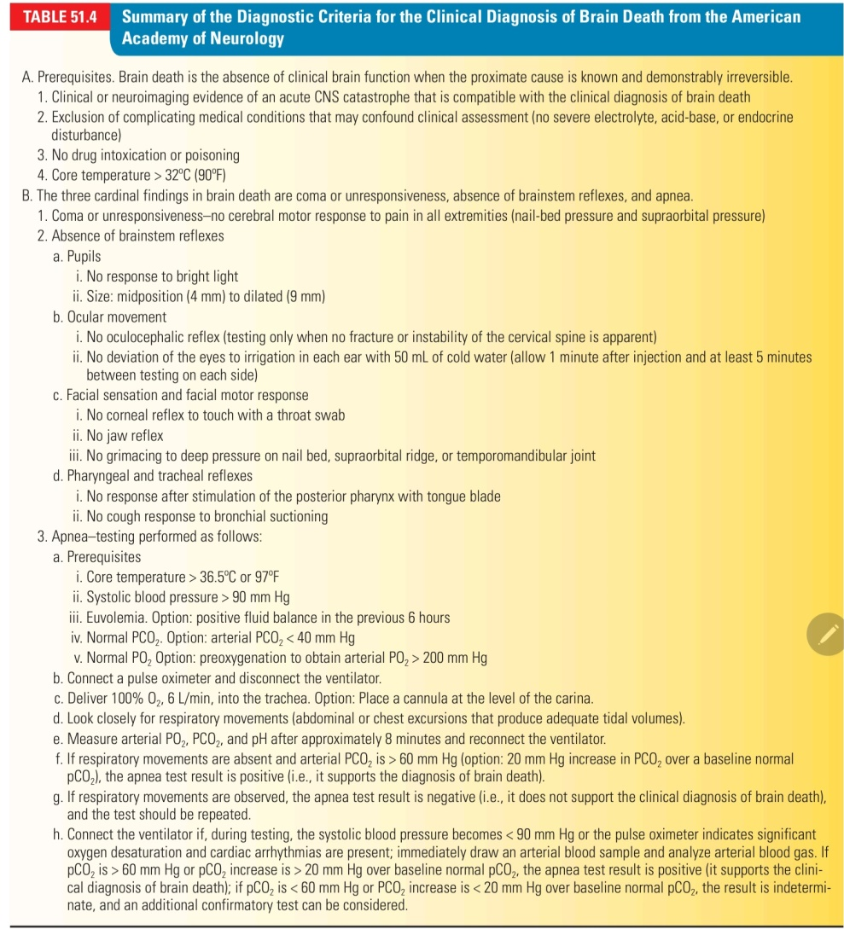

Slide 31
References
Harrison’s principle of internal medicine
DeJong’s

