Slide 1
INSULIN
CHIEF: Prof Dr. SYED BAHAVUDEEN HUSSAINI MD.,
ASSISTANT PROFESSORS : Dr. R VINOTH KANNAN MD .,
Dr V.P PRIYA MD ..,
PRESENTOR : Dr SHAREENA M T

Slide 2
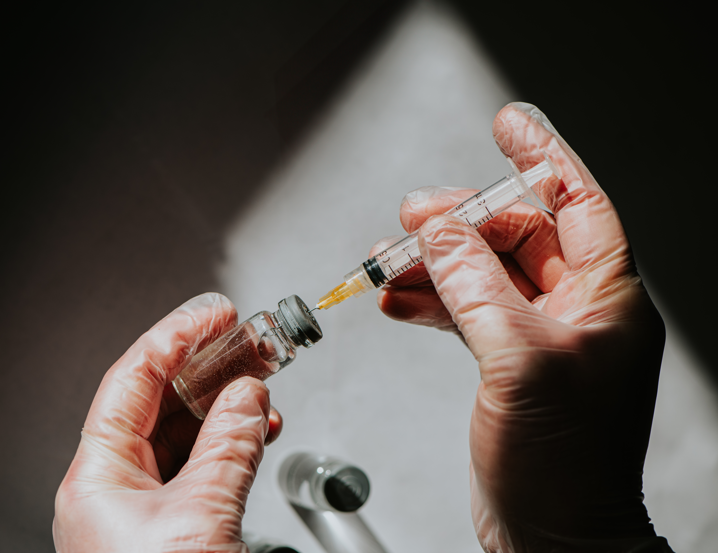
INTRODUCTION TO INSULIN
Insulin is not merely a glucose-lowering hormone; it is a master regulator of metabolism whose deficiency or resistance underlies the global epidemic of diabetes.
It is the principal anabolic hormone of the human body.
🧬 Basic Structure
51–amino acid peptide
Two chains: A (21 AA) & B (30 AA)
Linked by disulfide bonds
Derived from preproinsulin → proinsulin → insulin + C-peptide
C-peptide reflects endogenous insulin secretion
DISCOVERY
Discovered in 1921 by Banting & Best
First therapeutic use in 1922
Physiologic Secretion Pattern
Basal secretion (fasting state)
Prandial (bolus) secretion after meals.
Biphasic insulin response:
  First phase (rapid release of stored insulin)
  Second phase (new insulin synthesis)
Loss of first-phase response is early feature of Type 2 DM
Pathophysiologic Importance
Absolute deficiency → Type 1 Diabetes Mellitus
Relative deficiency + resistance → Type 2 Diabetes Mellitus
Severe deficiency → DKA / HHS

Slide 3
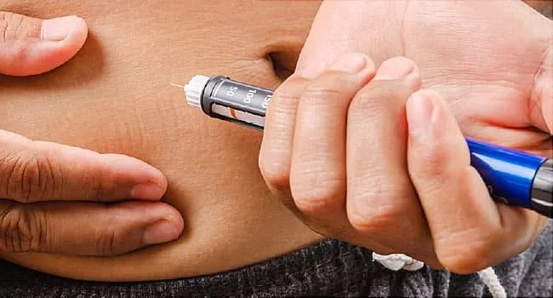
CLASSIFICATION OF INSULIN PREPARATION

Slide 4
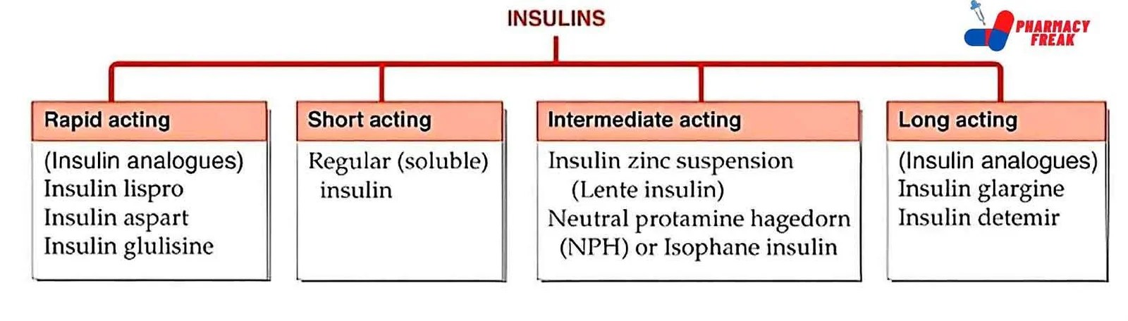
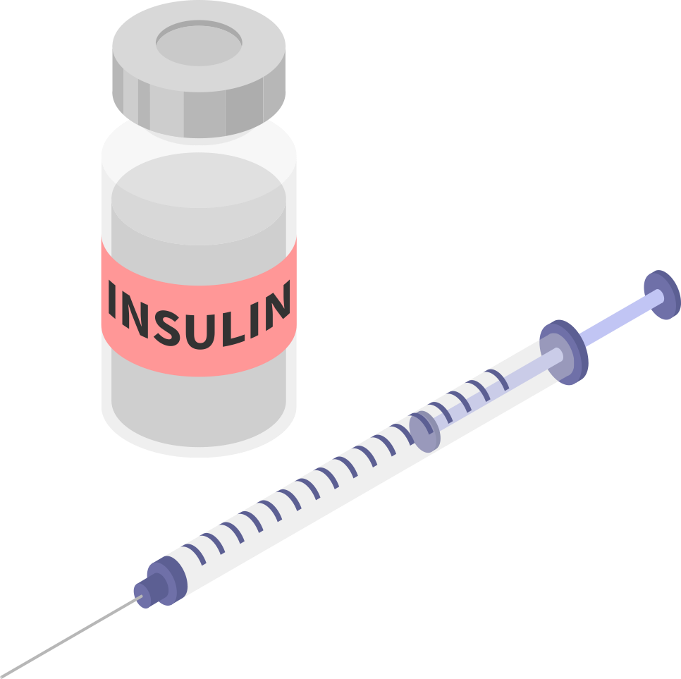

Slide 5
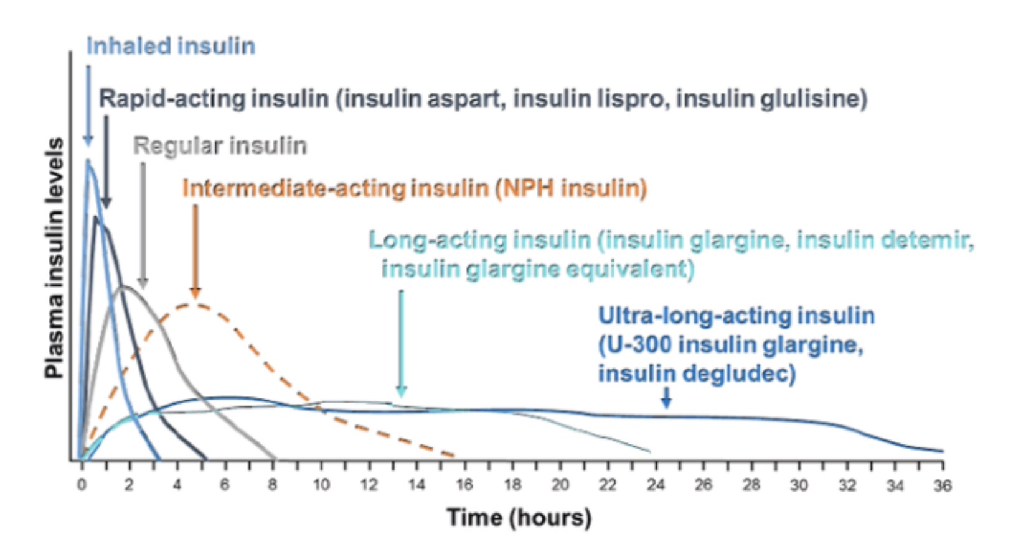

Slide 6
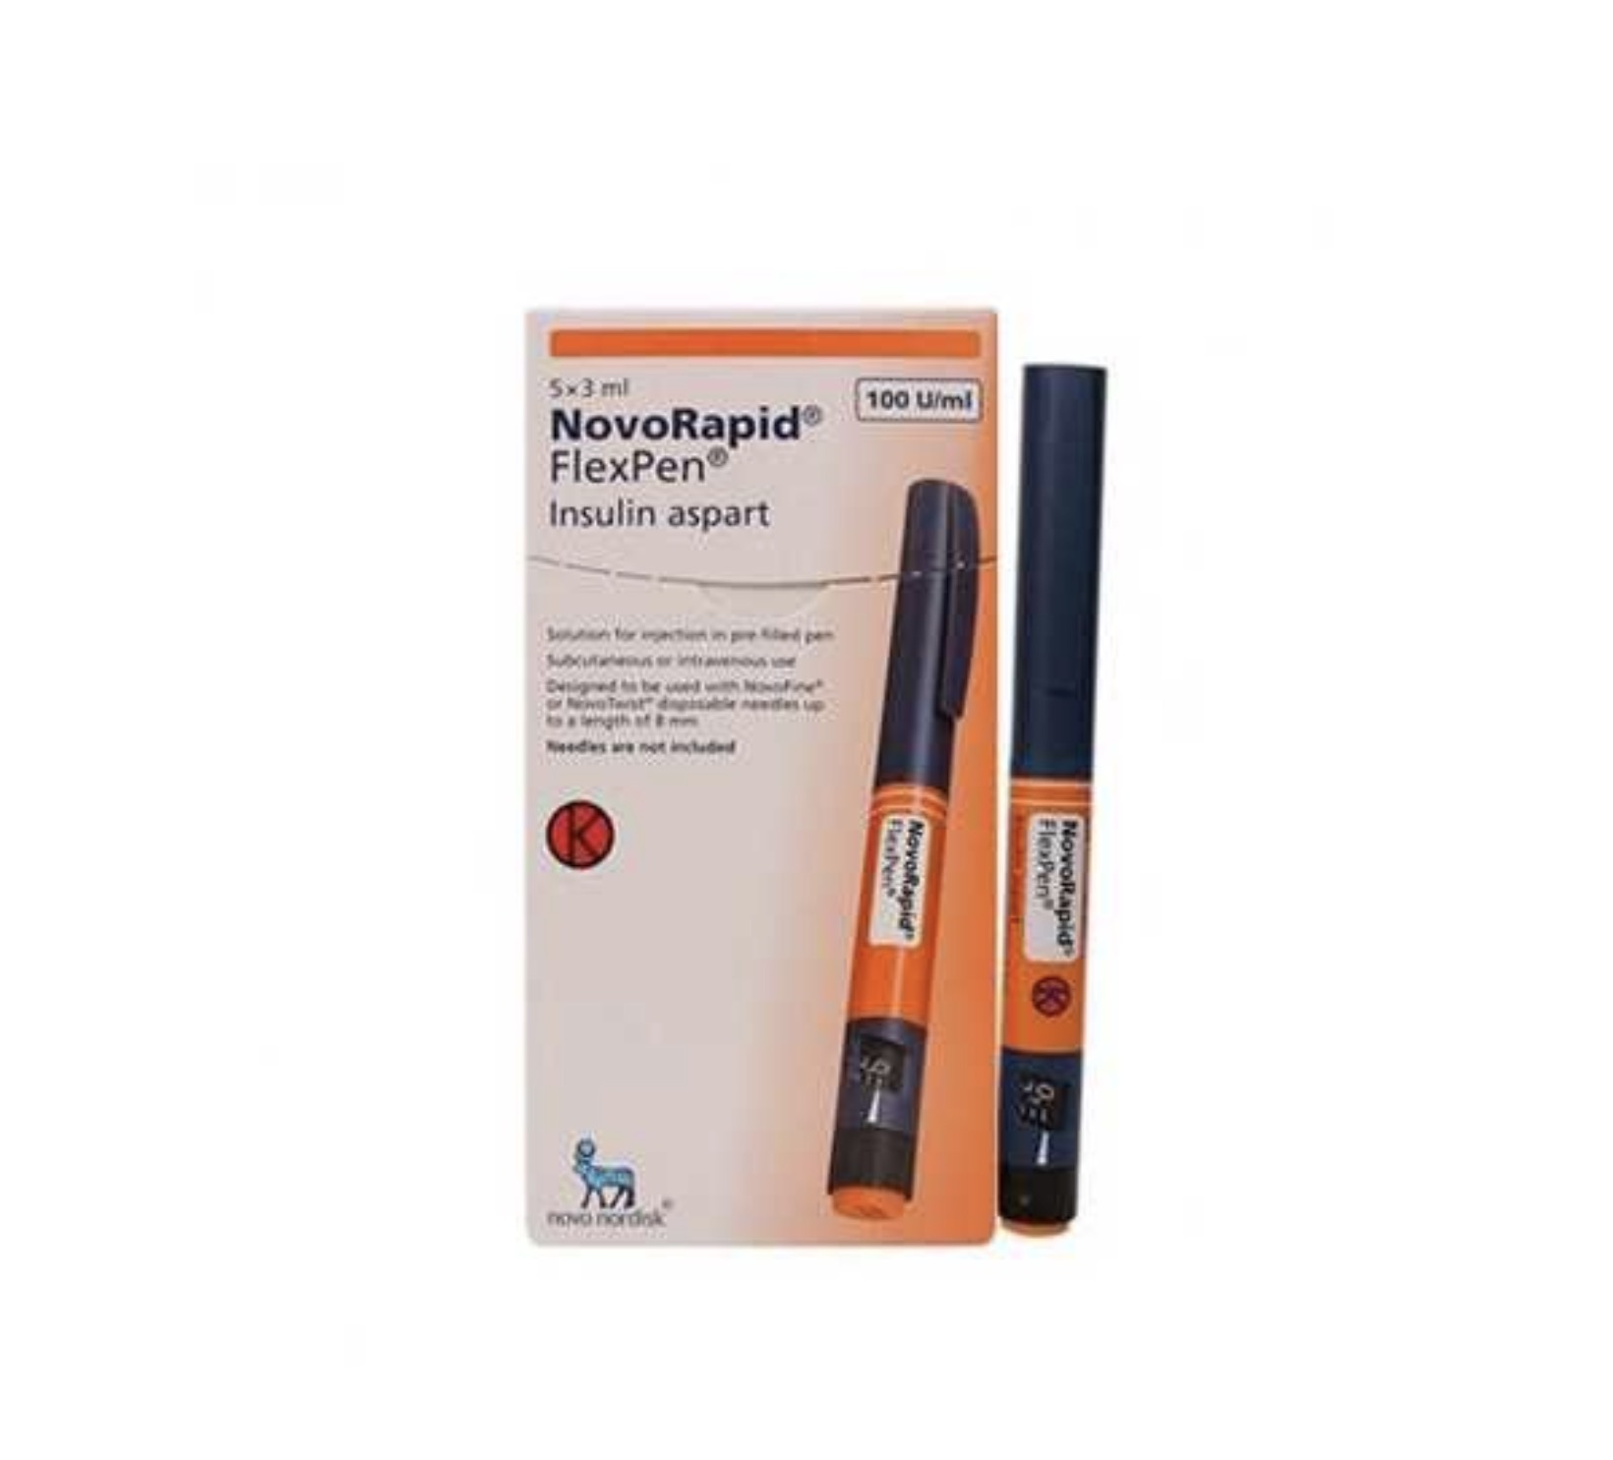
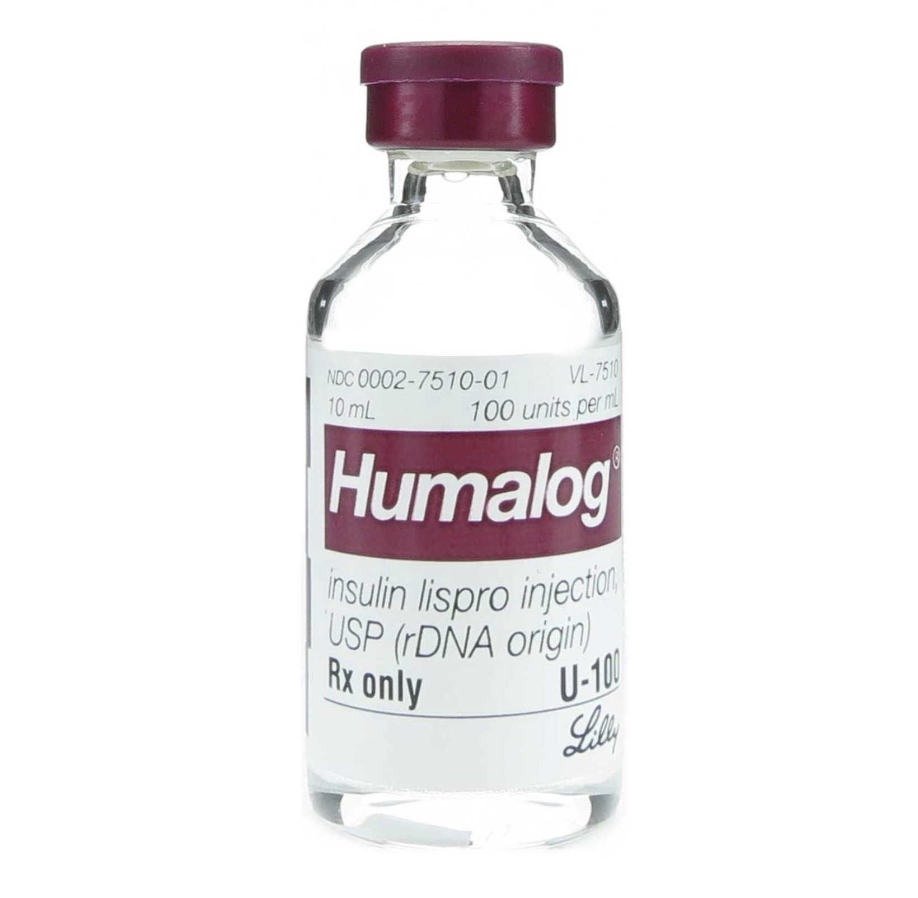
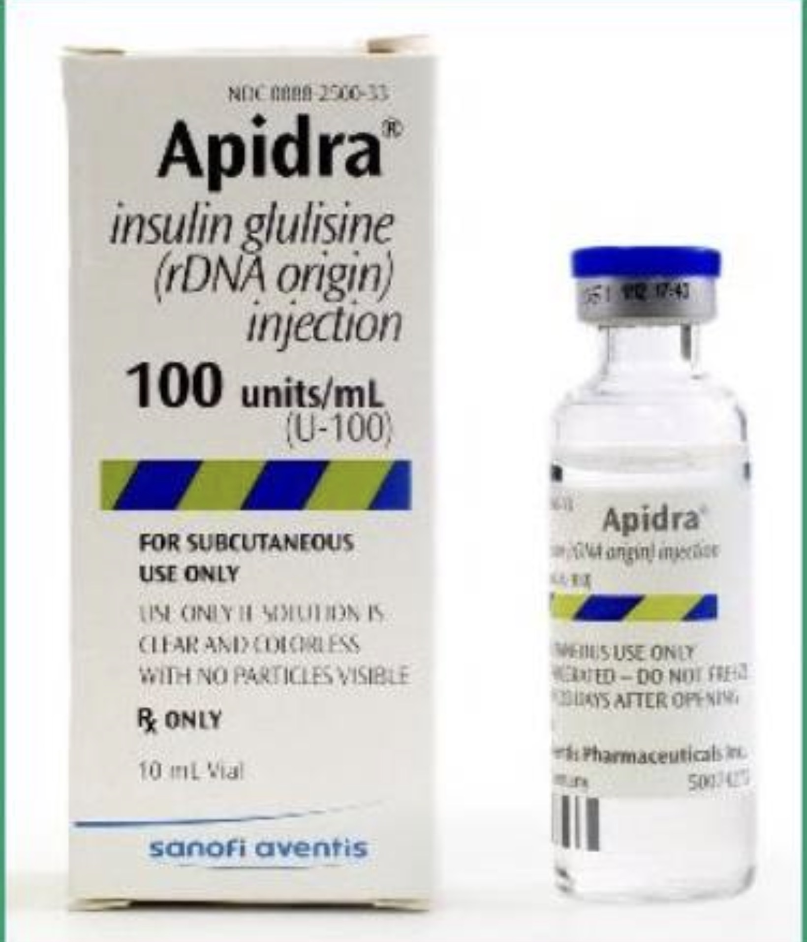
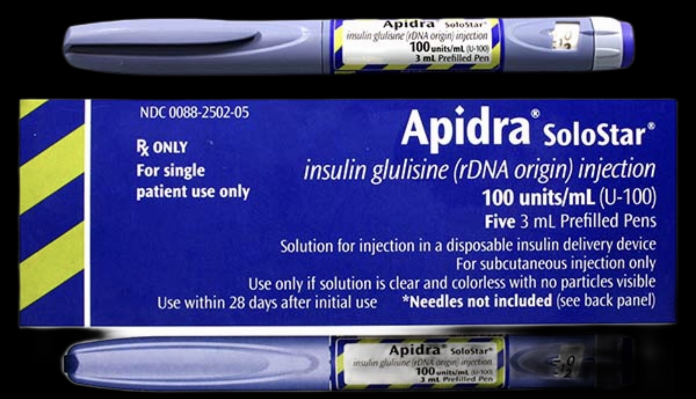
RAPID ACTING INSULIN
Insulin Lispro
Insulin Aspart
Insulin Glulisine
🔹 Pharmacokinetics
Onset: 10–20 min
Peak: 1–3 hr
Duration: 3–5 hr
🔹 Mechanism
Amino acid substitution → ↓ hexamer formation → rapid monomer absorption.
🔹 Clinical Use
Given just before meals
Best for postprandial glucose control
Used in:
  Basal-bolus regimens
  Insulin pumps
🔹 Advantages
✔ Less post-meal hyperglycemia
✔ Lower risk of late hypoglycemia

Slide 7
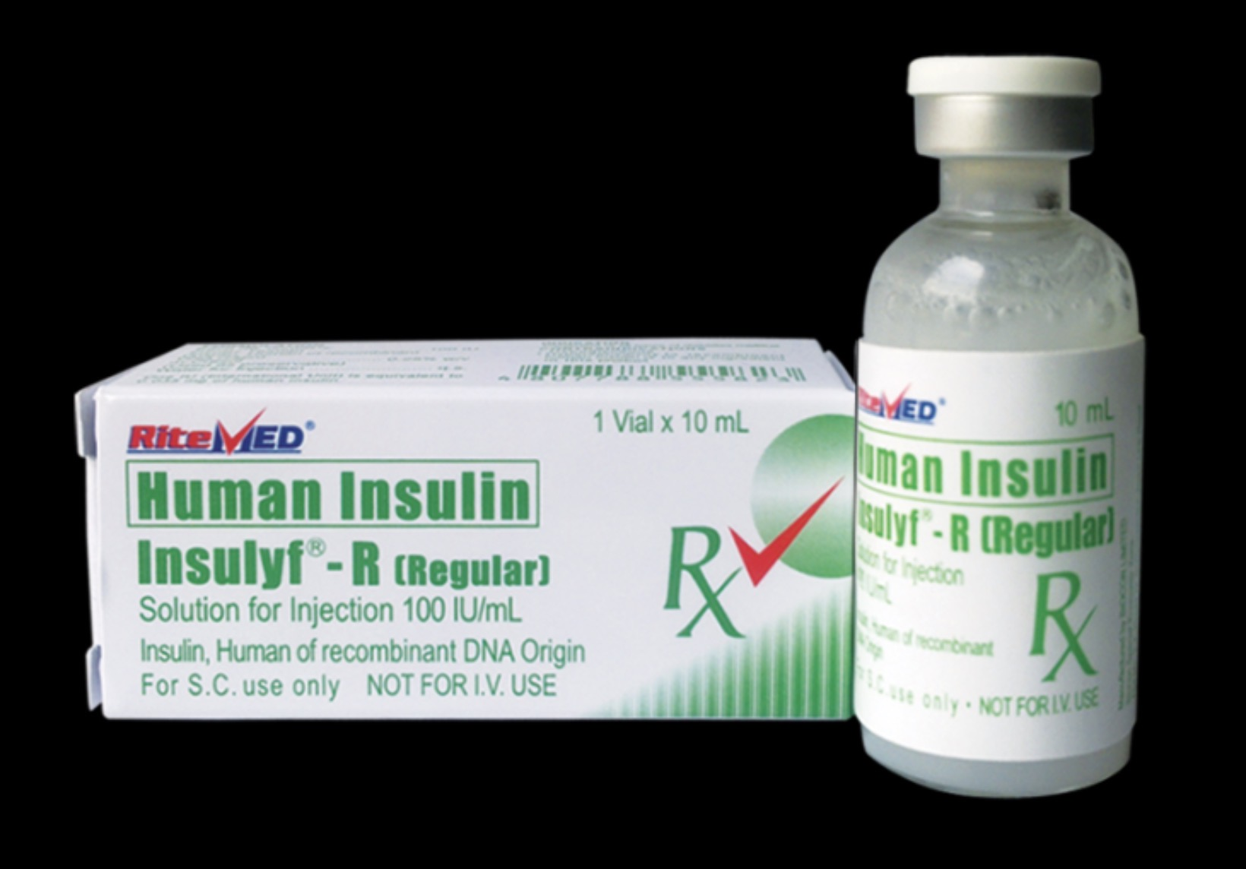
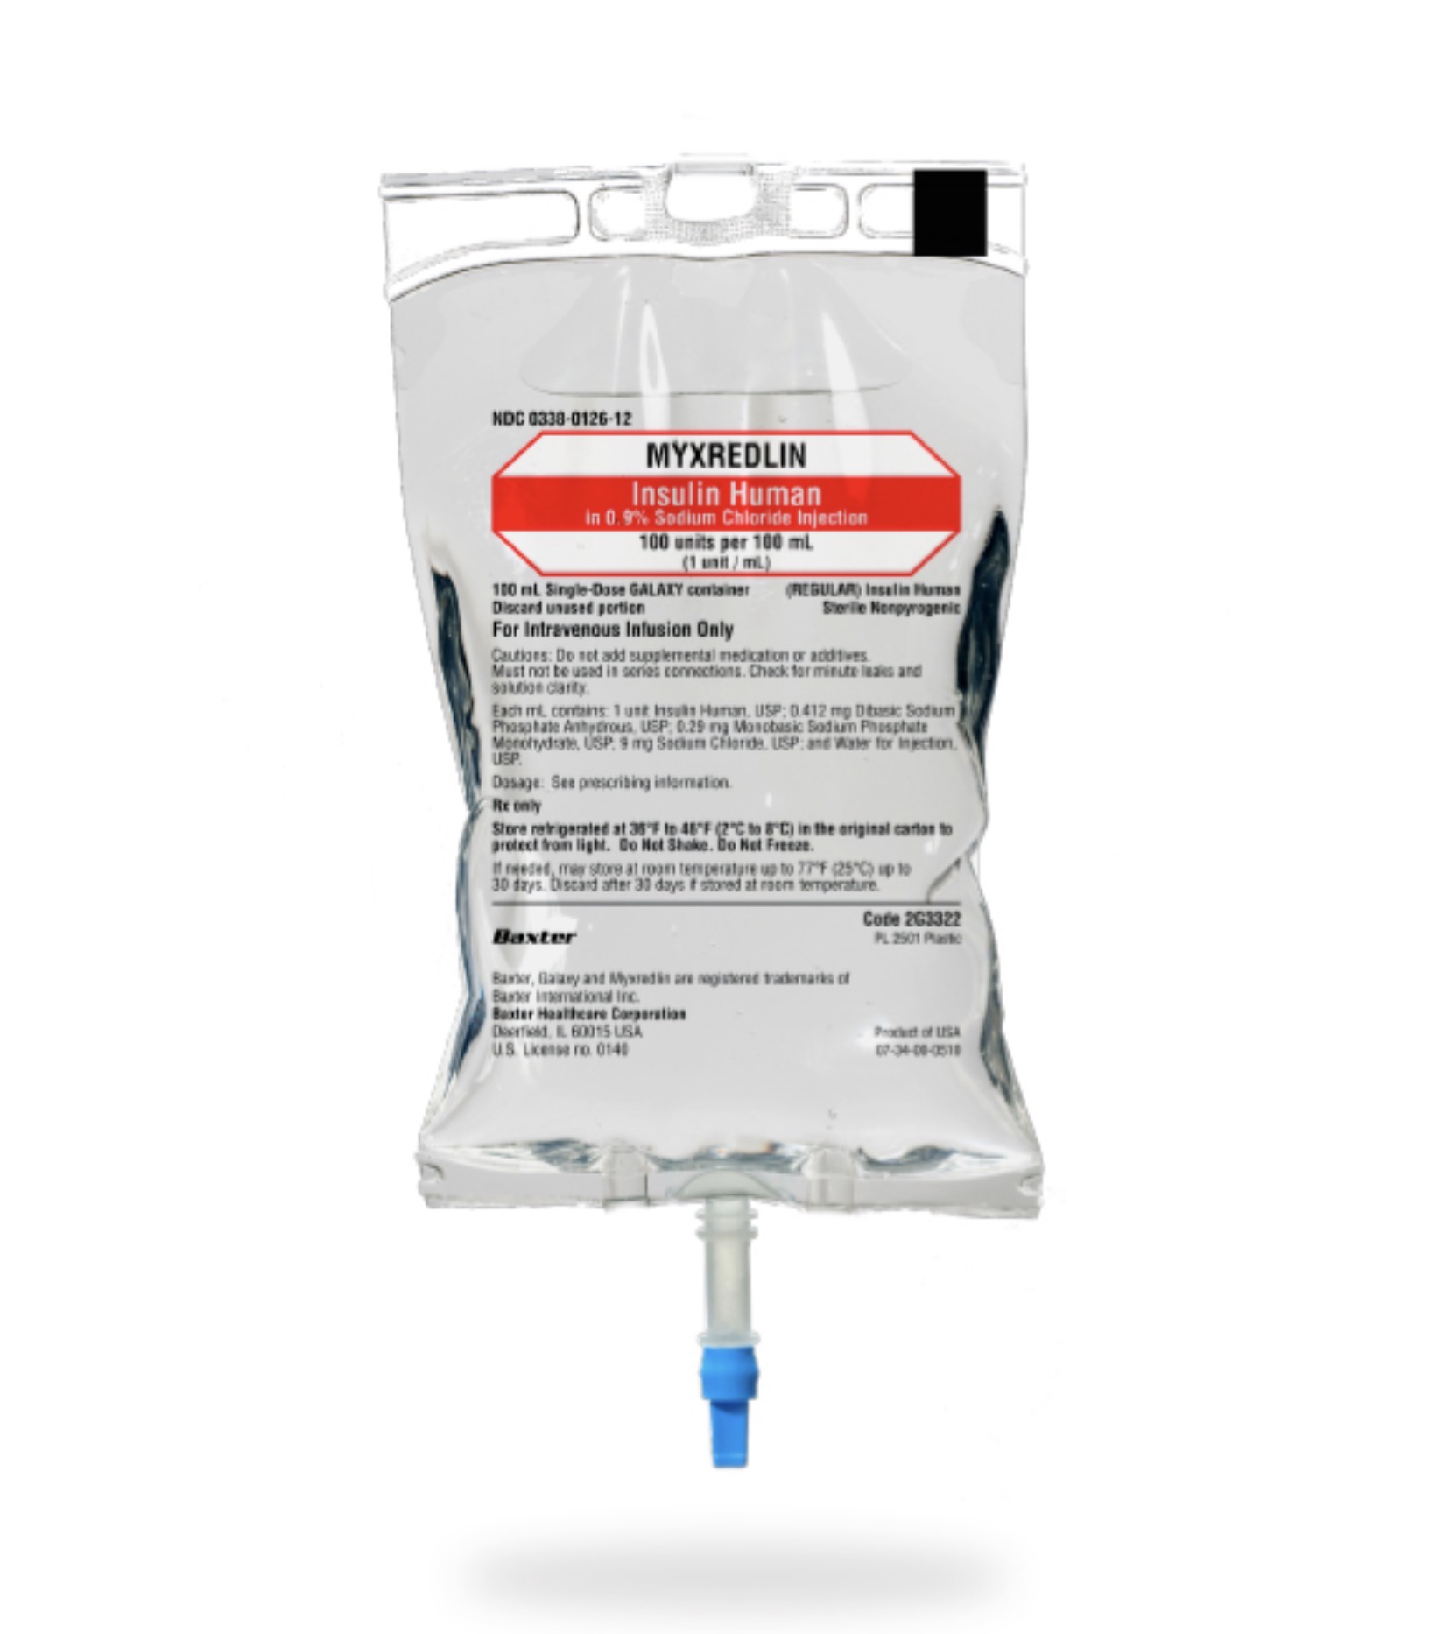
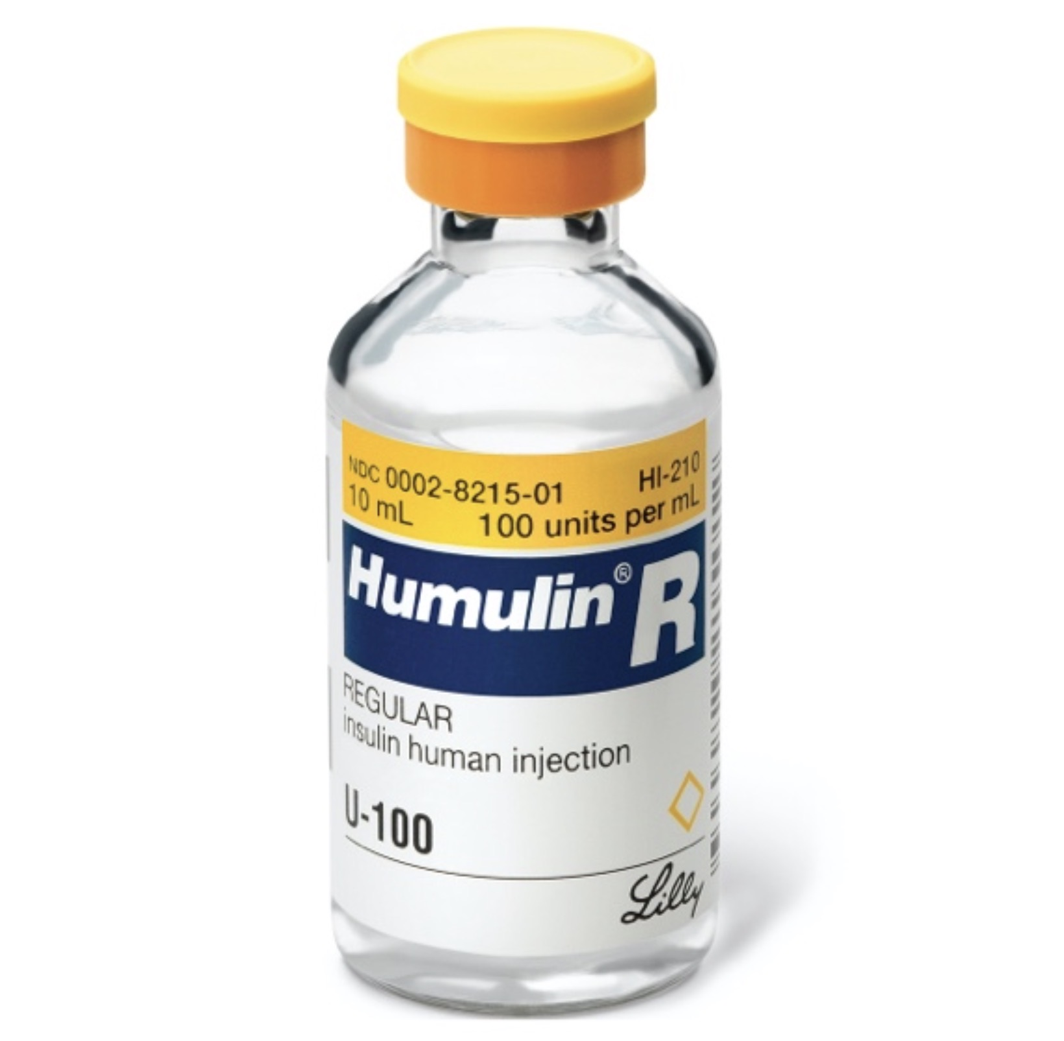
SHORT ACTING INSULIN
Regular Human Insulin (Neutral insulin)
🔹 Pharmacokinetics
Onset: 30–60 min
Peak: 2–4 hr
Duration: 5–8 hr
✅ Only insulin that can be given IV
🔹 Uses
DKA
HHS
Perioperative glucose control
Hyperkalemia (with glucose)

Slide 8
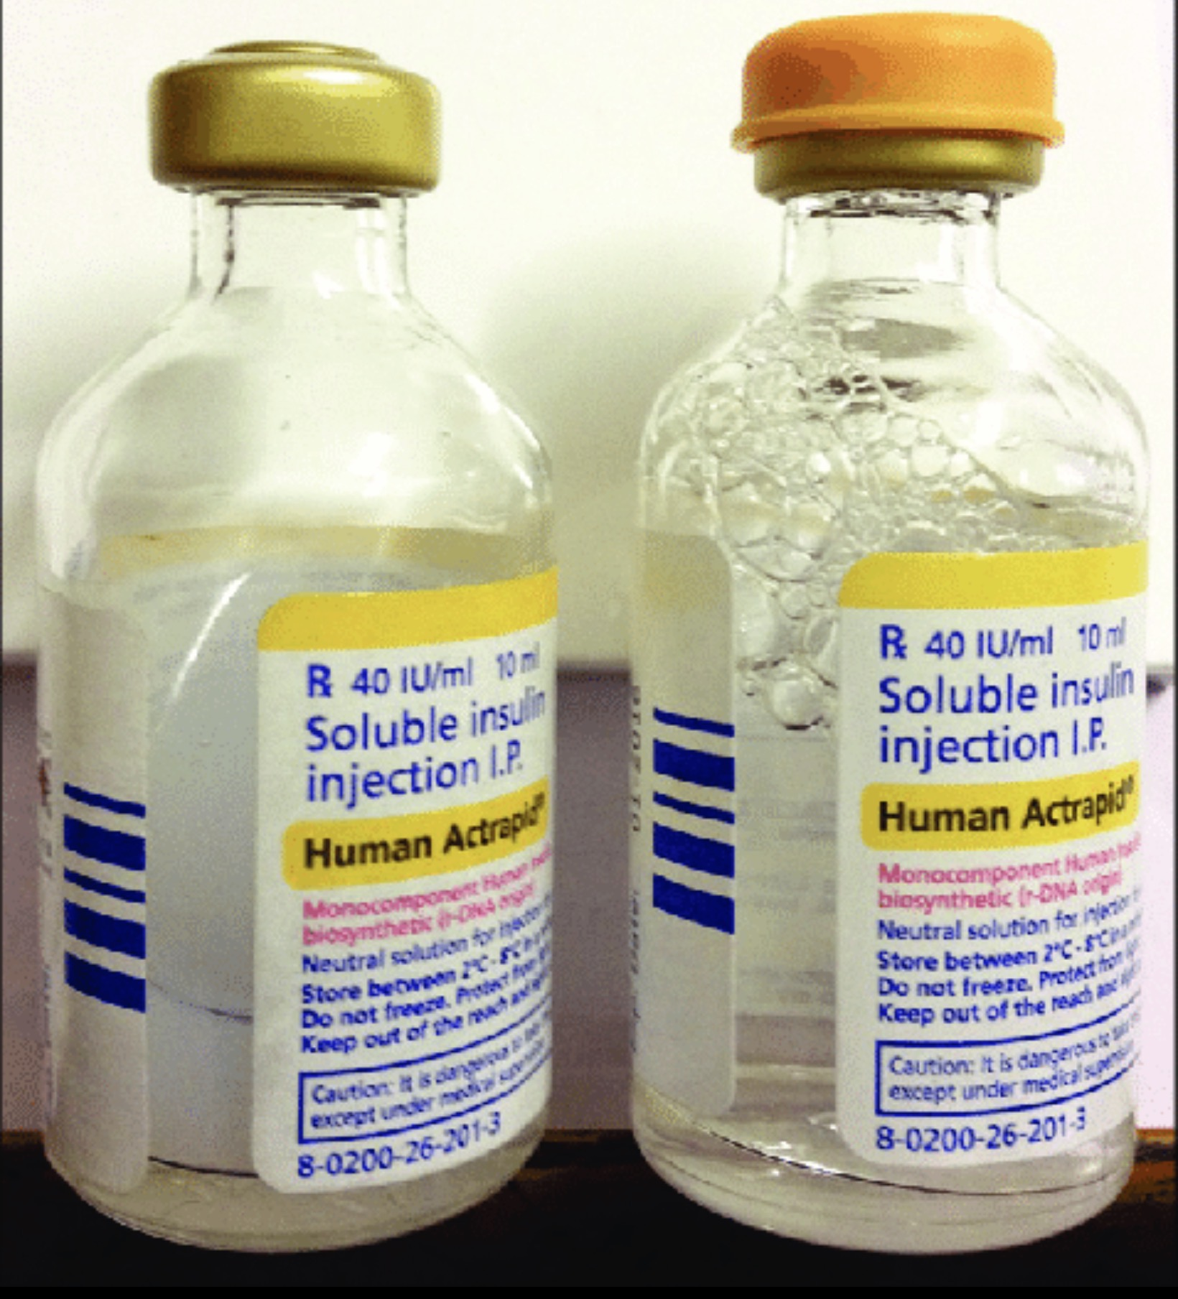
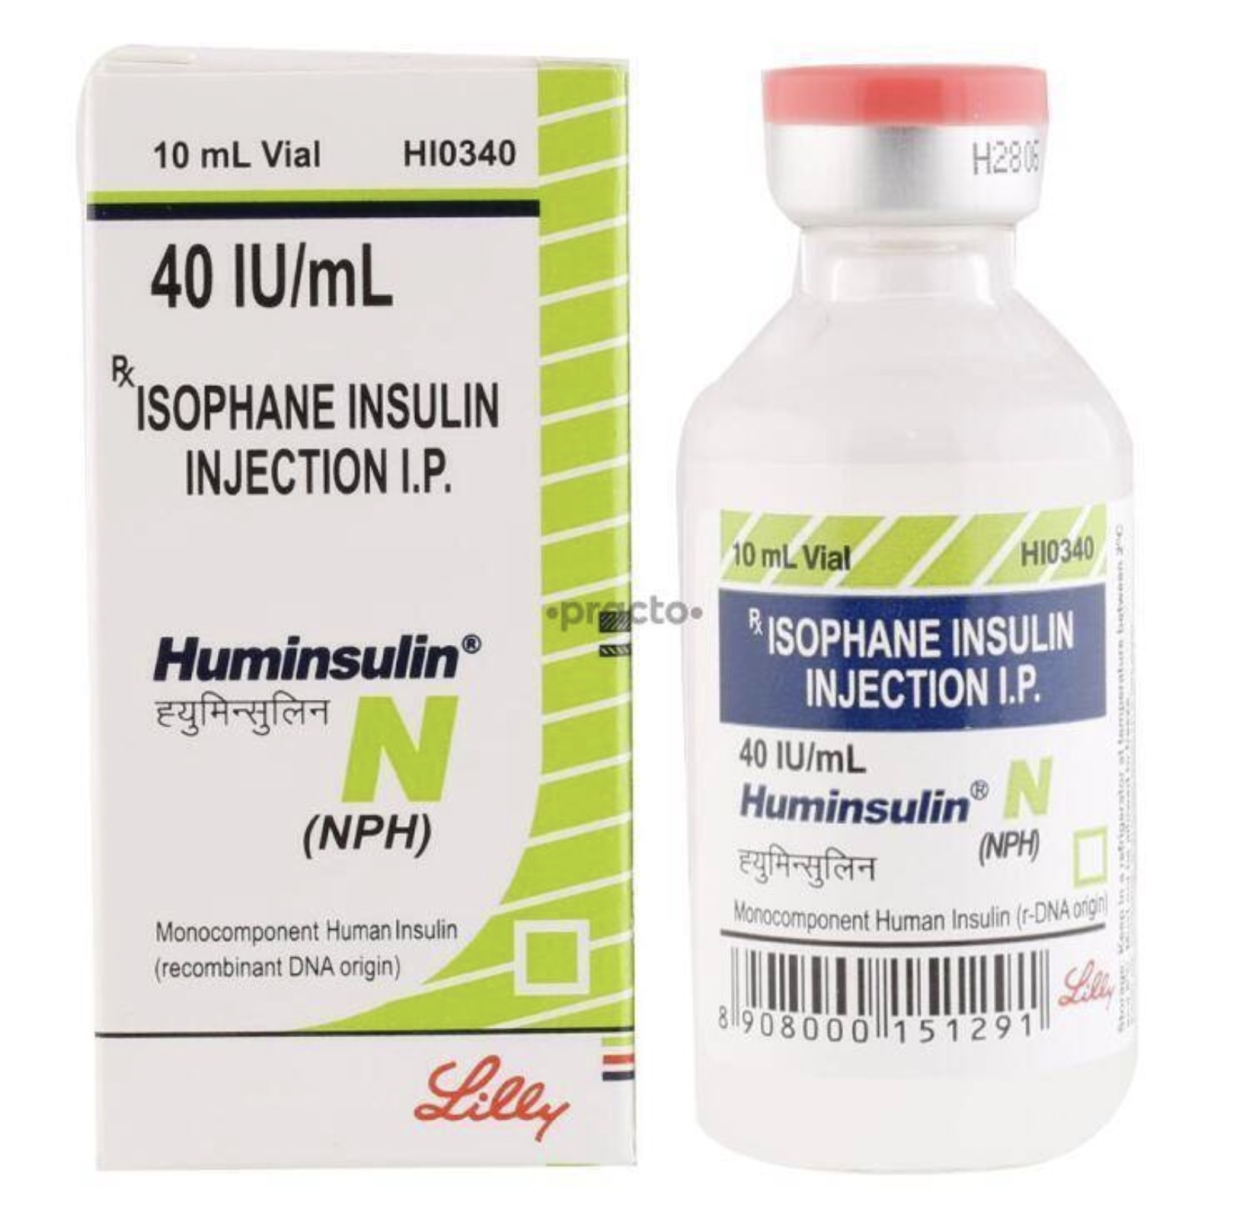
INTERMEDIATE ACTING INSULIN
NPH (Neutral Protamine Hagedorn)
🔹 Pharmacokinetics
Onset: 1–2 hr
Peak: 4–12 hr
Duration: 12–18 hr
🔹 Mechanism
Insulin + protamine → delayed absorption.
🔹 Important
⚠ Cloudy suspension → must roll before use.
🔹 Disadvantage
❌ Pronounced peak → risk of hypoglycemia

Slide 9
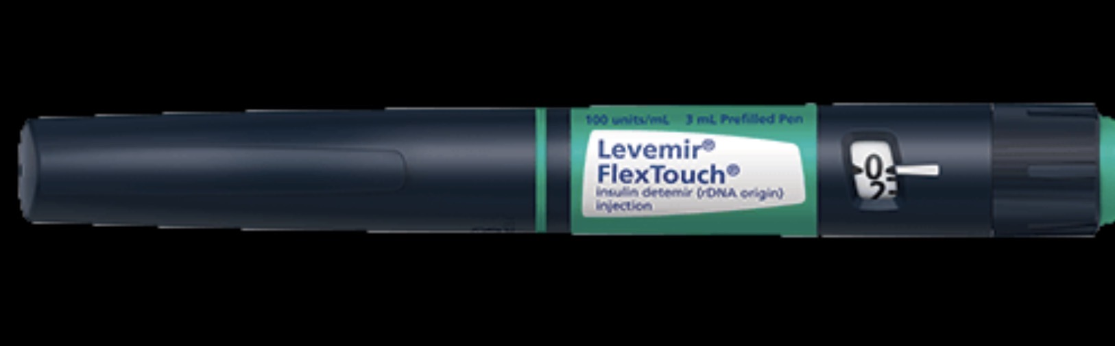
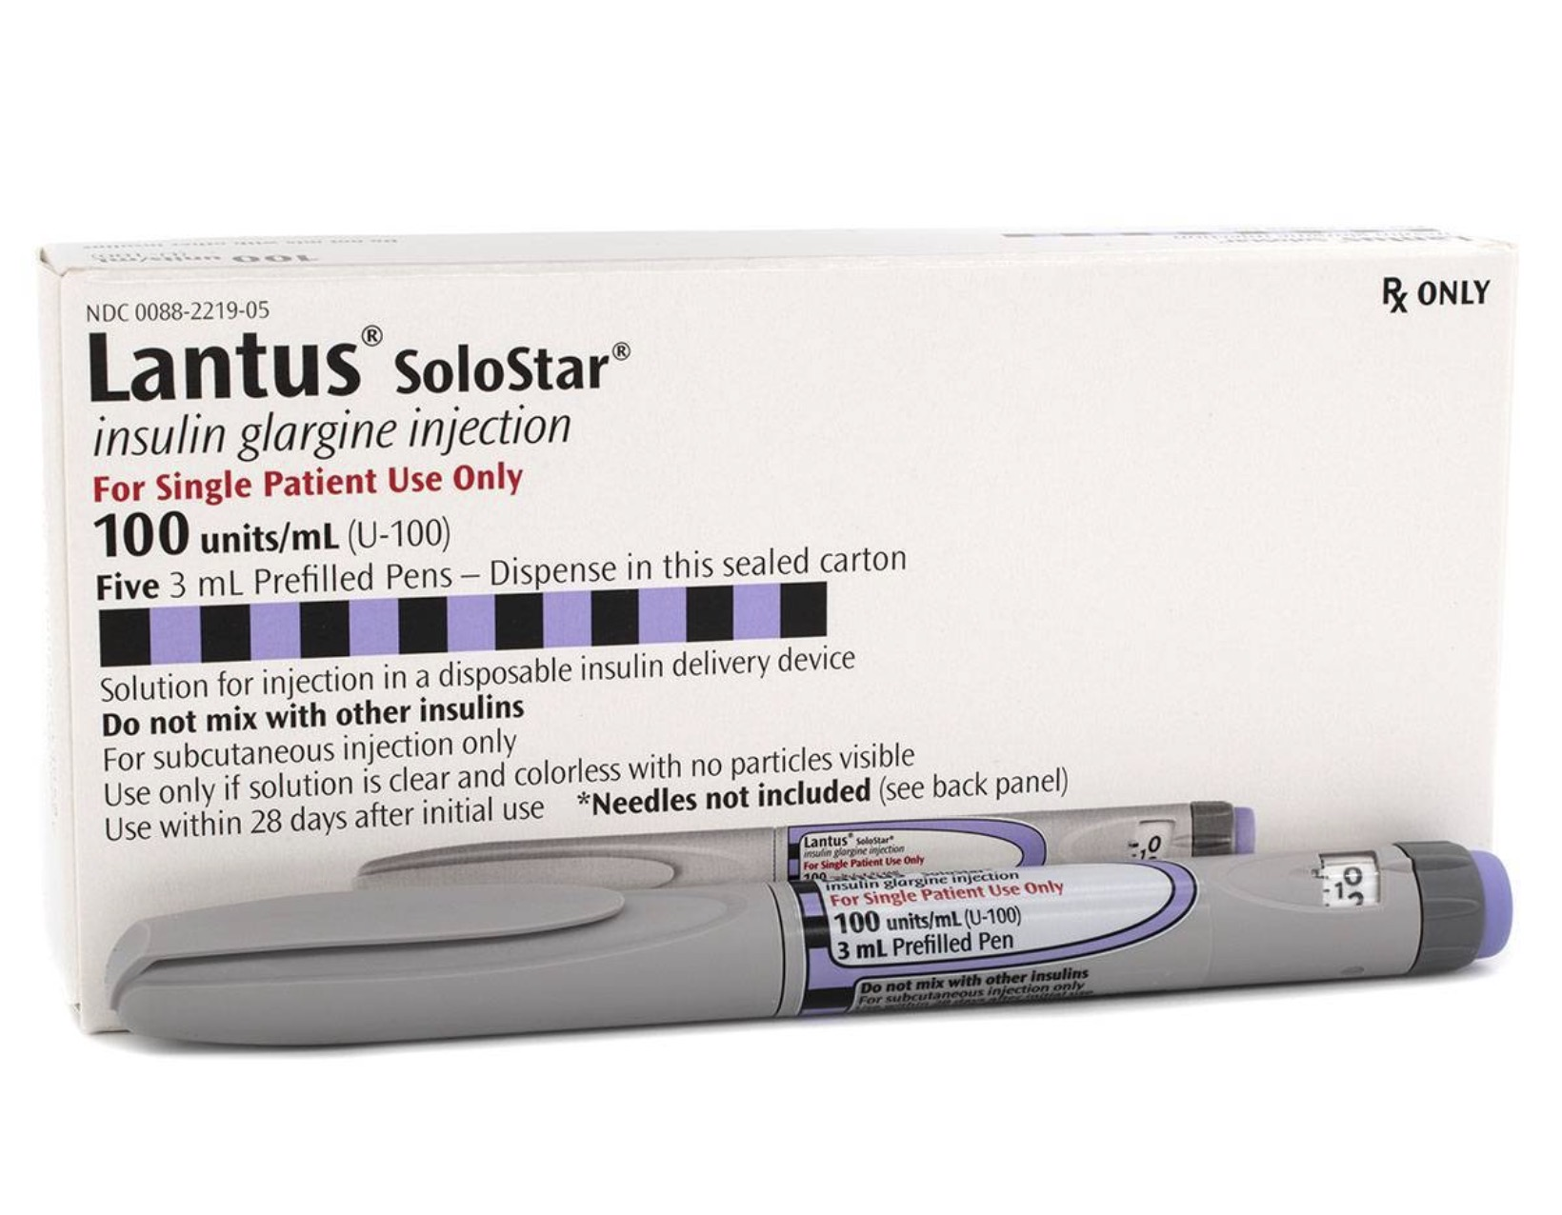
LONG ACTING INSULIN
Insulin Glargine
Insulin Detemir
🔹 Pharmacokinetics
Onset: 1–2 hr
Peak: No significant peak
Duration: ~20–24 hr
🔹 Mechanism
Glargine: Precipitates in subcutaneous tissue → slow release
Detemir: Albumin binding → prolonged action
🔹 Clinical Use
Provides basal insulin coverage
Once daily (sometimes detemir twice daily)
🔹 Advantage
✔ Lower nocturnal hypoglycemia vs NPH

Slide 10
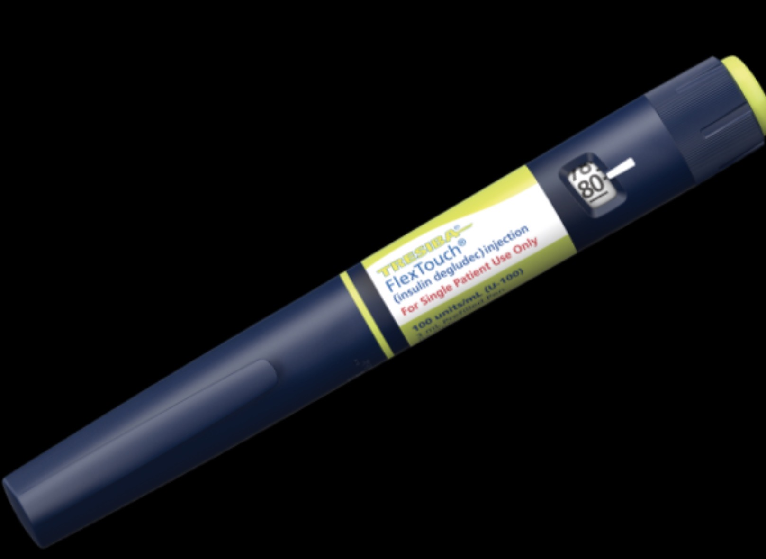
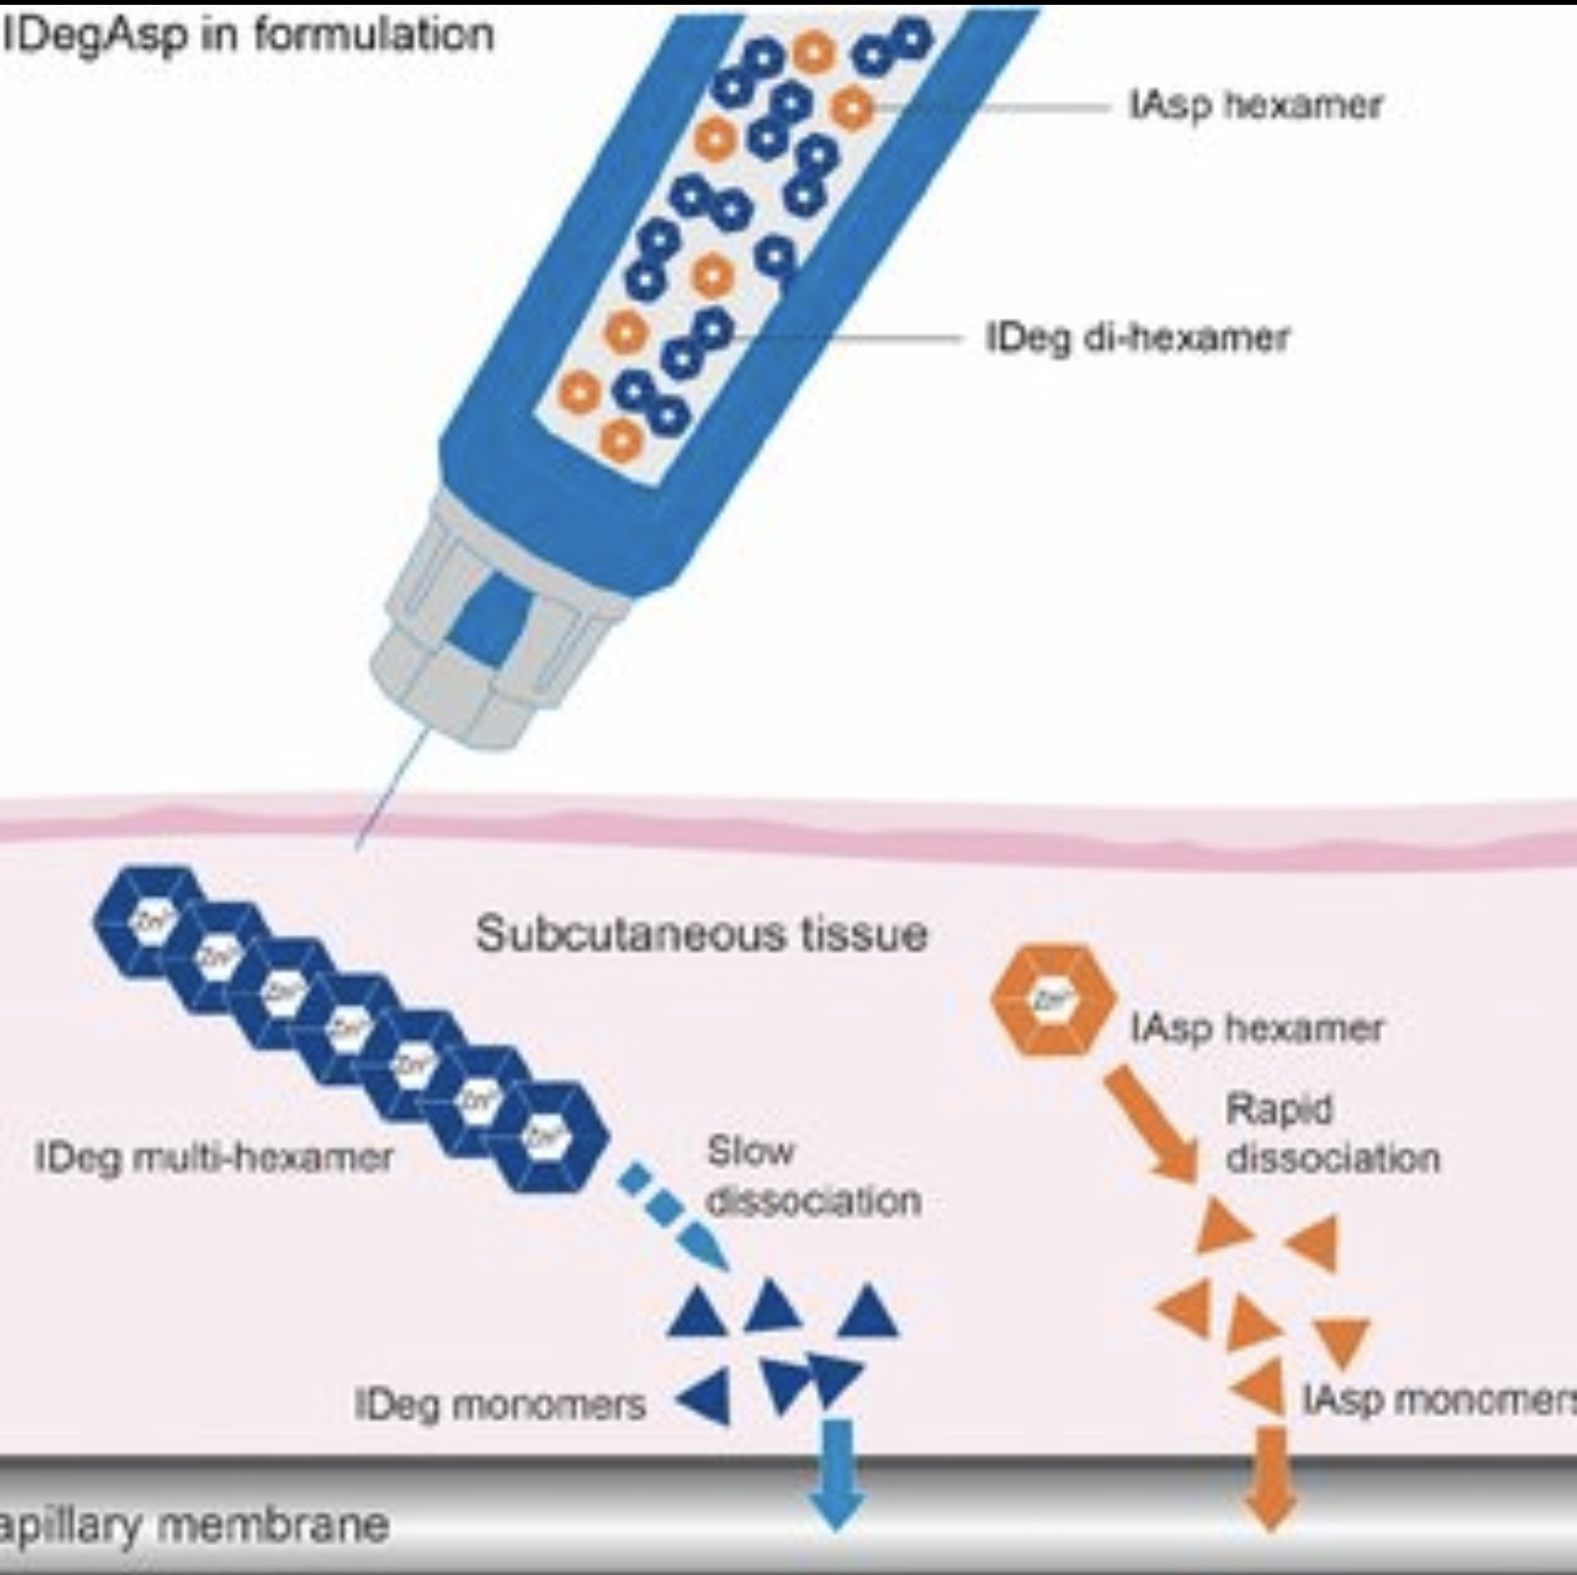
ULTRA LONG ACTING
🔹 Example
Insulin Degludec
🔹 Pharmacokinetics
Duration: >42 hr
Very flat profile
🔹 Advantage
✔ Minimal hypoglycemia
✔ Flexible dosing time

Slide 11
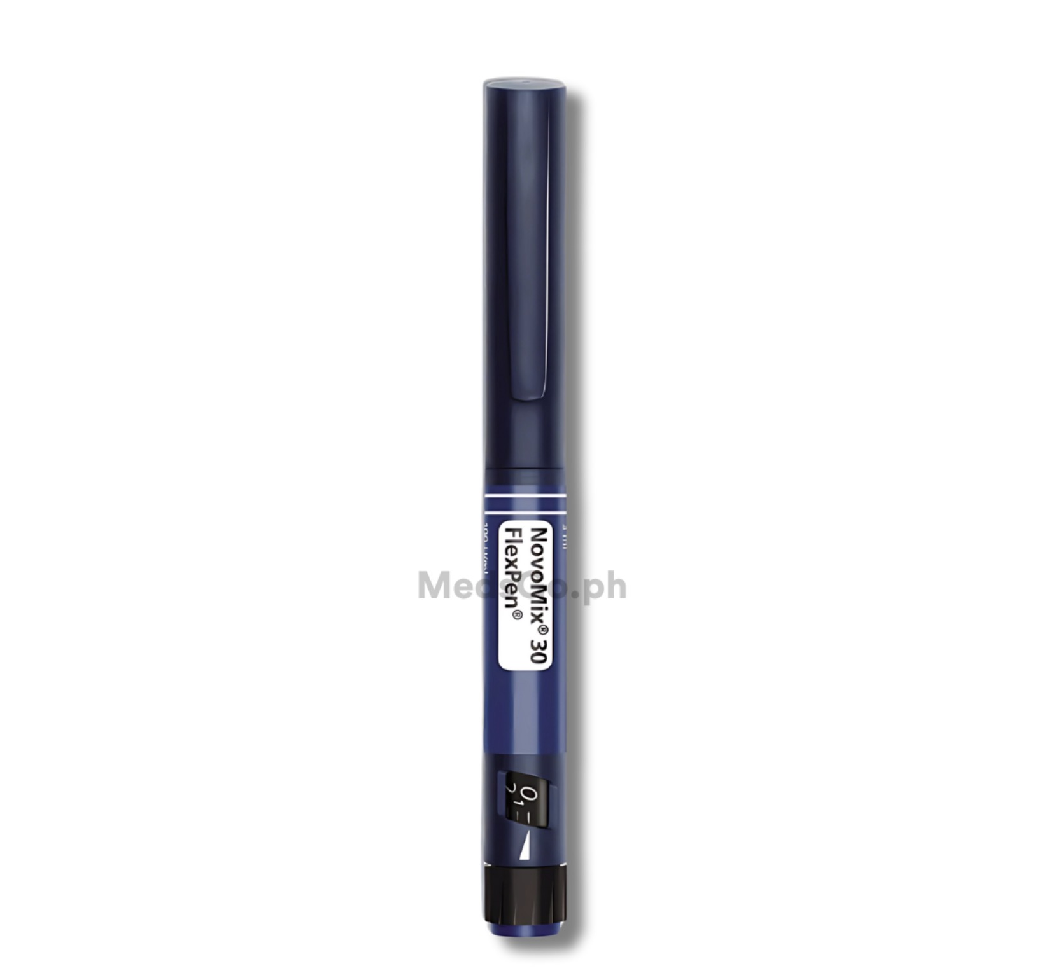
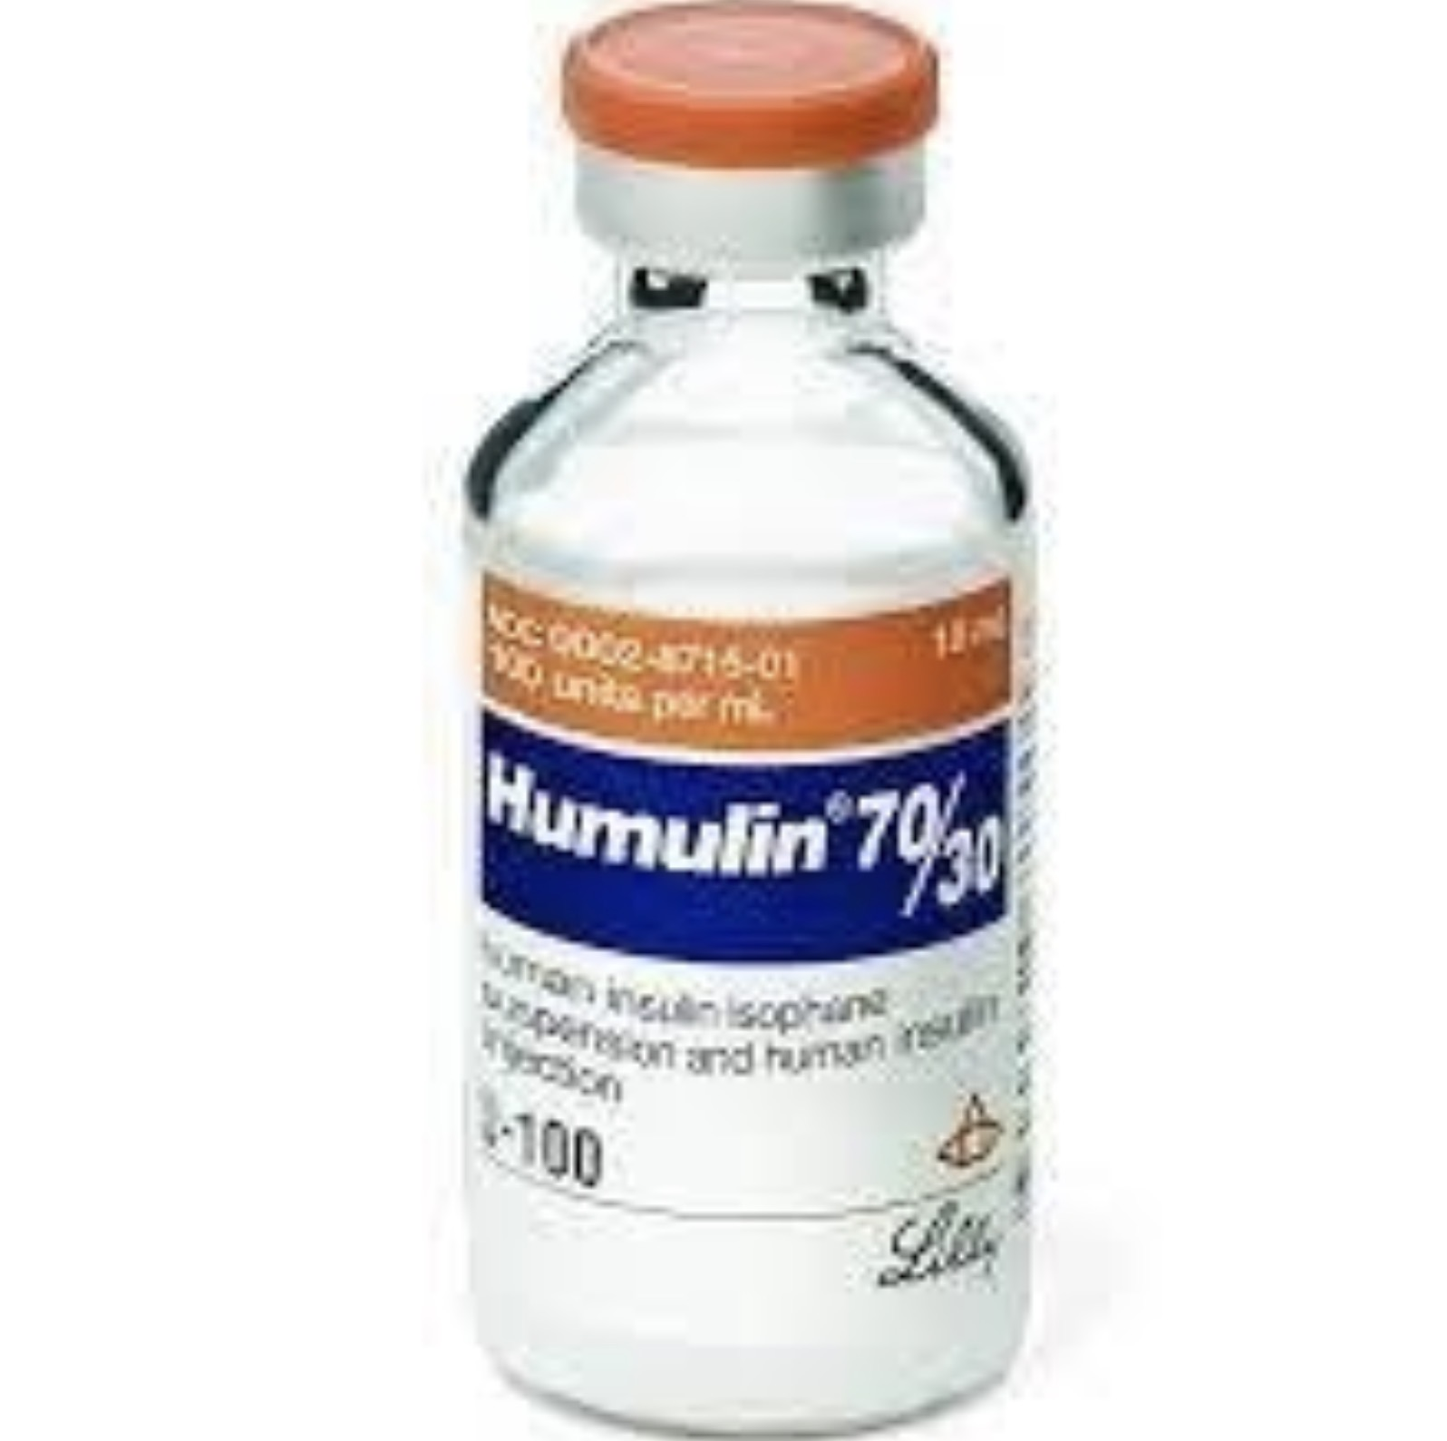
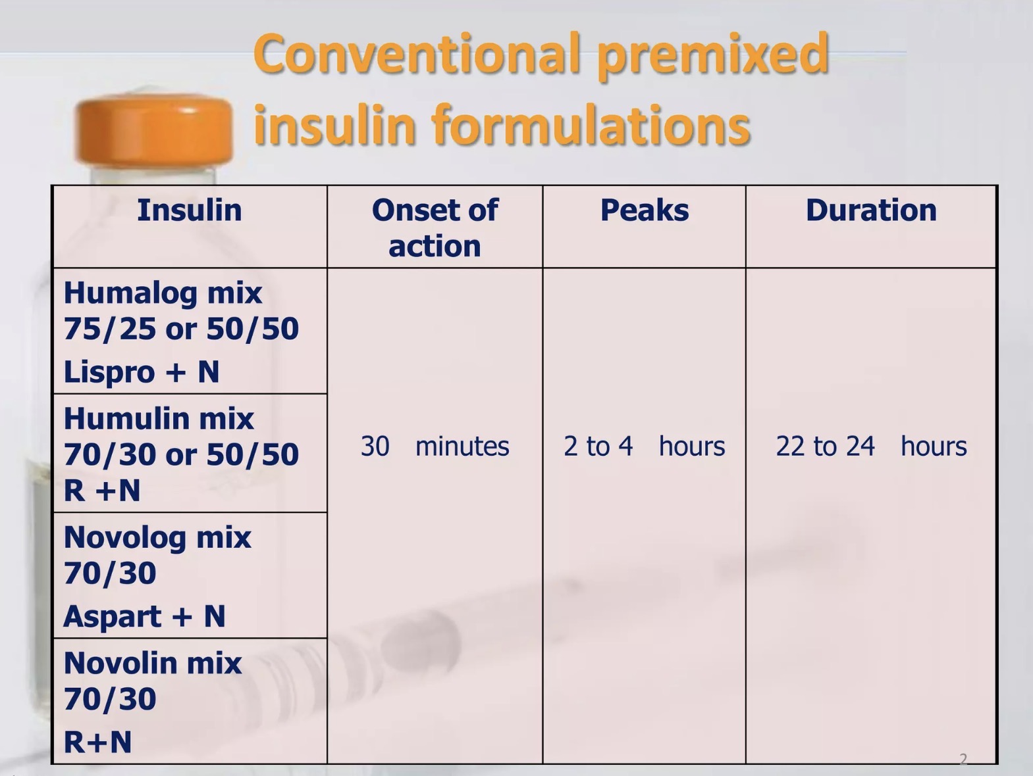
PREMIXED INSULIN
70/30 (NPH + Regular)
75/25 (Lispro mix)
70/30 Aspart mix
🔹 Use
Type 2 DM patients
Fixed meal schedule
🔹 Disadvantage
Less flexibility

Slide 12
MlXING OF INSULIN
Clear before cloudy
  Draw short/rapid-acting insulin first (clear)
  Then draw NPH (cloudy)
  Prevents contamination of short-acting insulin
. Do not mix long-acting analogs
  Glargine, Detemir, Degludec must not be mixed with other insulins
  Alters absorption and action
Proper technique
  Roll NPH vial gently (do not shake) to mix
  Use separate needles or pen adapters if necessary

Slide 13
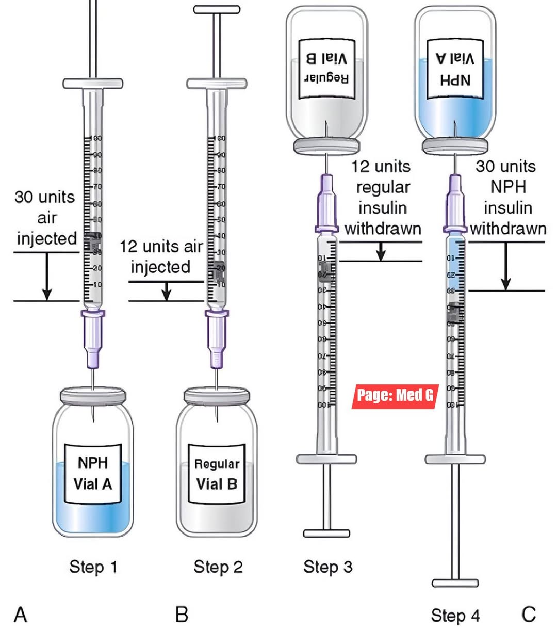

Slide 14
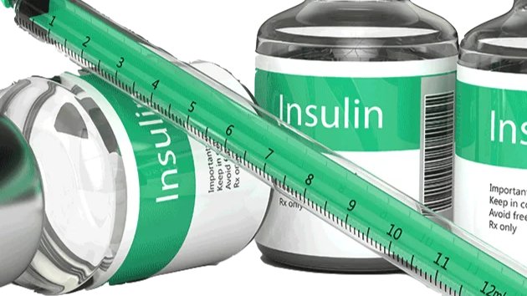
DELIVERY MODES OF INSULIN

Slide 15
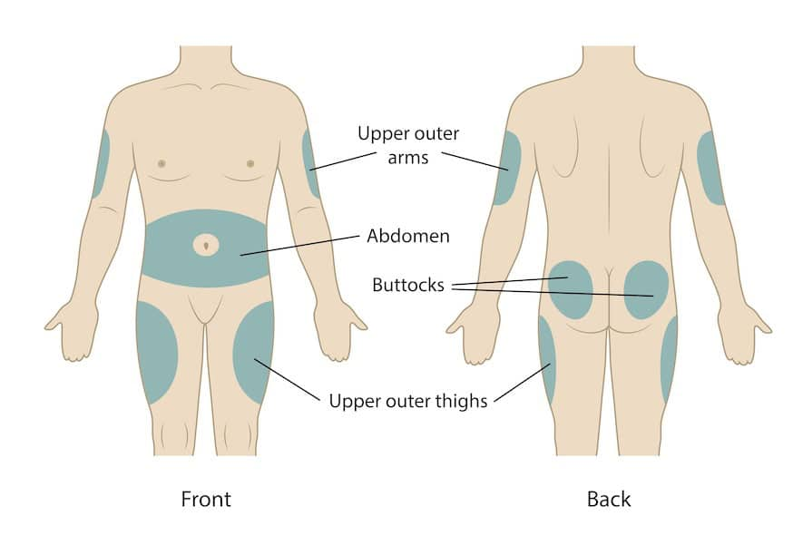
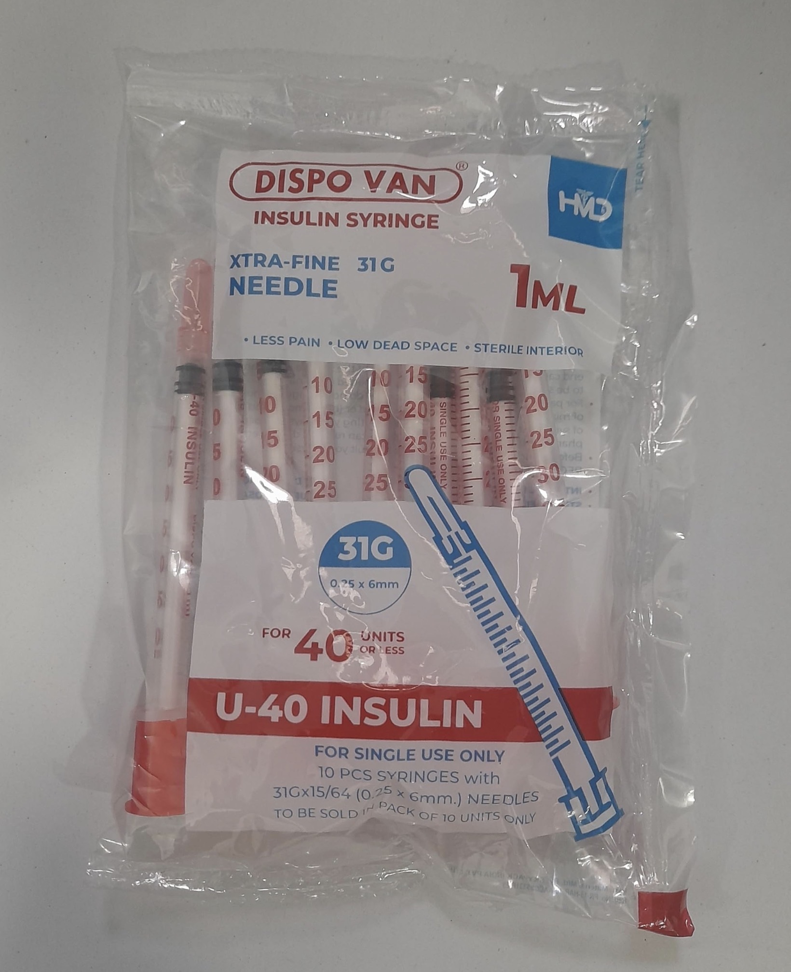
SYRINGES AND VIALS
Traditional method
🔹 Site
Abdomen (preferred – fastest absorption)
Thigh
Arm
Buttock
🔹 Advantages
✔ Cheap
✔ Widely available
🔹 Disadvantages
Less convenient
Dose errors possible
🔹 Clinical Pearl
Rotate sites → prevent lipohypertrophy.

Slide 16
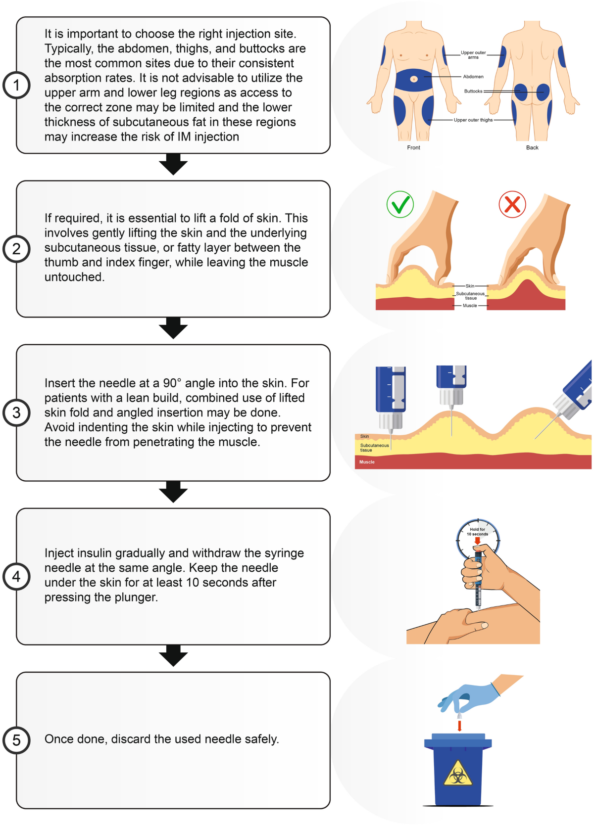

Slide 17
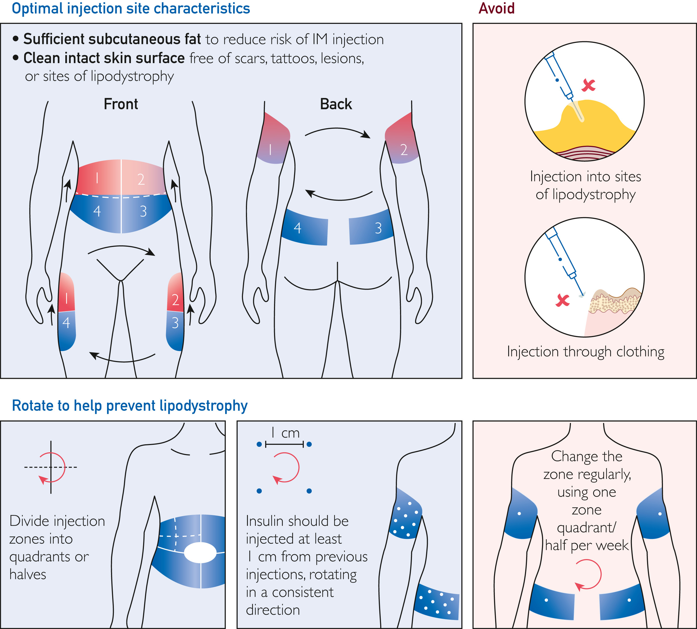

Slide 18
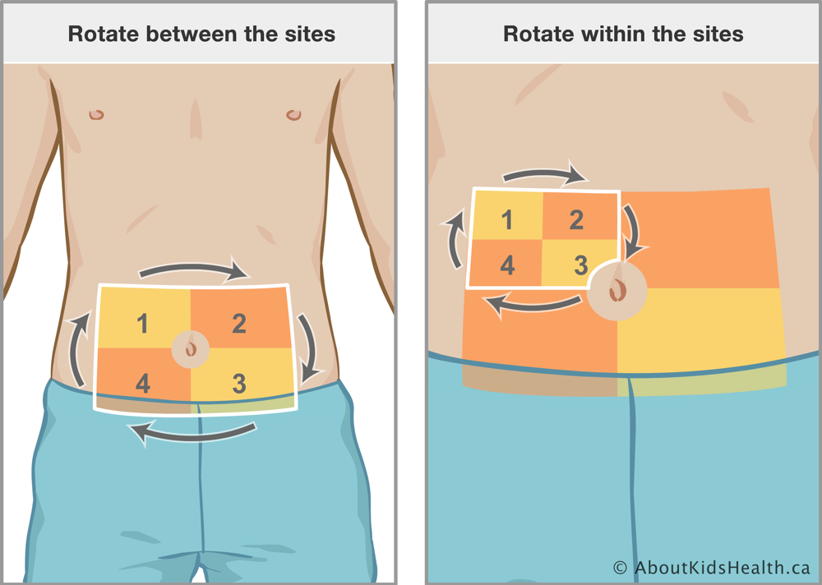

Slide 19
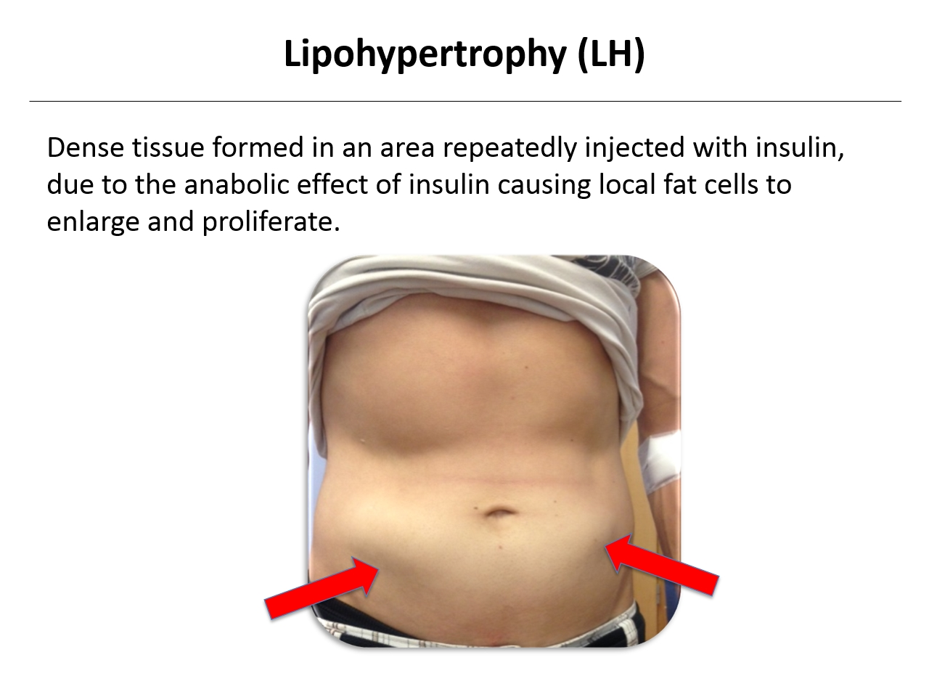

Slide 20
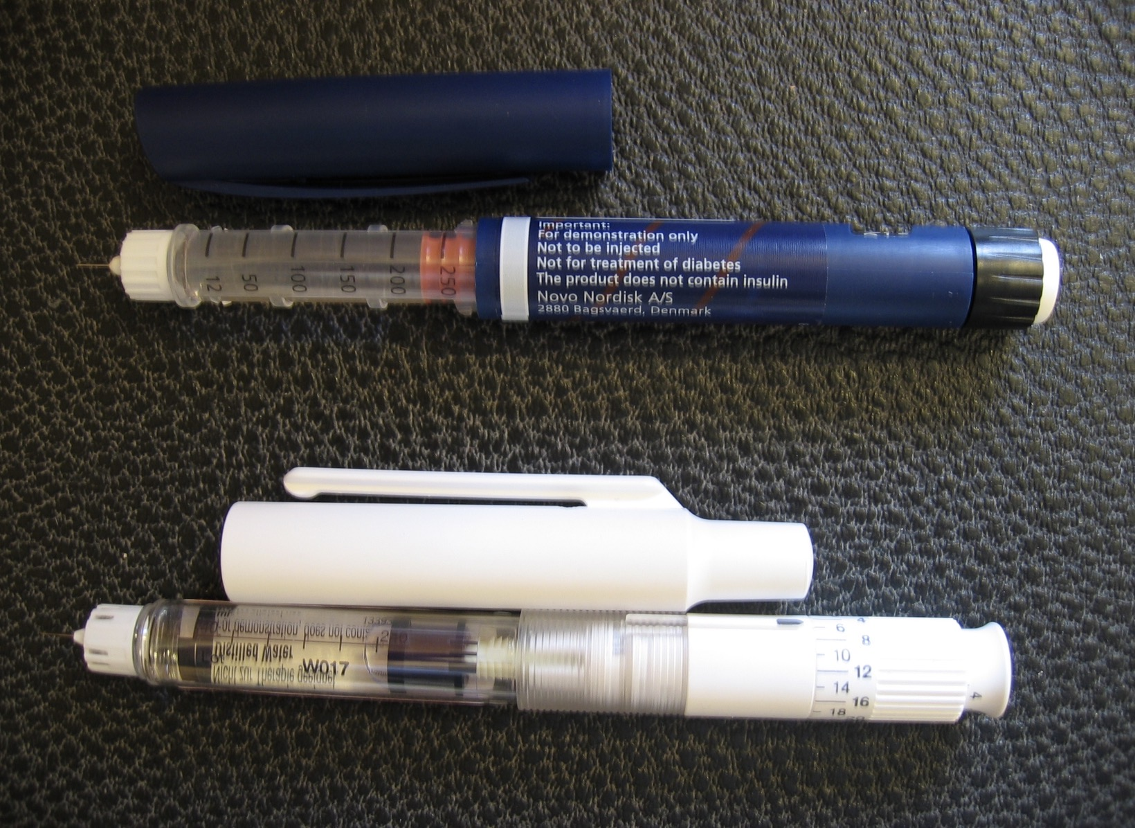
INSULIN PEN DEVICES
Disposable prefilled pens
Reusable cartridge pens
🔹 Advantages
✔ More accurate dosing
✔ Better compliance
✔ Less injection pain
🔹 Indications
Preferred in most T1DM and T2DM patients
Improves adherence → better glycemic control.

Slide 21
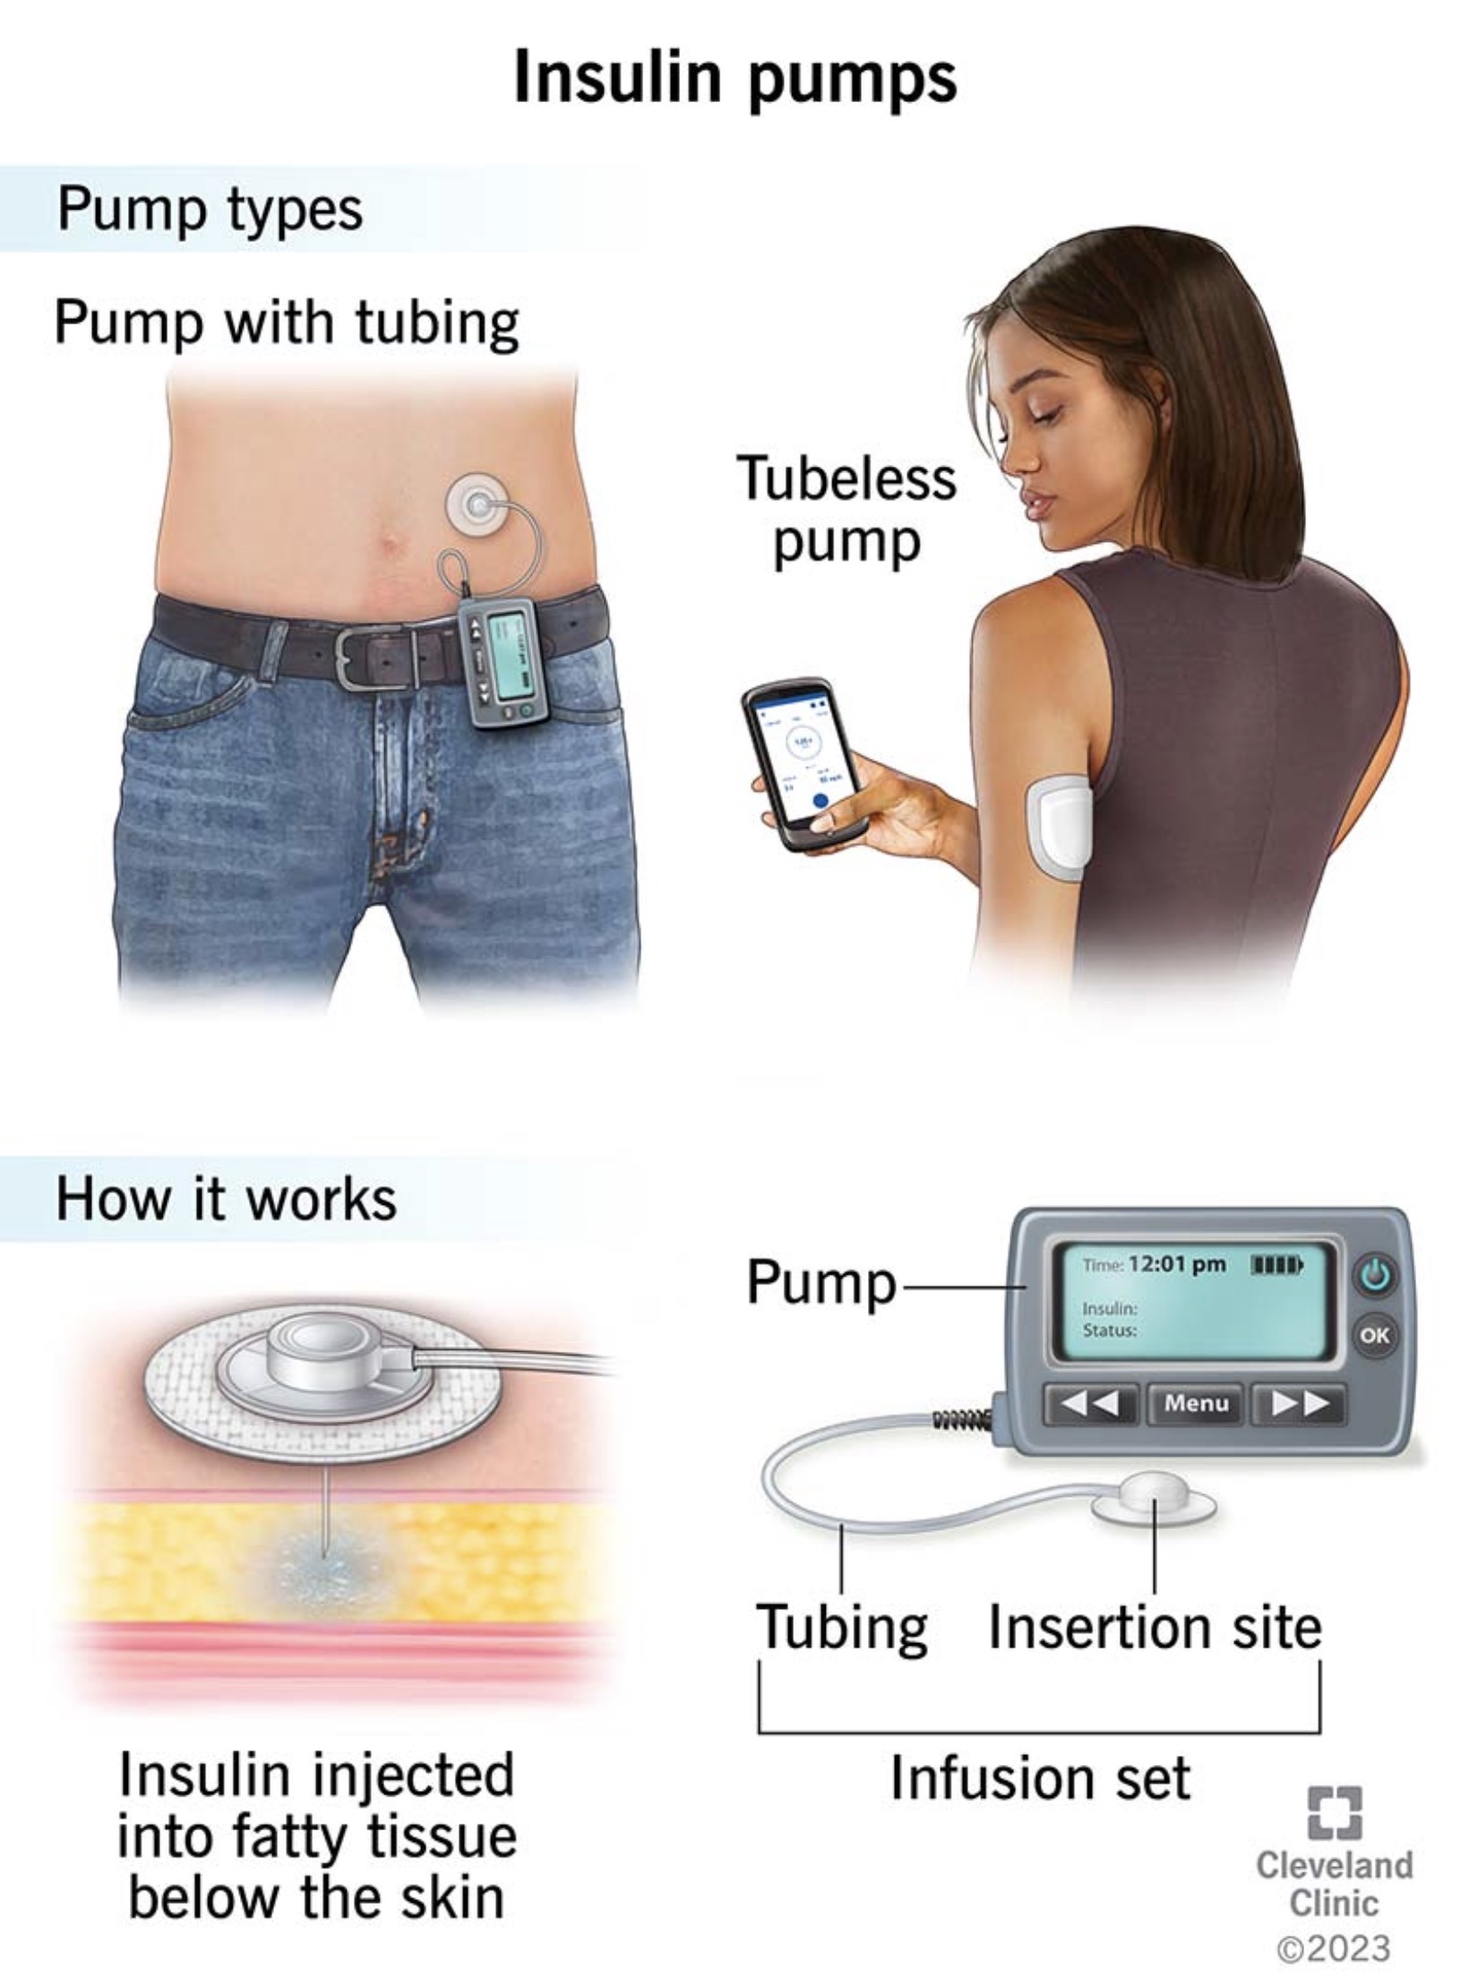
Continuous Subcutaneous Insulin Infusion (CSII) – Insulin Pump
Mainly Type 1 DM
Frequent hypoglycemia
Dawn phenomenon
🔹 Mechanism
Continuous basal infusion
Patient-activated bolus before meals
🔹 Advantages
✔ Mimics physiologic insulin secretion
✔ Better HbA1c control
✔ Reduces hypoglycemia
🔹 Disadvantages
Expensive
Risk of DKA if pump failure

Slide 22
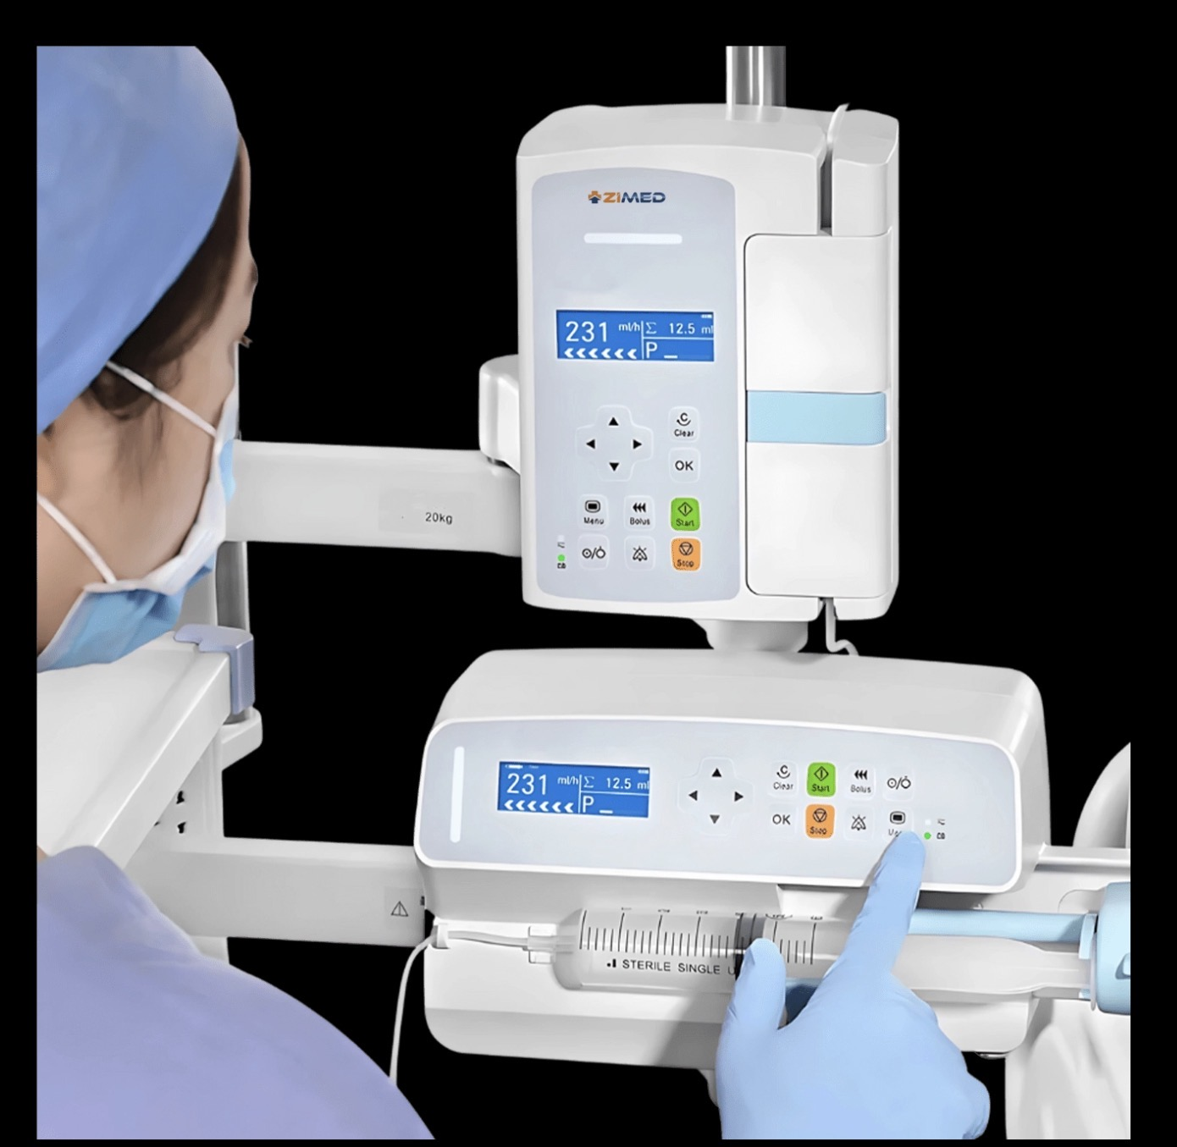
Intravenous insulin
Only Regular insulin
🔹 Indications
DKA
HHS
Perioperative hyperglycemia
ICU patients
Severe hyperkalemia
🔹 Advantage
✔ Immediate action
✔ Titrable

Slide 23
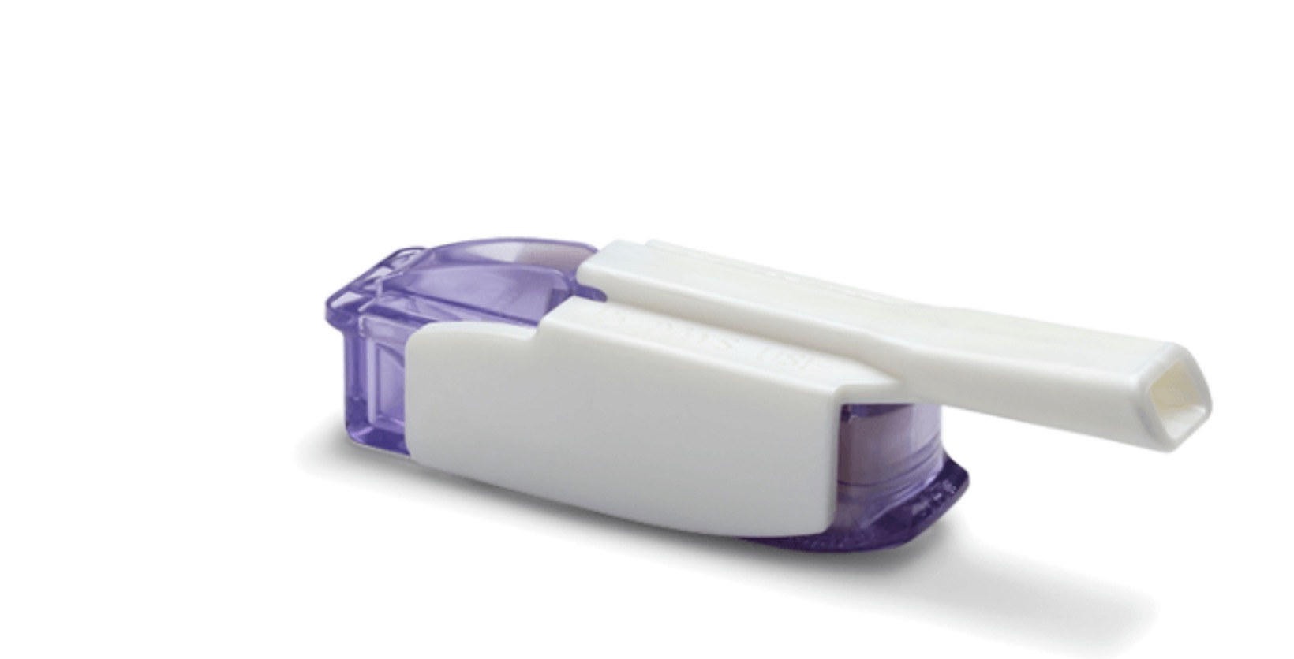

INHALED INSULIN
Afrezza (rapid-acting)
🔹 Use
Mealtime insulin in selected patients
🔹 Contraindications
Asthma
COPD
Smokers
🔹 Limitation
Requires pulmonary function testing.

Slide 24
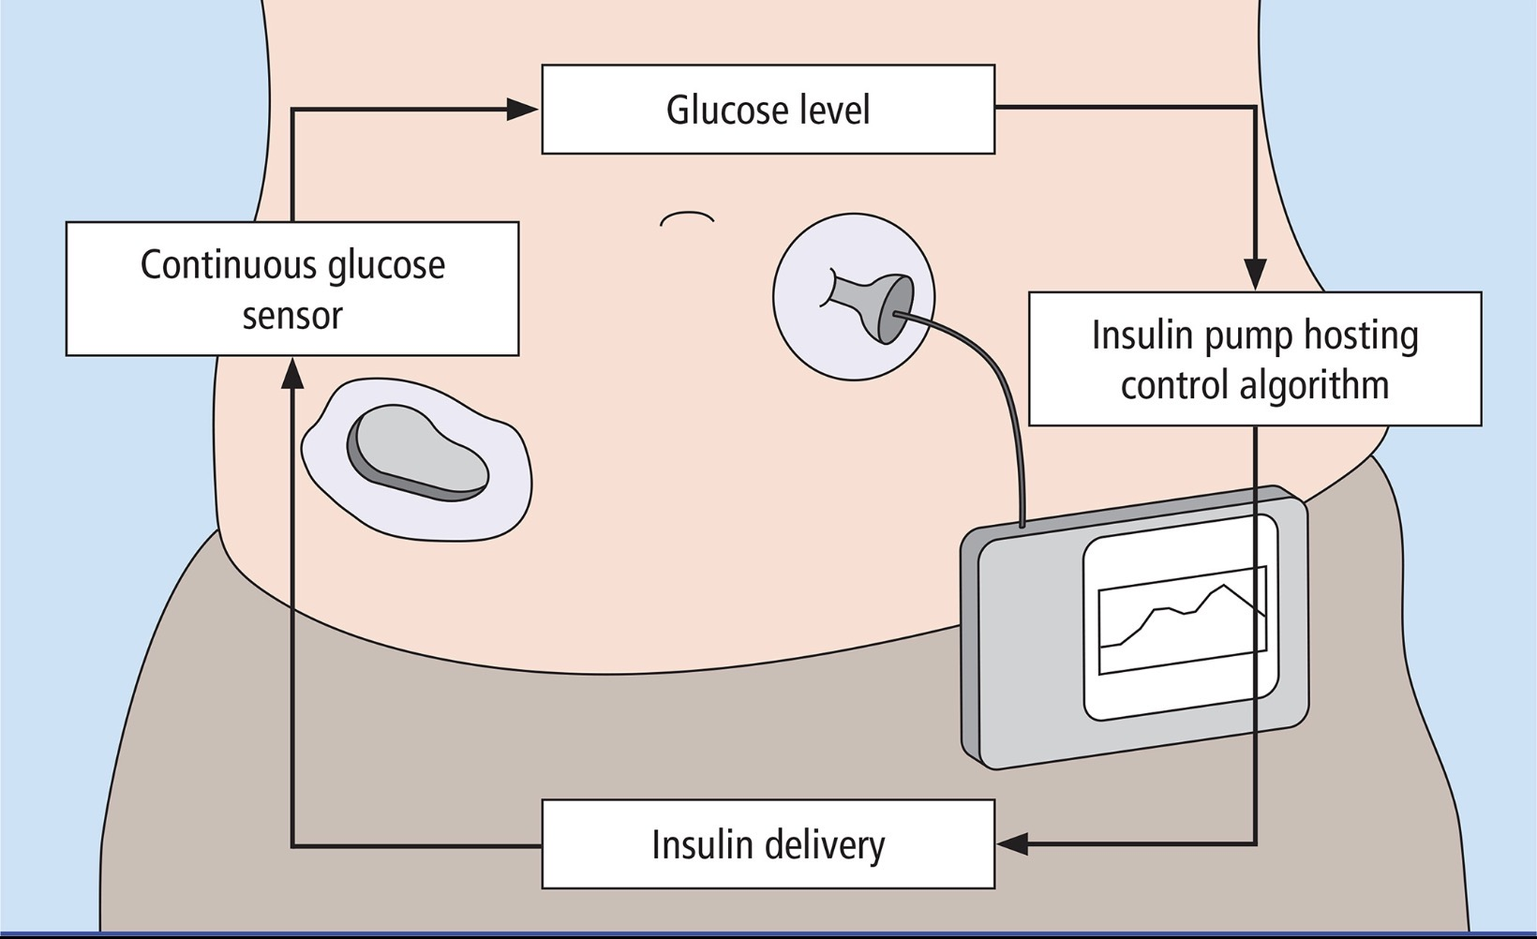
EMERGING AND ADVANCED INSULIN DELIVERY DEVICES
Hybrid Closed-Loop Systems (Artificial Pancreas)
Combines:
Continuous Glucose Monitoring (CGM)
Insulin pump
Control algorithm
Automatically adjusts basal insulin, but patient still gives meal bolus → hence “hybrid”.
🔹 Examples
Medtronic MiniMed 780G
Tandem Diabetes Care Control-IQ
Insulet Omnipod 5
🔹 Advantages
✔ Time-in-range >70%
✔ Reduced nocturnal hypoglycemia
✔ Better HbA1c control
🔹 Limitations
❌ Cost
❌ Requires patient training
❌ Risk of DKA if infusion interrupted
🔹 Indications
Type 1 DM
Recurrent hypoglycemia
Hypoglycemia unawareness

Slide 25
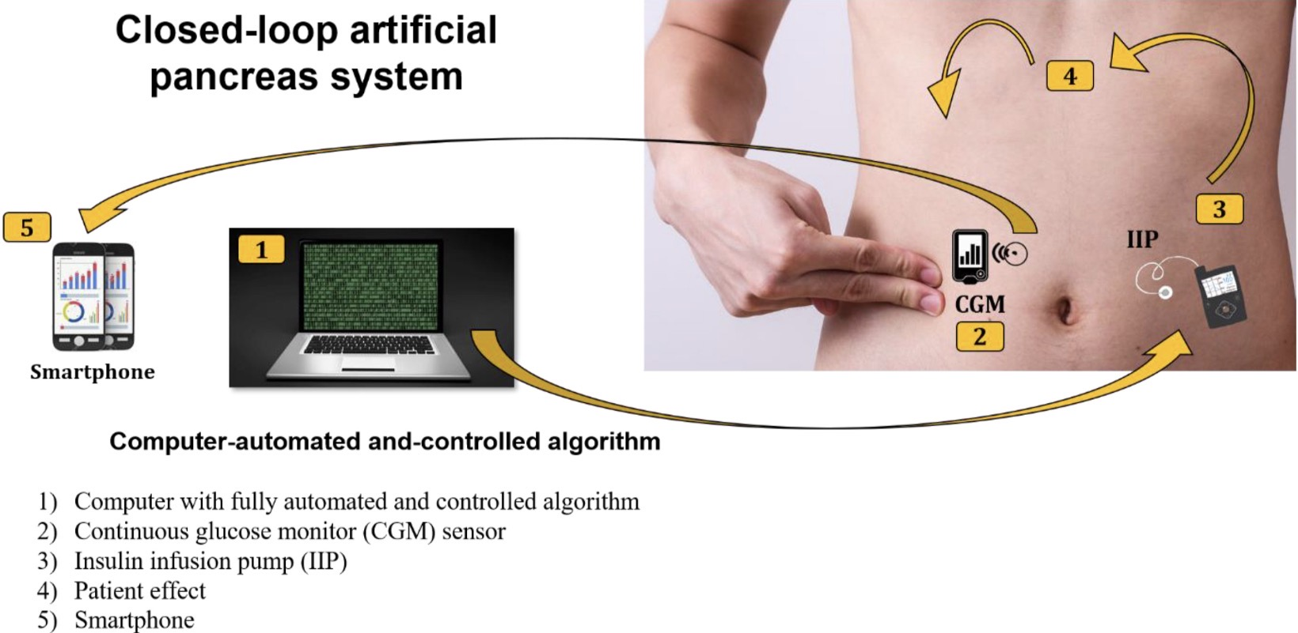
Fully Closed-Loop Systems (Next Generation)
No manual bolus needed. Algorithm adjusts insulin continuously.
🔹 Advanced Models
Dual hormone pumps (Insulin + Glucagon)
Adaptive AI-driven systems
🔹 Status
Some systems approved in limited settings
Many under clinical trials
🔹 Goal
True physiologic glucose regulation.

Slide 26
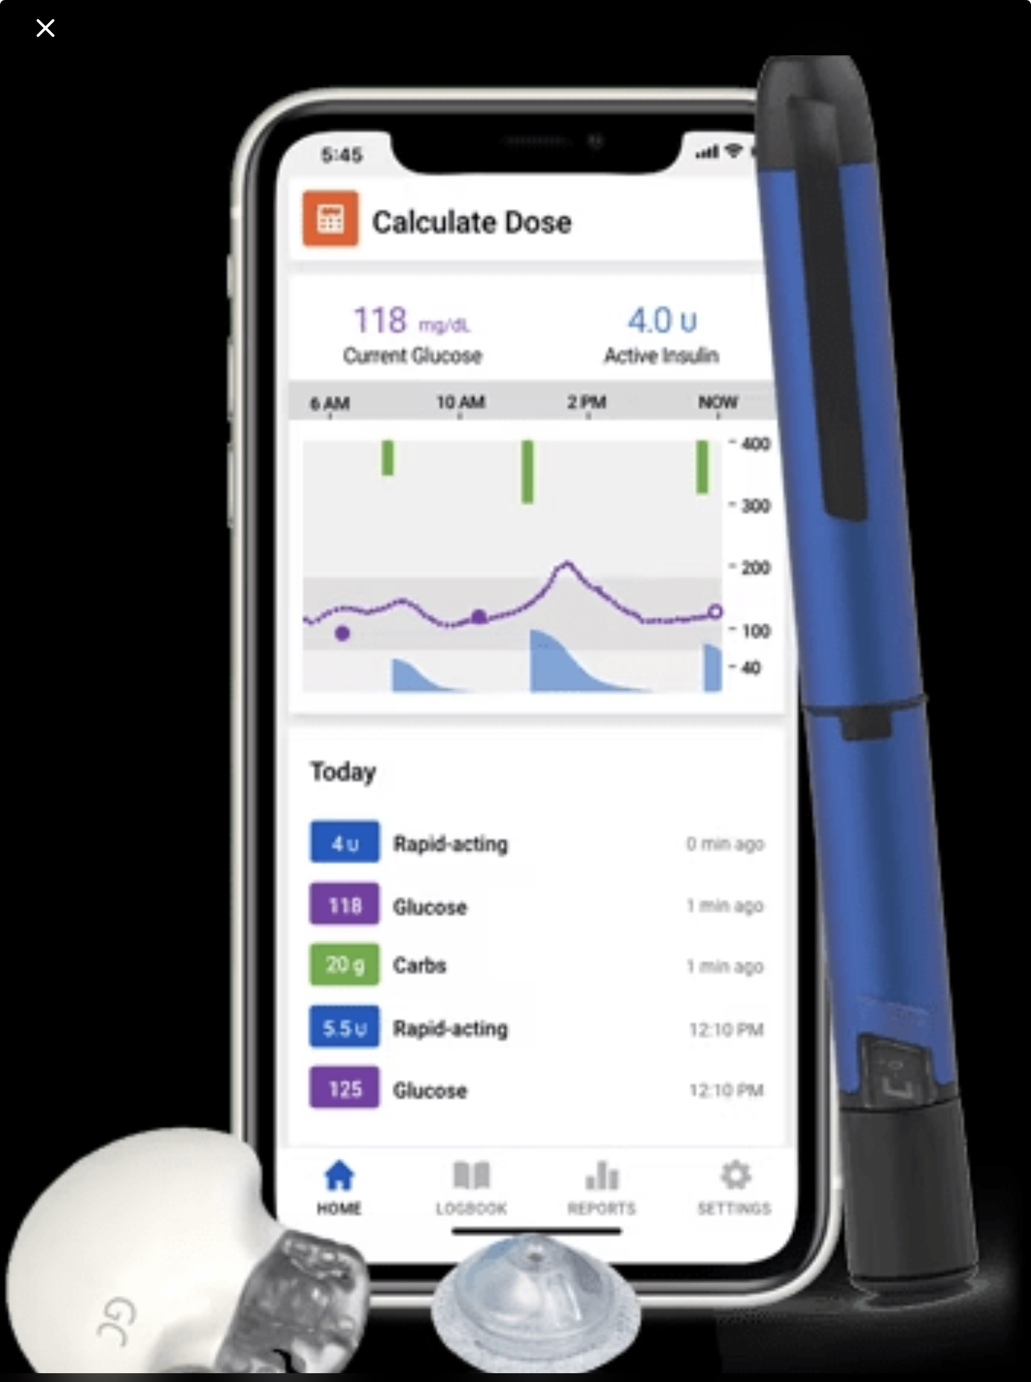
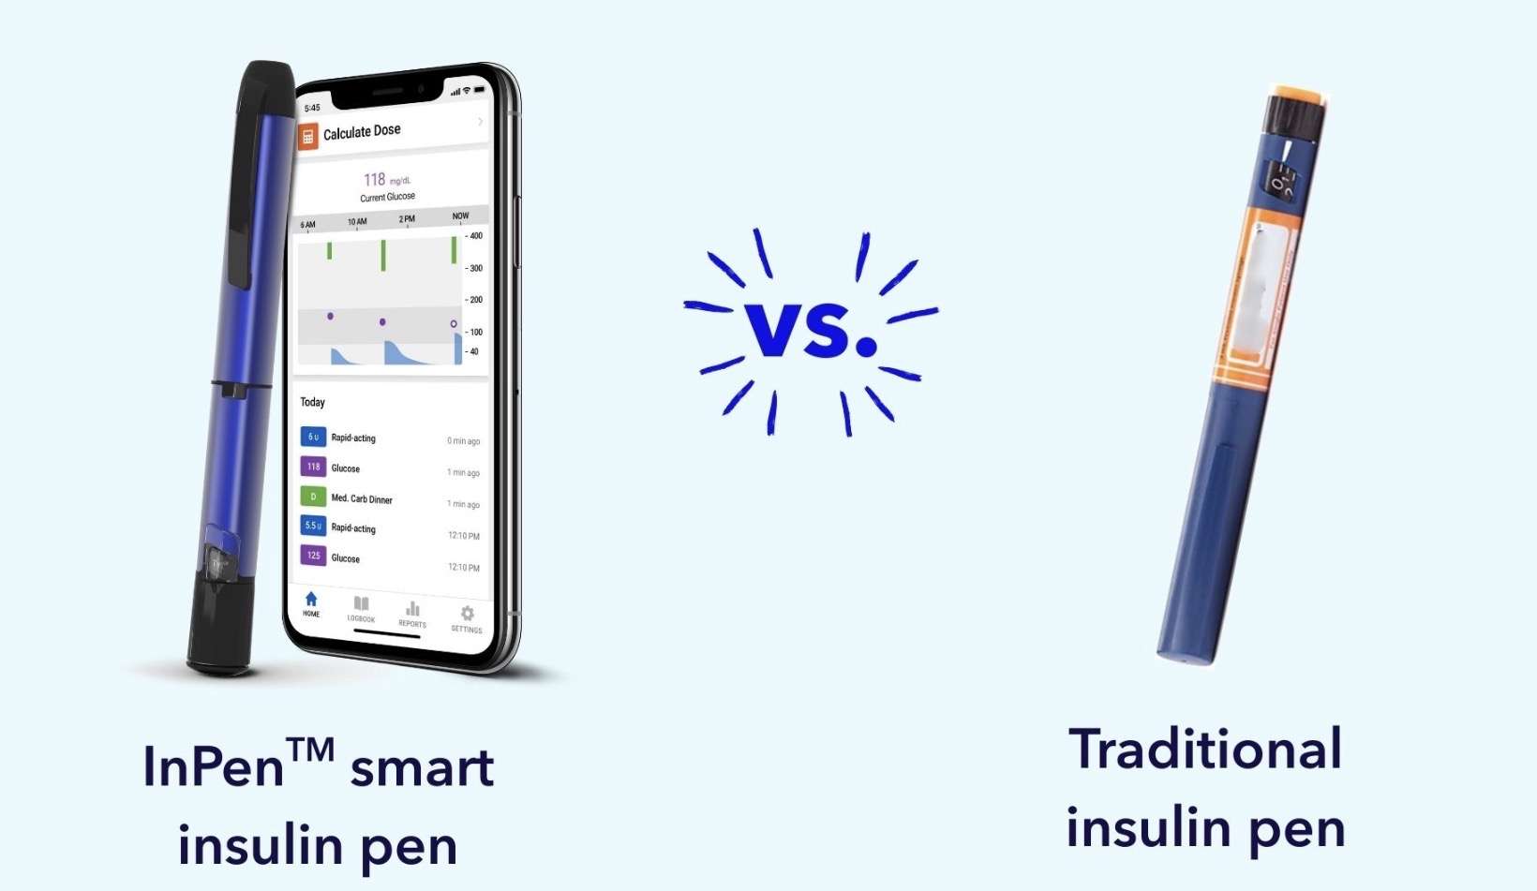
SMART INSULIN PEN
A smart insulin pen is:
A reusable or disposable insulin pen
With memory chip + Bluetooth
Linked to a mobile application
Capable of storing and analyzing dose data

Slide 27
SIDE EFFECTS OF INSULIN THERAPY
HYPOGLYCAEMIA
WEIGHT GAIN
PERIPHERAL OEDEMA ( due to salt and water retention in the short term)
LOCAL ALLERGY ( RARE )
INSULIN ANTIBODY FORMATION
LIPOHYPERTROPHY OR LIPOATROPHY AT INJECTION SITES

Slide 28
KEY POINTS
Hypoglycemia Risk (Highest → Lowest)
NPH > Regular > Long-acting analogs > Degludec

Slide 29
INDICATIONS OF INSULIN THERAPY
Absolute Indications
Type 1 Diabetes Mellitus
DKA
HHS
Severe hyperglycemia with catabolism
Pregnancy with diabetes
Relative / Clinical Indications
HbA1c >9–10% with symptoms
OHA failure
Acute illness
Perioperative period
Steroid-induced hyperglycemia

Slide 30
Causes of Poor Glycemic Control on Insulin
Lipohypertrophy
Poor adherence
Wrong injection technique
Inadequate titration
Steroid therapy
Insulin degradation
Always check technique before increasing dose.

Slide 31
Basal-Bolus Regimen (Physiologic Replacement)
Total Daily Dose (TDD):
0.4–0.6 U/kg/day (initial)
Divide:
50% basal
50% prandial (divided before meals)
Used in:
Type 1 DM
Advanced Type 2 DM
Hospitalized patients
Insulin Dose Adjustment Principles
Fasting high → adjust basal
Post-meal high → adjust bolus
Both high → increase TDD
Recurrent hypoglycemia → reduce 10–20%
Insulin Resistance (Clinical Clues)
Suspect if:
TDD >1 U/kg/day
Central obesity
Acanthosis nigricans
PCOS
Management:
Weight reduction
Add insulin sensitizers

Slide 32
DOSE ADJUSTMENTS OF INSULIN
Pregnancy
1st trimester → ↓ dose
2nd/3rd trimester → ↑ dose (insulin resistance)
Postpartum → sudden ↓ requirement
Chronic Kidney Disease (CKD)
↓ Insulin clearance
Reduce dose by 25–50% in advanced CKD
High hypoglycemia risk
Liver Disease
↓ Gluconeogenesis
↓ Insulin metabolism
Start low, titrate slowly
Steroid Therapy
Mainly ↑ postprandial glucose
Increase prandial insulin
NPH useful for daytime steroid cover
Acute Illness / Infection
↑ Insulin resistance
Increase dose by 10–30%
Never stop insulin in T1DM
Elderly
Start low (0.2–0.3 U/kg/day)
Avoid tight control
Prevent hypoglycemia

Slide 33
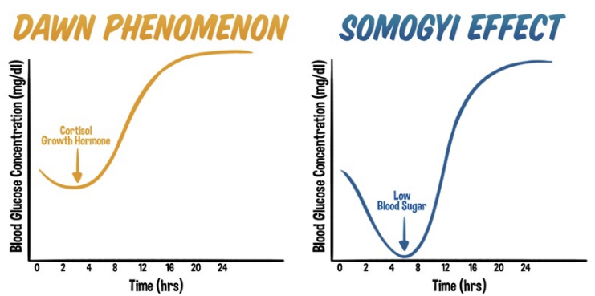
DAWN PHENOMENON vs SOMOGYI PHENOMENON
DAWN PHENOMENON
Early morning hyperglycemia due to normal circadian rise of counter-regulatory hormones, without preceding nocturnal hypoglycemia.
🔹 Pathophysiology
Between 3 AM – 8 AM:
↑ Growth hormone
↑ Cortisol
↑ Catecholamines
→ ↑ Hepatic gluconeogenesis
→ ↑ Insulin resistance
→ Fasting hyperglycemia
🔹 Key Feature
👉 No hypoglycemia at 3 AM
🔹 Diagnosis
Check 3 AM blood glucose
  Normal or high
CGM pattern: gradual rise toward morning
🔹 Management
Increase evening basal insulin
Shift basal insulin timing
Use long-acting analog (glargine/degludec)
Insulin pump: increase early morning basal rate

Slide 34
SOMOGYI PHENOMENON
Morning hyperglycemia caused by rebound response to nocturnal hypoglycemia.
🔹 Pathophysiology
Excess evening insulin → 2–3 AM hypoglycemia →↑ Counter-regulatory hormones →Morning hyperglycemia
🔹 Key Features
👉 Low glucose at 3 AM
🔹 Symptoms of Nocturnal Hypoglycemia
Night sweats
Nightmares
Morning headache
Fatigue
🔹 Diagnosis
3 AM glucose low
CGM shows nocturnal dip
🔹 Management
Reduce evening insulin dose
Add bedtime snack
Change insulin type

Slide 35
TYPES OF DIABETES MELLITUS
T1DM
Pathogenesis
Autoimmune destruction of pancreatic β-cells
Absolute insulin deficiency
Features
Usually childhood/adolescence
Lean body habitus
Prone to DKA
Autoantibodies:
GAD65
IA-2
ZnT8
islet cell

Slide 36
T2DM
Combination of:
Peripheral insulin resistance
Progressive β-cell dysfunction
Clinical
Strong genetic predisposition
Obesity related
Gradual onset
Less prone to DKA

Slide 37
MODY ( Maturity-Onset Diabetes of the Young)
A monogenic form of diabetes characterized by:
Early onset (<25 years)
Autosomal dominant inheritance
Primary defect in β-cell function
Absence of insulin resistance
Accounts for ~1–2% of diabetes cases (often misdiagnosed as Type 1 or Type 2).
Single gene mutation affecting β-cell transcription factors
Impaired insulin secretion
Preserved insulin sensitivity
Detectable C-peptide
No autoimmune antibodies
Unlike Type 1 → not autoimmune
Unlike Type 2 → not insulin resistance driven

Slide 38
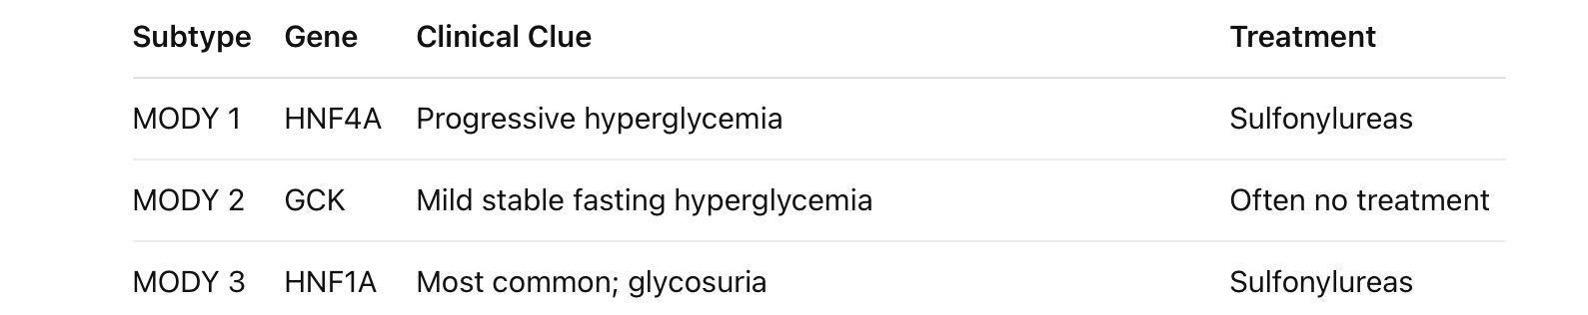
Types
When to Suspect MODY
Diabetes diagnosed before 25 years
Strong family history (3 generations)
Non-obese patient
No ketosis
Negative GAD antibodies
Detectable C-peptide
GENETIC TESTING -GOLD STANDARD FOR DIAGNOSIS FOR MODY
Dr. Mohan’s Diabetes Specialities Centre in Chennai does provide molecular genetic testing free of cost to the underprivileged patients

Slide 39
LADA (Latent Autoimmune Diabetes in Adults)
LADA is a slowly progressive autoimmune diabetes occurring in adults, with features intermediate between Type 1 and Type 2 diabetes.
Also called:
“Type 1.5 diabetes”
Autoimmune β-cell destruction
Slower progression compared to classic Type 1 DM
Initial insulin independence
Autoantibodies present:
GAD65 (most common)
IA-2 (less common)
ZnT8
Anti -islet
Unlike Type 2 →LADA Is autoimmune
Unlike Type 1 → LADA has slower β-cell loss
Diagnostic criteria
Age >30 years at diagnosis
Presence of pancreatic autoantibodies
No insulin requirement for first 6 months
Clinical features
Adult onset
Often lean or mildly overweight
Initially responds to oral agents
Progressive need for insulin (within months–years)
SUSPECT LADA IF
“Type 2 diabetic not responding to OHA as expected.”
Slower progression than Type 1
Often misdiagnosed as Type 2
Eventually requires insulin
TREATMENT
Early insulin therapy may preserve β-cell function
Avoid prolonged sulfonylurea use
Monitor C-peptide progression
.
LADA important clinically because
Misclassification delays insulin therapy → worsens glycemic control and β-cell preservation.

Slide 40
CASE SCENARIO -1

Slide 41
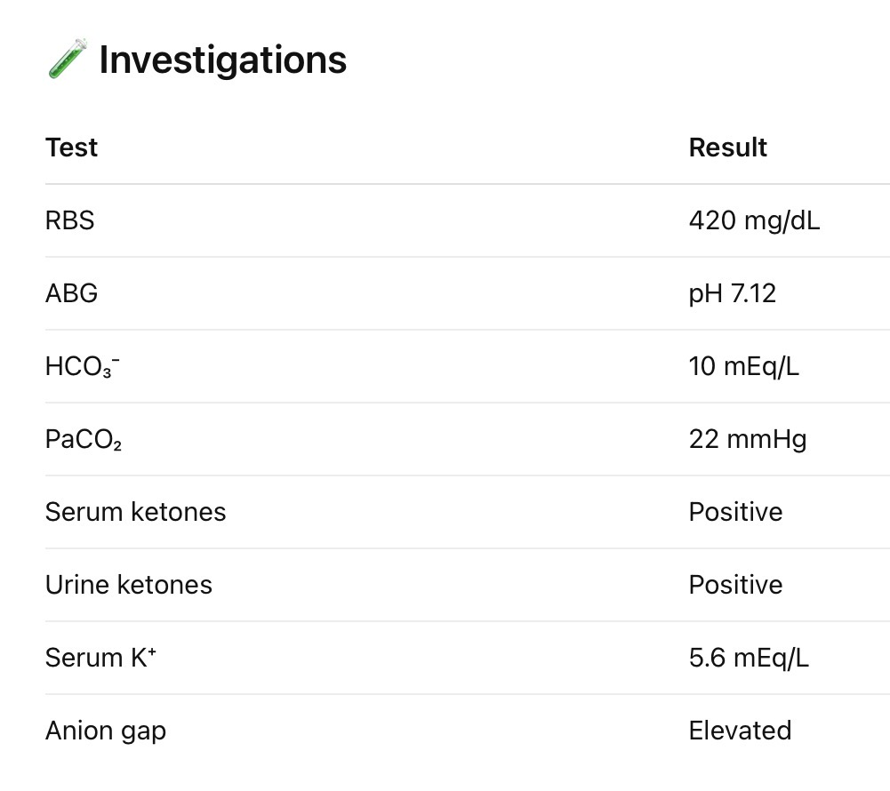
A 21-year-old female, known case of Type 1 Diabetes Mellitus, presents with:
2 days history of vomiting
Polyuria, polydipsia
Abdominal pain
Altered sensorium since morning
History reveals missed insulin doses due to fever.
ON EXAMINATION
Drowsy but arousable
BP: 90/60 mmHg
Pulse: 120/min
RR: 28/min (deep, labored breathing)
Dry mucous membranes
Fruity odor of breath

Slide 42
Diagnosis - DIABETIC KETOACIDOSIS

Slide 43
Criteria:
Glucose >250 mg/dL
pH <7.30
HCO₃⁻ <18
Positive ketones
High anion gap metabolic acidosis

Slide 44
MANAGEMENT OF DKA
Fluid Resuscitation (First Priority)
0.9% Normal saline
1–1.5 L in first hour
Then 250–500 mL/hr
When glucose <200 mg/dL → add 5% dextrose
Insulin Therapy
IV Regular insulin only
0.1 U/kg/hr infusion
Target: glucose fall 50–70 mg/dL per hour
When glucose <200 → reduce to 0.02–0.05 U/kg/hr
Potassium Management
>5.2 -Do not give K+
3.3-5.2 -Add 20-30 mEq/L
<3.3-Hold insulin, correct K+ first
Bicarbonate
Only if:
pH <6.9
Monitor
Hourly glucose
Electrolytes every 2–4 hr
Anion gap closure
Mental status

Slide 45
DKA resolved when:
Glucose <200 mg/dL
HCO₃⁻ ≥15
pH >7.3
Anion gap normalized

Slide 46
CASE SCENARIO -2

Slide 47
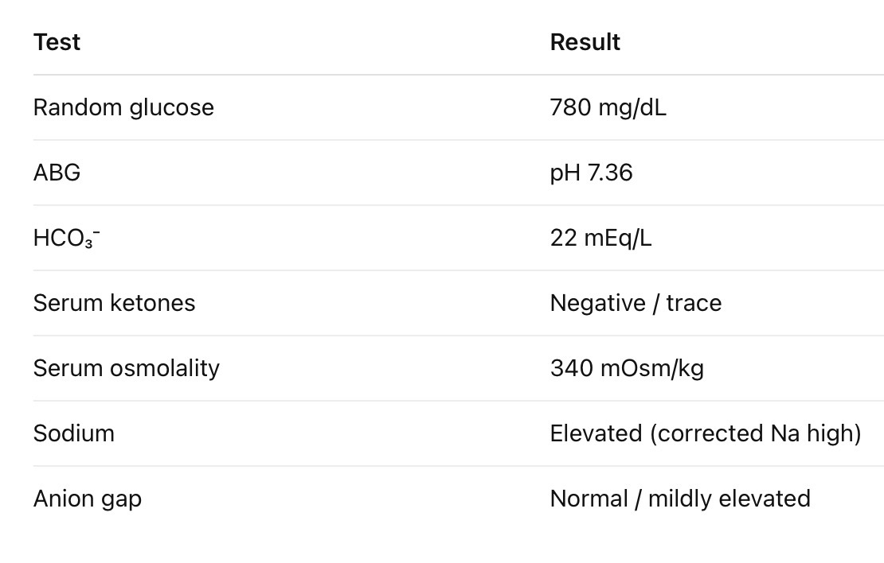
A 65-year-old male, known case of Type 2 DM, presents with:
4–5 days history of polyuria, polydipsia
Progressive weakness
Altered sensorium since morning
History of fever and poor oral intake
On examination:
Severely dehydrated
BP: 90/60 mmHg
Pulse: 118/min
No Kussmaul breathing
No fruity breath

Slide 48
HYPEROSMOLAR HYPERGLYCEMIC STATE
Diagnostic Criteria
Glucose >600 mg/dL
Effective serum osmolality >320 mOsm/kg
Minimal or no ketosis
pH >7.30
Severe dehydration
Pathophysiology
Relative insulin deficiency →Enough insulin to suppress ketosis -Not enough to prevent hyperglycemia
Leading to
→ Severe hyperglycemia
→ Osmotic diuresis
→ Profound dehydration
→ Hyperosmolarity
→ CNS dysfunction
Precipitating Factors
Infection (most common)
MI
Stroke
Steroids
Poor compliance

Slide 49
MANAGEMENT OF HHS
Fluid Replacement (MOST IMPORTANT)
0.9% Normal saline
1–1.5 L in first hour
Total deficit may be 8–12 liters
After stabilization:
Switch to 0.45% saline if corrected Na high
Add dextrose when glucose <300 mg/dL
Insulin Therapy
IV Regular insulin
0.1 U/kg/hr (without bolus often sufficient)
Goal: gradual glucose fall (50–70 mg/dL/hr)
Insulin requirement is lower than DKA.
Potassium Monitoring
Same principles as DKA:
Replace if <5.2
Hold insulin if K⁺ <3.3

Slide 50
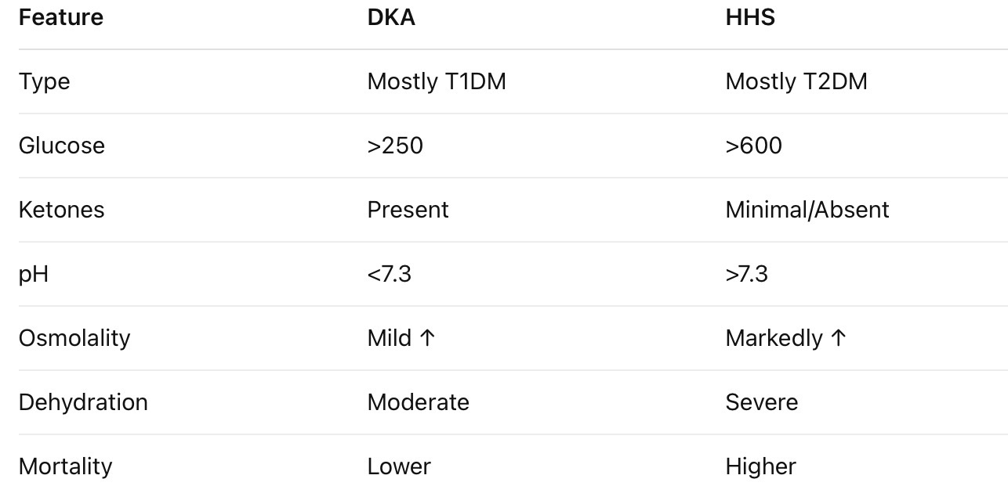
DKA VS HHS

Slide 51
THANK YOU!!

