Slide 1
RED CELLS – BLUE TINTS!
A PREGNANCY MYSTERY
IMCU I CHIEF – PROF DR. P.V BALAMURUGAN MD.,
IMCU I ASST PROF – DR. PALANIKUMARAN MD.,

Slide 2
Chief complaints
A 27 yr old female, primi, GA- 37W+ 4d came for routine antenatal check up on 24/10/25. (LMP- 6/2/25 and EDD-13/11/25)
As she was DCT +ve and her hemoglobin was 8 gram, she was admitted for further management of anemia. She also had previous blood transfusion history at 35 weeks of gestation.
On admission, she was asymptomatic with no significant complaints
Comfortable at rest
Pallor present, central cyanosis present
No pedal edema

Slide 3
Vitals:
BP- 120/80 mmHg
PR- 86/min
Spo2- 50%RA
S/E:
CVS- S1, S2 +
RS- BAE+, no added sounds
P/A- soft, BS+
CNS- NFND

Slide 4
Investigations:
LFT:
Sr. bil- 1.7 OT-33
Direct- 0.8 PT- 28
Indirect- 0.9 ALP- 158
RFT:
Urea- 16
Creat- 0.6
CBC:
TC- 12000 MCV- 98
Hb- 8 MCH- 32
Plt- 3lakh MCHC- 33
LDH- 383
CHG with PS:
Microcytic Hypochromic anemia
Retic- 5%

Slide 5
Respiratory medicine (o)
IMP: Desaturation f/e
Suggested:
NRM
CT chest
Vascular (o)

Slide 6
Imaging:
Xray- normal
CT-chest- normal

Slide 7
Cardiologist (o)
Echo :
No RWMA
EF 60%
No pericardial effusion
No clot
Imp: normal study / stable cardiac status
Physician (o)

Slide 8
Anasthetist (o):
Continue NRBM
Physician (o)

Slide 9
Past history revealed…

Slide 10
2021… On the day of her father’s death…
c/o giddiness for 1day -> went to a pvt hospital -> spo2 – 57% -> referred to GRH.
O/E: not tachypnoeic, cyanosis +, icterus +
Pt was suspected as a case of poisoning
Stomach wash given and pt was kept under NPO
Pt was connected to NIV

Slide 11
Later, she was treated as a case of ?drug induced methemoglobinemia
Treated with methylene blue
On the day of discharge:
Her spo2 was 61%

Slide 12
LAB:
Covid throat swab – neg
ECG – NSR/ NAD/ No ST changes
ANA – neg
CBC:
TC- 7800
Hb- 11.5
Plt- 1.9lakh
MCH- 32.2
MCHC- 31.9
ESR- 18
LFT:
T.Bil: 7.8 OT: 8
Dir:0.4 PT: 5
Ind: 7.4 ALP:15
Peripheral smear:
Microspherocytes (8%)
USG:
Mild splenomegaly
HbA2: 4.8%

Slide 13
Opinions:
Anesthesia:
Bubble contrast:
Mechanical ventilation
Endocrinology:
?Sick euthyroid illness
Cardiology:
CT- Chest
No intracardiac shunt
Left side chamber shows minimal bubble contrast after 5 cardiac cycle
Suggested- CTPA

Slide 14
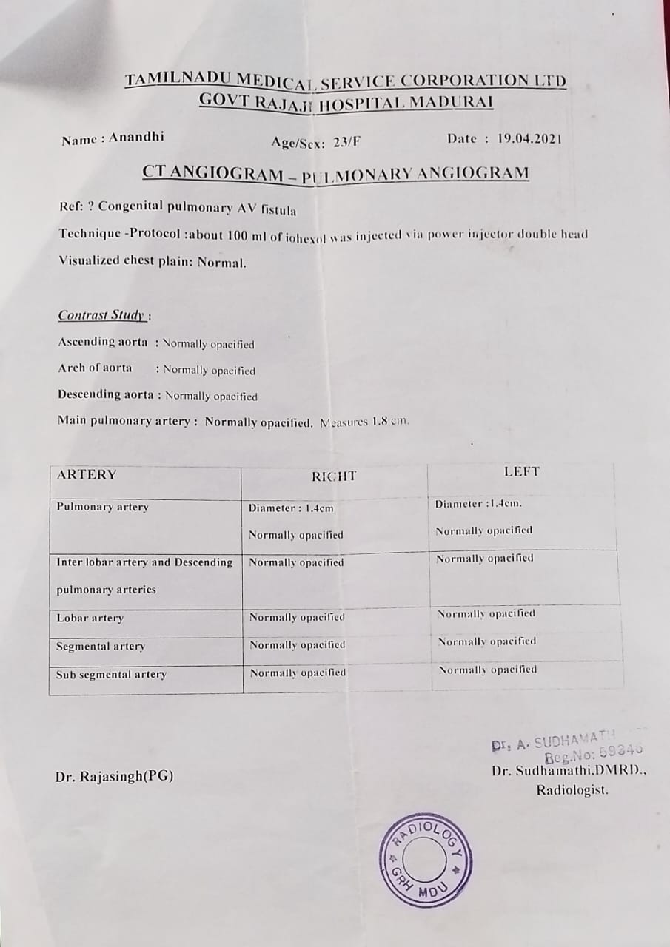
CTPA:
IMP: NORMAL

Slide 15
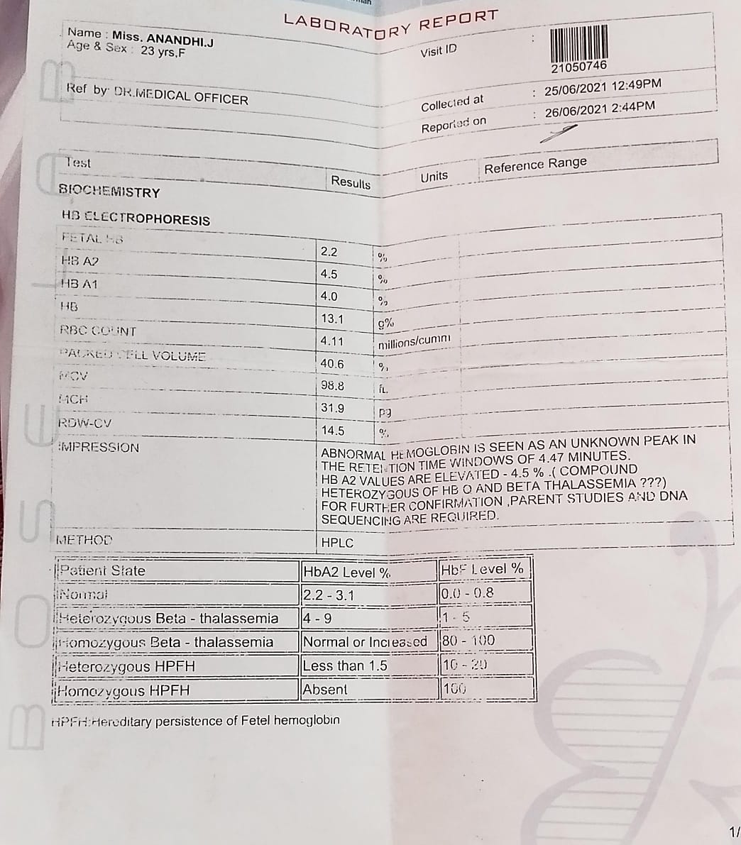
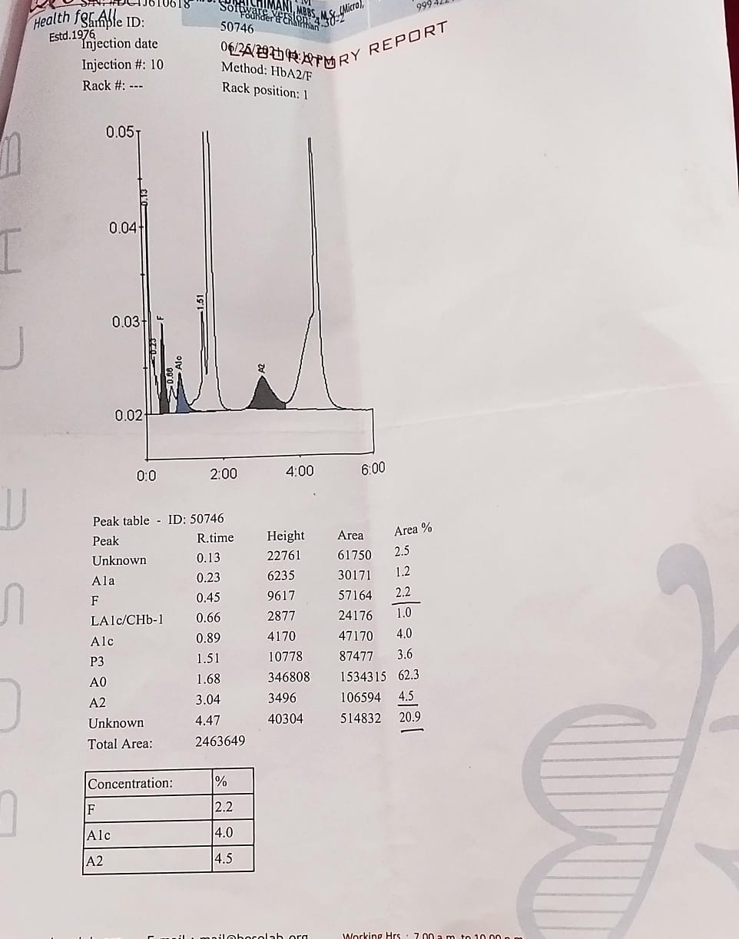
Hb Electrophoresis:

Slide 16
2025…
AT IMCU 1

Slide 17
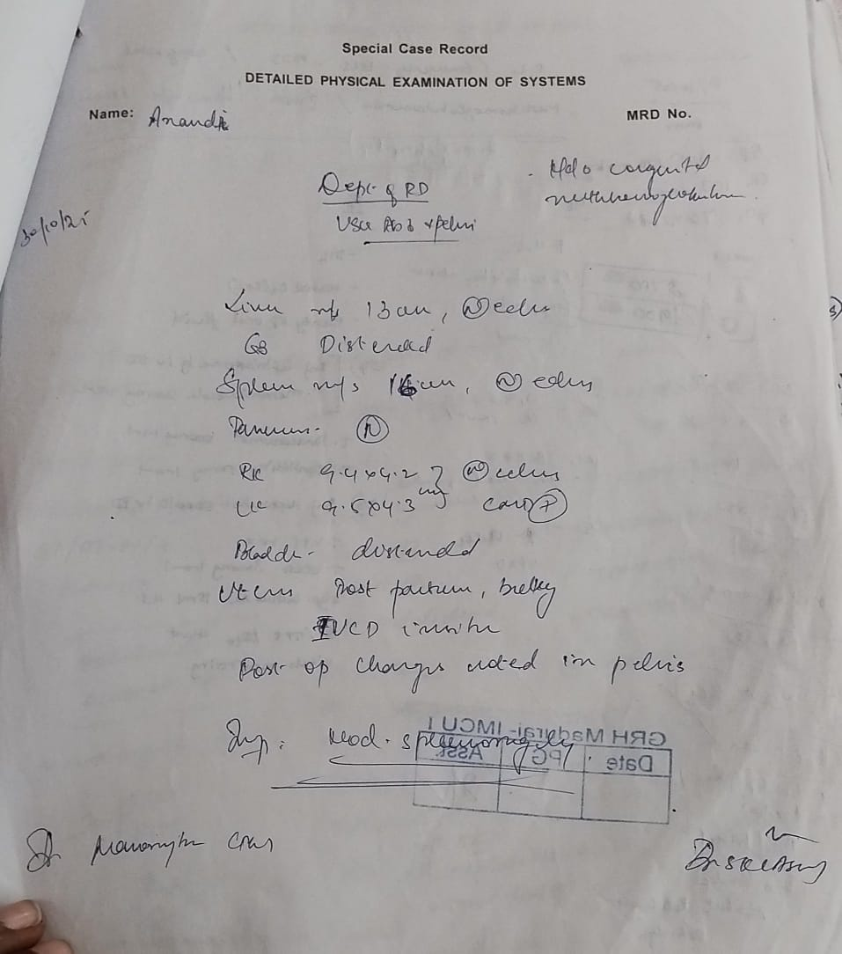
Radiologist (o)
USG abd and pelvis :
IMP: Moderate splenomegaly

Slide 18
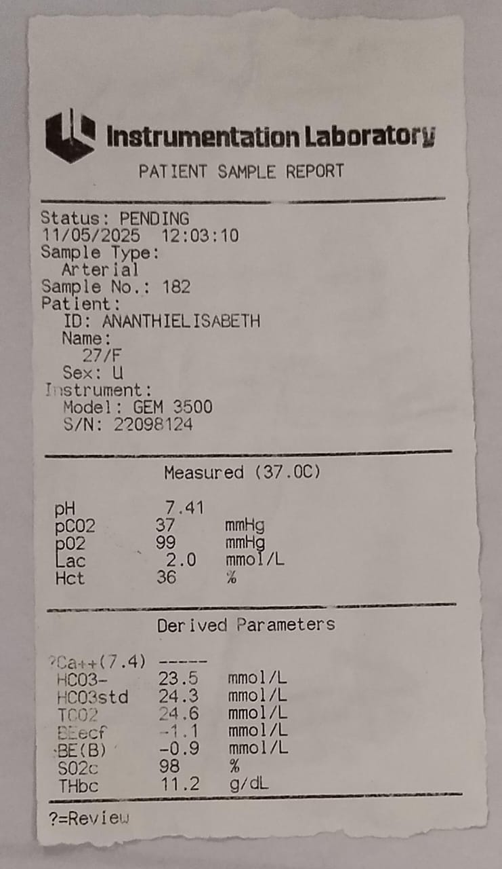
ABG
Imp: normal

Slide 19
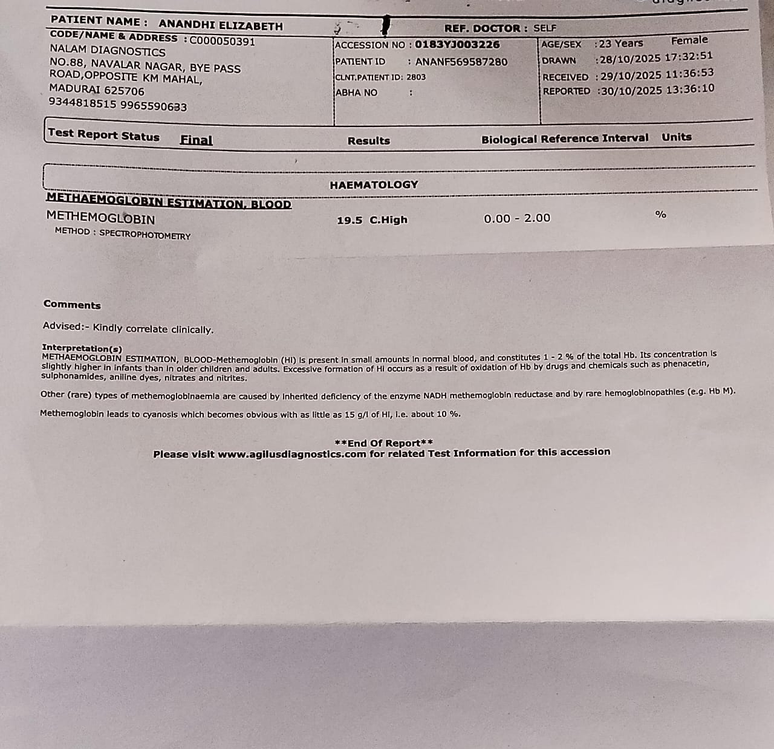
The missing report…
Methaemoglobin: 19.5%

Slide 20
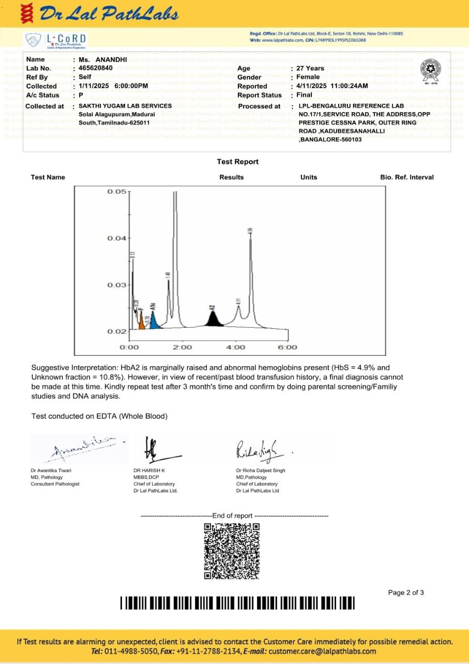

Slide 21
Let’s discuss…

Slide 22
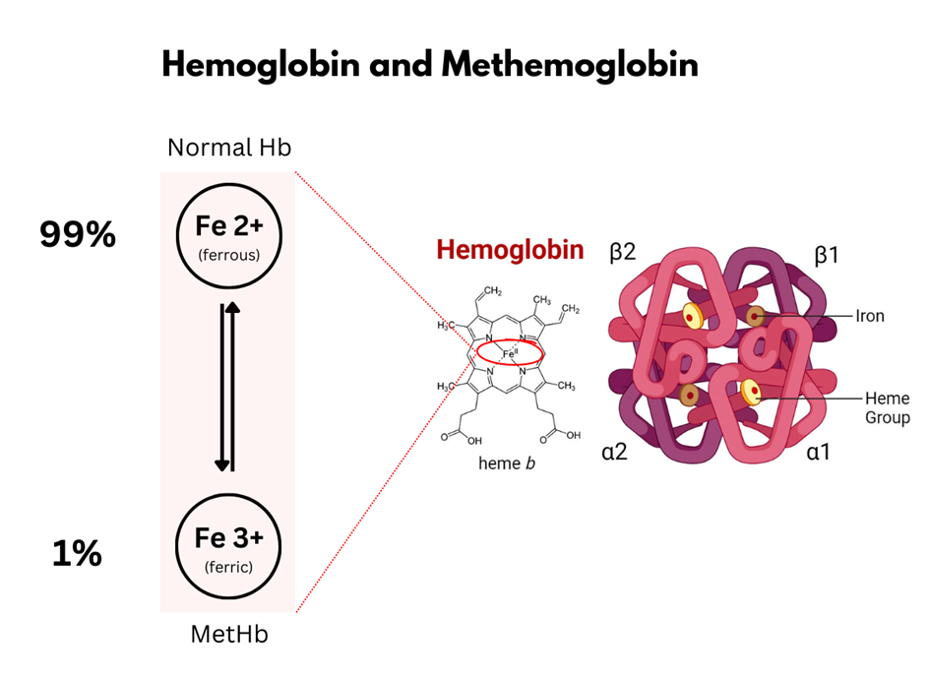
What is methemoglobin?

Slide 23
What is Congenital methemoglobinemia?
Hereditary disorder with chronically elevated methemoglobin.
Caused by cytochrome b5 reductase deficiency or Hb M variants.
Leads to impaired reduction of Fe³⁺ → Fe²⁺ in hemoglobin.
Results in lifelong cyanosis.
PaO₂ remains normal despite low SpO₂.

Slide 24
Types of Congenital Methemoglobinemia
1. Cytochrome b5 Reductase Deficiency
Type 1(Erythrocyte Type)
Type 2 (Generalized Type)
2. Hemoglobin M Variants

Slide 25
1. Cytochrome b5 Reductase Deficiency
a) Type I (Erythrocyte reductase deficiency):
Defect limited to RBCs.
Most common type.
Autosomal recessive.
Patients are cyanotic from infancy, but otherwise asymptomatic, normal growth.
MetHb usually 20–30%.
No neurological involvement.

Slide 26
b) Type II (Generalized reductase deficiency):
Type 2 is relatively severe and is endemic in specific populations of the world like Athabasca and Navajo Native Americans in the United States and Yakutsk, Siberian natives. Type 2 affects 10-15% of individuals with congenital cb5r deficiency.
Enzyme deficient in all tissues.
Severe → neurologic symptoms: developmental delay, microcephaly, dystonia, seizures.
High mortality in early childhood.

Slide 27
2) Hemoglobin M Disease:
Autosomal dominant.
Mutation in globin chain (α or β) stabilizes Fe³⁺ state.
Lifelong cyanosis, but NO response to methylene blue.
Patients otherwise asymptomatic.
Common variants:
α-chain (αM Boston, αM Iwate)
β-chain (βM Saskatoon, βM Hyde Park)

Slide 28
Clinical features:
Chocolate brown blood.
Cyanosis disproportionate to symptoms.
Normal PaO₂ on ABG; but low SpO₂ (~85%) on pulse oximetry.
Symptoms correlate with MetHb level:
10–20% → cyanosis
20–40% → headache, dizziness
40–60% → metabolic acidosis, arrhythmia
70% → death

Slide 29
Diagnosis:
1. Clinical Clues
Lifelong cyanosis from infancy
Chocolate-brown blood
SpO₂ ~85% (fixed)
Normal PaO₂ on ABG → “saturation gap”
2. Confirmatory Test
Co-oximetry → directly measures methemoglobin (gold standard)

Slide 30
3. Specific Tests:
Cytochrome b5 reductase activity
  ↓ in Type I / Type II
Hemoglobin electrophoresis / genetic testing
  Detects Hb M variants
4. Supportive Lab Findings
Normal ABG (PaO₂ normal)
Normal chest X-ray and cardiac evaluation
Normal CBC (except ↑ MetHb)

Slide 31
Important Differentiation:
Low SpO₂ + normal PaO₂ = Methemoglobinemia
Low SpO₂ + low PaO₂ = Respiratory cause

Slide 32
Treatment
1. Type I (RBC-restricted enzyme deficiency)
Methylene Blue (DOC)
Dose: 1–2 mg/kg
IV-Rapid response
Vitamin C (oral)Helps reduce methemoglobin chronically
Avoid oxidant drugs (dapsone, nitrates, benzocaine)

Slide 33
Type II (Generalized deficiency)
No effective treatment
Only supportive care
Poor prognosis due to severe neurological disease

Slide 34
3. Hemoglobin M Variants
Methylene Blue NOT effective
Only reassurance + avoid oxidant triggers
Important Precaution!!!
Do NOT give methylene blue in G6PD deficiency
→ risk of severe hemolysis

Slide 35
Drug induced methemoglobinemia:
Local anesthetics:
Benzocaine (topical) – most common
Lidocaine, Prilocaine (esp. in EMLA cream)
Antibiotics:
Dapsone (MC overall)
Sulfonamides
Nitrofurantoin
Nitrates/Nitrites:
Nitroglycerin, Nitroprusside
Amyl nitrite, well-water nitrate contamination

Slide 36
Others:
Metoclopramide
Phenazopyridine
Chloroquine
Rasburicase
Aniline dyes, industrial chemicals

Slide 37
Treatment
Immediate Actions
Stop offending drug (dapsone, benzocaine, nitrates, etc.)
Begin High-flow O₂ (non-rebreather mask)

Slide 38
Assess Severity:
Mild (<20% MetHb, asymptomatic)
O₂ + Observe
Remove offending agent
No methylene blue needed
Moderate/Severe
MetHb (>20% OR Symptoms: dyspnea, tachycardia, confusion)
→ Give methylene blue

Slide 39
Methylene Blue (Antidote):
1–2 mg/kg IV over 5 mins
Reassess at 1 hr
Repeat once if MetHb still high
Max ~7 mg/kg/day
If G6PD Deficient:
Do NOT give methylene blue
Give Ascorbic acid
Consider Exchange transfusion
Consider Hyperbaric oxygen (life-threatening)

Slide 40
Monitor:
Repeat MetHb levels q1–2 hrs
Watch for hemolysis (esp. if rasburicase-induced)
Monitor oxygenation + cardiac rhythm
Escalate if Refractory:
MetHb >50% with symptoms
Persistent hypoxia
→ Exchange transfusion or Hyperbaric O₂

Slide 41
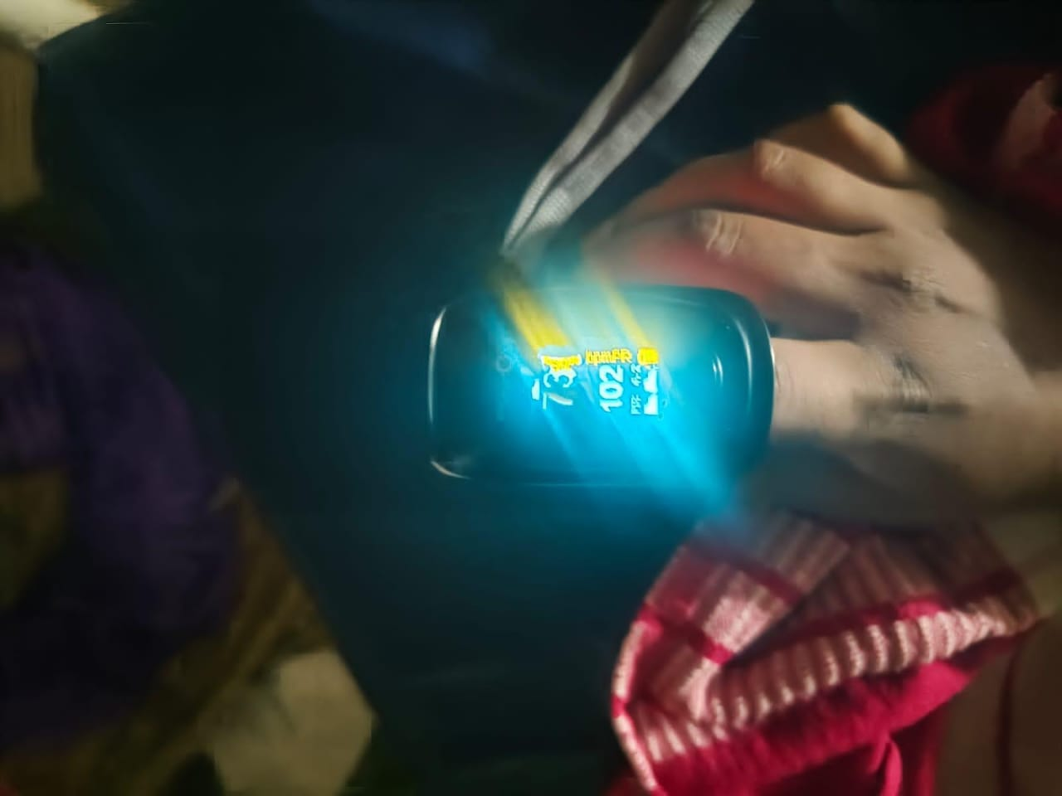
THANK YOU!

