Slide 1
ECG PRESENTATION

Slide 2
History
70 year old diabetic, hypertensive presented with
  h/o chest pain for 1 day.

Slide 3
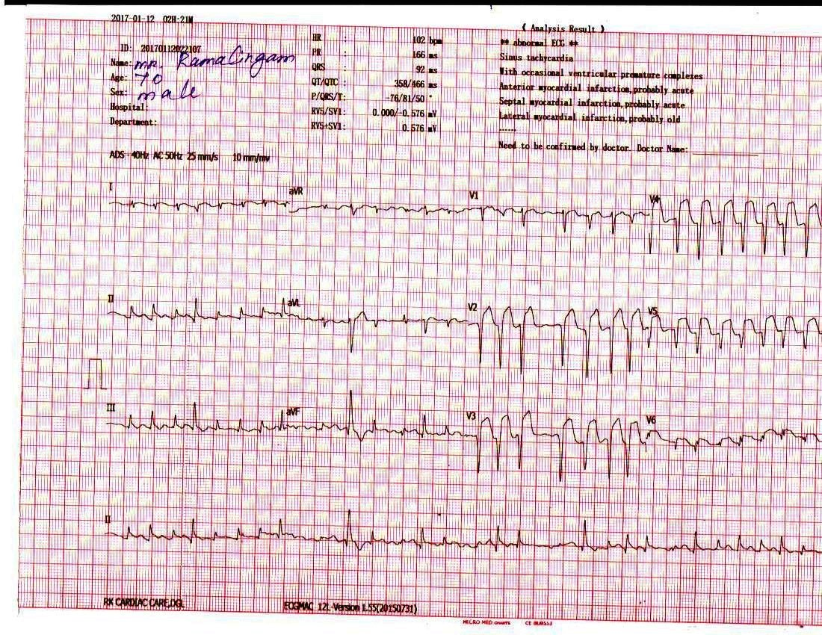

Slide 4
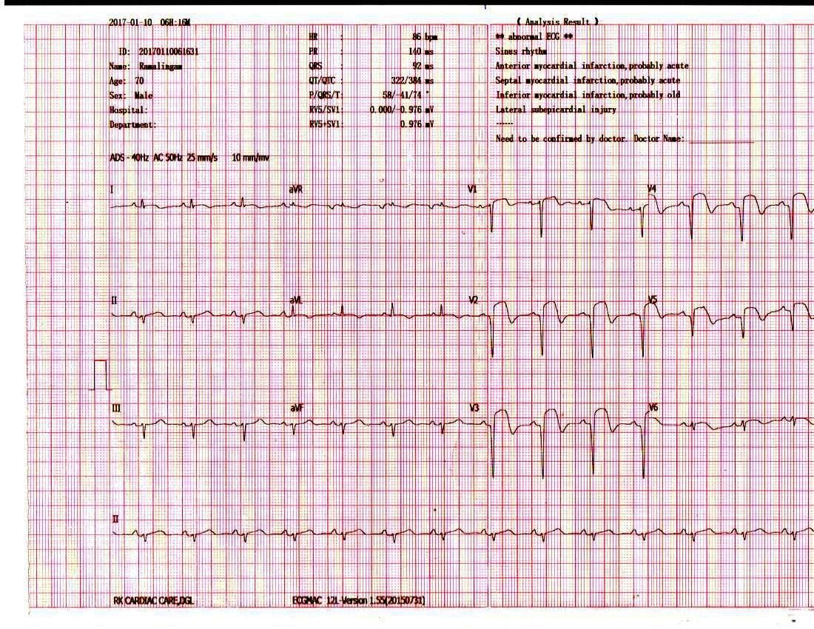

Slide 5
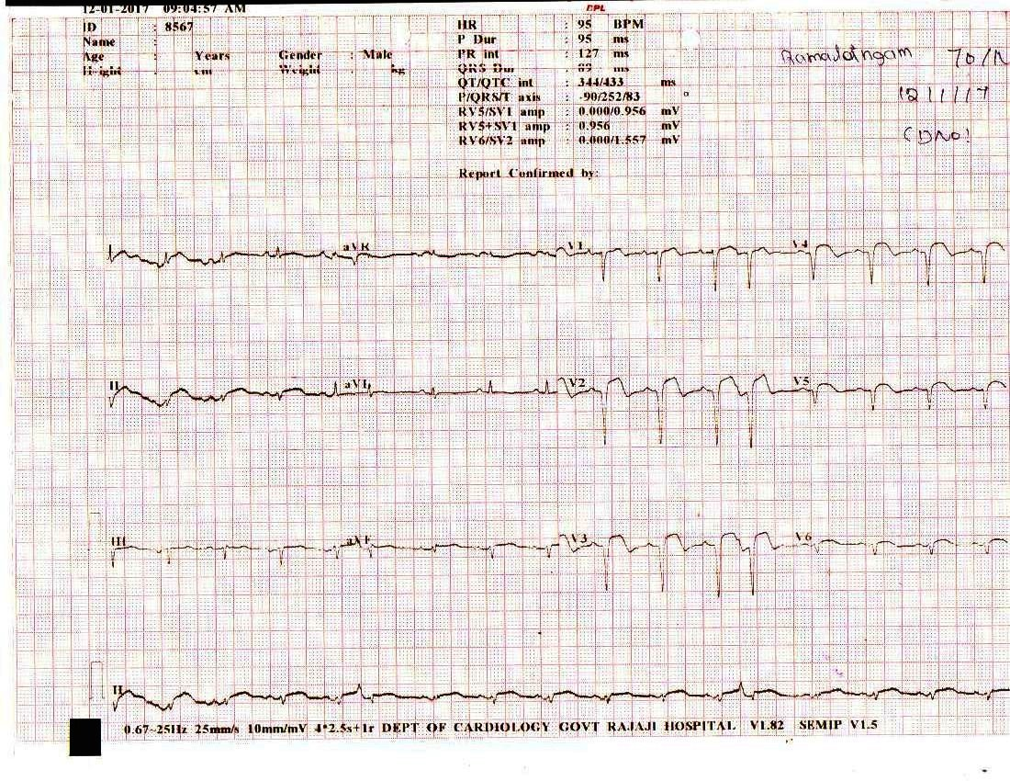

Slide 6
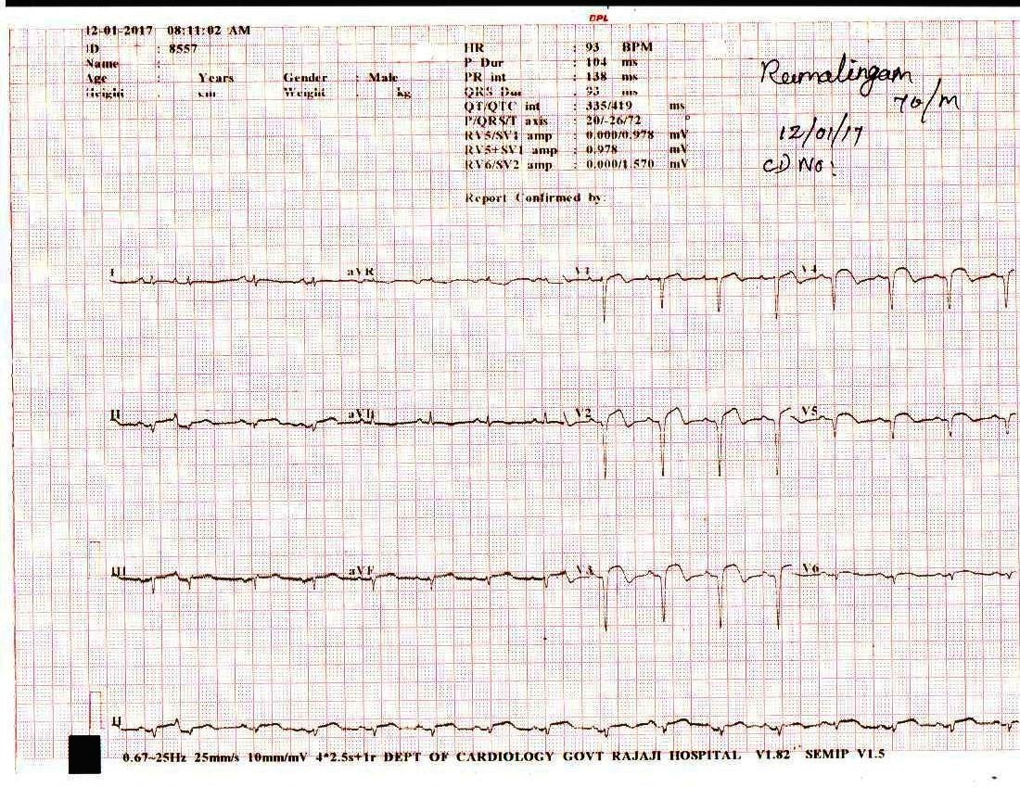

Slide 7
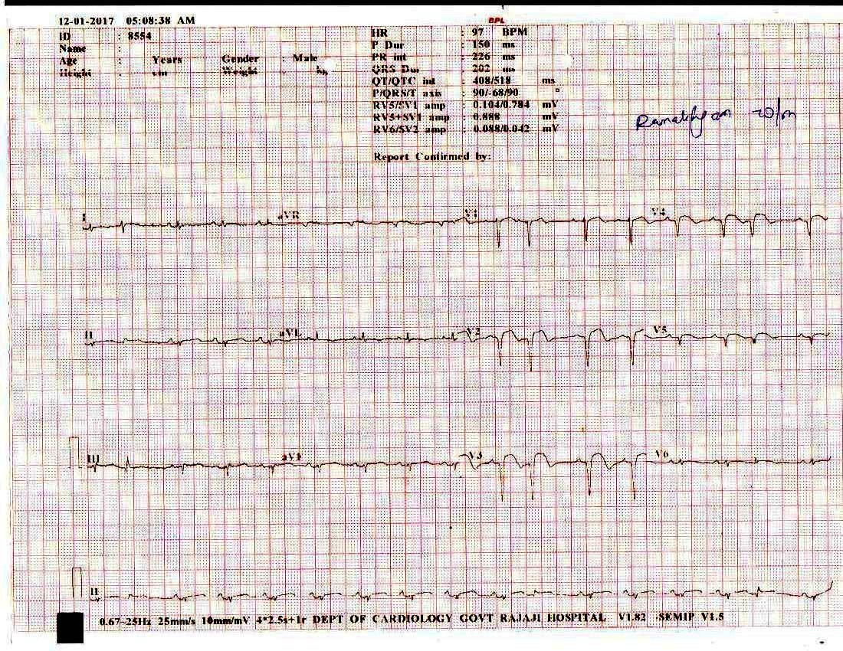

Slide 8
Diagnosed as Atrial fibrillation with AWMI.
Thrombolysed.
Reverted to sinus rhythm with DC shock.
CAG – TVD.
Plan- CABG.

