Slide 1
AN INTERESTING ECG FROM 2ND MEDICAL UNIT
CHIEF PROF.DR.S.PEER MOHAMED MD
ASST PROFESSORS:
DR M.SURESH KUMAR MD
DR M.SATHEESH KUMAR MD

Slide 2
Chief complains
47 years old male patient presented to GRH with complains of breathlessness

Slide 3
HISTORY OF PRESENTING ILLNESS
Patient was apparently normal until 2 days back then developed breathlessness of insidious onset aggravated on exertion, partly relieved by rest
H/o cough with expectoration +
No H/O fever
No H/O chest pain
PAST HISTORY:
k/c/o Rheumatic Heart disease since 1 year.

Slide 4
ON EXAMINATION:
Conscious oriented
Afebrile
BP- Right UL 110/30 mmHg left UL- 110/40 mmHg
Right LL 120/40 mmHg left LL – 120/40 mmHg
PR 90/min
SPO2 – 88 % RA with 99% with 6L SpO2.
SYSTEMIC EXAMINATION
CVS- Pansystolic murmur over Mitral area, Early diastolic murmur over aortic area
RS- B/L creps+
P/A - NAD
CNS- NAD

Slide 5
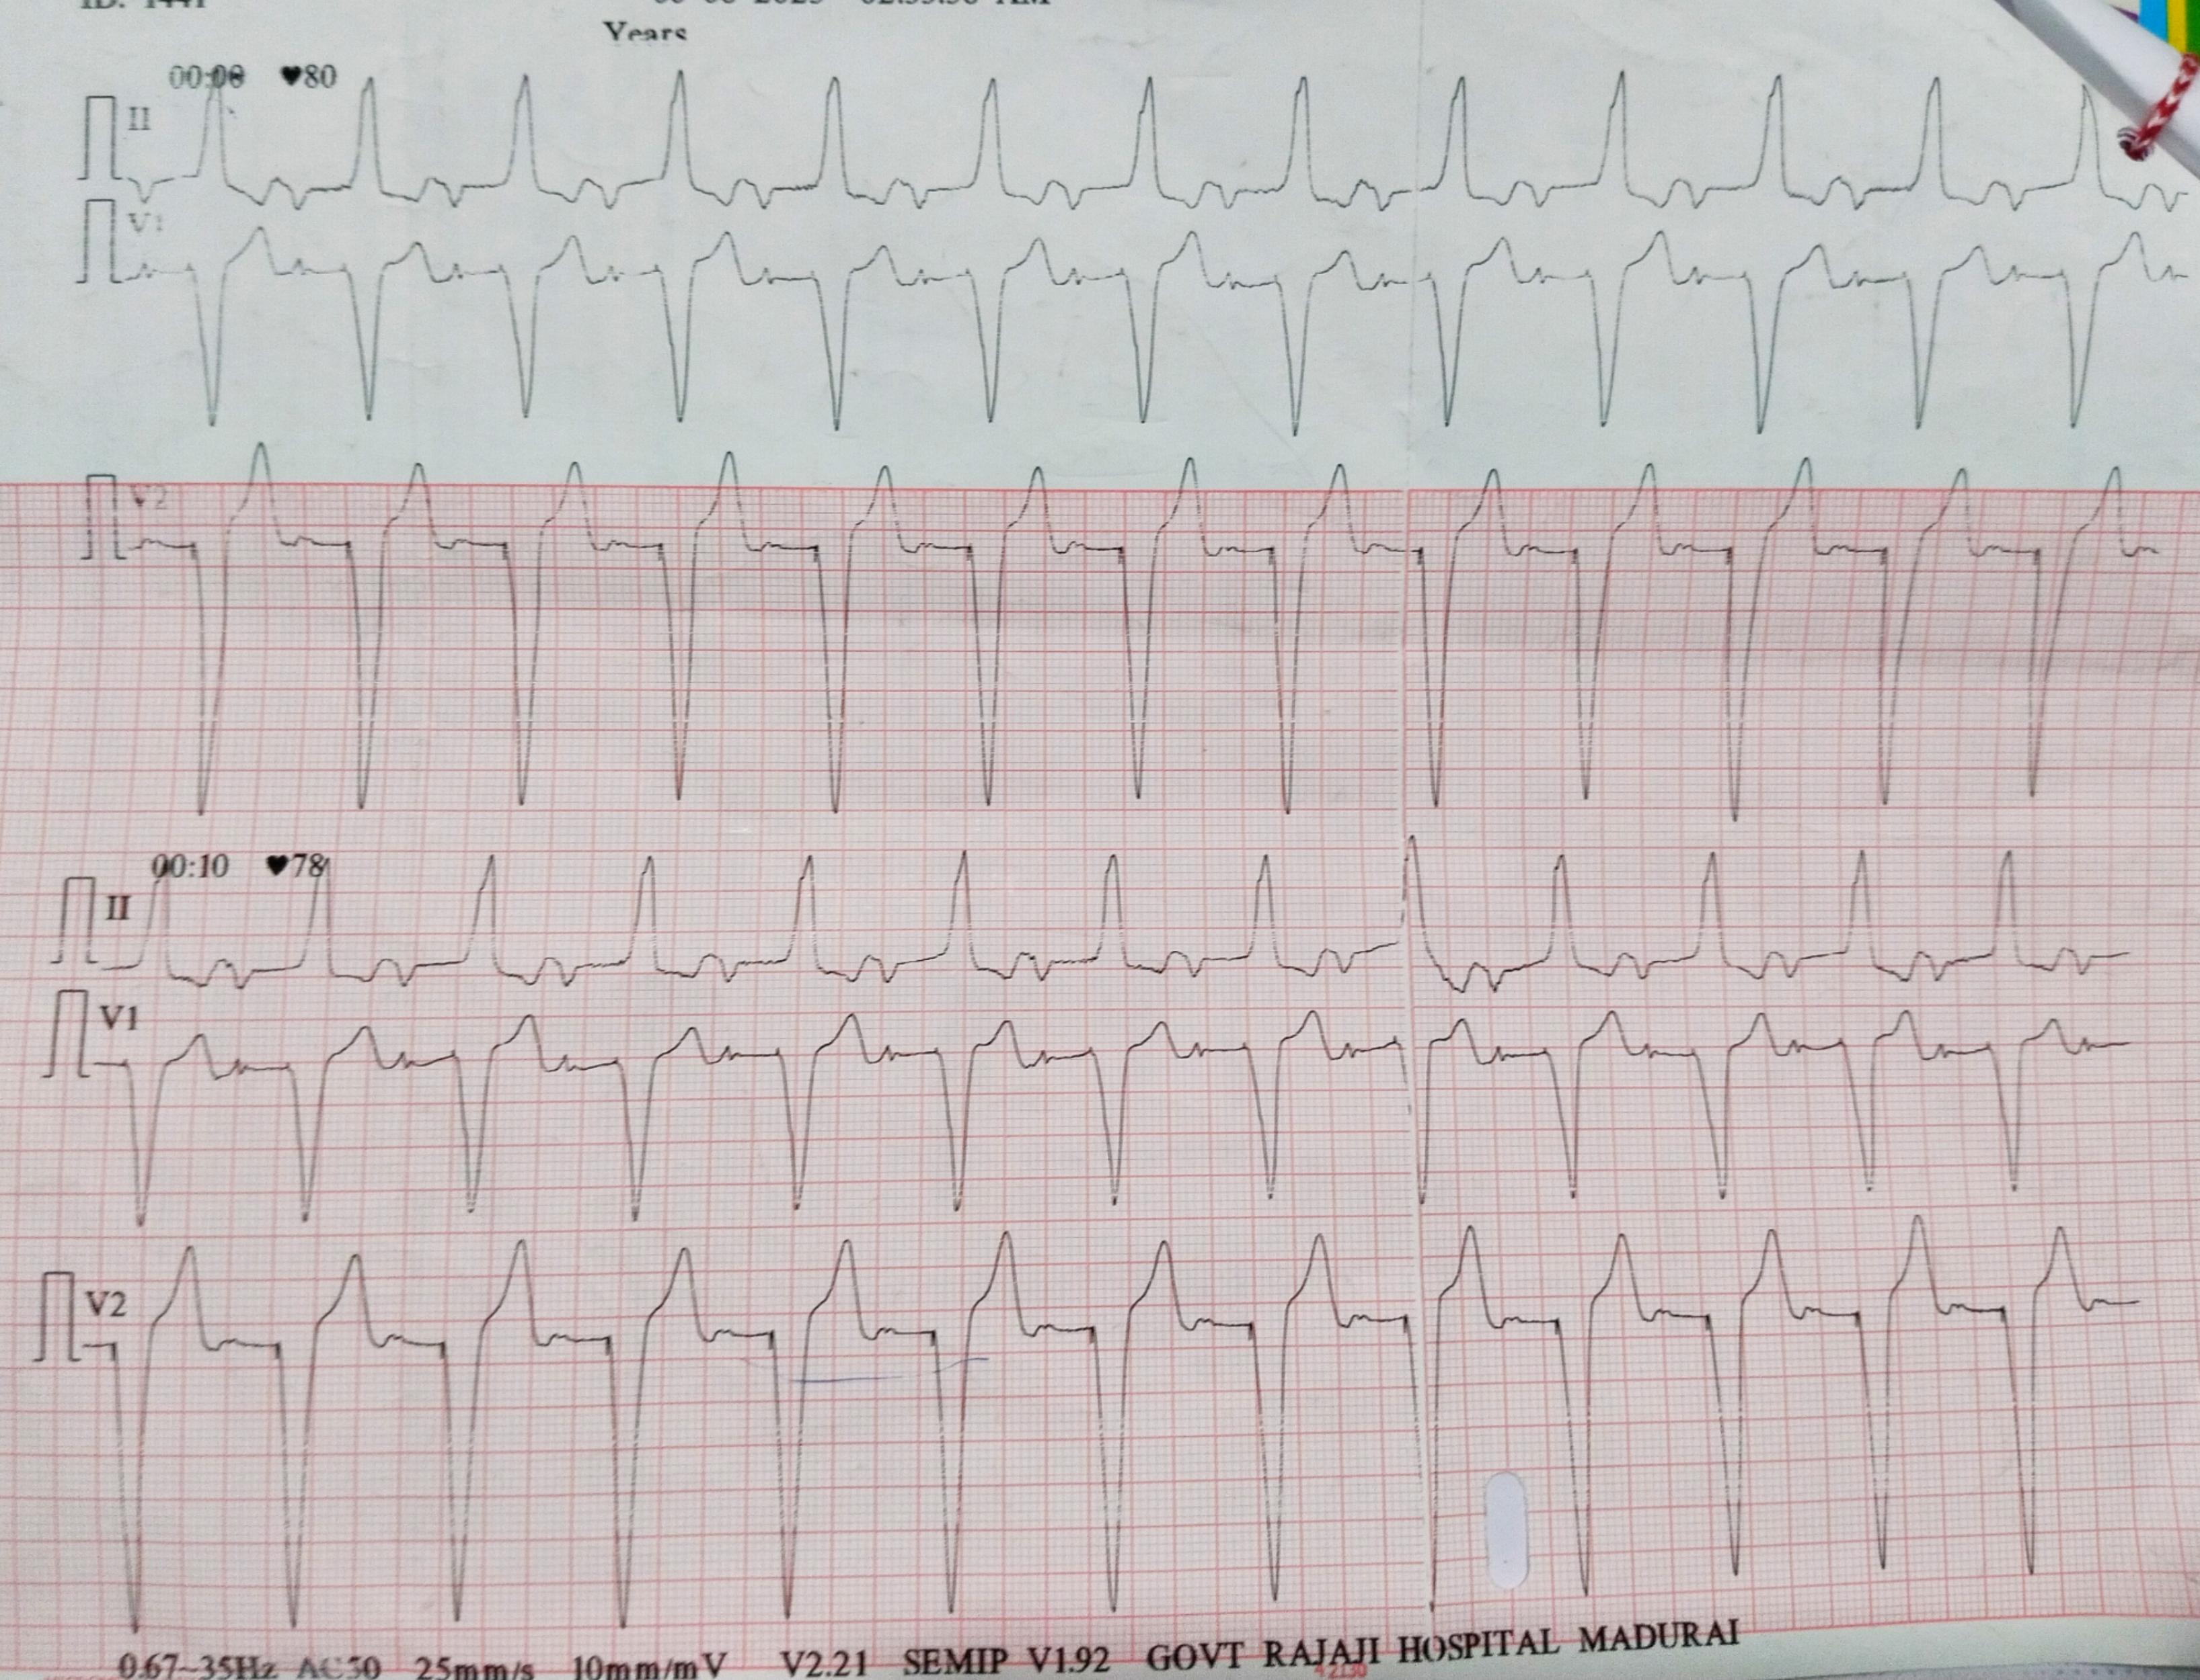
ECG

Slide 6
Let’s discuss

