Slide 1
JOURNAL CLUB
CHIEF-Dr.C.DHARMARAJ.MD.DCH
ASST PROF-Dr.M.ARUL PRAKASH MD DA
Dr.A.PRABHU MD
Dr.VINOTH KANNAN MD

Slide 2
Lipid profile as an indicator of severity in cirrhosis of Liver

Slide 3
INTRODUCTION
The liver plays a key role in lipid metaboism
Depending on species it is, more or less, the hub of fatty acid synthesis and lipid circulation through lipoprotein synthesis.
Hence,Deranged lipid profile can seve as a biomarker for assessing disease severity in cirrhotic patients

Slide 4
Method
STUDY -ANALYTICAL CROSS SECTIONAL STUDY
STUDY POPULATION-120
Sample size was calculated by mean [±standard deviation (SD)] difference of VLDL between the patients with MELD score 19–24 (16.8 ± 2.7) and >24 (15.0 ± 2.0), at 95% confidence interval and 80% power using Open Epi software. The calculated (minimum) sample size was 58.
Fasting lipid profile was taken from cirrhotic patients.
Total cholesterol,Triglycerides,HDL by direct method
VLDL,LDL levels were measured by Friedwald formul.

Slide 5
Inclusion crieteria
Age less than 18 years with cirrhosis
Admitted to medical wards
TOTAL-120
Of them, 76 (63%)were males, and 44 (37%) were females. Alcohol (84, 75.0%), hepatitis B (8, 7.1%), and NASH (6, 5.4%) were the most common cause of cirrhosis.

Slide 6
Exclusion criteria
DM/SHTN
Cerebrovascular diseases
Patients on lipid lowering drugs
Hypo/hyperthyroidism
Chronic kidney disease
Pancreatitis

Slide 7
All clinically diagnosed cirrhosis patients were prescribed a complete hemogram, renal function test, liver function test including serum protein,ultrasonogram of the abdomen, coagulation profile, and upper gastrointestinal endoscopy as part of the routine care.
Further, disease severity is categorized using Child-Turcotte-Pugh score. CTP scoring has three grades; score 5–6 is class A, score 7–9 is class B,and score 10–15 is class C.
After informed consent, the fasting serum lipid profile is measured among patients with cirrhosis. Total serum cholesterol, TGL, and high-density lipoprotein (HDL) were measured by the direct method, and serum LDL and VLDL were calculated using Fried Wald formula (LDL cholesterol =
Total cholesterol − [HDL cholesterol − TGL/5] and VLDL = Sr. TGLs/5)

Slide 8
RESULTS
A total of 44 (36.7%), 50 (41.7%), and 26 (21.6%) patients were classified with Child-Pugh score categories A, B, and C,respectively.The mean and SD of each lipid level for each category based on the Child-Pugh score is given in Table 1. A clear dose-response relationship (decreasing trend) is seen in the levels of lipids for increasing severity based on the Child-Pugh score.

Slide 9
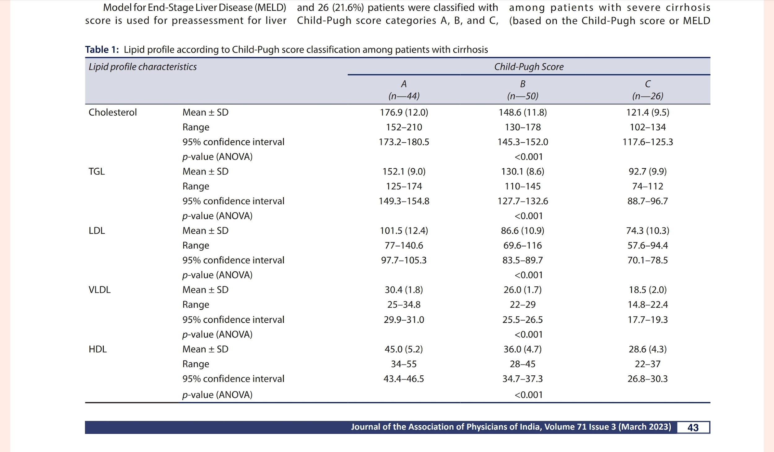

Slide 10
Similarly, the distribution of each lipid Level for each category based on the MELD score is given in Table 2.Except for the patients with a MELD score of ≤10, a clear dose-response relationship (decreasingtrend) is seen with all other levels of lipids for increasing severity based on the MELD score.

Slide 11
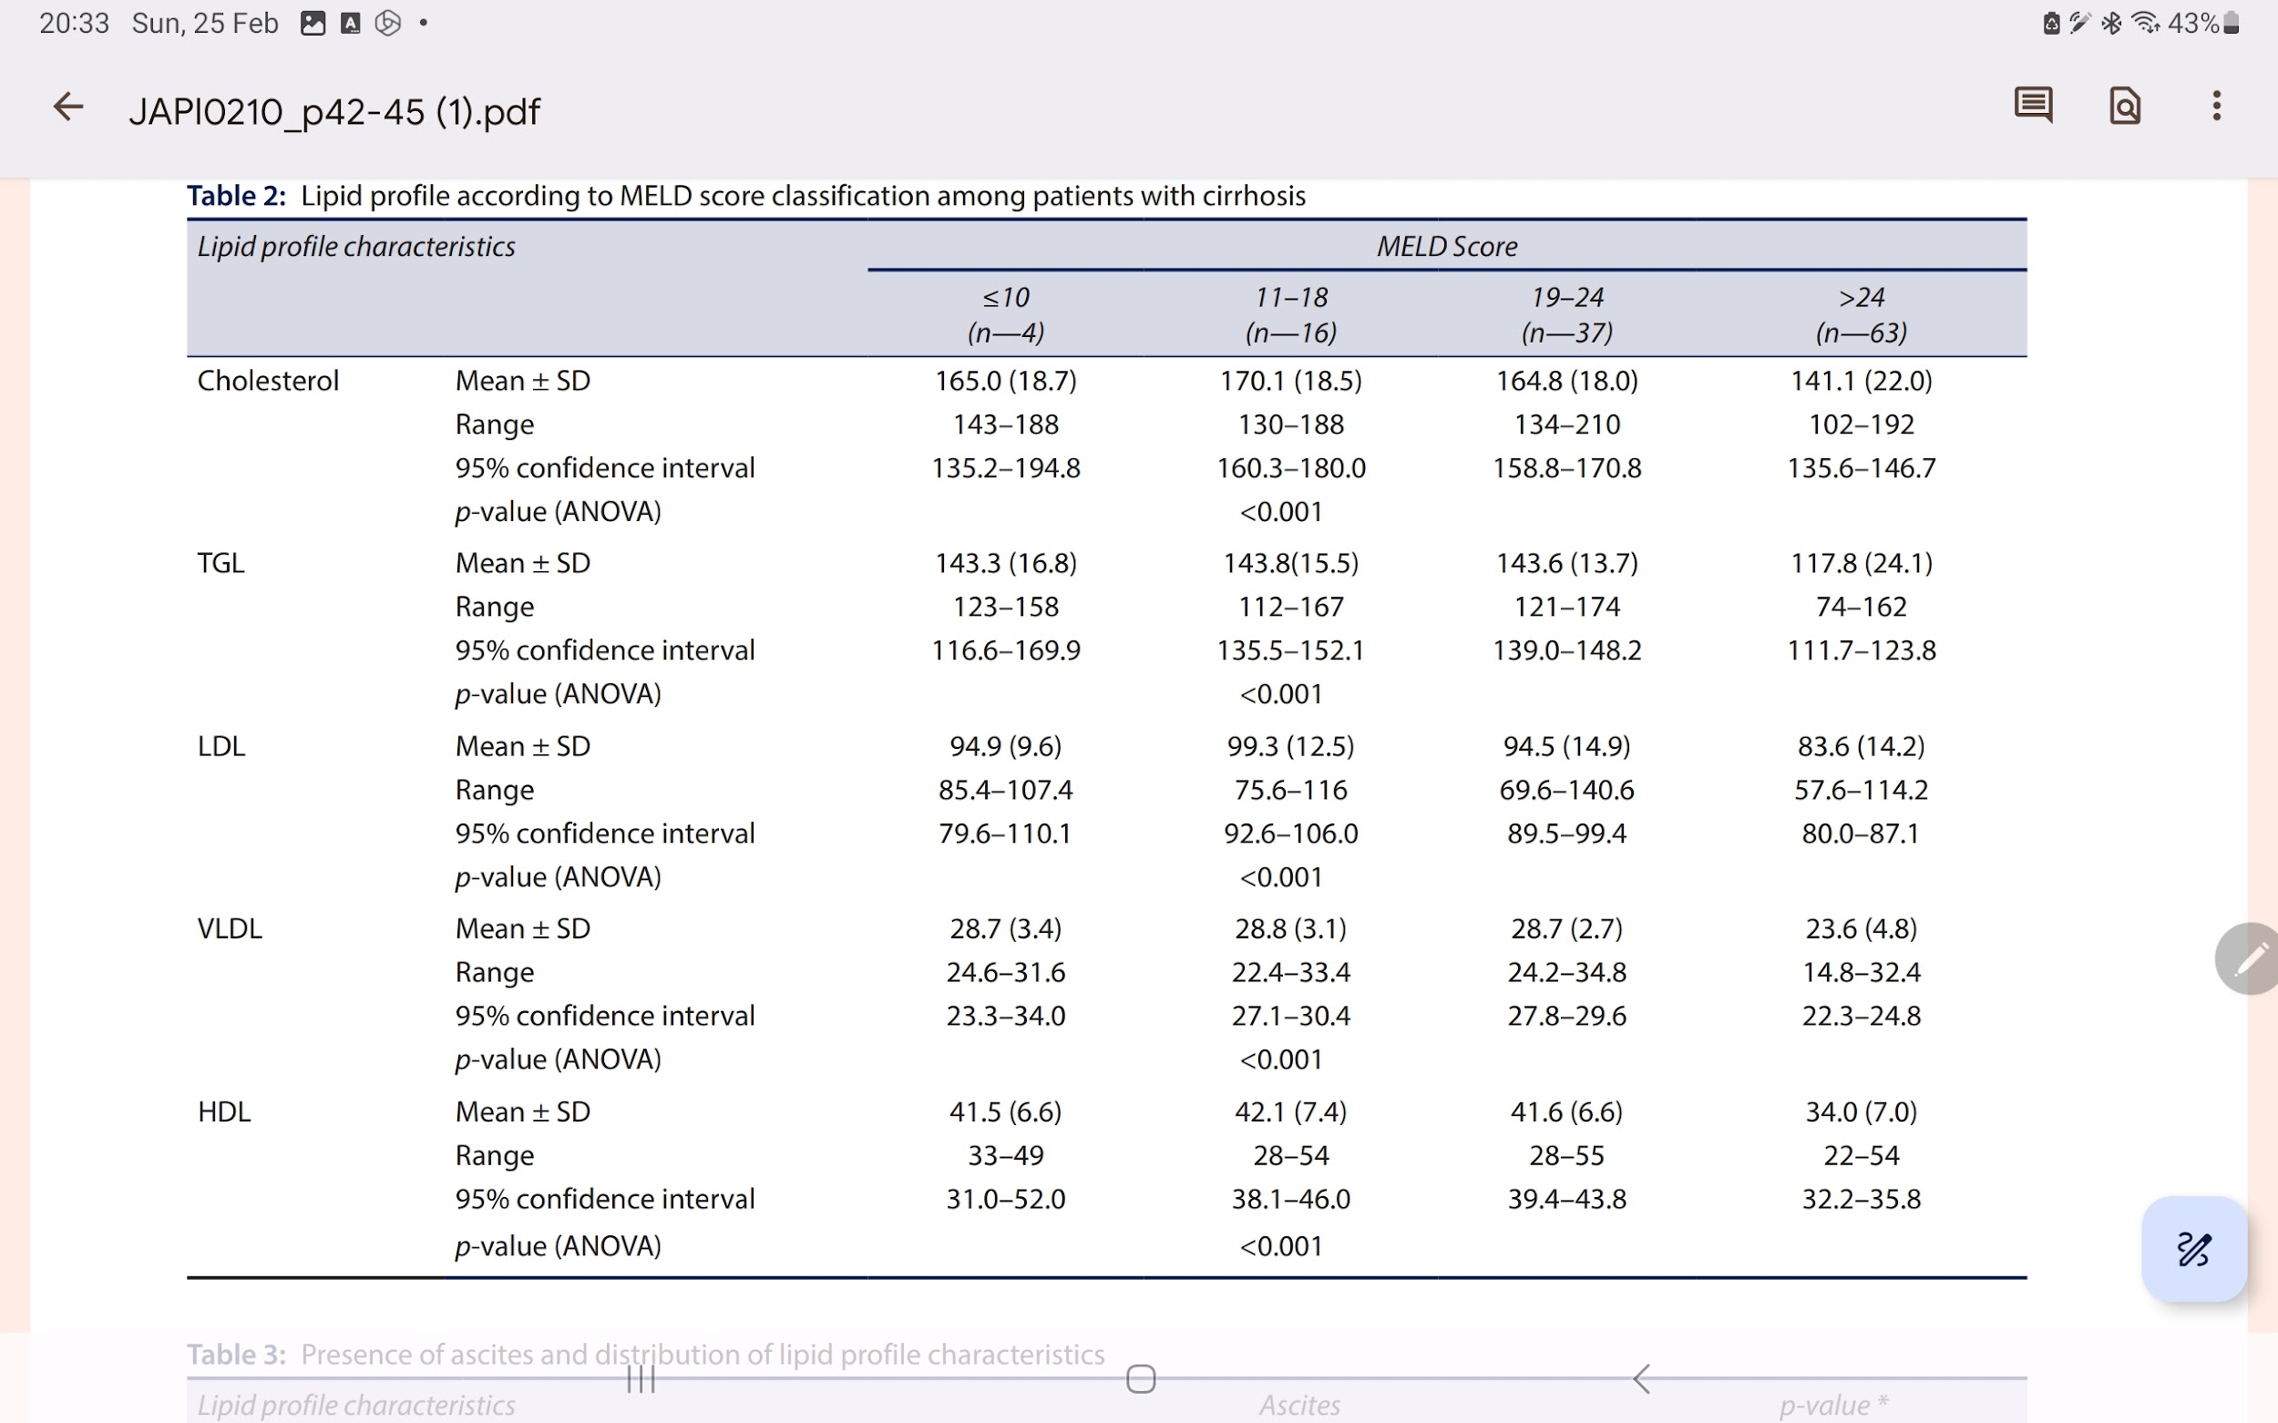

Slide 12
The distribution and association of Lipid profile with the presence of ascites, Spontaneous bacterial peritonitis, and UGI bleeding are given in Tables 3 to 5, respectively. The cholesterol, LDL, and HDL were significantly lower among patients with ascites and among patients with spontaneous bacterial peritonitis compared to their respective groups. However, none of the lipid profiles significantly differed based on the presence of UGI bleeding.

Slide 13
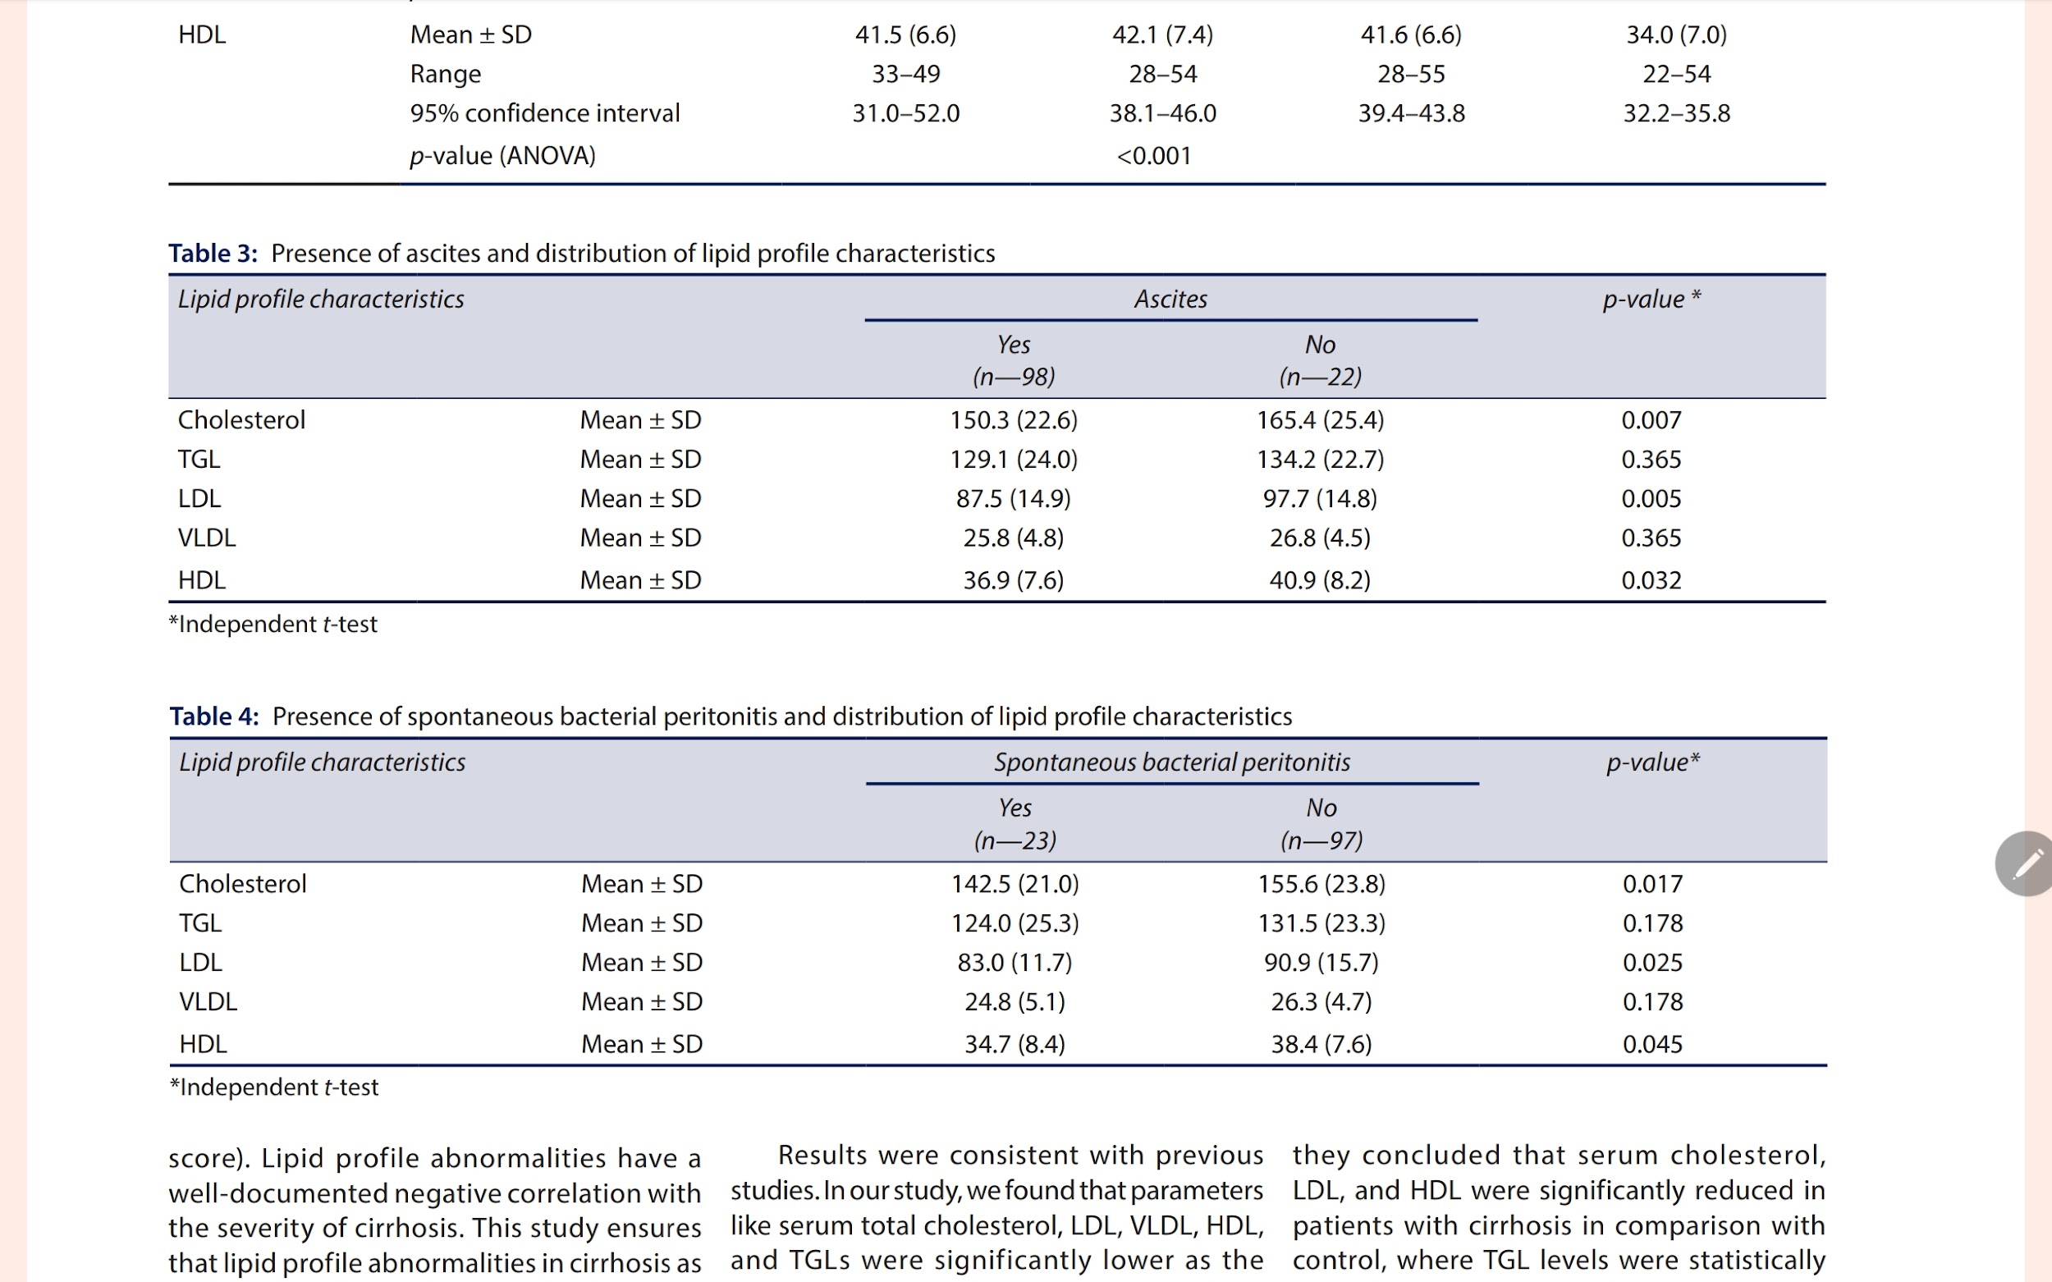

Slide 14
DISCUSSION
The decreased levels of LDL and HDL might be attributed to the reduced synthesis of apolipoproteins A and B.
Since apo B is involved in the synthesis of VLDL, the reduced level of TGLs is explained in cirrhosis. This can be due to insulin resistance found in liver cirrhosis.
The insulin signaling mechanism in cirrhosis is found to be critical for lipogenesis regulated by phosphoinositide 3-kinase and AKT serine/threonine kinase 2 signaling pathway.

Slide 15
CONCLUSION
The serum total cholesterol, LDL, VLDL, HDL, and TGLs were significantly lower as the stage of severity of cirrhosis advanced.
Further formulation of the scoring system in association with a preexisting scoring
system may provide a better assessment of patients’ prognoses in view of morbidity and mortality.
It is also a cost-effective method.

Slide 16
THANK YOU

